Slide 1

Comparing the 2020 European Seismic Hazard Model (ESHM20) with ShakeMap Footprints: application in Greece
Nikolaos Anterriotis-Kalpakidis
&
Anastasia Kiratzi
Department of Geophysics
Aristotle University of Thessaloniki

Slide 2
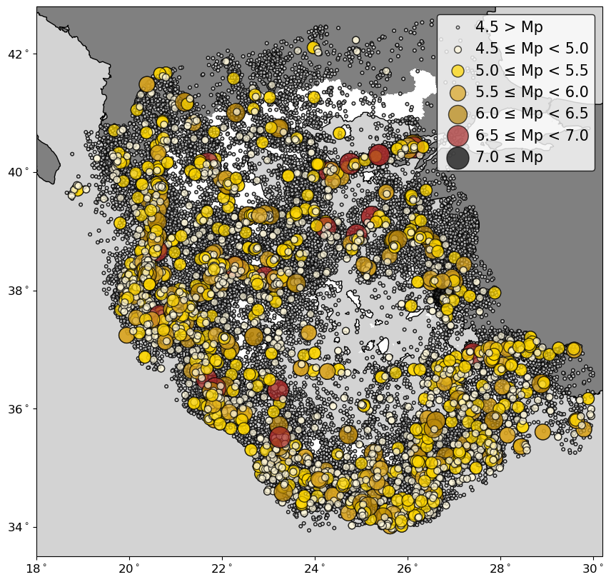
Scope – Workflow
Compare Probabilistic Seismic Hazard Assessment maps with observed data
Check their accuracy and reliability
Distribution of epicenters for the final uniform catalog. The 2,617 earthquakes (M_{p} ≥ 4.5) are marked from the color and side scale
Sources of observed Data: ShakeMap data
The 2020 European Seismic Hazard Model, ESHM20 was tested
Four (4) Aggregation levels were tested:
  Mean
  16th
  50th
  84th
Test was applied for three (3) Intensity Measures (IMs) PGA, Sa[0.3s], and Sa[1.0s]
Test was applied for a return period of 475 and 50 years
Build a uniform catalog for the 43,196 events in USGS ComCat from January 1973 to December 2022 [50 years]
Generate 2,617 ShakeMaps using USGS’ ShakeMap software [events with potency magnitude M_{p} ≥ 4.5]
Peak-motion and earthquake info (in USGS ShakeMap formats) can be retrieved via EPOS Data Portal

Slide 3
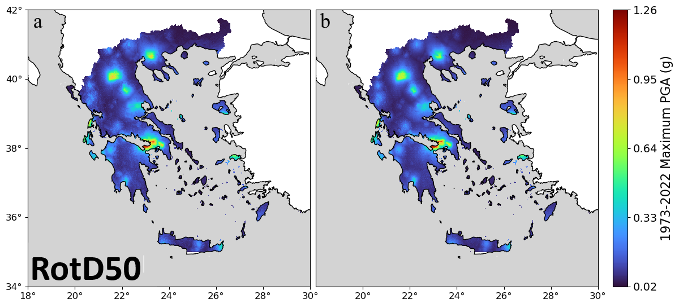
ShakeMap Data Processing
Observed soil-site max PGA
Adjusted rock-site max PGA
Retrieve the maximum IMs from the ShakeMaps
- Create a 0.01°×0.01° base grid (143,728 grid cells)
- Retrieve the maximum reported IM for each grid cell
Retrieve the expected IM from the ESHM20 maps for each grid cell
Adjust soil-site ShakeMap IMs to rock site levels
Site correction
  Adjust the observed IMs to rock sites using the amplification factors of the 2020 European Seismic Risk Model, ESRM20
Both ShakeMaps and ESHM20 IMs are valid to RotD50

Slide 4
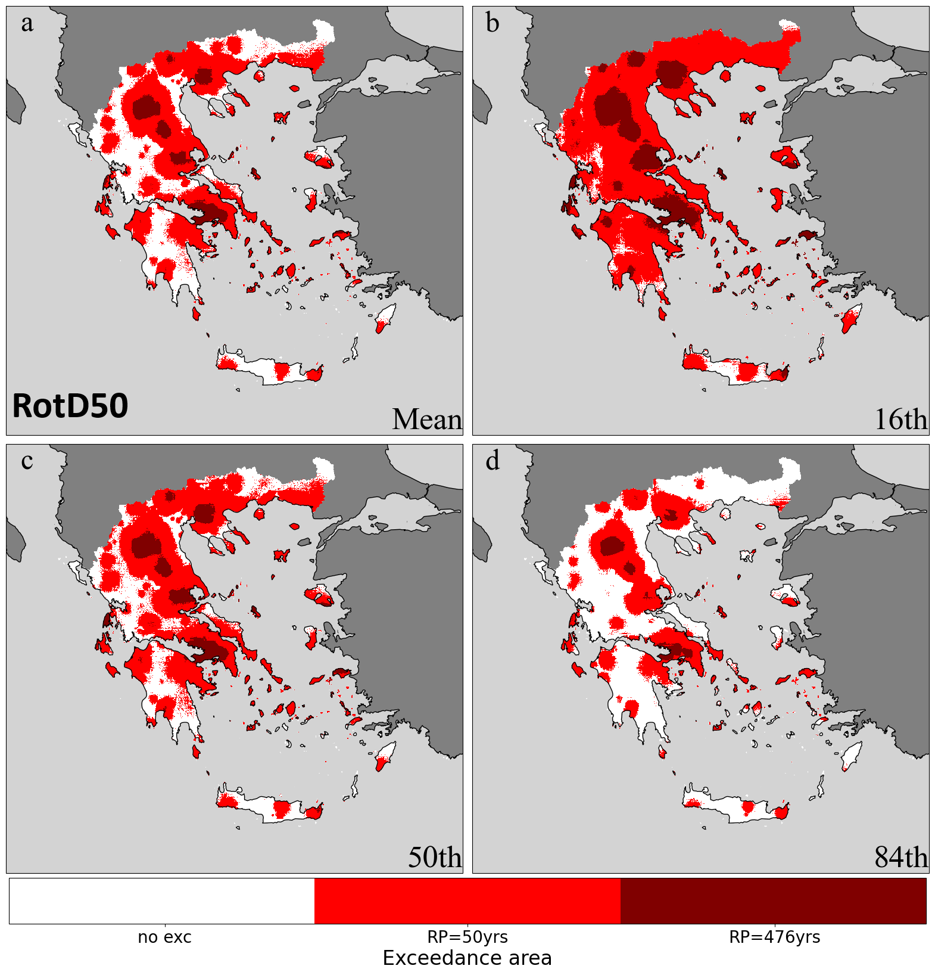
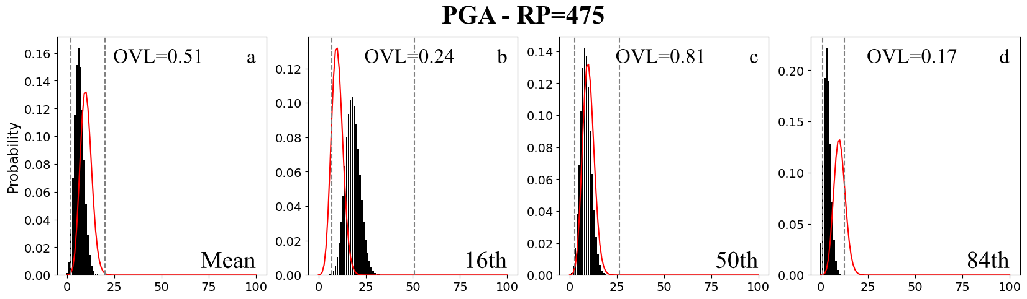
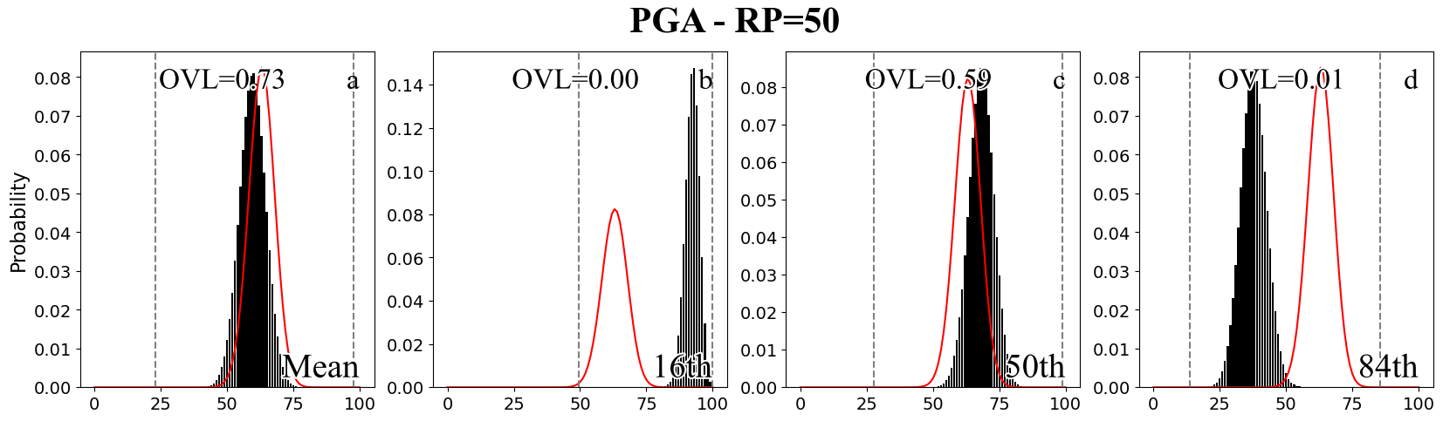
Spatial distribution of the exceedance area
Results
Calculate Fractional Exceedance area (exceeded sites / total sites) and compare with the target
Overlapping Coefficient (OVL) for quantitative comparison
Theoretical binomial distribution
Empirical distribution of the exceeded area
± 1 Std

Slide 5

Thank you for your attention
contact: nanterr@geo.auth.gr

Slide 6



A workflow to analytically investigate seismogenic sources of historical earthquakes: new insights from Central Italy pre-instrumental seismicity
V. Gironelli, L. Luzi, T. Volatili, E. Tondi
Contacts: 📩 Email: veronica.gironelli@ingv.it 🔗 LinkedIn: linkedin.com/in/veronica-gironelli-329b96210
Notes:
Introduce yourself with your name, affiliation and TCS only

Slide 7
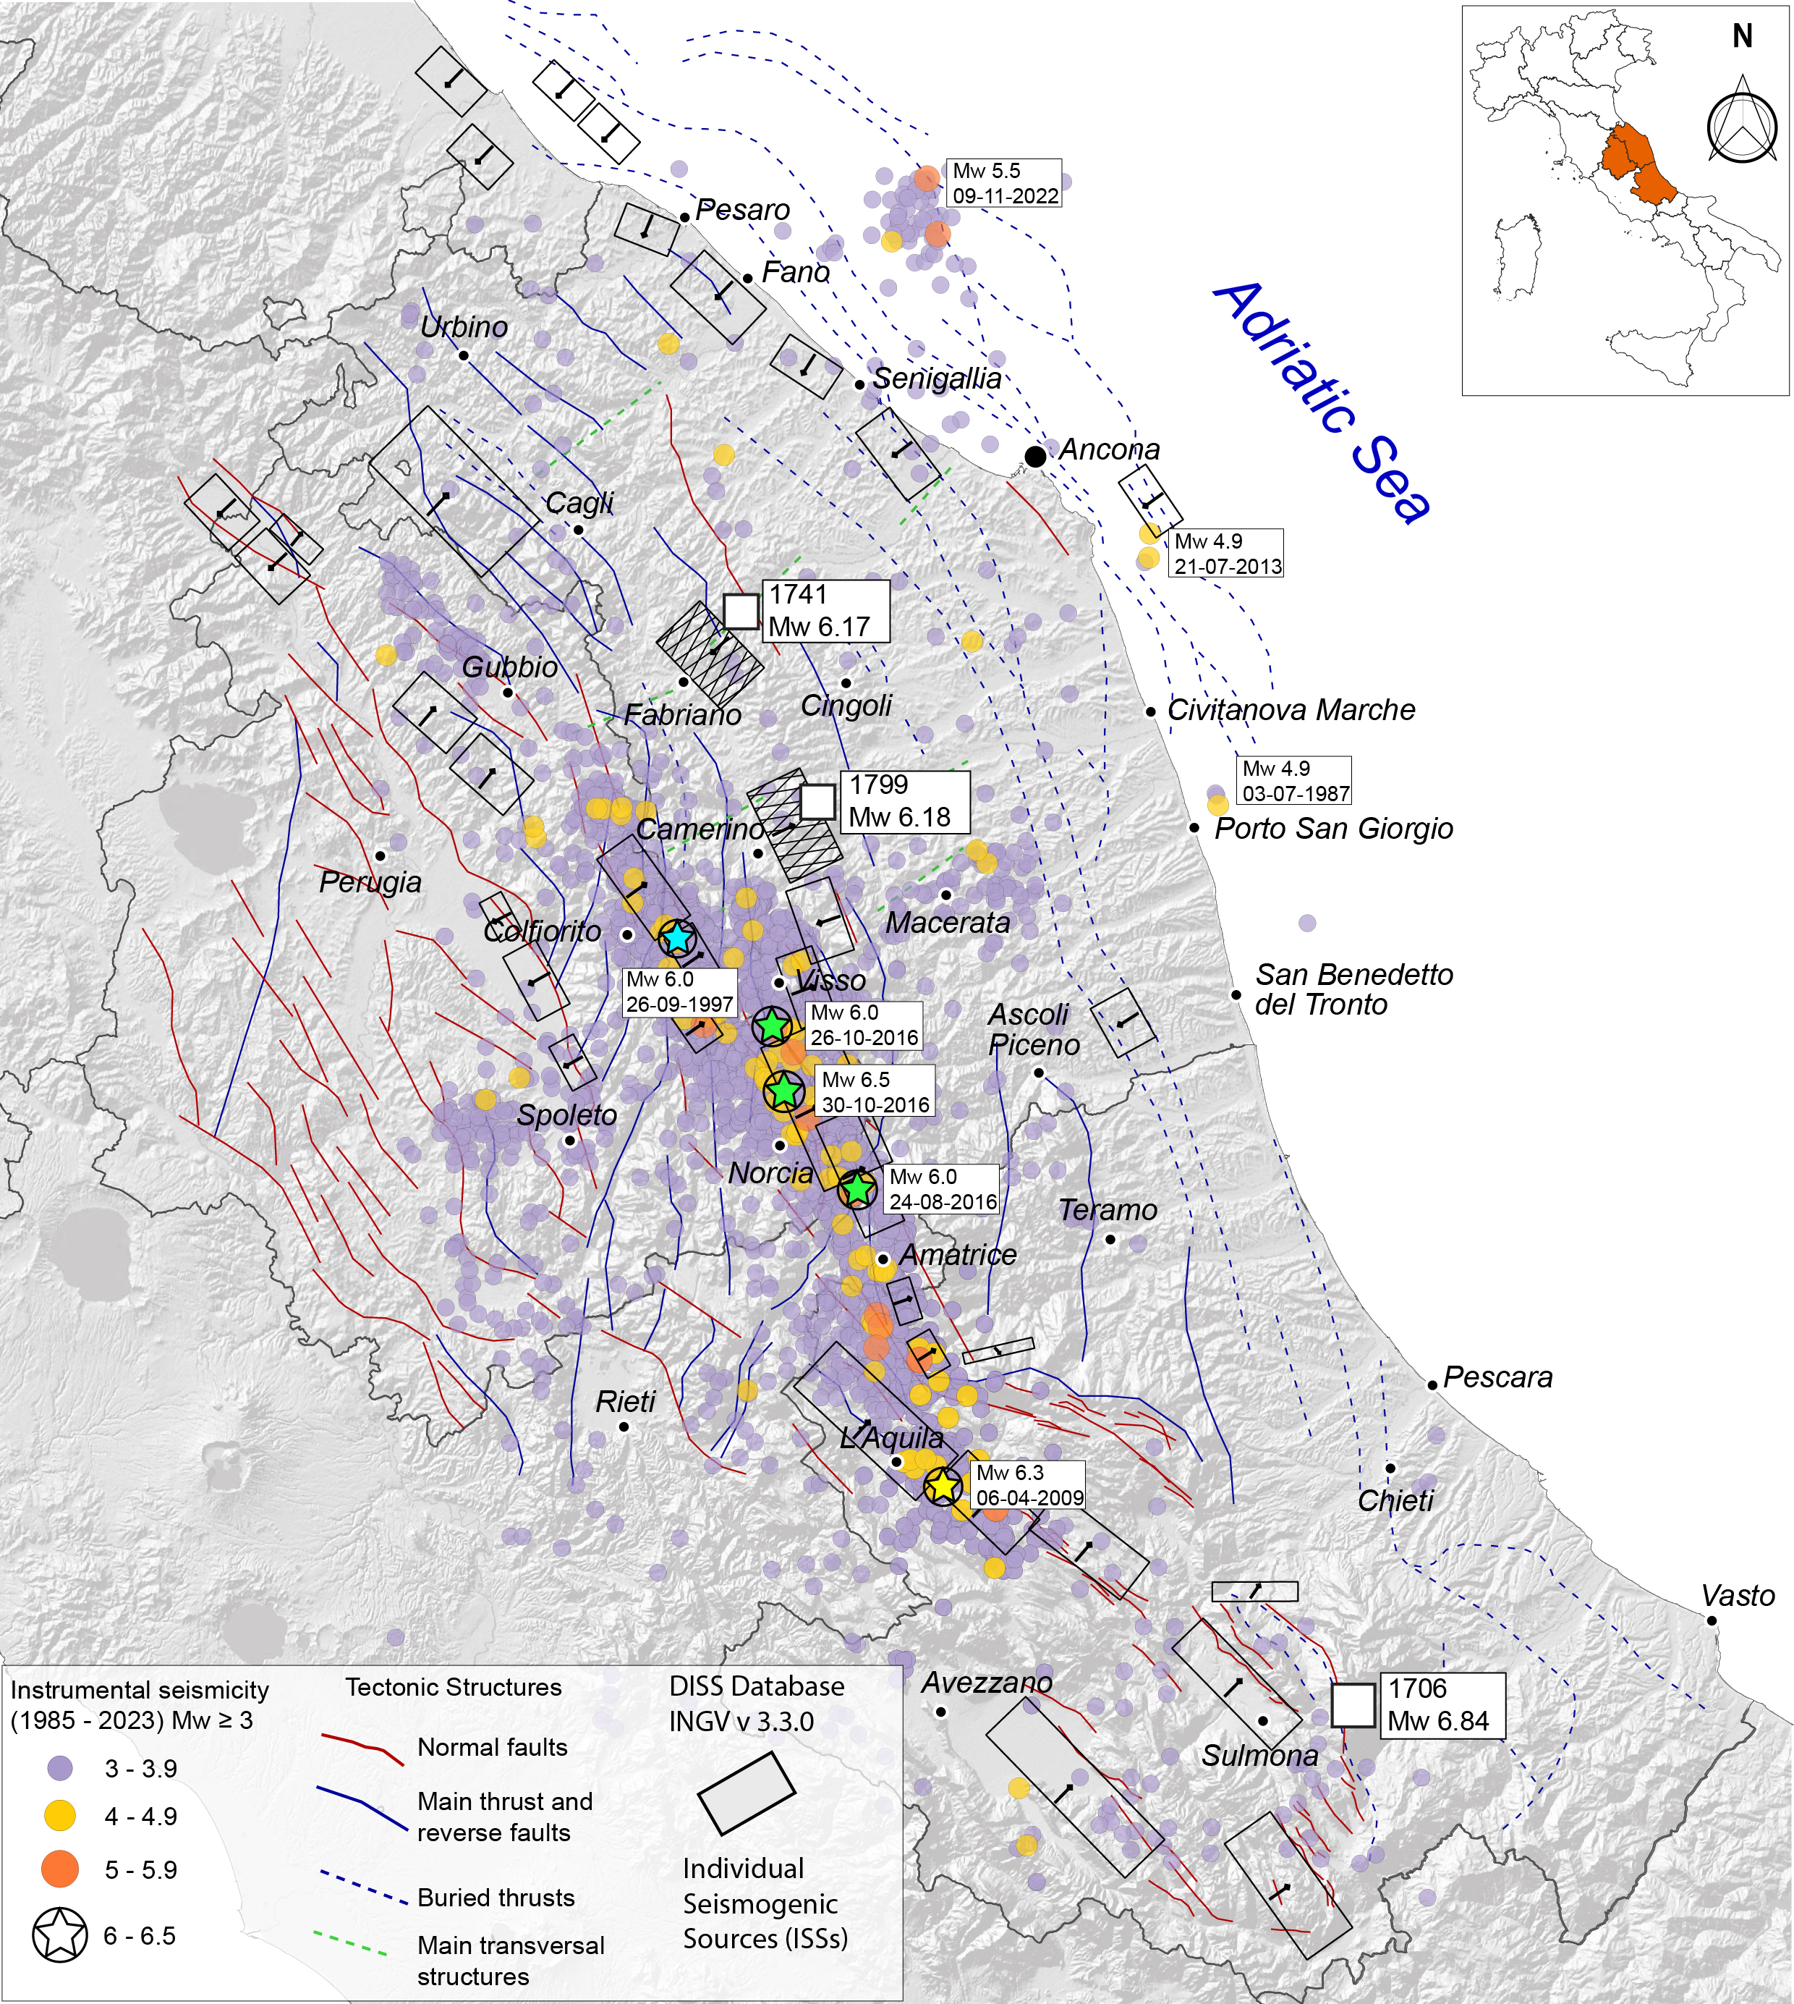

Uncertain Historical Seismogenic sources in Central Italy
STUDY AREA
Marche region
SH depends on expected ground motion;
April 24, 1741:
"Fabriano earthquake"
(Imax 9 MCS; Mw 6.17)
Ground motion depends on the source;
July 28, 1799:
"Camerino earthquake"
(Imax 9-10 MCS; Mw 6.18)
Most historical earthquake source are uncertain.
Abruzzi region
How to determine the 3D historical earthquake sources?
November 3, 1706:
"Maiella earthquake"
(Imax 10-11 MCS; Mw 6.84)
Notes:
SH → depends on ground motion;
Ground motion → controlled by the source;
Historical EQ source → often uncertain ?

Slide 8
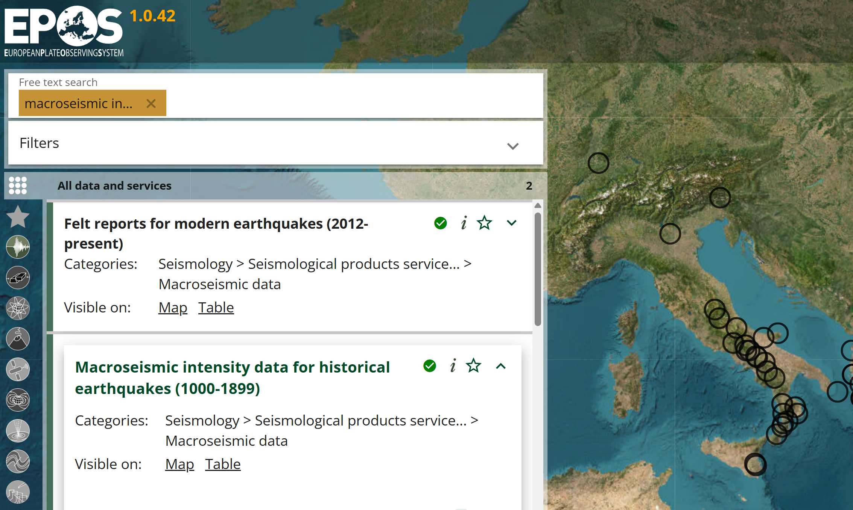
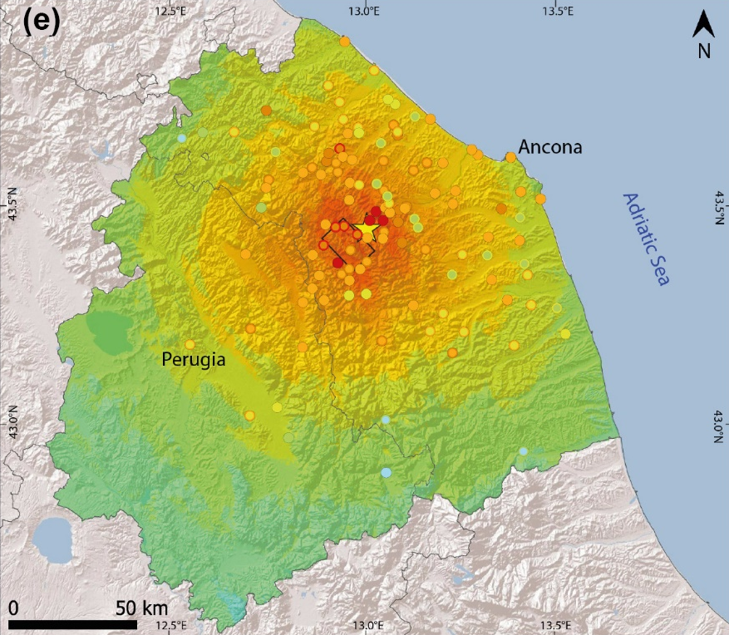
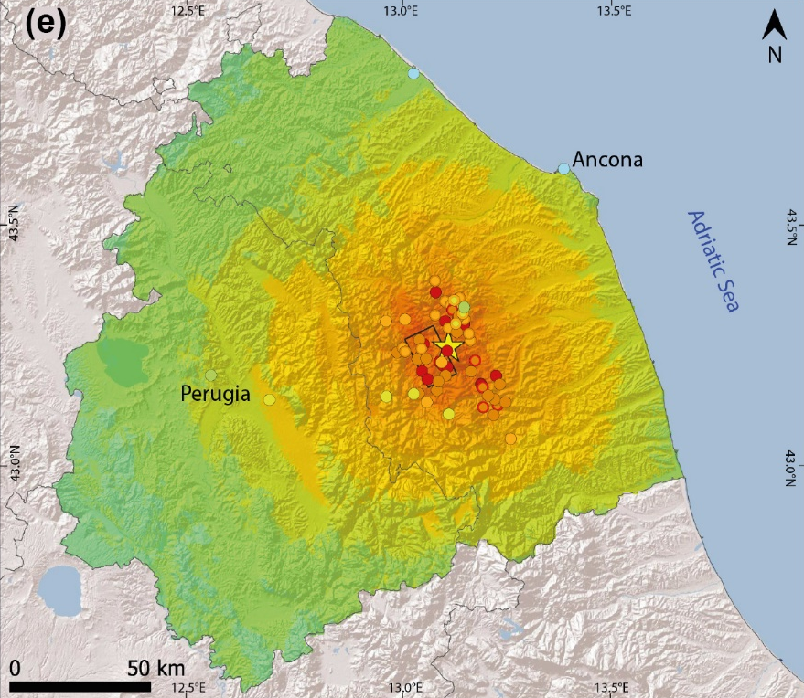
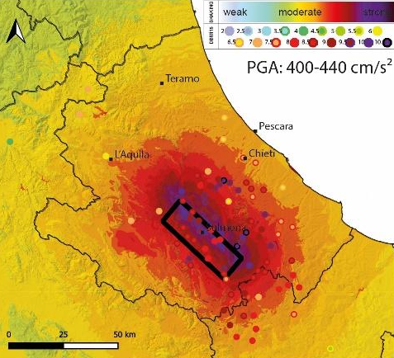

MATLAB-based WORKFLOW
INPUTS
PROCESSING
OUTPUTS
Earthquake data (magnitude, location, depth);
Source parameters (L, W, strike, dip, rake);
Macroseismic intensity data.
1
2
GMM + Vs30 map → GMPs prediction (PGA, PGV)
GMICE → Conversion of GMPs to intensity
Residual analysis → Best source evaluation by comparing obs vs. pred intensity
3
POSTER SESSION!
SHAKING SCENARIOS in PGA – PGV - INTENSITY

