Slide 1
Further exploitation of EPOSAR InSAR data for ICS-D implementation Occhipinti M.1, De Luca C.1, Manunta M.1, Monterroso F.1, Casu F.2
IREA-CNR, Naples, Italy
IREA-CNR, Milan, Italy

Slide 2
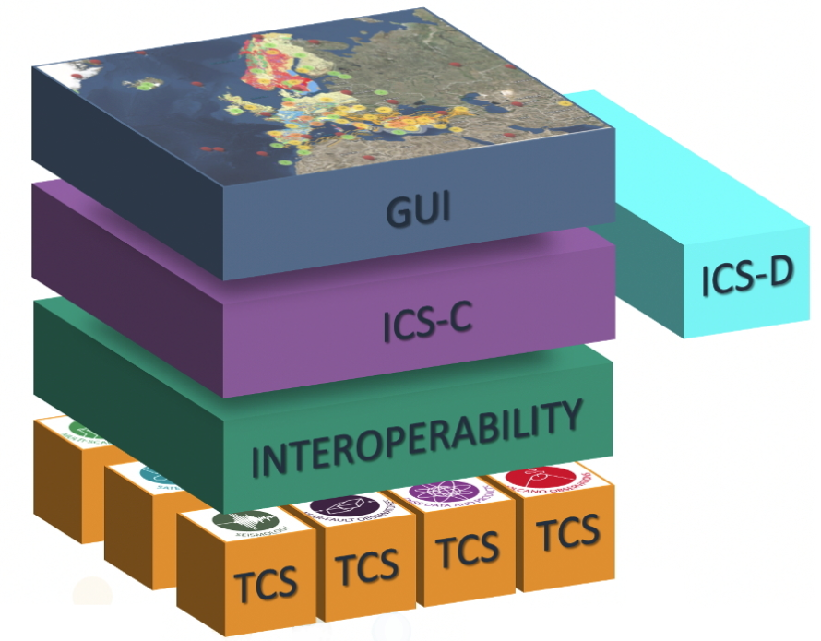
Further exploitation of EPOSAR InSAR data for ICS-D implementation
EPOSAR data
Workspace with processing scripts
Processing for the generation of added-value products

Slide 3
Further exploitation of EPOSAR InSAR data for ICS-D implementation
Combination of the LOS displacement maps to retrive the Vertical (Up) and Horizontal (East/West) displacement maps
EPOSAR data
INPUT DATA
OUTPUT DATA
LOS displacement maps
East-Up
displacement map
DES
ASC
LOS unit vector map (N E U)
U
E
DES
ASC

Slide 4
Further exploitation of EPOSAR InSAR data for ICS-D implementation
Reconstruction of the LOS displacement from the N-E-U components of GNSS data
EPOSAR data
INPUT DATA
OUTPUT DATA
GNSS information (N E U)
Comparison of the LOS displacement from GNSS with the LOS displacement from EPOSAR data
U
E
N
LOS unit vector map (N E U)
DES
ASC

Slide 5
Thanks for your attention

