Slide 1
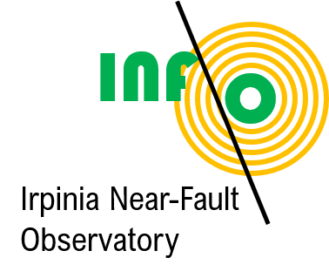
Seismic monitoring with DAS at the Irpinia Near Fault Observatory Claudio Strumia, Gaetano Festa, Raffaello Pegna, Diane Rivet, Alister Trabattoni, Gilberto Saccorotti, Antonio Scala, Francesco Scotto di Uccio

Slide 2
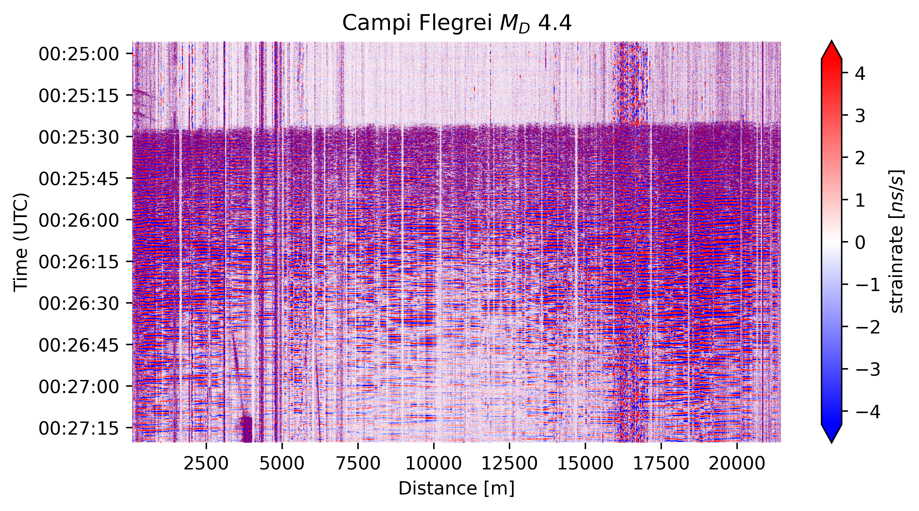
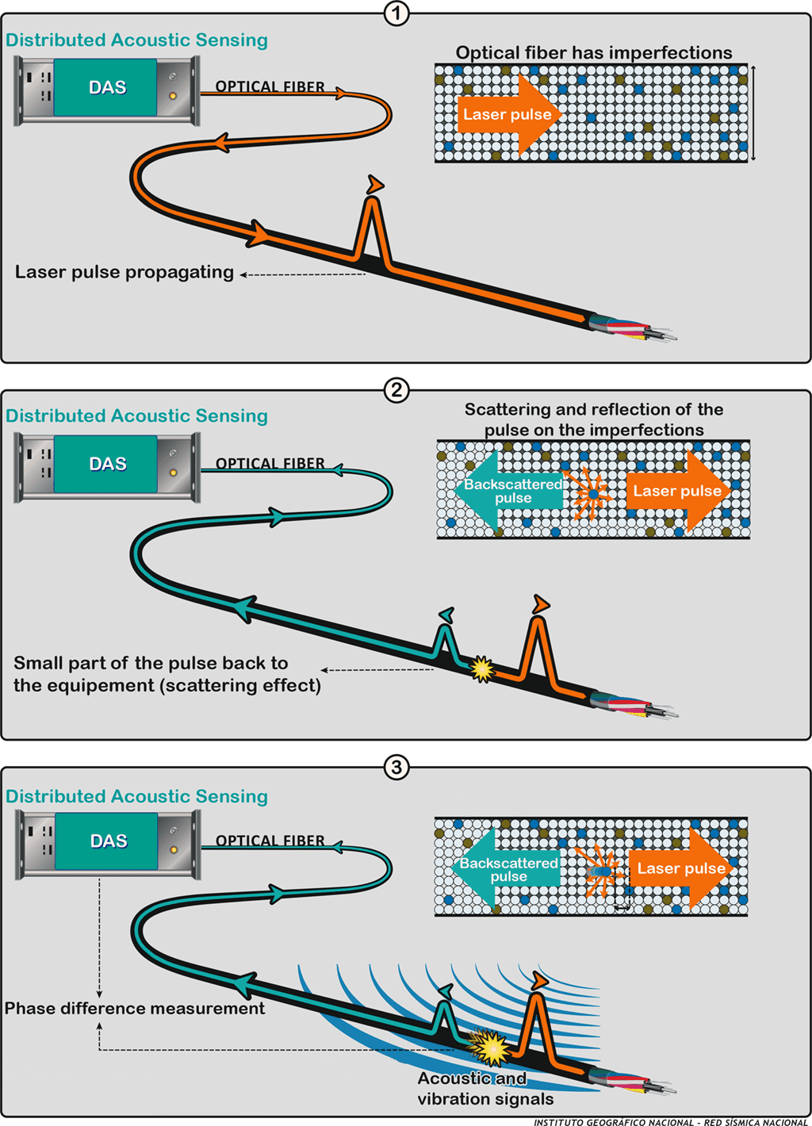
Distributed Acoustic Sensing (DAS)
Using fibre optic cables as antennas allows for long-range spatial continuous recordings

Slide 3
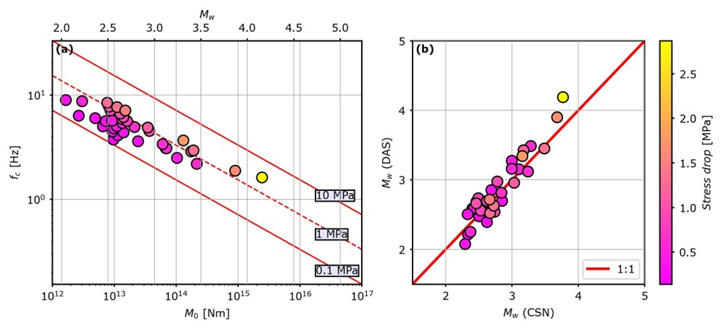
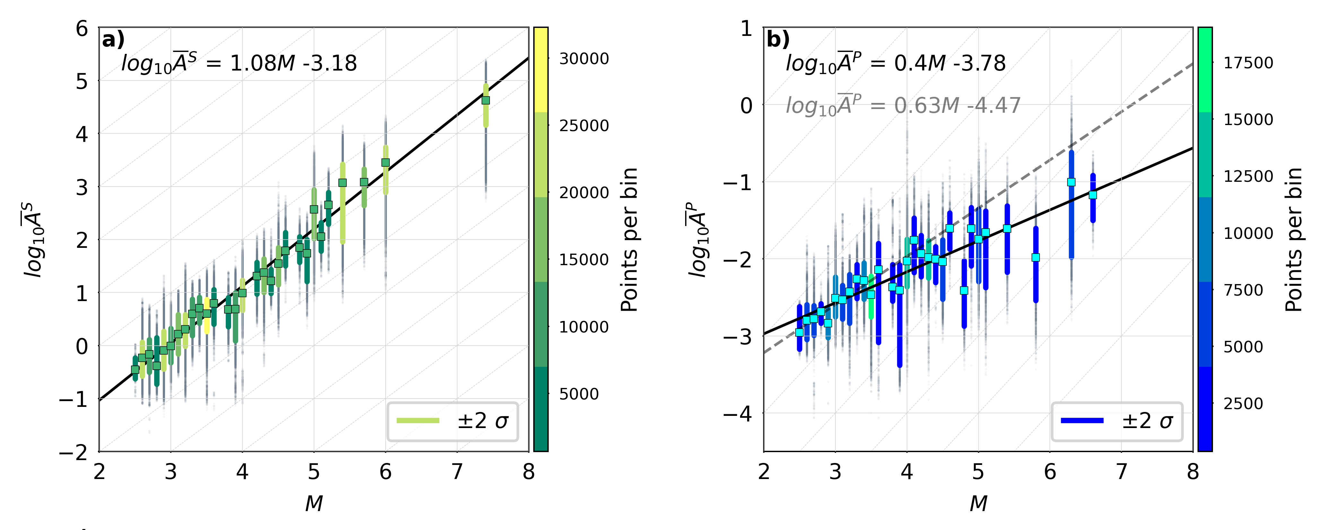
DAS amplitudes
Rapid magnitude estimation
Source parameters
Conversion to displacement

Slide 4
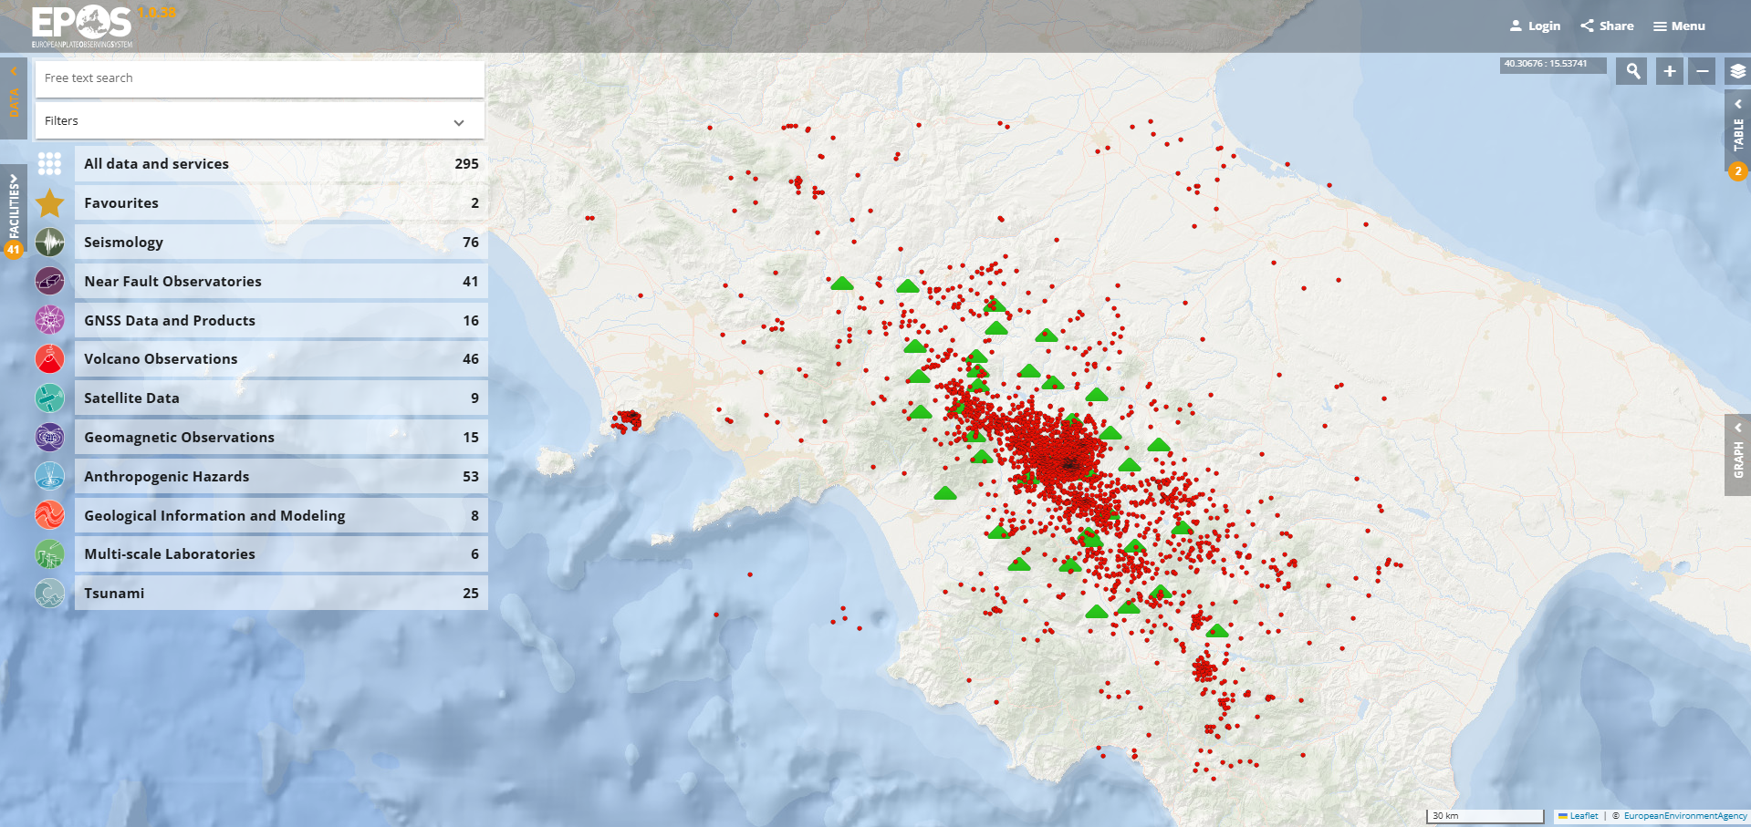
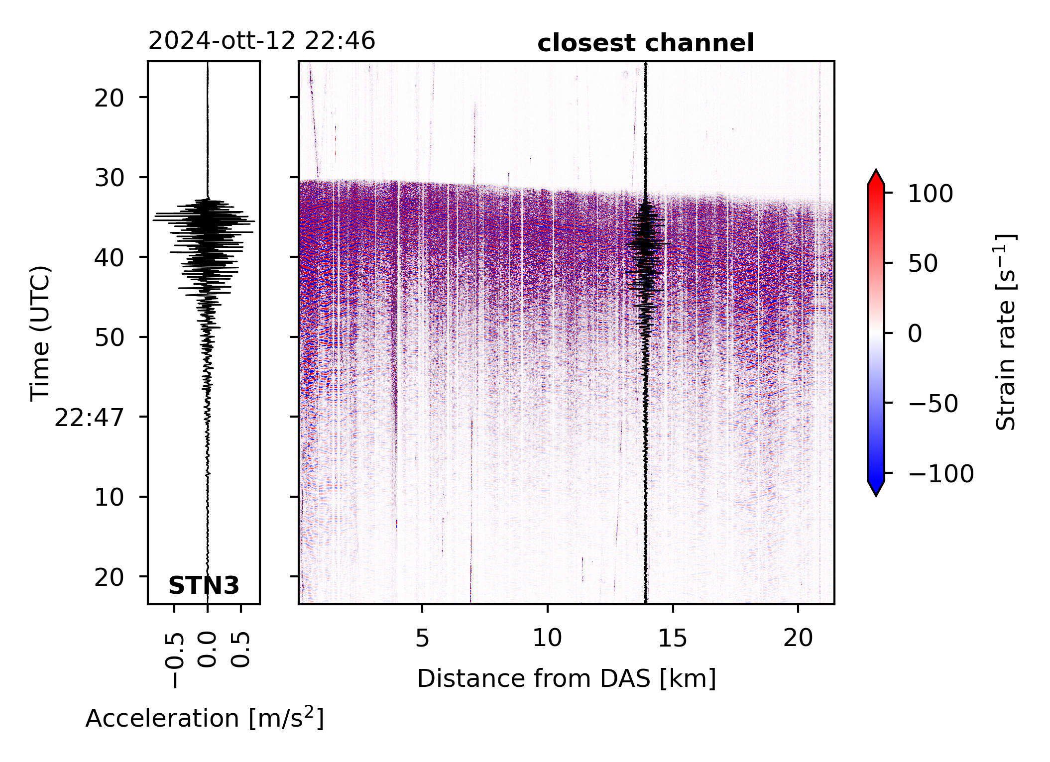
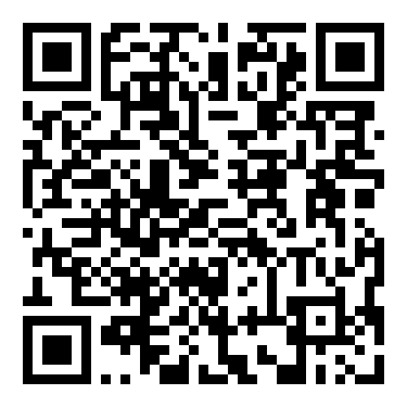
EPOS portal and more
Seismic catalogues
Continuous data from standard networks
Alister Trabattoni , Marie Baillet, Martijn van den Ende, Diane Rivet, Eleonore Stutzman, Claudio Strumia, Francesco Biagioli

Slide 5
EPOS portal and more
Continuous DAS data
Robust processing packages
Community shared standards
Alister Trabattoni , Marie Baillet, Martijn van den Ende, Diane Rivet, Eleonore Stutzman, Claudio Strumia, Francesco Biagioli

Slide 6
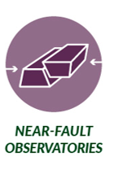
THANKS FOR THE ATTENTION
See you @ the poster session!

