Slide 1
An automatic ML workflow for microseismicity characterization at the Irpinia Near Fault Observatory Francesco Scotto di Uccio, Gaetano Festa, Luca Elia, Antonio Scala, Claudio Strumia

Slide 2
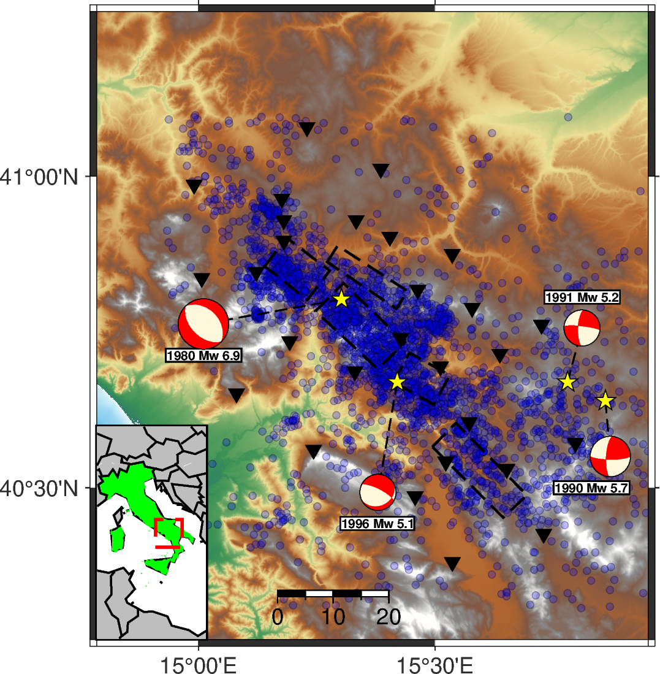
MICROSEISMICITY IN THE SOUTHERN APENNINES
years
days
Background microseismicity
Event preparation
SCIENTIFIC QUESTIONS
Can we automatize earthquake chacterization within the NFOs?
Can we generate enhanced catalogs with ML techniques ?
To what extent can NFO-trained models improve the detection ?

Slide 3
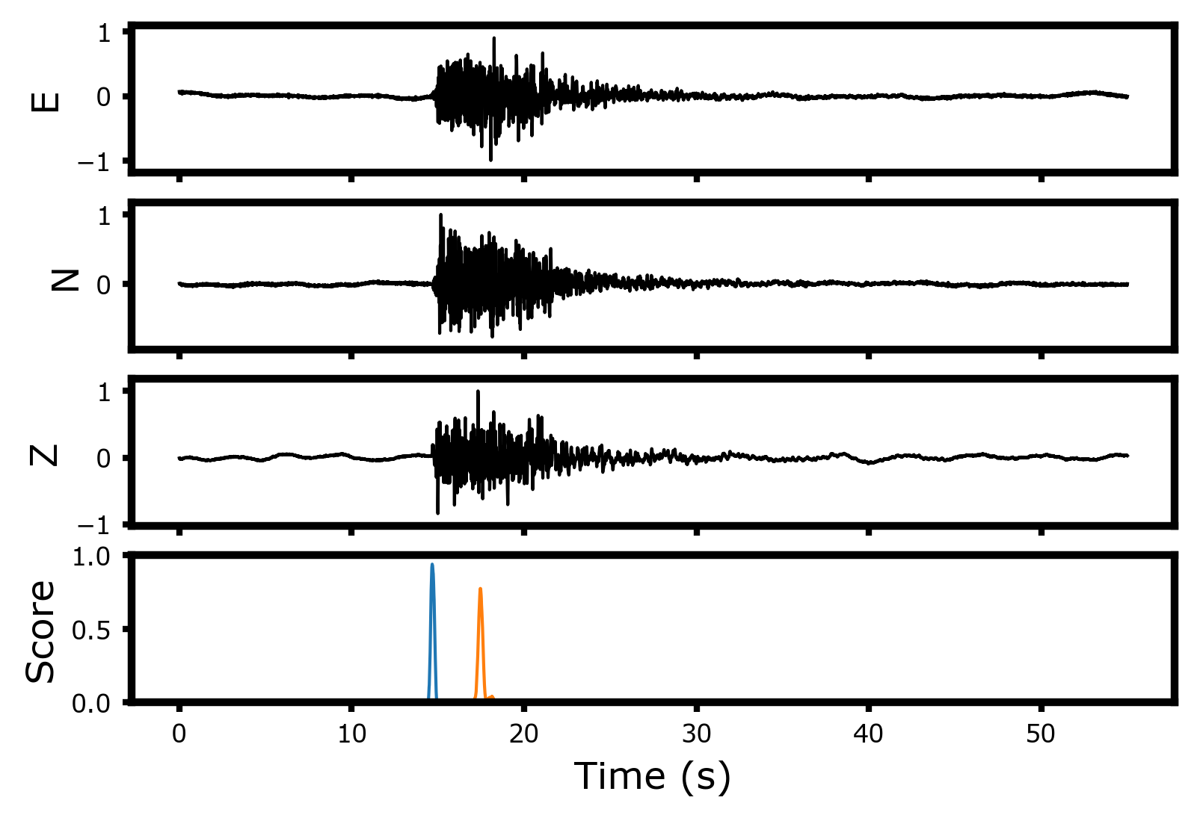
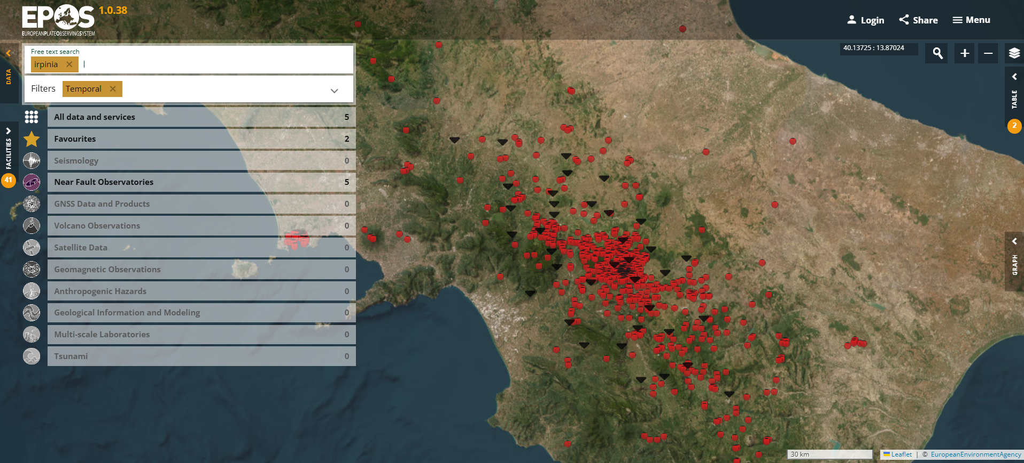
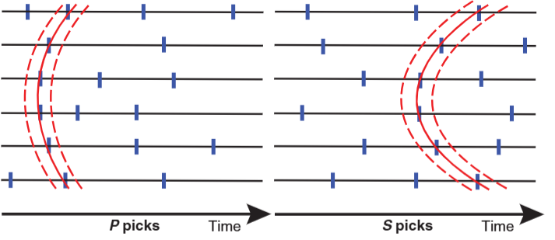
AUTOMATIC WORKFLOW @ INFO
OPERATIONAL
UNDER TESTING
Access to daily continuous records
Earthquake detection and determination of phase arrival times PhaseNet + REAL
Determination of hypocentral coordinates (HYPO71, NLLoc) and local magnitude
Estimation of source parameters and focal mechanisms

Slide 4
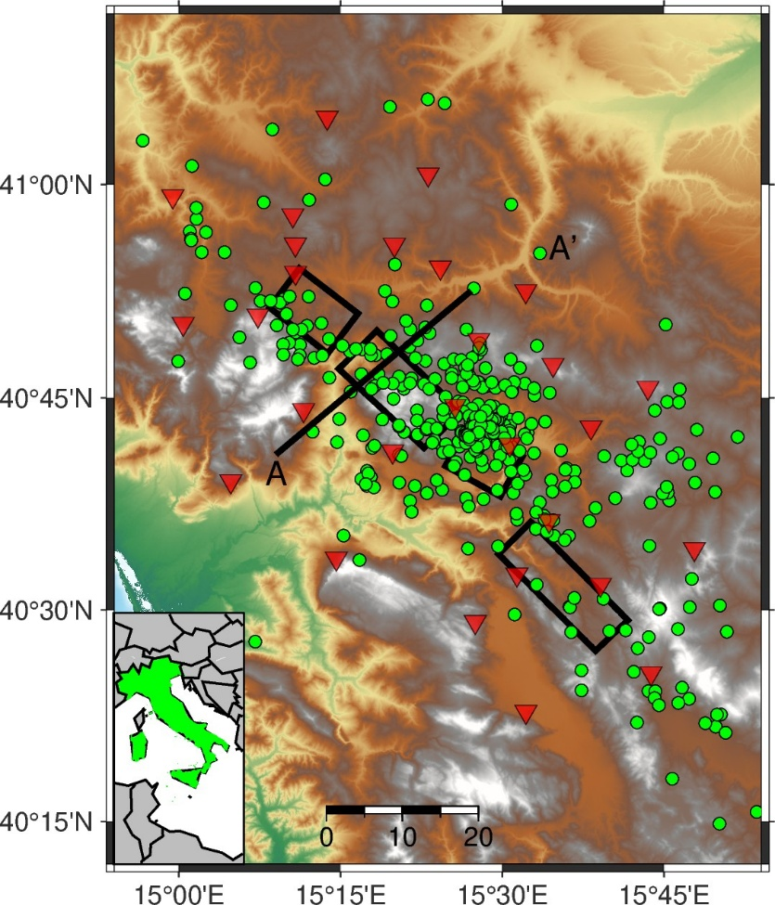
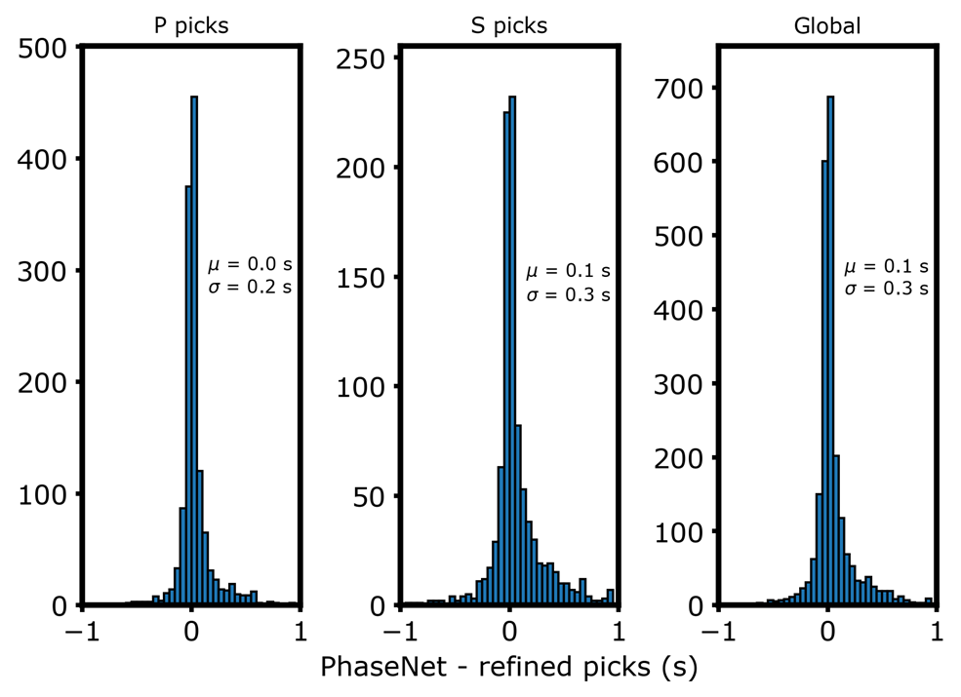
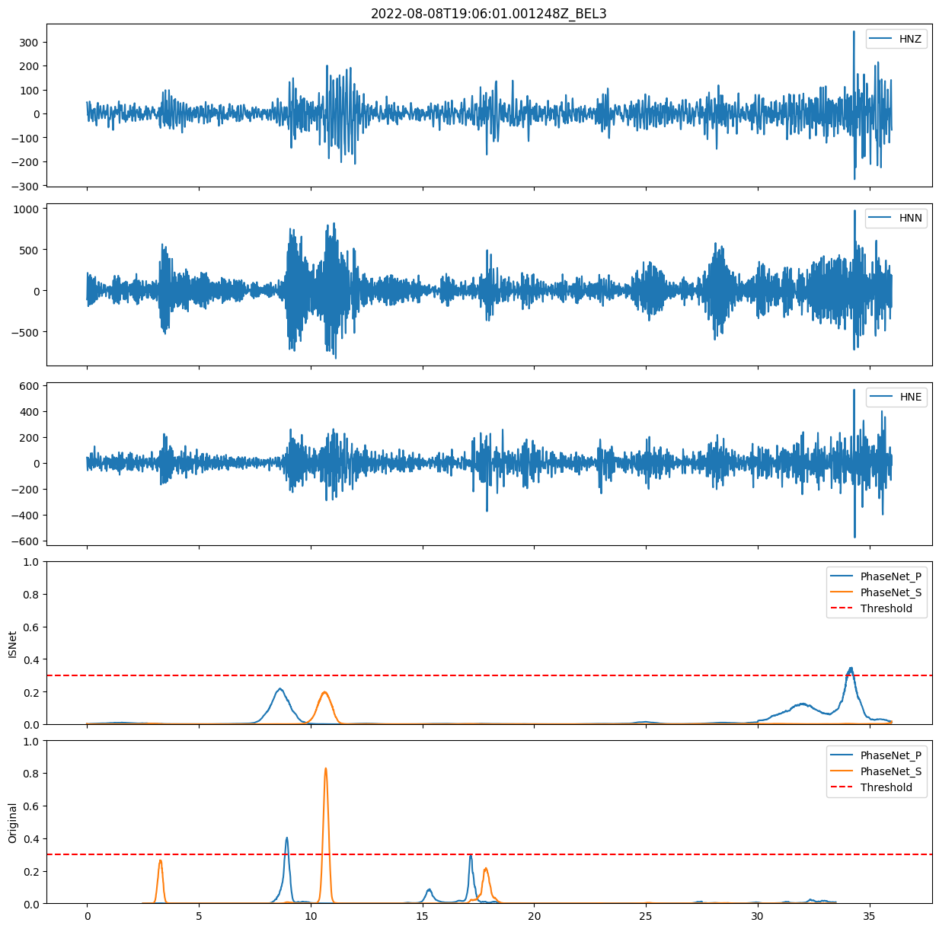
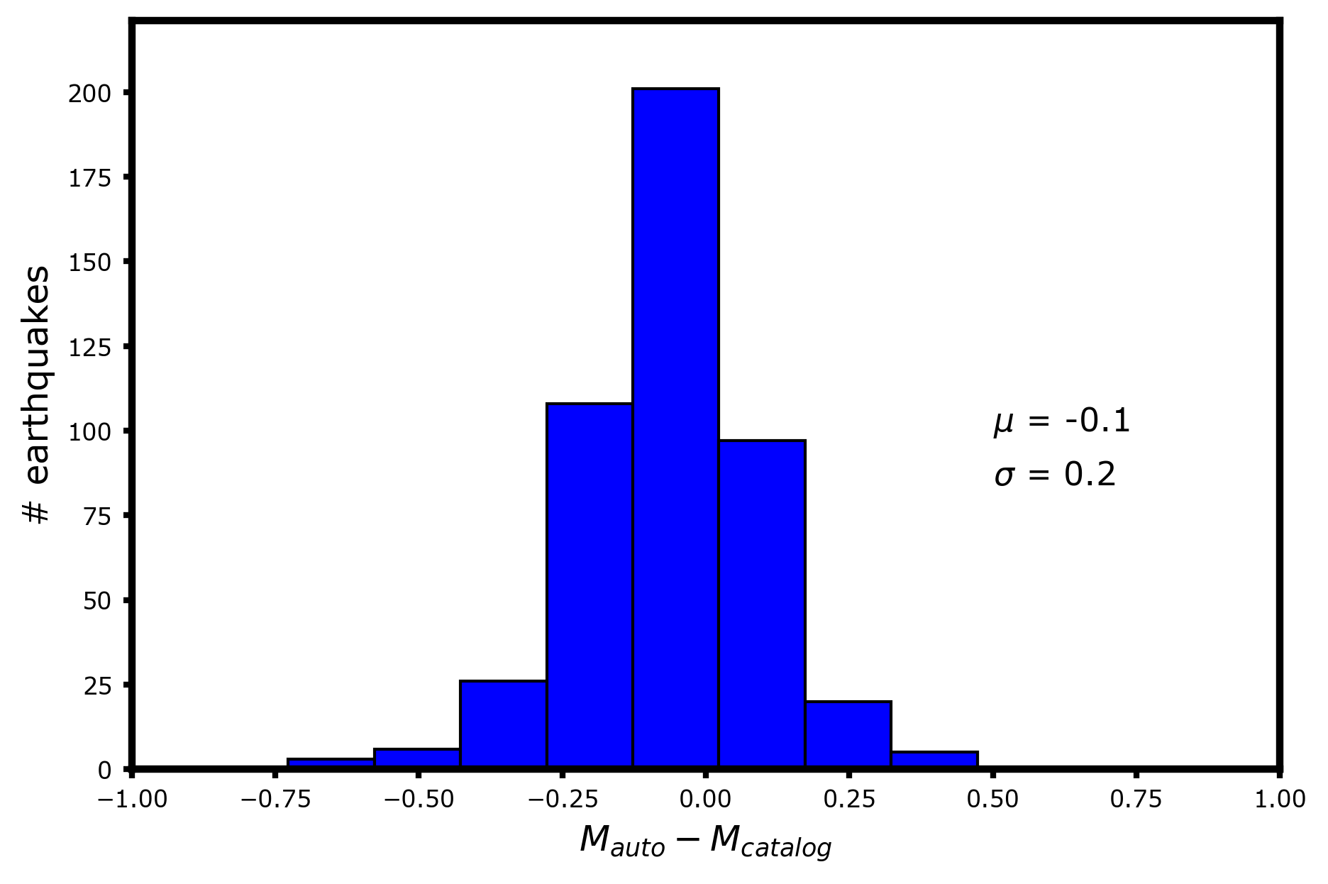
RESULTS & PERSPECTIVES
AUTOMATIC LOCATION AND MAGNITUDE ESTIMATION
TRAINING LOCAL ML MODEL
We trained PhaseNet on the INFO dataset since 2007
Coherency with catalog hypocenters and magnitude values
Few false positives (< 5%). Standardized catalog on EPOS data portal →Extension to other NFOs

Slide 5
THANK YOU FOR YOUR ATTENTION !

