Slide 1
Evaluating the Performance of Java Application Caches in EPOS GNSS Data and Products Portals
AUTHOR:
Vasco Senra

Slide 2
Abstract
Caching is a crucial component for enhancing the performance and scalability of web applications and database applications.
This study investigates the performance characteristics of various caching solutions, including in-memory and distributed caches, within web and database environments.
The primary objective is to identify optimal caching software and strategies, assess the impact of different caching frameworks on application responsiveness and throughput.
This work is done in part of my dissertation in computer engineering.

Slide 3
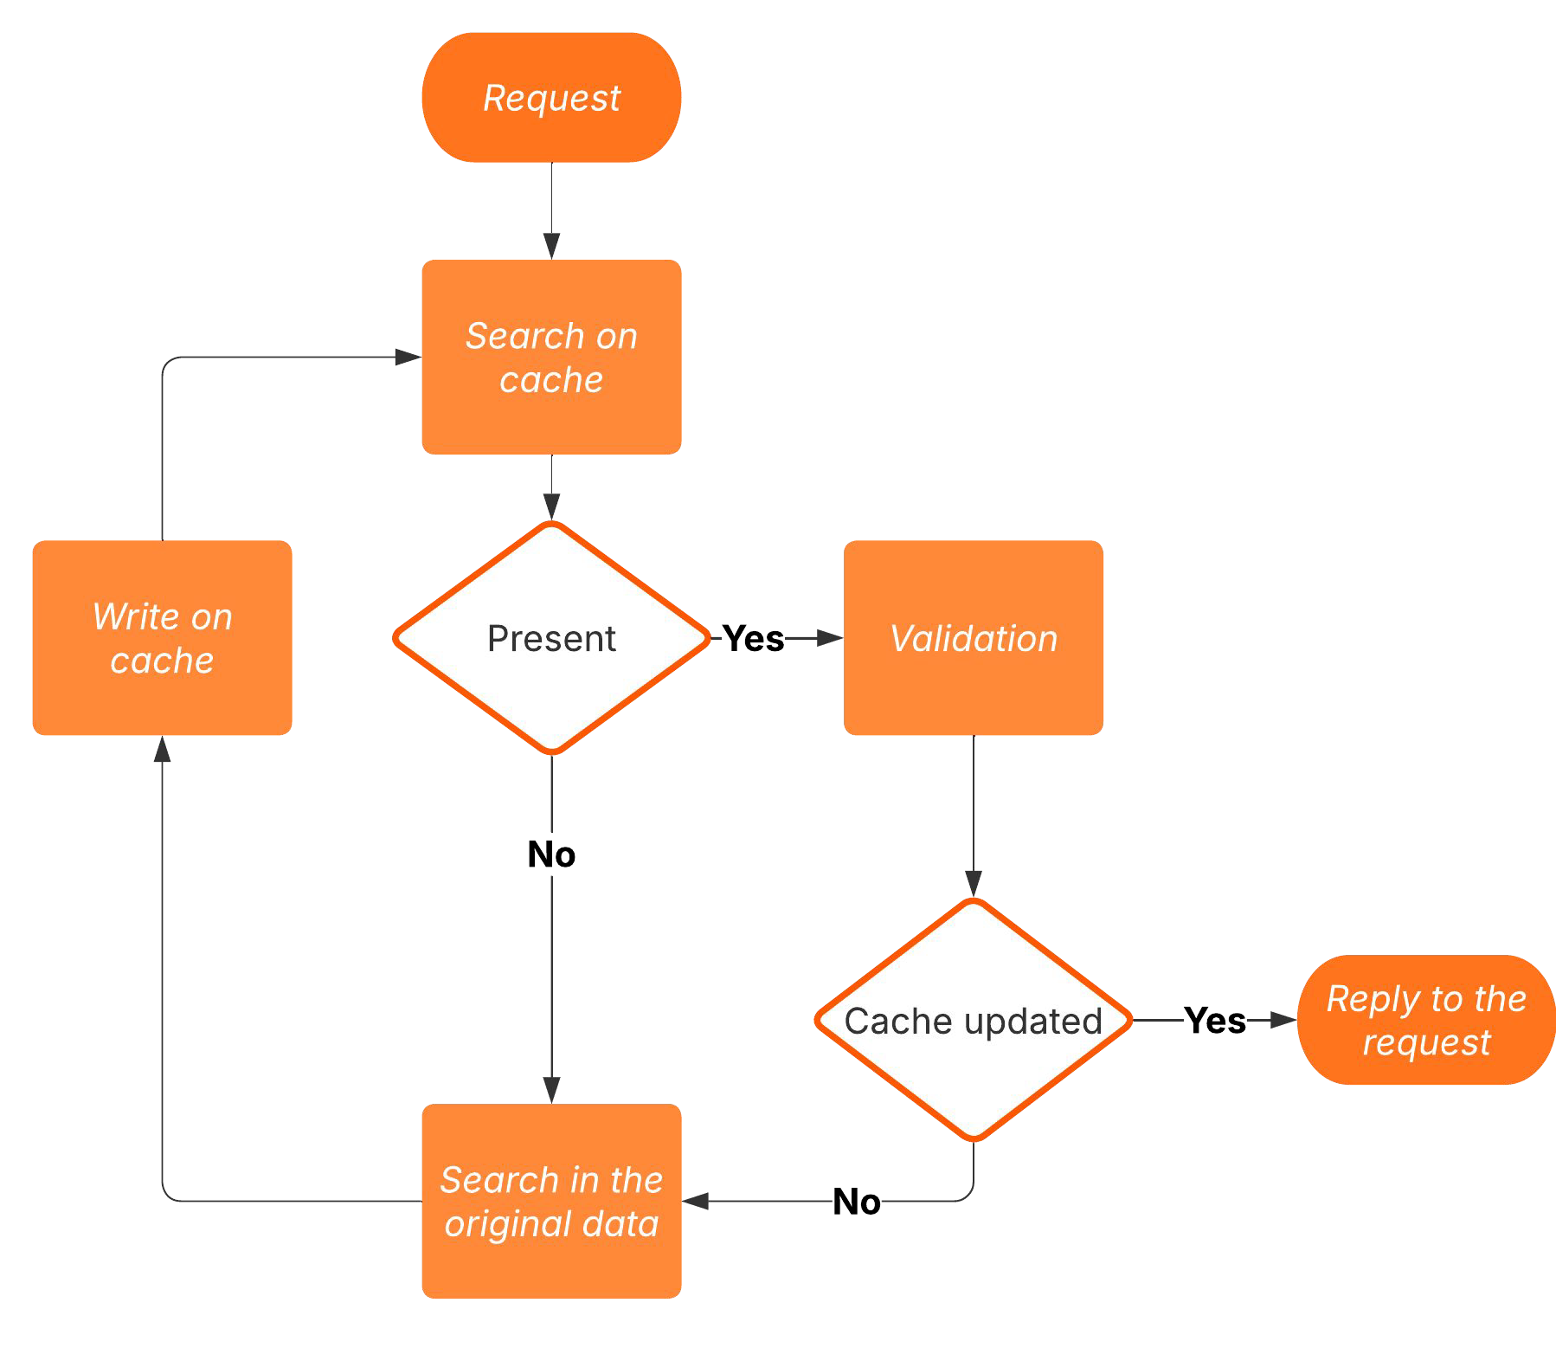
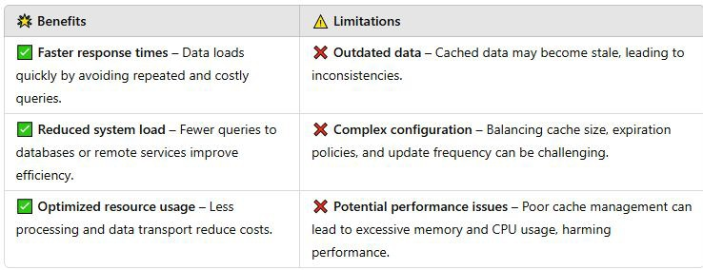
Cache Fundamentals
Cache is a type of fast, temporary storage designed to boost system performance by keeping copies of frequently accessed data in a location that's quicker and more efﬁcient than the original source. This helps prevent repeated searches in slower or more costly sources.

Slide 4
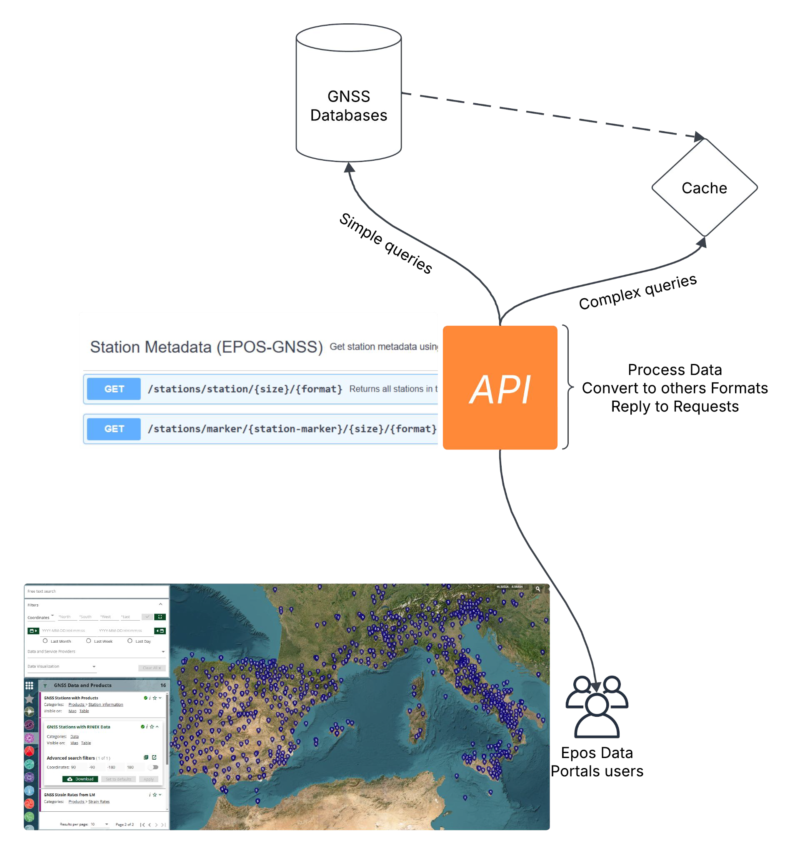
Case Study: EPOS GNSS TCS DataBase API and Portal

Slide 5
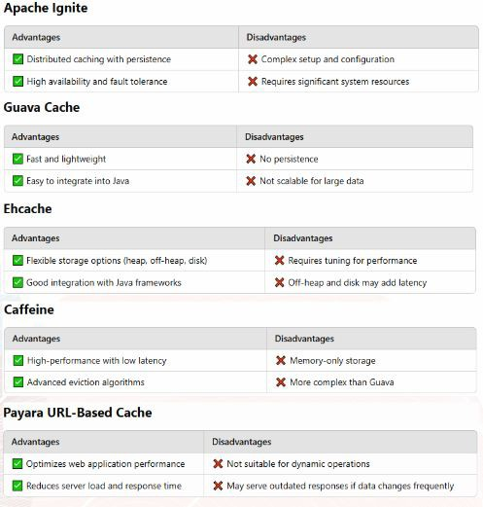
Frameworks on study
The following frameworks were chosen based on their availability and popularity.

