Slide 1
Geological information for the Italian Inventory of Geosites
Paolo Primerano * ISPRA - Istituto Superiore per la Protezione e la Ricerca Ambientale. Dipartimento per il Servizio Geologico d’Italia
*paolo.primerano@isprambiente.it

Slide 2
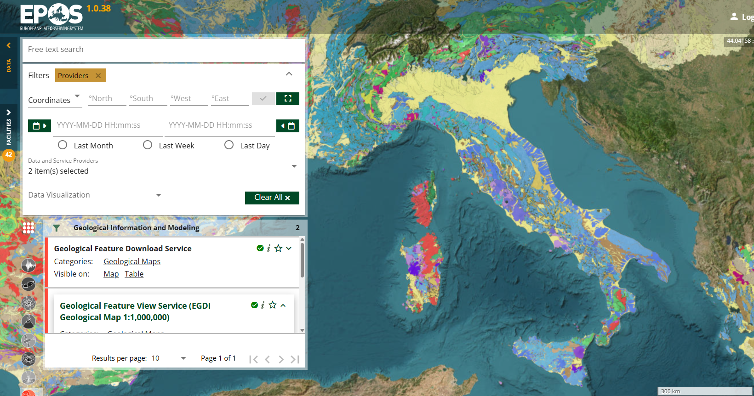
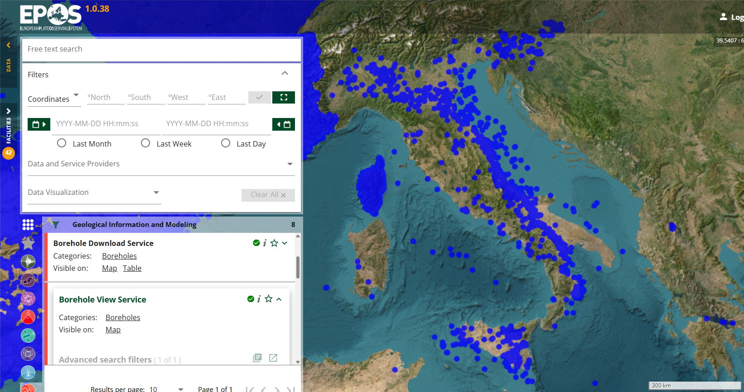
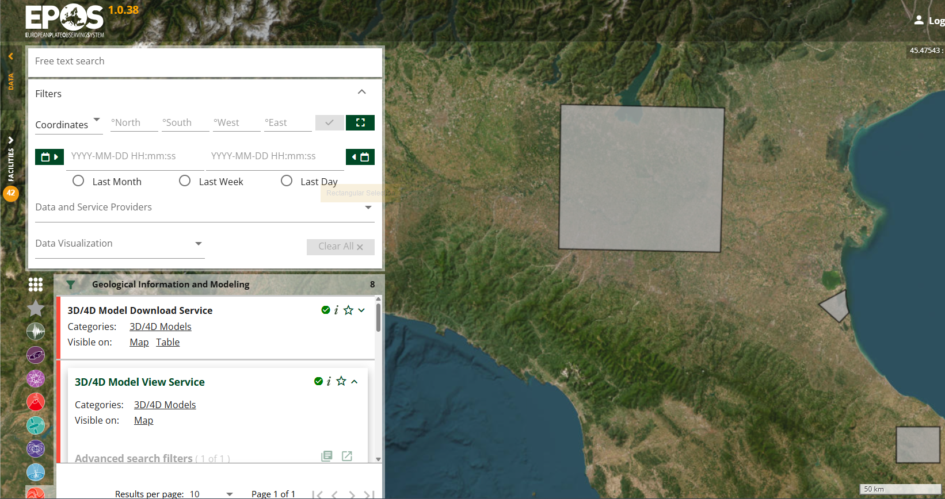
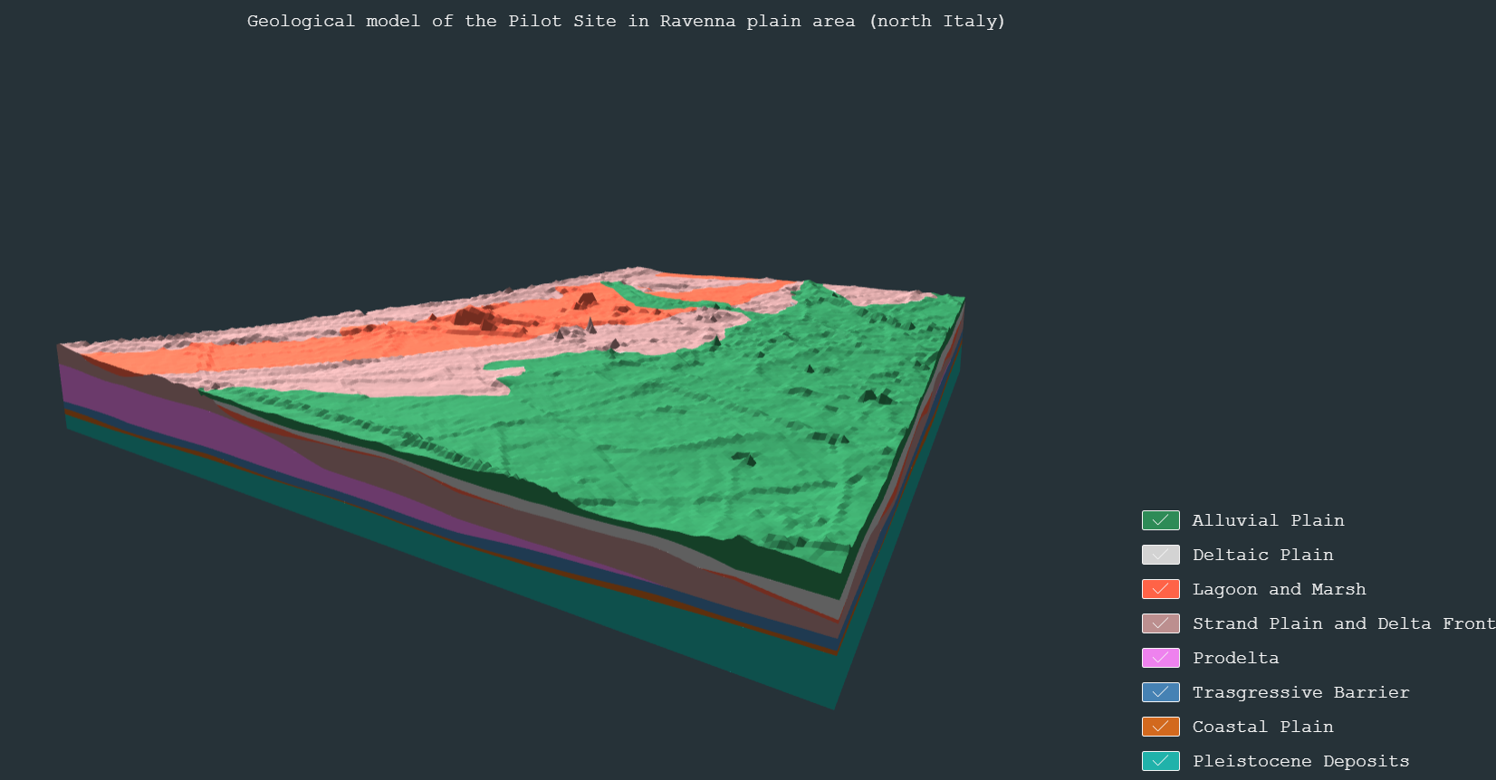
Introduction & datasets
Work & challenges
Paolo Primerano ISPRA (Italian Institute for Environmental Protection and Research)
Geological Survey of Italy
Datasets brought by ISPRA to TCS GIM data services
Geological map at 1:1M scale;
Boreholes:
deep (oil exploration)
shallow (geothermal resources exploration);
3D Geological models.
Geoscientific Research is supported by Public Service data collection, capitalisation, curation and regional/national inventories
Notes:
List of
Public mission of Geological Survey of Italy is Inventory, not research

Slide 3
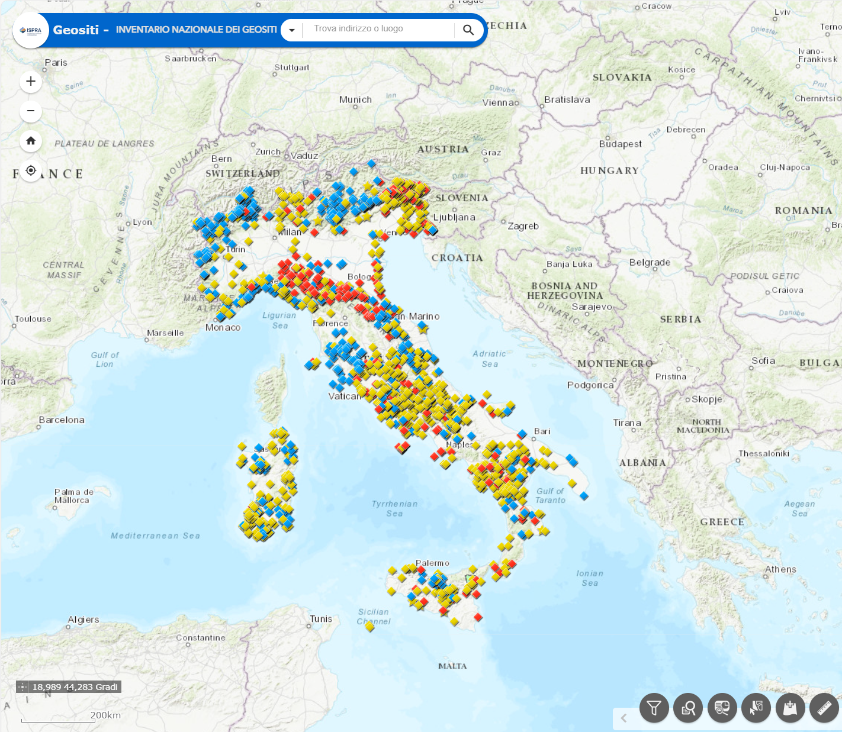
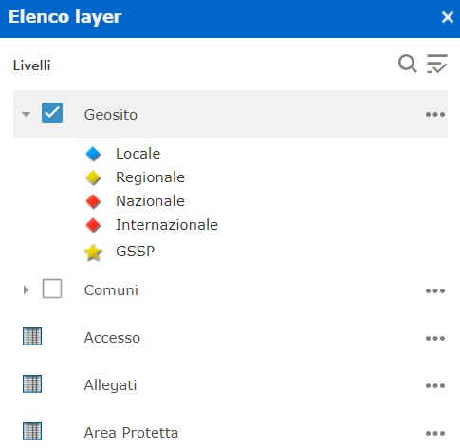
Introduction & datasets
Work & challenges
The Italian Geosites Inventory is a public access geodatabase to consult places where it is possible to appreciate geological characteristics.
Since the early 2000s, the Italian peninsula geoheritage has been catalogued to promote the conservation and the dissemination of geological knowledge.
The Italian geological heritage holds a great scientific, environmental, cultural, and tourist-recreational value.
An interactive map is available in the Inventory for searching information about approximately 3,000 geosites registered across the national territory.
Scan me to explore the Italian Geosites Inventory!
Notes:
The fundamental elements of geological heritage are geosites: “epigean, hypogeal or underwater sites, spatially limited and clearly distinguishable from the surrounding areas, with geological characteristics of intrinsic scientific interest that allow to understand the geological evolution of a territory”.

Slide 4
Introduction & datasets
Work & challenges
The number is continuously updated as the work proceeds simultaneously with:
the addition of new geosites;
the revision and if necessary, the elimination of geosites already present in the database, or outdated.
To reach even as many citizens and professionals as possible, a harmonized GeoSciML/INSPIRE compliant database will be published.
Geosites are essential to the development of geological sciences, because geology is based not only on archival documents and printed material, but also on places, outcrops and landscapes.
Scan me to explore the Italian Geosites Inventory!

Slide 5
Thanks for your kind attention.

