Slide 1
Application of the Magnetotelluric Method for Investigating Tectonic Structures and Hydrothermal Systems in the Sofia Basin, Bulgaria Dilyana Hristova National Institute of geophysics, geodesy and geography -Bulgarian Academy of Sciences TCS Geomagnetic Observations

Slide 2
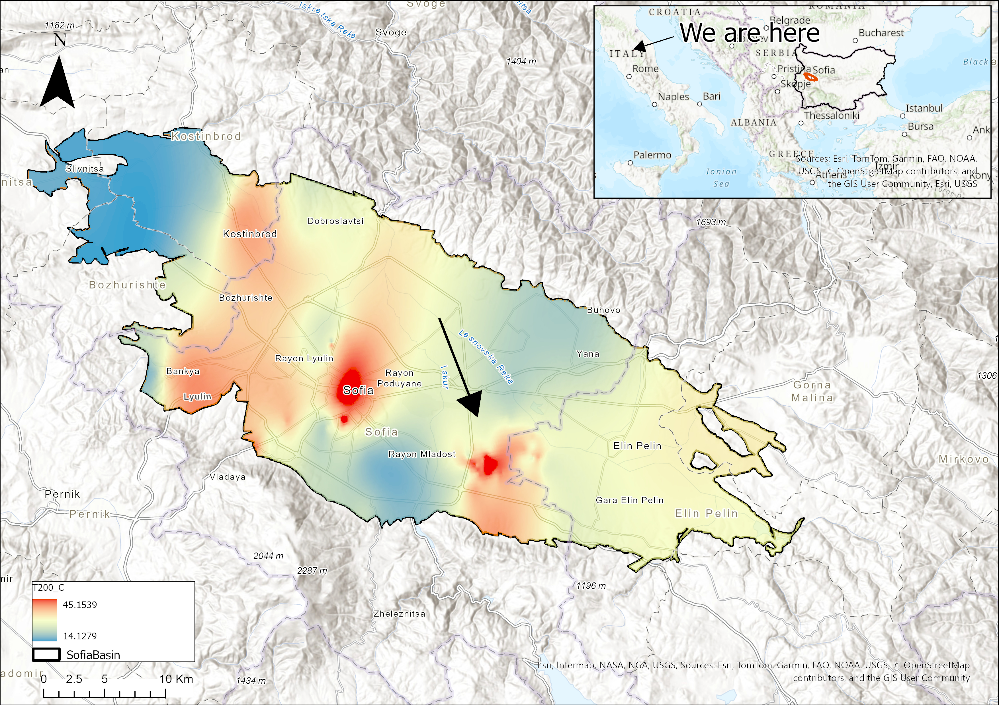
Research Focus & Objectives
What am I investigating?
What is the objective?

Slide 3
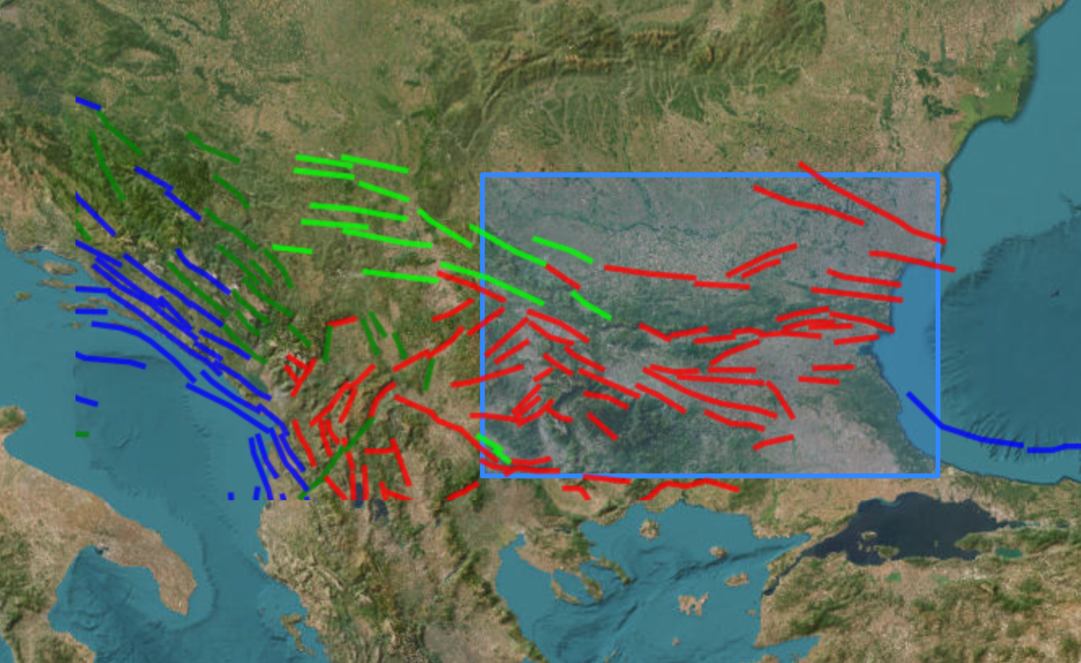
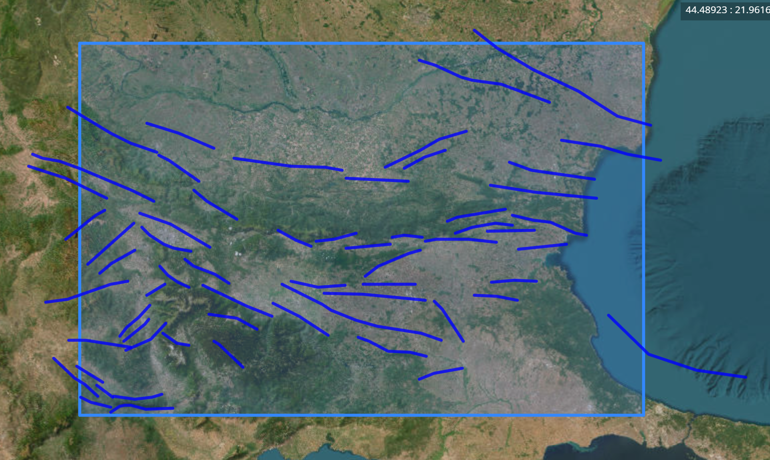
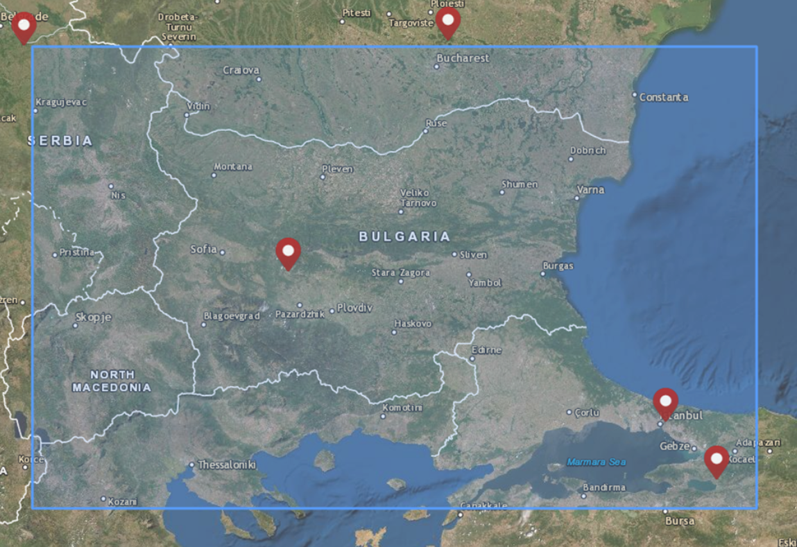
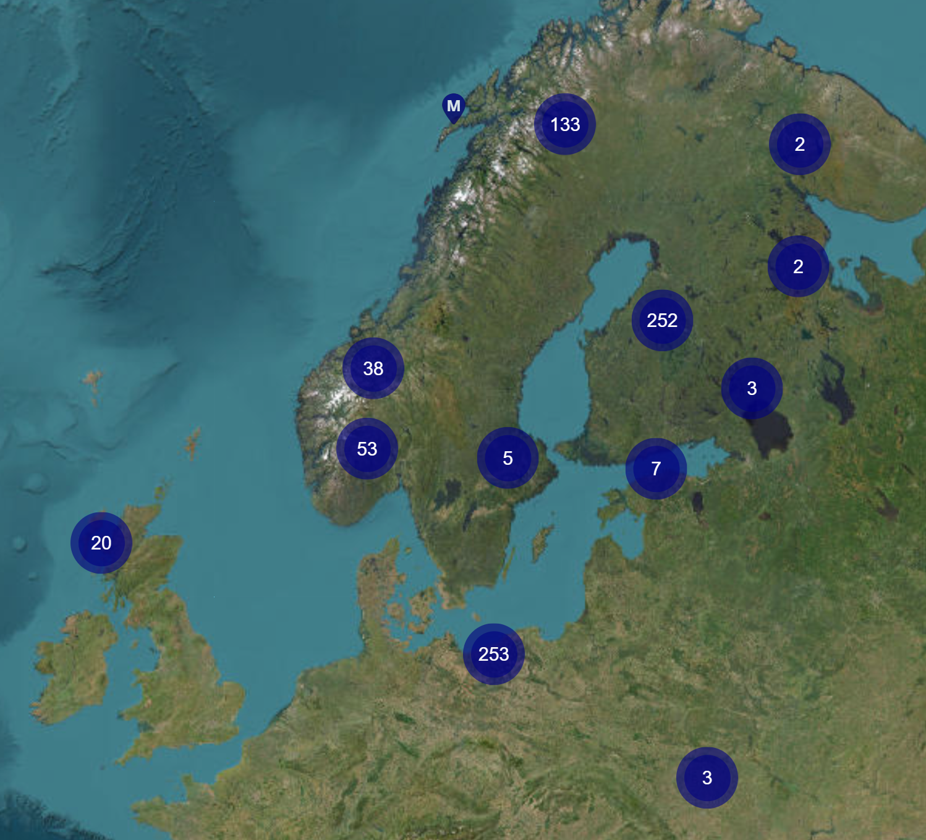
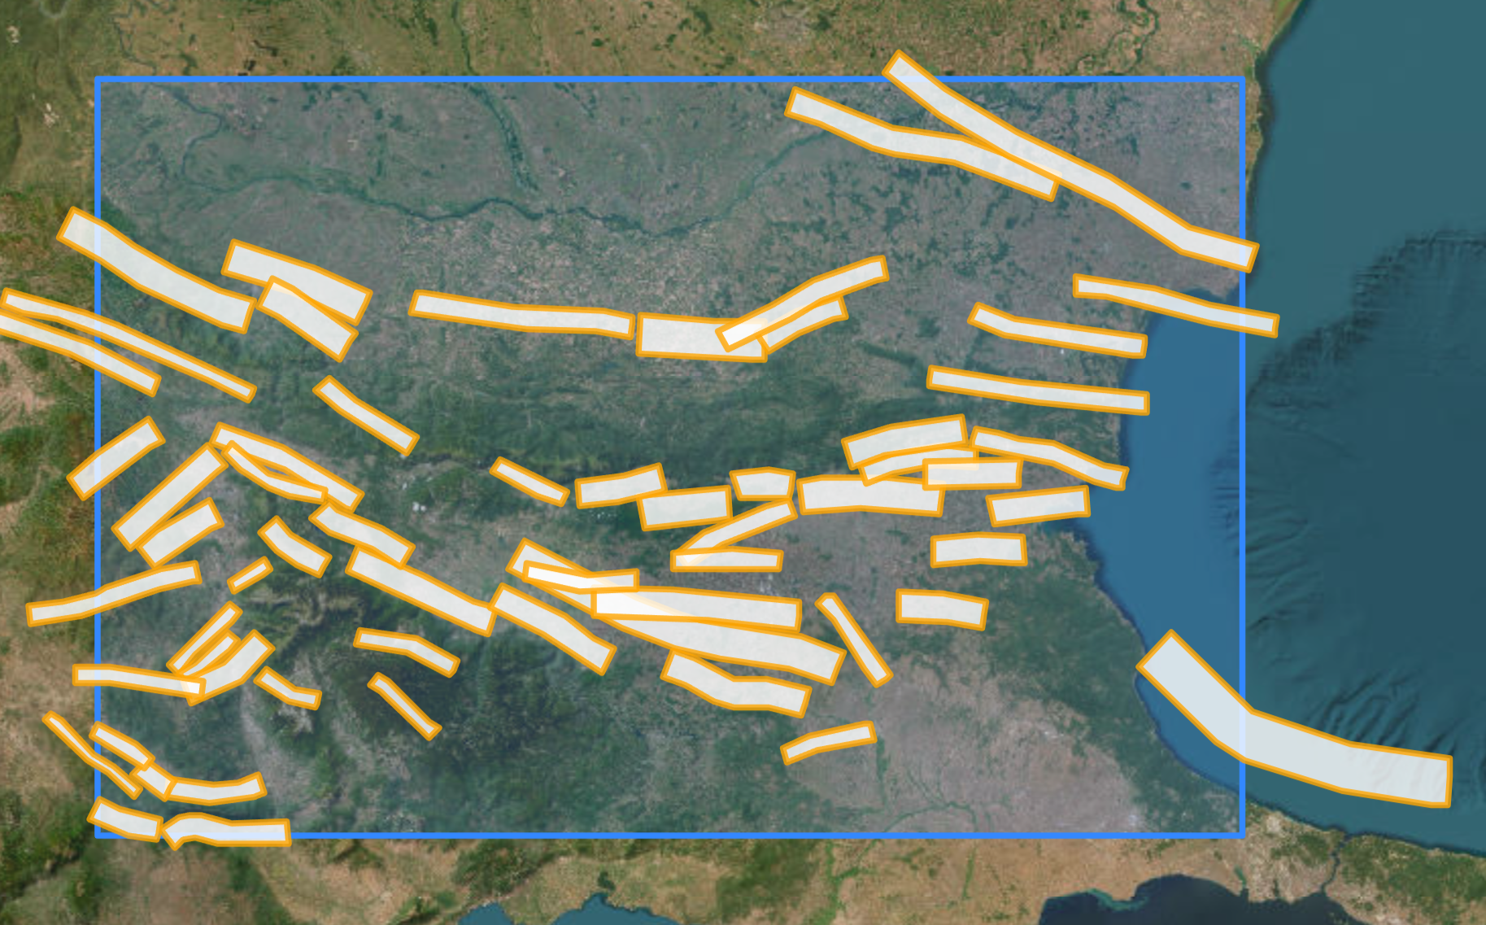
Research Progress & EPOS Data
What is the current stage of my research?
What EPOS data am I using?
European Fault Source Model 2020 (OGC WMS)
European Fault Source Model 2020 - Crustal Faults (OGC WFS)
World Data Centre (WDC) Geomagnetic Observatory Station List
European Fault Source Model 2020: 3D Triangular Meshes - Crustal Faults (OGC WFS)
Magnetotelluric sites view

Slide 4
Thank you for your attention!
Feel free to stop by my poster so we can chat more about my research!
Dilyana Hristova PhD Student ✉️ dilyana.m.hristova@gmail.com

