Slide 1
The World Data Centre For Geomagnetism, Edinburgh Oli Chambers British Geological Survey ochambers@bgs.ac.uk

Slide 2
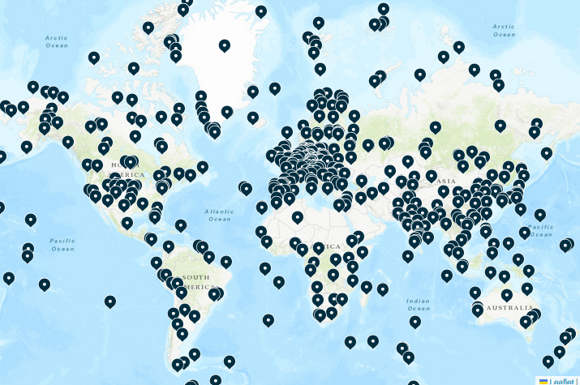
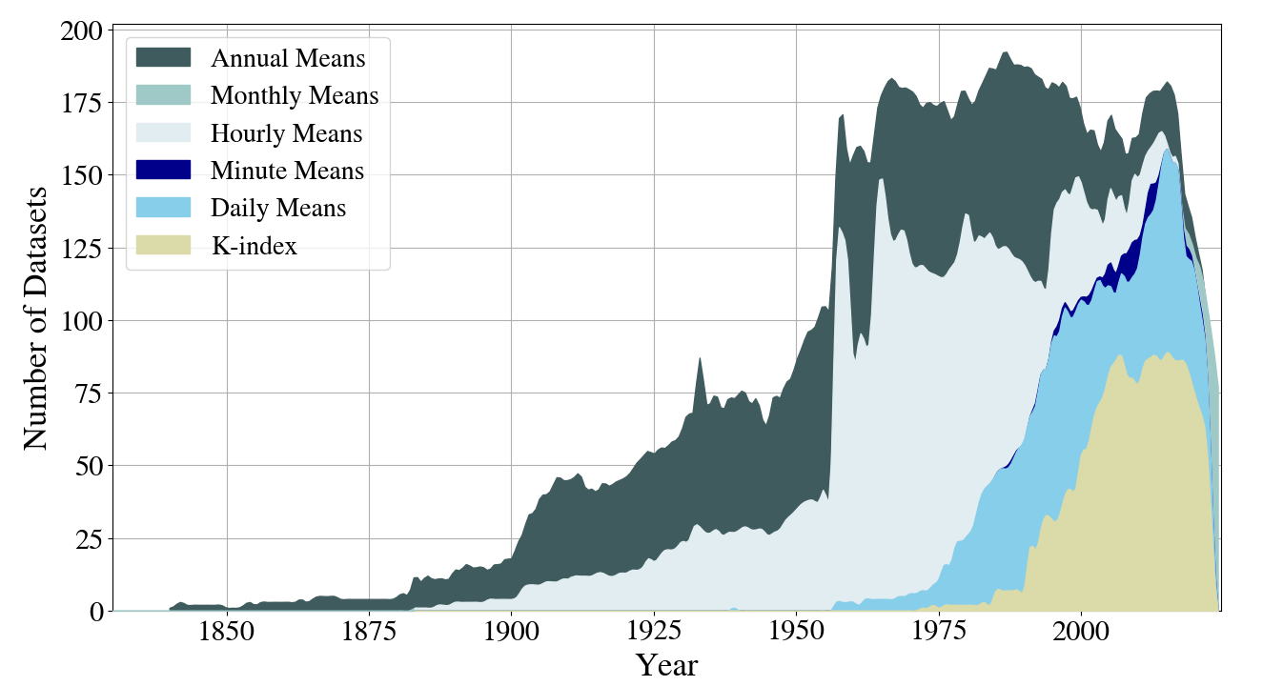
What is the WDC?
574 Geomagnetic Observatories. 218 currently operational.
Data files spanning ~85 million hours
Oldest data from Prague in 1830-07-02

Slide 3
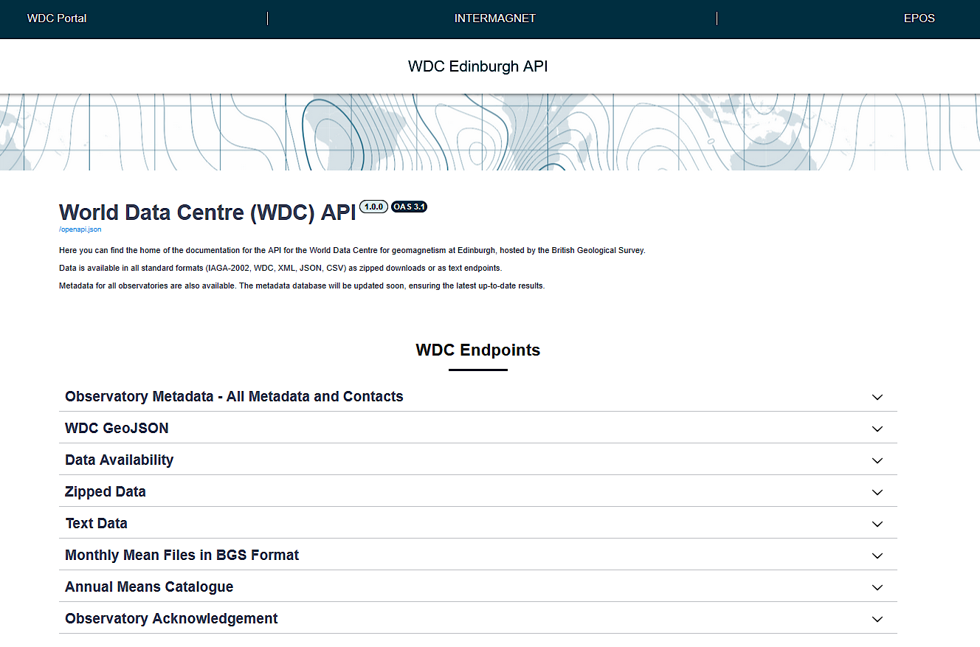
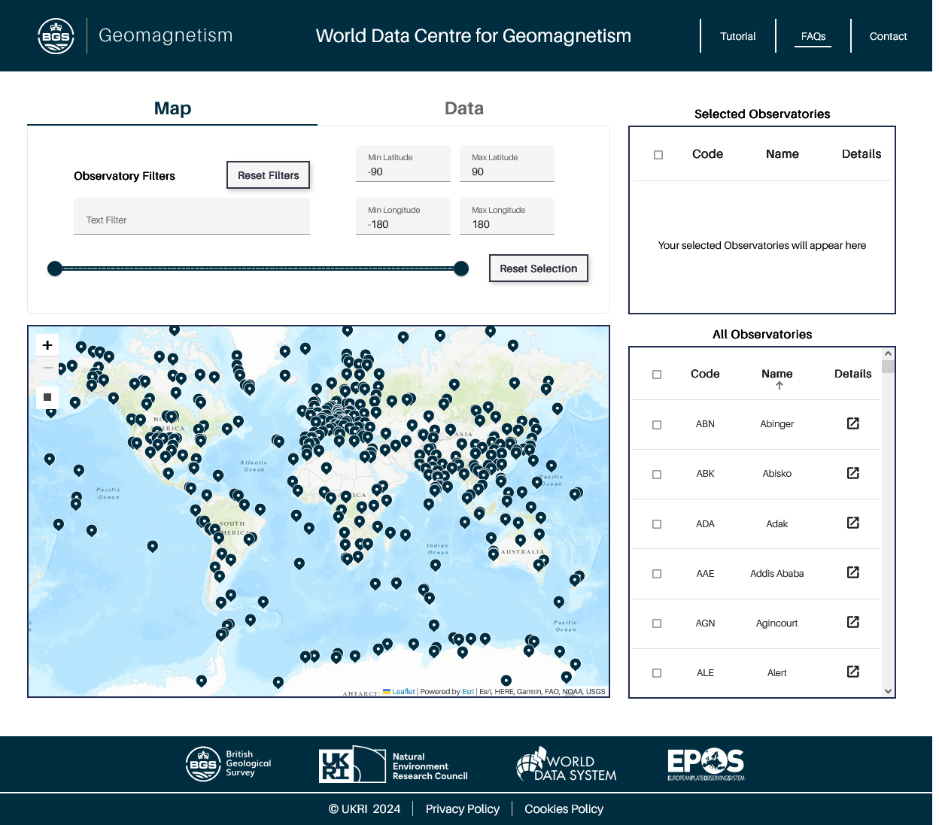
WDC API
WDC Data Portal

Slide 4
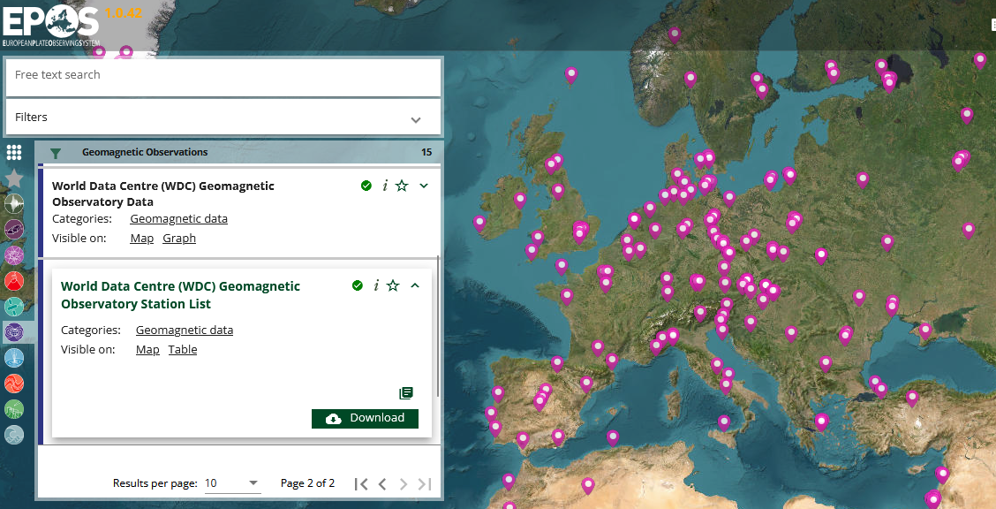
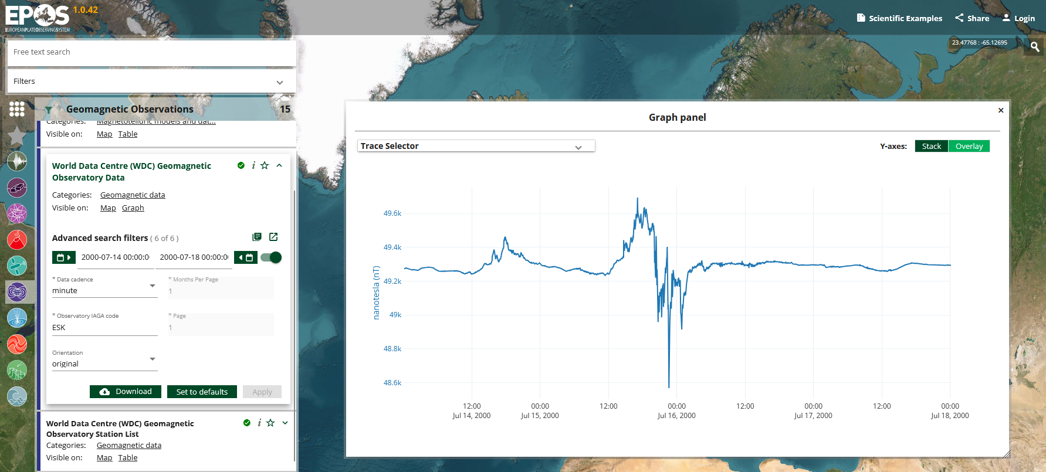
EPOS Platform
2 dedicated endpoints
30-day testing period
Uses geoJson & covJson

Slide 5
Thank you!
Feedback Welcome!
wdcapi.bgs.ac.uk

