Slide 1
Castanhão Reservoir-Triggered Seismicity - a new EPISODE on EPOS EPISODES Platform H. Ciechowska, B. Orlecka-Sikora, Ł. Rudziński, A.F. do Nascimento, A. Vuan

Slide 2
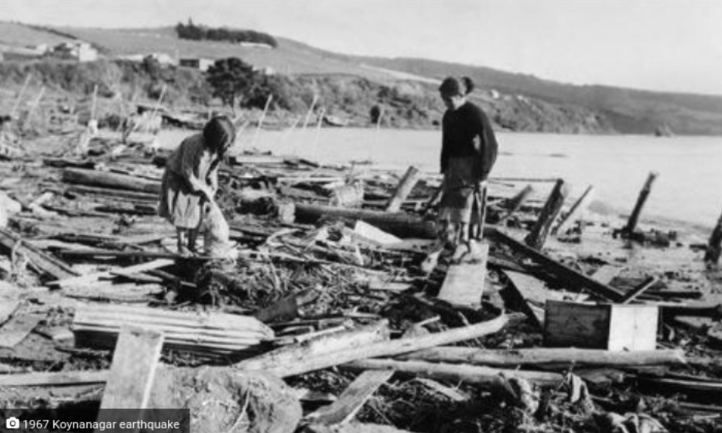
Reservoir-Triggered Seismicity
✦ Anthropogenic origin,
✦ May be caused by reservoir impoundment and change in pore pressure in underlying layers,
✦ May cause dam damage and, in turn, fatalities,
✦ Many factors impacting the activity - mechanisms not well understood yet.
Koynanagar earthquake, India, Dec. 11, 1967
Credits: pudhari.news

Slide 3
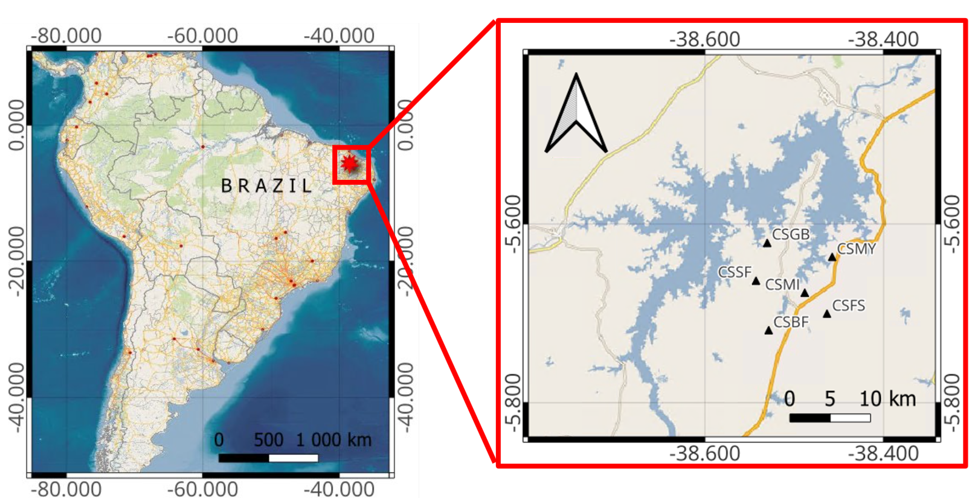
Study Site – Castanhão Reservoir, NE Brazil
✦ Ceará, NE Brazil (known for its natural resources),
✦ Built over the Jaguaribe River (used to be the largest intermittent river – the flow regulated by the dam now),
✦ The biggest reservoir in the state.

Slide 4
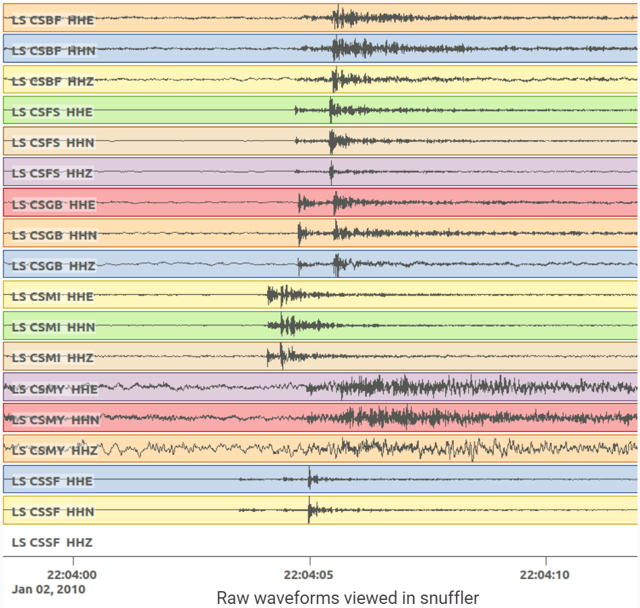
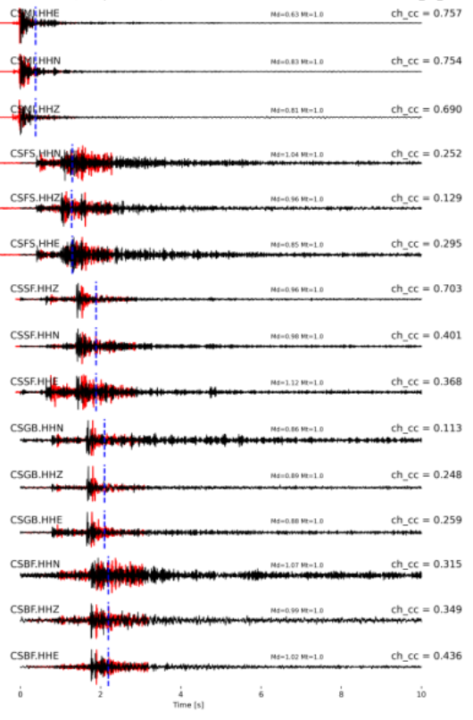
Castanhão EPISODE – Data
Example of PyMPA template matching
applied to the data
Example of the raw seismological data

Slide 5
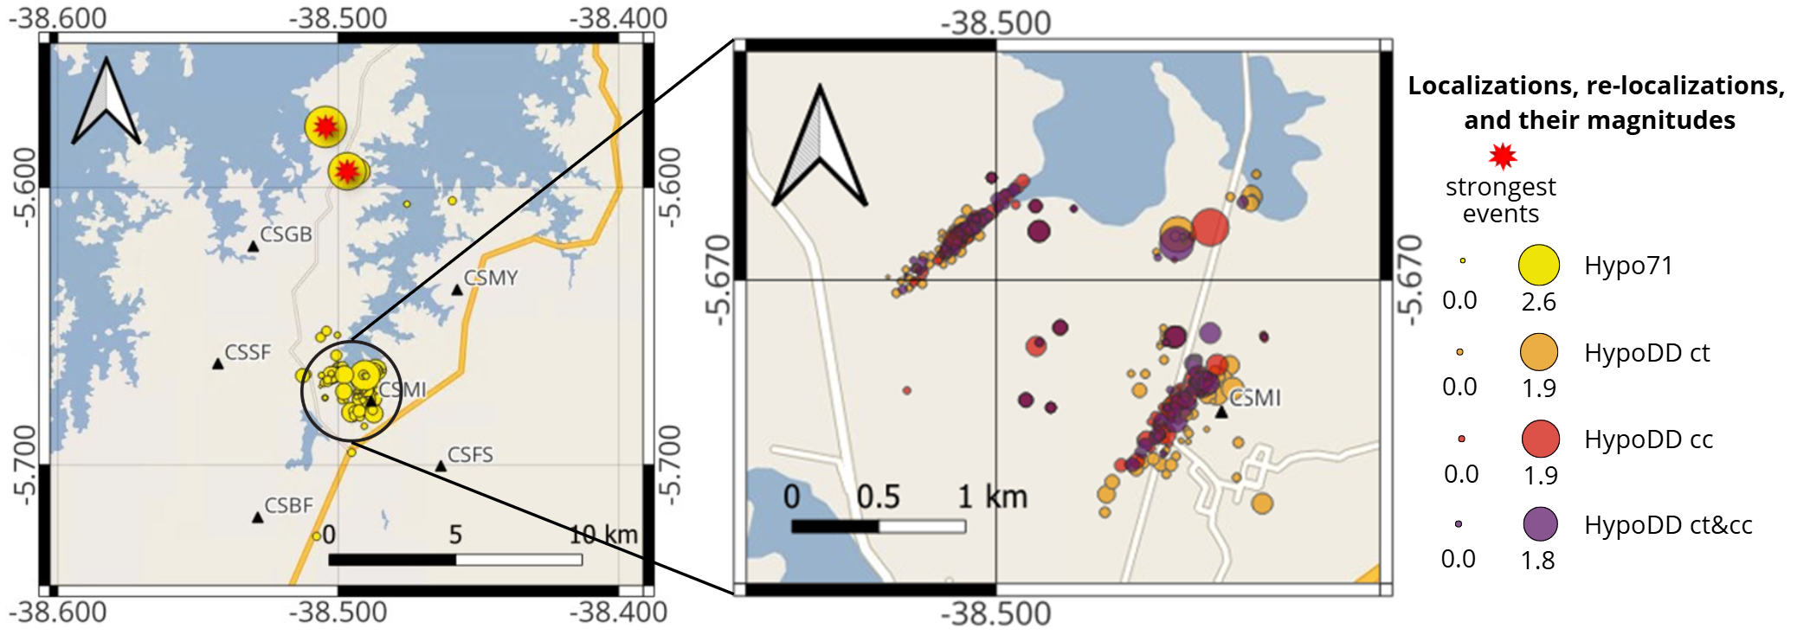
Castanhão EPISODE

Slide 6
Thank you for attention! contact: hciechowska@igf.edu.pl

