Slide 1
EPOS - European Plate Observing System
A community perspective
Gaetano Festa, SCC Chair, Univ. Napoli Federico II| gaetano.festa@unina.it| 18/03/2025
Notes:
Title slide

Slide 2
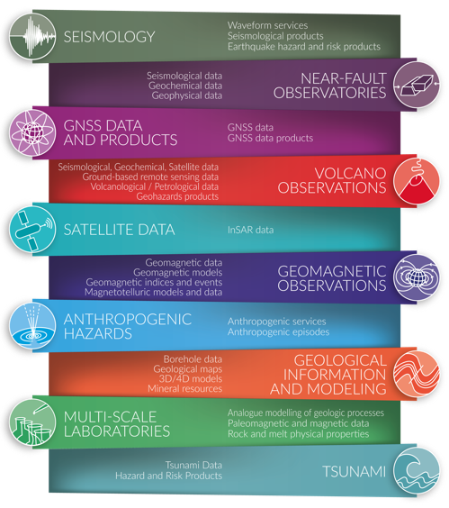
The EPOS Thematic Core Services
Currently, 10 different solid Earth science disciplines collaborate across EPOS (Thematic Core Services, TCS)
TCS are outside the ERIC perimeter, they contribute to the data, product and service provision to EPOS, and they are represented in the Service Coordination Committee
TCS are technically coordinated with the ICS for platform operation via the TCS-ICS interaction group
Notes:
Content slide

Slide 3
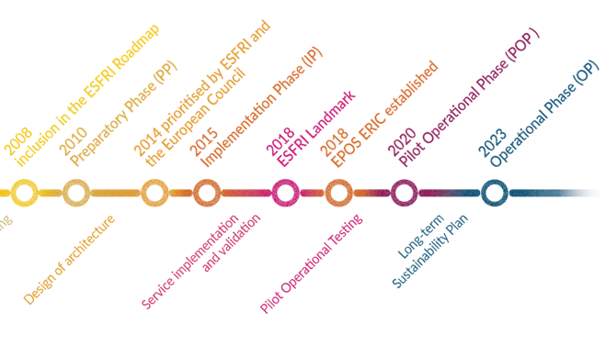
Communities through the EPOS journey
From data protection and embargoing to data sharing and OPEN SCIENCE
Design, implementation, validation, testing, operation of services
Community growth and development of new communities within the EPOS development – different level of maturity of TCS. Cross-TCS best practices for open data.
Notes:
Content slide

Slide 4
The Community perspective for the EPOS Science Program
Accessing to solid Earth science data, products, software, services and research infrastructures to facilitate scientific research;
Favouring Multidisciplinary/ Transdisciplinary use of solid Earth science DDSS;
Advancing in hazard assessment and risk mitigation;
Providing products related to the exploitation of geo-resources;
Fostering the implementation of services addressing societal challenges;
Strengthening the field of computational Earth Science;
Driving IT innovation and fostering FAIR data management practices;
Enhancing international collaborations and promoting the global dimension of solid Earth science research;
Providing training initiatives and ensuring the dissemination on solid Earth science.
Notes:
Content slide

Slide 5
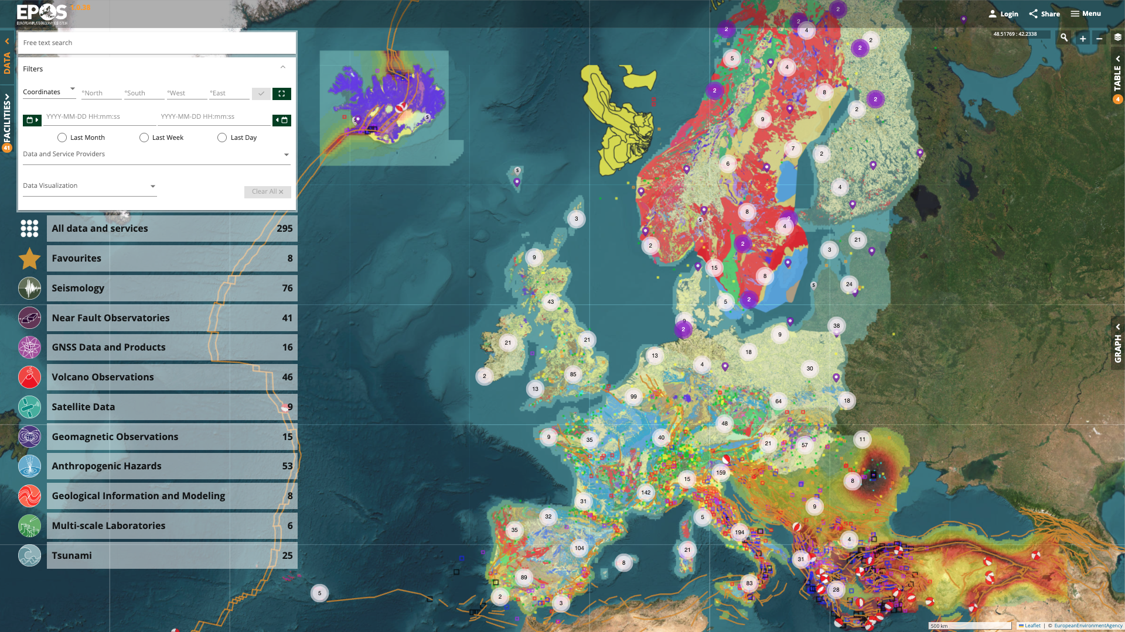
Access to community data and products
Facilitating and enhancing research by providing openly accessible and interoperable data and products across diverse domains within solid Earth science.
Integration of TCS data and services through the EPOS Platform.
Long-term provision of data and services
Engage data and service providers and National Research Organizations.
Developing the EPOS portfolio by integrating new data and services from existing TCS and emerging ones.
Enhancing the functionalities of the EPOS Platform based on user feedback.
Notes:
Content slide

Slide 6

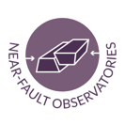








Community governance models
TCS are governance frameworks for community-specific coordination and data integration across different disciplines
TCS Consortium with its own governance
TCS Consortia designed to adopt joint strategies to tackle scientific, technical, financial, legal and ethical issues and best practices for data harmonization
Notes:
Content slide

Slide 7





Within-Community and Cross-Community projects
EPOS as a flywheel (and a brand!) for community projects to be developed and supported within the EU programmes and at National Level.
Italian contribution to enhancing NRI – seismic, geodetic, volcanic, NFOs - and data provision
Dutch contribution building multiscale facilities from micro- to field scale
Contribution for data distribution – GNSS and other disciplines from Belgian institutes – SERVE
Enhancing services (VA and TA) within Land/Sea Ris to foster curiosity-driven research
Consolidation and enhancement of EPOS RI through new services for science, society and private sector
Notes:
Content slide

Slide 8












International collaborations, new communities, ECR
Activating a global network of collaborations to capitalize on joint investments and expertise
Integrating new communities into the EPOS framework: Built Environment Data, Gravimetry, Ground Instability, …
Favouring breakthrough, game-changing research, through the involvement of Early Career researchers into EPOS ecosystem (training, user feedback, schools, grants)
Notes:
Content slide

Slide 9
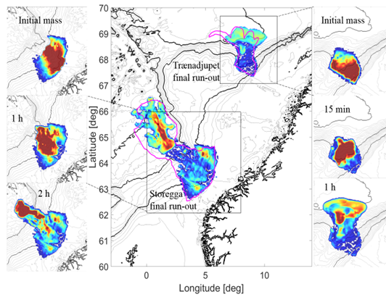
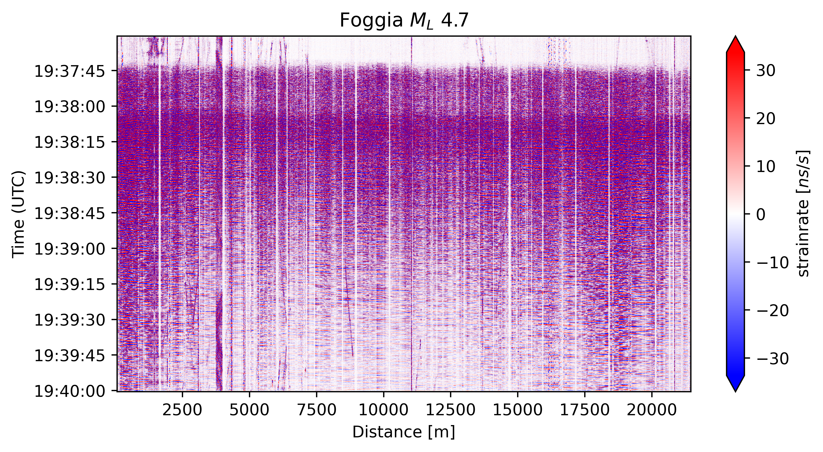
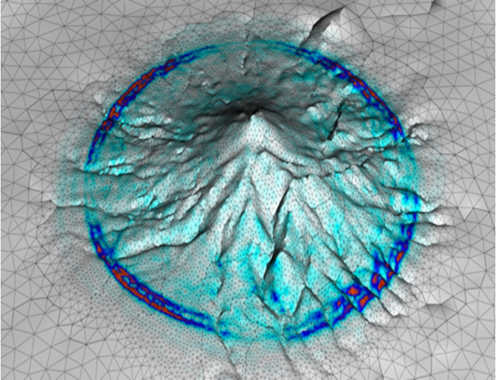
Challenges and Opportunities
The EPOS Platform has a complex structure managing a variety of data-types (time series, maps,…) and formats: TCS also have developed community portals to handle TCS data and allow specific visualization/ processing operations.
Not all DDSS ready to be integrated: Software and workflows, Simulation Data Lakes, DAS data,…
EPOS and actual scientific challenges: AI-ready data and products, visualization and processing tools on top of data provision, near-real-time monitoring (also in case of a natural crisis), connection to HPC
Data
Types/
formats
Notes:
Content slide – 2 boxes with titles

Slide 10

Thank you for your attention!
Gaetano.festa@unina.it
www.epos-eu.org/on | social media #EPOSon
Notes:
Thank you slide

Slide 11
Notes:
Logo only

