Slide 1
Welcome
to the 2025 edition of the EPOS Days
Lilli Freda
EPOS ERIC Executive Director

Slide 2
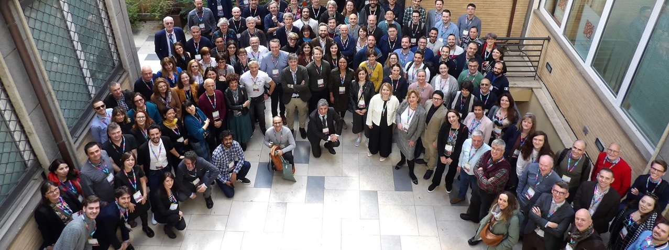
As a tradition … The EPOS Community meets every year
Bring the EPOS Community together
Make EPOS known to researchers, potential contributors, new potential partners, users … and learn about them
Purpose of the EPOS Days

Slide 3
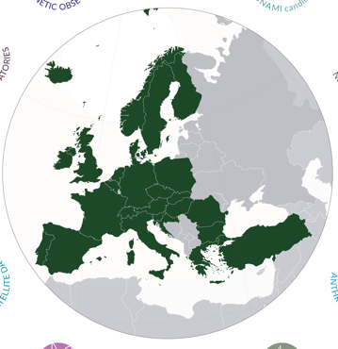
EPOS is the reference Research Infrastructure
for solid Earth science in Europe
EPOS brings together countries and aggregates research communities around the paradigm of Open Science
EPOS integrates scientific DATA generated across Europe and across disciplines making them universally accessible
EPOS enables excellent science and innovation
511 Data and Service Providers
172 Research Organisations
26 European Countries
10 Scientific Domains
5 International Organizations
EPOS is operated by an ERIC
(European Research Infrastructure Consortium)

Slide 4
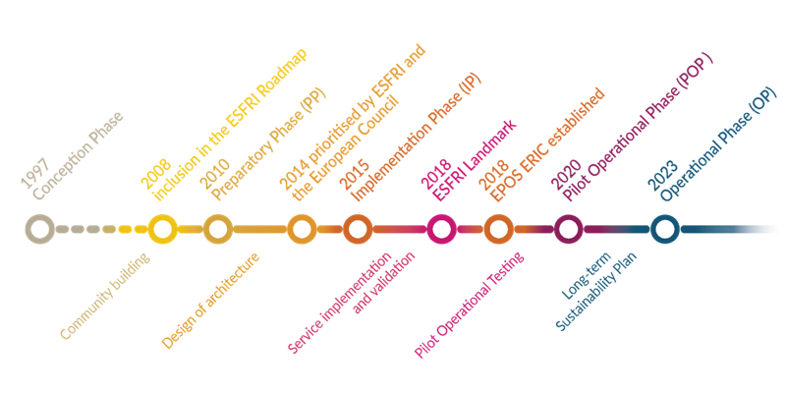
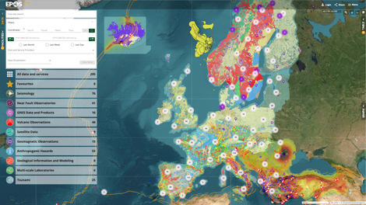
A long journey … to arrive where we are today
To establish a sustainable and long-term access to solid Earth science data and services integrating diverse European Research Infrastructures under a common federated framework
The EPOS Platform fully operational
Providing open access
to harmonized and interoperable
scientific data and products
29,295 visitors from 124 Countries
updated in March 2025

Slide 5
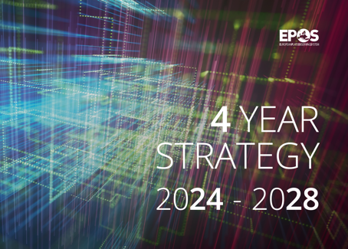
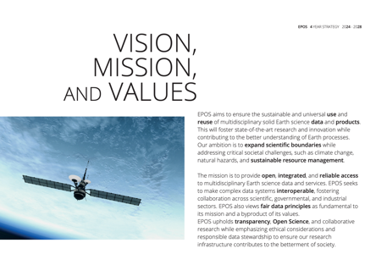
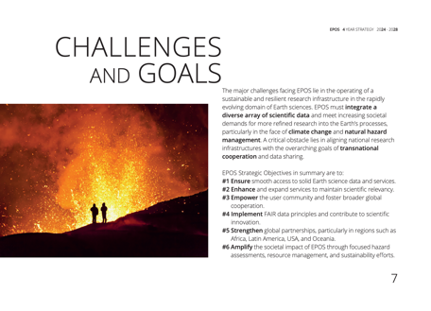
Notes:
Content slide

Slide 6
EPOS ERIC Strategy 2024-2028
The EPOS Community scientific perspective ensures EPOS remains aligned with its vision and mission
A need to move from the relatively broad scientific perspective
to specific and actionable strategic objectives to guide the infrastructure operation
The EPOS ERIC Strategy 2024-2028 to enables excellent science and innovation
encompasses six distinct Strategic Objectives (SO)
designed to complement the research plans of individual Thematic Core Services
SO1 | Ensuring smooth and seamless access to solid Earth science data and services
SO2 | Enhancing and advancing services for solid Earth science
SO3 | Enlarging, widening and empowering the user community
SO4 | Implementing principles of Open Science and FAIR data management, and contributing to e-science innovation
SO5 | Amplifying and spreading the societal value of EPOS
SO6 | Boosting global cooperation
EPOS ON project is supporting the implementation of the Strategic Objectives

Slide 7
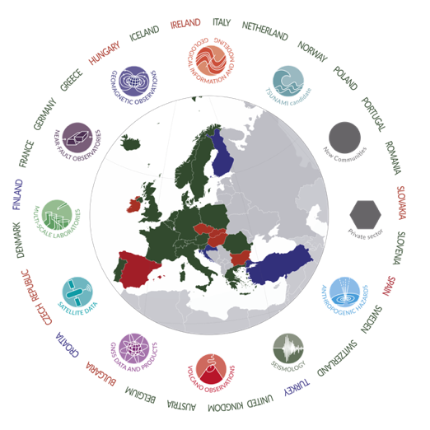
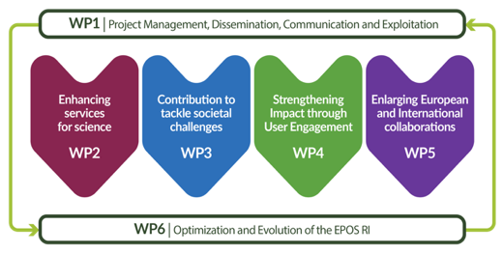
EPOS ON Project
A community effort
To perform activities aimed
at supporting
the optimization and evolution
of the EPOS Research Infrastructure

Slide 8
EPOS ON Project and Strategic Objectives
Enhancing and advancing services for solid Earth science
Integration of new services (including from new countries and new communities)
Integration of new thematic communities
Roadmap for integration of data generated in collaboration with private sector
Integration of ICS-D Prototypes
EPOS Days Sessions: Thematic Core Services
New Services and Communities
Technical Challenges, Opportunities and Solutions

Slide 9
EPOS ON Project and Strategic Objectives
Amplifying and spreading the societal value of EPOS
Integration of services relevant for risk management related to different hazards
Cooperation roadmap with the EU Union Civil Protection Knowledge Network
Methodology for the application of ethical labels to EPOS services
Recommendations for the consolidation of the EPOS ethical guidelines
Identification of how EPOS contribute to environmental impact reduction
EPOS Days Sessions: Thematic Core Services
New Services and Communities
Technical Challenges, Opportunities and Solutions

Slide 10
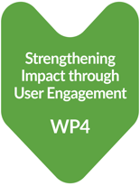
EPOS ON Project and Strategic Objectives
Enlarging, widening and empowering the user community
Recommendations for the improvement of the EPOS User Strategy
Implementing EPOS Training programme
Engagement of early career researchers
EPOS Days Sessions: Early Career Researchers
SCC Open Session

Slide 11
EPOS ON Project and Strategic Objectives
Boosting global cooperation
Implementation of the MoUs in place
New collaborations with international initiatives in Europe, Africa, Latin America, US, New Zealand
EPOS Days Sessions: International Collaboration

Slide 12
EPOS ON Project and Strategic Objectives
WP6 - A solid set of recommendations for the optimization and evolution of the EPOS RI
Design and implementation of an IT tool for the integrated management of the EPOS RI
A more efficient mechanism for the interaction between EPOS ERIC and national organizations
EPOS Days Sessions: EPOS in the National landscape
Cross-Countries Collaboration Meet & Greet
New Development in ICS-TCS

Slide 13
The Operational Phase represents yet another challenging stage for EPOS
In line with its mission, EPOS must demonstrate its value in
enabling excellent science and innovation
Current pressing societal demands require studies to which EPOS can
… and must contribute
(e.g. interplay between climate change and natural hazards,
sustainable use of natural geo-resources, environmental impact, risk management, urban planning, social equity, capabilities of artificial intelligence in scientific research)
EPOS is called to meet the dynamic demands of users
for multidisciplinary research in solid Earth science
while exploring its role in trans-disciplinary research expanding global partnerships
Notes:
(e.g. interplay between climate change and natural hazards, sustainable use of natural geo-resources, environmental impact, risk management, urban planning, social equity, capabilities of artificial intelligence in scientific research)

Slide 14
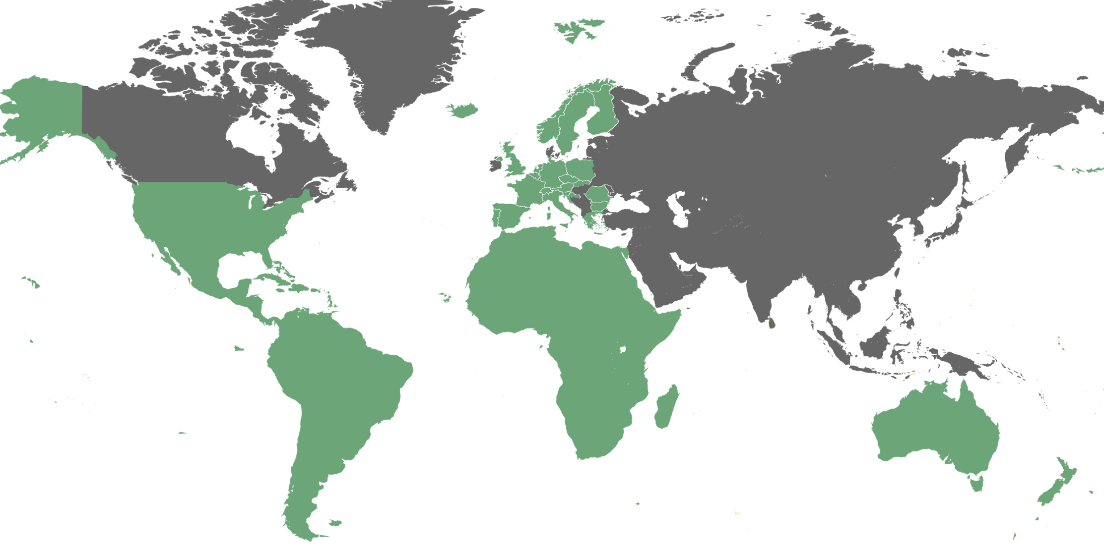
EPOS Days 2025 edition
140 | Registered Participants
5 | Continents
22/26 | European Countries / EPOS Countries
20 | Early Career Researchers
14 | National “EPOS”
6 | “New” Communities
8 | International Organizations

Slide 15
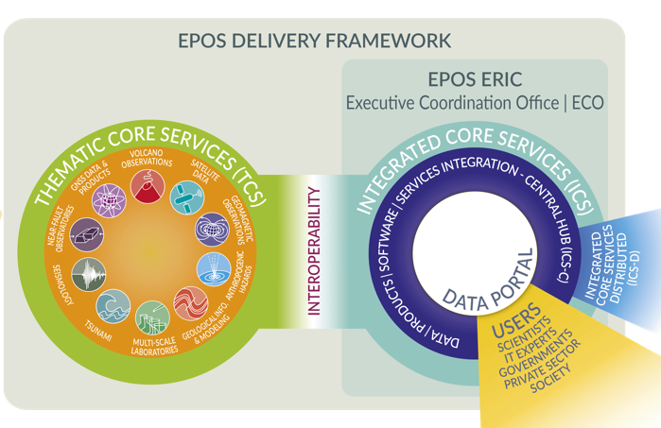
Functional Architecture
EPOS has been built by assembling key elements
to allow the whole system to work as a single, but distributed, sustainable research infrastructure
DATA Generation
DATA Integration
DATA Access
ICS integrate data and services and make them FAIRly accessible through a single-access point
NRIs generate and manage data for science and society
TCS provide the governance framework necessary to ensure
that data and metadata, from different sources and in different formats,
are harmonised and made accessible through services on the Platform
Users exploit the EPOS Platform to
access, visualise, combine, download data from different scientific domains

Slide 16
Functional Architecture
EPOS has been built by assembling key elements
to allow the whole system to work as a single, but distributed, sustainable research infrastructure
DATA Generation
DATA Integration
DATA Access
298 Services
511 Data and Service Providers
172 Research Organisations
10 Scientific Domains
New Communities
International Organizations
Users exploit the EPOS Platform to
access, visualise, combine, download data from different scientific domains

Slide 18
Functional Architecture
EPOS Days 2025 Programme
DATA Generation
DATA Integration
DATA Access
Day 3: Technical challenges, opportunities and solutions
Day 2
EPOS in national landscape
Day 1: Early Career Researchers, Thematic Core Services,
Day 2: International Collaboration, New Services and communities
Users exploit the EPOS Platform to
access, visualise, combine, download data from different scientific domains

