Slide 1
A Digital Twin for GEOphysical extremes
Project Overview
Kick-off meeting
Barcelona, 19-20 September 2022
Arnau Folch and Ramon Carbonell
Geociencias Barcelona (GEO3BCN-CSIC)

Slide 2
A Digital Twin for GEOphysical extremes
Project Information
Type of Action | Horizon-RIA
Call | HORIZON-INFRA-2021-TECH-01 (Next generation of scientific instrumentation, tools and methods)
Topic | HORIZON-INFRA-2021-TECH-01-01 (Interdisciplinary digital twins for modelling and simulating complex phenomena at the service of research infrastructure communities)
Grant Agreement No | 101058129
Start Date | 1 Sep 2022
End Date | 31 Aug 2025
Budget (EU part) | 11,138,287€
Budget (total) | 15,110,537€ (includes co-funding from Switzerland and U.K.)
Person Months (PMs) | 1712 in total (1399 from EU funds)
Partners | 26

Slide 3
HORIZON-INFRA-2021-TECH-01-01
4 Digital Twins projects funded
Biodiversity Digital Twin for Advanced Modelling, Simulation and Prediction Capabilities (BioDT)
1
Digital Twin providing advanced modelling, simulation and prediction capabilities across relevant research infrastructures, the BioDT project will be able to more accurately model interaction between species and their environment.
2
A Digital Twin for GEOphysical extremes (DT-GEO)
Deploy 12 Digital Twin Components (DTCs) embedding flagship simulation codes, AI layers, large volumes of (real-time) data streams, data assimilation methodologies, and overarching workflows for deployment and execution in centralised HPC and virtual cloud computing RIs.
DestinE
An interdisciplinary Digital Twin Engine for science (interTwin)
3
Prototype of an interdisciplinary Digital Twin Engine (DTE), an open source platform that provides generic and tailored software components for modelling and simulation to integrate application-specific Digital Twins (DTs). Use cases for high-energy physics, radio astronomy, astrophysics, climate research, and environmental monitoring. Consortium shares 4 partners with DT-GEO (CSIC, CNRS, LIP, UPV)
4
eBRAIN-Health - Actionable Multilevel Health Data (eBRAIN-Health)
Deliver a distributed research platform for modelling and simulating complex neurobiological phenomena of human brain function and dysfunction in a data protection compliant environment.
Human brain

Slide 4
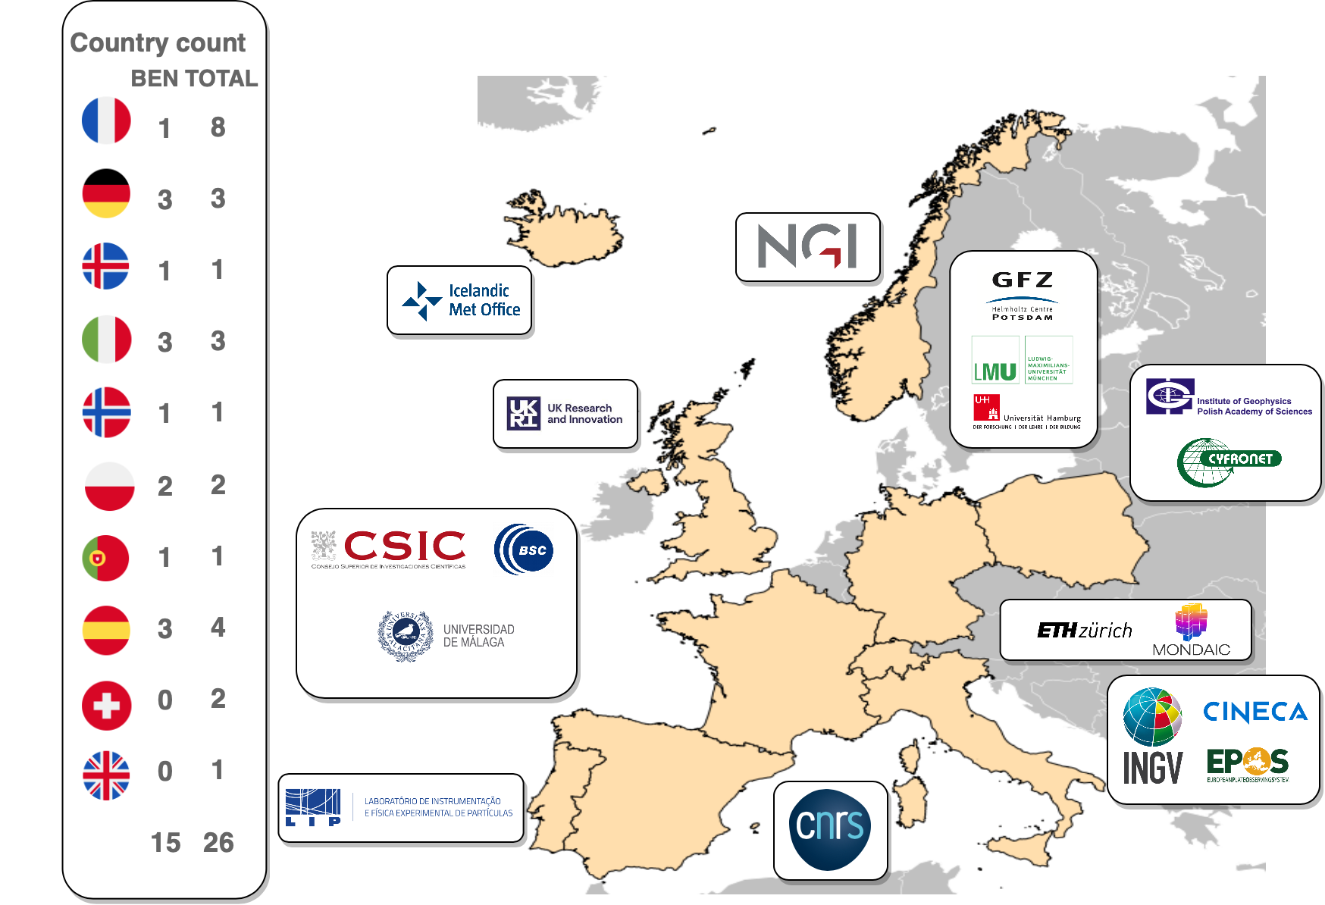
A Digital Twin for GEOphysical extremes
Consortium Composition
26
Participating Organisations
From 10 different countries
Beneficiary Partners
15
CSIC, INGV, IGF, CIN, BSC, NGI, UMA, GFZ, LMU, IMO, UHAM, LIP, CNRS, EPOS, ACK
Affiliated Entities
8
UPV (affiliated to CSIC)
UNISTRA, UGA, IRD, OCA, UCA, IPGP, UP (all affiliated to CNRS)
Associated Partners
3
2 from Switzerland (ETH and MON)
1 from U.K. (UKRI)

Slide 5
The concept of Digital Twin
A digital twin is a virtual lifecycle environment that:
Contains a data-informed replica of a real system;
Contains model-based prediction capabilities (scenarios) and;
Provides feedback (decisions) to modify the real system (i.e. to close the lifecycle loop)
Analogy with the DevOps cycle in software engineering

Slide 6
A Digital Twin for GEOphysical extremes
4 General (high-level) Objectives
O1
Deploy a pre-operational prototype of Digital Twin (DT) on geophysical extremes for its future integration in the Destination Earth initiative.
Implement 12 self-contained Digital Twin Components (DTCs) addressing specific hazardous phenomena from volcanoes, tsunamis, earthquakes, and anthropogenically-induced extremes to conduct precise data-informed early warning systems, forecasts, and hazard assessments across multiple time scales.
O2
Provide a flexible framework for EOSC-enabling and FAIR-validation of project assets and outcomes and its integration in the European Plate Observing System (EPOS) and HPC/virtual cloud computing (EuroHPC) Research Infrastructures (RIs).
O3
O4
Verify DTCs in operational environments at 13 Site Demonstrators (SDs) of particular relevance located in Europe and beyond.

Slide 7






A Digital Twin for GEOphysical extremes
Background and DT-GEO project ecosystem
2018 | 2019 | 2022 | 2021 | 2022 | 2023 | 2024 | 2025 | 2026 | 2027 | 2028 | 2029 | 2030
ChEESE-1P
ChEESE-2P
simulation codes ?
Codes, Pilot Demonstrators and services on geohazards
Codes, Pilot Demonstrators and services on geohazards
eFlows4HPC
workflows
(UCIS4EQ)
DestinE
UC use-case
(earthquakes)
workflow software stack (pillar on natural hazards)
High-resolution operational digital twins
DTCs ?
DT-GEO
simulation codes
Digital twin components
FAIR evaluator
EOSC-Synergy
e-infrastructures
EPOS-ERIC
high TRL services and data
ICS-C and ICS-D
Service access to data and HPC-based models

Slide 8
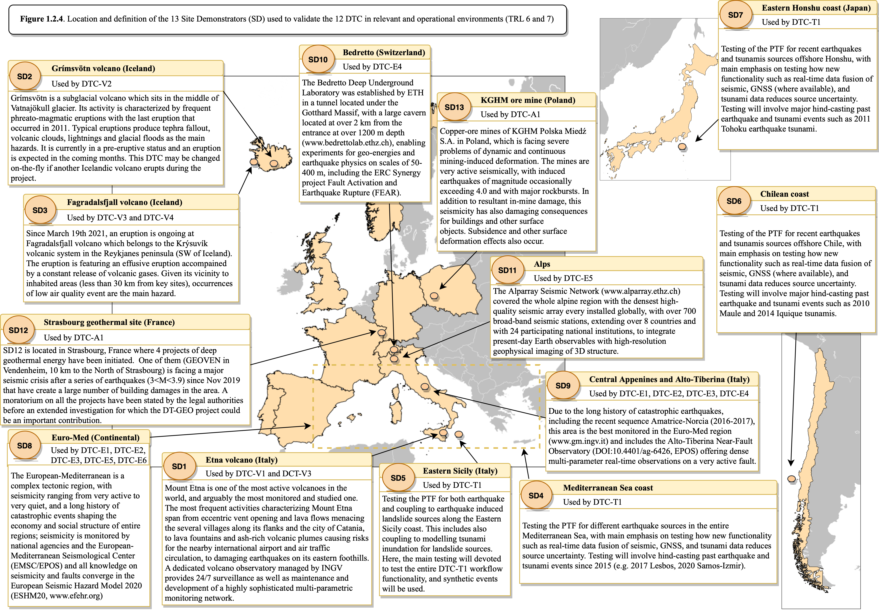
13 Site Demonstrators (SDs)

Slide 9

THANK YOU
@dtgeo_eu
linkedin.com/company/dt-geo/

