Slide 1
The Joint European Research Infrastructure of Coastal Observatories
JERICO
March 13th 2024
Miguel Charcos on behalf of JERICO-RI partners in the context of the collaboration between EPOS and JERICO under JERICO-S3
Notes:
Good morning, everyone. I am Miguel Charcos from SOCIB, and it is my privilege to represent JERICO-RI partners today. I am here to discuss the pivotal role of the Joint European Research Infrastructure of Coastal Observatories, known as JERICO, in advancing our understanding of marine coastal systems.
Today, I will highlight the synergy between JERICO and EPOS. This collaboration happens in the framework of the JERICO-S3 project.

Slide 2
Overview
Introduction to JERICO
JERICO-RI
e-JERICO and JERICO-CORE
EPOS - JERICO collaborations
Collaboration framework
JERICO-CORE pilot and EPOS platforms
Collaboration Outcomes
Future collaborations
‹#›
Notes:
In today's presentation, I will discuss three areas:
Firstly, an introduction to JERICO, where I will give an overview the JERICO Research Infrastructures (RI) and discuss the the e-JERICO and the JERICO-CORE platforms.
Secondly, I will explore the collaboration between EPOS and JERICO. I will look at the collaborative framework that has been established in relation to the JERICO-CORE pilot and EPOS platform.I will review the outcomes of this collaboration, highlighting the outcomes and the lessons learned.
Lastly, I will cast our gaze towards the horizon, to the possible future collaborations.

Slide 3
The Joint European Research Infrastructure of Coastal Observatories (JERICO-RI)
Technical Design
RI Design, Evaluation of Innovative Solutions, and Business Plan
‹#›
Notes:
As we chart the course of JERICO's development over the past decade, we witness a trajectory of innovation and expansion. From 2011, JERICO began by laying a strong technological foundation, which has been instrumental in capturing physical data from our seas. Advancing into JERICO-Next, we integrated biological data, enhancing our insight into marine biodiversity and ecosystem health.
Now, within the span of JERICO-S3, we're not only drawing from an established network but also paving the way for the future with a long-term vision for regional and societal needs. And as we peer into the horizon with JERICO-DS and JERICO RI, we are crafting a technical framework for a sustainable, open-data ecosystem aligned with ESFRI's vision.
Each phase of JERICO's evolution marks a leap towards a more profound understanding and a more integrated European coastal observing system.

Slide 4
JERICO-RI in Numbers
Notes:
Let's take a moment to appreciate the scale of JERICO-RI. The reach of our infrastructure spans beyond 17 countries, illustrating a European-wide commitment to understanding and protecting our coastal waters. This network is bolstered by the expertise and collaboration of more than 39 partners. Over 672 platforms form the backbone of JERICO-RI. This expansive network of infrastructures enables us to gather a wealth of data, offering unparalleled insights into the marine environment. These include a variety of platforms including buoy, a ship, gliders, drifters, or a sensor...

Slide 5
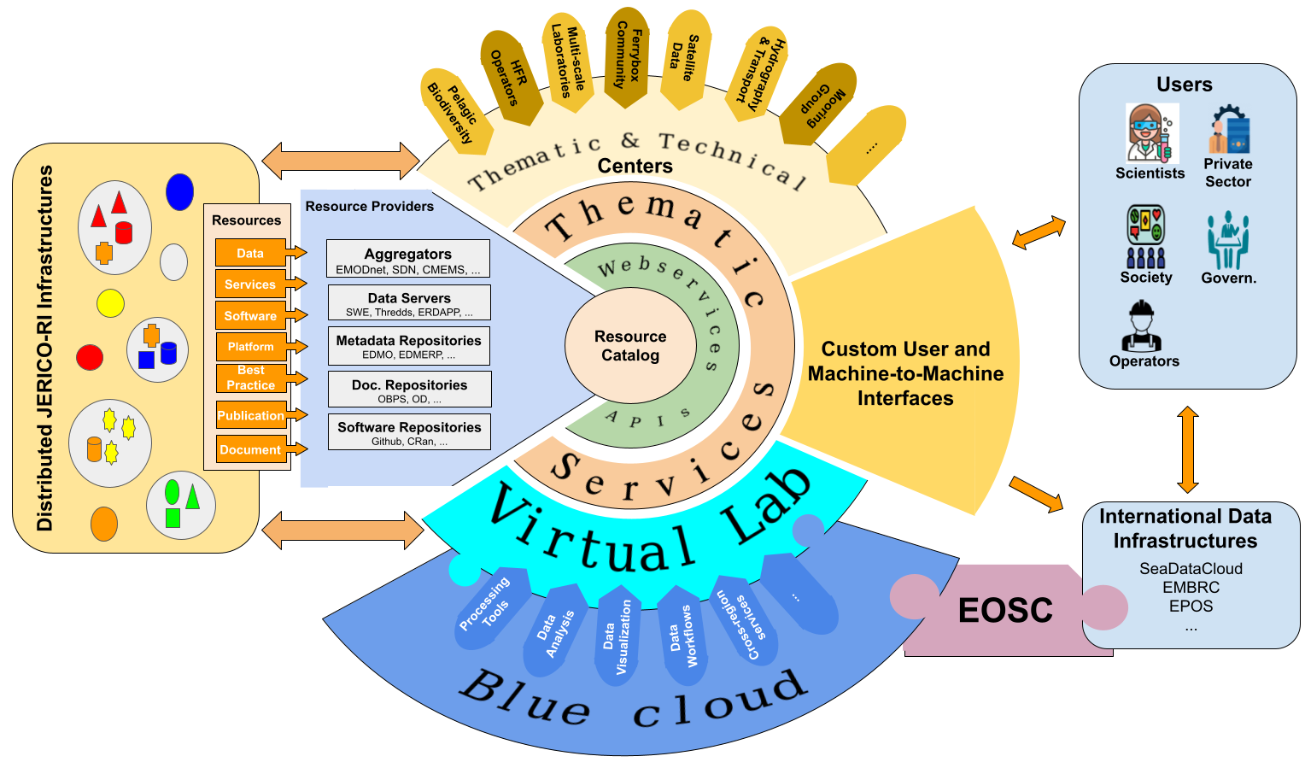
JERICO e-infrastructure: e-JERICO
Notes:
Diving into the digital realm, e-JERICO stands as a beacon of innovation within the JERICO-RI framework. It encapsulates a virtual ecosystem where data flows seamlessly between infrastructure, services, and users.
At its core, the resource catalogue and the VRE hosted by Blue Cloud are the heart and mind of this system, allowing co-development and assessment of JERICO activities and data flow of the vast amount of ocean data. These central hubs will interoperate the European Open Science Cloud (EOSC), which represents a monumental leap in making marine data accessible and fostering open science.
Surrounding this core are thematic and technical centers which will be able to access the catalog information through, a spectrum of web services, and APIs that provide a rich catalog of resources. They are the gears that ensure the machinery of e-JERICO runs smoothly, offering custom user and machine-to-machine interfaces that empower scientists, private sector stakeholders, societal groups, and government entities.
This concept has been designed with the user in mind, providing custom interfaces for a wide range of stakeholders, including scientists, the private sector, and governmental bodies. The goal is to ensure that the data is not only accessible but also utilizable in various real-world applications.

Slide 6
e-JERICO: Development Plans
Build capabilities
Foundation of infrastructure
JERICO-CORE Pilot (JERICO-S3)
e-JERICO Roadmap (JERICO-DS)
JERICO-CORE (ESFRI)
e-JERICO Sustained Infra
- Pilot Development
- Pilot Operation
- Sustained infrastructure design
Support foundation of services and communities
Provide collaborative hub for research
Expose resources and support standardization
Integrated
JERICO-CORE Pilot (BC2026)
Advanced
JERICO-CORE Pilot (OSTrails)
Preparatory Phase
Implem. Phase
JERICO-PP
JERICO-IMP
- Integration & automation
- Resource assessment
- SKG interoperability w/ EOSC
- FAIRness assessments
- maDMP
CoastPredict CORE (CORIS) - UN Ocean Decade Program
Notes:
As we look at e-JERICO's development plans, it's evident that we are not just building infrastructure but crafting a roadmap for the future of marine science. The plans underscore a dual focus: enhancing capabilities and laying a solid foundation.
Starting with JERICO-CORE under JERICO-S3, we've embarked on pilot development and operations, which was crucial for the standardization and understanding of marine resources. This sets the stage for e-JERICO under JERICO-DS, where we aim for sustained infrastructure design that is robust and future-proof.
The development plan also outlines a pivotal pilot that is developed in two stage: the Integrated JERICO-CORE Pilot and the Advancement JERICO-CORE Pilot capabilities. In particular the OSTrails project is essential for integration, automation, and resource assessment, ensuring interoperability with the EOSC and adherence to FAIR data principles.
At the foundation level, we're working towards establishing JERICO-CORE as part of ESFRI, with e-JERICO providing a sustained infrastructure. Evenmore, JERICO-CORE pilot expands globally in the context of CoastPredict, which is part of the UN Ocean Decade Program. This endorsement demonstrates our global commitment to predicting and sharing ocean information, essential for the sustainable management of coastal areas.

Slide 7
e-JERICO: Development Plans
Build capabilities
Foundation of infrastructure
JERICO-CORE Pilot (JERICO-S3)
e-JERICO Roadmap (JERICO-DS)
JERICO-CORE (ESFRI)
e-JERICO Sustained Infra
- Pilot Development
- Pilot Operation
- Sustained infrastructure design
Support foundation of services and communities
Provide collaborative hub for research
Expose resources and support standardization
Integrated
JERICO-CORE Pilot (BC2026)
Advanced
JERICO-CORE Pilot (OSTrails)
Preparatory Phase
Implem. Phase
JERICO-PP
JERICO-IMP
- Integration & automation
- Resource assessment
- SKG interoperability w/ EOSC
- FAIRness assessments
- maDMP
CoastPredict CORE (CORIS) - UN Ocean Decade Program
Notes:
In the context of the JERICO-S3 project, our collaboration framework with EPOS is a strategic milestone in the JERICO-CORE roadmap. During JERICO-S3, we have laid the groundwork for pilot development and operations, focusing on exposing resources and ensuring standardization across disciplines. This integration facilitates the sharing of knowledge and resources, streamlining research efforts across various platforms and domains.

Slide 8
e-JERICO: JERICO-CORE Prototype
HARVESTERS & SDK
EPOS
APIs
D2PTS &
Pilot
ICOS...
Notes:
Key to this system are HARVESTERS & SDK, tools designed to gather and process data from diverse sources, ensuring a rich and seamless flow of information into our central repositories.
BC Virtual lab for VRE. This compatibility extends to the European Open Science Cloud (EOSC), promoting open science and enhancing international collaboration with infrastructures like EMBRC, EuroBioImaging, and ICOS.
The e-JERICO API ensures compatibility with EPOS, facilitating the representation of resources in the EPOS digital ecosystem.

Slide 9
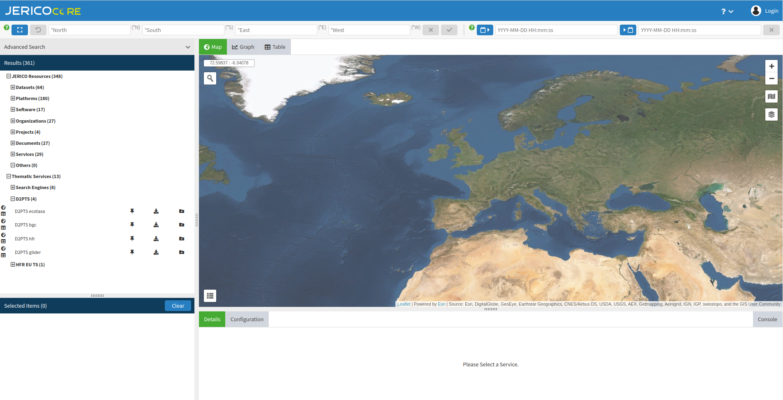
JERICO-CORE pilot and EPOS platforms
MoU to frame the collaboration in the context of JERICO-S3 finishing June 2024
EPOS shared code with JERICO partners to support the creation of JERICO-CORE pilot (https://ui.core.jerico-ri.eu/)
JERICO-CORE team adapted the code and provided feedback of potential improvements

Slide 10
JERICO-CORE pilot and EPOS platforms
CERIF
JERICO-CORE API

Slide 11
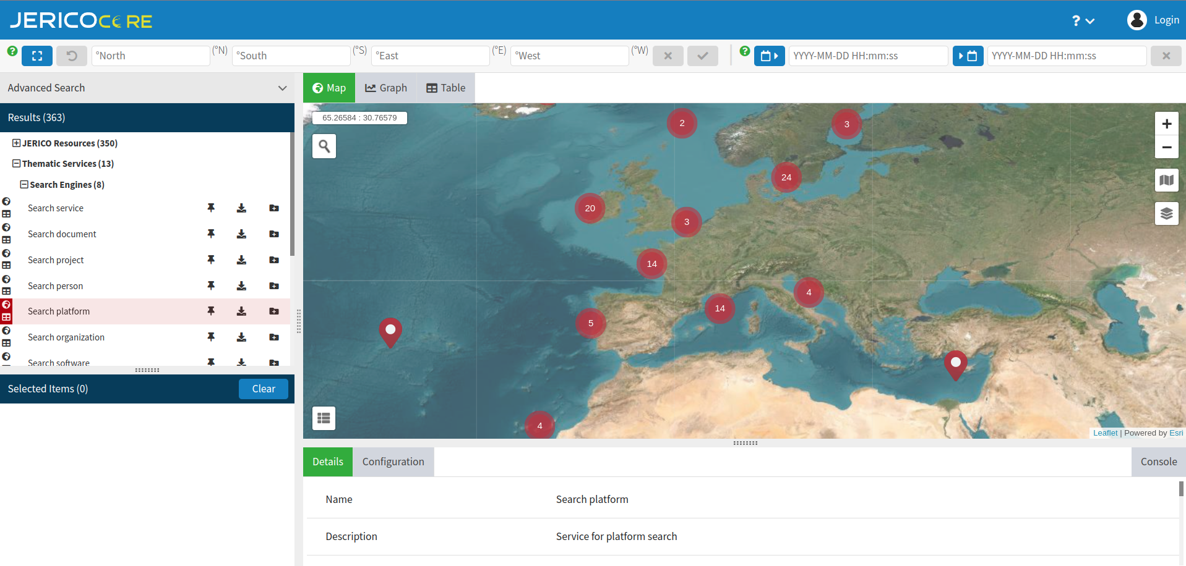
JERICO-CORE pilot and EPOS platforms

Slide 12
EPOS-JERICO Collaboration: Synergies and Outcomes for JERICO
Cross-Disciplinary Collaboration Benefits under EOSC
Enriched from interdisciplinary approach and sharing
Insights from an Established ERIC: Governance and Technology
Benefited from EPOS’s expertise in ERIC governance and pioneering technologies, setting a benchmark for operational excellence.
Leveraging EPOS Technology: Catalyzing JERICO’s Initial Exploration
Utilizing EPOS technology as a foundational tool enabled JERICO to effectively map out its capabilities and pinpoint specific JERICO needs.

Slide 13
Distinguishing JERICO and EPOS Collaboration
Varied Needs & Developmental Stages
Diverge significantly in their specific needs and current operational statuses.
Different Asset Representation
EPOS's advanced dataset visualization techniques contrast with current JERICO's focus on enhancing asset discoverability
Contextual Differences
Existing ocean RIs and Initiatives: Aggregators, Blue Cloud, DD&AS, BEACON, …

Slide 14
EPOS-JERICO: Potential Future Collaborations
OStrails: Plan, Track and Assess.
Cross disciplinary and EOSC interoperability
ENVRI
Integrate full potential of EPOS visualisation
JERICO updates of EPOS code to meet own requirements
JERICO as EPOS Thematic Core Services
Joint projects
Interdisciplinary Thematic Service (Tsunamis, alert system/response)
Digital Twins interoperability (DestinE)

Slide 15
Part of this work was supported by the JERICO-S3 project. This project has received funding from the European Union‟s Horizon 2020 research and innovation programme under grant agreement n° 871153."
Part of this work was supported by the JERICO- DS project. This project has received funding from the European Union‟s Horizon 2020 research and innovation programme under grant agreement n° 951799

