Slide 1
AuScope update
Dr Tim Rawling, CEO of AuScope

Slide 2
We acknowledge the Traditional Owners of the land on which our research infrastructure and community operate across the Australian continent, and pay our respects to Elders past and present.
We recognise the connection they have with land, sea, sky and waterways for tens of thousands of years.
Notes:
I would like to acknowledge the Traditional Owners of the land on which our research infrastructure and community operate and on which we meet today, which is the Wurundgeri People of the Kulin Nation. I pay our respects to the Elders past and present and recognise the connection they have had with land, sea, sky and waterways - for tens of thousands of years.

Slide 3
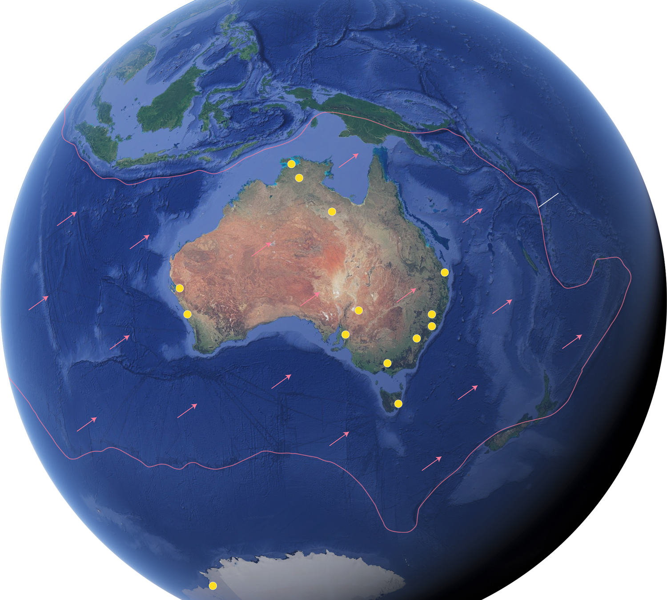

Global Context
Pacific Plate
Pacific Rim
Of Fire
Indo-Australian Plate
Plate Boundary
Plate Movement
AuScope Node
Antarctic Plate
Notes:
We have quite a mixture of scientists and non-scientists in the audience today so I would like to start by giving some geological context for the geoscience research infrastructure investments in Australia.
So let’s start by considering Australia’s unique geological setting, challenge and opportunities.
- We live on one of the most remarkable geological environments on the planet
- Australian continent is large. Our land and marine jurisdiction is enormous.
- It is the earth's Fastest moving plate
- Active margins where new crust is being created in the south and destroyed in the north and east
- Our plate has a long history of mountain building and deformation has led to the formation of highly fertile crust for both mineral and energy systems. Something our national prosperity has been strongly influenced by.
- The crust is also old and weathered means many of these deposits are hidden beneath shallow cover sequences and are very difficult to find
- As we strive to achieve net zero emissions, we will need to substantially increase domestic supply of critical and battery metals including copper and the rare earths. In fact in the next 2 decades, if we are to build the green power generation and storage capacity and electric vehicles required, we will need to find as much copper as we have mined in all of human history. In terms of copper alone this is the equivalent of finding a new Escondida, the largest copper mine in the world, every year for the next ten years. So far we have only found one of these!
- As population grows and the climate changes understanding the complex systematics of our groundwater resources also becomes more critical
Here lies a significant opportunity that will rely heavily on research and technological advances to be realised.
- We live on highly stressed crust. No handle on risk associated with geohazards – long and recent history of volcanism and earthquake - those of us on the south east coast were shaken by a M6 earthquake the week before last and the first Australians would have experienced both significant earthquakes >M8 and volcanic activity – because of the intraplate setting our modern observation record is too short to fully characterise this risk
- At the end of the day AuScope is a research and technological enabler that allows geoscientists to investigate how the planet works, how it changes through time and the crustal services it provides to us. This allows us to understand human impacts on the earth and its changing habitability.

Slide 4
Notes:
AuScope was established in 2008 to develop a national RI capability for the earth and geospatial science communities funded by the National Collaborative Research Infrastructure Strategy (NCRIS)
- We are an integrated infrastructure that includes field based observational infrastructure deployments (geophysics and geospatial), analytical laboratories (Geochemistry), characterisation facilities (HyLogger), data repositories, analytics tools and simulation and modelling codes to add value to the data.
- We have a free data model based on economic rivalry principles
whereby if you make data free to use, without impacting on the ability of another to use it – empowers people – it empowers researchers - attracts exploration capital to Australia.

Slide 5
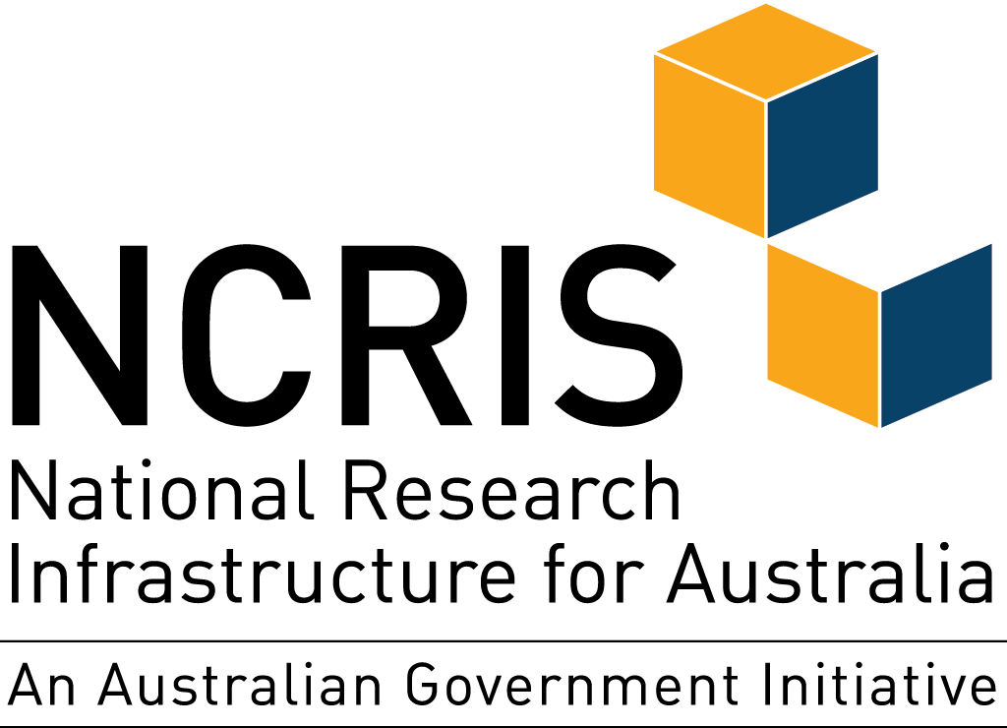
Background
NCRIS
24 Projects
  400 partners, 1500 technical staff/experts, 51,000 Australian and 10,000 international researchers
Since 2006
Commonwealth investing $4B 2018-2028
1:1.4 co-investment
5-yearly Roadmaps and bi-annual RIIP
Self-organised broad collaborative discipline groups
National Earth and Environmental Science Facilities Forum - NEESFF
AuScope is funded through the National Collaborative Research Infrastructure Strategy (NCRIS)
auscope.org.au
| @auscope

Slide 6
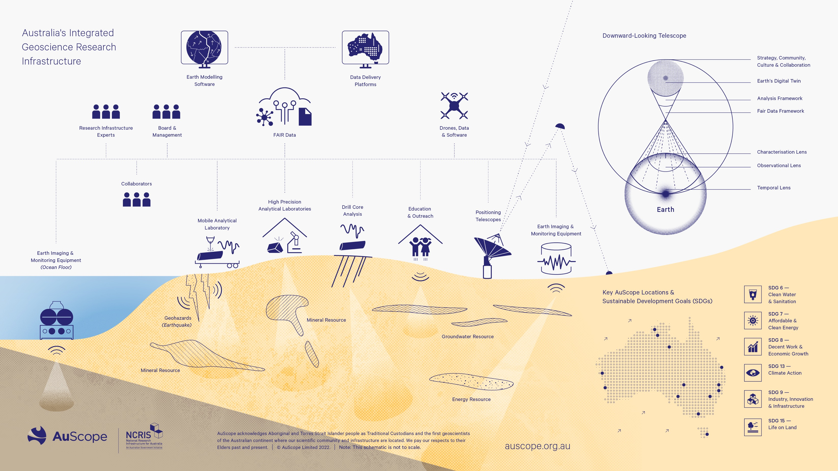
Notes:
AuScope was established in 2008 to develop a national RI capability for the earth and geospatial science communities funded by the National Collaborative Research Infrastructure Strategy (NCRIS)
We are an integrated infrastructure that includes field based observational infrastructure deployments (geophysics and geospatial), analytical laboratories (Geochemistry), characterisation facilities (HyLogger), data repositories, analytics tools and simulation and modelling codes to add value to the data.
We also have permanent, semi-permanent and temporary instrument deployments right across the country, in Antarctica and on the sea-floor
We have a free data model based on economic rivalry principles whereby if you make data free to use, without impacting on the ability of another to use it – empowers people – it empowers researchers - attracts exploration capital to Australia.
We operate as a not-for-profit company limited by guarantee with an independent Board and have received over $130M government funding and nearly $200M of partner co-investment since 2008
We are about to embark on a new phase of capital investment built around the concept of a distributed, integrated downward looking telescope. Like the square kilometer array only much bigger (and cooler)

Slide 7






Notes:
To deliver these programs, we work with
- 21 partners across the country including GA, CSIRO, state and territory geological surveys, 10 major universities and one CRC.
- Collaborations with aligned NCRIS orgs (TERN, IMOS, NCI, ARDC, APPF and Pawesy )
Developing international collaborations with EPOS, IRIS, USArray, EarthCube, Unavco
While we are different from EPOS in the sense that we occupy a single regulatory environment you can imagine that some of our challenges are similar dealing with multiple partners with established data structures and varying strategic goals.
Each of these organisations occupy a distinctive space within this research ecosystem and we work collaboratively to facilitate positive research outcomes across all our stakeholders
We have outreach programs in place with 50 secondary schools in regional and urban areas through our AuSIS project – addressing one of the most significant risks to our disciple – which is lack of exposure to geosciences for numerate students entering tertiary science programs.

Slide 8
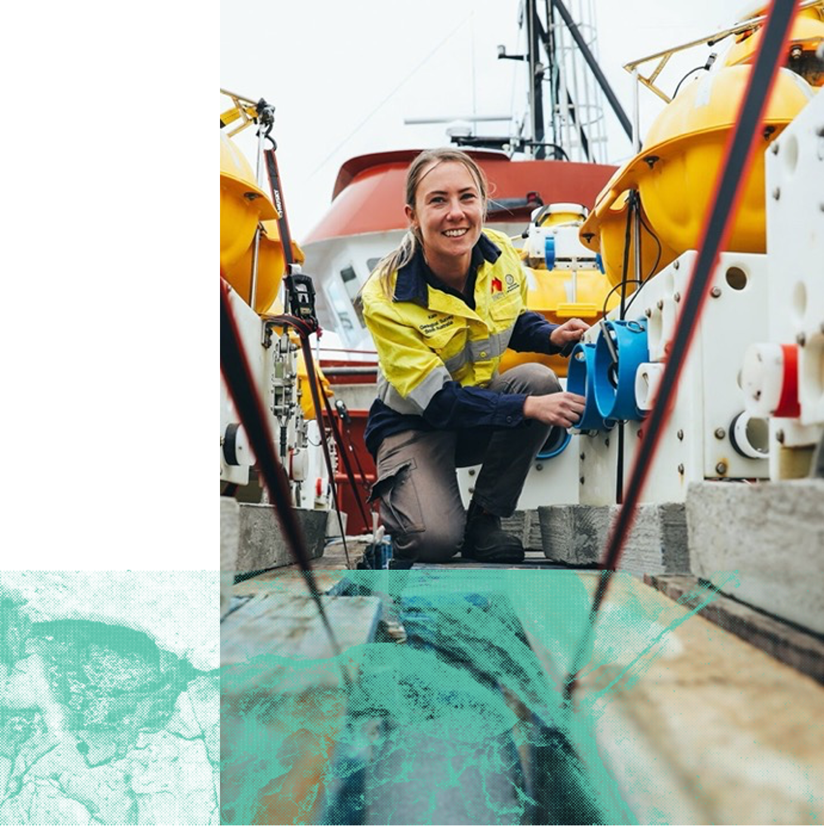
Usage
Over 550 unique users and 256,000 uses per year
Over 173,000 software downloads
36,000 secondary school students engaged
An average of 750 academic papers per year
1,600,000 drill core metres
5,652 field deployments of instruments
Support 85 jobs nationally
54%
18%
14%
9%
5%
=
=
=
=
=
Users From Universities
Users From Industry
Users From State Agencies
Users From International Orgs
Users From Federal Agencies
Photographer — Robert Lang
Notes:
Our users are diverse
you can see that whilst we predominantly serve the academic research community, we also have strong user number across government agencies and industry
Our software products also have huge impact with over 170,000 downloads
Our engagement program, AuSIS reaches 36,000 secondary school students across the country each year
AuScope employs about 85 people nationally, mostly through our partner institutions.

Slide 9
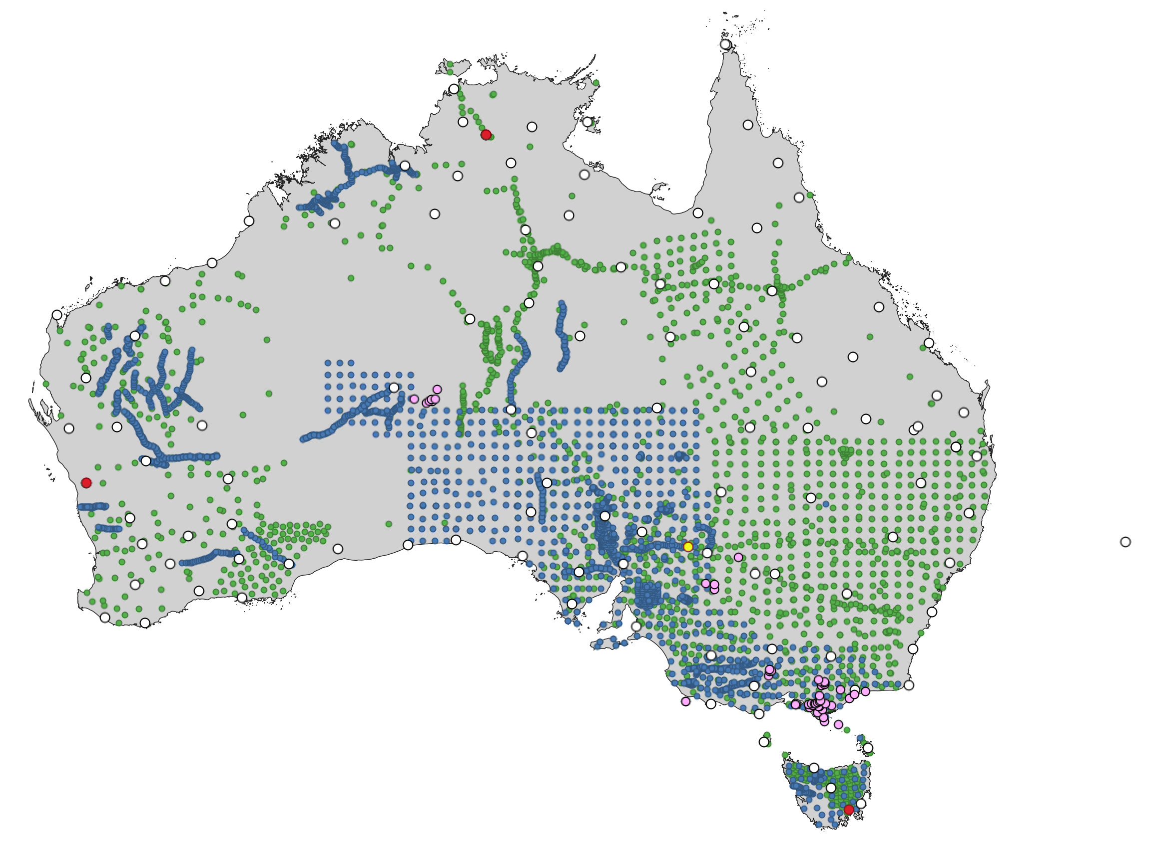

Aftershock Seismometer
Very Long Baseline Interferometry Telescopes
Global Navigation Satellite System
Downward Looking Telescope Supersite
Ocean Bottom Seismometer
Magnetotellurics
Passive seismic
Impact – Field observation
Opportunity
auscope.org.au | @auscope
Notes:
We have a significant observational capability.
This map shows observational sites that we have deployed over the last decade.
These include
- national passive seismic and magnetotellurics monitoring arrays,
- after shock seismometers,
- ocean bottom seismometers,
- very long baseline interferometry telescopes,
global navigation satellite system sites.
It does not show all of the Antarctic, Macquarie Ridge andLord Howe Rise sites or the reflection seismic data acquisition transects.
Together these observation sites allow us to image the subsurface, monitor earthquake hazard, and monitor deformation and movement in the earth surface and our plate.
This data is critical to allow us to better understand our dynamic earth, sustainably utilize the crustal services it provides and upon which we rely, and understand the impact of human activity on its delicate systems.

Slide 10
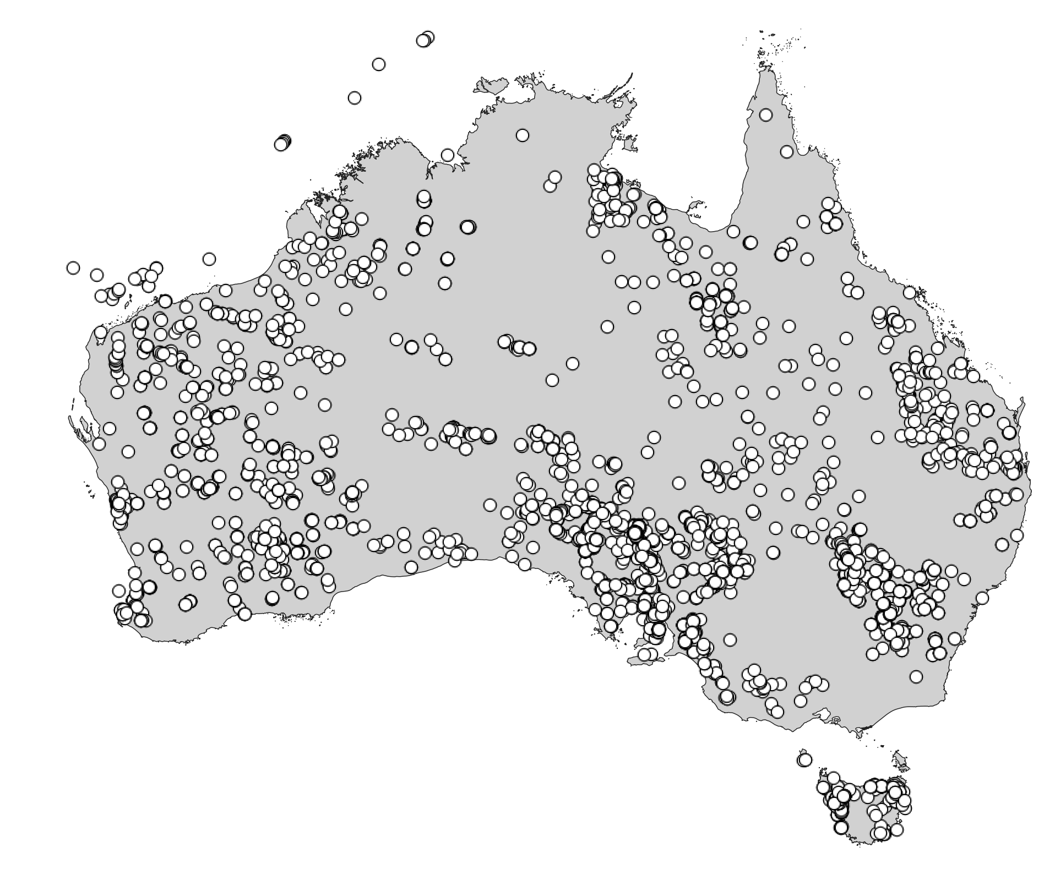
National Virtual Core Library logged well
Impact – Subsurface observation
Opportunity
auscope.org.au | @auscope
Notes:
We also provide researchers with access to the subsurface through borehole access, long-term downhole optic fiber monitoring sites and hyperspectral logging of over 1.6M m of drilling from across the country.
As Jess said during the video earlier this data effectively provides access to the subsurface to anyone, anywhere anytime and has been critical to industry, government and academic geologists alike through the pandemic when many of us were confined to our desks.
It also leverages an enormous but previously inaccessible industry and government funded infrastructure, the tens of thousand of boreholes that have been drilled across the country, for public good generating an estimated $15:1 in ROI.

Slide 11
Notes:
The challenge for the next decade
The Australian geoscience community has been considering the most critical challenges facing our discipline and what research focus we should support over the coming decade
As a result a number of documents have been released recently
- Academy of Science Decadal Plan
- Uncover Roadmap – which was jointly developed by industry and academia
- Each of these identify four key strategic challenges relevant to the earth and geospatial sciences – critical mineral security, energy security, water and food sustainability and geohazards.
- These also align with 6 of the UN SDG’s
- In order to tackle these challenges each of these roadmaps agree that we need to undertake research that will facilitate Predictive geoscience

Slide 12
https://bit.ly/2UJGFcB
Notes:
The critical outcome of this process was the recognition that, to better understand the earth in 3 and 4 dimensions and the processes that operate within it we need to provide datasets and tools designed to facilitate a predictive capacity.
- To do this we are building a new integrating RI system that connects the existing AuScope projects and adds a number of new elements providing capacity to support evolving geoscience research areas.
- We conceptually describe this integrated system as a Downward Looking Telescope
- The DLT is a distributed observational, characterisation and computational infrastructure providing the capability for Australian geoscientists to image and understand the composition of the Australian Plate with unprecedented fidelity.
- Like a telescope it allows us to “see” into the earth, using a series of lenses.
- These are a Temporal Lens – seeing through time
- An observational lens – monitoring change
- A Characterisation lens – examining properties of rocks
- Data framework
- And an analytical framework to model different earth processes.
- Builds on existing 11 AuScope projects with investment in over 20 new program elements.
- The DLT will provide geoscientists with the tools required to develop this predictive geoscience capacity and will underpin research programs focussed on addressing the search for critical minerals, energy systems, groundwater and to manage the risk of geohazards.

Slide 13
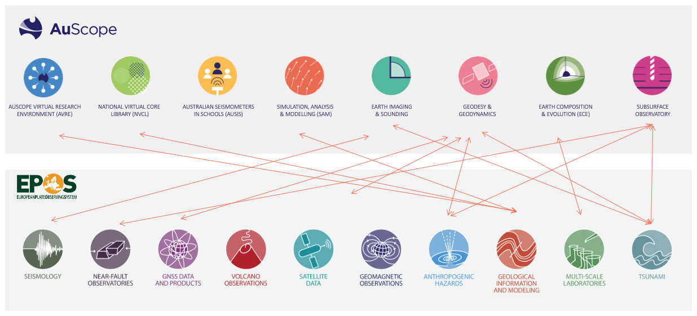
Notes:
Strong alinment

Slide 14
auscope.com.au
Tw @AuScope
Ig @AuScopeToolkit
Li /auscope-limited
Image — Curtin University
Notes:
Thank you for your time today. I hope that this presentation has given you a sense of AuScope programs and activities, our collaborative approach and the well-developed nature of our plans to build a Downward Looking Telescope to support the next generation of Australian geoscience research.

