Slide 1
EPOS in Belgium
C. Bruyninx
Royal Observatory of Belgium
F. Hernandez
Vlaams Instituut voor de Zee

Slide 2
It’s complicated …
Belgium is a federal country
Scientific research is split:
Federal, Flemish, and Walloon component
First steps in EPOS
2010-2014: EPOS Preparatory Phase (EPOS PP)
Federal research agency
Royal Observatory of Belgium (ROB)
Geodetic Working Group
Seismology Working Group

Slide 3
History - Funding
EU funding
EPOS ERIC
National (federal) support
2015-2019:
EPOS IP
Belgium becomes founding member of EPOS ERIC
BELSPO
2018-2022: EPOS-BE
Upgrade ROB’s GNSS and seismic infrastructure to prepare it for contributing to EPOS
2021-2025: SERVE
To reinforce federal role in ESFRI
Make pan-European GNSS services to EPOS more sustainable
Increase uptake of EPOS at Belgian federal level + map data provision
ROB
federal Belgian Science Policy Office (BELSPO)
the Flemish Departement Economie, Wetenschap en Innovatie (EWI)
the Service public de Wallonie - Direction générale opérationnelle de l'Economie, de l'Emploi & de la Recherche (DGO6).
2020-2023:
EPOS SP
ROB
2018: ROB in TCS “GNSS data and products” Consortium
2022-2025:
DT-GEO
VLIZ
2022-2026:
Geo-INQUIRE
ROB, VLIZ
6 pan-European GNSS services
Belgian GNSS data node
2024-2027:
EPOS ON
ROB, VLIZ
2023: VLIZ joins TCS “Tsunami” Consortium
Global services: Sea-level Station Monitoring Facility

Slide 4
History - Funding
EU funding
EPOS ERIC
National (federal) support
2015-2019:
EPOS IP
Belgium becomes founding member of EPOS ERIC
BELSPO
2018-2022: EPOS-BE
Upgrade ROB’s GNSS and seismic infrastructure to prepare it for contributing to EPOS
2021-2025: SERVE
To reinforce federal role in ESFRI
Make pan-European GNSS services to EPOS more sustainable
Increase uptake of EPOS at Belgian federal level + map data provision
ROB
federal Belgian Science Policy Office (BELSPO)
the Flemish Departement Economie, Wetenschap en Innovatie (EWI)
the Service public de Wallonie - Direction générale opérationnelle de l'Economie, de l'Emploi & de la Recherche (DGO6).
2020-2023:
EPOS SP
ROB
2018: ROB in TCS “GNSS data and products” Consortium
2022-2025:
DT-GEO
VLIZ
2022-2026:
Geo-INQUIRE
ROB, VLIZ
6 pan-European GNSS services
Belgian GNSS data node
2024-2027:
EPOS ON
ROB, VLIZ
2023: VLIZ joins TCS “Tsunami” Consortium
Global services: Sea-level Station Monitoring Facility

Slide 5
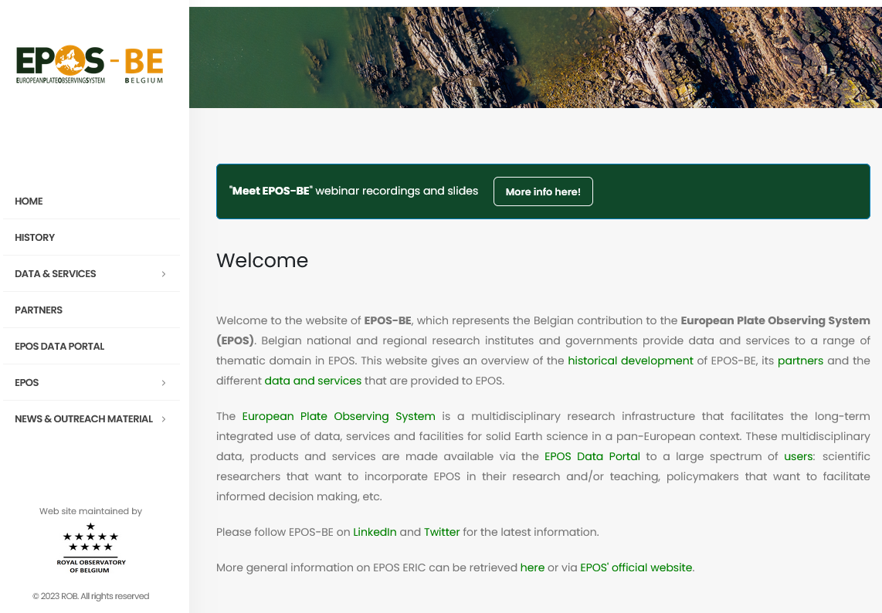
Organisation and Governance
No national Belgian EPOS consortium
“EPOS-BE” is mostly referring to web site https://www.epos-be.eu maintained presently by ROB

Slide 6
Involvement of Belgian agencies
Since 2014, Belgian involvement in EPOS driven by federal government BELSPO and ROB
data and service provider in TCS GNSS data and products
data provider in TCS seismology
Since 2023, Flemish institute VLIZ
Data and service provider in TCS Tsunami
? Flemish VITO become data node in TCS Anthropogenic hazards?
In addition, more Belgian agencies are providing data to EPOS (see EPOS-BE web site)
TCS GNSS data and products: GNSS data provision, coordinated by ROB at the national level (committed to operate national GNSS data node): CSL, SPW, DV, NGI
TCS geomagnetic observations: RMI

Slide 7
Current activities and challenges
Make EPOS known in Belgium …
EPOS-BE web site: https://www.epos-be.eu
- what is EPOS
- who provides data to EPOS
November 2023: “Meet EPOS-BE” webinar
Funding for operational services
Some external funding for Research & Development
No external funding for the operation of EPOS services
Agencies should themselves fund the operation of the EPOS services.
As ROB’s dotation has decreased by 30% over the last 10 years, this is difficult to sustain.

