Slide 1


The National Node in the Kingdom of Denmark
Thomas Funck (GEUS)

Slide 2
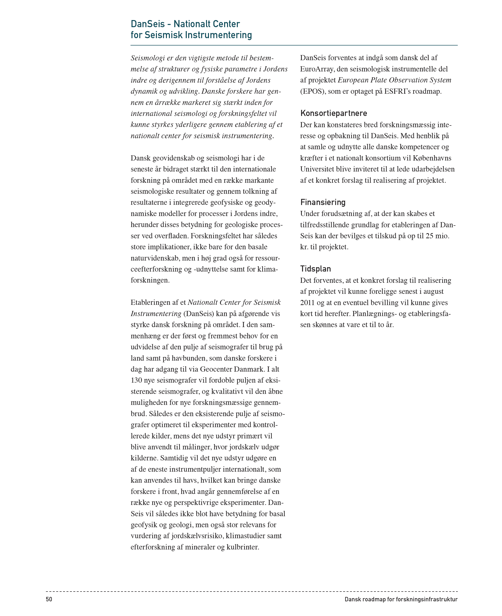
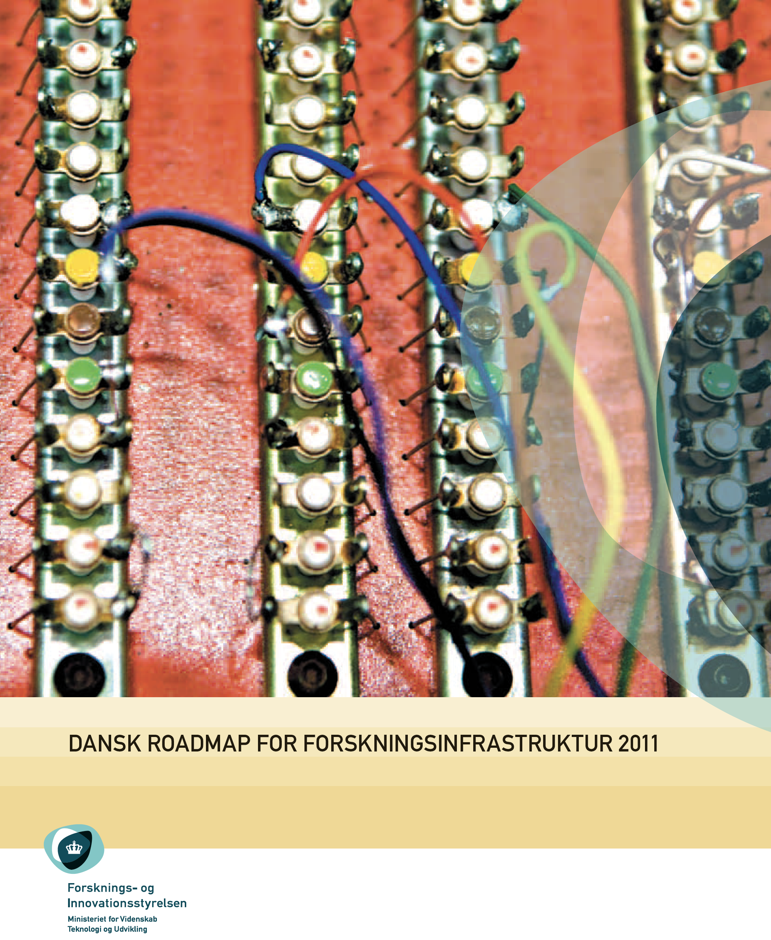
History
2011:
DanSeis on Danish Roadmap for Research Infrastructure

Slide 3
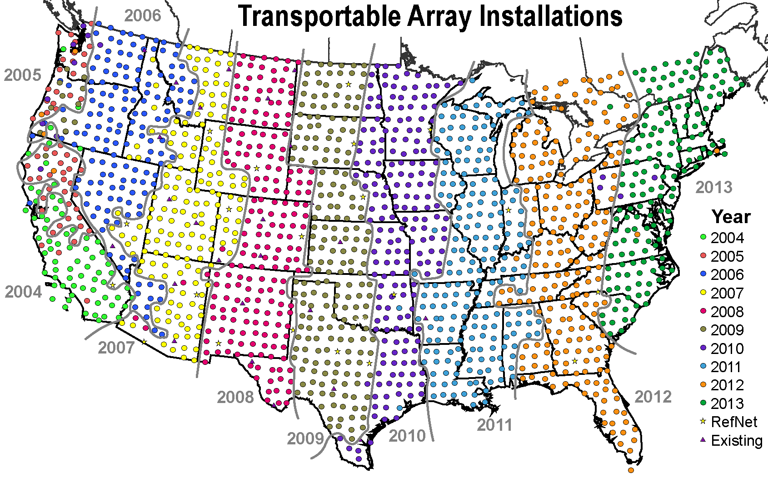
DanSeis and EPOS
DanSeis: A pool of broadband seismometers
To become part of EuroArray
60 km seismometer spacing over Europe
The idea was that EuroArray would become part of EPOS
EPOS membership fee for 10 years was part of DanSeis proposal
USArray
http://www.usarray.org/files/images/maps/Install_plan_2014.png

Slide 4
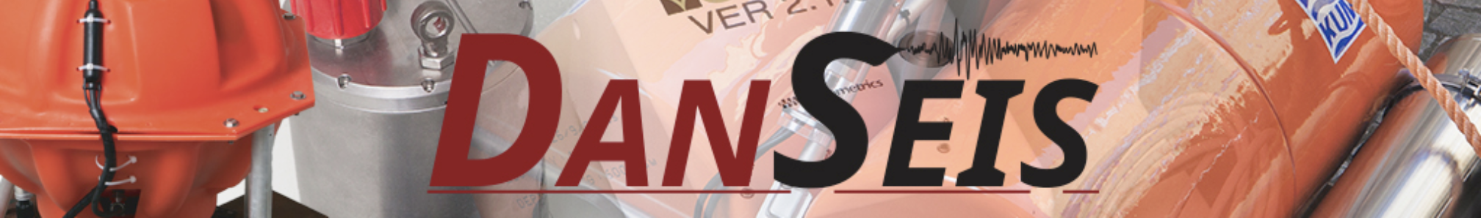
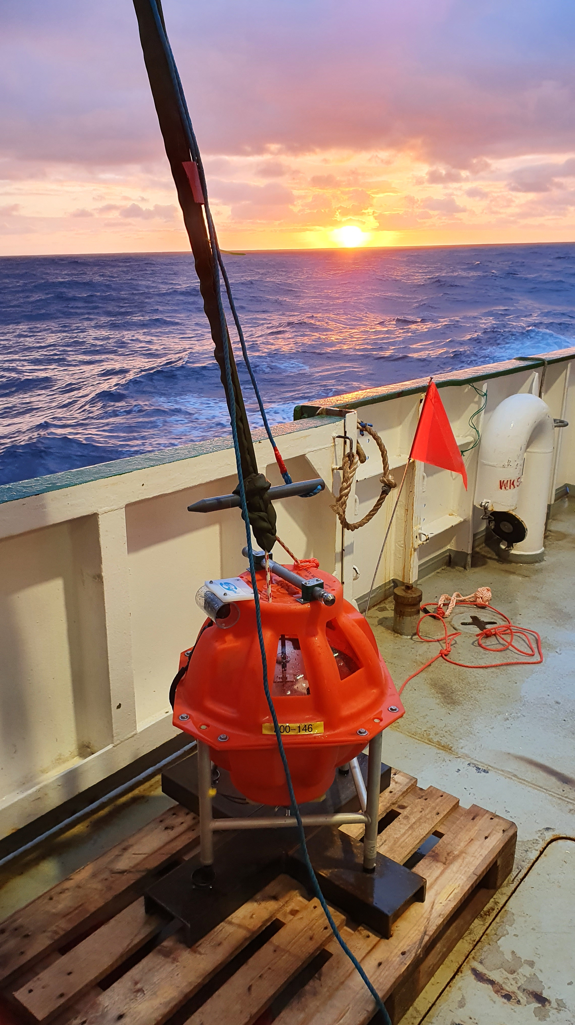
DanSeis
National Danish Pool of Seismometers
Marine and land instruments
Broadband and short-period
Available to international research projects
https://danseis.dk

Slide 5
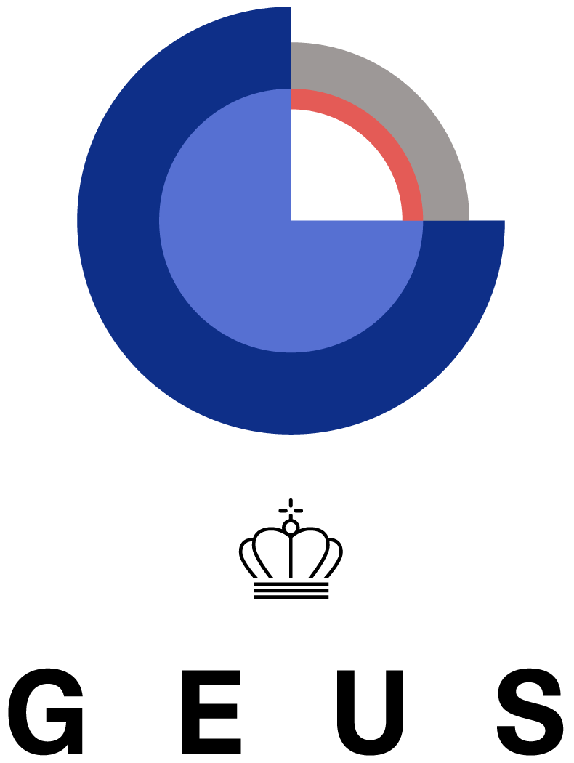


Geological Survey of Denmark and Greenland (GEUS)
University of Copenhagen
Aarhus University
Technical University of Denmark
Members of the EPOS DK consortium
Formed in 2011

Slide 6
EPOS DK consortium
Consortium has a Steering Group (two meetings a year)
Four partners are in the Steering Group plus ICS-C representative and the Ministry of Higher Education and Science
Consortium supports the ministerial delegate in EPOS General Assembly
No external funding for activities of the EPOS DK node
In January 2024, an EPOS DK Day was arranged

Slide 7
Financial support
Denmark is paying an annual membership fee of 50 k€
From 2019 to 2028: 40 k€ thereof are paid by the DanSeis grant
Remaining 10 k€ by the EPOS-DK consortium members
Ministry of Higher Education and Science does not pay membership fees for established ERICs

Slide 8

Integrated Core Services – Central Hub (ICS–C)
In 2015, BGS (UK), BRGM (France), and GEUS (Denmark) put in a bid to host the ICS-C
In 2016, the consortium was selected by the BGR
GEUS could not become a hosting country due to legal aspects
Instead, GEUS has a multi-year collaboration agreement for monitoring the ICS-C

Slide 9
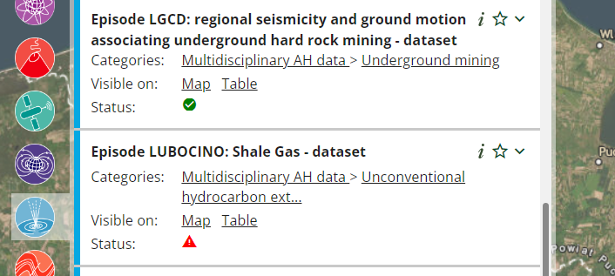
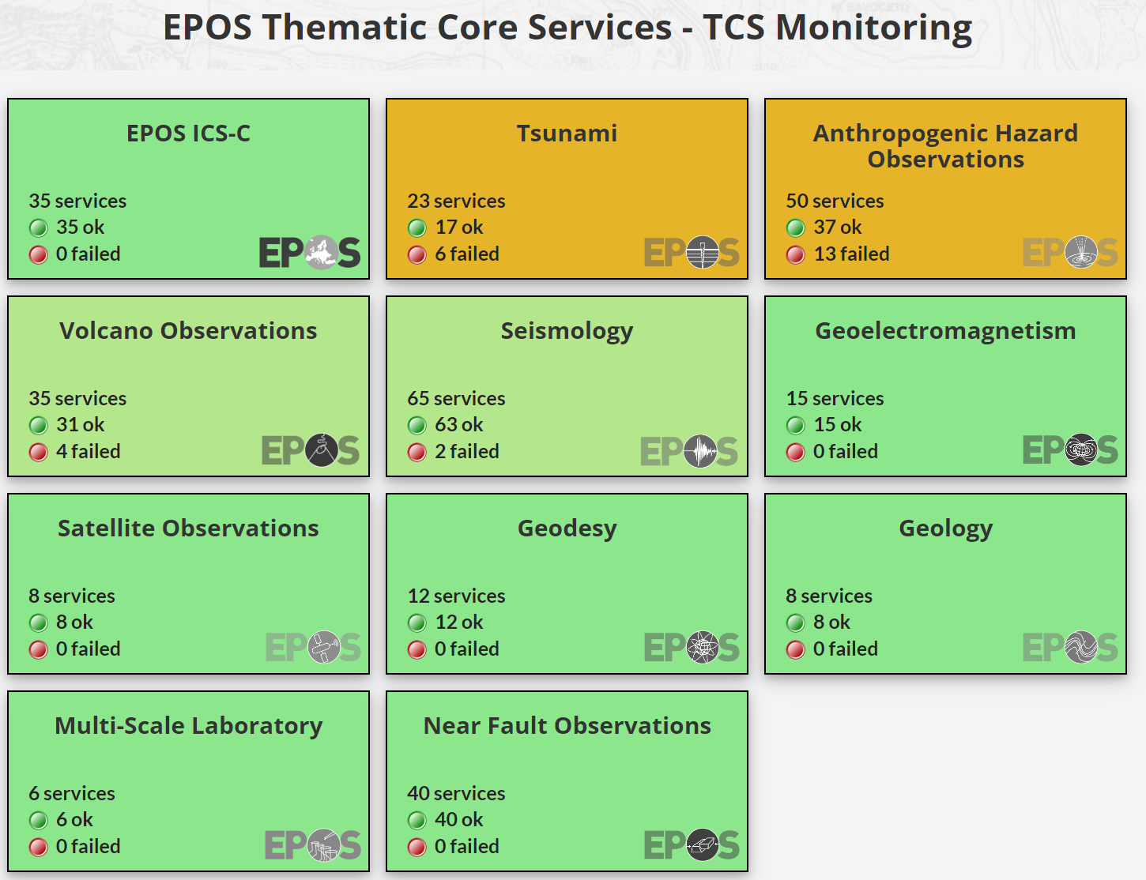
Monitoring of ICS-C
EPOS services are monitored in real-time using the open source tool Zabbix
Status of a TCS is indicated by an icon on the data portal
The active status of all services can also be seen on the EPOS monitoring page data.geus.dk/eposmonitoring/
Monthly reports are generated detailing the uptime of services

Slide 10

Thematic Core Services – Seismology
GEUS is core participant of ORFEUS, the European Infrastructure for seismic waveform data in EPOS
GEUS is an active member of EMSC (European-Mediterranean Seismological Centre), the European infrastructure for seismological parameters and products in EPOS
GEUS’ seismic waveform data are available through the European Integrated Data Archive EIDA

Slide 11
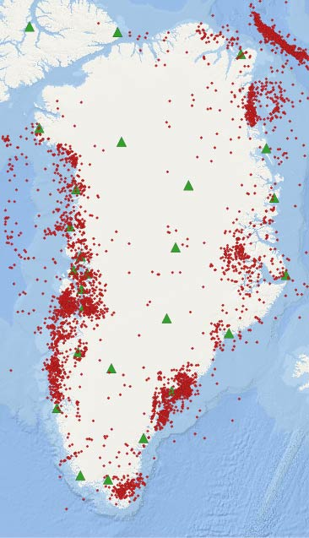
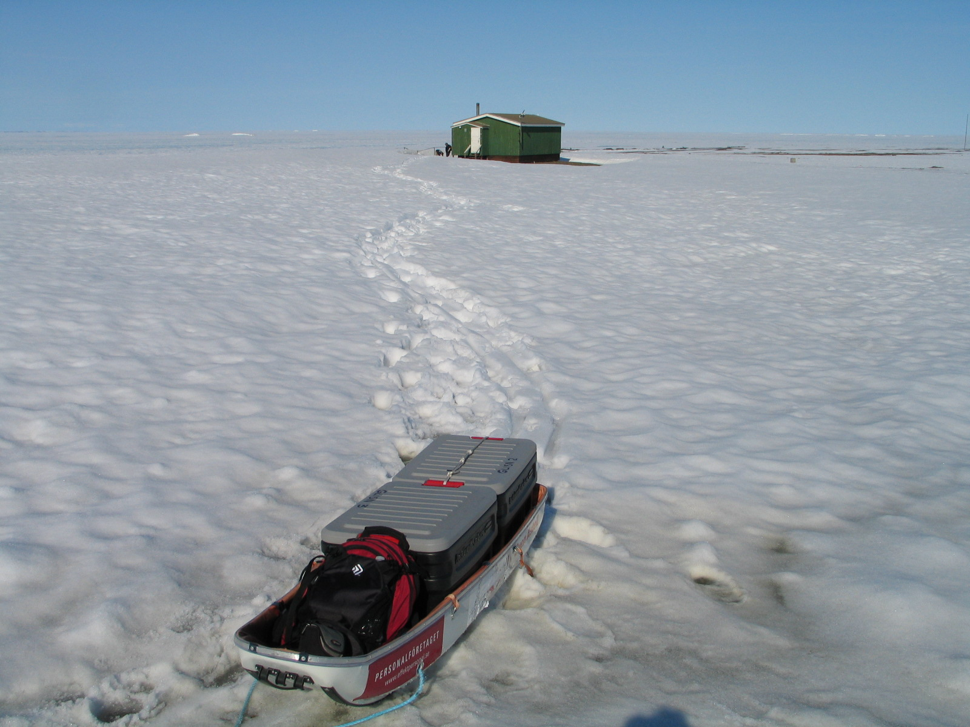
Seismic monitoring in Greenland
Earthquakes
Landslides
Cryo-generated events

Slide 12
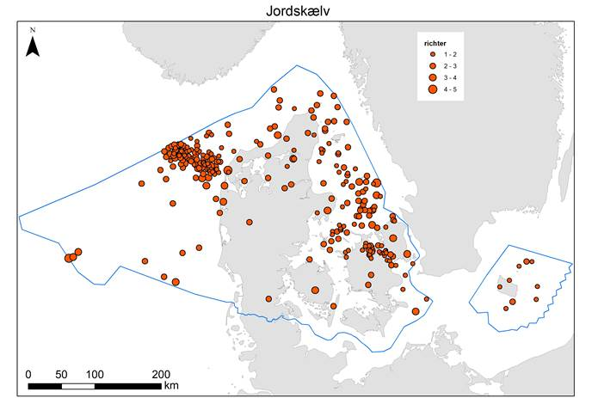
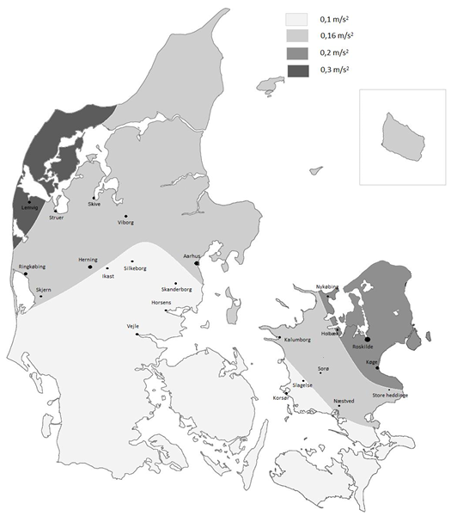
Earthquakes
Seismic monitoring in Denmark
Earthquakes
Induced events (CCS, geothermal)
Explosions
Seismic hazard
From the National Annex to Eurocode 8, DS/EN 1998-1 DK NA:2020

Slide 13
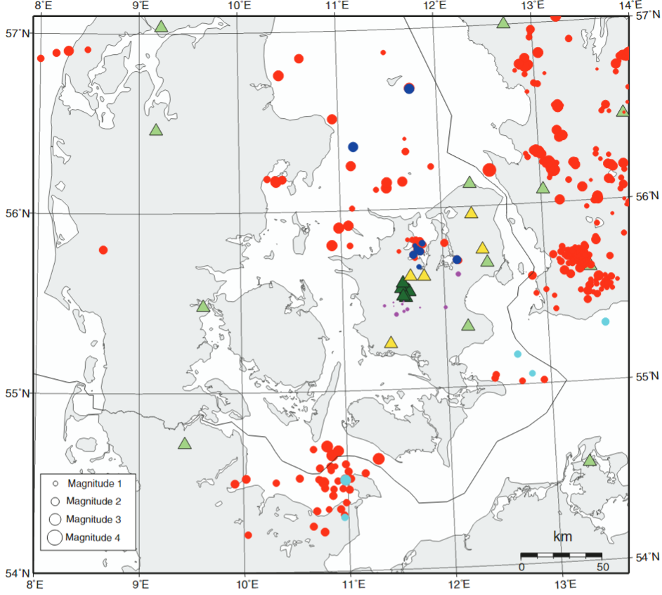
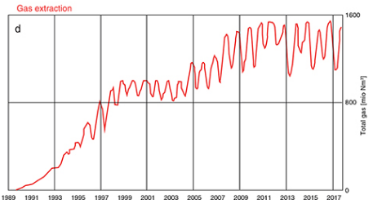
Example for the use of DanSeis broadband seismometers
Monitoring at a gas storage facility from October 2018 to March 2020
Gas extraction
Dahl-Jensen et al. (2021) https://doi.org/10.34194/geusb.v47.5552

Slide 14

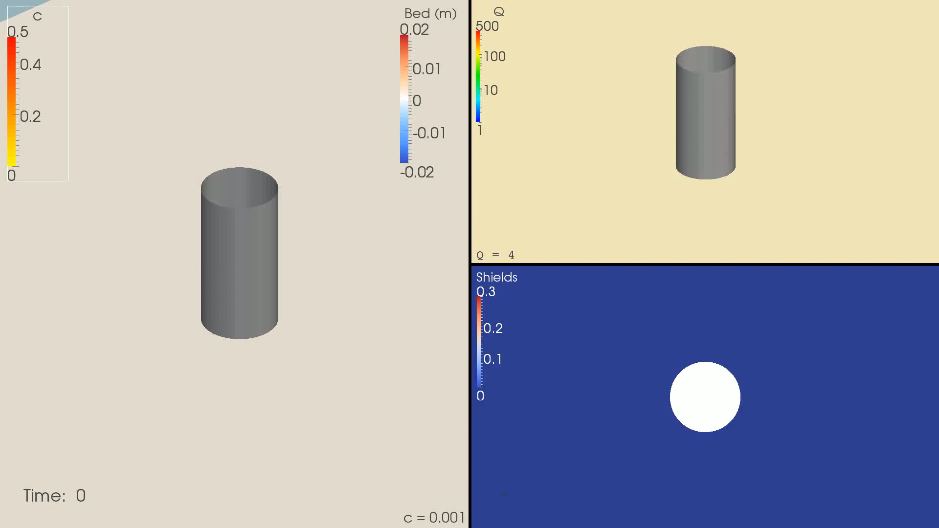
Thematic Core Services – Tsunami
Participation of Technical University of Denmark (DTU)
Numerical Modelling
Example:
Simulation of tsunami-induced boundary layers and scour around monopiles
(courtesy: David R. Fuhrmann)

Slide 15

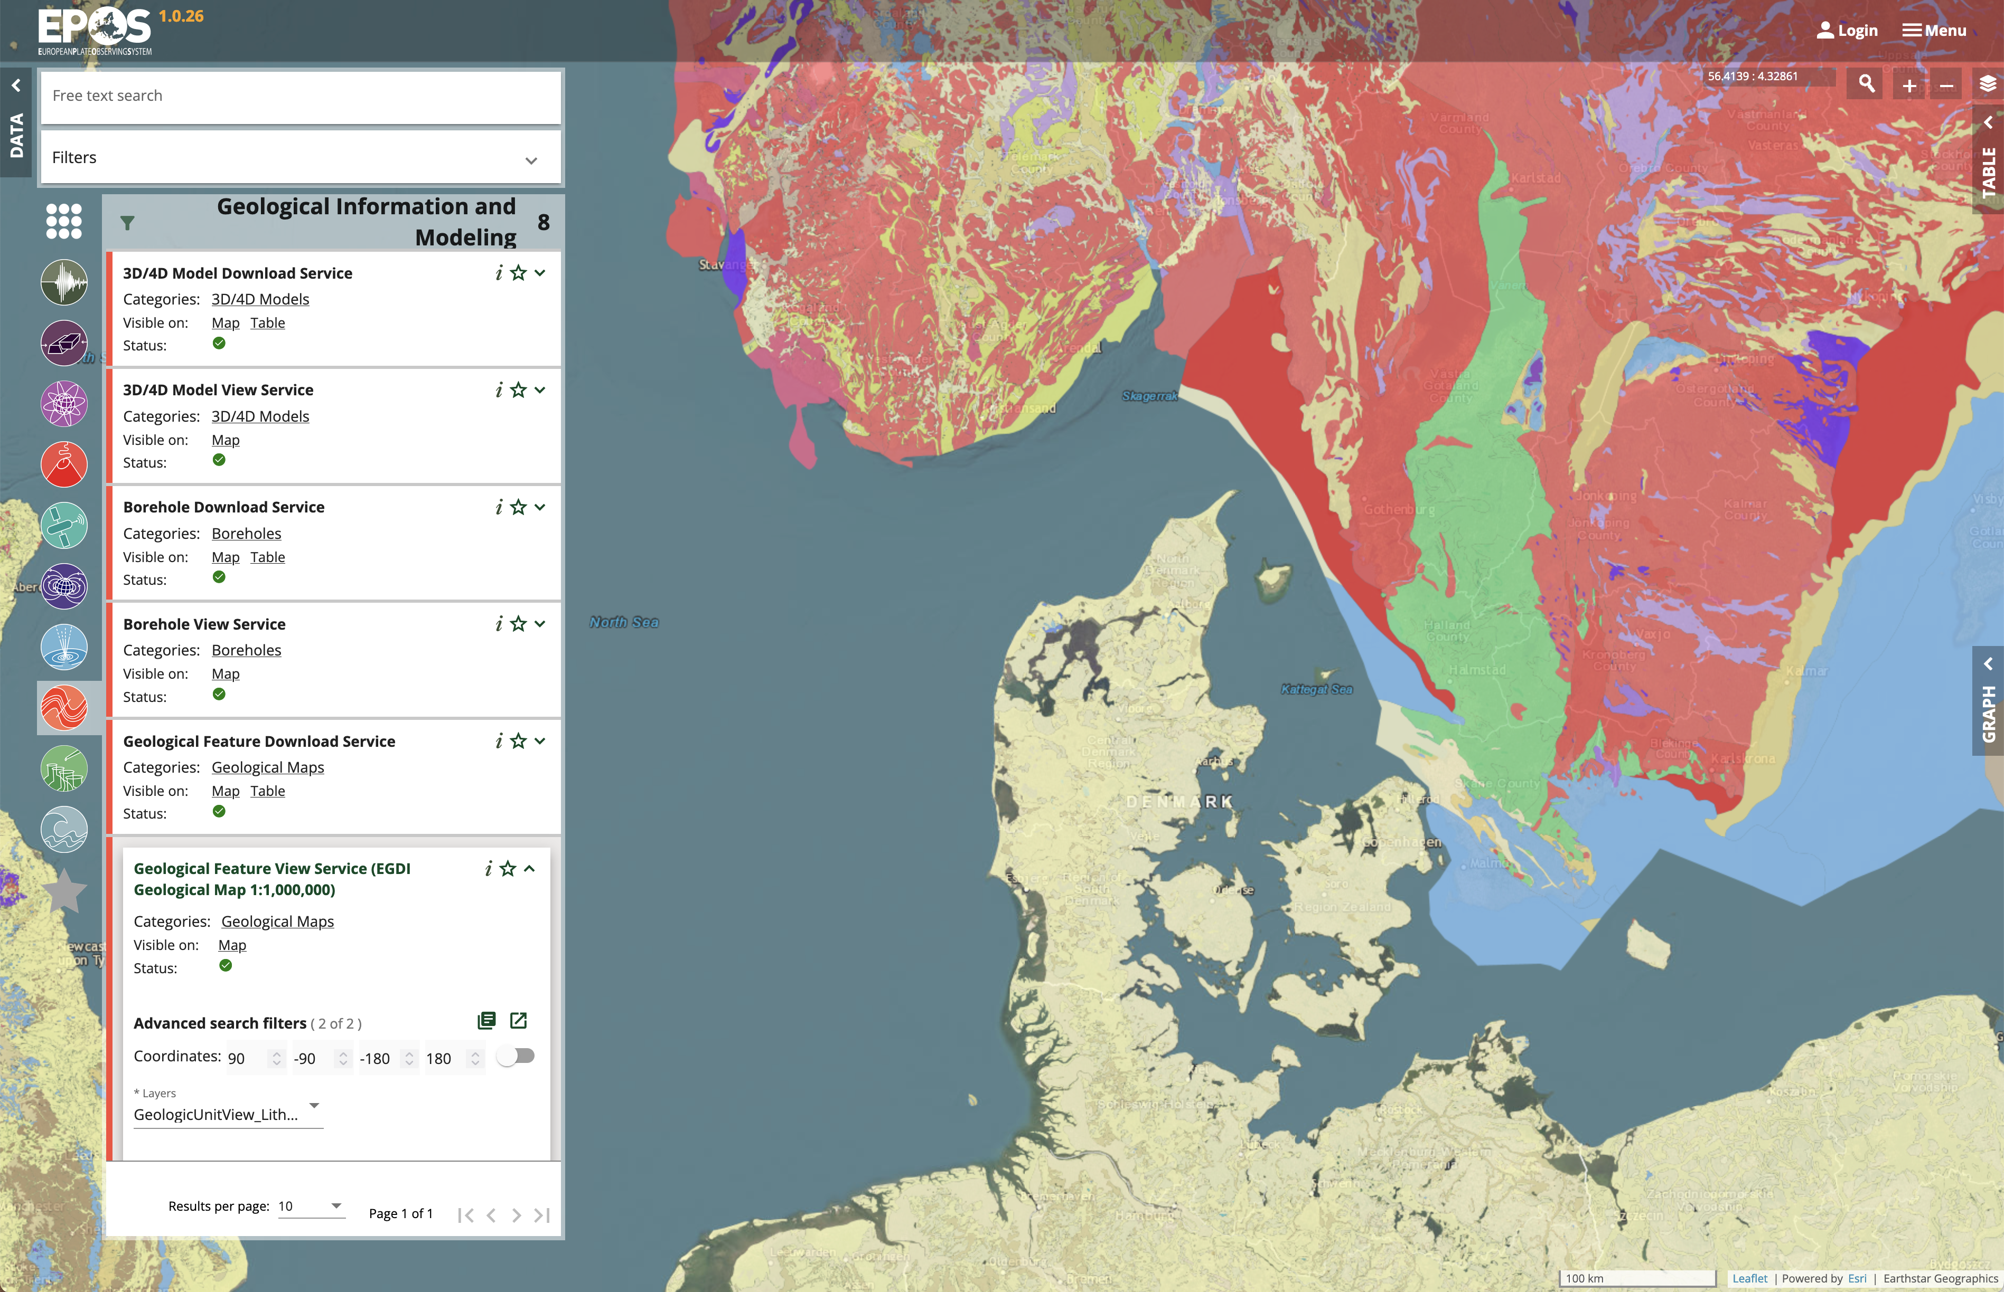
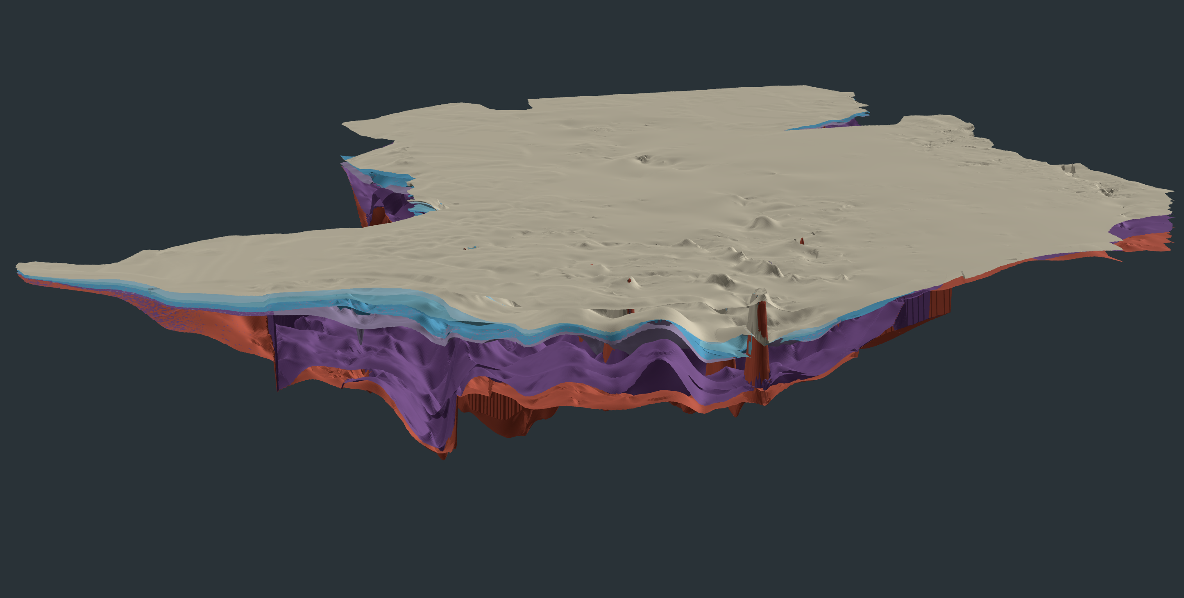

TCS – Geological Information and Modelling
GEUS / EuroGeoSurveys contribute
Geological Maps
Borehole data
Deep 3D geothermal models
https://geusegdi01.geus.dk/dkdeep/

Slide 16

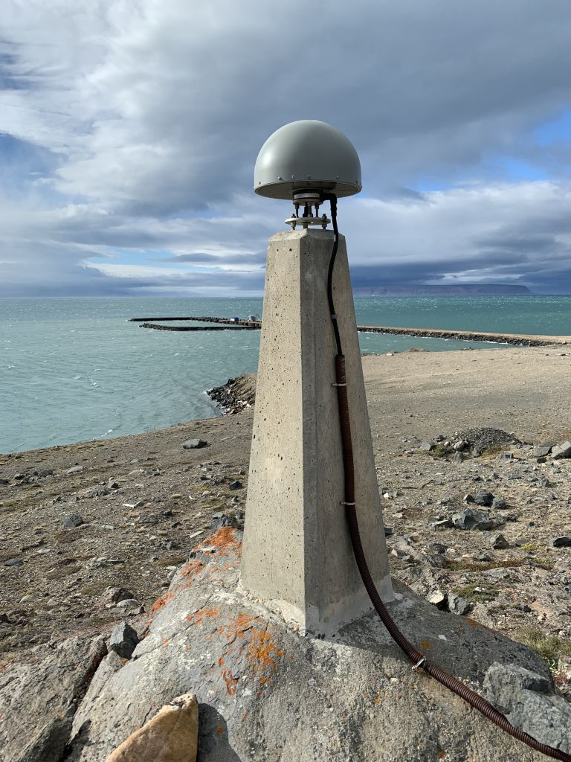
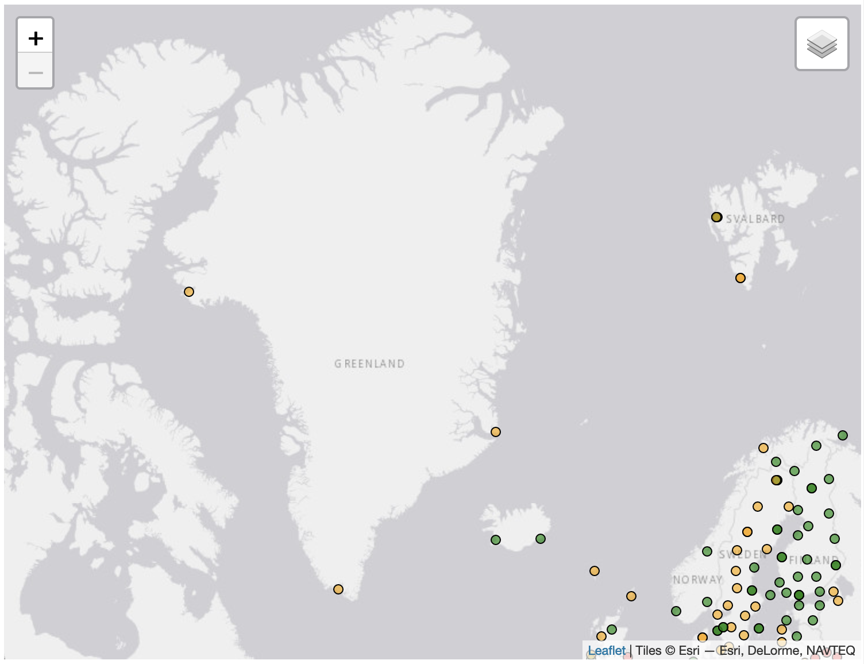
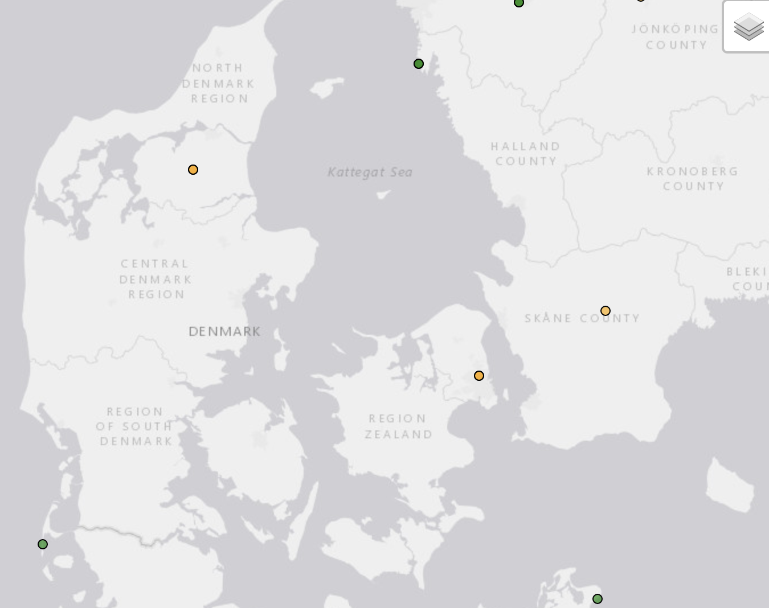
TCS – GNSS Data and Products
Technical University of Denmark participates in the EUREF Permanent GNSS Network
3 stations in Greenland: Thule Airbase, Qaqortoq, Scoresbysund
2 stations in Denmark: Suldrup, Copenhagen
Thule Airbase, Greenland
https://epncb.eu/_networkdata/siteinfo4onestation.php?station=THU200GRL

Slide 17

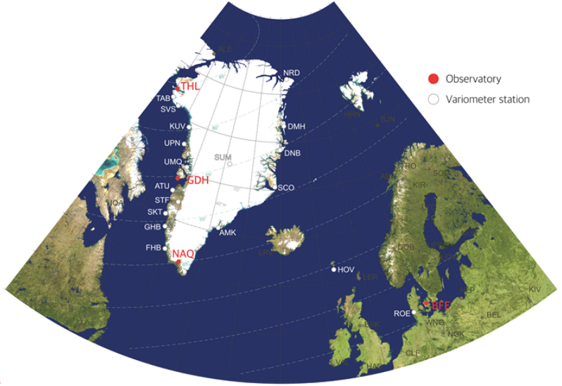
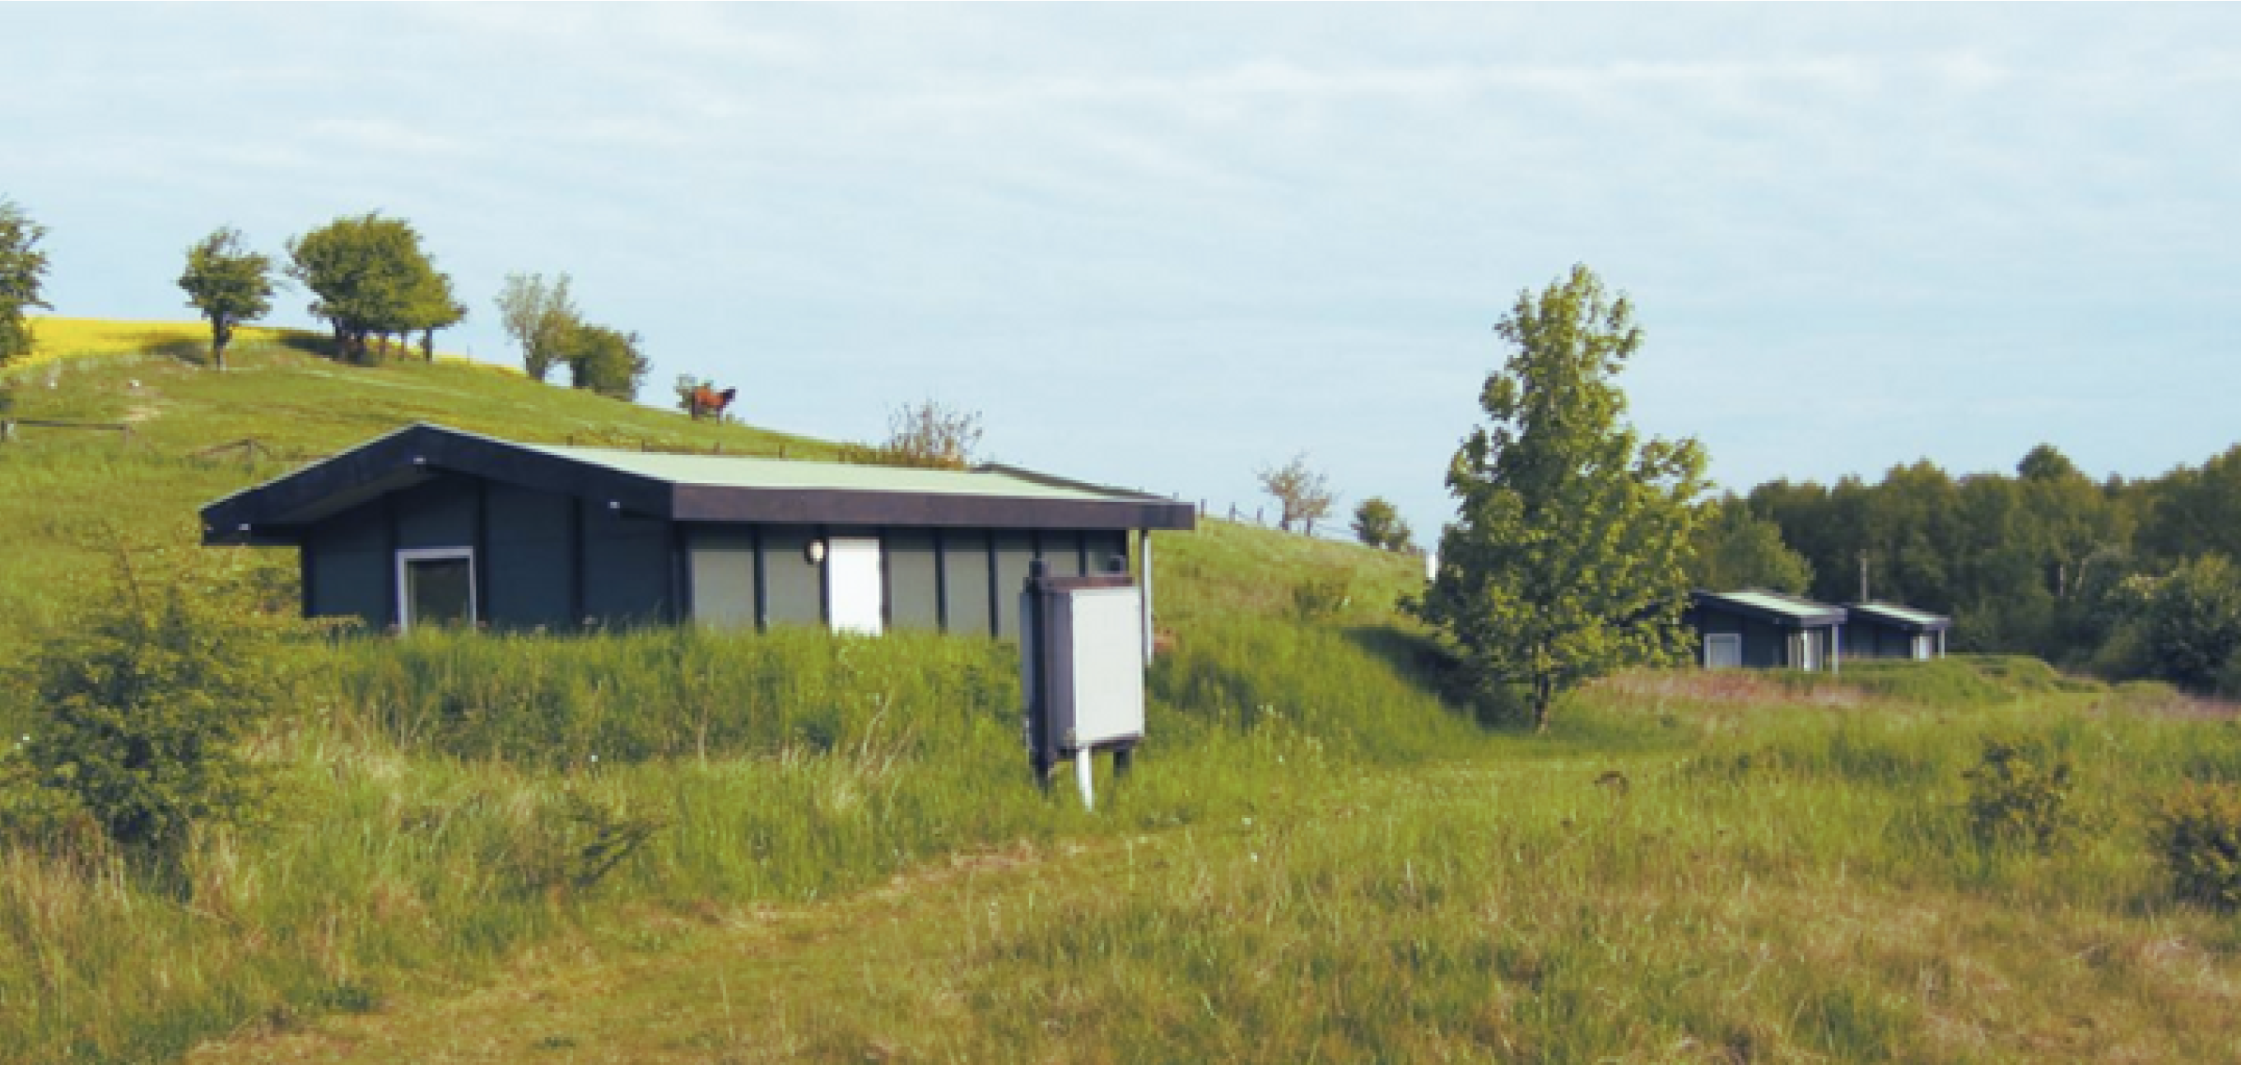
TCS – Geomagnetic Observations
DTU Space, National Space Institute is part of INTERMAGNET
Geomagnetic observatory: Brorfelde, Denmark
Three observatories in Greenland: Qeqertarsuaq, Narsarsuaq, Qaanaaq
https://www.space.dtu.dk/english/research/scientific_data_and_models/magnetic-ground-stations
Observatory Brorfelde (Photo: DTU Space)

Slide 18





Nordic EPOS
A FAIR Nordic EPOS Data Hub
A consortium of Nordic geophysical institutions, universities and surveys that are members of national EPOS consortia
Financed by NordForsk (2020–2022) to promote Nordic collaboration on research infrastructure
University of Helsinki (Finland)
Geological Survey of Denmark and Greenland (Denmark and Greenland)
Icelandic Meteorological Office (Iceland)
University of Bergen (Norway)
University of Oulu (Finland)
Uppsala University (Sweden)

Slide 19
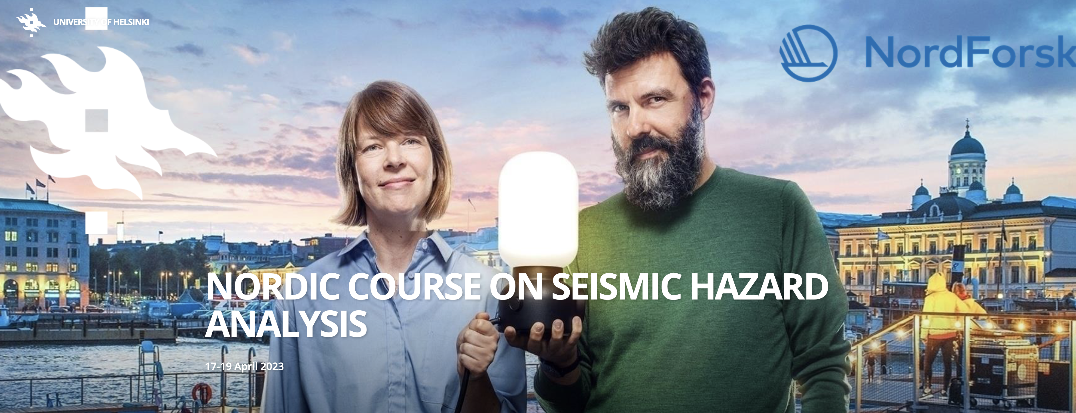
Nordic EPOS – Activities
Training in usage of EPOS-RI data and services
Nordic data integration and FAIRness
Nordic station management of seismological networks
Induced seismicity, safe society
Ash and gas monitoring
Geomagnetic hazards
Communication and dissemination
Engagement of Baltic countries
https://blogs.helsinki.fi/seismichazard/

Slide 20
Scientific Evaluation of EPOS ERIC period 2019-2023
Evaluation was very positive
The panel was also very constructive in its analysis
One recommendation: EPOS as data archive for vintage high-resolution seismic profiles
Often acquired for hydrocarbon exploration
Now data can be useful for geothermal energy or carbon-capture and storage

Slide 21
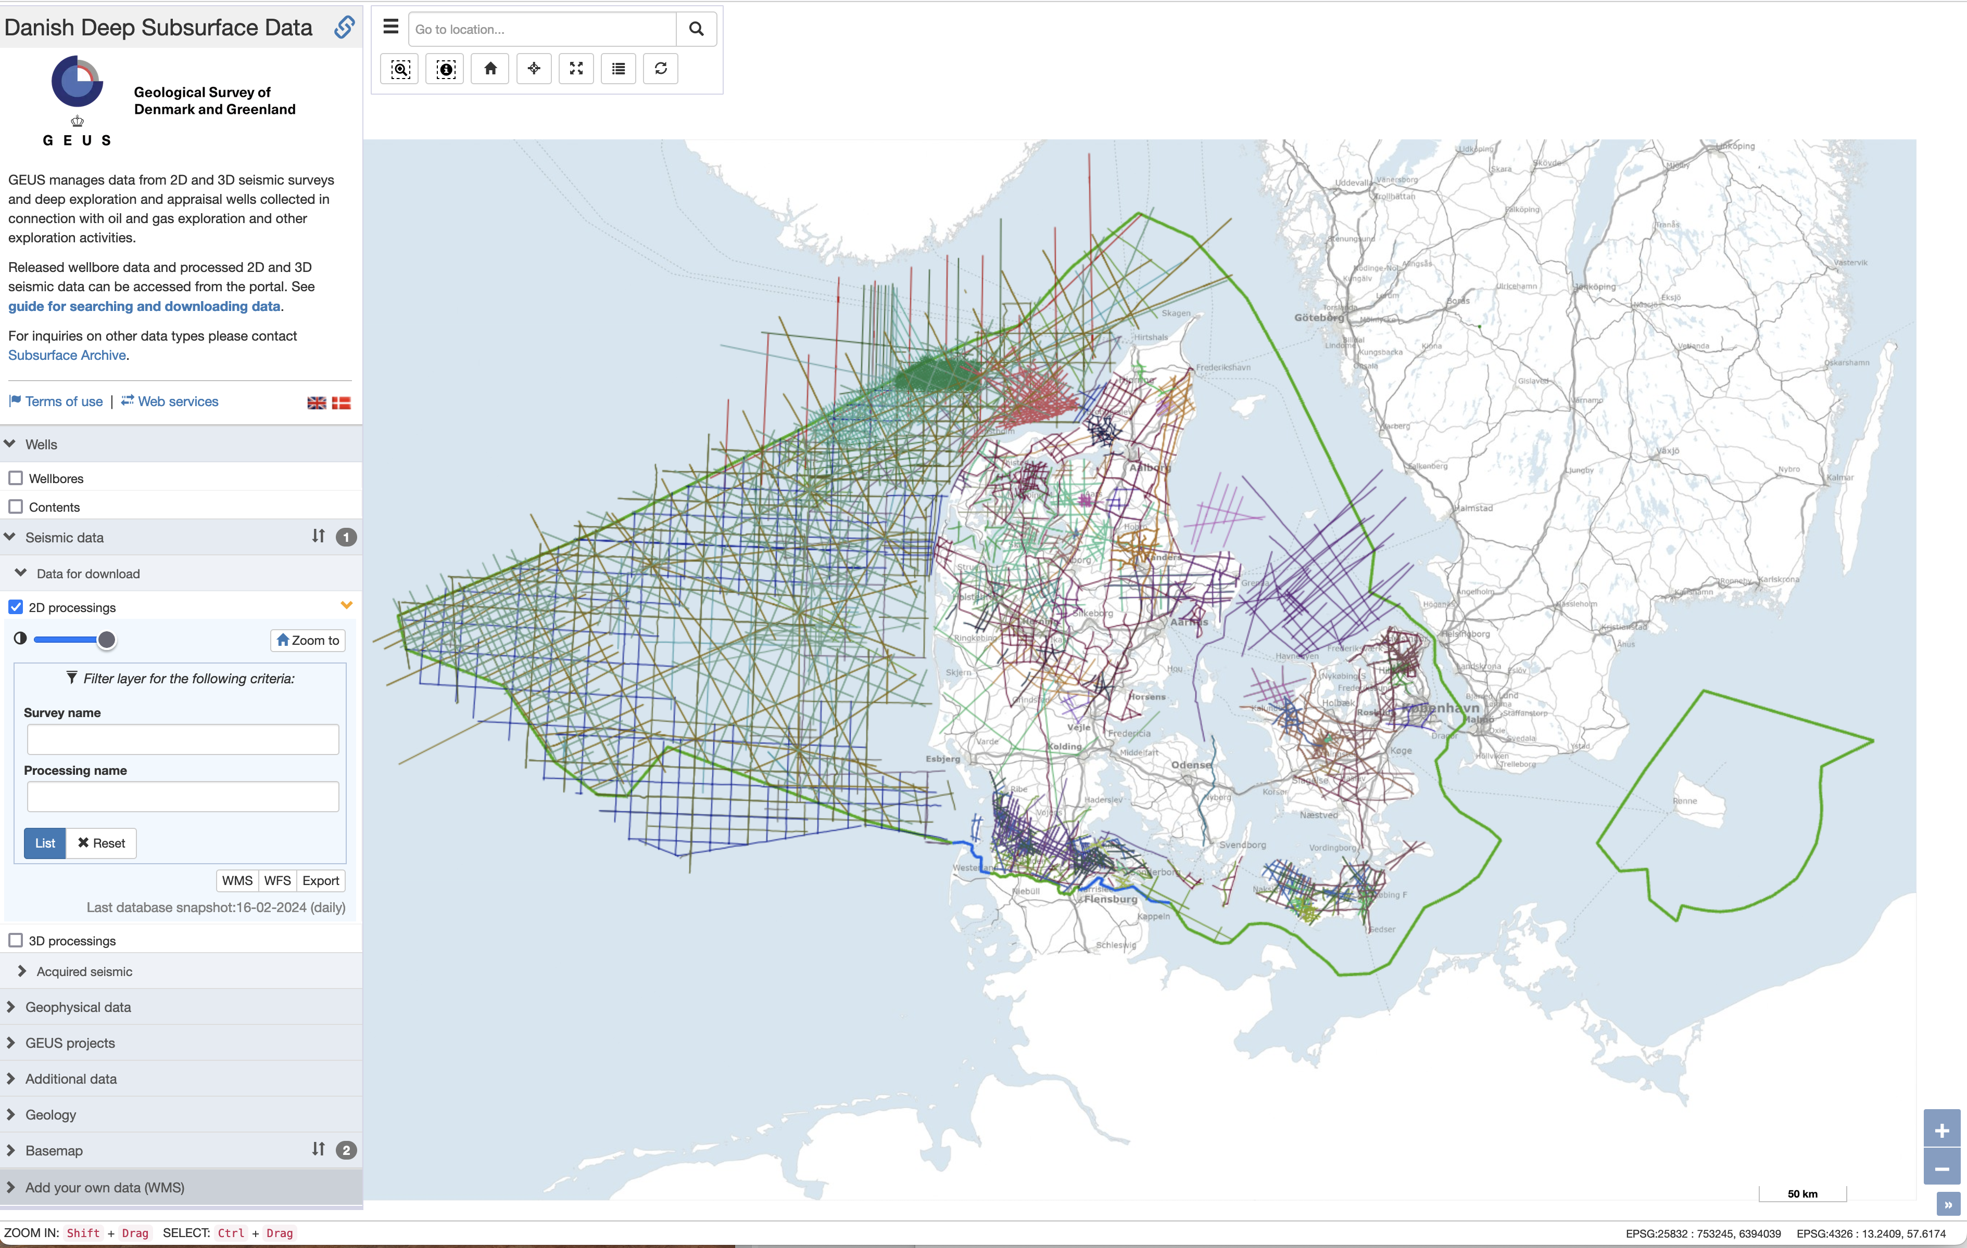
Danish government decided to make seismic reflection data publicly available, free of charge
Available from the Danish Deep Subsurface Data Portal at GEUS

Slide 22
Future TCS (Gravity)
There is a great interest in gravity data in Denmark
Can be used for many applications
Technical University of Denmark (DTU) is the national agency in charge of gravity data
DTU has expressed interest in participation in a TCS

