Slide 1


EPOS-ES
Adelina Geyer
Olaya Dorado
Agencia Estatal Consejo Superior de Investigaciones Científicas - CSIC

Slide 2
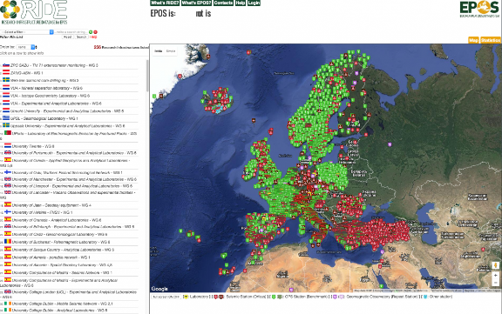
www.epos-es.org | info_eposes@geo3bcn.csic.es | @EPOS_ES
History of EPOS-ES and financial support
CSIC Project calls for:
Large European Research Infrastructures
100 keuros
NATIONAL FUNDING
Thematic network
CGL2016-81965-REDT 18 keuros
Thematic network
RED2022-134516-E
60 keuros
EPOS - RIDE
EPOS - PP
EPOS - IP
EPOS - SP
EPOS-ES
Kick-off meeting
EPOS
Preparatory Phase
EPOS
Implementation Phase
EPOS
Sustainability Phase
17 may
2008
2011
2014 / 2015
2019 / 2020
2023
European Strategy Forum on Research Infrastructures (ESFRI)
EUROVOLC
DT-GEO
EUROPEAN FUNDING
GEO-INQUIRE

Slide 3







www.epos-es.org | info_eposes@geo3bcn.csic.es | @EPOS_ES
Participants
Agreement for economic funding of membership fees and the participation of Spain in the ESFRI EPOS-ERIC (5 year credit renewal):
Ministerio de Ciencia, Innovación e Universidades (MICIU) - former Ministerio de Ciencia e Innovación (MICINN) -
Consejo Superior de Investigaciones científicas (CSIC)
Centro Nacional de Información Geográfica (CNIG) -
Instituto Geográfico Nacional (IGN)
Universidad de Granada (UGR)
Universidad de Alicante (UA)
Universidad de Salamanca (USAL)
Universidad de Barcelona (UB)
Spanish representation in EPOS-ERIC
Maria Vallejo Abascal (MICIU)
Ramón Carbonell (CSIC)
National experts:
Adelina Geyer (CSIC)
Carmen López (IGN)
Current Spanish ESFRI policy requires the membership fees to be covered by one (or more) institution(s). In case of EPOS-ERIC, the Ministry of Science, Innovation and Universities does not provide any economic support.

Slide 4








www.epos-es.org | info_eposes@geo3bcn.csic.es | @EPOS_ES
Participants
General Action Protocol (PGA) EPOS – Spain. Open document agreement signed by :
Ministerio de Ciencia e Innovación (MICINN)
Consejo Superior de Investigaciones científicas (CSIC)
Centro Nacional de Información Geográfica (CNIG) - Instituto Geográfico Nacional (IGN)
Universidad de Granada (UGR)
Universidad de Alicante (UA)
Universidad de Salamanca (USAL)
Universidad de Barcelona (UB)
Observatorio del Ebro (OE)
Universidad Complutense de Madrid (UCM)
Universidad Politécnica de Madrid (UPM)
Universidad Politécnica de Valencia (UPV)

Slide 5
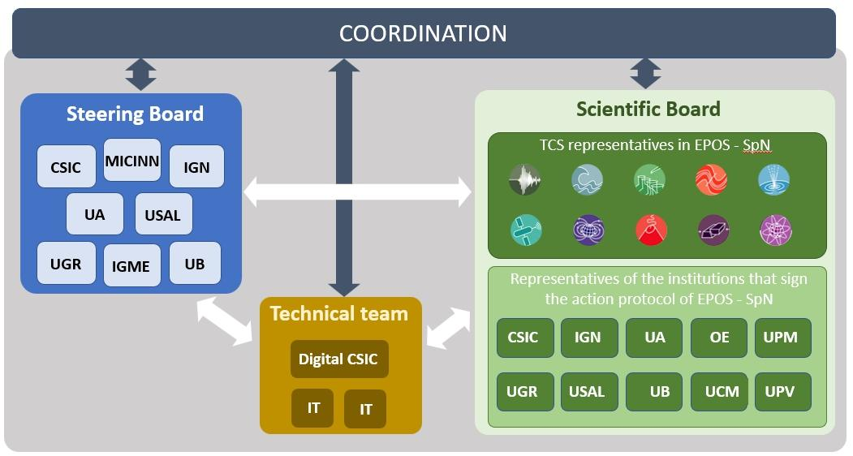
www.epos-es.org | info_eposes@geo3bcn.csic.es | @EPOS_ES
Organisation and governance
TCS representatives in EPOS-ES
Representatives of the institutions signing the general action protocol of EPOS-ES

Slide 6




www.epos-es.org | info_eposes@geo3bcn.csic.es | @EPOS_ES
Organisation and governance
EPOS-ES Coordination
Adelina Geyer (CSIC)
Project Manager
Olaya Dorado (CSIC)
Juan Vicente
Cantavella
(IGN)
Antonio Azor
(UGR)
José Antonio Sánchez
(IGN)
Itahiza Domínguez Cerdeña (IGN)
Adelina Geyer (CSIC)
José Luis Fernández
(CSIC)
National Scientific Advisor for the Spanish Representative at the National Authorities Consultation Board
Ramón Carbonell (CSIC)
Coordinators and TCS representatives are envisaged to rotate among the different institutions signing the general agreement.
José Fernández
(UCM – CSIC)
Juan José Curto
(OE)
Diana Nuñez
(UCM)
José Román Hernández
(IGME)
Jorge Macías (UMA)
Íñigo Aniel-Quiroga (IHCAN)

Slide 7
www.epos-es.org | info_eposes@geo3bcn.csic.es | @EPOS_ES
EPOS-ES GOALS
Establish an organized structure of EPOS-Spain that allows coordinating the activities and initiatives and defining the roadmap of actions to be carried out in the short, medium, and long term.
Implement and develop the Spanish nodes of the 10 TCSs and identify the DDSSs that can be integrated into EPOS and those services to be developed in the future.
Act as a speaker and information point for the rest of the national community in Earth Sciences, of the actions and initiatives that are being carried out at a European level, especially those directly related to EPOS.

Slide 8

www.epos-es.org | info_eposes@geo3bcn.csic.es | @EPOS_ES
EPOS-ES GOALS
Establish an organized structure of EPOS-Spain that allows coordinating the activities and initiatives and defining the roadmap of actions to be carried out in the short, medium, and long term.
Implement and develop the Spanish nodes of the 10 TCSs and identify the DDSSs that can be integrated into EPOS and those services to be developed in the future.
Act as a speaker and information point for the rest of the national community in Earth Sciences, of the actions and initiatives that are being carried out at a European level, especially those directly related to EPOS.

Slide 9
www.epos-es.org | info_eposes@geo3bcn.csic.es | @EPOS_ES
EPOS-ES GOALS
Establish an organized structure of EPOS-Spain that allows coordinating the activities and initiatives and defining the roadmap of actions to be carried out in the short, medium, and long term.
Implement and develop the Spanish nodes of the 10 TCSs and identify the DDSSs that can be integrated into EPOS and those services to be developed in the future.
Act as a speaker and information point for the rest of the national community in Earth Sciences, of the actions and initiatives that are being carried out at a European level, especially those directly related to EPOS.
DDSS: Data, data products, software and services

Slide 10

www.epos-es.org | info_eposes@geo3bcn.csic.es | @EPOS_ES
EPOS-ES GOALS
Establish an organized structure of EPOS-Spain that allows coordinating the activities and initiatives and defining the roadmap of actions to be carried out in the short, medium, and long term.
Implement and develop the Spanish nodes of the 10 TCSs and identify the DDSSs that can be integrated into EPOS and those services to be developed in the future.
Act as a speaker and information point for the rest of the national community in Earth Sciences, of the actions and initiatives that are being carried out at a European level, especially those directly related to EPOS.
DDSS: Data, data products, software and services

Slide 11

www.epos-es.org | info_eposes@geo3bcn.csic.es | @EPOS_ES
EPOS-ES GOALS
Explore the generation of connections between the Spanish nodes of other ESFRIs to expand the potential and use of EPOS (e.g. with EMSO).
Promote the use of EPOS in national and international research programs and initiatives. In particular, explore the possibilities of developing research projects within the framework of European calls.
Strengthen the digital service base of national institutions that contribute to EPOS with DDSSs.
Pursue the establishment of links with national HPC resources (Red nacional de supercomputación)

Slide 12

www.epos-es.org | info_eposes@geo3bcn.csic.es | @EPOS_ES
EPOS-ES GOALS
Explore the generation of connections between the Spanish nodes of other ESFRIs to expand the potential and use of EPOS (e.g. with EMSO).
Promote the use of EPOS in national and international research programs and initiatives. In particular, explore the possibilities of developing research projects within the framework of European calls.
Strengthen the digital service base of national institutions that contribute to EPOS with DDSSs.
Pursue the establishment of links with national HPC resources (Red nacional de supercomputación)

Slide 13

www.epos-es.org | info_eposes@geo3bcn.csic.es | @EPOS_ES
EPOS-ES GOALS
Explore the generation of connections between the Spanish nodes of other ESFRIs to expand the potential and use of EPOS (e.g. with EMSO).
Promote the use of EPOS in national and international research programs and initiatives. In particular, explore the possibilities of developing research projects within the framework of European calls.
Strengthen the digital service base of national institutions that contribute to EPOS with DDSSs.
Pursue the establishment of links with national HPC resources (Red nacional de supercomputación)

Slide 14

www.epos-es.org | info_eposes@geo3bcn.csic.es | @EPOS_ES
EPOS-ES GOALS
Explore the generation of connections between the Spanish nodes of other ESFRIs to expand the potential and use of EPOS (e.g. with EMSO).
Promote the use of EPOS in national and international research programs and initiatives. In particular, explore the possibilities of developing research projects within the framework of European calls.
Strengthen the digital service base of national institutions that contribute to EPOS with DDSSs.
Pursue the establishment of links with national HPC resources (Red nacional de supercomputación)

Slide 15
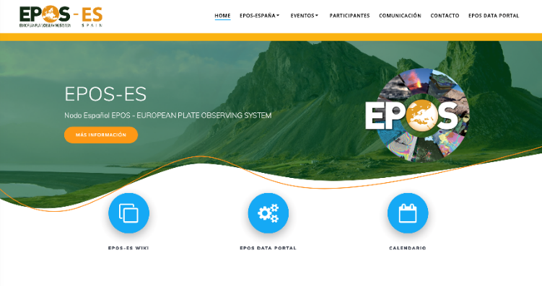
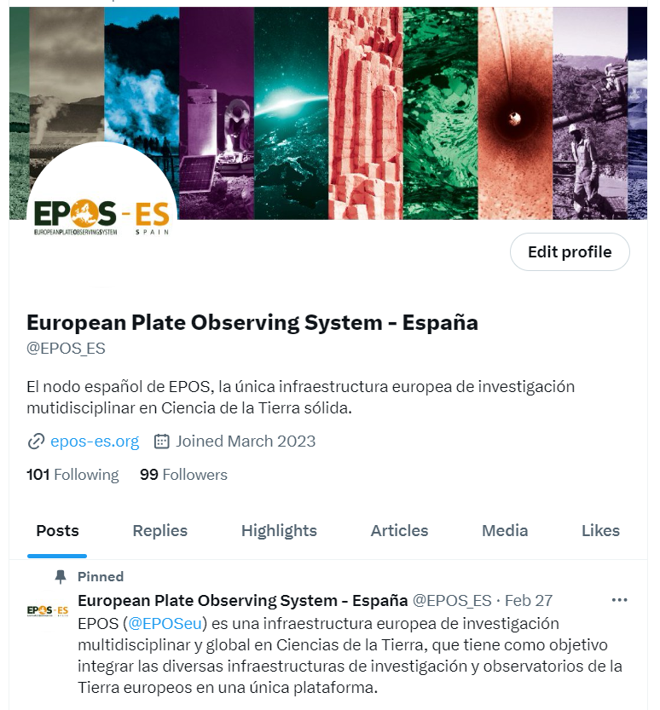
www.epos-es.org | info_eposes@geo3bcn.csic.es | @EPOS_ES
2023 Activities
  Database of specialists and working groups
    Specific mailing lists for each TCSs and also for the entire network
  Dissemination plan of activities and results
    Web page
    Presence in social media
    Brochure and informative postcards

Slide 16

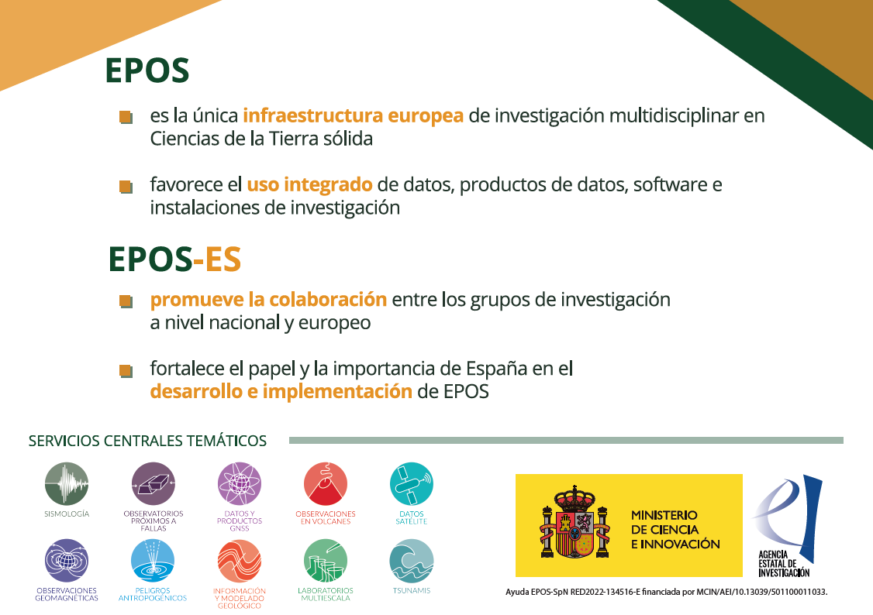
www.epos-es.org | info_eposes@geo3bcn.csic.es | @EPOS_ES
2023 Activities

Slide 17
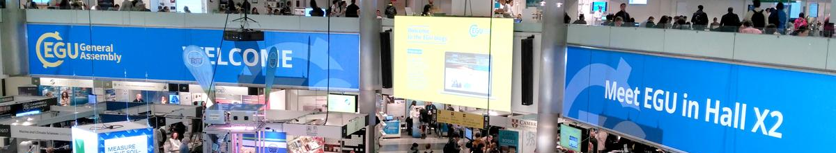
www.epos-es.org | info_eposes@geo3bcn.csic.es | @EPOS_ES
2023 Activities
Meetings and presence in conferences:
    Organization of the General Assembly of EPOS-Spain
    Organization of internal meetings of each TCSs
    Participation of the Spanish TCSs coordinators in the meetings at the European level
    Attendance at international scientific conferences
    Internal network coordination meetings

Slide 18
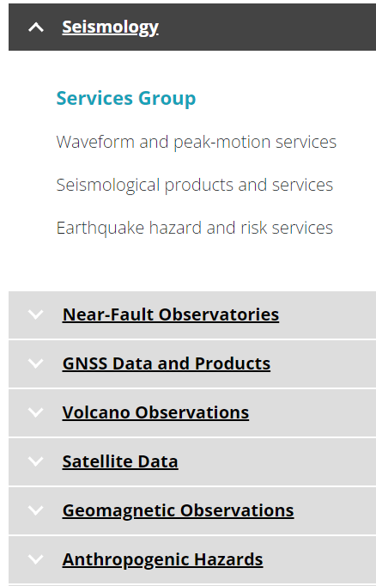
www.epos-es.org | info_eposes@geo3bcn.csic.es | @EPOS_ES
Roadmap for 2024
  Dissemination plan of activities and results
    Preparation of press releases
    Brochure and informative postcards
    News bulletin
  Identification of potential DDSSs to integrate into EPOS
    Definition of the roadmap
    Prioritization for its integration
    List of in-house services to be developed in the future
    Ensure the presence of Spain in discussion forums, strategic meetings, etc.

Slide 19

www.epos-es.org | info_eposes@geo3bcn.csic.es | @EPOS_ES
Roadmap for 2024
  Link EPOS-Spain to other already consolidated European organizations and initiatives (e.g. GeoSurveys and Geo-8)
    Strengthen collaborative ties
    Establish a direct communication channel
  Extend and encourage the use of EPOS
    Within the framework of national research and training groups
    In Master's and Doctorate programs, making available to research centers and academics a list of possible scientific projects to be carried out, based on the exploitation of the DDSSs accessible through EPOS.

Slide 20

www.epos-es.org | info_eposes@geo3bcn.csic.es | @EPOS_ES
Roadmap for 2024
  Analyze the infrastructural needs of national Earth Science laboratories and research groups
    Identify the most appropriate calls and coordinate the submission of applications.
  Coordinate with other international institutions that participate in EPOS, the design and drafting of proposals to the specific calls for HORIZON EUROPE infrastructure.

Slide 21


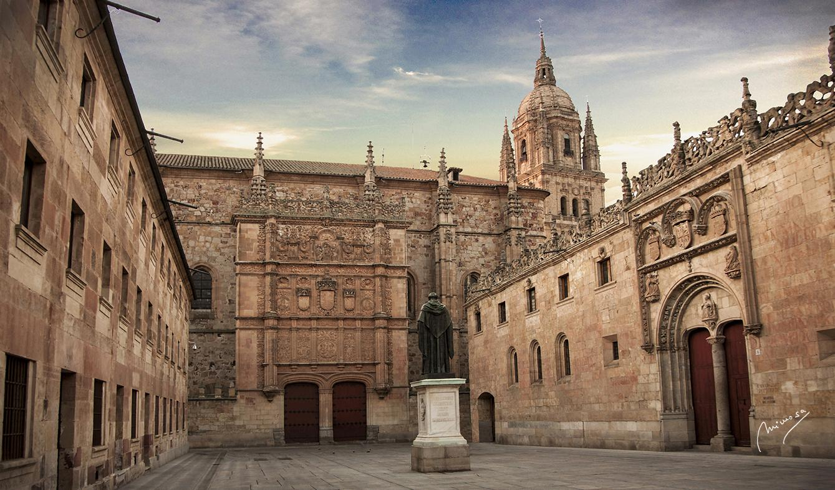
www.epos-es.org | info_eposes@geo3bcn.csic.es | @EPOS_ES
Roadmap for 2024
  Organize special sessions or conferences in general assemblies of national scientific societies (e.g., Asamblea Hispano Portuguesa de Geodesia y Geofísica, Sociedad Geológica de España)
  Summer School (Salamanca, 8th July) addressed to scientific staff, Early Career researchers and graduate students to train in the use of the EPOS portal, explain the potential of the DDSSs integrated to date, and encourage interest in the development of interdisciplinary research.

Slide 22
THANK YOU

