Slide 1


Hellenic Plate Observing System
HELPOS
Anastasia Kiratzi
Professor of Seismology
Aristotle University of Thessaloniki, Greece

Slide 2
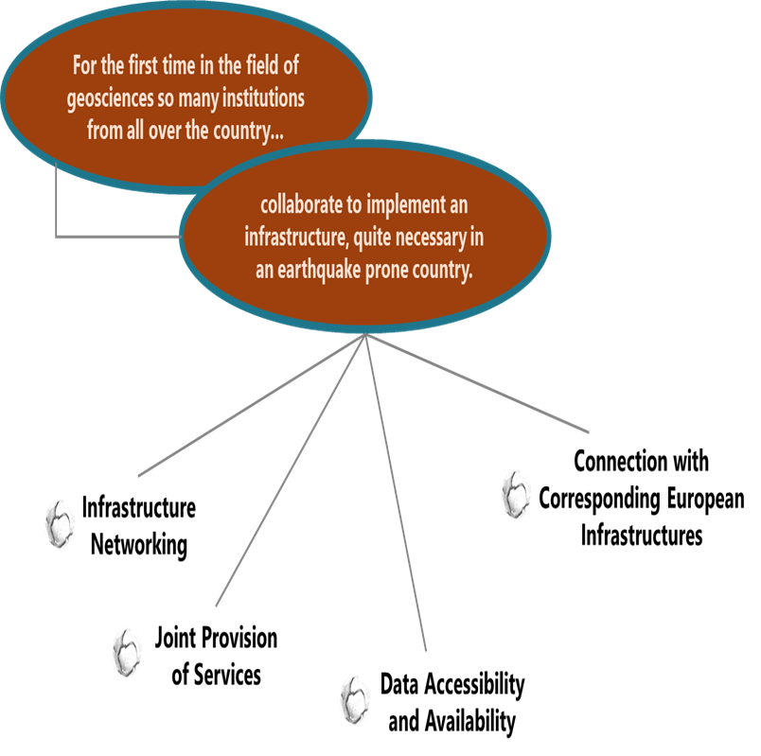
History and rationale
2017 – 2021 Budget ~4 million Euros
Motivation
HELPOS
Effective prevention and management of natural disasters
Coordination of the national bodies that monitor the solid Earth
Availability of high-quality data generated by direct observations
Services
establish
Ιn the domain of Geosciences and Earthquake Engineering
A coherent and integrated research infrastructure
In 2017:
28 RI's were funded via the Greek National Research Infrastructure initiative – 2014-2020 (93 million Euros)
HELPOS was amongst the 6 RI’s funded in the domain “Environment and sustainable development”

Slide 3
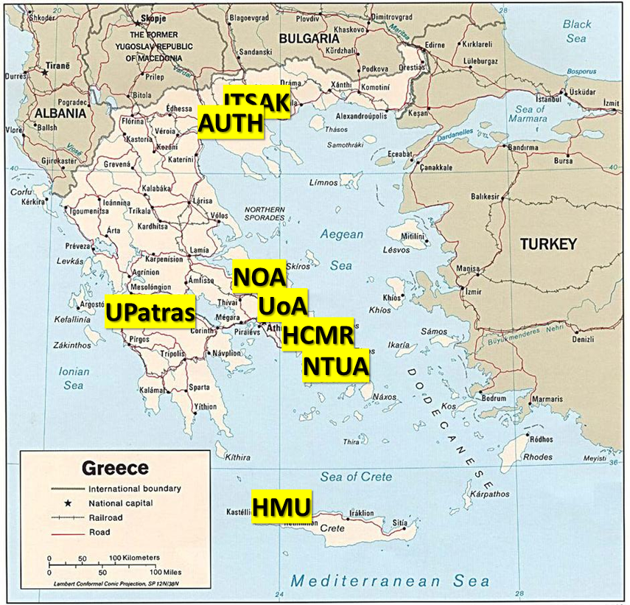
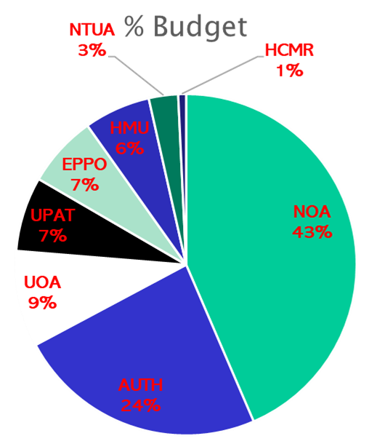
Partnership
Total Budget: ~ 4 Μ€
NOA | Institute of Geodynamics (National Observatory of Athens)
AUTH | Department of Geophysics (Aristotle University of Thessaloniki)
 | Laboratory of Soil Mechanics, Foundation and Geotechnical Earthquake Engineering
 | Department of Geodesy and Topography
EPPO | Institute of Engineering Seismology and Earthquake Engineering (EPPO)
UoA | Department of Geophysics – Geothermics (University of Athens)
 | Department of Informatics & Telecommunications
HMU | Institute of Physics of Earth’s Interior and Geohazards (Hellenic Mediterranean University)
UPAT | Seismological Laboratory (University of Patras)
 | Geotechnical Engineering Laboratory
NTUA | Department of Geotechnical and Engineering (National Technical University of Athens)
 | Laboratory of Geodesy
HCMR | Institute of Oceanography (Hellenic Centre for Marine Research)
Partners are actively involved in the EPOS TCS’s
Delegation to the EPOS GA
Notes:
3

Slide 4
Governance
Well established governance and communication with the NRI
The General Assembly is the supreme governing body
Distributed Eight entities with their various departments for a total of 13 members
Six members tied with a MoU
Two others are collaborating, anticipating that they will become members
Two internal bodies assisting the GA
Steering Committee
Prof. A. Tselentis ( NOA)
Prof. A. Kiratzi (AUTH)
Prof. E. Sokos (UPAT)
Technical Committee
Prof. P. Papadimitriou (UoA)
Prof. C. Papazachos (AUTH)
Dr. Ch. Evangelidis (NOA)
Notes:
4

Slide 5
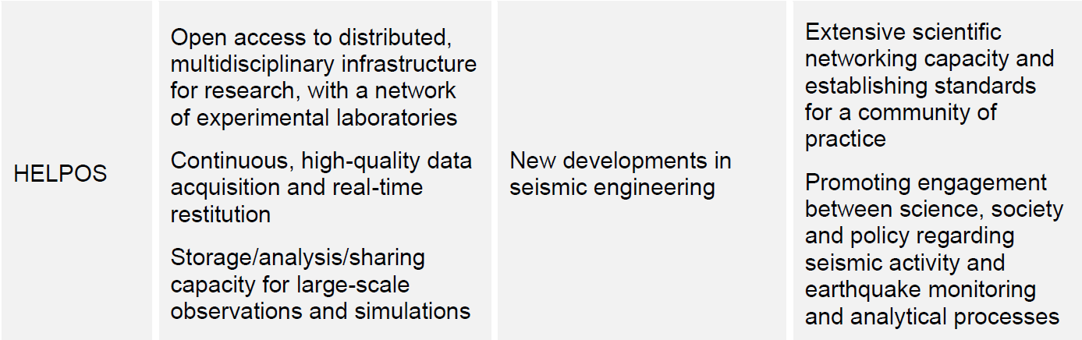
2022 – HELPOS Evaluation by a panel of external experts
Key Points
The reputation is well established also at the international level, and established structural connections with European Ris
HELPOS has clear participation in European projects.
These experiences shape their service provision, their ability to deliver excellent science, their results and outreach potential, and ultimately, their financial sustainability
HELPOS described a publication record above target and a balanced participation of younger and female researchers.
Intellectual property is being handled through an attribution request and licence system

Slide 6
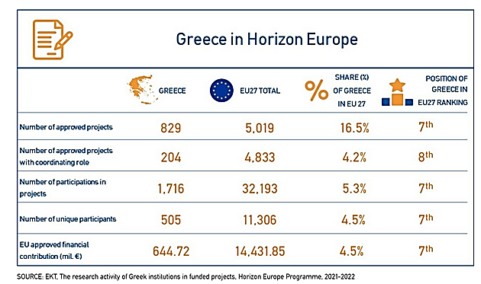
Funding 2021-2022
Horizon 2021-2022 funding
Financial support
Mainly from projects (EU +private sector + public services)
EPOS-ERIC funding via the annual Work Programs
Mainly to NOA for EIDA-node development & maintenance
Participation in EPOS-ERIC
Opportunities to be part of a vivid community and participate in research proposals

Slide 7
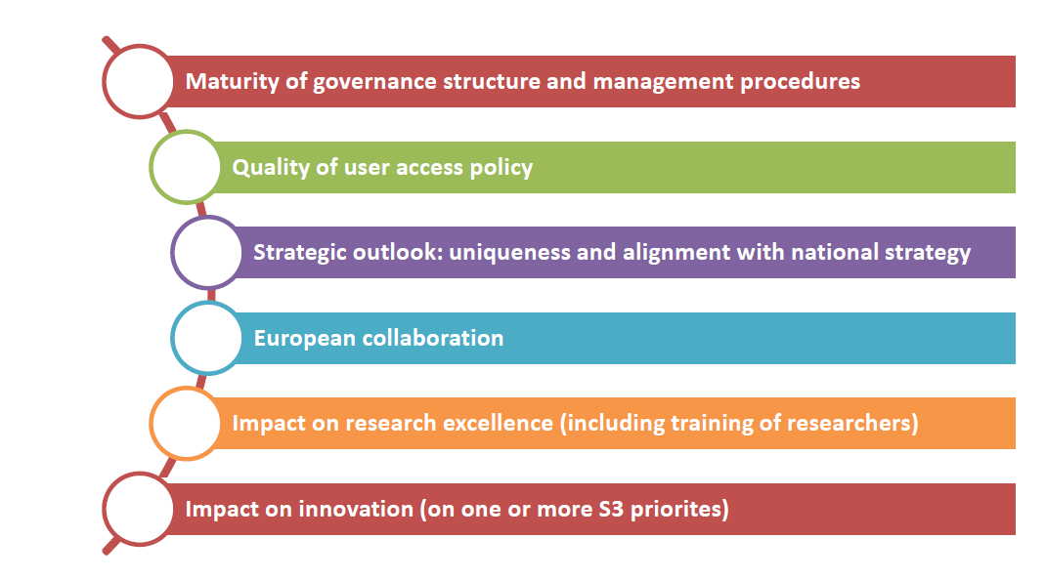
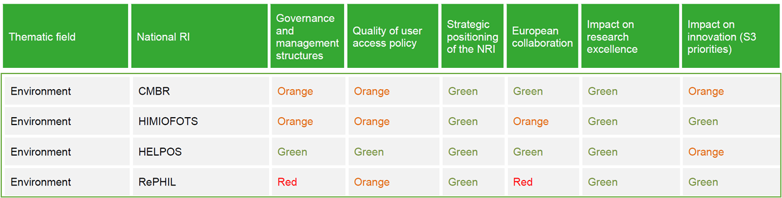
Feb 2024 – A proposal to secure funding for 5 years
Maintain our impact on policy, helping to support the decision-making process
“HELPOS has a clear mandate to monitor, store and provide real-time data from an extensive network of telemetric stations distributed in the country, forming a complex surveillance system of international value for seismic research activities”
Criteria
2022 Evaluation
@EPOS-ERIC Nominal fees

Slide 8
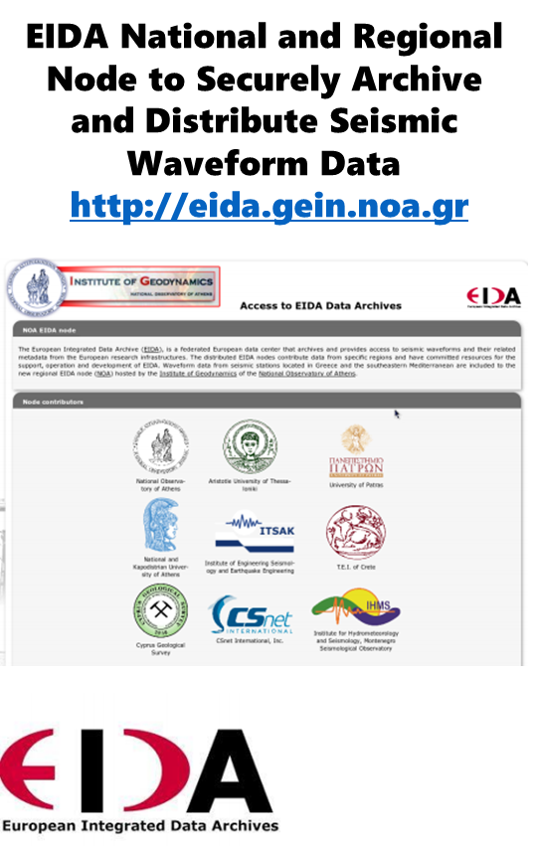
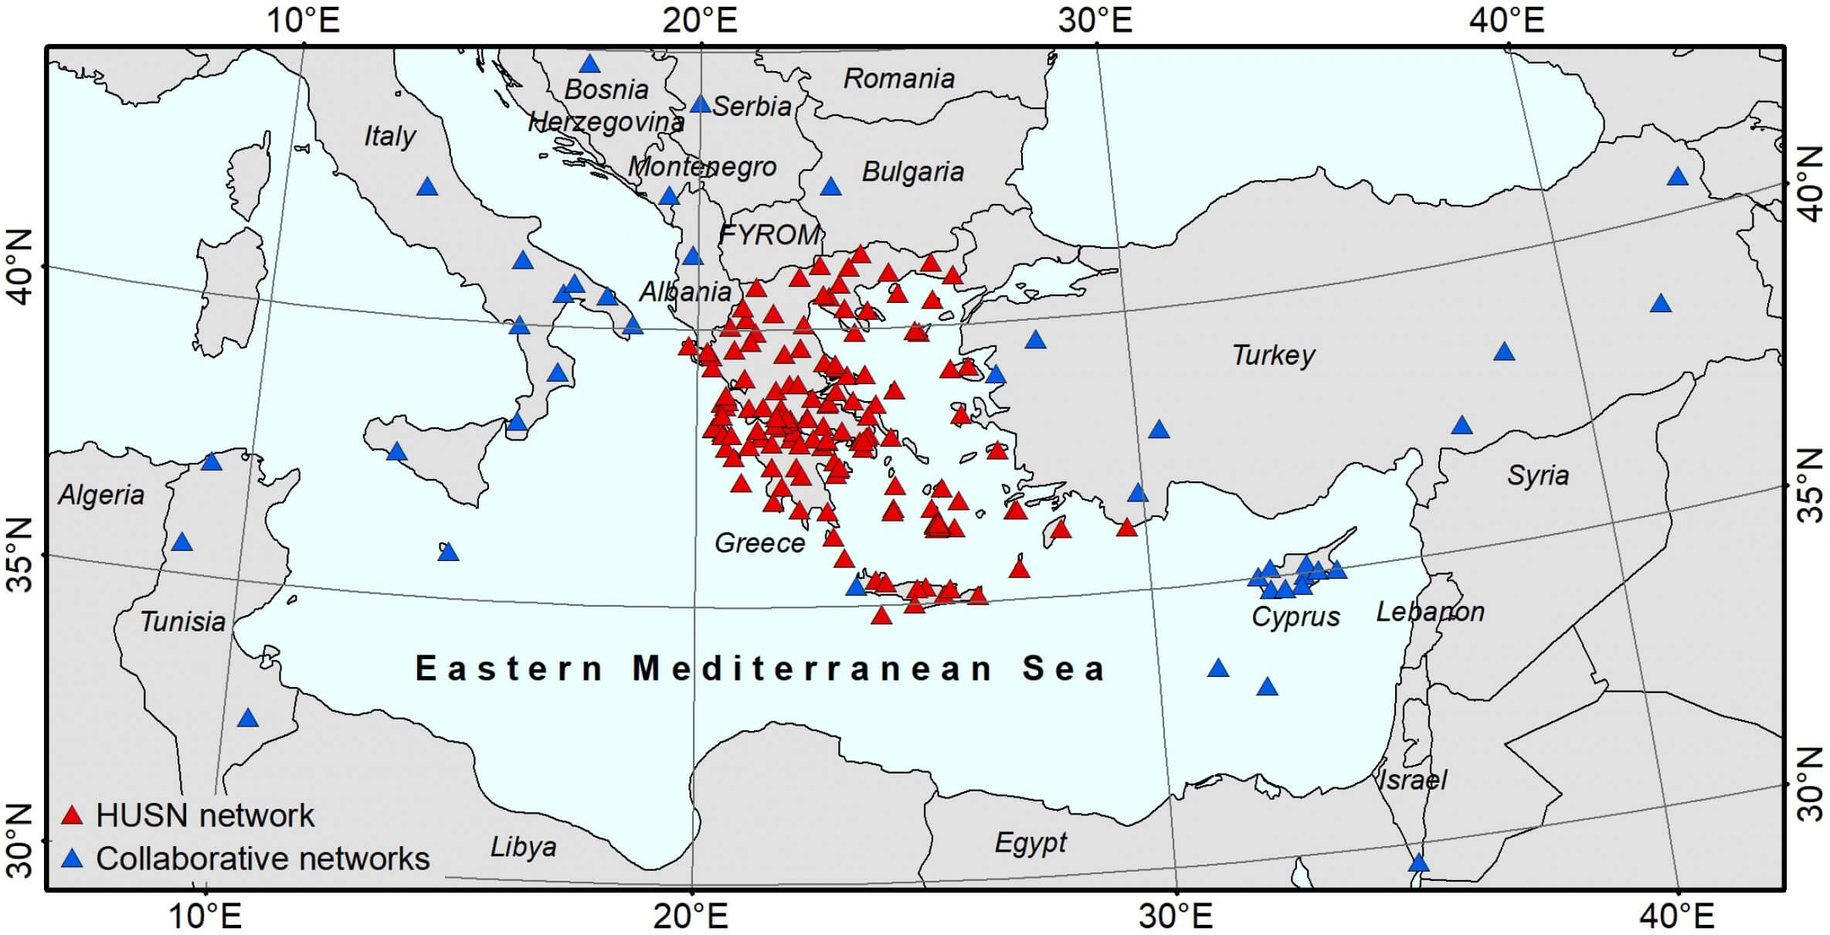
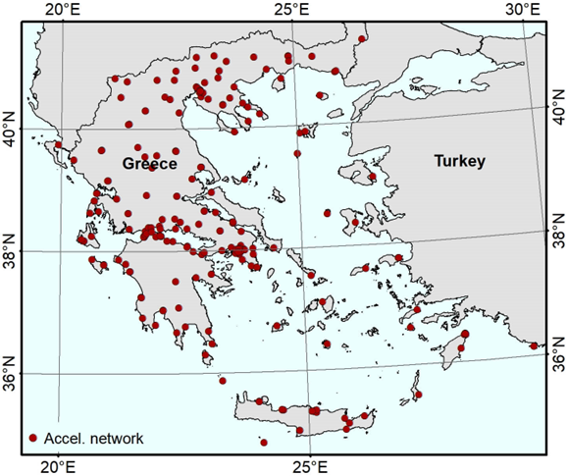
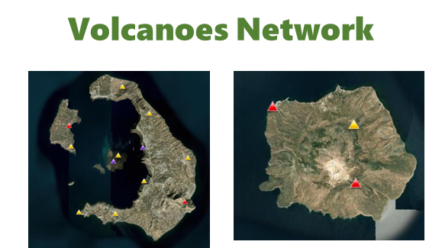
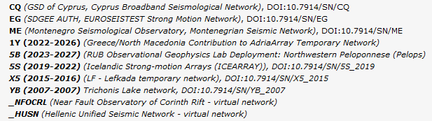
Upcoming plans
Increase the number of archived stations in our data-centres (from northern Africa, additional strong motion)
Broad Band
Strong Motion

Slide 9
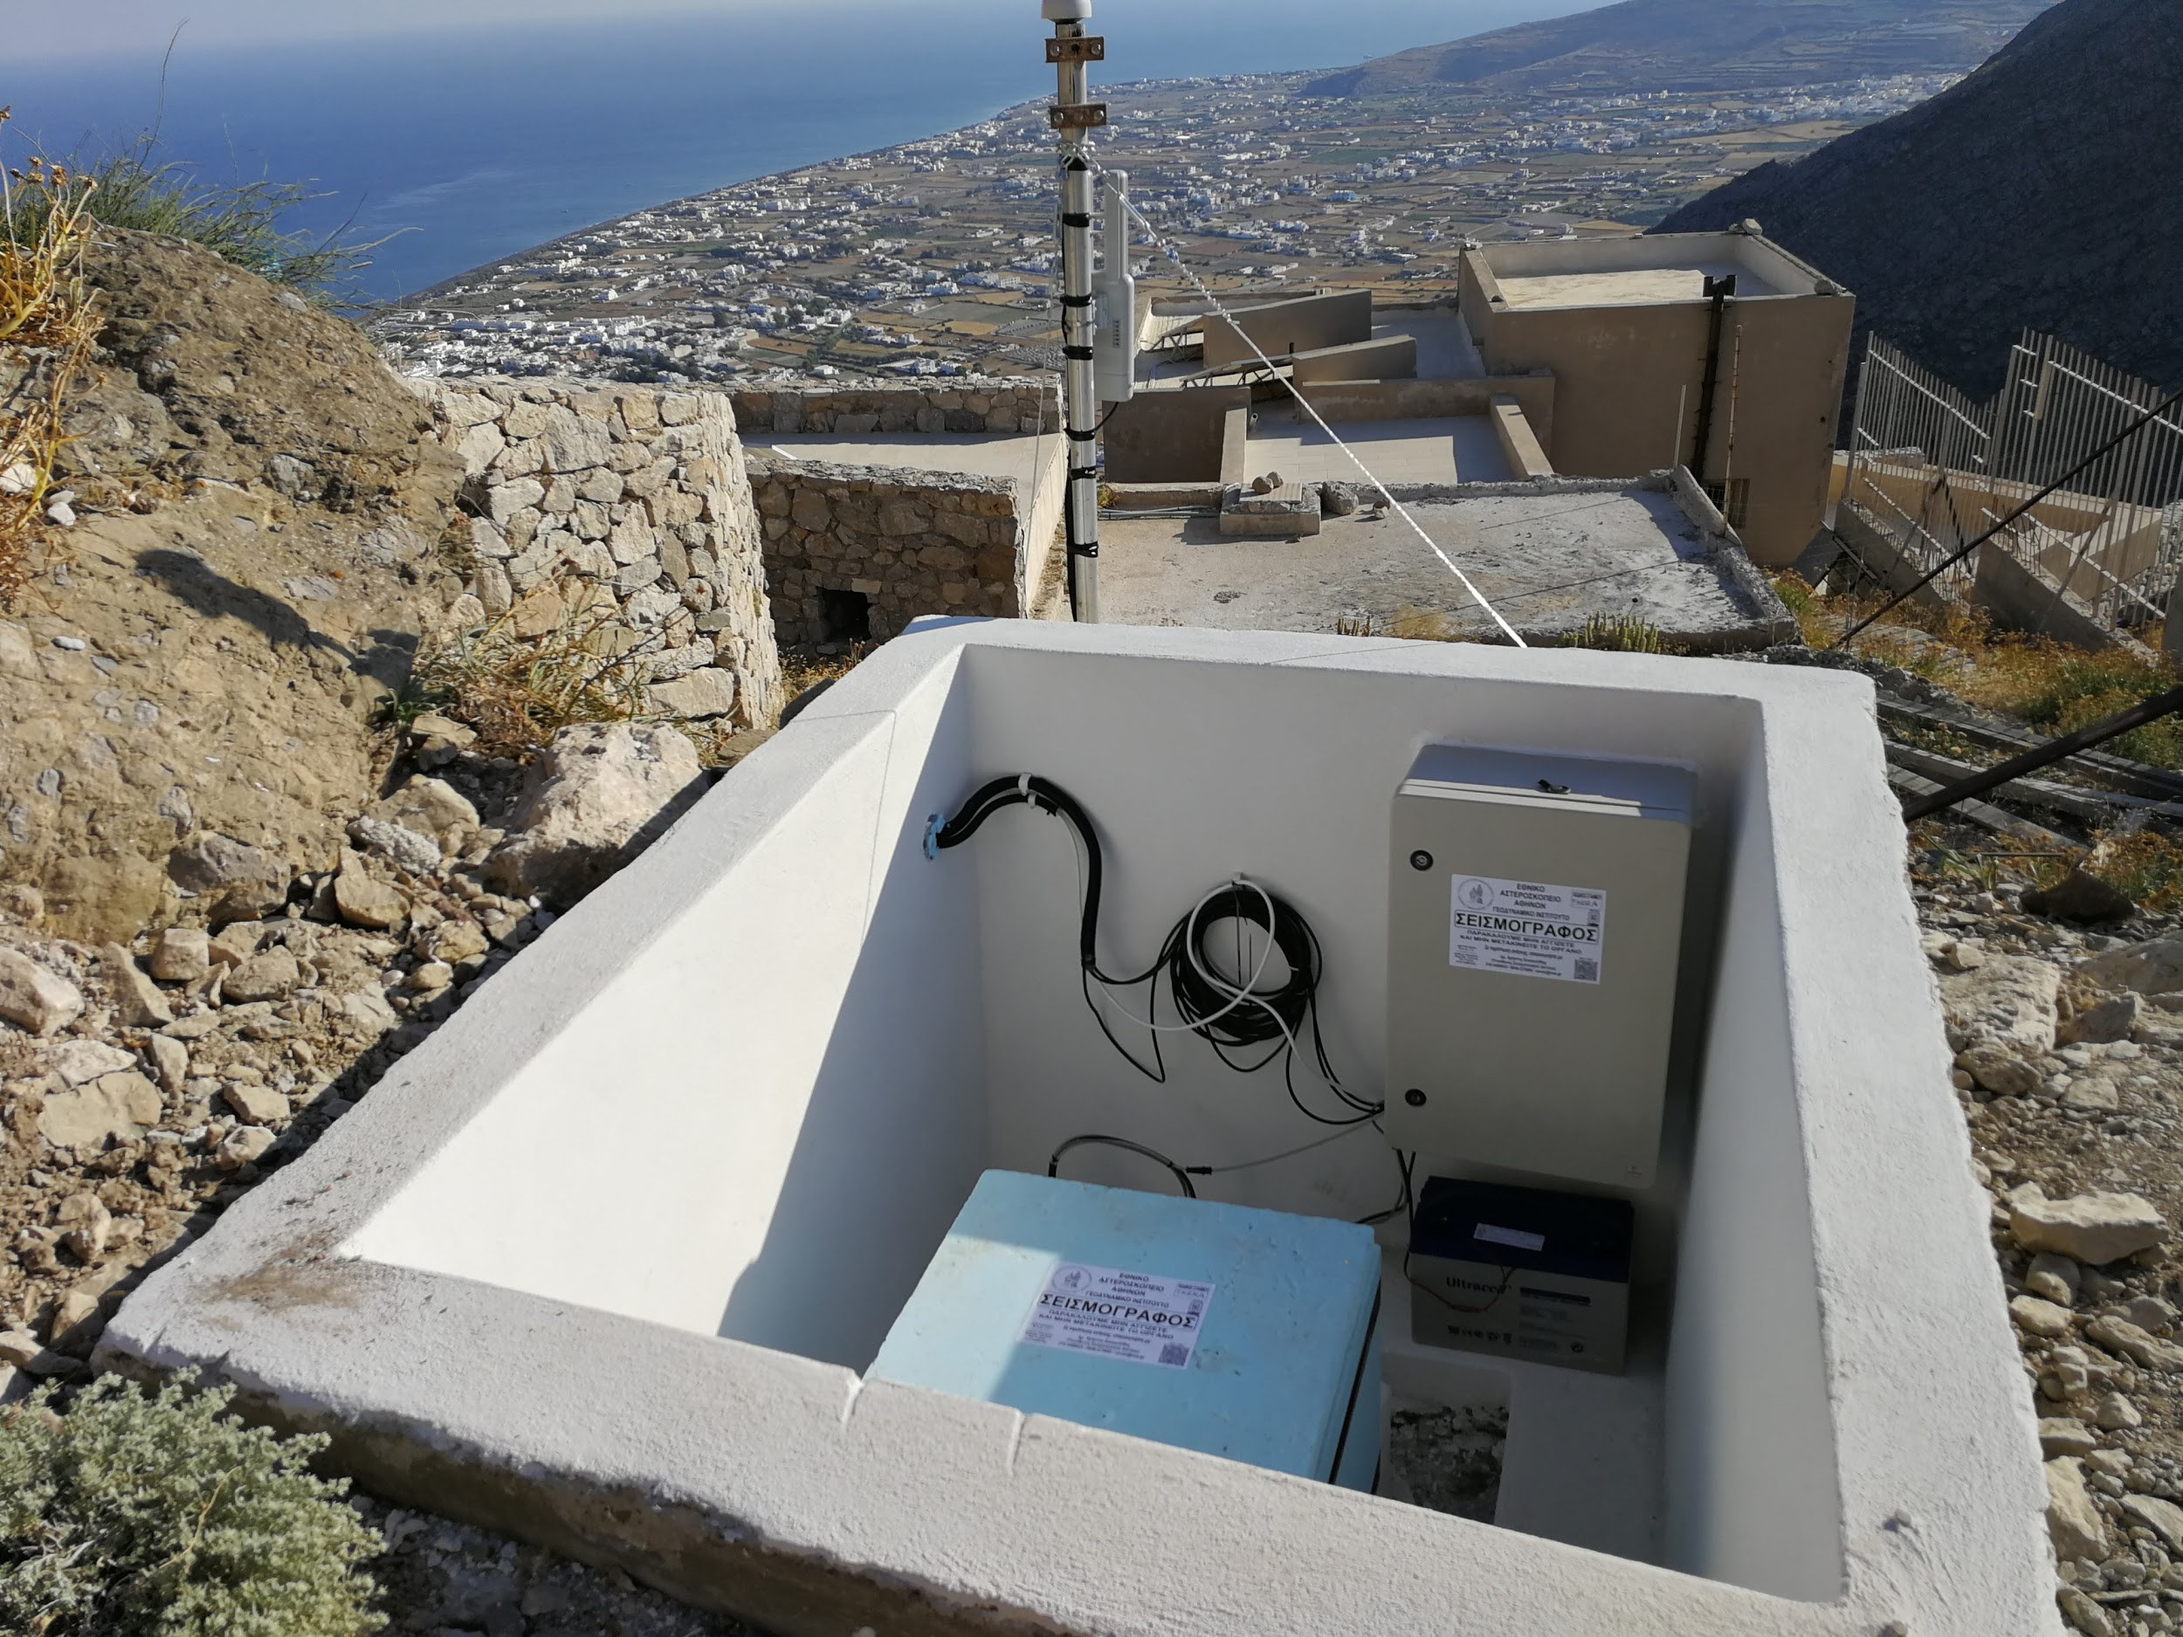
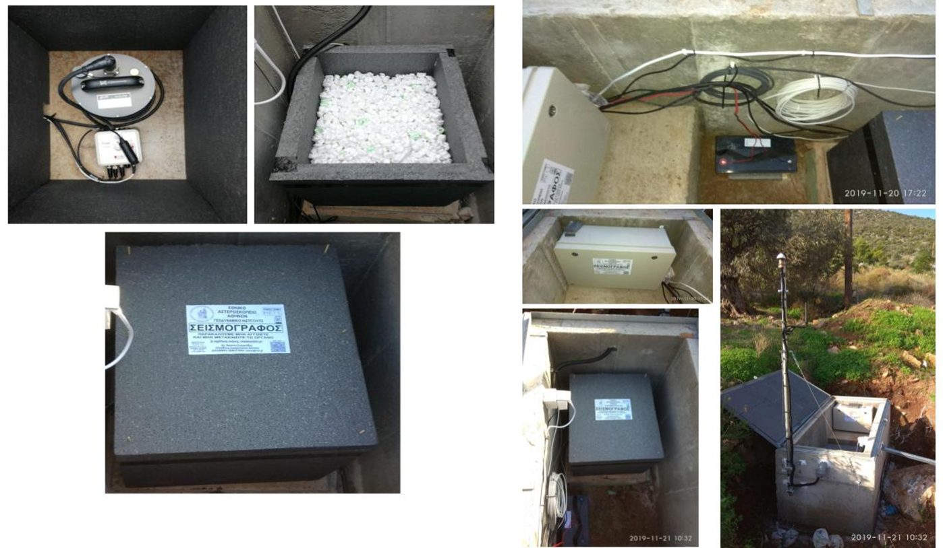
Collocated Seismic + GNSS + other + boreholes
Upgrade of Backbone Seismic Stations
Best Practices for Seismic and GNSS Stations

Slide 10
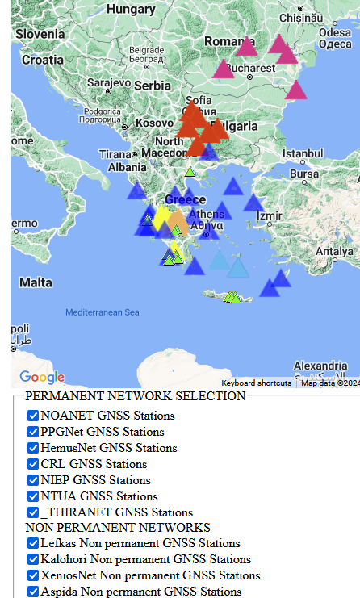
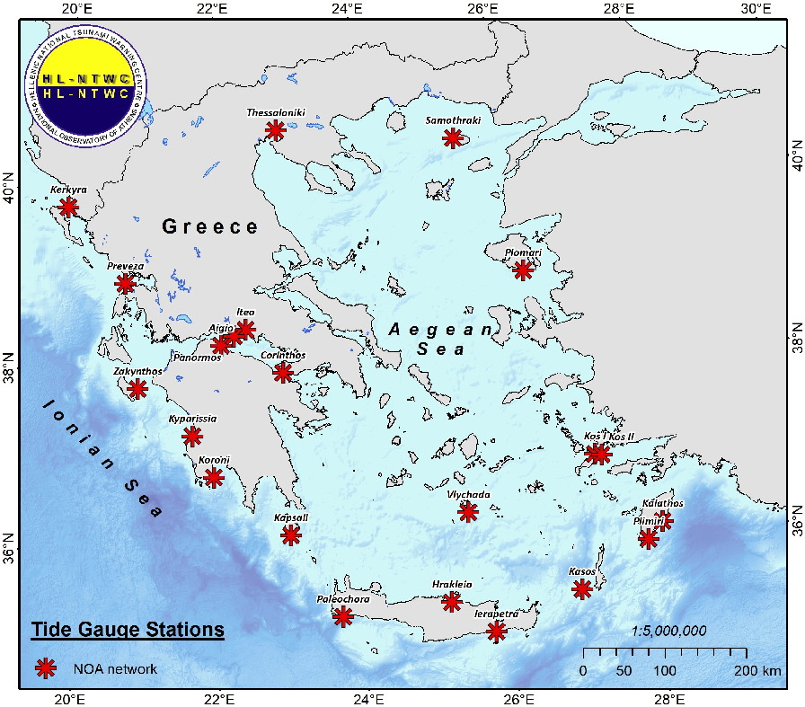
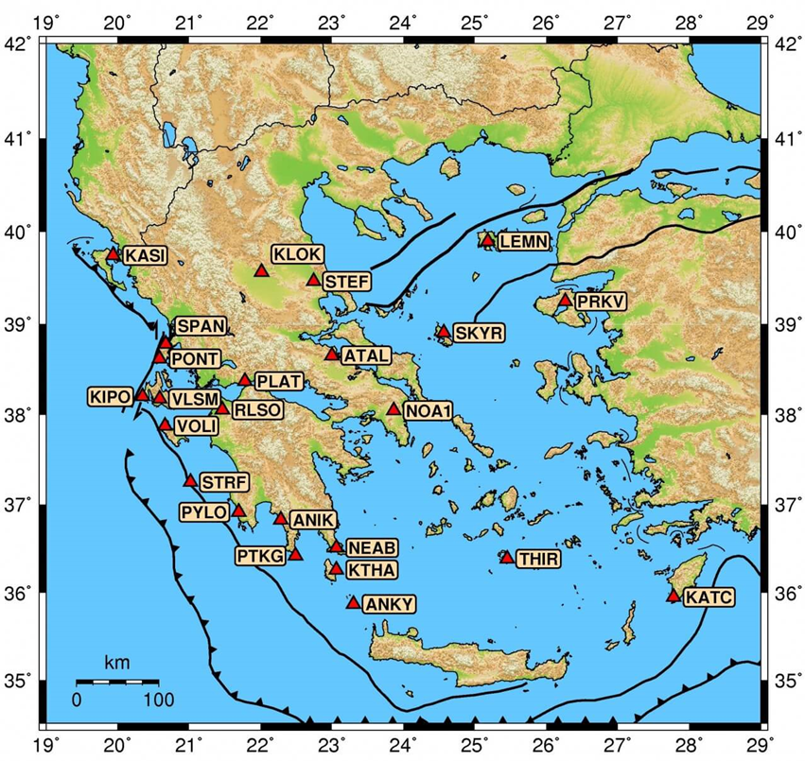
Densify the networks
Tide Gauge Network
GNSS Network
Data from GNSS Network are freely available GSAC repository or the ftp archive.

Slide 11
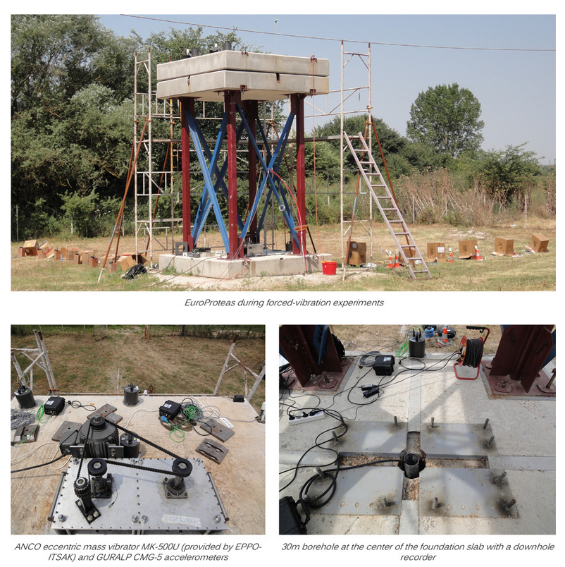
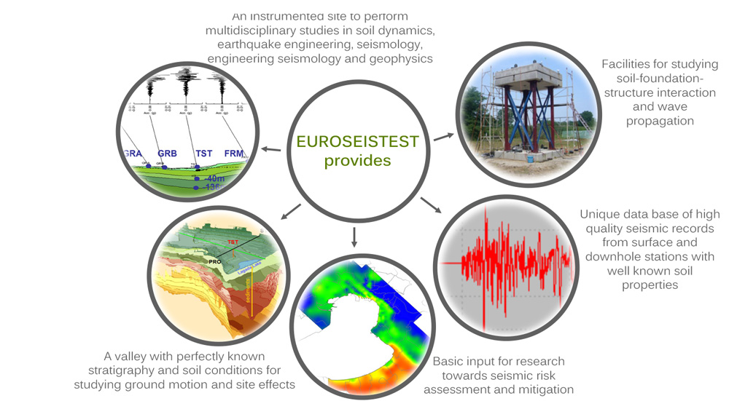
Transnational Access: Leverage of unique prototypes
EUROPROTEAS
A large-scale prototype soil-foundation-structure system
- the first of its kind large-scale model structure in Europe.
EuroProteas is dedicated to studying soil - foundation - structure interaction (SFSI) and wave propagation in the soil and the structure.

Slide 12
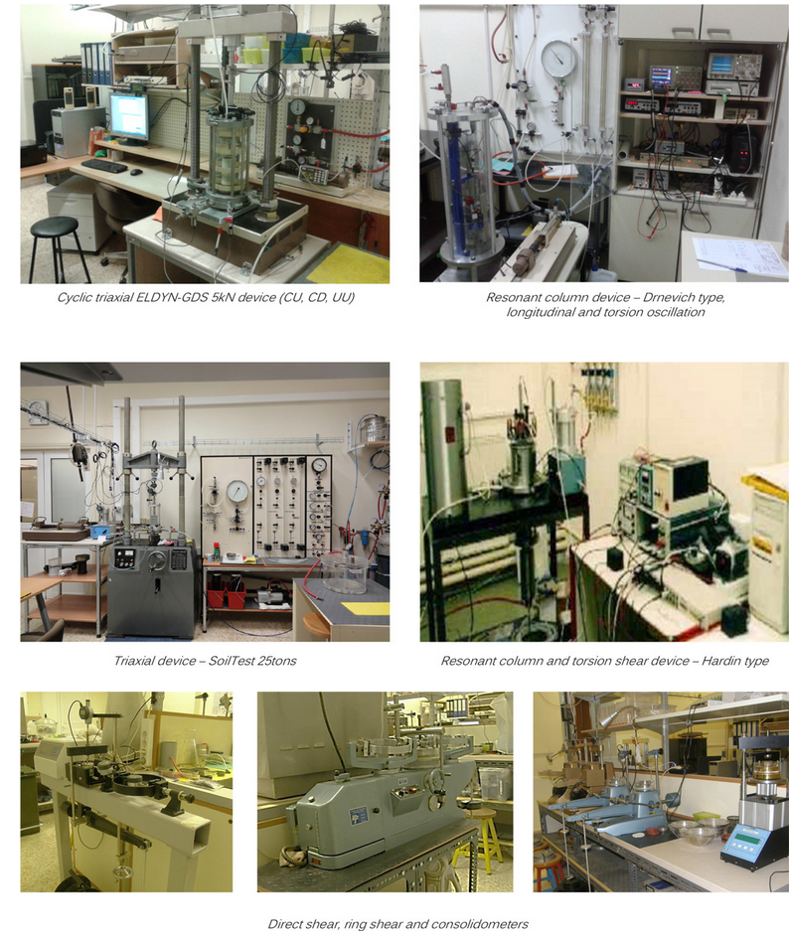
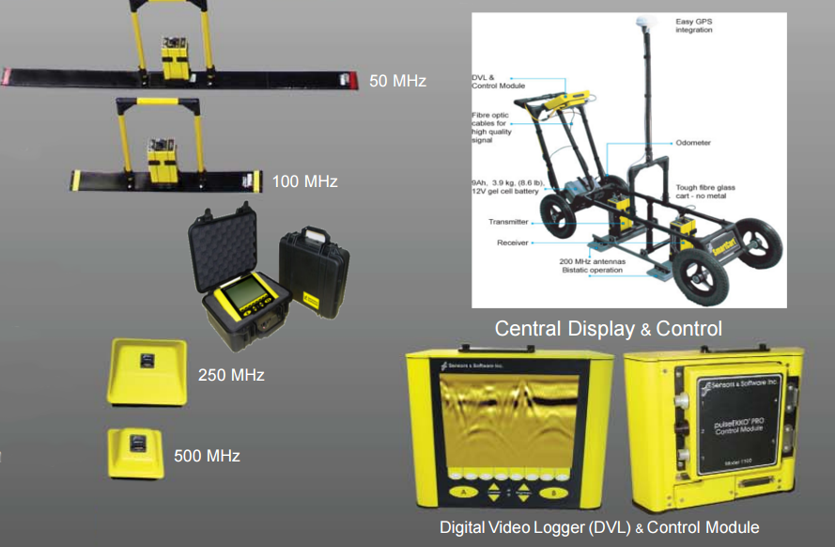
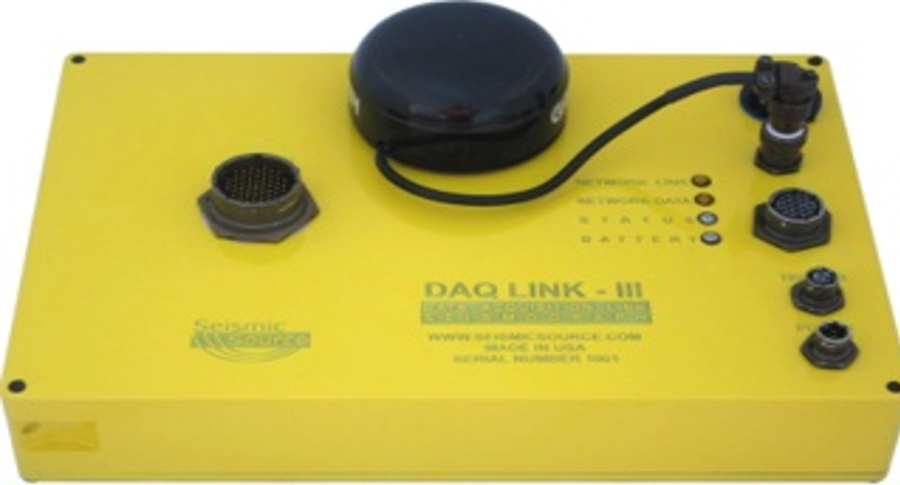
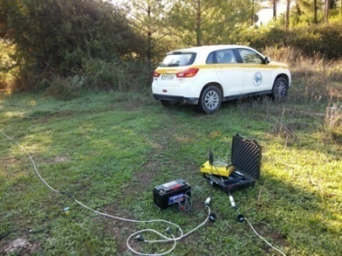
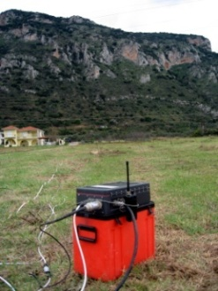
Foster Collaboration: geophysical & engineering community & Industry users
Engineering Labs
Geophysical Instrumentation

Slide 13
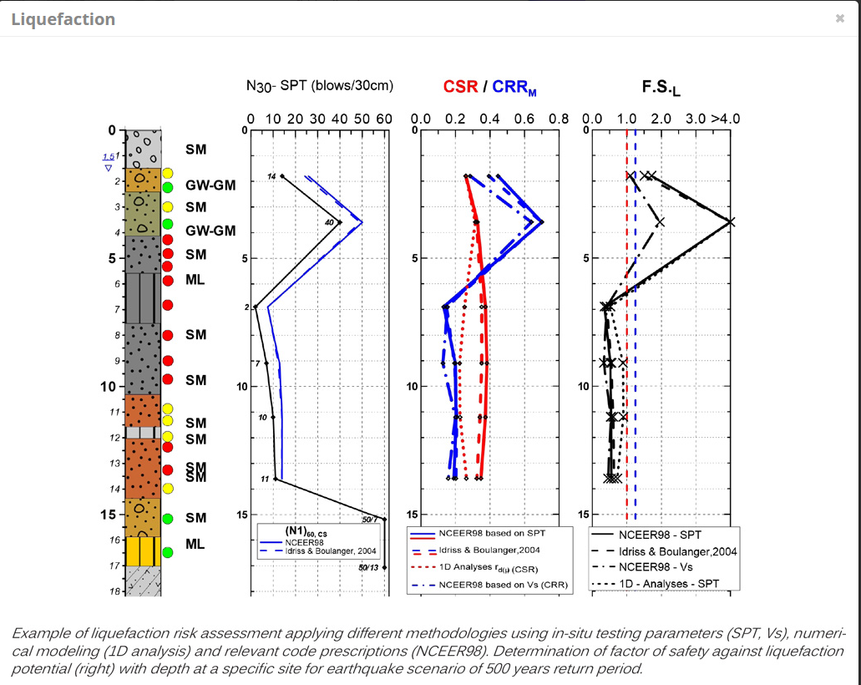
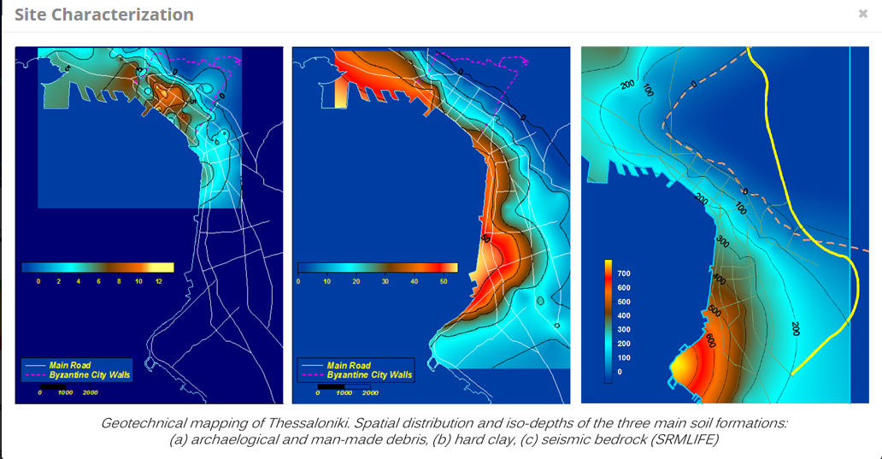
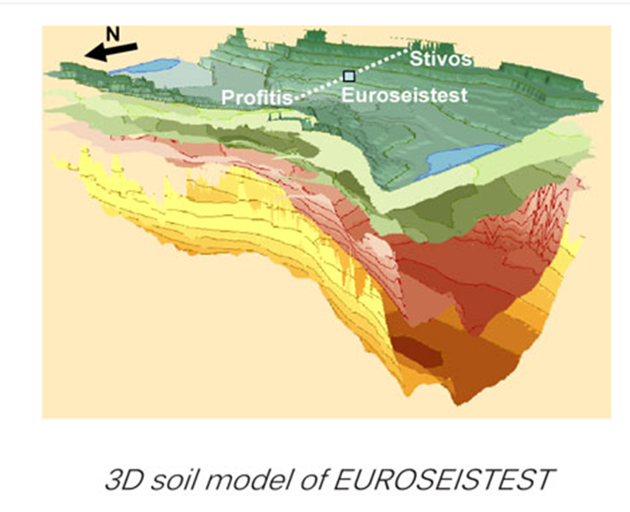
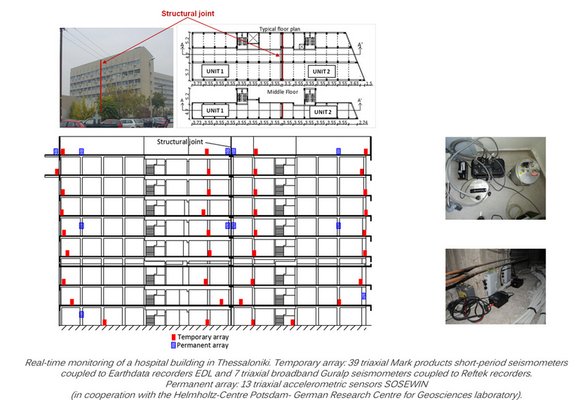
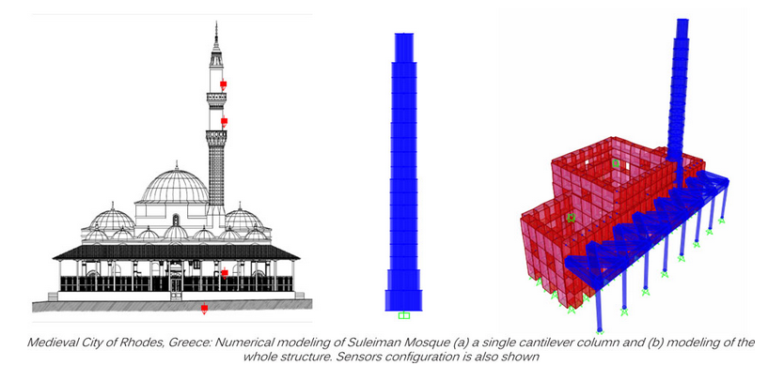
Professional Geophysical & Engineering Services: Standardize protocols and procedures
Site Characterization
3D Geological Modelling
Liquefaction
structural health monitoring
Vulnerability assessment of cultural heritage assets

Slide 14
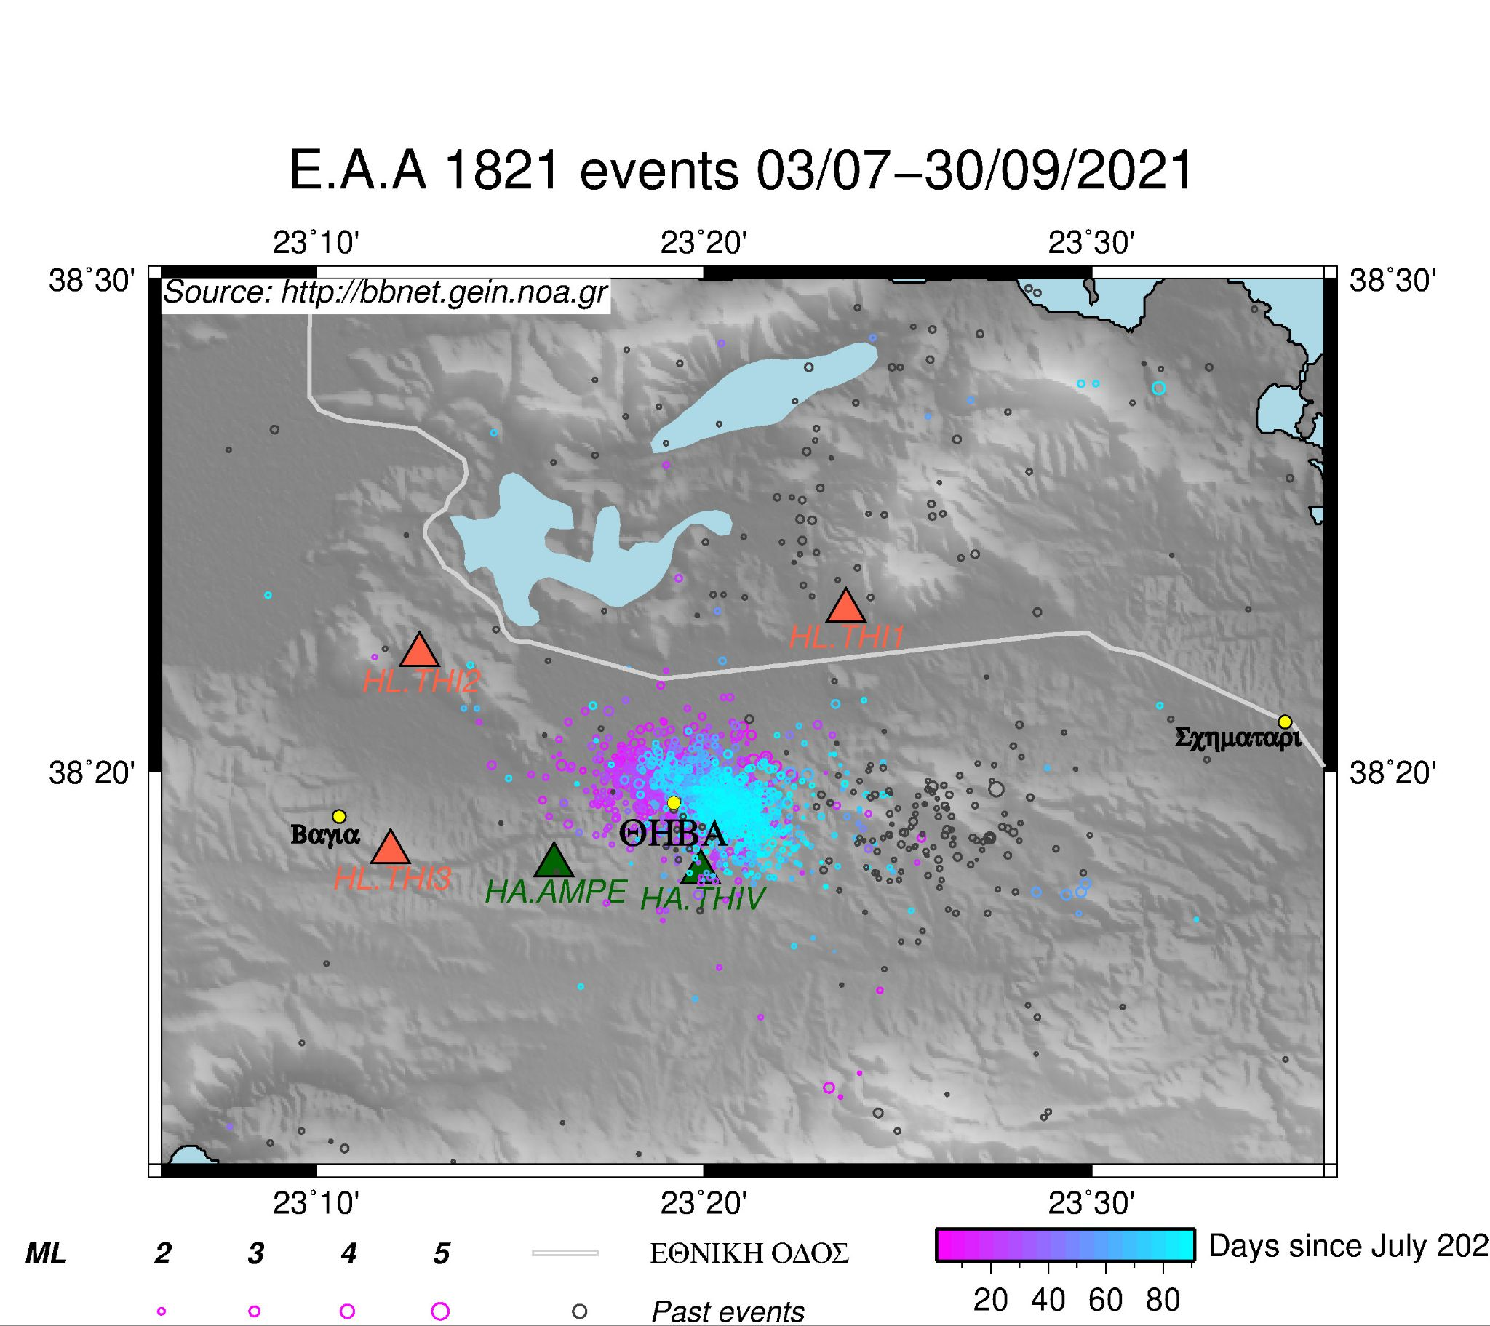
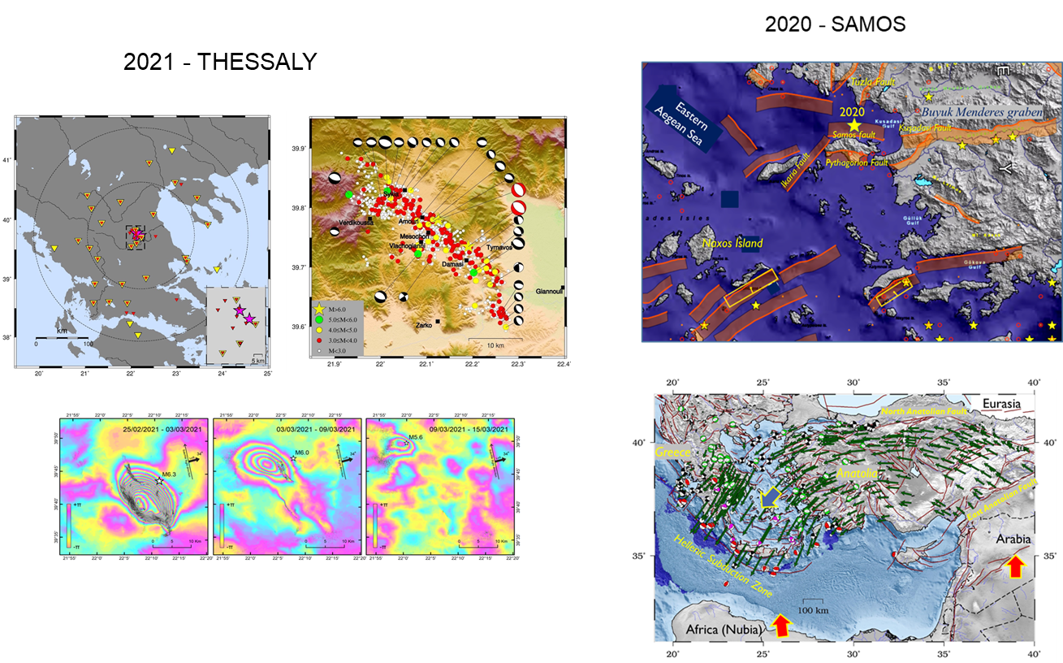
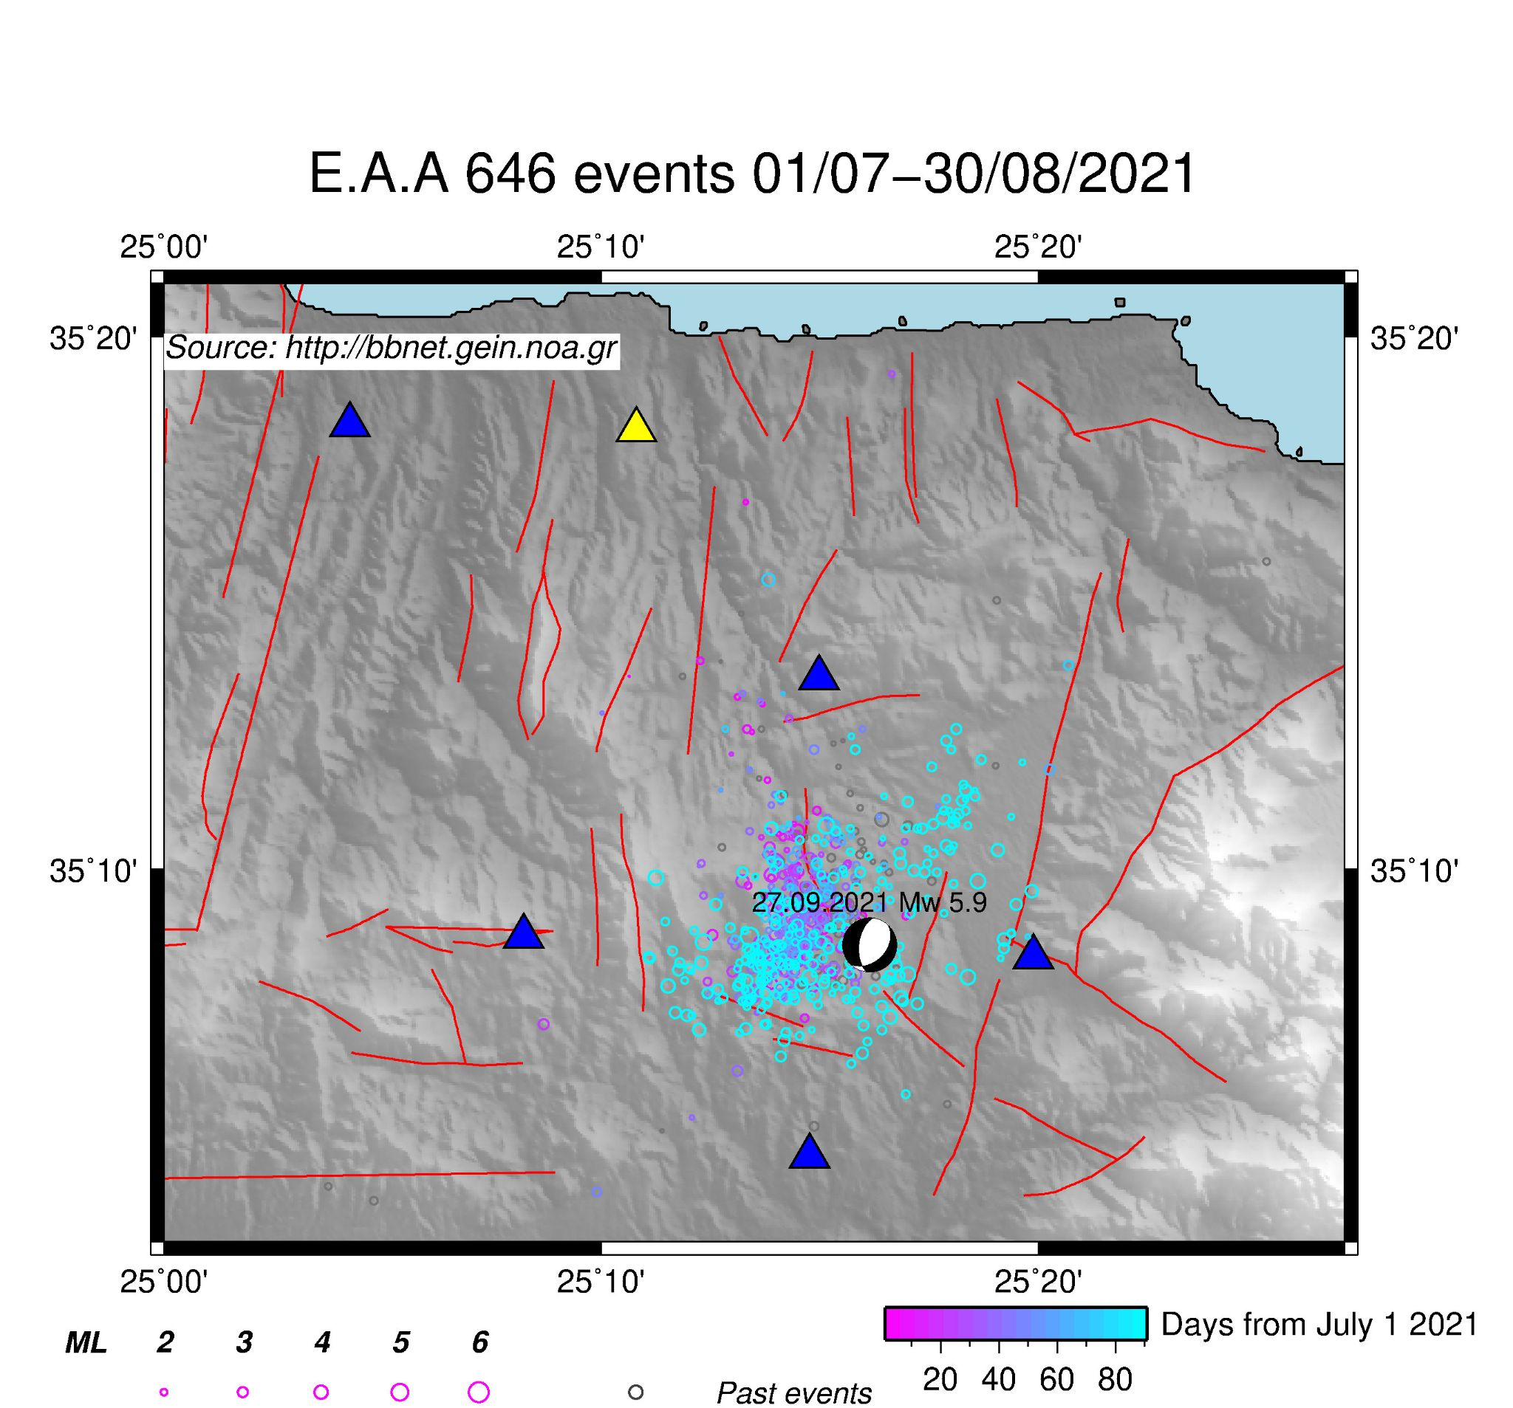
Upgrade the Mobile Pool for Field Monitoring & foster cross border collaboration
THEBES
ARKALOCHORI-CRETE

Slide 15
Thank you
Acknowledging the collaboration and inspiration of the entire HELPOS research team
Specifically of our PhD and post-doc students

