Slide 1
EPOS Slovenia
Stanka Šebela and Magdalena Aljančič
Karst Research Institute ZRC SAZU

Slide 2
History and rationale
Milestones in the EPOS cooperation with Slovenia
2010: EPOS PP project started and ZRC SAZU became associate partner within the project;
2011: March, EPOS was listed on the Slovenian roadmap of research infrastructures 2011‒2020;
2013: October 23th, Slovenian Ministry of Education, Science and Sports signed the Letter of Intent for Slovenia‘ cooperation in EPOS consortium.
2015: September 18th, ZRC SAZU becomes a member of the EPOS IP project (48 months) [Horizon 2020 – Programme for Research and Innovation (2014-2020), Grant Agreement No. 676564, INFRADEV-3-2015 – Individual implementation and operation of ESFRI projects].

Slide 3
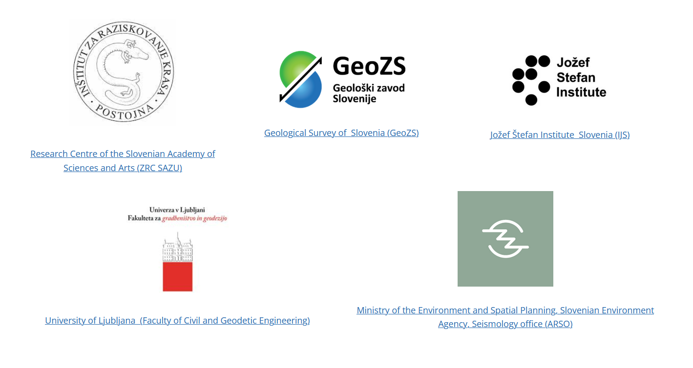
History and rationale
Milestones in the EPOS cooperation with Slovenia
2016: EPOS was listed as priority research infrastructure project (environmental sciences).
2016 May 4th: the national consortium EPOS-SI was established.
Partners in the Slovenian consortium:
Karst Research Institute ZRC SAZU – leading partner;
Geological Survey Slovenia (GeoZS)
University of Ljubljana (Faculty of Civil and Geodetic Engineering, UL-FGG)
Jožef Stefan Institute Slovenia (IJS)
Ministry of the Environment and Spatial Planning, Slovenian Environment Agency, Seismology office (ARSO)

Slide 4
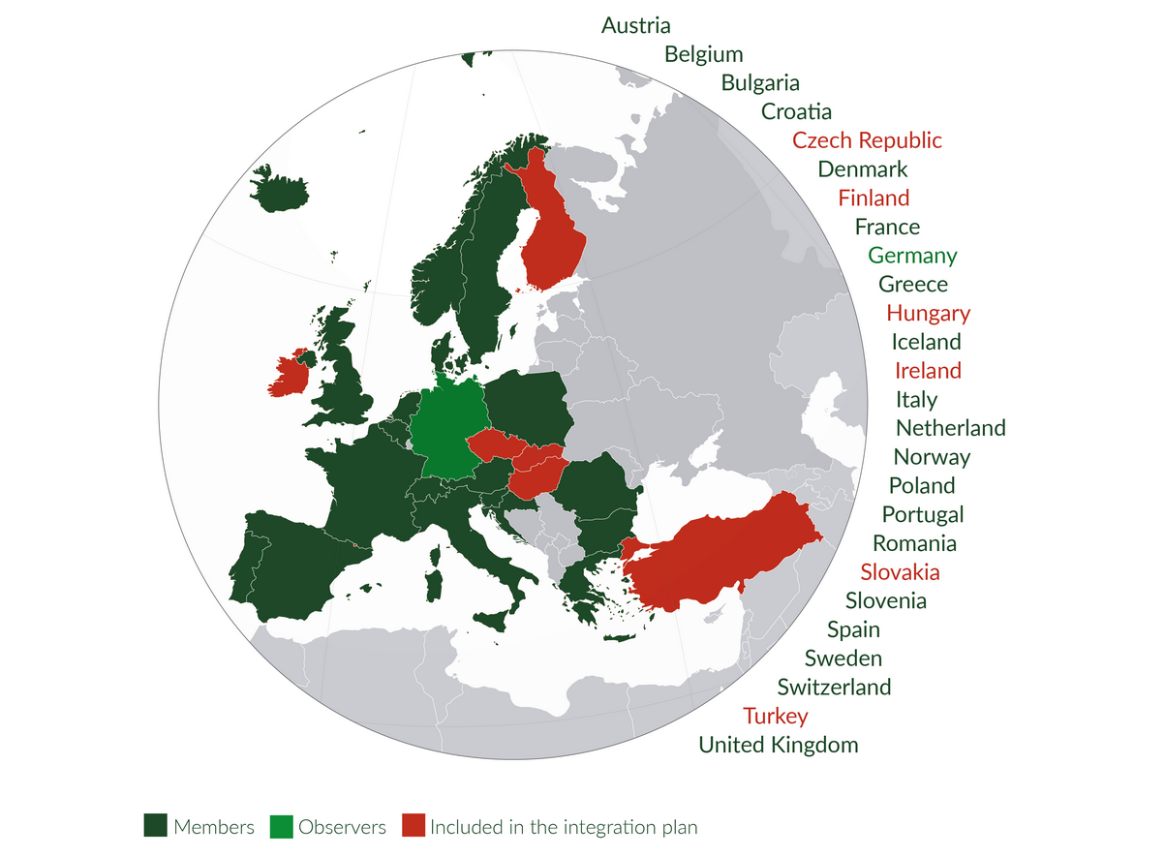
History and rationale
Milestones in the EPOS cooperation with Slovenia (2017 - 2023)
2017: the Slovenian Government authorizes the Slovenian Ministry of Education, Science and Sports to make all necessary procedures to become member of EPOS-ERIC and for its realization (no. 51102-8/2017/3).
2018: October 30th, the European Commission granted the legal status of European Research Infrastructure Consortium (ERIC) to EPOS. Slovenia is one of the countries in establishment of EPOS-ERIC starting to 1st November 2018.
https://www.epos-eu.org/epos-eric

Slide 5
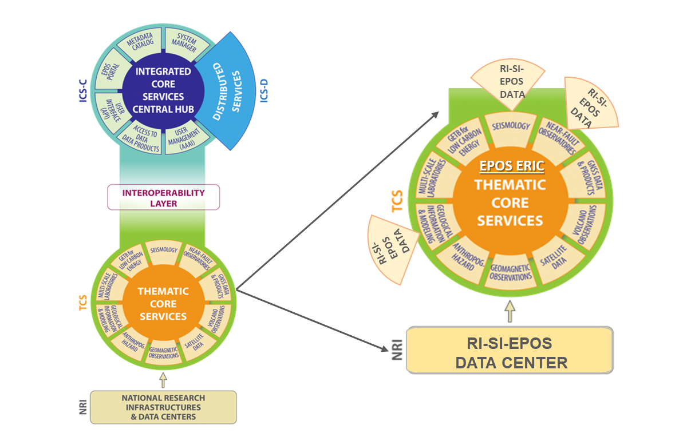
History and rationale
Milestones in the EPOS cooperation with Slovenia (2017 - 2023)
2019: July 1st, start of the project Development of Research Infrastructure for the International Competitiveness of the Slovenian Development of Research Infrastructure Space (RI-SI-EPOS). Project was completed in August 2021.
2020: January 1st – start of the EU-funded EPOS SP project (long-term sustainability of the EPOS Research Infrastructure). ZRC SAZU was partner, project was completed in April 2023.
2021: June - the SLO KARST NFO managed by ZRC SAZU was accepted as observer in EPOS NFO community
ZRC SAZU & ARSO
GeoZS

Slide 6
Organisation and governance
EPOS Slovenia consortium (https://epos-ip.zrc-sazu.si/):
Karst Research Institute ZRC SAZU – leading partner;
Geological Survey Slovenia (GeoZS)
University of Ljubljana (Faculty of Civil and Geodetic Engineering, UL-FGG)
Jožef Stefan Institute Slovenia (IJS)
Ministry of the Environment and Spatial Planning, Slovenian Environment Agency, Seismology office (ARSO)
Dr. Albin Kralj: Member of the EPOS ERIC General Assembly. He works at the Slovenian Ministry of Higher Education, Science and Innovation and is a national delegate in ESFRI.
Dr. Stanka Šebela: the coordinator of the EPOS Slovenia National Distributed Centre.

Slide 7
Financial support
MINISTRY OF HIGHER EDUCATION, SCIENCE AND INNOVATION
EPOS SLOVENIA CONSORTIUM
GeoZS
UL-FGG
IJS
ARSO
ZRC SAZU
Leading partner
RI-SI-EPOS (2019-2021)
RI-SI-EPOS (2019-2021)
EPOS SP (2020 - 2023)
EPOS ON (2024- 2027)
ESFRI (2022 - 2027)

Slide 8
Financial support
Co-financing of international infrastructure project EPOS
(https://izrkp.zrc-sazu.si/en/programi-in-projekti/co-financing-of-international-infrastructure-project-epos)
Programme ID I0-E017
Slovenian Research And Innovation Agency, Ministry of Higher Education, Science and Innovation
Planned activities of NRRI ESFRI project EPOS for the period 2022 to 2027:
Goal 1: Development of research community in Slovenia that works in the field of geosciences.
Goal 2: Maintainance and development of research infrastructure in Slovenia in the field of geosciences.
Goal 3: Direct cooperation in EPOS-ERIC activities.
Goal 4: To make aware researchers, academic communities and wider public about news related to geosciences.
Goal 5: Participation of RI EPOS activities at university studies.

Slide 9
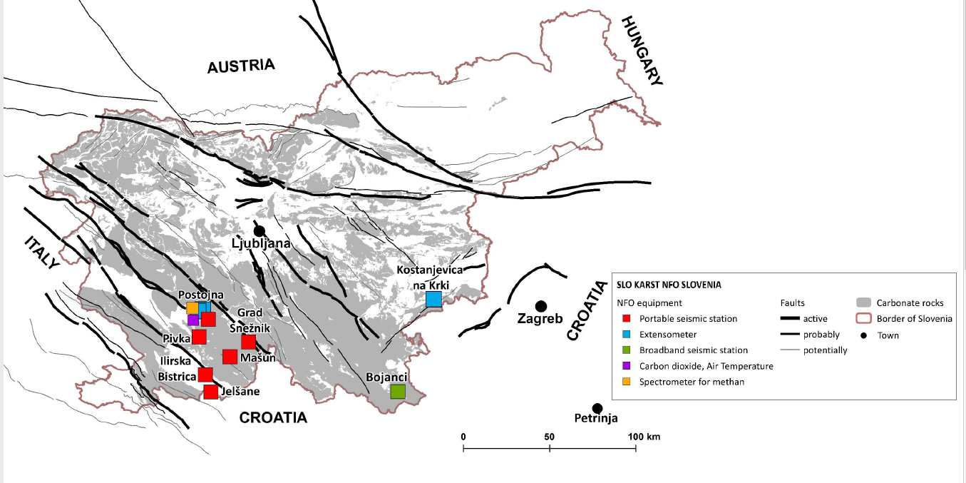
Current activities
1. Establishment and development of the Slovenian NFO site: SLO KARST NFO
In Slovenia, karst covers 49% of the country and there are registered more than 15,270 caves. Development of the new NFO network from the area south of Postojna is highly important for gaining new scientific data and products and for realization of the continuously monitoring of chemical and physical processes governing active faults as well as the genesis of earthquakes.
Šebela, S., Tasič, I., Pahor, J., Mali, M., Novak, U., Aljančič, M.. Development of SLO KARST Near Fault Observatory site in SW Slovenia. Carbonates Evaporites 38, 43. https://doi.org/10.1007/s13146-023-00864-y
Research Centre of the Slovenian Academy of Sciences and Arts, & Slovenian Environment Agency (2020): Slovenian Karst NFO Network. ZRC SAZU and Slovenian Environmental Agency. Dataset/Seismic Network. https://doi.org/10.7914/7w0j-ge89

Slide 10
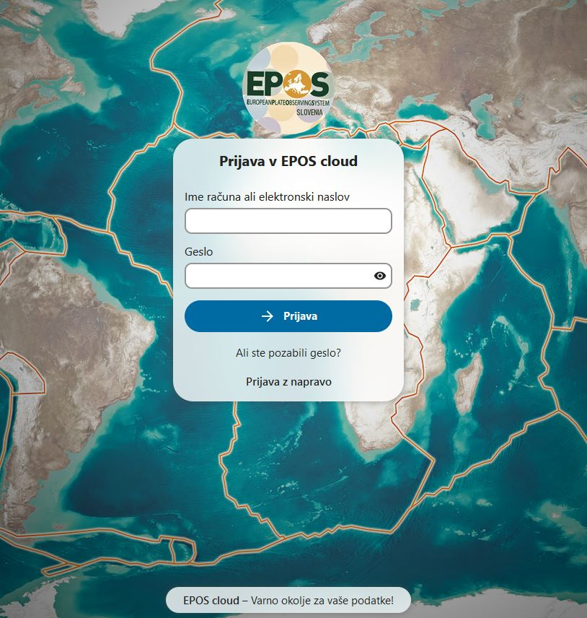
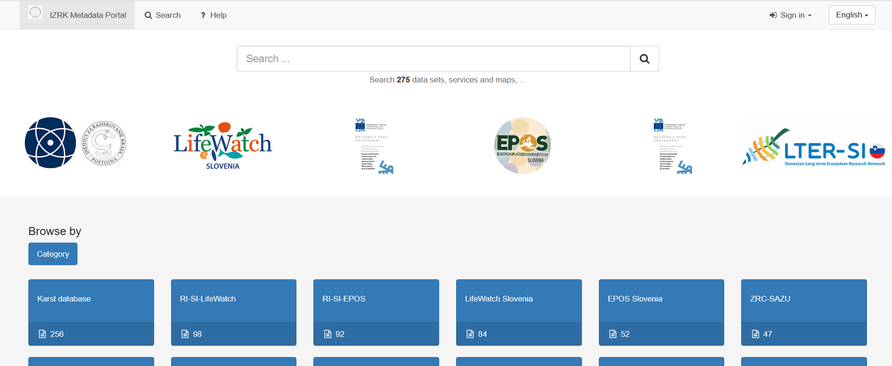
Current activities
2. IZRK Metadata Portal & NextCloud repository
End-user benefits
- standardized metadata for multidisciplinary research domains (e.g., hydrological, bio-geo-chemical data, time series, models and codes);
- native ISO metadata standards for geodata;
- established platform with interoperability APIs.
Users
The metadata portal is open to all members of the Slovenian EPOS community and their stakeholders and collaborators from Slovenia and abroad.
https://epos-cloud.izrk.zrc-sazu.si/
https://metadata.izrk.zrc-sazu.si/

Slide 11
Current activities
ZRC SAZU – geological and seismological data, https://metadata.izrk.zrc-sazu.si , KarstDB (in development)
GeoZS – geological data, https://egeologija.si/; Geological field observatories
ARSO – seismological data, https://potresi.arso.gov.si/
UL FGG – GNSS data, https://gu-signal.si/gnss/
IJS – radon and carbon dioxide data

Slide 12
Future plans
Plans & Main challenges for 2024
ZRC SAZU partner in EPOS ON project (2024 -2027)
SLO KARST NFO full membership within EPOS NFO to be in place in 2024-2025
ZRC SAZU - partner in the new EU Horizont Transformer 2 proposal (submitted on March 2024)
Enlarging research staff to work in the new project
Development and operation of the EPOS Slovenia data Center
Contribution of EPOS Slovenia partners to EPOS Data portal
Expectations
Increasing research contribution of EPOS Slovenia partners in EPOS community
SLO KARST NFO research data to be available via FDSN and FRIDGE portals

Slide 13
Thank you!
EPOS Slovenia
Stanka Šebela, PhD.
National representative for EPOS Slovenia
Karst Research Institute ZRC SAZU
Web: https://epos-ip.zrc-sazu.si
E-mail: sebela@zrc-sazu.si
Twitter: @EPOS_Slovenia
EPOS Slovenia Data & Sites

