Slide 1

«National strategies for sustainable data and service provision»
FINLAND - FIN-EPOS https://www.helsinki.fi/en/infrastructures/fin-epos
EPOS DAYS |Rome |March 13, 2024
Annakaisa Korja

Slide 2
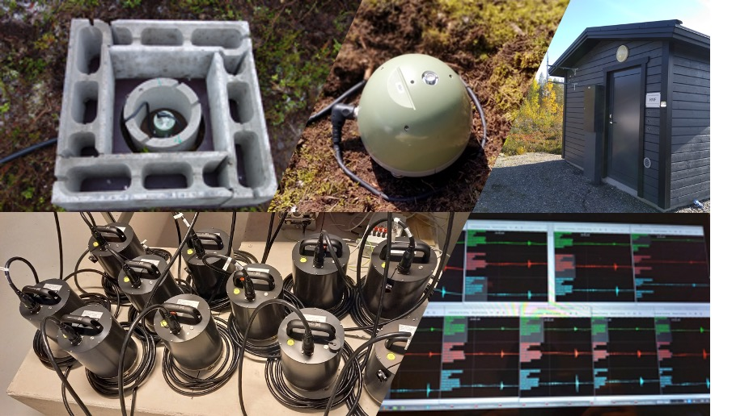
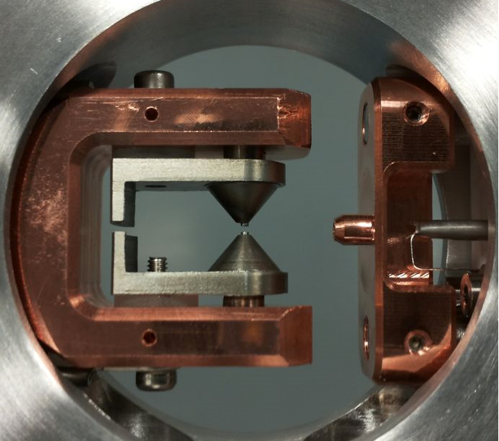
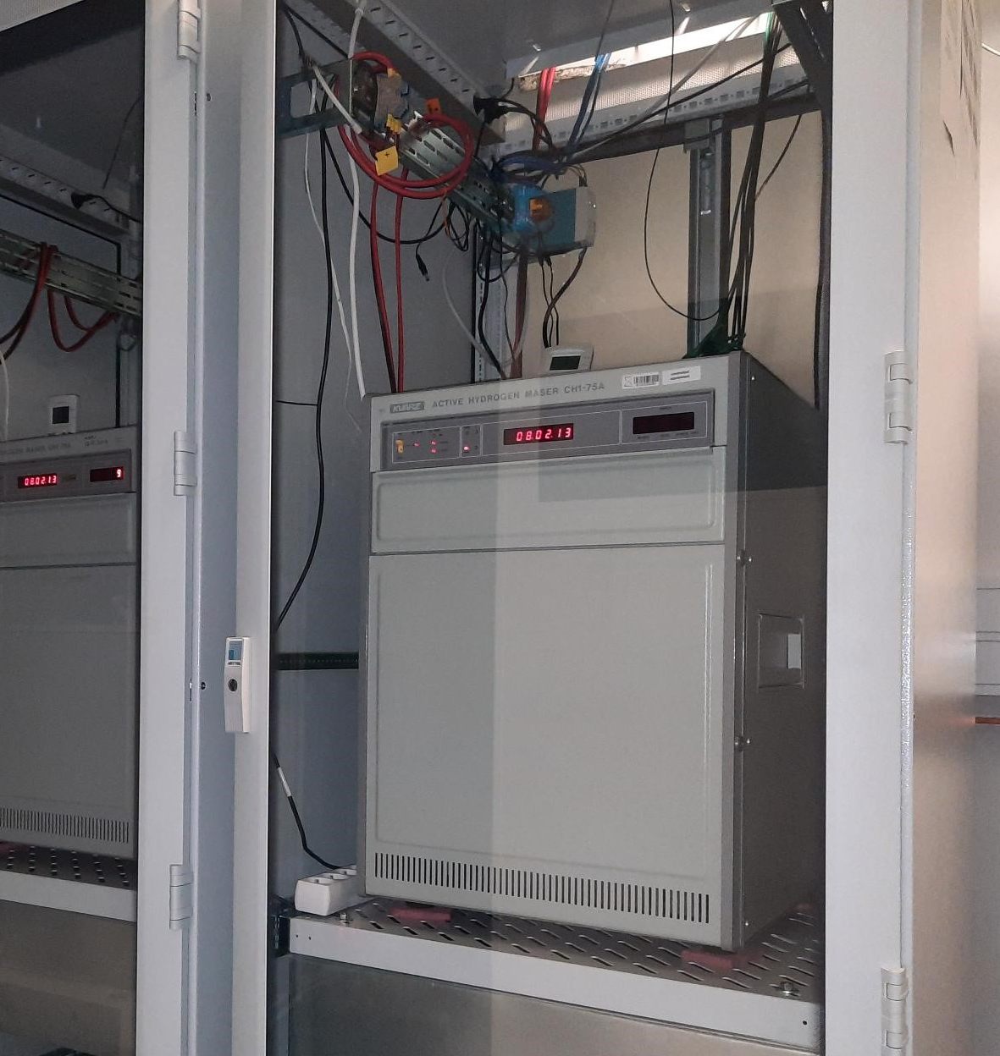





FIN-EPOS in brief
National research infrastructure connected to EPOS
  Included in Roadmap for Finnish research infrastructures 2021–2024
Community of universities & national research institutes
  Coordination office at Institute of Seismology, University of Helsinki
Maintain national geophysical, geodetic, geomagnetic observatories & laboratories
  Open & free data available
Enhance Finnish role and data delivery to EPOS
  Finland foreseen to join as observer in EPOS ERICin 2025
  Developing RI projects
Read more:
https://www.helsinki.fi/en/infrastructures/fin-epos

Slide 3
Equipment, data or network | Data centers |  | TCS/EPOS
 | National | International
FNSN - Permanent seismic network | ISUH, UOULU, FENCAT | ORFEUS, EMSC, ISC, EFEHR, AHED | TCS Seis
Induced seismicity episode data | OMS internal | UOULU AH national node | TCS AH
GNSS (FinnRef) | FGI internal | EUREF Permanent GNSS Network | TCS GNSS
IMAGE magnetometer network | FMI, SGO Internal | INTERMAGNET, IMAGE | TCS GM
CSC Research data services | IDA, PAS FairData services | N/A
Geological and geophysical map data | GTK HAKKU | EGS: EGDI | TCS Geol
Callio Lab Coordination | UOULU | N/A | TCS Labs
EMMA Muon Monitor | UOULU | N/A | TCS Labs
OTA/HKI seismic network, induced seismicity data set | ISUH | GEOFON | TCS AH/ TCS Seis planned
DSS, refraction and reflection data | ISUH, CSC, GTK HAKKU |  | Planning meeting at EGU2024
Physical rock properties | GTK HAKKU, ISUH |  | TCS Labs
FLEX-EPOS Mobile instrument pool | ISUH
FLEX-EPOS Mobile instrument pool | ISUH | Metadata planned | TCS Seis/ ORFEUS
Otaniemi, Outokumpu deep drillholes | GTK, ISUH | N/A

Slide 4
Plans for data and service provision
National research infrastructure road map - FIRI 2025-2028 call deadline in April 2024
FIN-EPOS roadmap application focuses on
- Securing data and computational facilities to FLEX EPOS mobile network
Building a joint front page for Finnish EPOS services
Diversing the Finnish geophysical instrument pool with MT instruments
Building a partnership in European Quantum gravimeter network
Updating the rock physical laboratory with a magnetic shield, + new magnetic measurement instruments
Application to be an EPOS ERIC Observer member in 2025
Active collaboration with Nordic partners Nordic EPOS 2024 -
Scientific Meetings, hotline, workshops and joint training and short courses

Slide 5
Plans data and service provision
Active collaboration in TSC Seismology and AH
- ORFEUS workshop in Helsinki in fall 2024
- Supporting emerging ideas for European level mobile pool metadata service
- Involved in the Splinter meeting on "DSS metadata service"
- Active collaboration in EFEHR, EMSC,
- ISUH has extra national funding for developing interdisciplinary environmental science
- two 5-year positions for using EPOS datasets
- Data scientist to enhance the data delivery
- Environmental seismologist to initiate novel science (call opening soon!)
Active collaboration in EPOS-ON
– UOULU partner in developing Muongraphy data center
Active collaboration with TSC Geomagnetic
-GTK focuses on securing open access to Finnish MT legacy data
Activities of TCS Laboratory
interests in developments in Geochemistry, Deep drillholes, Paleomagnetism,

Slide 6
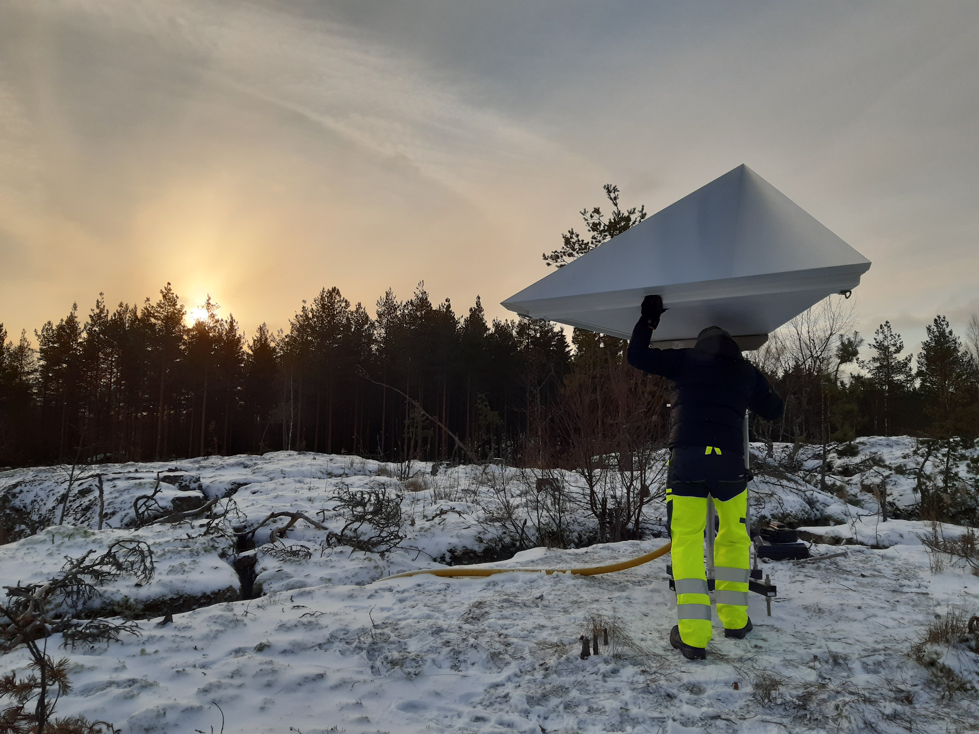
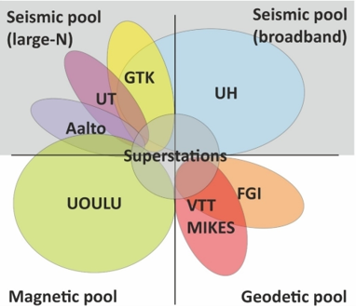
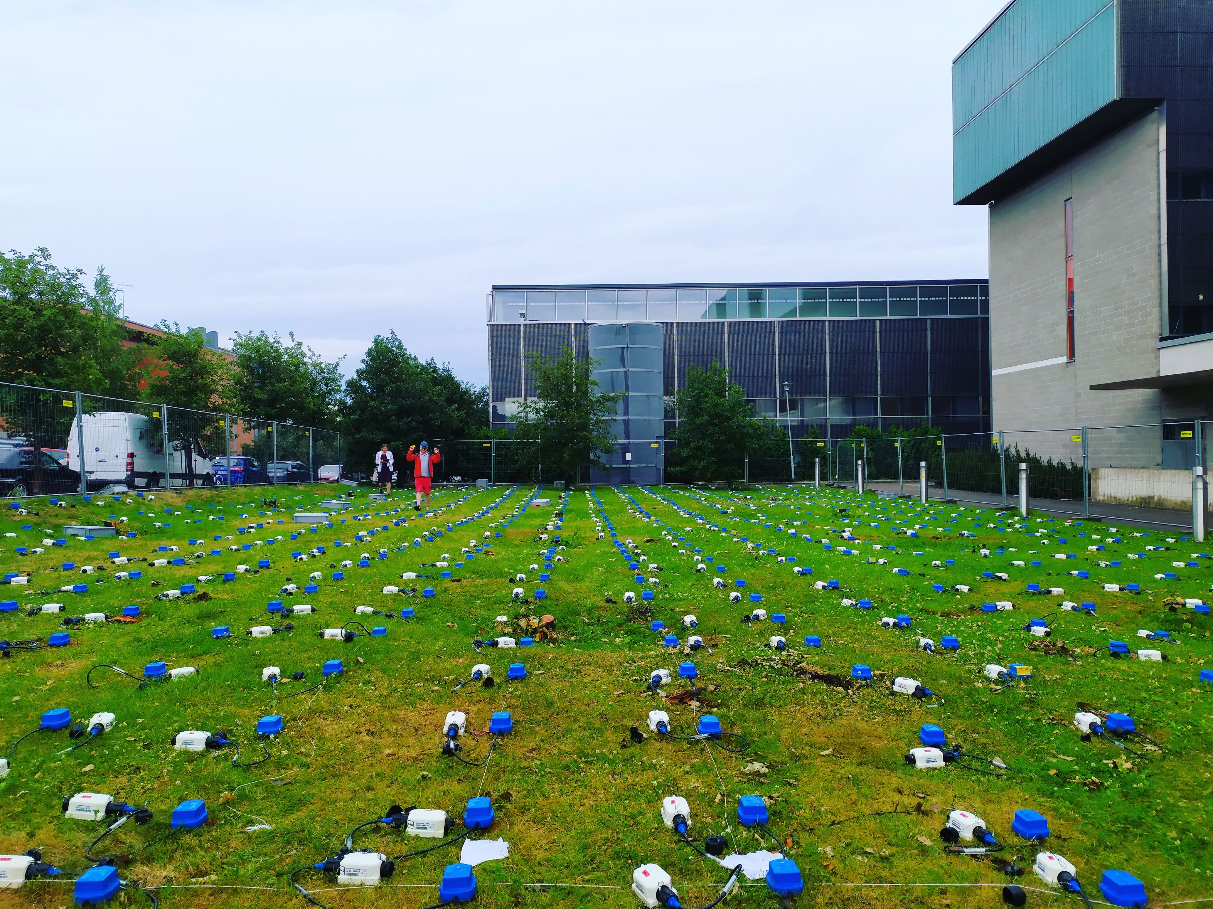
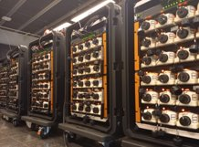
FLEX-EPOS
FLEX-EPOS Home - XWiki (helsinki.fi)FLEX-EPOS Home - XWiki (helsinki.fi)
Flexible instrument network for enhanced geophysical observations and multi-disciplinary research (FLEX-EPOS) –project
  One of the progressing projects under FIN-EPOS in 2021-2024
  4,1 M€ FIRI funding from Academy of Finland
A national pool of geophysical instruments
Instruments can be used in collaboration with one of the pool partners.
2 open calls annually

Slide 7
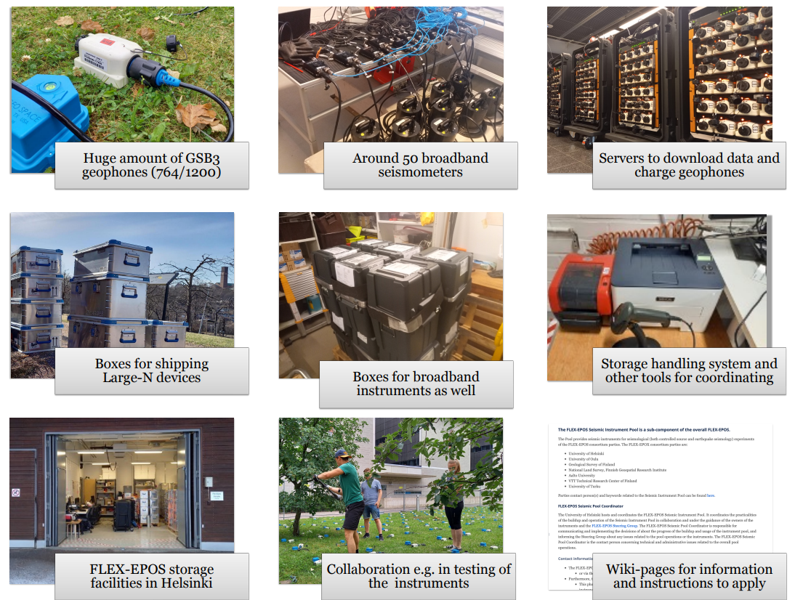
Created, maintained, and operated in by national co-operation
Universities of Helsinki, Turku, Oulu, Aalto and Geological Survey of Finland
SIP Coordinator: Institute of Seismology
  PI Gregor Hillers,
  Coordinator Romeo Courbis
Seismic instrument
pool (SIP)

Slide 8
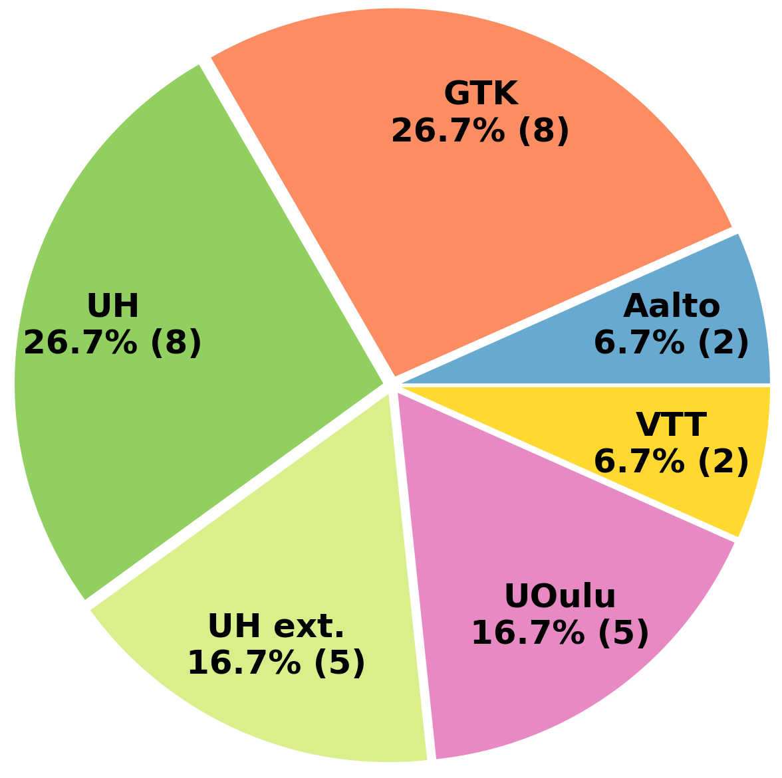

FLEX-EPOS/Seismic instrument pool (SIP)
Data policy:
From FLEX-EPOS Principle of Operation: “[…] data produced within FLEX-EPOS will be part of the national FIN-EPOS and shared with EPOS ERIC […]”
Each project PI is responsible for the primary and long-term storage of its data.
Maximum 3 years of embargo.
Institutions involved in the 30 projects with FLEX-EPOS seismic pool from 2021 to summer 2024:
Two open calls annually​
Last one was 27.11.2023 – 16.1.2024​
  Opens two months prior to a Steering Group meeting ​
  Closes one week prior to SG meeting​
Seven (7) applications received
UH worked with external collaborators:
Foreign universities, governmental organisations
Private company

Slide 9
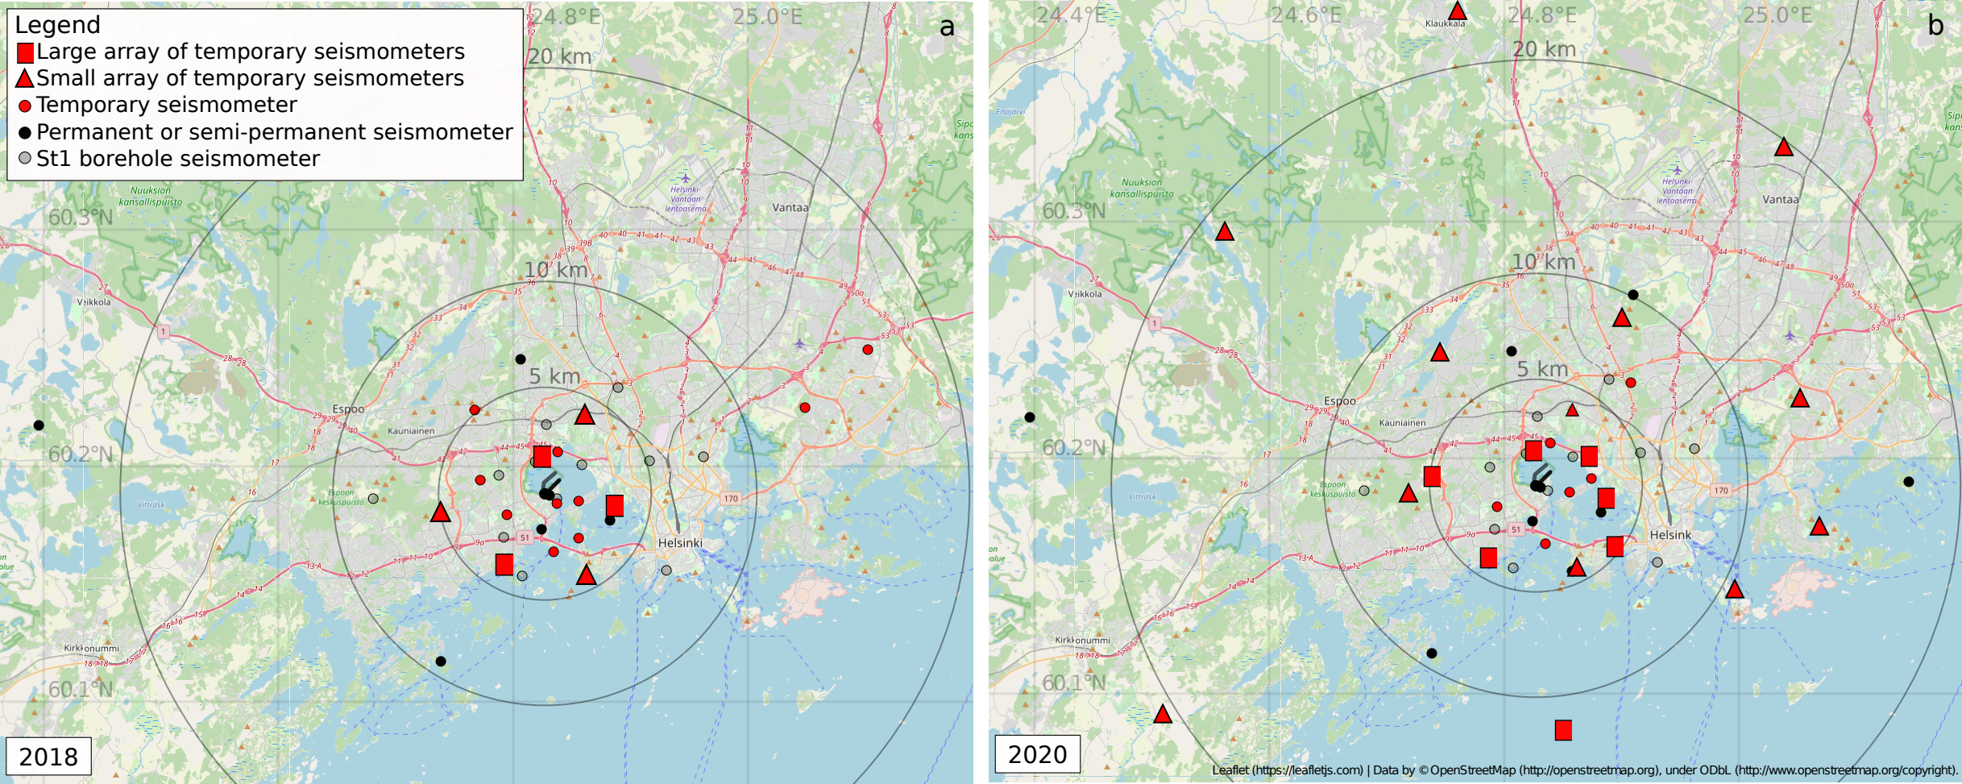
Potential data for TCS AH: Otaniemi geothermal experiment
2018 2020

Slide 10
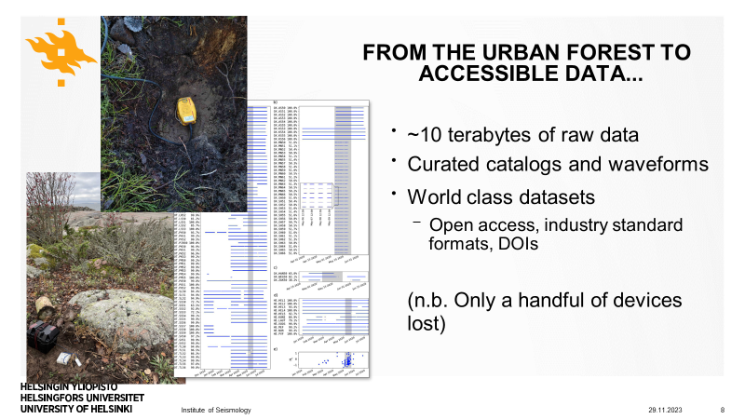

Slide 11
Potential data to be linked to TCS AH

1st stimulation: 7 May – 20 August 2018
2nd stimulation: 6 - 24 May 2020
Stored at GFZ Data Services, under CC BY 4.0 license

For 2018, data are available subject to filling a request form at https://doi.org/10.5880/GIPP.201802.1
For 2020, currently just the metadata available, end of moratorium 30 August, 2024, https://doi.org/10.5880/GIPP.201925.1
Pick Datasets were published in CSC Fairdata service under CC BY 4.0 license,
Total number of events​
ISUH: 350 + 250 prelim analysis​
IMS 500​
Template matching​
5500 10–20 Hz
8000 20–40 Hz

Slide 12
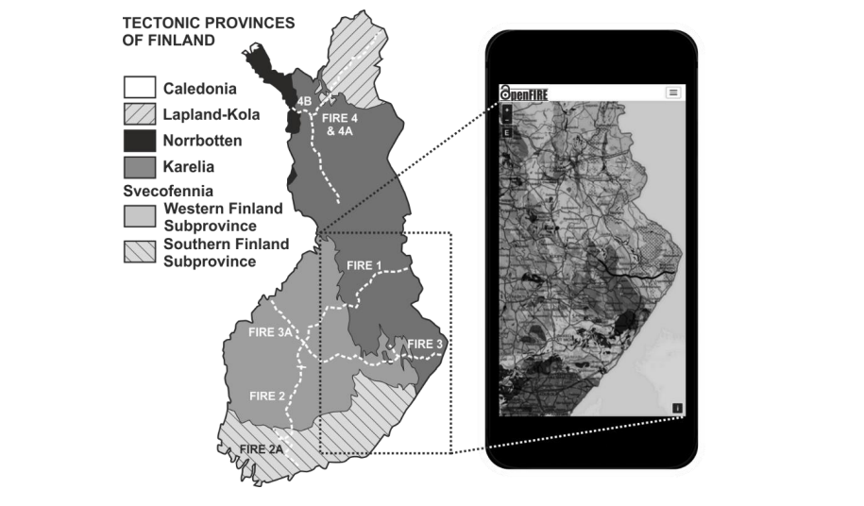
FIRE data
DSS database
The Finnish Reflection Experiment (FIRE) dataset consists of 2,104 km of seismic CMP reflection data.
https://www.helsinki.fi/en/infrastructures/fin-epos/the-finnish-reflection-experiment
The OpenFIRE service provides open access to
all original seismic reflection data
processed data products
summaries of geological descriptions
scientific references
Data can be downloaded at
https://etsin.fairdata.fi/
An EPOS compatible web service

Slide 13
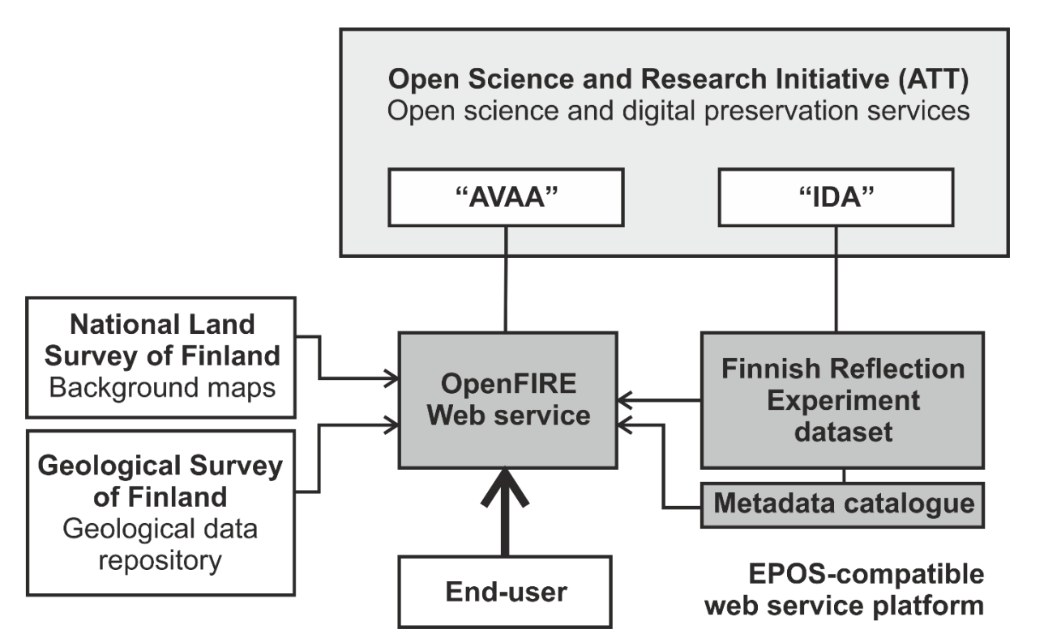
FIRE data at CSC
https://www.helsinki.fi/en/infrastructures/fin-epos/the-finnish-reflection-experiment
Data can be downloaded at
https://etsin.fairdata.fi/
An EPOS compatible web service
Potential data set for
EPOS DSS metadata portal

Slide 14
Thank you!
FIN-EPOS https://www.helsinki.fi/en/infrastructures/fin-epos

Slide 16
Induced seismicity (Otaniemi, Helsinki area)​
Data sets available via CSC IDA service:
Vuorinen, T. A., Veikkolainen, T., Taylor, G., Gal, M., Oinonen, K., Hillers, G., & Rintamäki, A. IMS waveform, time and location data products from stimulations of deep geothermal wells in Espoo in 2020. University of Helsinki, Institute of Seismology. https://doi.org/10.23729/8138398c-8b79-4217-8617-aae33fbed953
Vuorinen, T. A., Veikkolainen, T., Taylor, G., Gal, M., Oinonen, K., & Hillers, G. IMS waveform, time and location data products from stimulations of deep geothermal wells in Espoo in 2018. University of Helsinki, Institute of Seismology. https://doi.org/10.23729/6d15a5ea-7671-4bab-88a1-71f4ed962276
Vuorinen, T. A., Veikkolainen, T., Oinonen, K., Hällsten, J., Uski, M., Heikkilä, T., Koskenniemi, P., Rintamäki, A., Voutilainen, A., Salmenperä, I., Kortström, J., & Tiira, T. ISUH waveform, time and location data products from stimulations of deep geothermal wells in Espoo in 2018. University of Helsinki, Institute of Seismology. https://doi.org/10.23729/39cfac4f-4d0d-4fb4-83dc-6f67e8ba8dce
Vuorinen, T. A., Veikkolainen, T., Oinonen, K., Hällsten, J., Uski, M., Heikkilä, T., Rintamäki, A., Voutilainen, A., Salmenperä, I., Kortström, J., & Tiira, T. ISUH waveform, time and location data products from stimulations of deep geothermal wells in Espoo in 2020. University of Helsinki, Institute of Seismology. https://doi.org/10.23729/cdfd937c-37d5-46b0-9c16-f6e0c10bc81f

Slide 17
Induced seismicity (Otaniemi, Helsinki area)​
Data sets available via GFZ Potsdam service:
Hillers, Gregor; Rintamäki, Annukka E.; Vuorinen, Tommi A. T.; Luhta, Tuija; Arhe, Katriina; Galvin, Keith; Keskinen, Jukka; Kortström, Jari T.; Lin, Tzu-Chi; Lindblom, Pasi Y.; Oksanen, Tahvo J.; Pownall, Jonathan M.; Seipäjärvi, Pirita J.; Taylor, George; Tsarsitalidou, Christina; Voutilainen, Ahti I.; Whipp, David M. (2021): A 70 3-component sensor deployment to monitor the 2020 EGS stimulation in Espoo/Helsinki, southern Finland - Dataset. GFZ Data Services. https://doi.org/10.5880/GIPP.201925.1
Hillers, Gregor; Vuorinen, Tommi A. T.; Arola, Eemil J.; Katajisto, Väinö E.; Koskenniemi, M. Pietari; McKevitt, Blathnaid M.; Rezaei, Sara; Rinne, Lauri A.; Salmenperä, Ilmo E.; Seipäjärvi, Pirita J.; Väkevä, L. Sakari O.; Voutilainen, Ahti I.; Arhe, Katriina; Juntunen, Anssi K.; Keskinen, Jukka; Lindblom, Pasi Y.; Oinonen, Kati; Tiira, Timo (2019): A 100 3-component sensor deployment to monitor the 2018 EGS stimulation in Espoo/Helsinki, southern Finland - Datasets. GFZ Data Services. https://doi.org/10.5880/GIPP.201802.1

