Slide 1
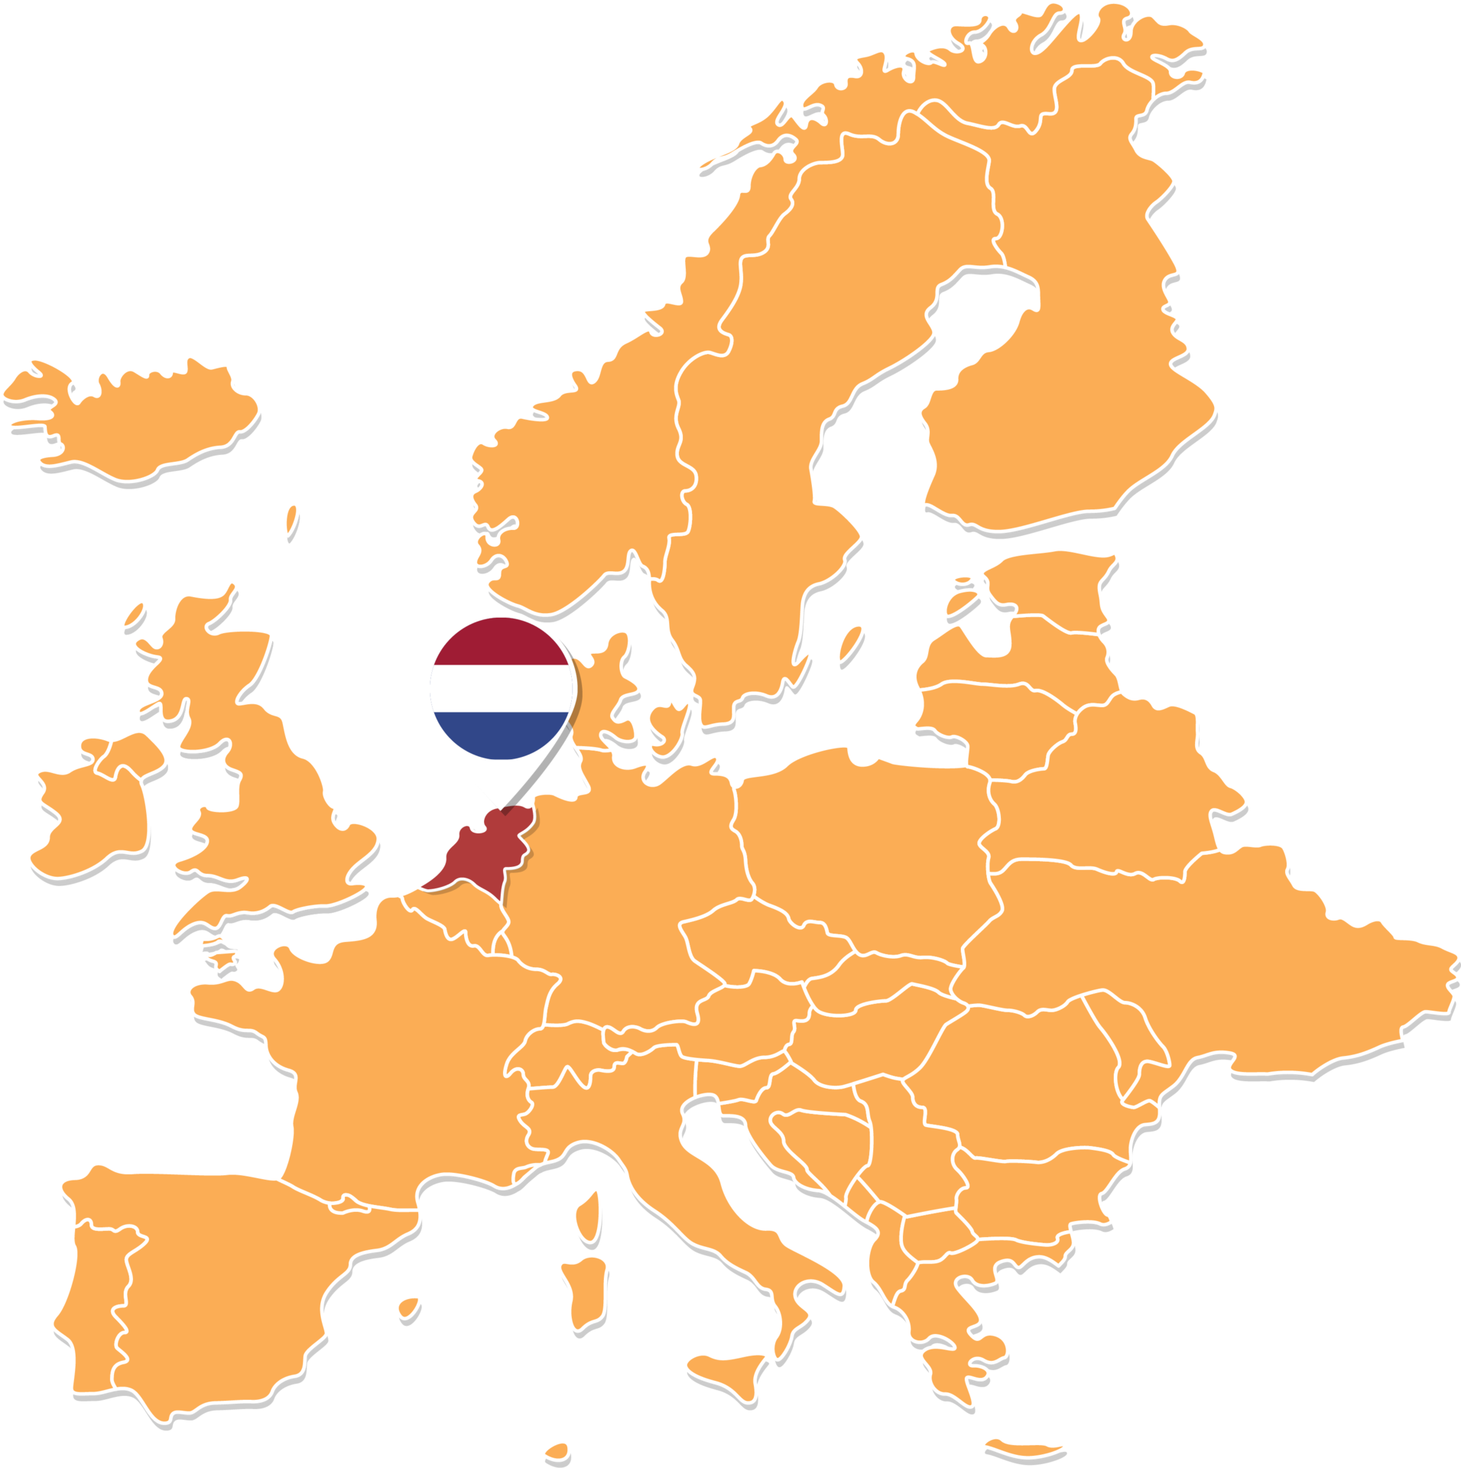
Presenting: Ronald Pijnenburg Directors: Martyn Drury, Andre Niemeijer

Slide 2
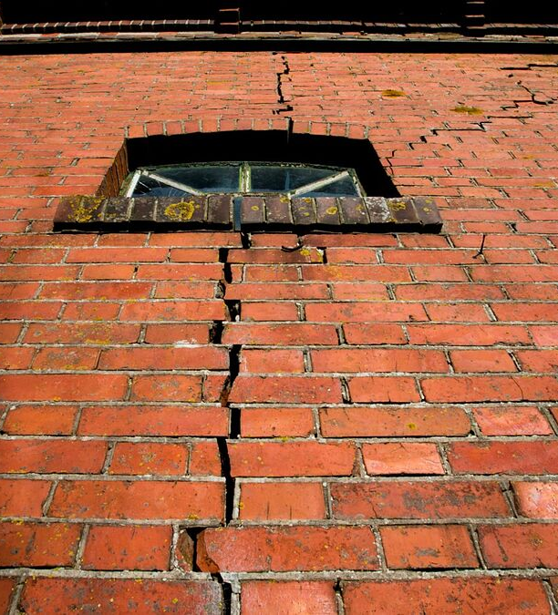
Improves the means for subsurface research
Earthquakes in Groningen

Slide 3
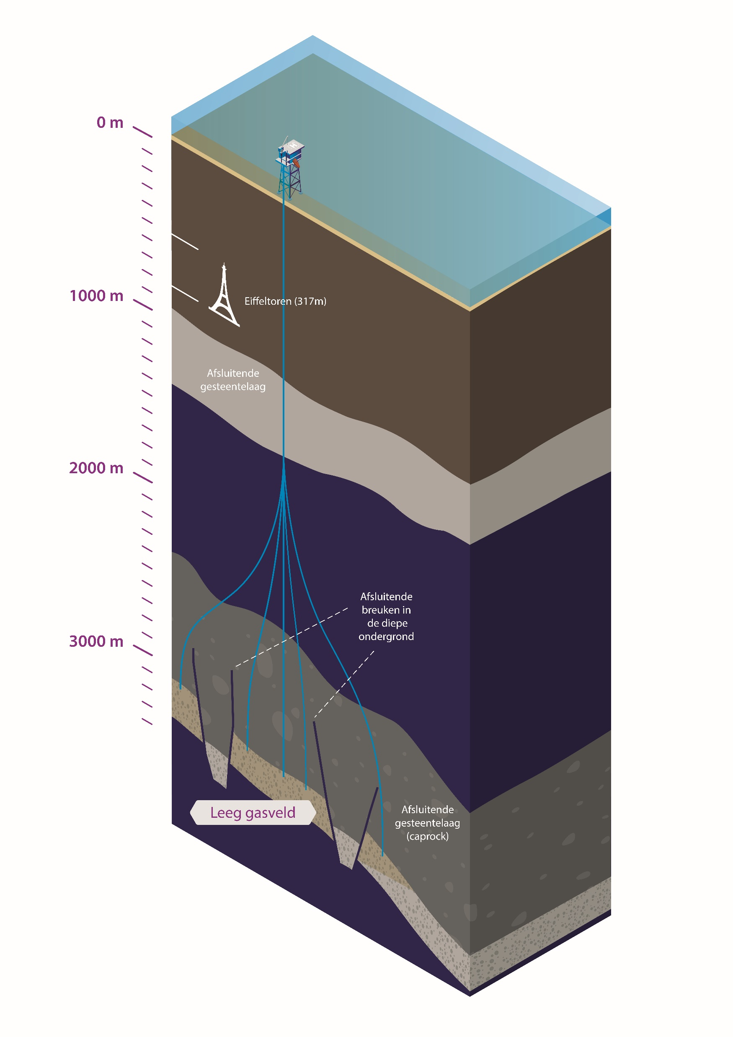
Improves the means for subsurface research
CO₂ storage in subsurface
porthosco2.nl

Slide 4
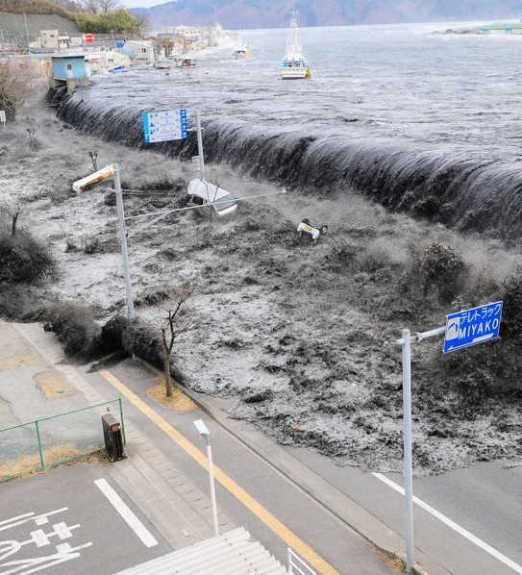
Improves the means for subsurface research
Geohazards
Tsunami Japan, 2011

Slide 5
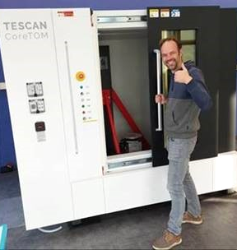
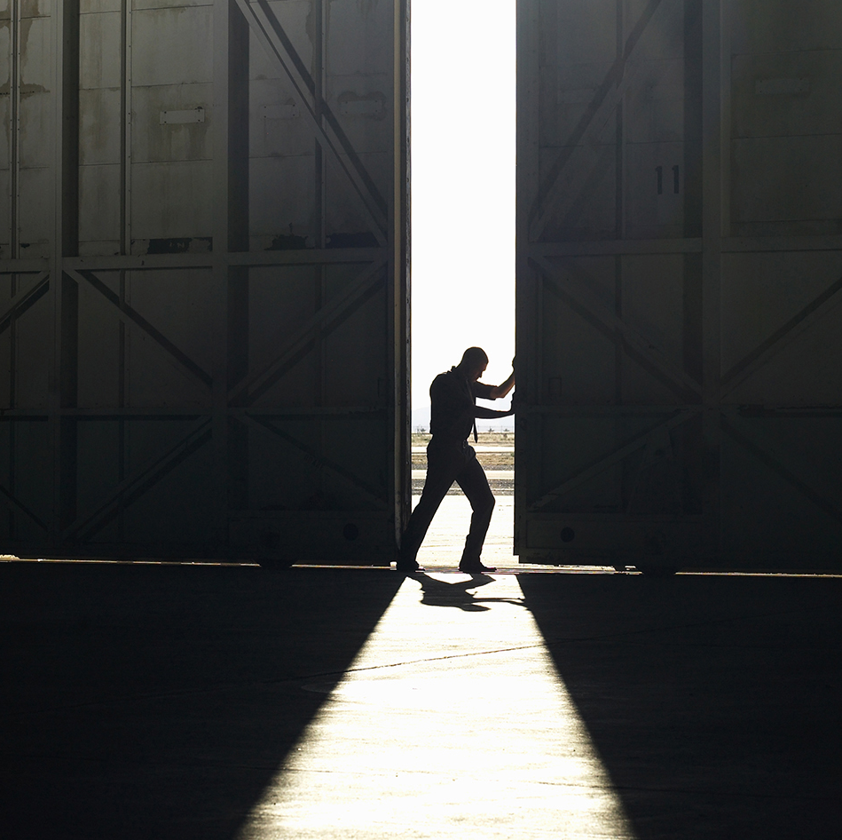
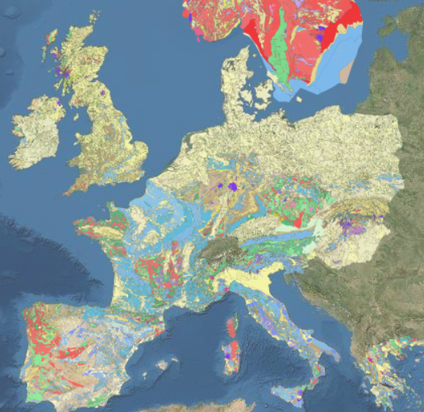
Facility development
Here: new CT scanner at TU Delft
Improves the means for subsurface research
Facility access
Free of charge, (inter)national
EPOS-NL 12 M€ in 2019-2024
Data access
Through the EPOS data portal

Slide 6
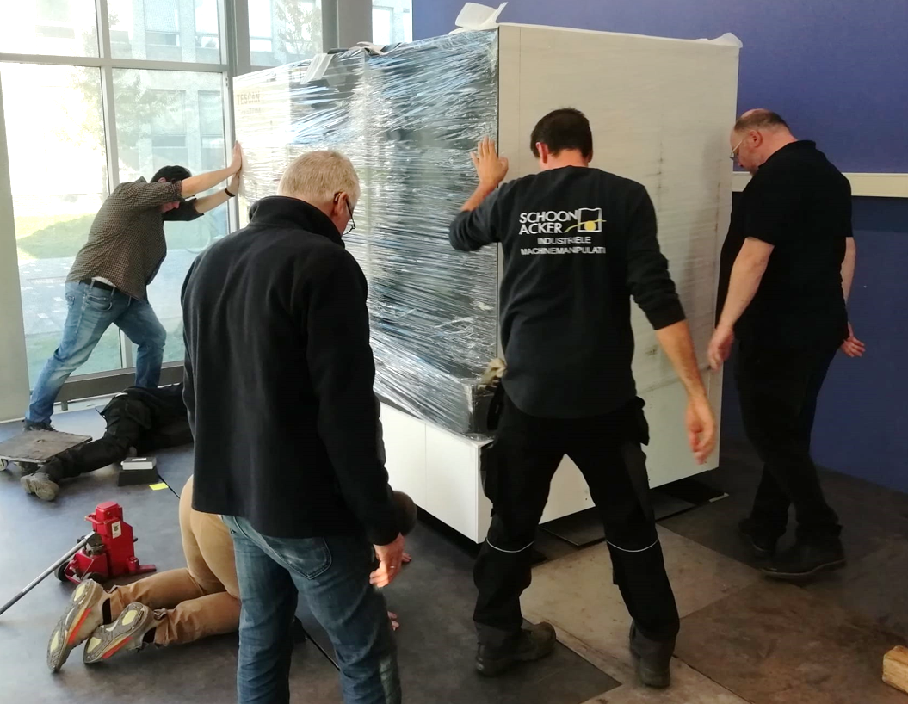
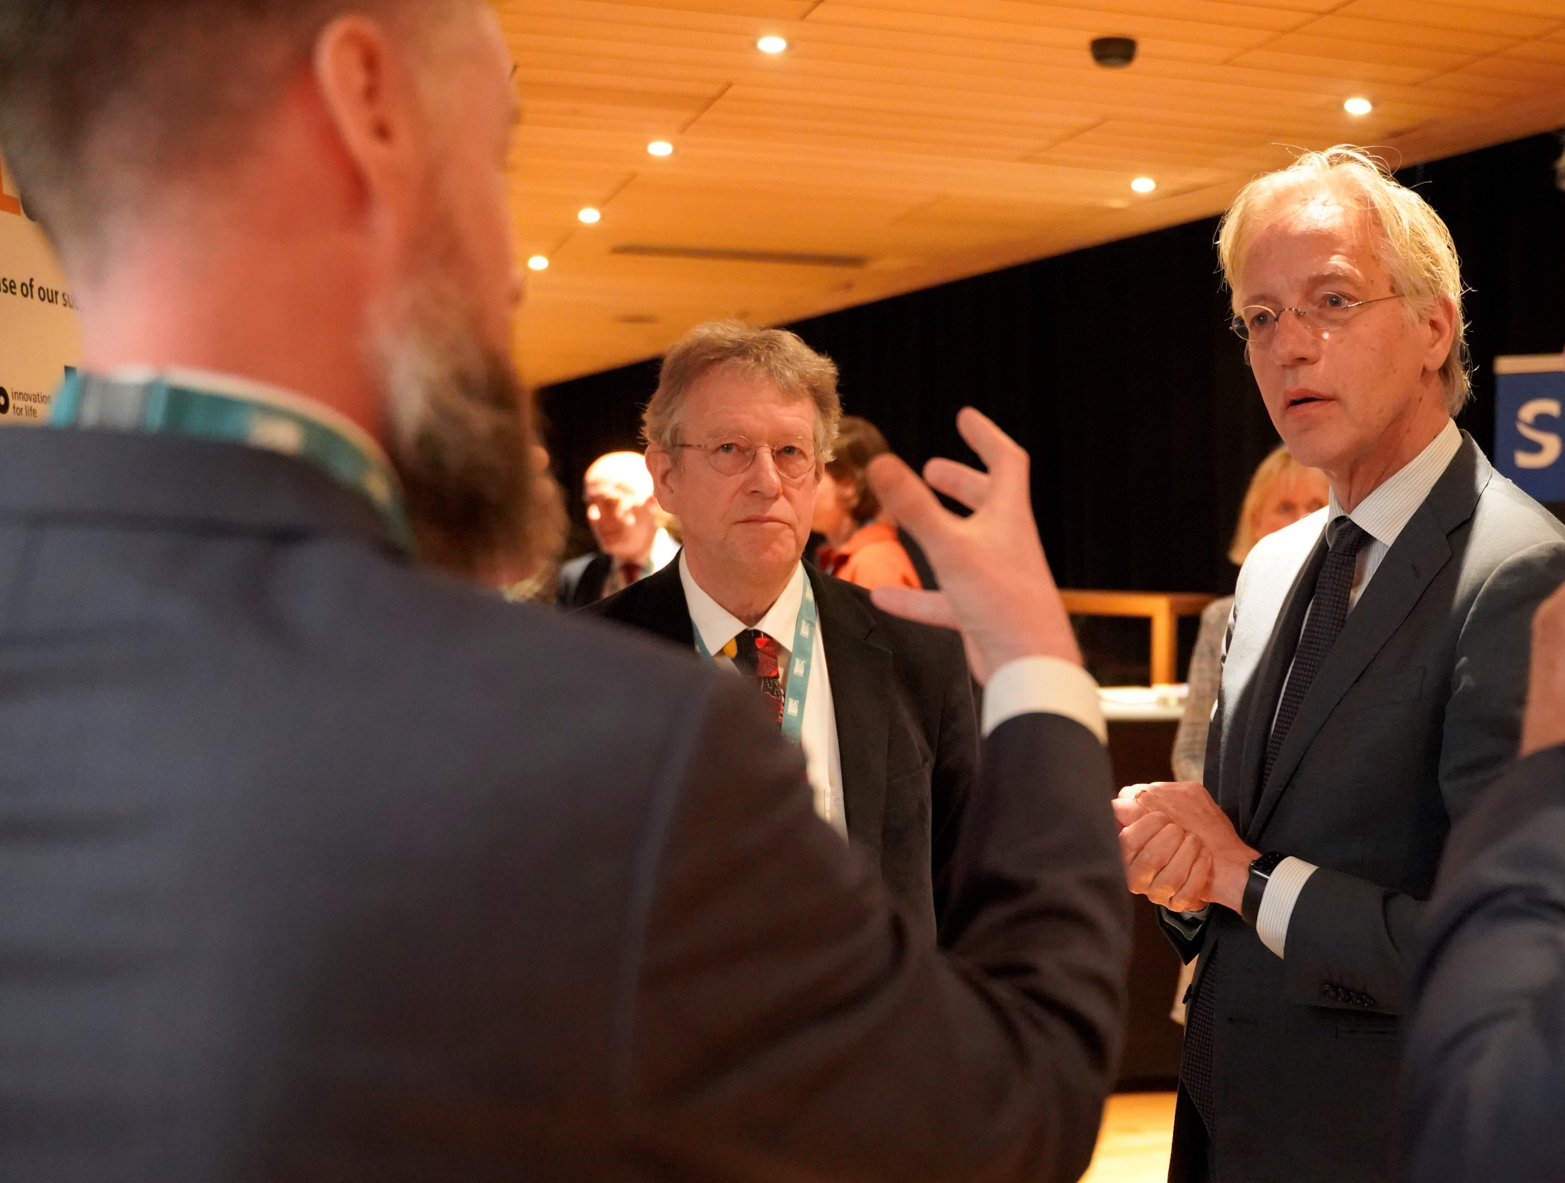
Facility development
Here: new CT scanner at TU Delft
Award ceremony with
Minister Robbert Dijkgraaf
Improves the means for subsurface research
Facility access
Free of charge, (inter)national
EPOS-NL 12 M€ in 2019-2024
EPOS-eNLarge 18 M€ in 2023-2028
Data access
Through the EPOS data portal
Just awarded! (by Dutch Research Council NWO)

Slide 7
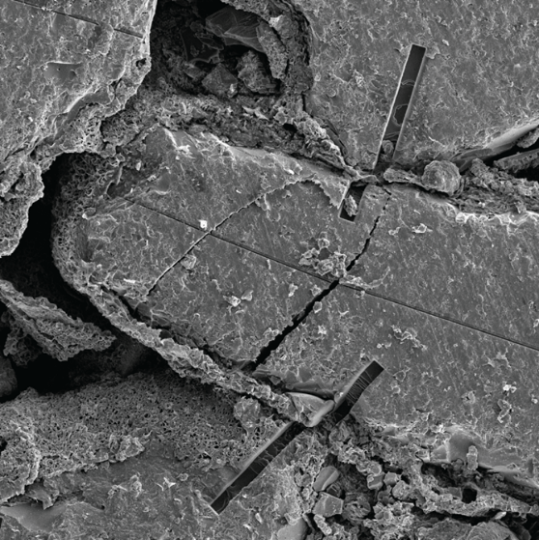
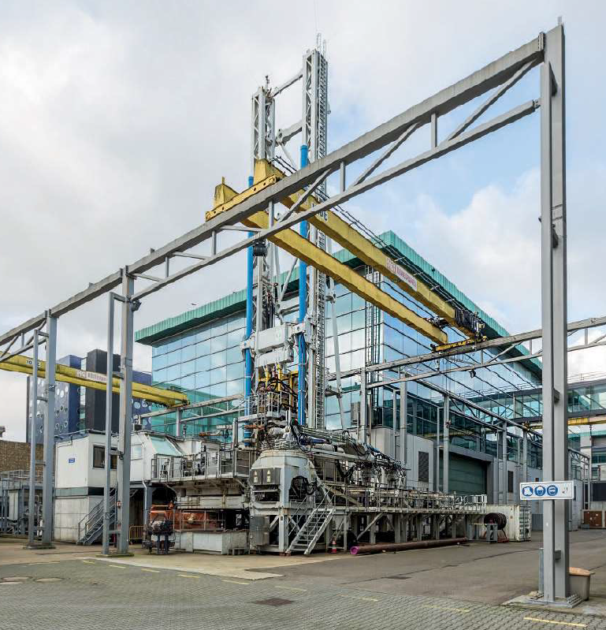
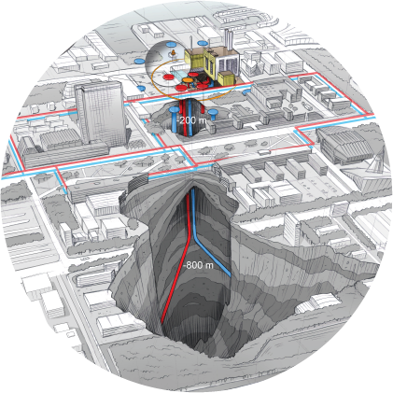
Bridging lab scales
to field scales
nm mm dm m hm
hm km global
Imaging dynamics
MINT: Multi-scale Imaging and Tomography facility
ESL: Earth Simulation Lab
€ 2.0m
Large scale experiments
RCSG: Rijswijk Centre for Sustainable Geo-energy
€ 1.0m
Field monitoring
DSUEL: Delft Subsurface Urban Energy Lab
ORFEUS: Fibre optics
€ 8.8m
Data and lab access
EPOS: European Plate Observing System
€ 5.8m
Notes:
We will enable scientific breakthroughs in terms of:
Say something about the individual facilities:
Earth Simulation Lab and the Multi-scale Imaging and Tomography facility (MINT)
Rijswijk Centre for Sustainable Geo-energy (RCSG)
Delft Subsurface Urban Energy Lab (DSUEL)
Data sharing is vital

Slide 8
Bridging lab scales
to field scales
nm mm dm m hm
hm km global
Imaging dynamics
MINT: Multi-scale Imaging and Tomography facility
ESL: Earth Simulation Lab
€ 2.0m
Large scale experiments
RCSG: Rijswijk Centre for Sustainable Geo-energy
€ 1.0m
Field monitoring
DSUEL: Delft Subsurface Urban Energy Lab
ORFEUS: Fibre optics
€ 8.8m
Data and lab access
EPOS: European Plate Observing System
€ 5.8m
Notes:
We will enable scientific breakthroughs in terms of:
Say something about the individual facilities:
Earth Simulation Lab and the Multi-scale Imaging and Tomography facility (MINT)
Rijswijk Centre for Sustainable Geo-energy (RCSG)
Delft Subsurface Urban Energy Lab (DSUEL)
Data sharing is vital

Slide 9
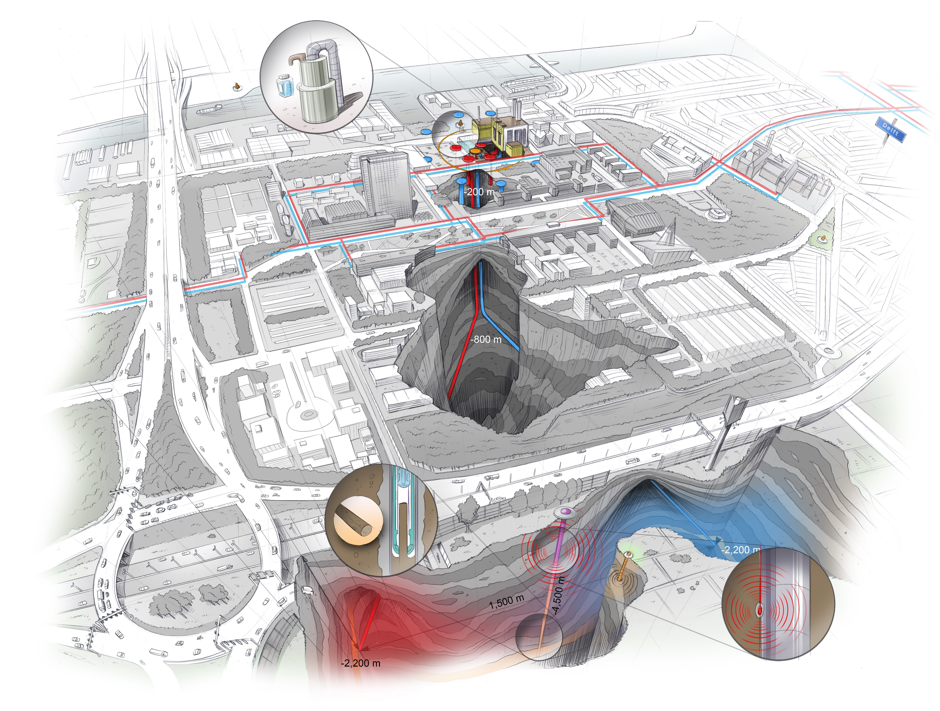
Bridging lab scales
to field scales
Geothermal doublet drilled in Summer ‘23
In coming years
EPOS-eNLarge will contribute <4.5 km deep, monitoring well
Notes:
We will enable scientific breakthroughs in terms of:
Say something about the individual facilities:
Earth Simulation Lab and the Multi-scale Imaging and Tomography facility (MINT)
Rijswijk Centre for Sustainable Geo-energy (RCSG)
Delft Subsurface Urban Energy Lab (DSUEL)
Data sharing is vital

Slide 10
Bridging lab scales
to field scales
www.EPOS-NL.nl
Notes:
We will enable scientific breakthroughs in terms of:
Say something about the individual facilities:
Earth Simulation Lab and the Multi-scale Imaging and Tomography facility (MINT)
Rijswijk Centre for Sustainable Geo-energy (RCSG)
Delft Subsurface Urban Energy Lab (DSUEL)
Data sharing is vital

Slide 11
Facility development
(here: new CT scanner in Delft)
Improves the means for subsurface research
Facility access
Free of charge, (inter)national
Data access
Through the European data portal

Slide 12
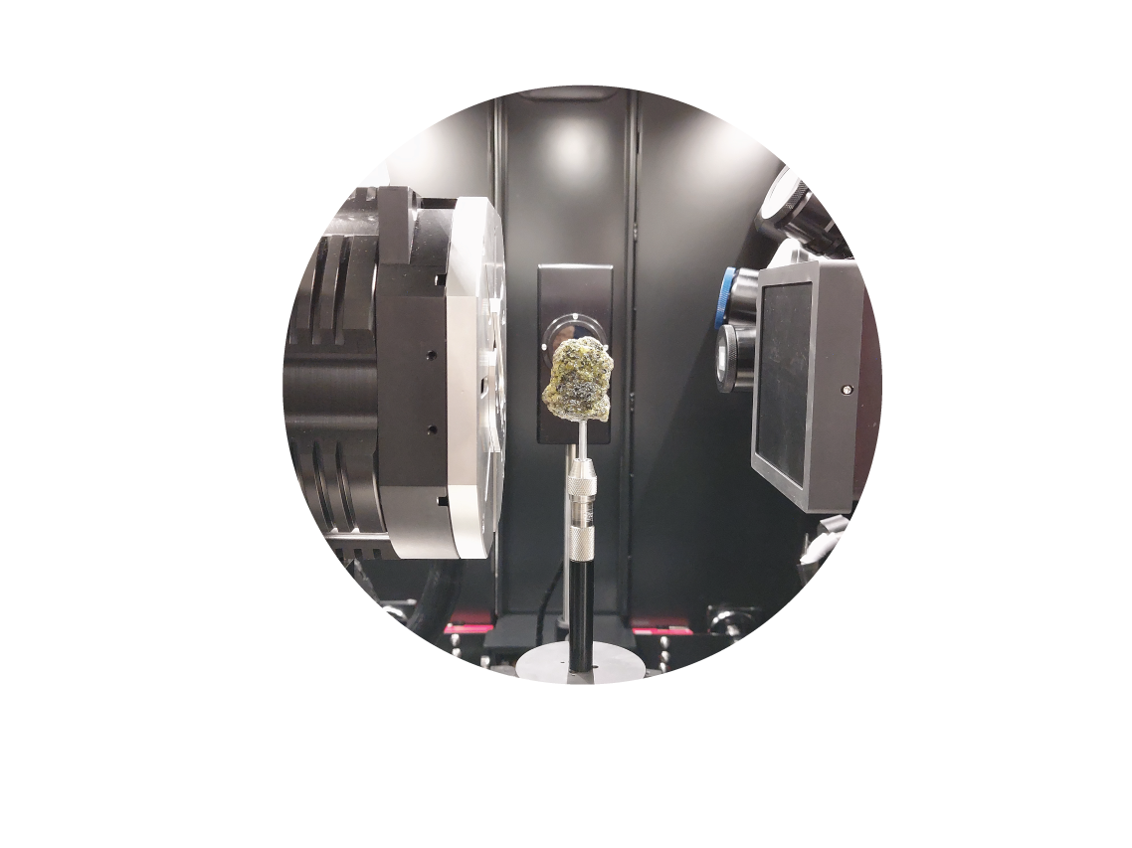
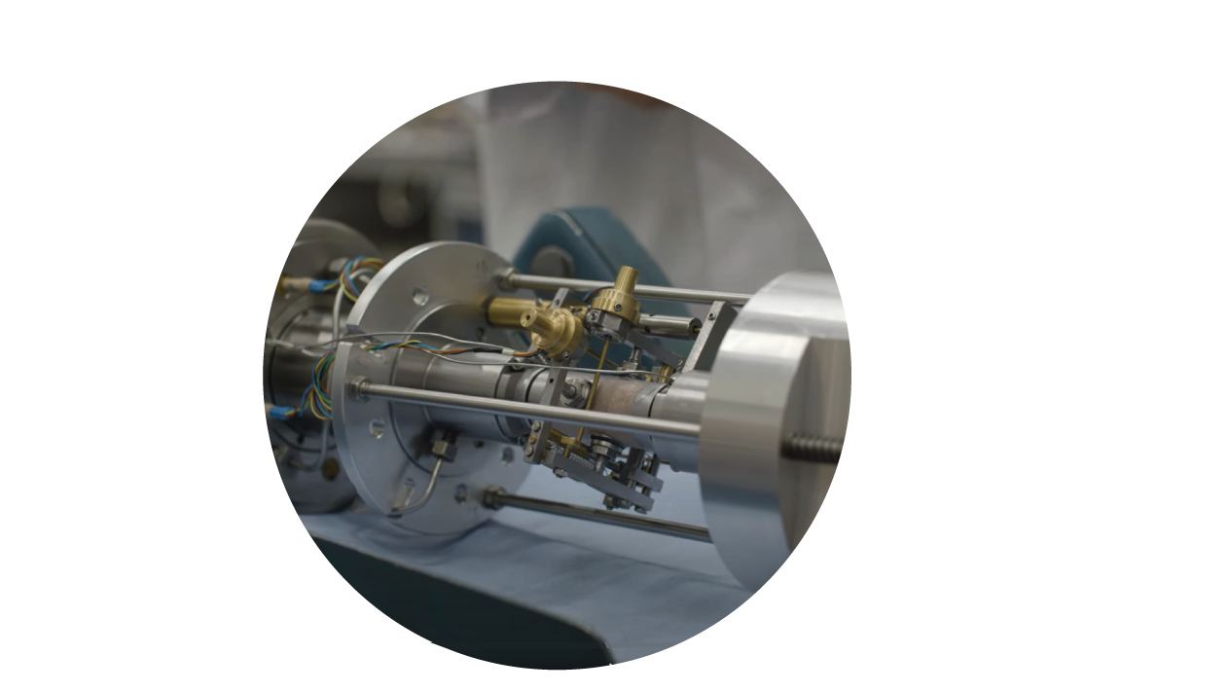
Facility Access
Free of charge access to Earth scientific research labs in the Netherlands
Tectonic modelling lab (UU)
High Pressure and Temperature lab (UU)
Porous Media Lab (UU)
Delft Petrophysics Lab (TUD)
Multi-scale Imaging and Tomography (UU+TUD)
Rijswijk Centre for Sustainable Geo-energy (TNO)
Includes travel + accommodation
expertise + support
In 2023, the labs at UU and TUD provided 542 days of access to external researchers
→ Of which196 days through EPOS-NL

Slide 13
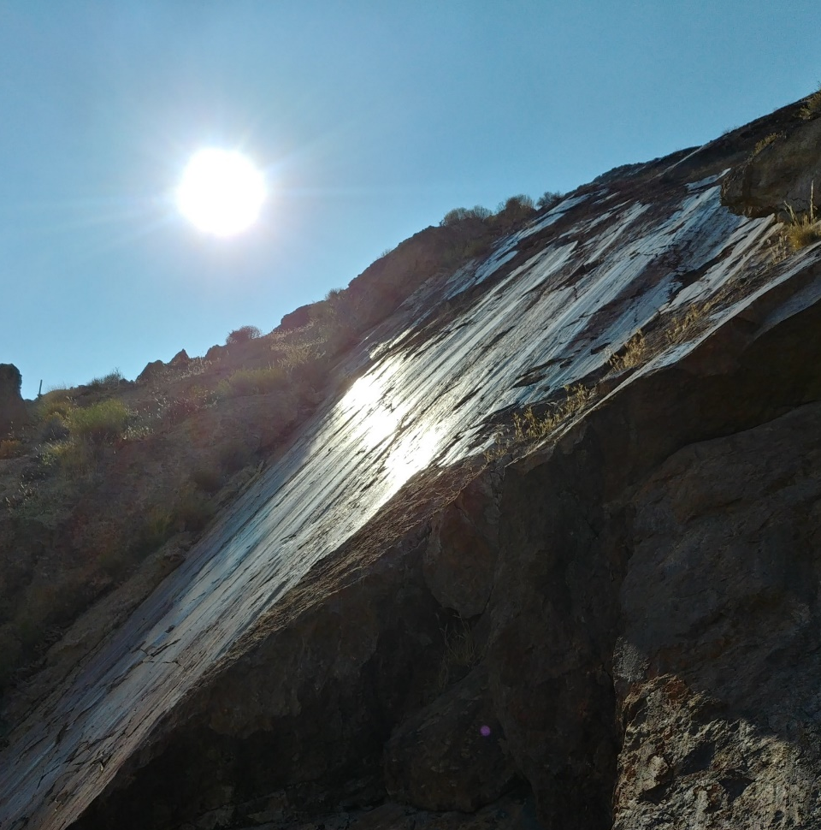
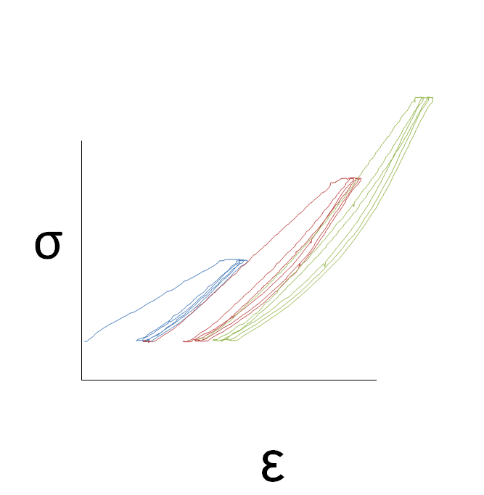
What do you want to do?
“Experimental rock mechanics and transport”
Lab experiments at crustal P/T conditions
Quantify rock/fault strength
Explore time-dependent deformation
Analyze permeability evolution during deformation
Benchmark your model with data from natural samples

Slide 14
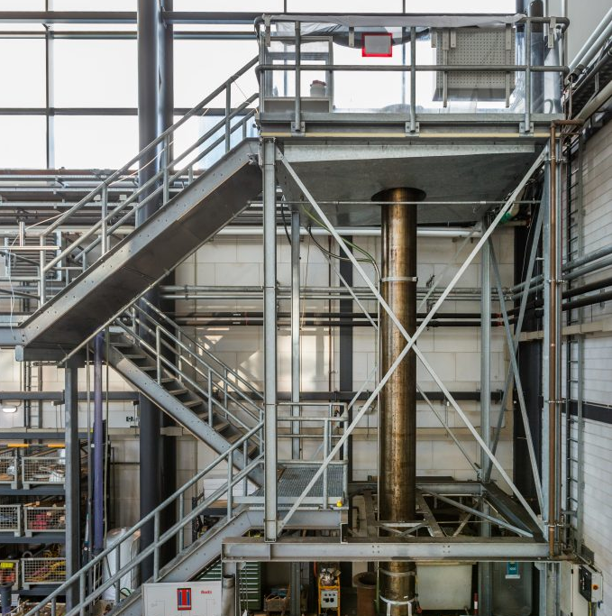
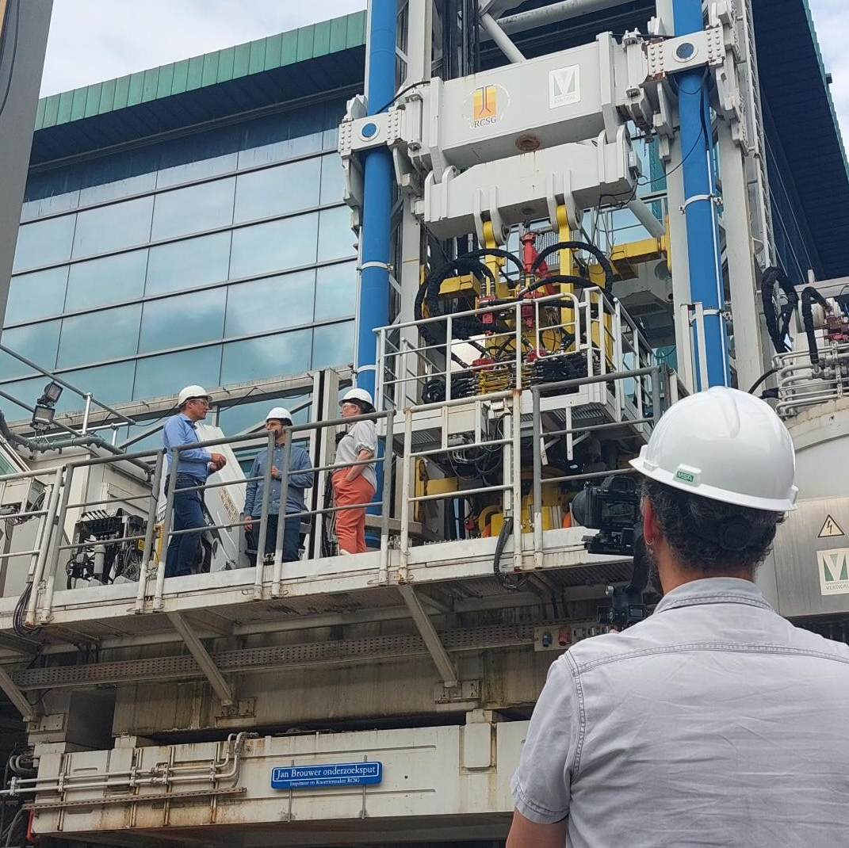
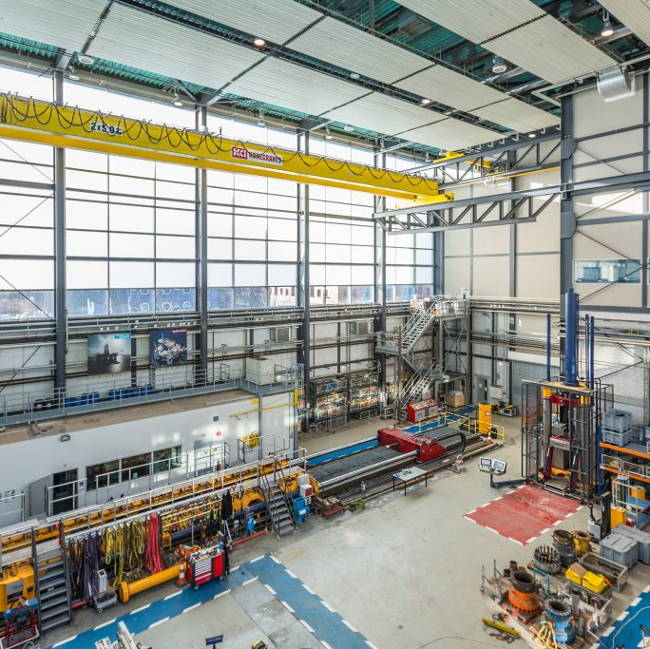
What do you want to do?
“Large-scale compression and fluid transport”
Long-range fluid transport testing and particle tracking
Upscaling rock mechanics:
Hydrostatic compression of 6m tall core
Axial compression of 0.5m diameter samples
Drilling simulation (physical)

Slide 15
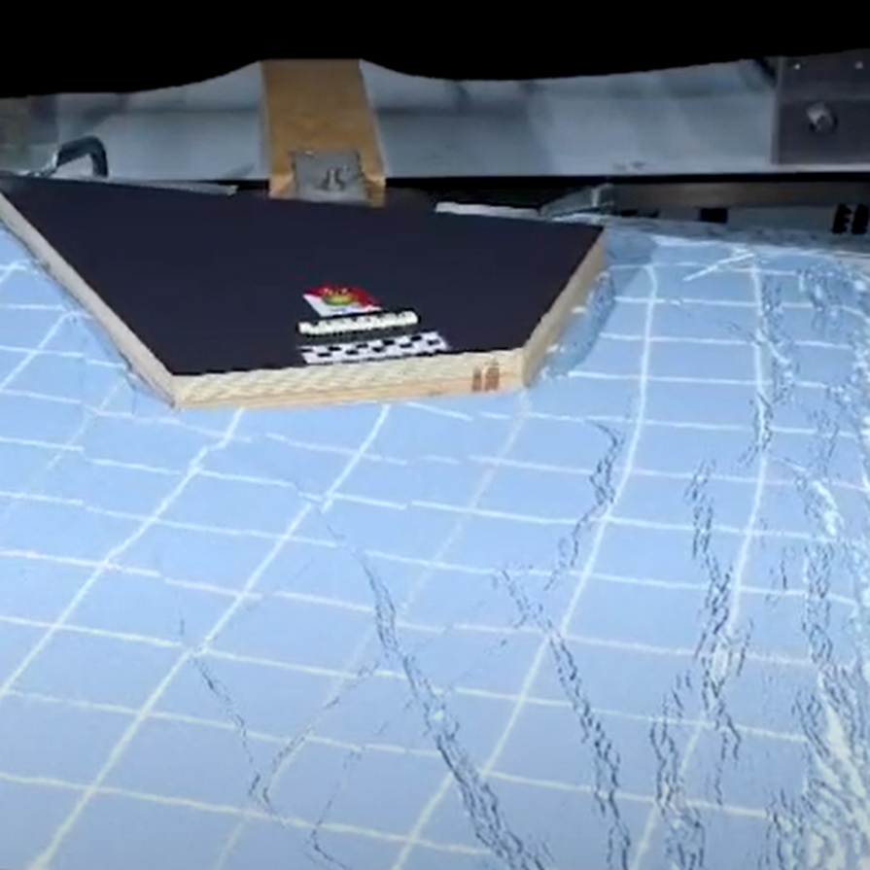
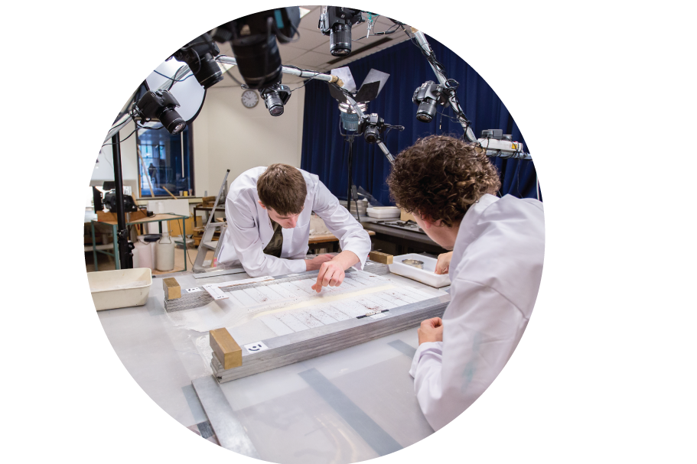
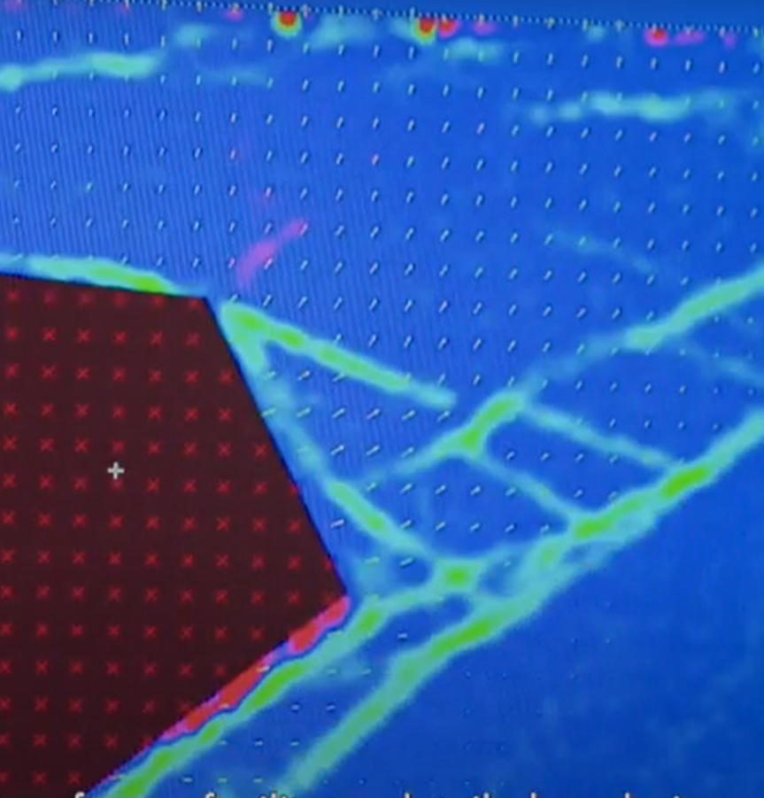
What do you want to do?
“Analogue modelling of tectonic processes”
Scaled-down models of deforming crust or lithosphere
2D/3D monitoring of model evolution
Explore processes underlying deformation
Why and where do faults form?
Study sedimentary basins during mountain building

Slide 16
What do you want to do?
Multi-scale, multi-dimensional, correlative characterization
Automated mapping of crystal defects and orientation
Identify micro/nano-processes governing lab or field behavior
“Microscopy and tomography”
Down scale

Slide 17
Facility Access
Apply to our next call
Dutch labs: rock deformation, fluid transport, analogue modelling, microscopy and tomography
Next call: July 2024
www.EPOS-NL.nl
www.EXCITE-network.eu
Next call: April 2024
>24 European microscopy & tomography facilities

Slide 18
Facility development
(here: new CT scanner in Delft)
Improves the means for subsurface research
Facility access
Free of charge, (inter)national
EPOS-NL 12 M€ in 2019-2024
EPOS-eNLarge 18 M€ in 2023-2028
Data access
Through the European data portal

Slide 19
Fragmented data availability in Europe
All data findable in one place

Slide 20
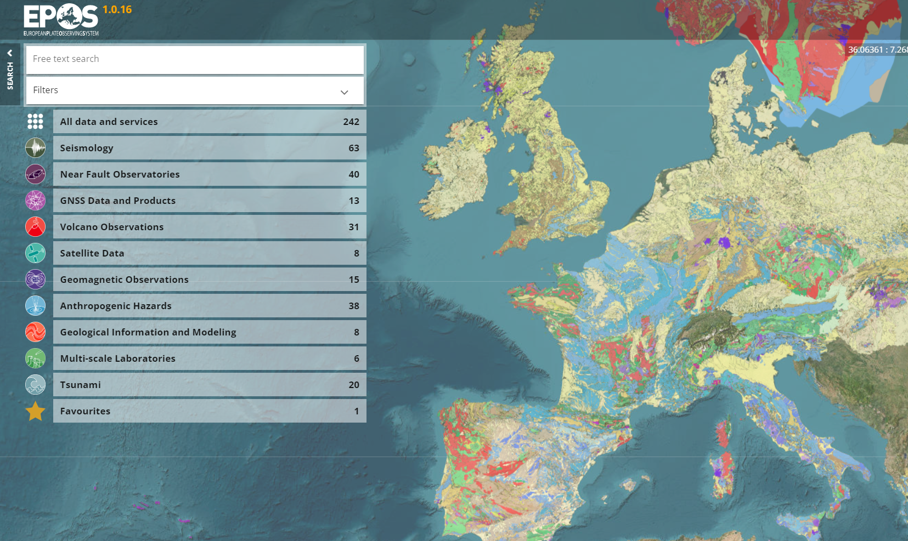
Central access to Earth scientific data
epos-eu.org/dataportal

Slide 21
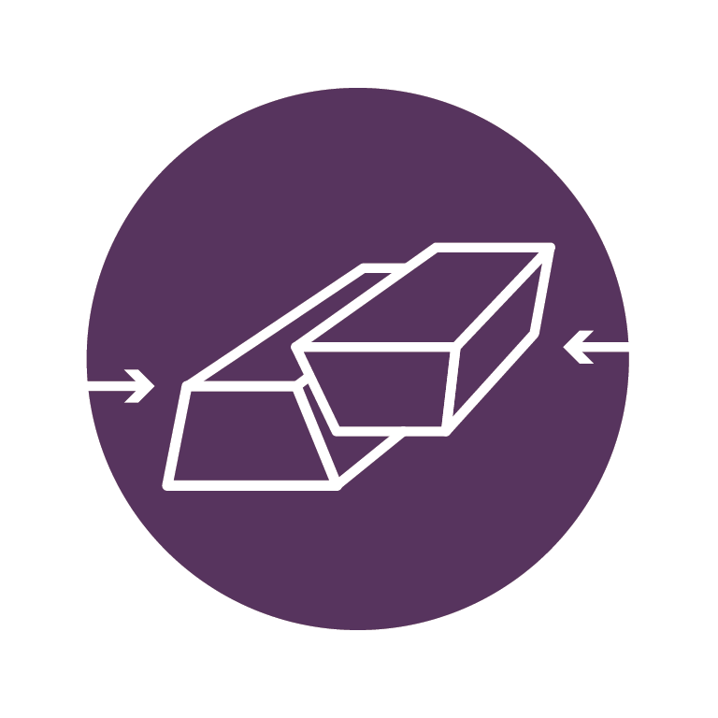
Central access to Earth scientific data
Seismology
Near Fault Observatories
GNSS Data & Products
Volcano Observations
Satellite data
Geomagnetic Observations
Anthropogenic Hazards
Coordinated in NL
Multi-Scale Laboratories
epos-eu.org/dataportal
Geological Information and Modelling
Tsunami

Slide 22
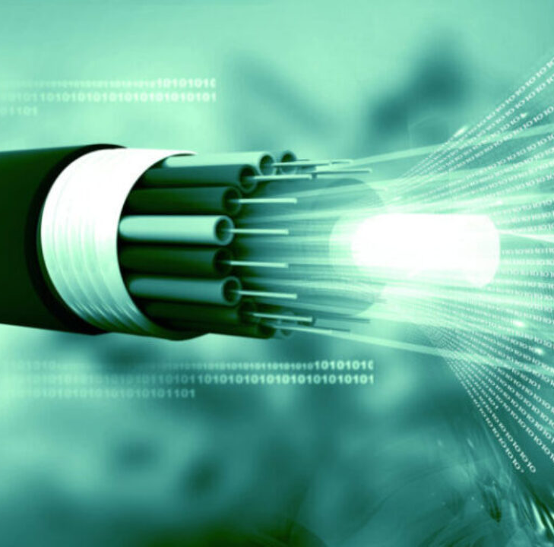
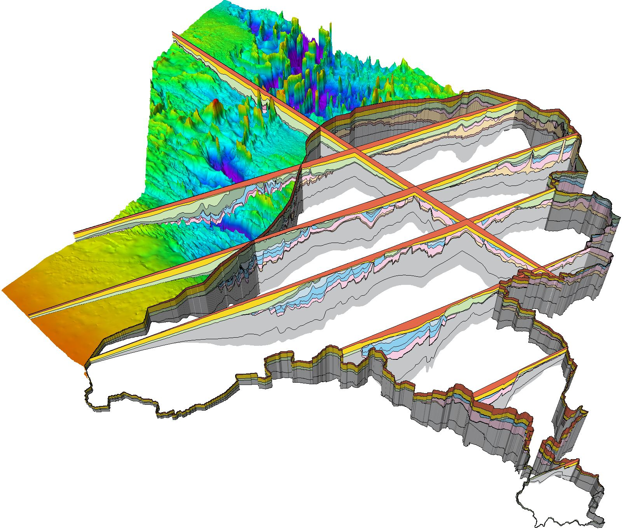
Central access to Earth scientific data
Seismology
Near Fault Observatories
GNSS Data & Products
Volcano Observations
Satellite data
Geomagnetic Observations
Anthropogenic Hazards
Multi-Scale Laboratories
epos-eu.org/dataportal
Geological Information and Modelling
Tsunami

Slide 23
The Dutch infrastructure for solid Earth sciences
www.EPOS-NL.nl
info@EPOS-NL.nl

