Slide 1



EPOS PL
Poland

Slide 2

Polish Roadmap for Research Infrastructures
Strategic document comprising the most ambitious research infrastructure projects of great socio-economic significance, chosen through a transparent process carried out in accordance with international standards
EPOS included in the Roadmap since 2011 (updates of the document in 2015 and 2020)
EPOS – important tool for integration of national and transnational research infrastructures for solid Earth science in Europe providing access to data, services and facilities
From 2012, the Ministry taking part in the works being undertaken at international level

Slide 3
Funding mechanisms
Under the present funding scheme the Ministry supports Polish participation in European and international research infrastructures by covering:
annual membership fee – directly to EPOS ERIC
national contribution – to the Polish consortium
Additional sources of financing:
call for proposals dedicated to the research infrastructures included in the Polish Roadmap, members of the international infrastructures consortia
call for proposals for new equipment launched by the Ministry every year (not only for research infrastructure projects)

Slide 4
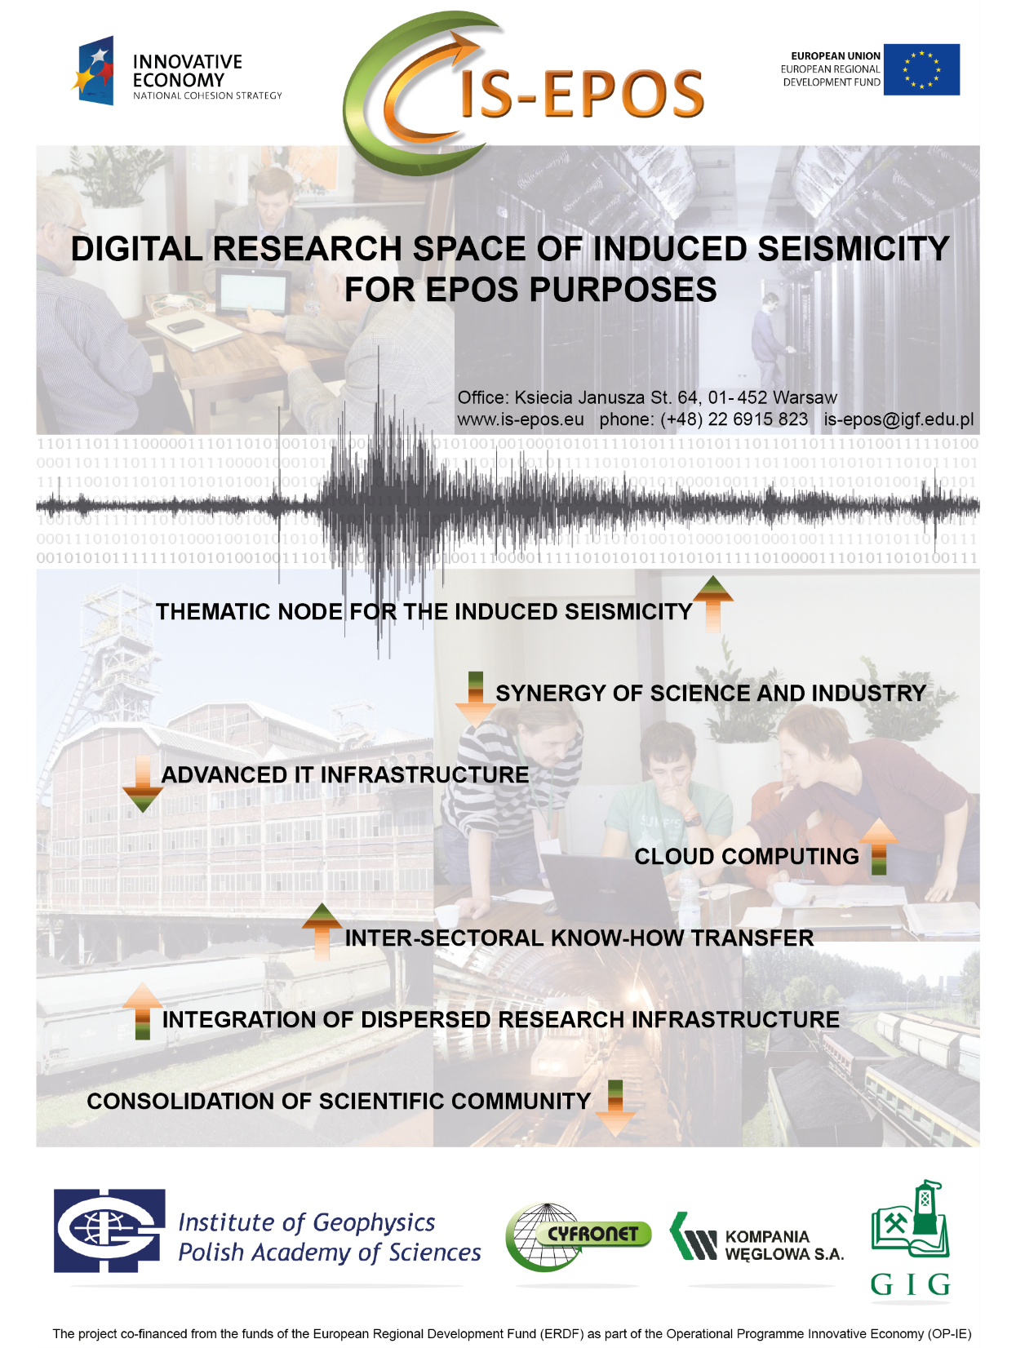







IS-EPOS: Digital Research Space of Induced Seismicity for EPOS Purposes
Prototype of
Thematic Core Services for Anthropogenic Hazards
The project co-financed from the funds of the European Regional Development Funds (ERDF) as part of the Operational Prgoramme Innovative Economy. 2013 – 2015, budget: ~ 4 mnl EURO
Coordination: Professor Stanisław Lasocki

Slide 5
4.08.2016 EPOS PL Consortium Agreement signed by all Members, the aim of which is: to establish cooperation
between consortium members as part of the implementation of the EPOS program in Poland,
to include the national research and observation infrastructure in the field of Earth sciences into the
European infrastructure and global databases.
Institute of Geophysics PAS
Institute of Geological
Sciences PAS
AGH Compyter Centre CYFRONET
Central Mining Institute
Institute of Geodesy and
Cartography
Wroclaw University of
Environmental and Life Science,
Military University of Technology,
Polish Mining Group
Space Research Centre of the PAS

Slide 6
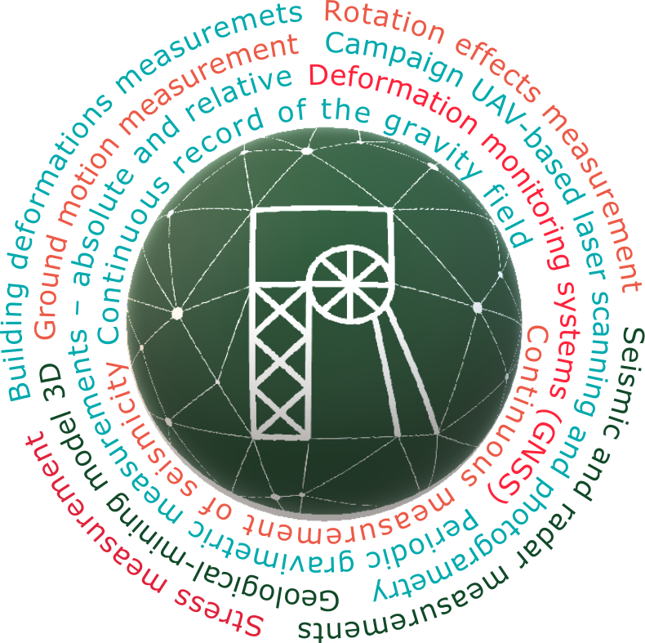



EPOS-PL POIR.04.02.00-14-A0003/16
Priority IV: Increasing the research potential
Action 4.2: Development of modern research infrastructure of the science sector
Period of realization: 2016 – 2021, Project value: 15 mln EURO
ERDF co-financing: 11 MLN EURO
MUSE - Multidisciplinary Upper Silesian Episode - Three measurement polygons for the integrated approach to geodynamic processes.
e-Research Platform - a new functionality of IS-EPOS platform of TCS AH
EPOS-PL+ POIR.04.02.00-00-C005/19
Priority IV: Increasing the research potential
Action 4.2: Development of modern research infrastructure of the science sector
Period of realization: 2020 – 2023, Project value: 12.5 mln EURO
ERDF co-financing: 9 MLN EURO
EPOS-AI Platform - functionality of TCS AH
The integration of Satellite Data Research Infrastructure Center
The geophysical safety system for mine support pillars

Slide 7
PROJECT name: TCS AH (Thematic Core Services Anthropogenic Hazard) węzeł tematyczny dla zagrożeń antropogenicznych​
​
FUNDING PROGRAMME: support to the research infrastructures included in the Polish Roadmap, members of the international infrastructures consortia
CONNECTED to the: European Plate Observing System, European Research Infrastructure Consortium (EPOS ERIC) – EPOS Thematic Core Service Anthropogenic Hazards​
​
PARTICIPANTS: IG PAS, CYFRONET, CMI
​
FUNDING AMOUNT: 4 075 000,00 PLN​ = 930 000 EUR
​
PERIOD: 1/02/2021 – 31/12/2023
TASK 1: TCS AH Governance and Coordination​
TASK 2: TCS-ICS Integration​
TASK 3: OUTREACH and DISSEMINATION​
TASK 4: EPISODES Platform and DATA Centres

Slide 8
On behalf of the EPOS Polish community I would like to thank you for your attention

