Slide 1
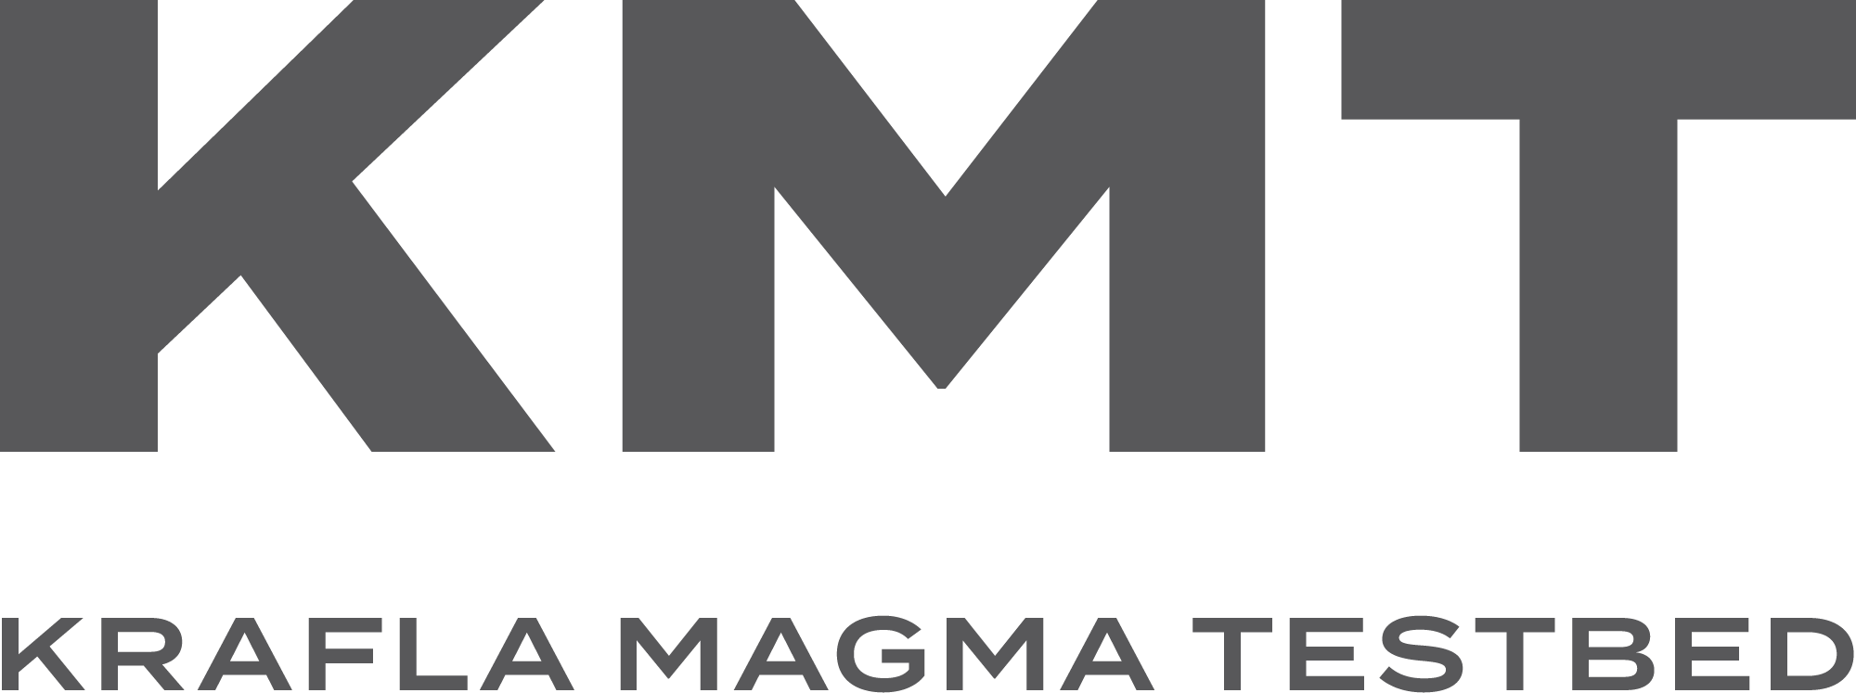
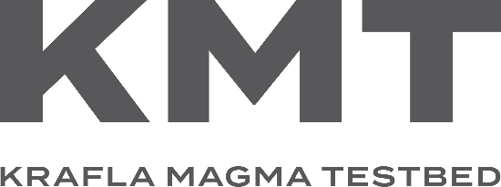
Establishing the World’s First
Magma Observatory

Slide 2
Establishing the World’s First
Magma Observatory

Slide 3
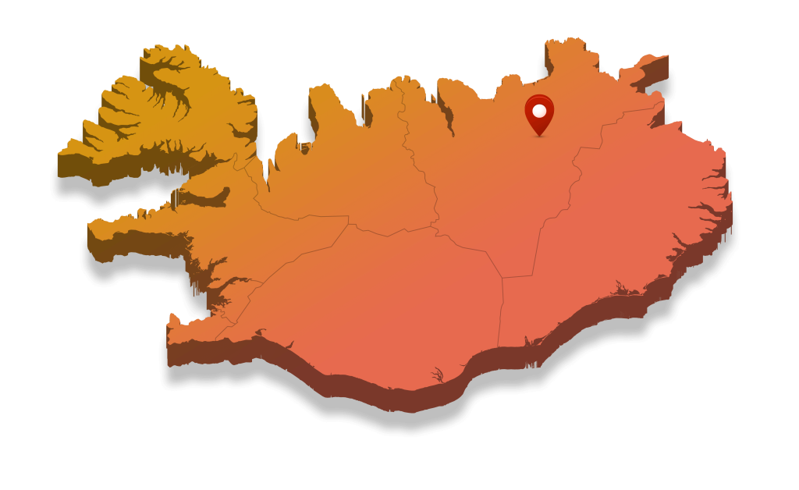
Establishing the World’s First
Magma Observatory

Slide 4
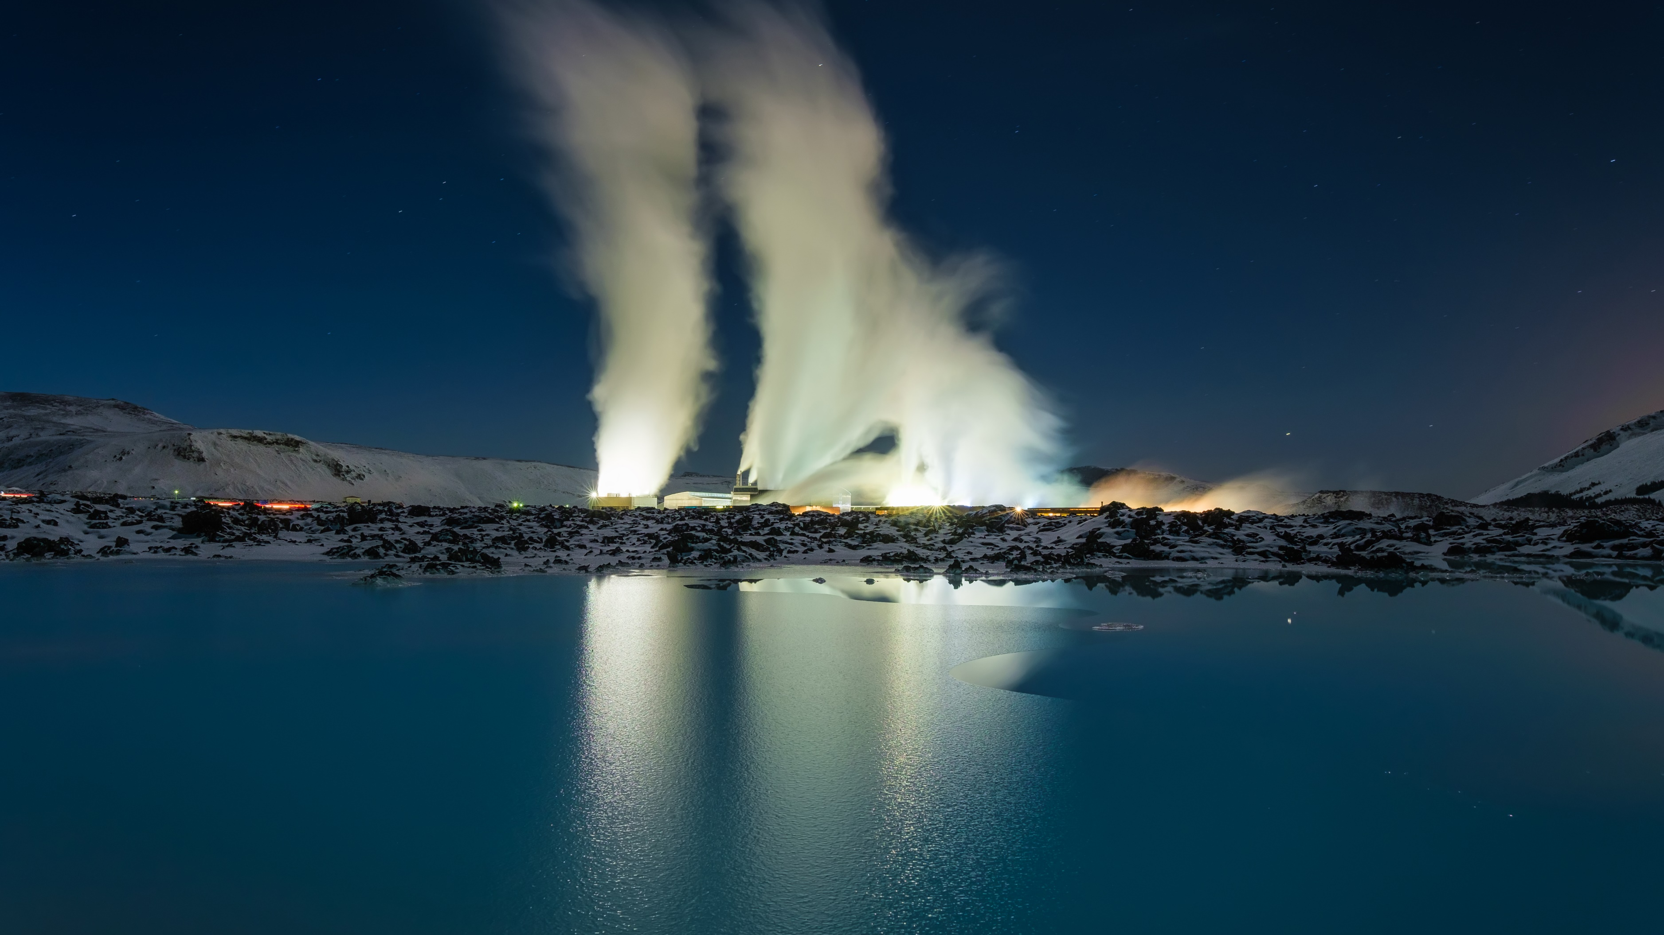
Why Iceland?
Hottest crust on Earth = Shortest path to magma
The forefront of super- hot geothermal research and development
An international magnet for geoscientists for two centuries

Slide 5
Why Iceland?
Hottest crust on Earth = Shortest path to magma
The forefront of super- hot geothermal research and development
An international magnet for geoscientists for two centuries

Slide 6
Krafla is unique
One of the most researched magma-hydrothermal area in the world
Unique synergy for volcano and geothermal science to come together
Easily accessible with a plentiful water supply
The Vision
The Vision
A world-class international in-situ magma laboratory with access to the magma-rock hydrothermal boundary through wells
We stand at the threshold of obtaining fundamental new knowledge of magma in the Earth’s crust

Slide 7
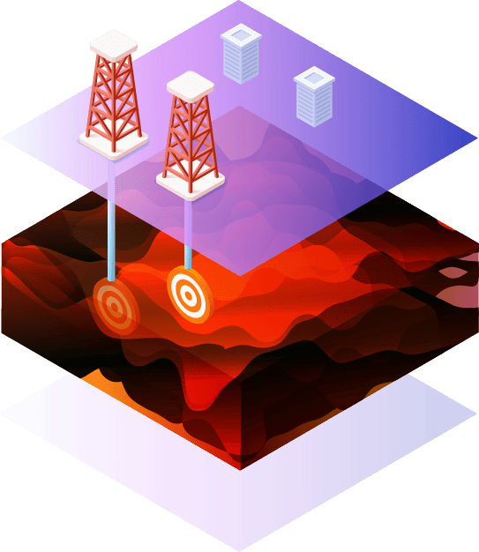
Two Boreholes
One to drill, sample, and instrument the rock-magma interface
One to conduct experiments directly on the magma and to flow-test the system to discover how to exploit this extreme enthalpy resource.
The Vision

Slide 8
Krafla is unique
One of the most researched magma-hydrothermal area in the world
Unique synergy for volcano and geothermal science to come together
Easily accessible with a plentiful water supply
Why Iceland?
Hottest crust on Earth = Shortest path to magma
The forefront of super- hot geothermal research and development
An international magnet for geoscientists for two centuries

Slide 9
Krafla is unique
The Vision
A world-class international in-situ magma laboratory with access to the magma-rock hydrothermal boundary through wells
We stand at the threshold of obtaining fundamental new knowledge of magma in the Earth’s crust
The Vision
This will revolutionise capabilities in three key areas

Slide 10
The Vision
A world-class international in-situ magma laboratory with access to the magma-rock hydrothermal boundary through wells
We stand at the threshold of obtaining fundamental new knowledge of magma in the Earth’s crust
This will revolutionise capabilities in three key areas
Fundamental science
→ Magma-hydrothermal coupling
Direct volcano monitoring
→ Ground truth for surface observations
Super-hot geothermal energy
→ From heat of magma crystallization; accessed by thermal fracturing
The Vision

Slide 11
The Vision
A world-class international in-situ magma laboratory with access to the magma-rock hydrothermal boundary through wells
We stand at the threshold of obtaining fundamental new knowledge of magma in the Earth’s crust
This will revolutionise capabilities in three key areas
Fundamental science
→ Magma-hydrothermal coupling
→ Origin of continents
Direct volcano monitoring
→ Ground truth for surface observations
→ Instrumenting real magma
→ Magma manipulation, volcanic unrest experiments
Super-hot geothermal energy
→ From heat of magma crystallization; accessed by thermal fracturing
The Vision

Slide 12
One to drill, sample, and instrument the rock-magma interface
One to conduct experiments directly on the magma and to flow-test the system to discover how to exploit this extreme enthalpy resource
Two Boreholes
The magma body resides at 2.1 km depth below the floor of Krafla Caldera

Slide 13
One to drill, sample, and instrument the rock-magma interface
One to conduct experiments directly on the magma and to flow-test the system to discover how to exploit this extreme enthalpy resource
Two Boreholes
The magma body resides at 2.1 km depth below the floor of Krafla Caldera
The Borehole design is already well underway

Slide 14
One to drill, sample, and instrument the rock-magma interface
One to conduct experiments directly on the magma and to flow-test the system to discover how to exploit this extreme enthalpy resource
Two Boreholes
The magma body resides at 2.1 km depth below the floor of Krafla Caldera
The Borehole design is already well underway
Thanks to our leading experts and deep drilling engineers
Sveinbjörn Hólmgeirsson
Kristinn Ingason
Bjarni Steinar Gunnarsson
Sigrún Nanna Karlsdóttir
Þorleikur Jóhannesson
Ragnar Ásmundsson
Kristján F Alexandersson
Hilmar Már Einarsson

Slide 15
One to drill, sample, and instrument the rock-magma interface
One to conduct experiments directly on the magma and to flow-test the system to discover how to exploit this extreme enthalpy resource.
Two Boreholes
The magma body resides at 2.1 km depth below the floor of Krafla Caldera
The Borehole design is already well underway
World-renowned geoscientists and geothermal experts are involved with KMT
Thanks to our leading experts and deep drilling engineers
John Eichelberger
Yan Lavalleé
Paolo Papale
Anette Mortensen
Sveinbjörn Hólmgeirsson
Kristinn Ingason
Bjarni Steinar Gunnarsson
Sigrún Nanna Karlsdóttir
Vordís Eiriksdóttir
Freysteinn Sigmundsson
Sigurður H. Markússon
Bjarni Pálsson
Þorleikur Jóhannesson
Ragnar Ásmundsson
Kristján F Alexandersson
Hilmar Már Einarsson

Slide 16
The Borehole design is already well underway
Thanks to our leading experts and deep drilling engineers
World-renowned geoscientists and geothermal experts are involved with KMT
Thanks to our leading experts and deep drilling engineers
John Eichelberger
Yan Lavalleé
Paolo Papale
Anette Mortensen
Sveinbjörn Hólmgeirsson
Kristinn Ingason
Bjarni Steinar Gunnarsson
Sigrún Nanna Karlsdóttir
Vordís Eiriksdóttir
Freysteinn Sigmundsson
Sigurður H. Markússon
Bjarni Pálsson
Þorleikur Jóhannesson
Ragnar Ásmundsson
Kristján F Alexandersson
Hilmar Már Einarsson
KMT is an open-access research platform. The infrastructure will be available for the wider international scientific community, institutions, and private companies for experimentation and product development.

Slide 17
World-renowned geoscientists and geothermal experts are involved with KMT
John Eichelberger
Yan Lavalleé
Paolo Papale
Anette Mortensen
Vordís Eiriksdóttir
Freysteinn Sigmundsson
Sigurður H. Markússon
Bjarni Pálsson
KMT is an open-access research platform. The infrastructure will be available for the wider international scientific community, institutions, and private companies for experimentation and product development.
Revolutionary benefits across sectors

Slide 18
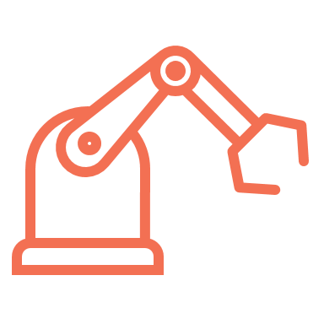
KMT is an open-access research platform. The infrastructure will be available for the wider international scientific community, institutions, and private companies for experimentation and product development.
Revolutionary benefits across sectors
Scientific | Societal | Economic | Technological
A world class research facility to transform knowledge on the migration of magma and fluid, furthering volcanology, seismic, and geothermal research | Improving civil protection and living conditions for the 1 billion people who live within 100km of an active volcano | Providing more effective geothermal energy production at lower cost | Investigating in-situ; more effective volcano disaster protection systems; and new technology in drilling, measuring, and modelling in geothermal energy

Slide 19
Revolutionary benefits across sectors
Scientific | Societal | Economic | Technological
A world class research facility to transform knowledge on the migration of magma and fluid, furthering volcanology, seismic, and geothermal research | Improving civil protection and living conditions for the 1 billion people who live within 100km of an active volcano | Providing more effective geothermal energy production at lower cost | Investigating in-situ; more effective volcano disaster protection systems; and new technology in drilling, measuring, and modelling in geothermal energy

Slide 20
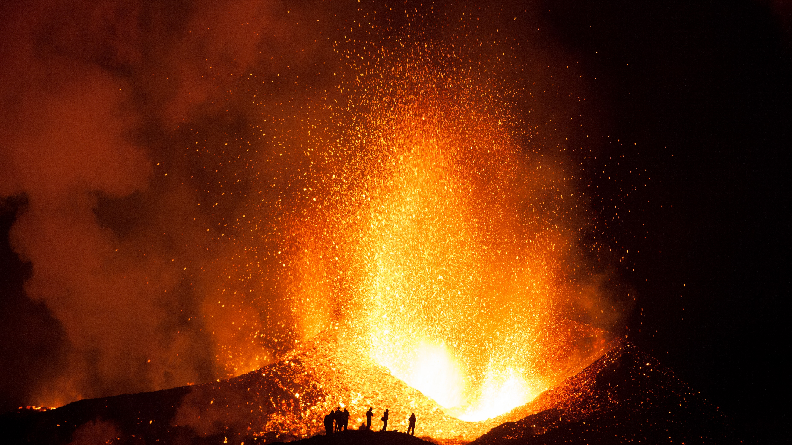
Revolutionary benefits across sectors
Scientific | Societal | Economic | Technological
A world class research facility to transform knowledge on the migration of magma and fluid, furthering volcanology, seismic, and geothermal research | Improving civil protection and living conditions for the 1 billion people who live within 100km of an active volcano | Providing more effective geothermal energy production at lower cost | Investigating in-situ; more effective volcano disaster protection systems; and new technology in drilling, measuring, and modelling in geothermal energy
KMT & EPOS Synergy
KMT is a world class, multi-disciplinary, cross-European project that:
Plays into all aspects of EPOS services and has implications for fundamental research, civil contingency, and energy science.

Slide 21
Revolutionary benefits across sectors
Scientific | Societal | Economic | Technological
A world class research facility to transform knowledge on the migration of magma and fluid, furthering volcanology, seismic, and geothermal research | Improving civil protection and living conditions for the 1 billion people who live within 100km of an active volcano | Providing more effective geothermal energy production at lower cost | Investigating in-situ; more effective volcano disaster protection systems; and new technology in drilling, measuring, and modelling in geothermal energy
KMT & EPOS Synergy
KMT is a world class, multi-disciplinary, cross-European project that:
Plays into all aspects of EPOS services and has implications for fundamental research, civil contingency, and energy science.
Co-funding is expected from key private sector partners, and the management system is well established and based on an EPOS/ECORD structure

Slide 22
Revolutionary benefits across sectors
Scientific | Societal | Economic | Technological
A world class research facility to transform knowledge on the migration of magma and fluid, furthering volcanology, seismic, and geothermal research | Improving civil protection and living conditions for the 1 billion people who live within 100km of an active volcano | Providing more effective geothermal energy production at lower cost | Investigating in-situ; more effective volcano disaster protection systems; and new technology in drilling, measuring, and modelling in geothermal energy
KMT & EPOS Synergy
KMT is a world class, multi-disciplinary, cross-European project that:
Plays into all aspects of EPOS services and has implications for fundamental research, civil contingency, and energy science.
Co-funding is expected from key private sector partners, and the management system is established

Slide 23
Revolutionary benefits across sectors
Scientific | Societal | Economic | Technological
A world class research facility to transform knowledge on the migration of magma and fluid, furthering volcanology, seismic, and geothermal research | Improving civil protection and living conditions for the 1 billion people who live within 100km of an active volcano | Providing more effective geothermal energy production at lower cost | Investigating in-situ; more effective volcano disaster protection systems; and new technology in drilling, measuring, and modelling in geothermal energy
KMT & EPOS Synergy
KMT is a world class, multi-disciplinary, cross-European project that:
Plays into all aspects of EPOS services and has implications for fundamental research, civil contingency, and energy science.
Co-funding is expected from key private sector partners, and the management system is well established and based on an EPOS/ECORD structure

Slide 24
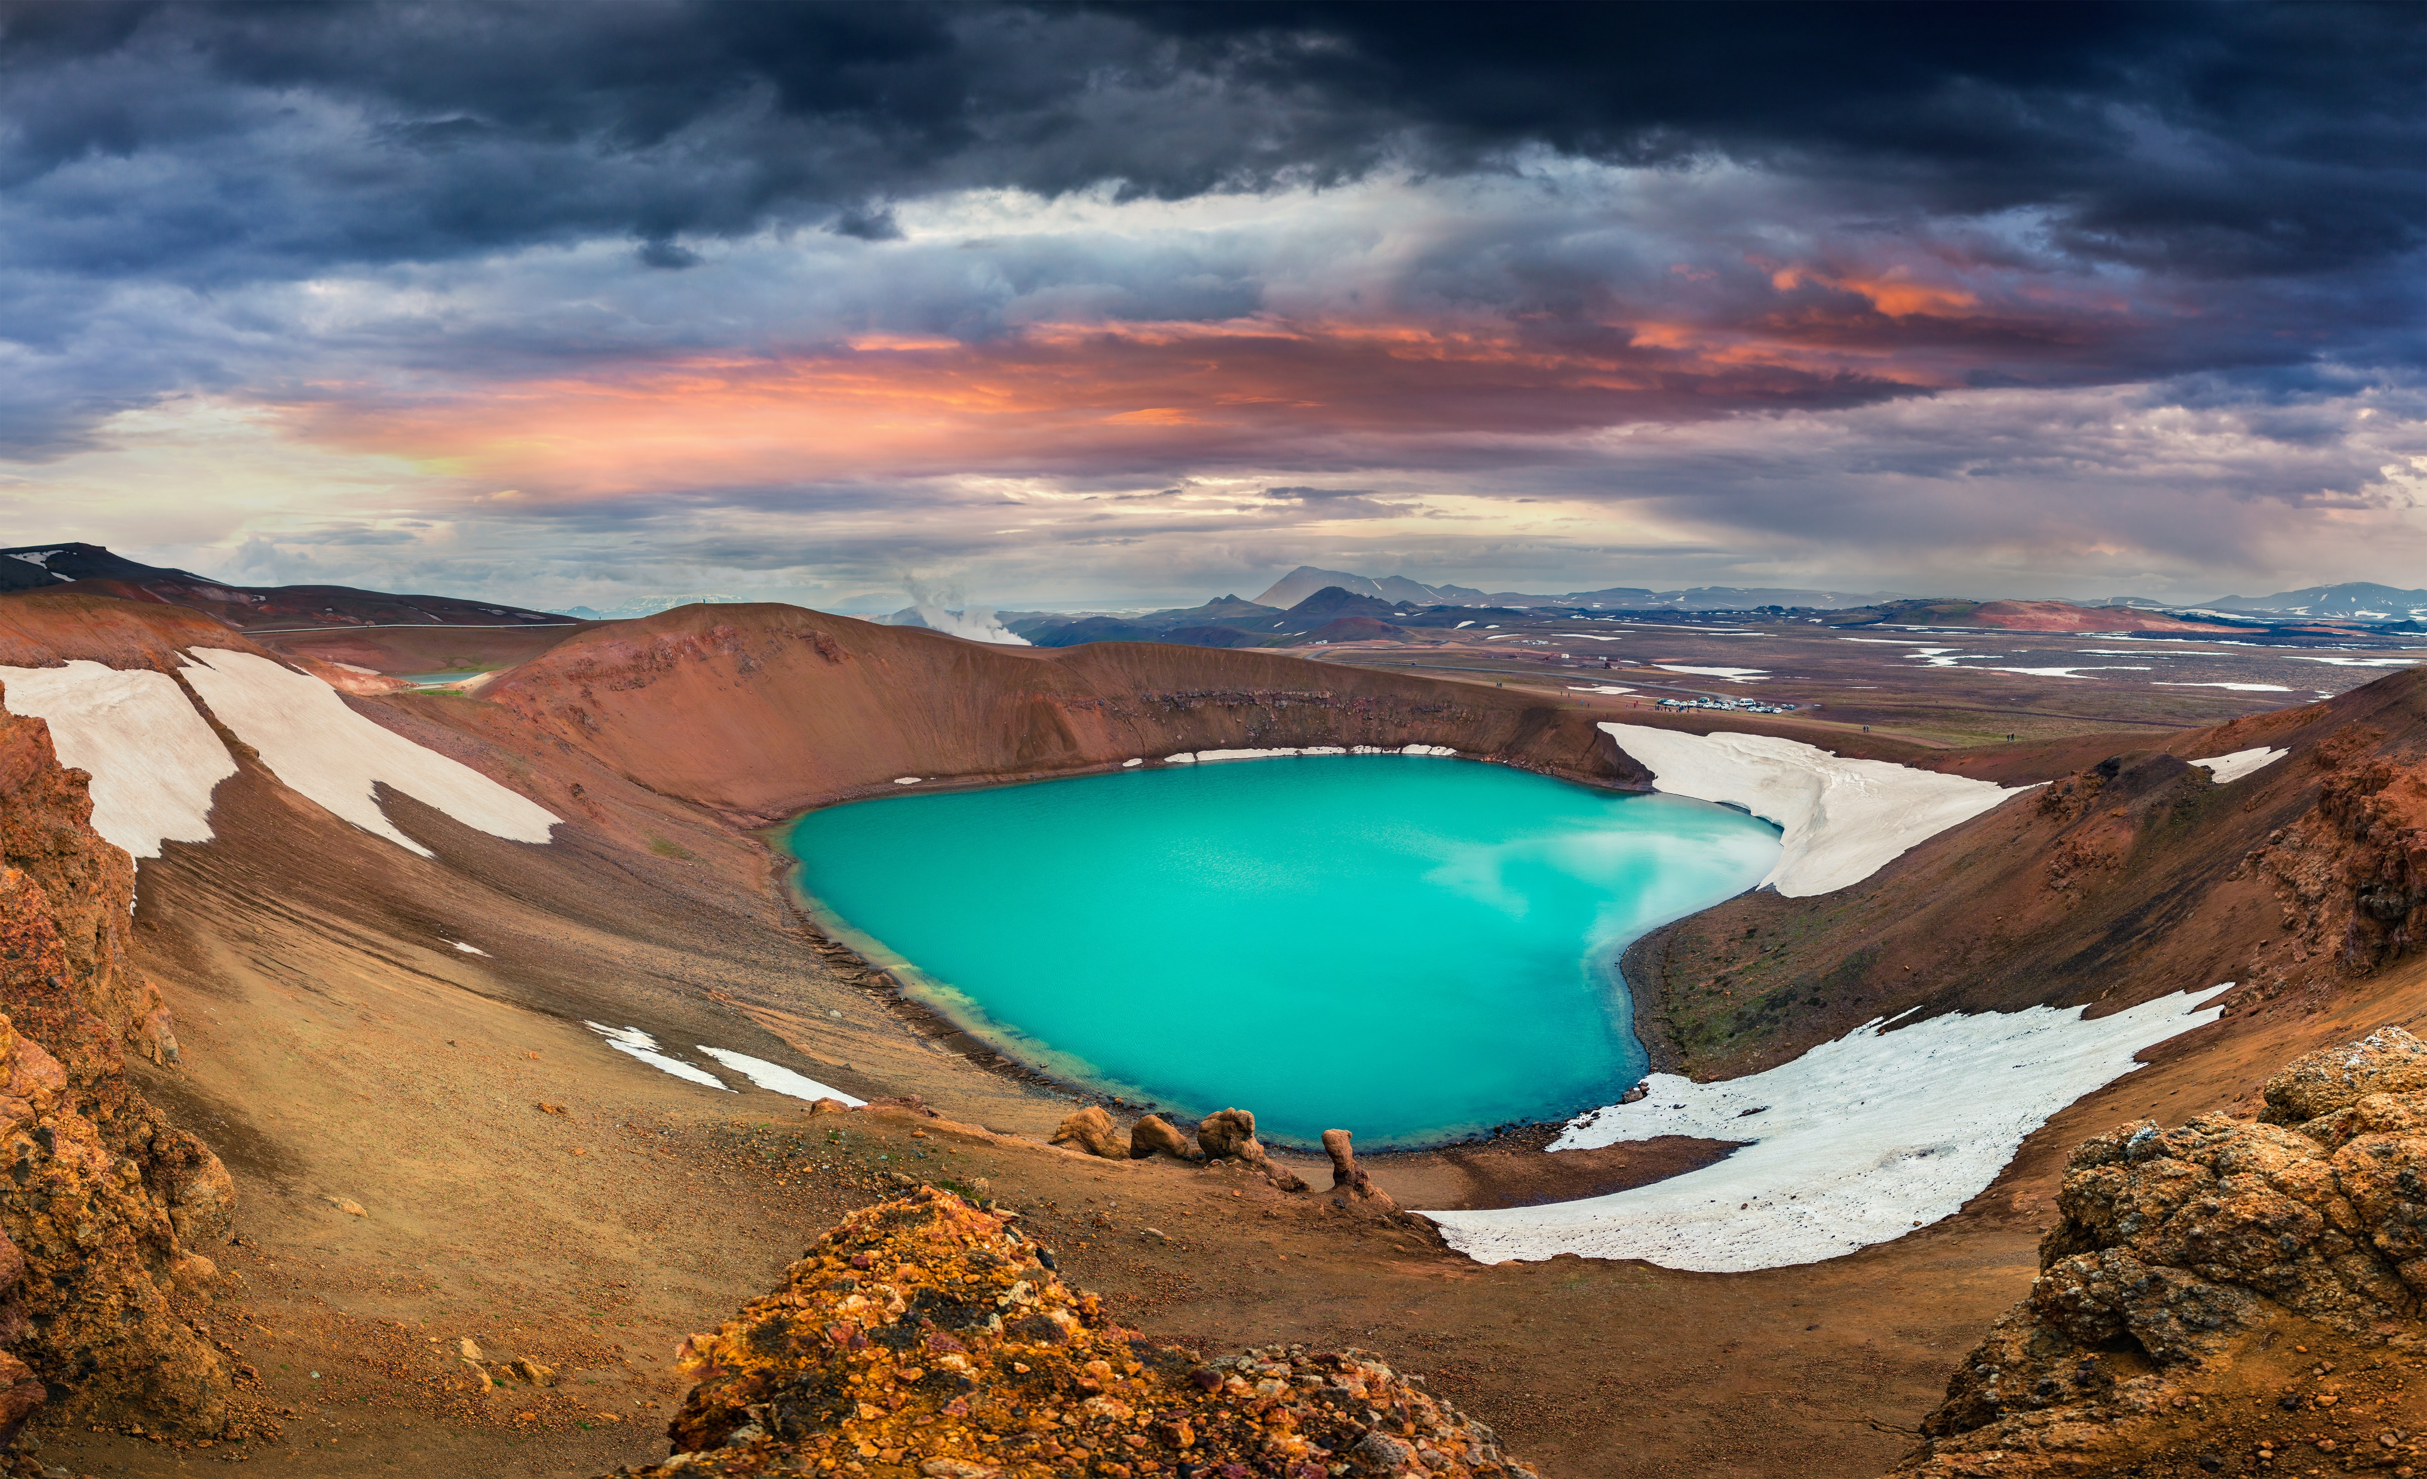
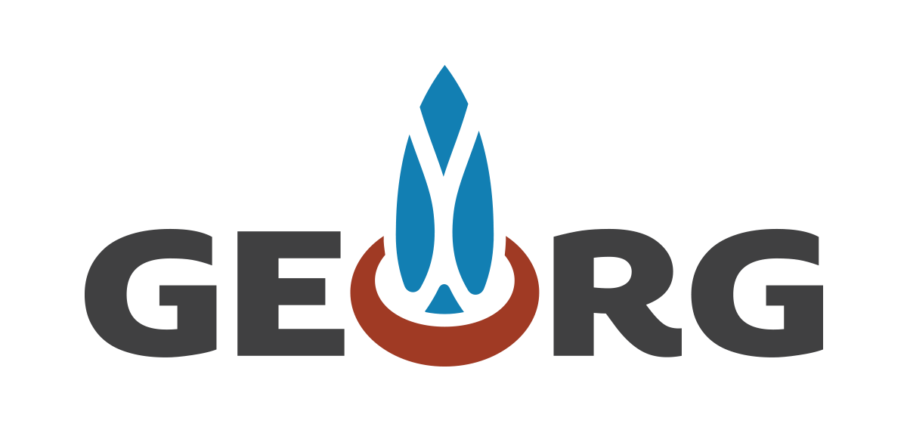
Revolutionary benefits across sectors
Scientific | Societal | Economic | Technological
A world class research facility to transform knowledge on the migration of magma and fluid, furthering volcanology, seismic, and geothermal research | Improving civil protection and living conditions for the 1 billion people who live within 100km of an active volcano | Providing more effective geothermal energy production at lower cost | Investigating in-situ; more effective volcano disaster protection systems; and new technology in drilling, measuring, and modelling in geothermal energy
A Non-Profit Organization (NPO) has already been established under Icelandic law

Slide 25
A Non-Profit Organization (NPO) has already been established under Icelandic law
The work of the NPO will be coordinated by
GEORG Geothermal Research Cluster

Slide 26
A Non-Profit Organization (NPO) has already been established under Icelandic law
The work of the NPO will be coordinated by
GEORG Geothermal Research Cluster
With an international project office with long-standing experience in managing complex projects

Slide 27
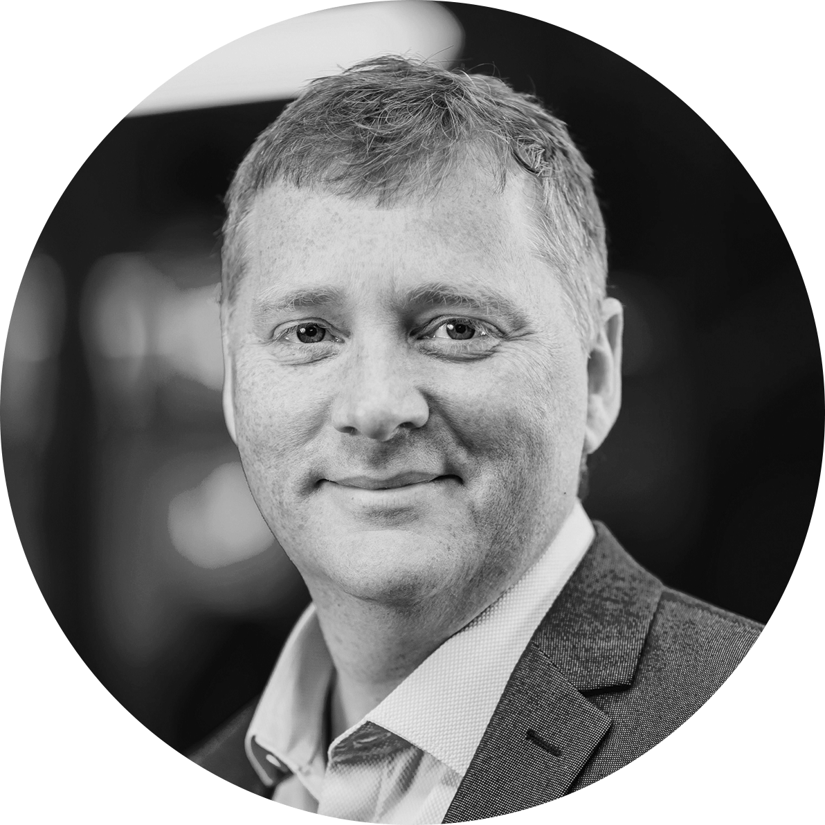
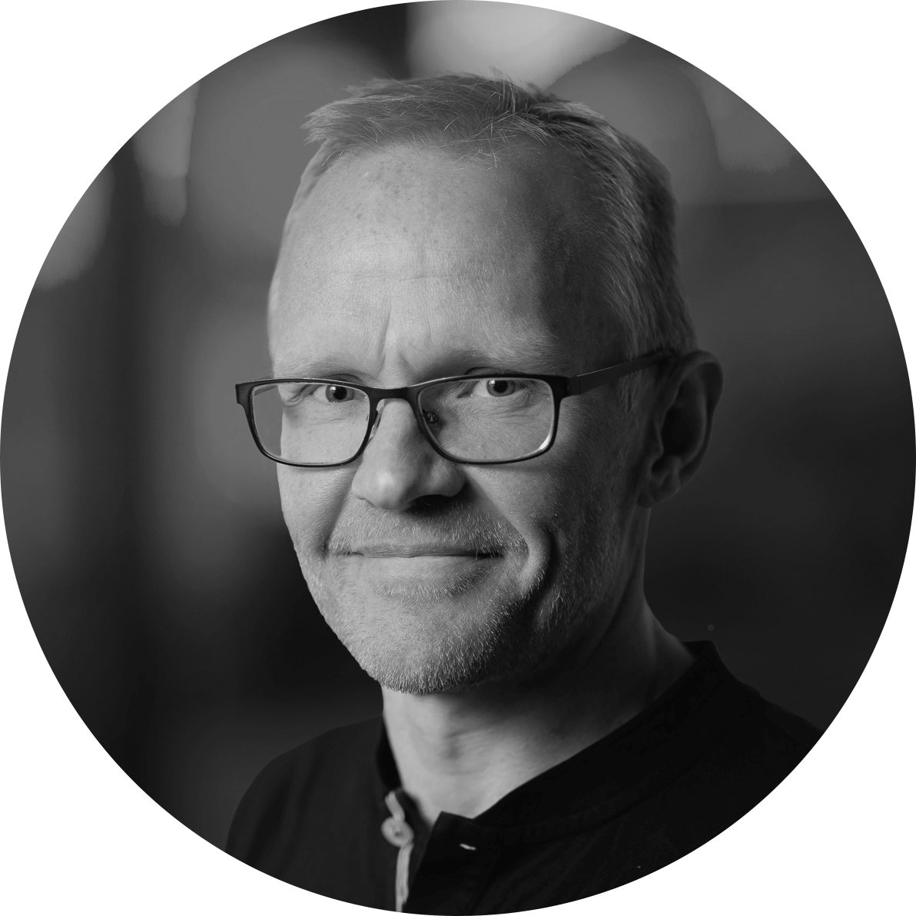
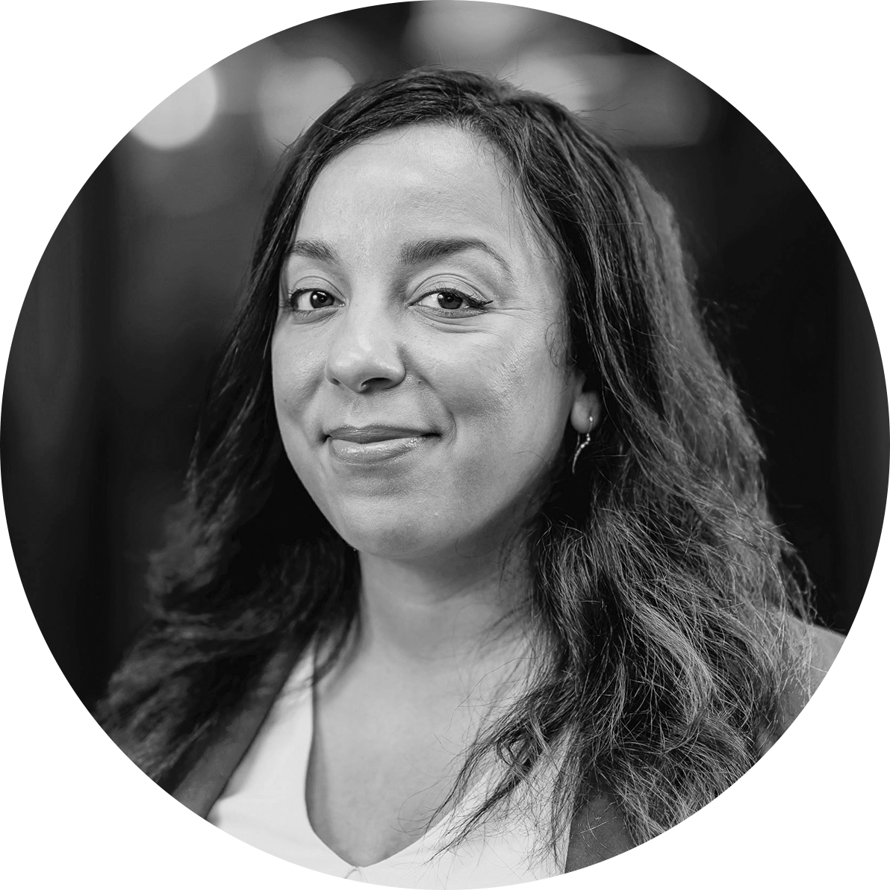
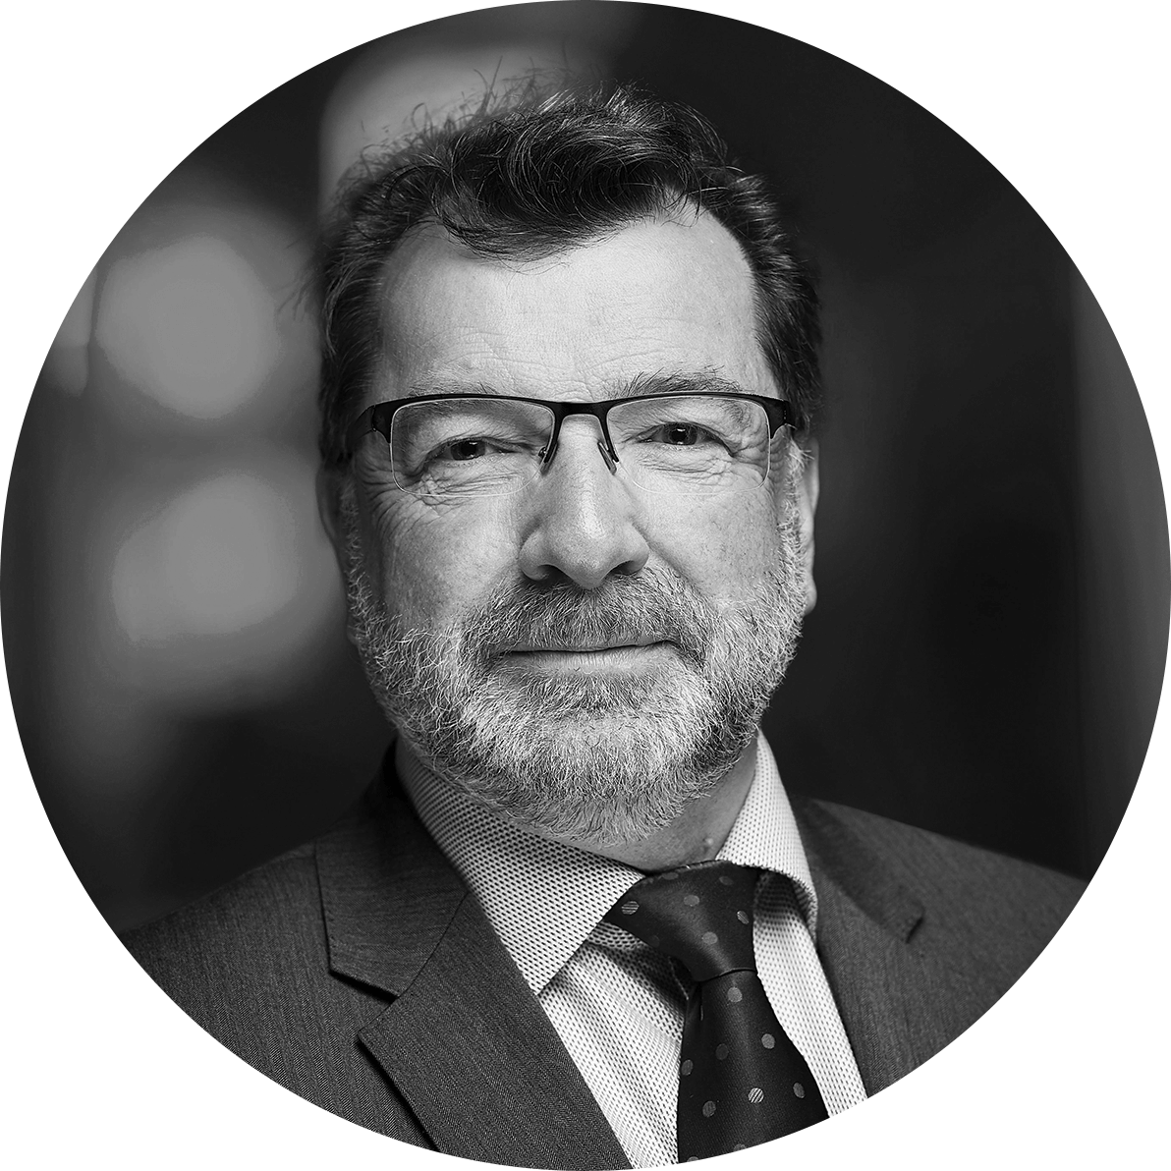
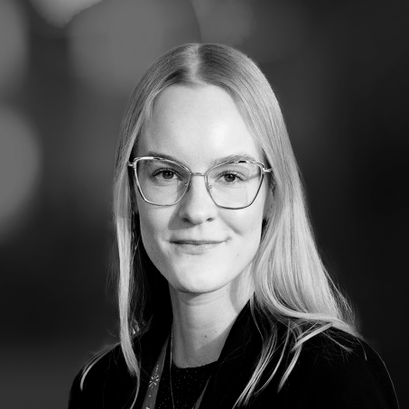
The work of the NPO will be coordinated by
GEORG Geothermal Research Cluster
Hjalti Páll Ingólfsson
Björn Þór Guðmundsson
Amel
Barich
John
Ludden
Eva Laufey
Eggertsdóttir
With an international project office with long-standing experience in managing complex projects

Slide 28
A Non-Profit Organization (NPO) has already been established under Icelandic law
The work of the NPO will be coordinated by
GEORG Geothermal Research Cluster
The estimated funding needs of the project are $105 million over the next 6 years
Hjalti Páll Ingólfsson
Björn Þór Guðmundsson
Amel
Barich
John
Ludden
Eva Laufey
Eggertsdóttir
With an international project office with long-standing experience in managing complex projects

Slide 29
The work of the NPO will be coordinated by
GEORG Geothermal Research Cluster
The estimated funding needs of the project are $105 million over the next 6 years
Hjalti Páll Ingólfsson
Björn Þór Guðmundsson
Amel
Barich
John
Ludden
Eva Laufey
Eggertsdóttir
With an international project office with long-standing experience in managing complex projects
KMT enjoys strong support from the Government of Iceland, and financial support as well as scientific acknowledgment from ICDP

Slide 30
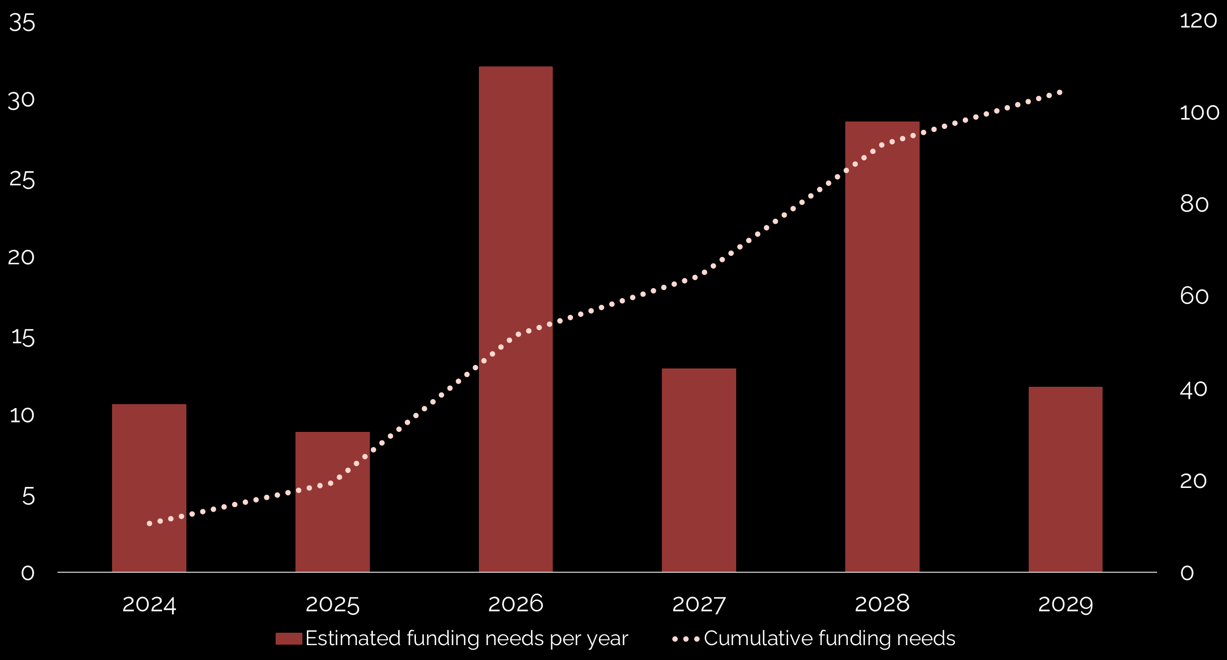
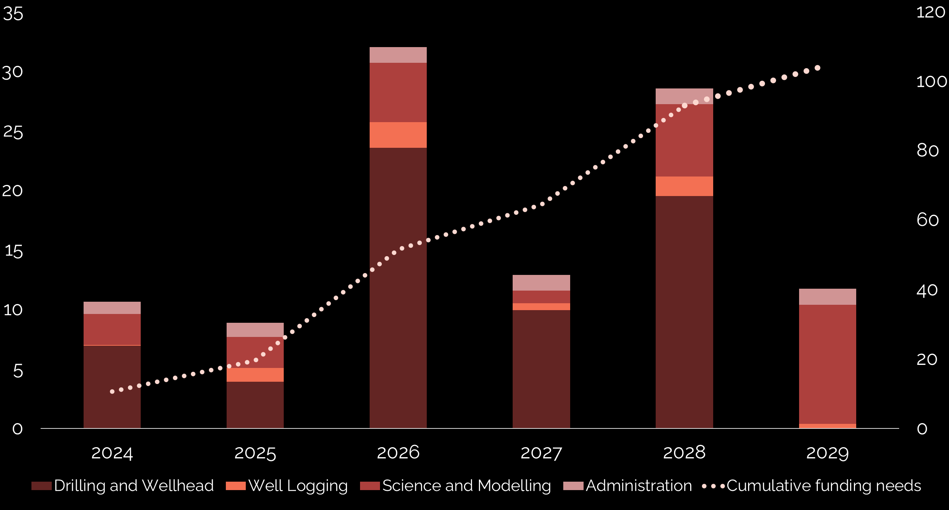
The estimated funding needs of the project are $105 million over the next 6 years

Slide 31
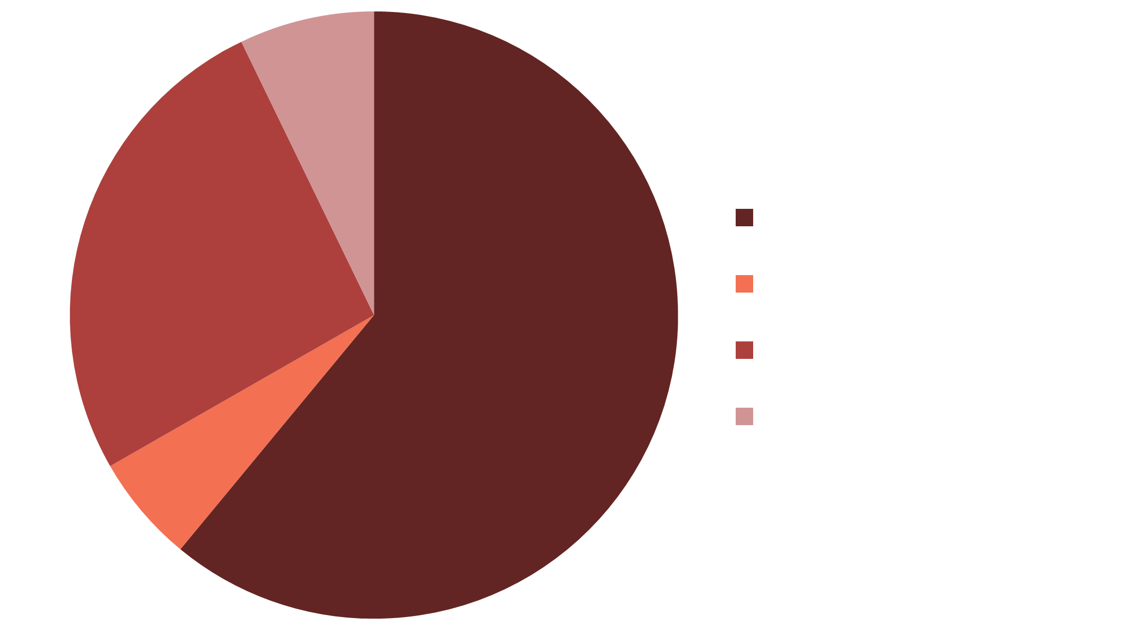
The estimated funding needs of the project are $105 million over the next 6 years

Slide 32
The estimated funding needs of the project are $105 million over the next 6 years

Slide 33
The estimated funding needs of the project are $105 million over the next 6 years
KMT welcomes new partners, both in the interest of scientific collaboration and financial contribution
KMT enjoys strong support from the Government of Iceland, and financial support as well as scientific acknowledgment from ICDP

Slide 34
The estimated funding needs of the project are $105 million over the next 6 years
KMT welcomes new partners, both in the interest of scientific collaboration and financial contribution
KMT enjoys strong support from the Government of Iceland, and financial support as well as scientific acknowledgment from ICDP

Slide 35
The estimated funding needs of the project are $100 million over the next 10 years
KMT welcomes new partners, both in the interest of scientific collaboration and financial contribution
Get in touch!

Slide 36
KMT welcomes new partners, both in the interest of scientific collaboration and financial contribution
Get in touch!
Join us in

Slide 38
Get in touch!
Join us in
www.KMT.is
Info@kmt.is
Krafla Magma Testbed - KMT
Krafla Magma Testbed (KMT)
@KraflaMagmaTestbed
@KMT_Project

Slide 39
Get in touch!
Join us in
www.KMT.is
Info@kmt.is
Krafla Magma Testbed - KMT
Krafla Magma Testbed (KMT)
@KraflaMagmaTestbed
@KMT_Project

