Slide 1



EUREF, and the link between EUREF and EPOS
EPOS days, 11-14 March 2024, Rome, Italy
Juliette Legrand, Martin Lidberg, Carine Bruyninx,
W. Söhne, R. Dach, A. Kenyeres, K. Kollo, T. Liwosz, B. Männel, R. Pacione, M. Sacher, J. Schwabe, C. Völksen, J. Zurutuza, A. Araszkiewicz, Z. Altamimi, A. Caporali, M. Poutanen, J. A. Torres

Slide 2
Content
What is EUREF?
  Mission
  EUREF Governance
  EUREF Data and Products
EUREF – EPOS link

Slide 3
What is EUREF?

Slide 4
What is EUREF? –”WHO WE ARE”
“EUREF is the Reference Frame Sub-Commission for Europe
of the International Association of Geodesy (IAG) ,
integrated in the Sub-Commission 1.3, Regional Reference Frames,
under Commission 1 – Reference Frames”
The Sub-Commission EUREF was founded in 1987
at the IUGG General Assembly held in Vancouver.*
And since that time, it is responsible for the harmonization
of the geodetic infrastructure (in a broad sense) in Europe.
EUREF aims at continuing to be
the recognized expert organization on geodesy for Europe.
* From: http://www.euref.eu/

Slide 5
EUREF’s primary mission and vision
“EUREF’s primary mission is to establish and maintain homogenous and sustainable reference frames:
  the European Vertical Reference System
    physical or gravity related heights
  the European coordinate reference system ETRS89
    geodetic reference frame attached to the European Plate
    convenient tool to express position time series and velocities of crustal deformations in a standardized way!
Both ETRS89 and EVRS are recommenced by the EU INSPIRE directive (Infrastructure for Spatial Information in Europe), they are mandatory for exchange of geodata within the stable part of Europe.
including data, products, services and tools, based on best available scientific background and taking into account user needs.

Slide 6
EUREF Governance
Chair: M. Lidberg*
Governing Board: chair (W. Söhne*)
members from both mapping and scientific agencies
Coordinators
  Network Coordinator (C. Bruyninx*)
  Analysis Center Coordinator (T. Liwosz*)
  Reference Frame Coordinator (J. Legrand*)
  Troposphere Coordinator (R. Pacione)
Working Groups
  EPN Densification Working Group (2015 – now, chaired by A. Kenyeres*)
  Deformation Models Working Group (2012-now , chaired by M. Lidberg*)
  EPN Reprocessing Working Group (2009 - now , chaired by C. Voelksen)
  EPN Real-Time Analysis Project (2008 - now , chaired by W. Söhne*)
* member of EPOS GNSS TCS consortium board

Slide 7
EUREF – Data and Products

Slide 8
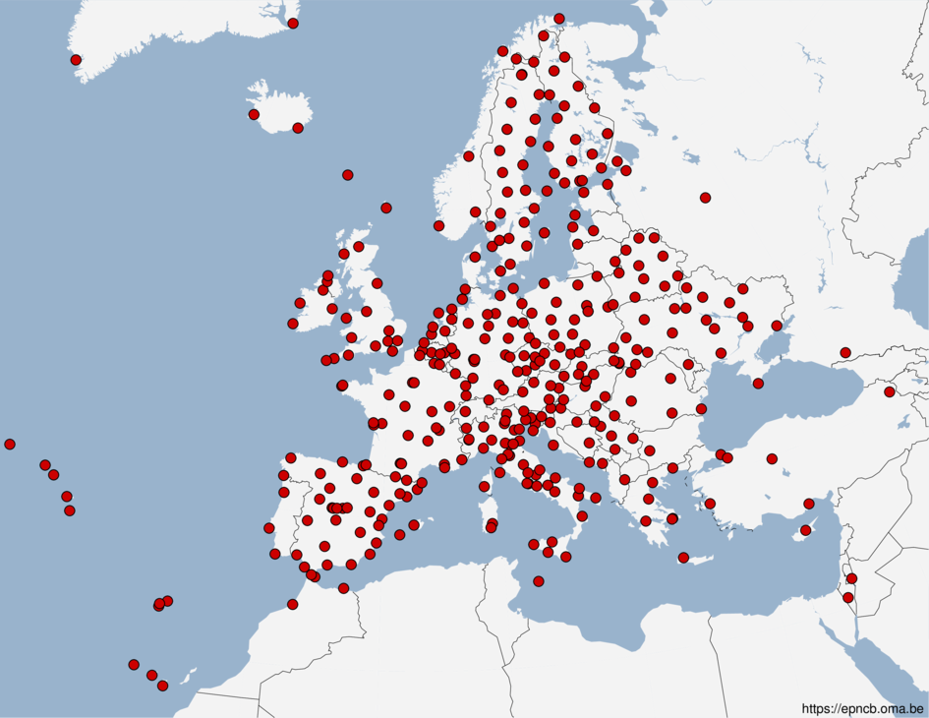
The EUREF Permanent GNSS network, EPN
Started in 1996
More than 400 GNSS stations
EPN Central Bureau (ROB): daily monitoring and management of the EPN (Network Coordinator)
3 Data Centers (BKG, BEV, ROB EPN historical data center) archive and provide access to GNSS data
17 Analysis Centers analyze the data
3 coordinators generate the EPN products:
  Analysis Center Coordinator: Combined Daily Positions in the latest ITRF, rapid and final product, daily updates
  Reference Frame Coordinator: Positions and Velocities in the latest ITRF or ETRF,
  Position time series, updated every 15 weeks
  Troposphere Coordinator
100+ agencies/universities providing operational data/products (using 100% in kind)
Well-defined standards/guidelines for homogenous long-term quality of the EPN products
https://epncb.oma.be/

Slide 9
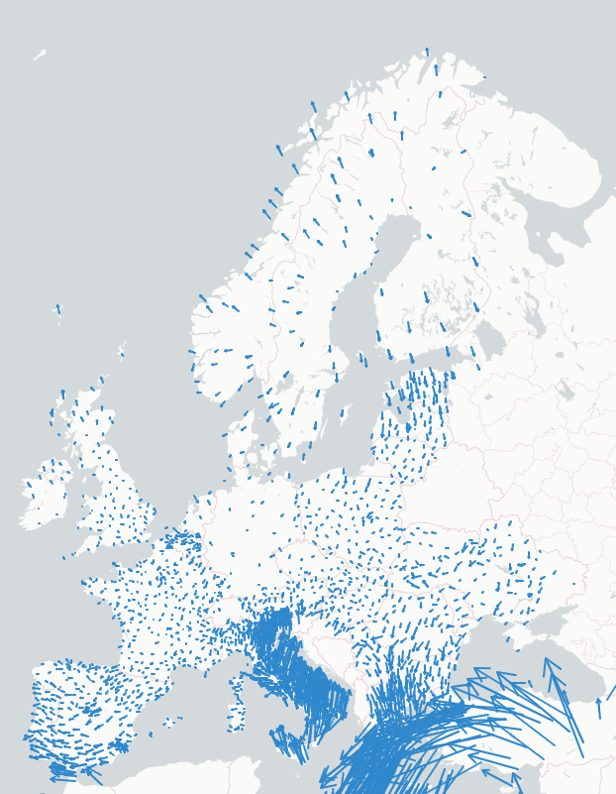
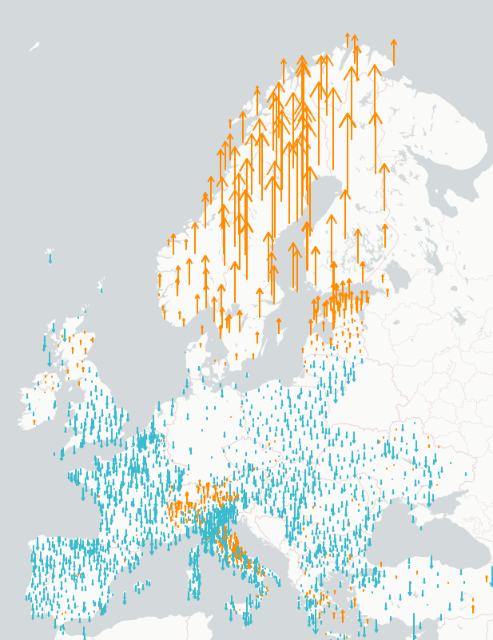


EPN Densification Working Group
WG started in 2015
densification activities started in 2010 in EUREF (2007 for EUPOS)
Goal: dense European velocity field
Harmonization and homogenization of existing national Permanent GNSS solutions and station metadata
30 Analysis Centers providing position solutions
A Combination Center:
  Weekly Position time series
  Velocity field for 2600+ stations expressed in IGb14
Future versions also based on EPOS solutions
https://epnd.sgo-penc.hu/
Horizontal velocity field in ETRF2000
Vertical velocity field in ETRF2000

Slide 10
EUREF WG on deformation models
EuVeM2022: European Velocity Model 2022
  3D Gridded deformation model for Europe
  derived from EPN densification velocity field
  using collocation methodology
  Intended for scientific use and practical geodetic needs (such as coordinate transformations)
Strain rates (LM)
  Collaboration between EUREF Deformation Models Working Group and EPOS
  https://www.lantmateriet.se/doi/10.23701/sr.0001
  Preliminary version calculated from EPN densification velocity field
  Future versions calculated from EPND-EPOS velocities

Slide 11
European Vertical Reference System and Frame, EVRS/EVRF
EVRS is realized through a common adjustment of available national precise levelling networks that form the United European Levelling Network, UELN
The height reference is the level of Normaal Amsterdam Peil, NAP
The recent realization EVRF2019
  ~14 000 observations / ~11 000 unknowns
  Average standard uncertainty ~1mm/√km
  Reduced to epoch 2000.0 for areas with clear secular velocities where velocity models are available (Fennoscandia and Switzerland)
Provides physical height reference e.g. used to understand water level around Europe, including sea level topography

Slide 12
EUREF – EPOS link

Slide 13
EUREF – EPOS link
EPOS ambition out of the scope of EUREF
3000+ stations
Less strict guidelines
Products focusing on solid earth research
But harmonization with EUREF
must be guaranteed!
EUREF appointed person to
ensure interface with EPOS
2011: EPOS reaches out to EUREF
2015: Start EPOS Implementation Phase
2018: Signature of the consortium agreement
2019: EUREF resolution encouraging its members to contribute to EPOS
2020: Start of EPOS Pilot Operational Phase
2022: Formalization of collaboration EUREF-EPOS: Signature of MoU
2023: Start of the EPOS Operational Phase
2024: Signature of a EPOS/EUREF Work Plan

Slide 14
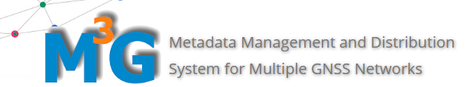
EUREF – EPOS link
EUREF is not a legal entity
Several Agencies participating to EUREF helped to:
  shape the future EPOS infrastructure
  start of the development of an interface between EUREF data centers and product and EPOS
  assure EUREF standards are transposed to EPOS
2011: EPOS reaches out to EUREF
2015: Start EPOS Implementation Phase
2018: Signature of the consortium agreement
2019: EUREF resolution encouraging its members to contribute to EPOS
2020: Start of EPOS Pilot Operational Phase
2022: Formalization of collaboration EUREF-EPOS: Signature of MoU
2023: Start of the EPOS Operational Phase
2024: Signature of a EPOS/EUREF Work Plan
ROB started to develop a common tool for GNSS station medatata management: M³G
One place to handle stations common to EPOS and EUREF
M3G under permanent development: both EUREF and EPOS share a common desire to evolve towards FAIR data principles
No consensus in EUREF GB to include the whole EPN in EPOS

Slide 15
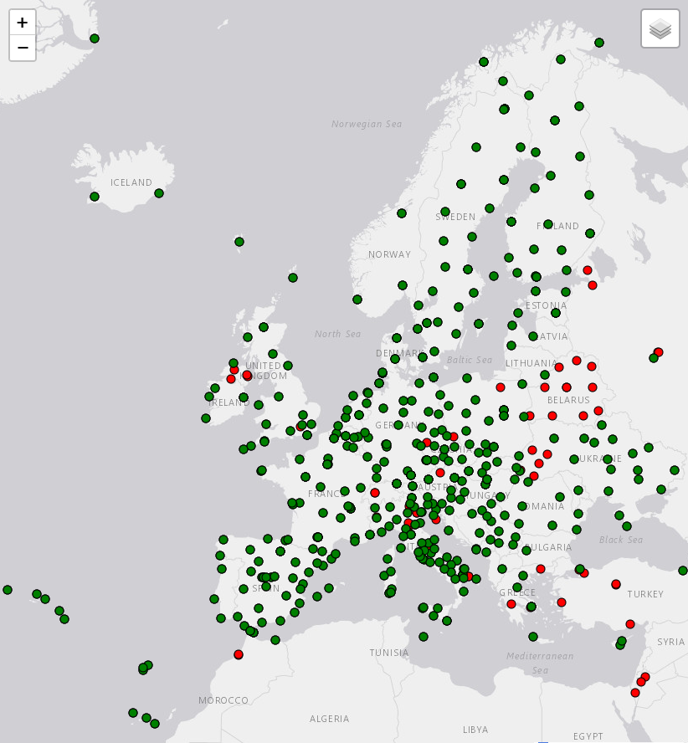
EPN stations integrated in EPOS
EPN stations in EPOS
EPN stations not in EPOS
EUREF doesn’t own the GNSS data
need for explicit permission of each individual data providers
440 from 507 EPN stations in EPOS
Number of EPN stations integrated in EPOS

Slide 16
EUREF – EPOS link
5 Agencies participating to EUREF signed the consortium agreement
BKG (Bundesamt für Kartographie und Geodäsie, DEU)
SGO/LTK (Satellite Geodetic Observatory/Lechner Non-profit Ltd., HUN)
LM (Lantmäteriet, SWE)
ROB (Royal Observatory of Belgium, BEL)
WUT (Warsaw University of Technology, POL)
The mission of TCS EPOS-GNSS is to provide, through the European Plate Observing System (EPOS), access to GNSS data, meta-data, and products in support of the Solid Earth Sciences. To achieve this goal, EPOS-GNSS:
facilitates access to relevant GNSS data, meta-data, and data products,
coordinates the archiving of relevant GNSS data, metadata and data products,
promotes best practice for GNSS station operation, data quality control and data management,
maintains and distributes open source software for GNSS data, metadata and product discoverability,
maintains and develops GNSS data products.
These efforts are done in close partnership with EUREF, the IAG sub-commission for the European Reference Frame.
2011: EPOS reaches out to EUREF
2015: Start EPOS Implementation Phase
2018: Signature of the consortium agreement
2019: EUREF resolution encouraging its members to contribute to EPOS
2020: Start of EPOS Pilot Operational Phase
2022: Formalization of collaboration EUREF-EPOS: Signature of MoU
2023: Start of the EPOS Operational Phase
2024: Signature of a EPOS/EUREF Work Plan

Slide 17
EUREF – EPOS link
EUREF 2019 Resolution No2
The Reference Frame Sub-commission for Europe (EUREF) IAG
recognising that that the European Plate Observing System (EPOS) will maintain a sustainable European infrastructure for solid Earth studies from 2020 onwards, including a GNSS infrastructure and related GNSS-based products
and noting the efforts of the EUREF community towards the derivation of a European deformation model in order to improve cross-boundary positioning
and considering that many European countries active in EUREF are a member (or planning to become a member) of the EPOS European Research Infrastructure Consortium (ERIC)
encourages the EUREF community to also contribute to EPOS especially to its GNSS component
2011: EPOS reaches out to EUREF
2015: Start EPOS Implementation Phase
2018: Signature of the consortium agreement
2019: EUREF resolution encouraging its members to contribute to EPOS
2020: Start of EPOS Pilot Operational Phase
2022: Formalization of collaboration EUREF-EPOS: Signature of MoU
2023: Start of the EPOS Operational Phase
2024: Signature of a EPOS/EUREF Work Plan

Slide 18
EUREF – EPOS link
2011: EPOS reaches out to EUREF
2015: Start EPOS Implementation Phase
2018: Signature of the consortium agreement
2019: EUREF resolution encouraging its members to contribute to EPOS
2020: Start of EPOS Pilot Operational Phase
2022: Formalization of collaboration EUREF-EPOS: Signature of MoU
2023: Start of the EPOS Operational Phase
2024: Signature of a EPOS/EUREF Work Plan
Start of EPOS Pilot Operational Phase
4 Agencies participating to EUREF committed to provide EUREF or EUREF/EPOS data or products
SGO/LTK (Satellite Geodetic Observatory/Lechner Non-profit Ltd., HUN)
LM (Lantmäteriet, SWE)
ROB (Royal Observatory of Belgium, BEL)
WUT (Warsaw University of Technology, POL)

Slide 19
EUREF related data and products
Data Services
Centralized access to daily RINEX data through EPOS-GNSS Data Gateway (DGW)
  Common EUREF-EPOS system (M³G) (ROB) for collection of, and access to, station metadata
  Access to EUREF RINEX data from the EPN Historical Data Center hosted by ROB through ROB-EUREF data node
    ⇒ 440 stations, 37% of the RINEX files discoverable at the DGW
Contributions from
EPN station managers
EPN Central Bureau
Product Services
Centralized access to GNSS products through EPOS-GNSS Product Portal
  EUREF products
    EPN daily combined position solutions (WUT-EUREF)
    EPN reference frame product (ROB-EUREF)
      Velocity field and position time series for 380 stations
  Common EUREF-EPOS products
    EPND+EPOS velocities (SGO/LTK-EPND)
      Velocity field and position time series for 2600+ stations
    Strain rates (LM)
Contributions from
EPN analysis centers
EPN analysis center coordinator
EPN reference frame coordinator
EPN densification WG
EPN densification analysis centers
EPN deformation modeling WG

Slide 20
EUREF – EPOS link
Summer of 2022 : EPOS and EUREF sign MoU
1st time we have a formal agreement between EUREF and EPOS to collaborate.
Before the link was only done through “agencies participating to EUREF” which were also contributing to EPOS at their own responsibility!
collaboration on standards and guidelines
develop common components
inform each other on progress, projects or initiatives
raise awareness of the complementarity of the two initiatives in each of the two communities
2011: EPOS reaches out to EUREF
2015: Start EPOS Implementation Phase
2018: Signature of the consortium agreement
2019: EUREF resolution encouraging its members to contribute to EPOS
2020: Start of EPOS Pilot Operational Phase
2022: Formalization of collaboration EUREF-EPOS: Signature of MoU
2023: Start of the EPOS Operational Phase
2024: Signature of a EPOS/EUREF Work Plan

Slide 21
EUREF – EPOS link
2011: EPOS reaches out to EUREF
2015: Start EPOS Implementation Phase
2018: Signature of the consortium agreement
2019: EUREF resolution encouraging its members to contribute to EPOS
2020: Start of EPOS Pilot Operational Phase
2022: Formalization of collaboration EUREF-EPOS: Signature of MoU
2023: Start of the EPOS Operational Phase
2024: Signature of a EPOS/EUREF Work Plan

Slide 22
EUREF – EPOS link
Work plan 2024 -2025
Meetings (virtual) to map GNSS standards and guidelines in use within EPOS and EUREF and identify needs for harmonisation.
Meetings (virtual) to map EPOS and EUREF operational GNSS activities and their interconnection with the goal to exploit complementarities and optimize the services provided by both.
Presentation of the services provided by the EPOS TCS Satellite Data to EUREF Governing Board and symposium.
Participation to symposia or workshops organised by the other Party with the goal to present past and future activities related to the MoU.
2011: EPOS reaches out to EUREF
2015: Start EPOS Implementation Phase
2018: Signature of the consortium agreement
2019: EUREF resolution encouraging its members to contribute to EPOS
2020: Start of EPOS Pilot Operational Phase
2022: Formalization of collaboration EUREF-EPOS: Signature of MoU
2023: Start of the EPOS Operational Phase
2024: Signature of a EPOS/EUREF Work Plan

Slide 23
Work Plan and Perspectives
Work Plan
  Meetings (virtual) to map GNSS standards and guidelines in use within EPOS and EUREF and identify needs for harmonisation.
  Meetings (virtual) to map EPOS and EUREF operational GNSS activities and their interconnection with the goal to exploit complementarities and optimize the services provided by both.
  Presentation of the services provided by the EPOS TCS Satellite Data to EUREF Governing Board and symposium.
  Participation to symposia or workshops organised by the other Party with the goal to present past and future activities related to the MoU.
Other potential area of possible EUREF/EPOS cooperation:
  European gravity field
  Absolute gravity observations and time series
  Geoid model / height reference surface

Slide 24
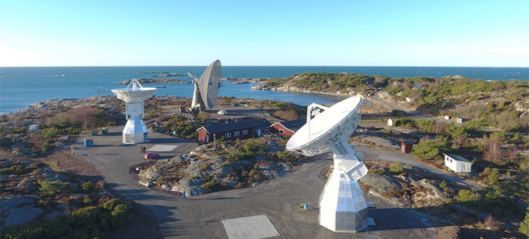
Thanks for your attention!
martin.lidberg@lm.se

Slide 25








The International Association of Geodesy (IAG)
IAG is one of the Associations
within the International Union of Geodesy and Geophysics (IUGG)
Several of the EPOS TCSs have implicitly a scientific link to one of these associations

