Slide 1
EarthScope Consortium
vision for partnership

Slide 2
What is EarthScope?

Slide 3
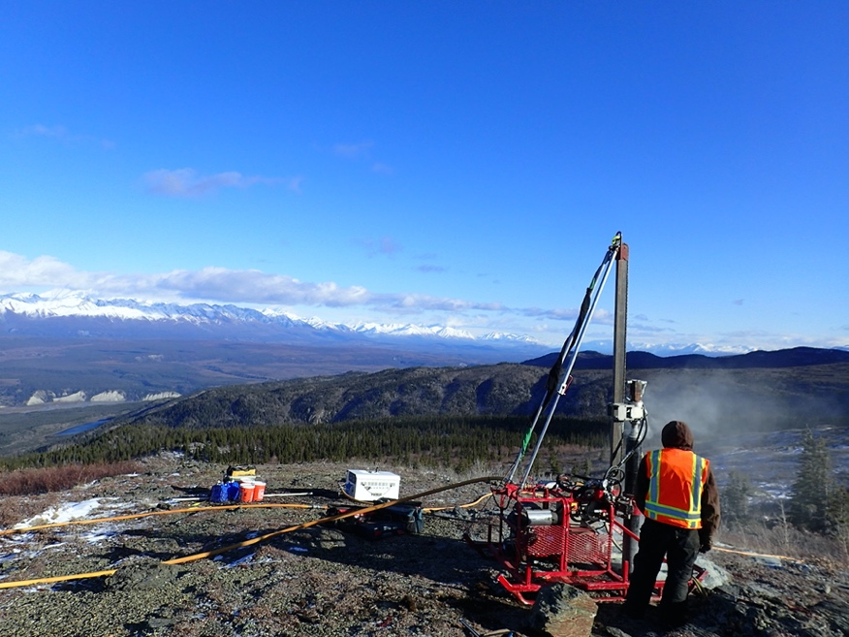
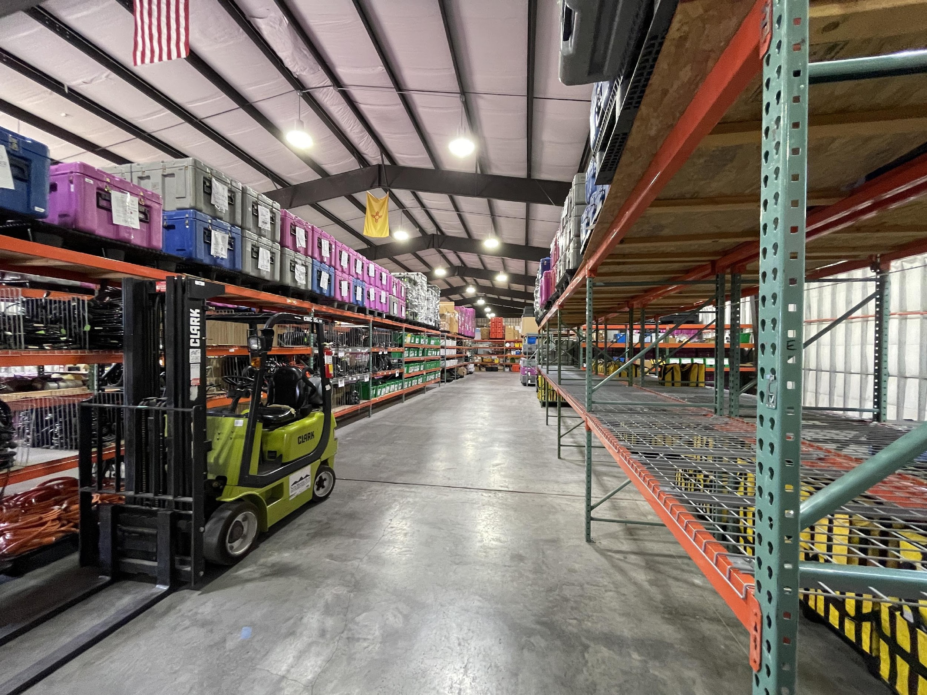
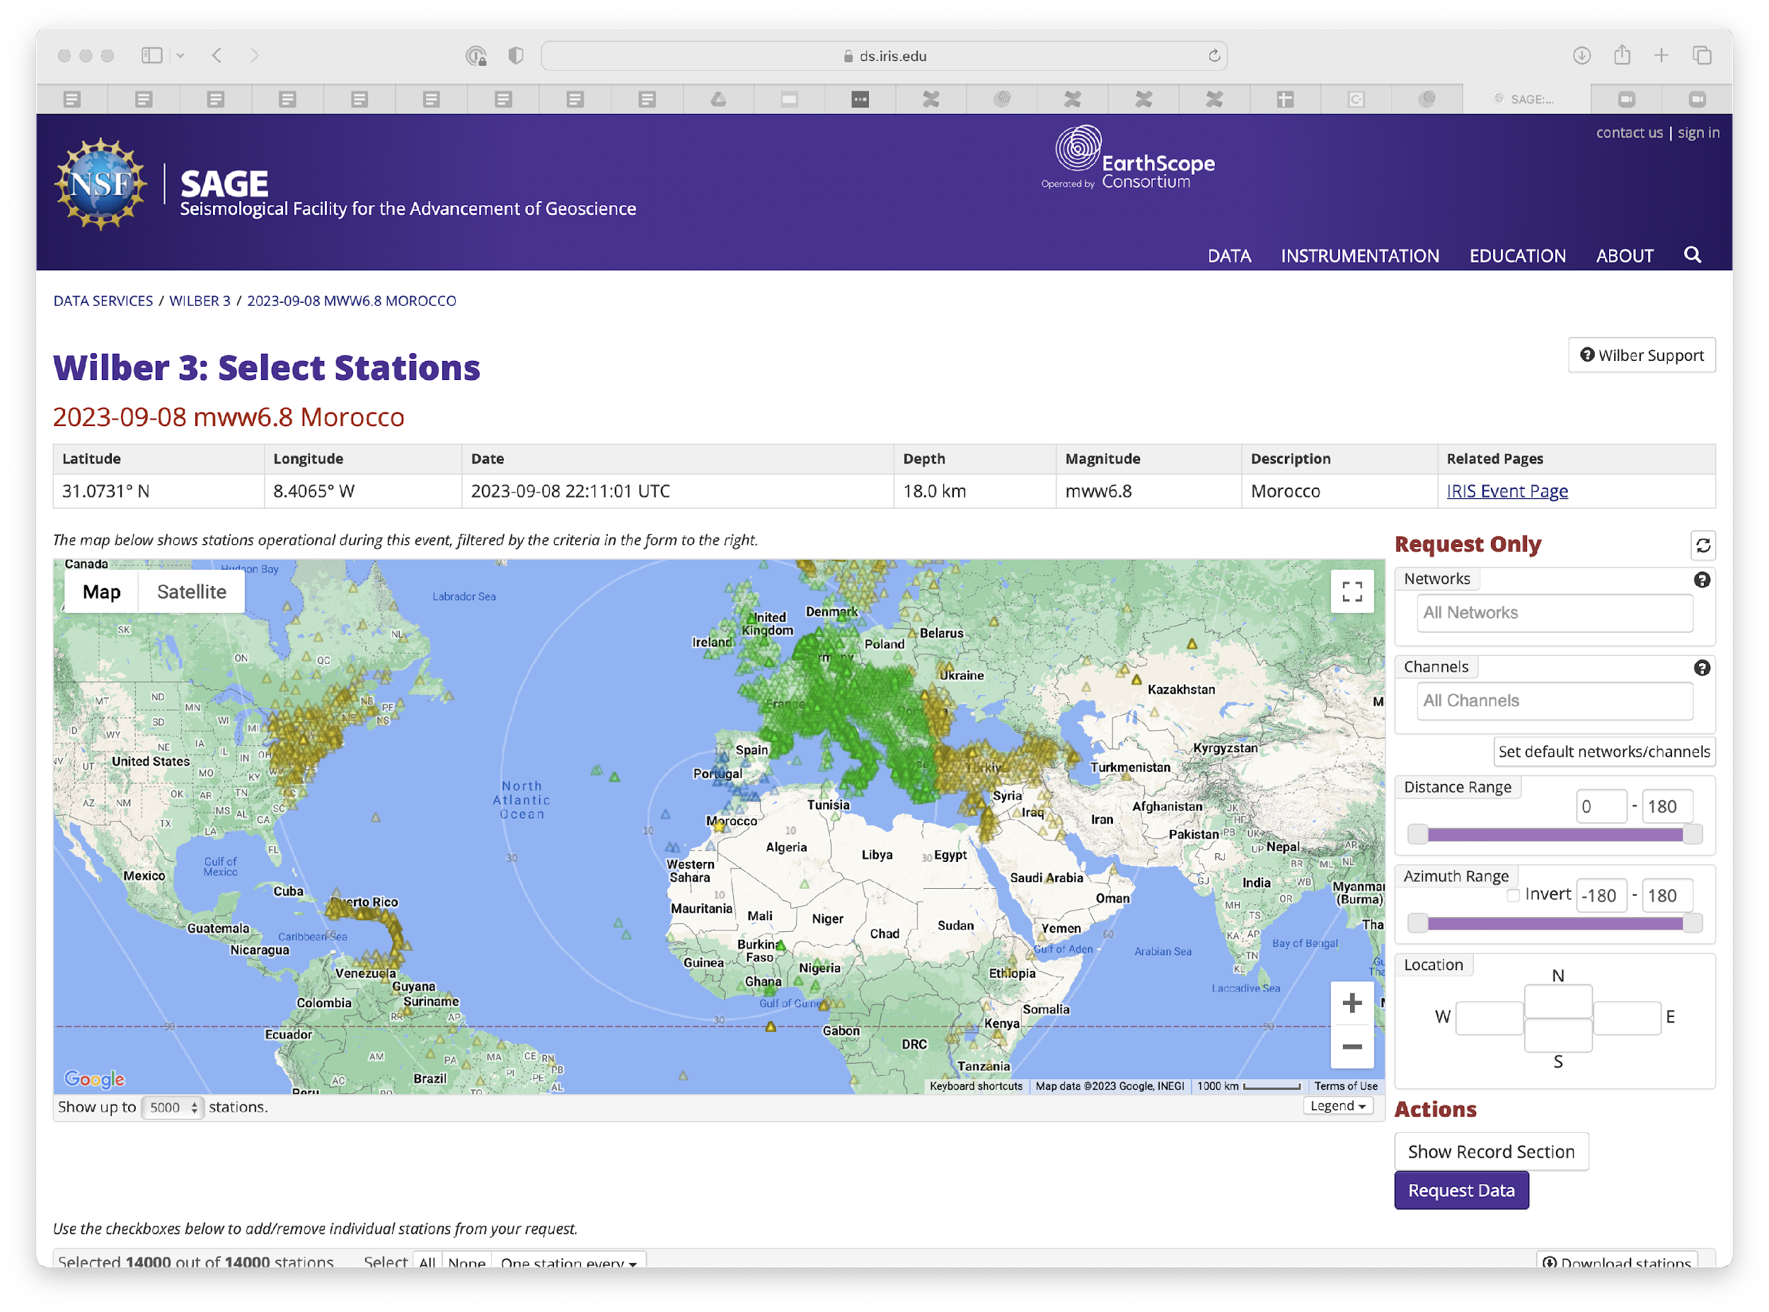
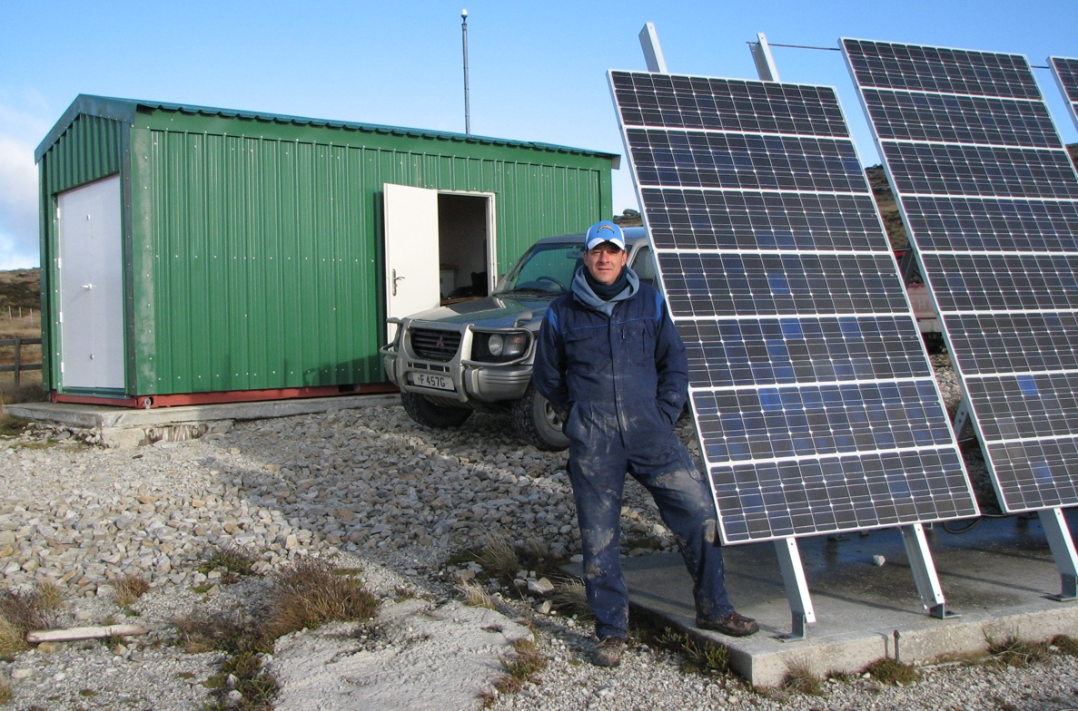
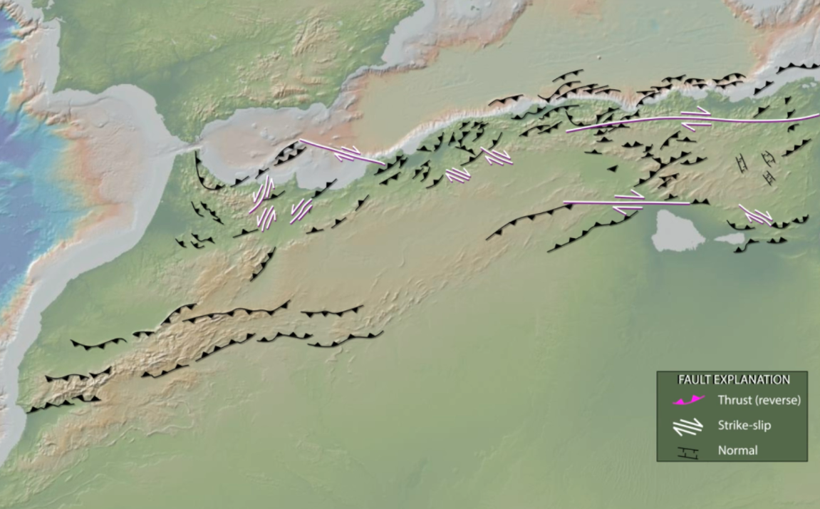
components of SAGE
active source
portable seismic
data and products
GSN
MT
engagement
GSN

Slide 4
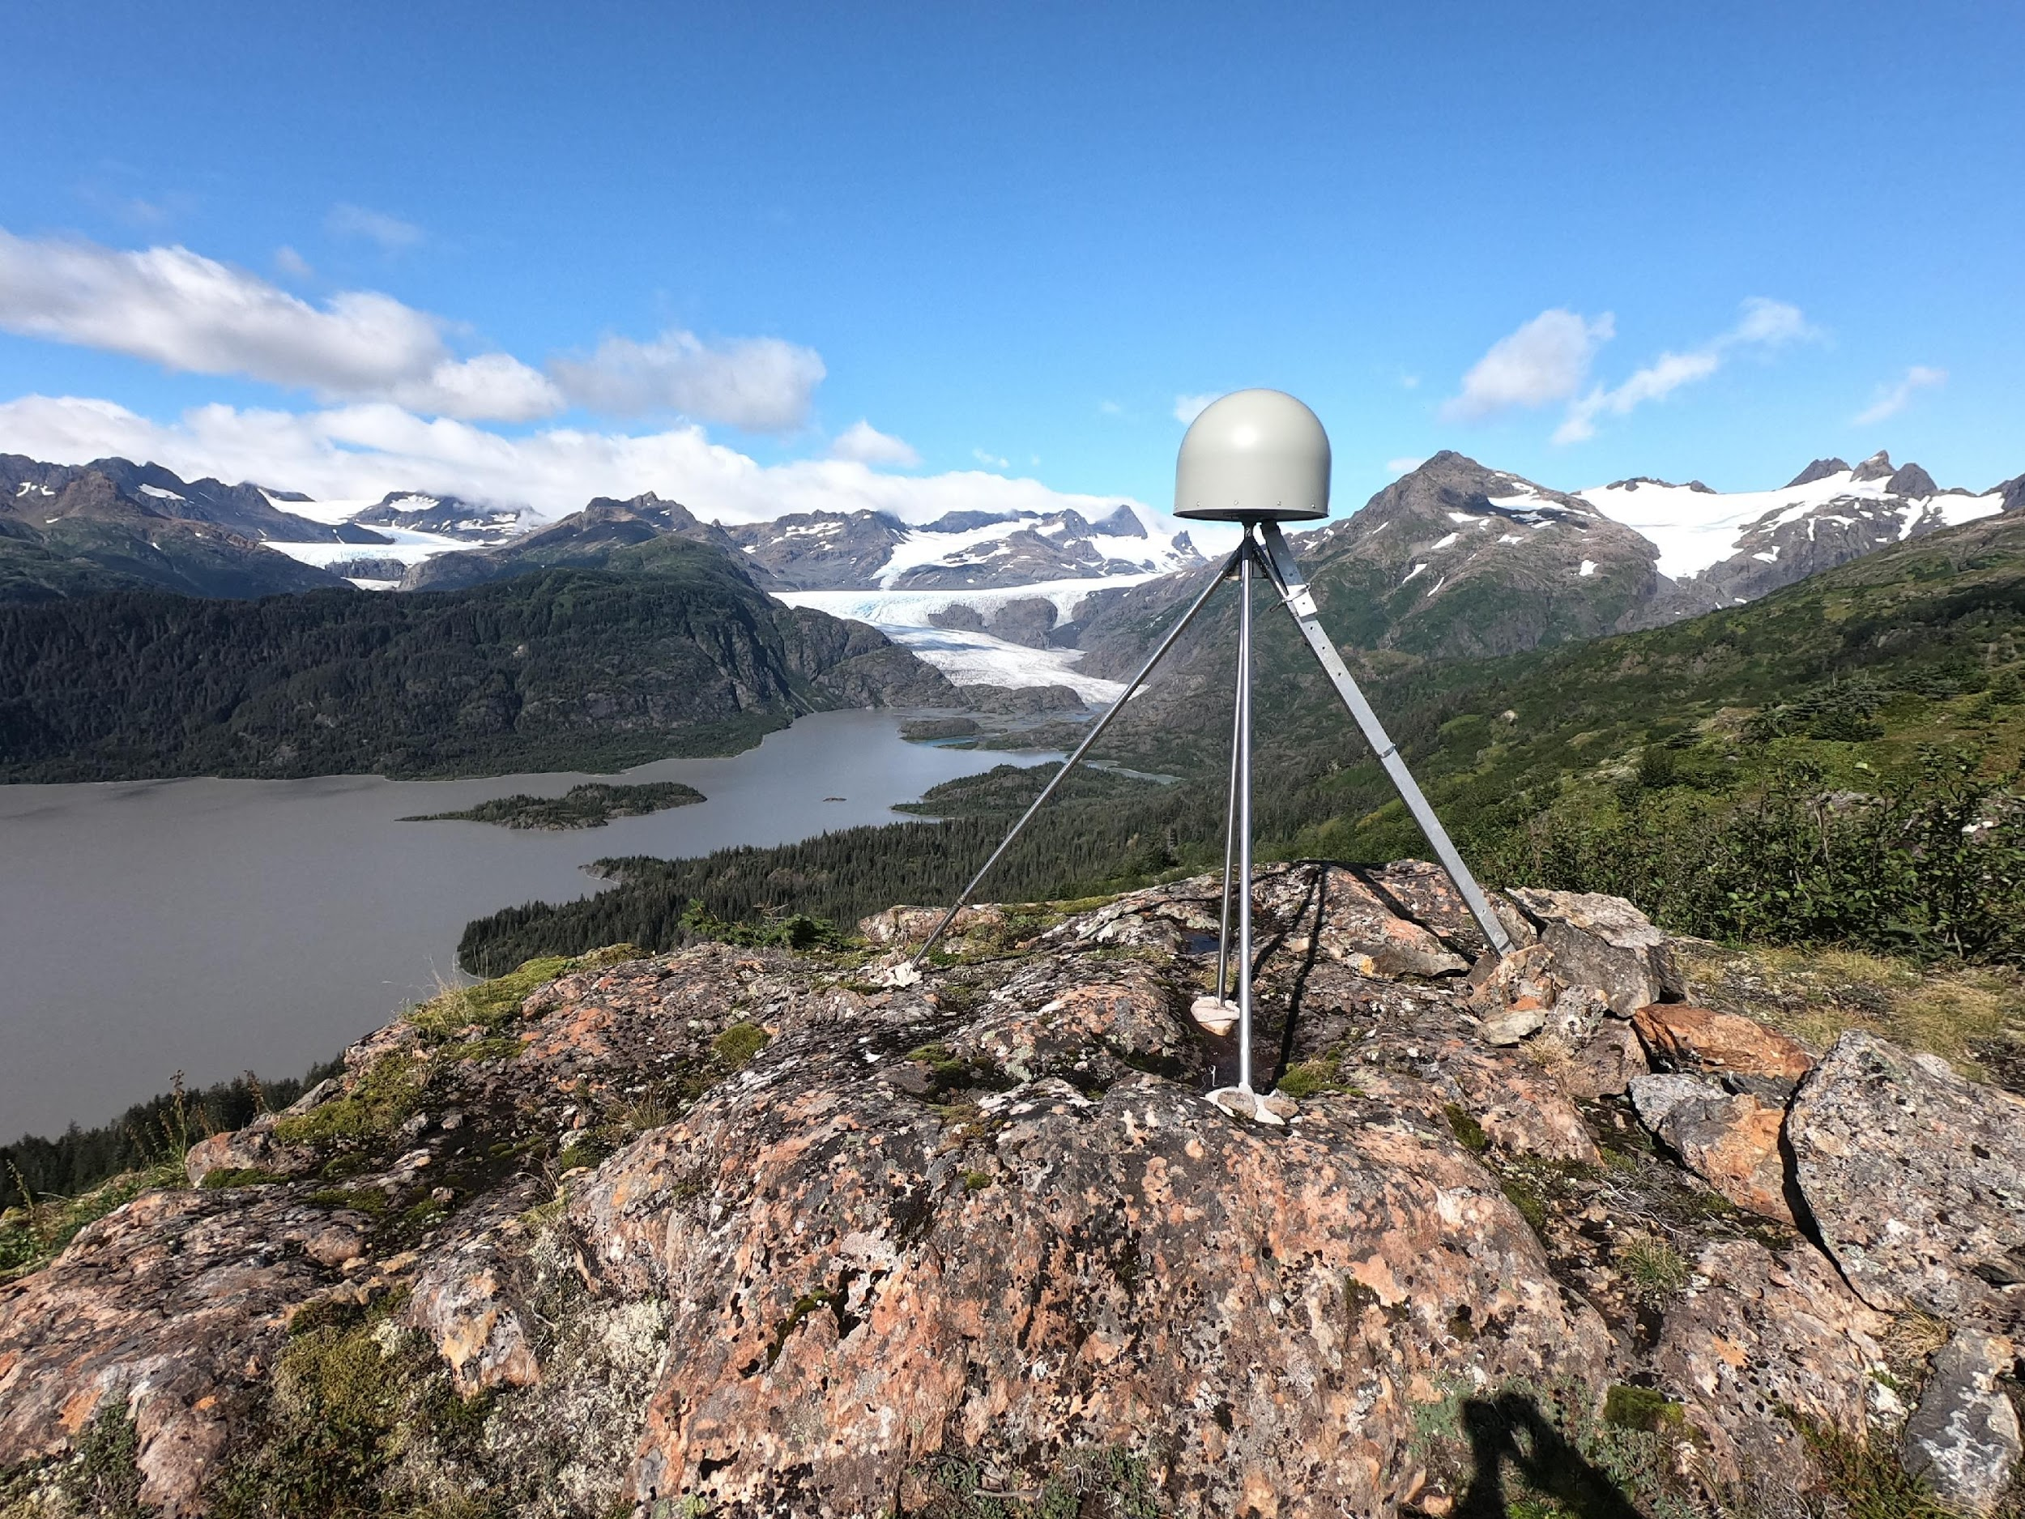
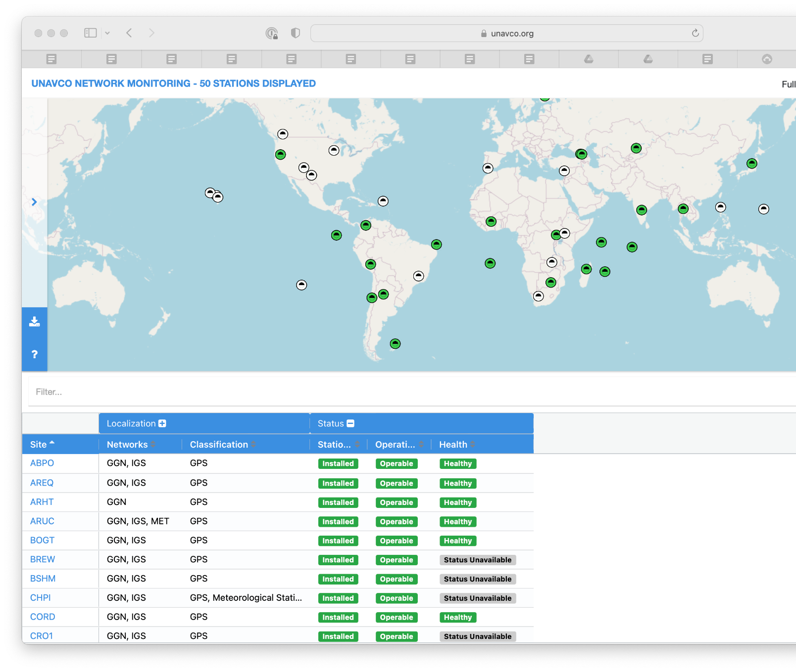
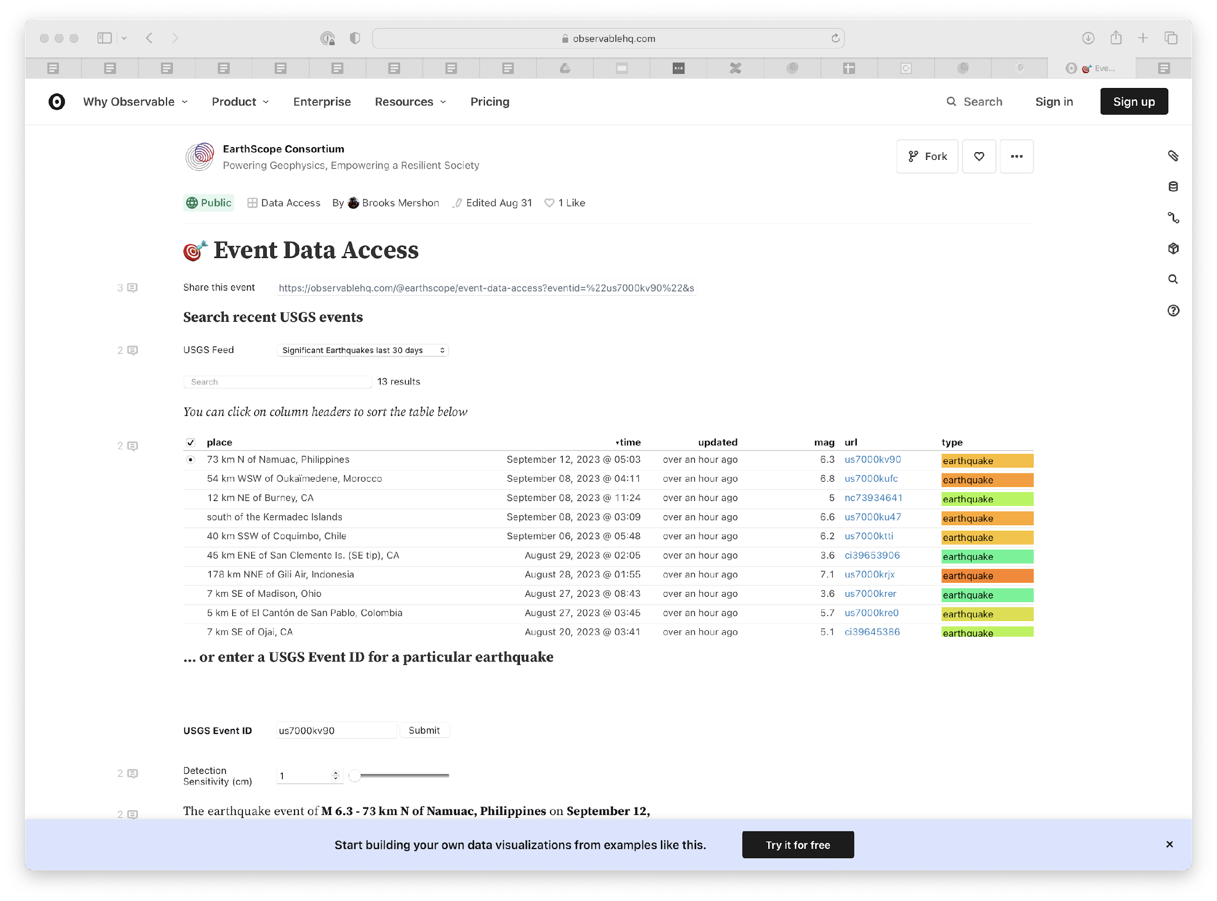
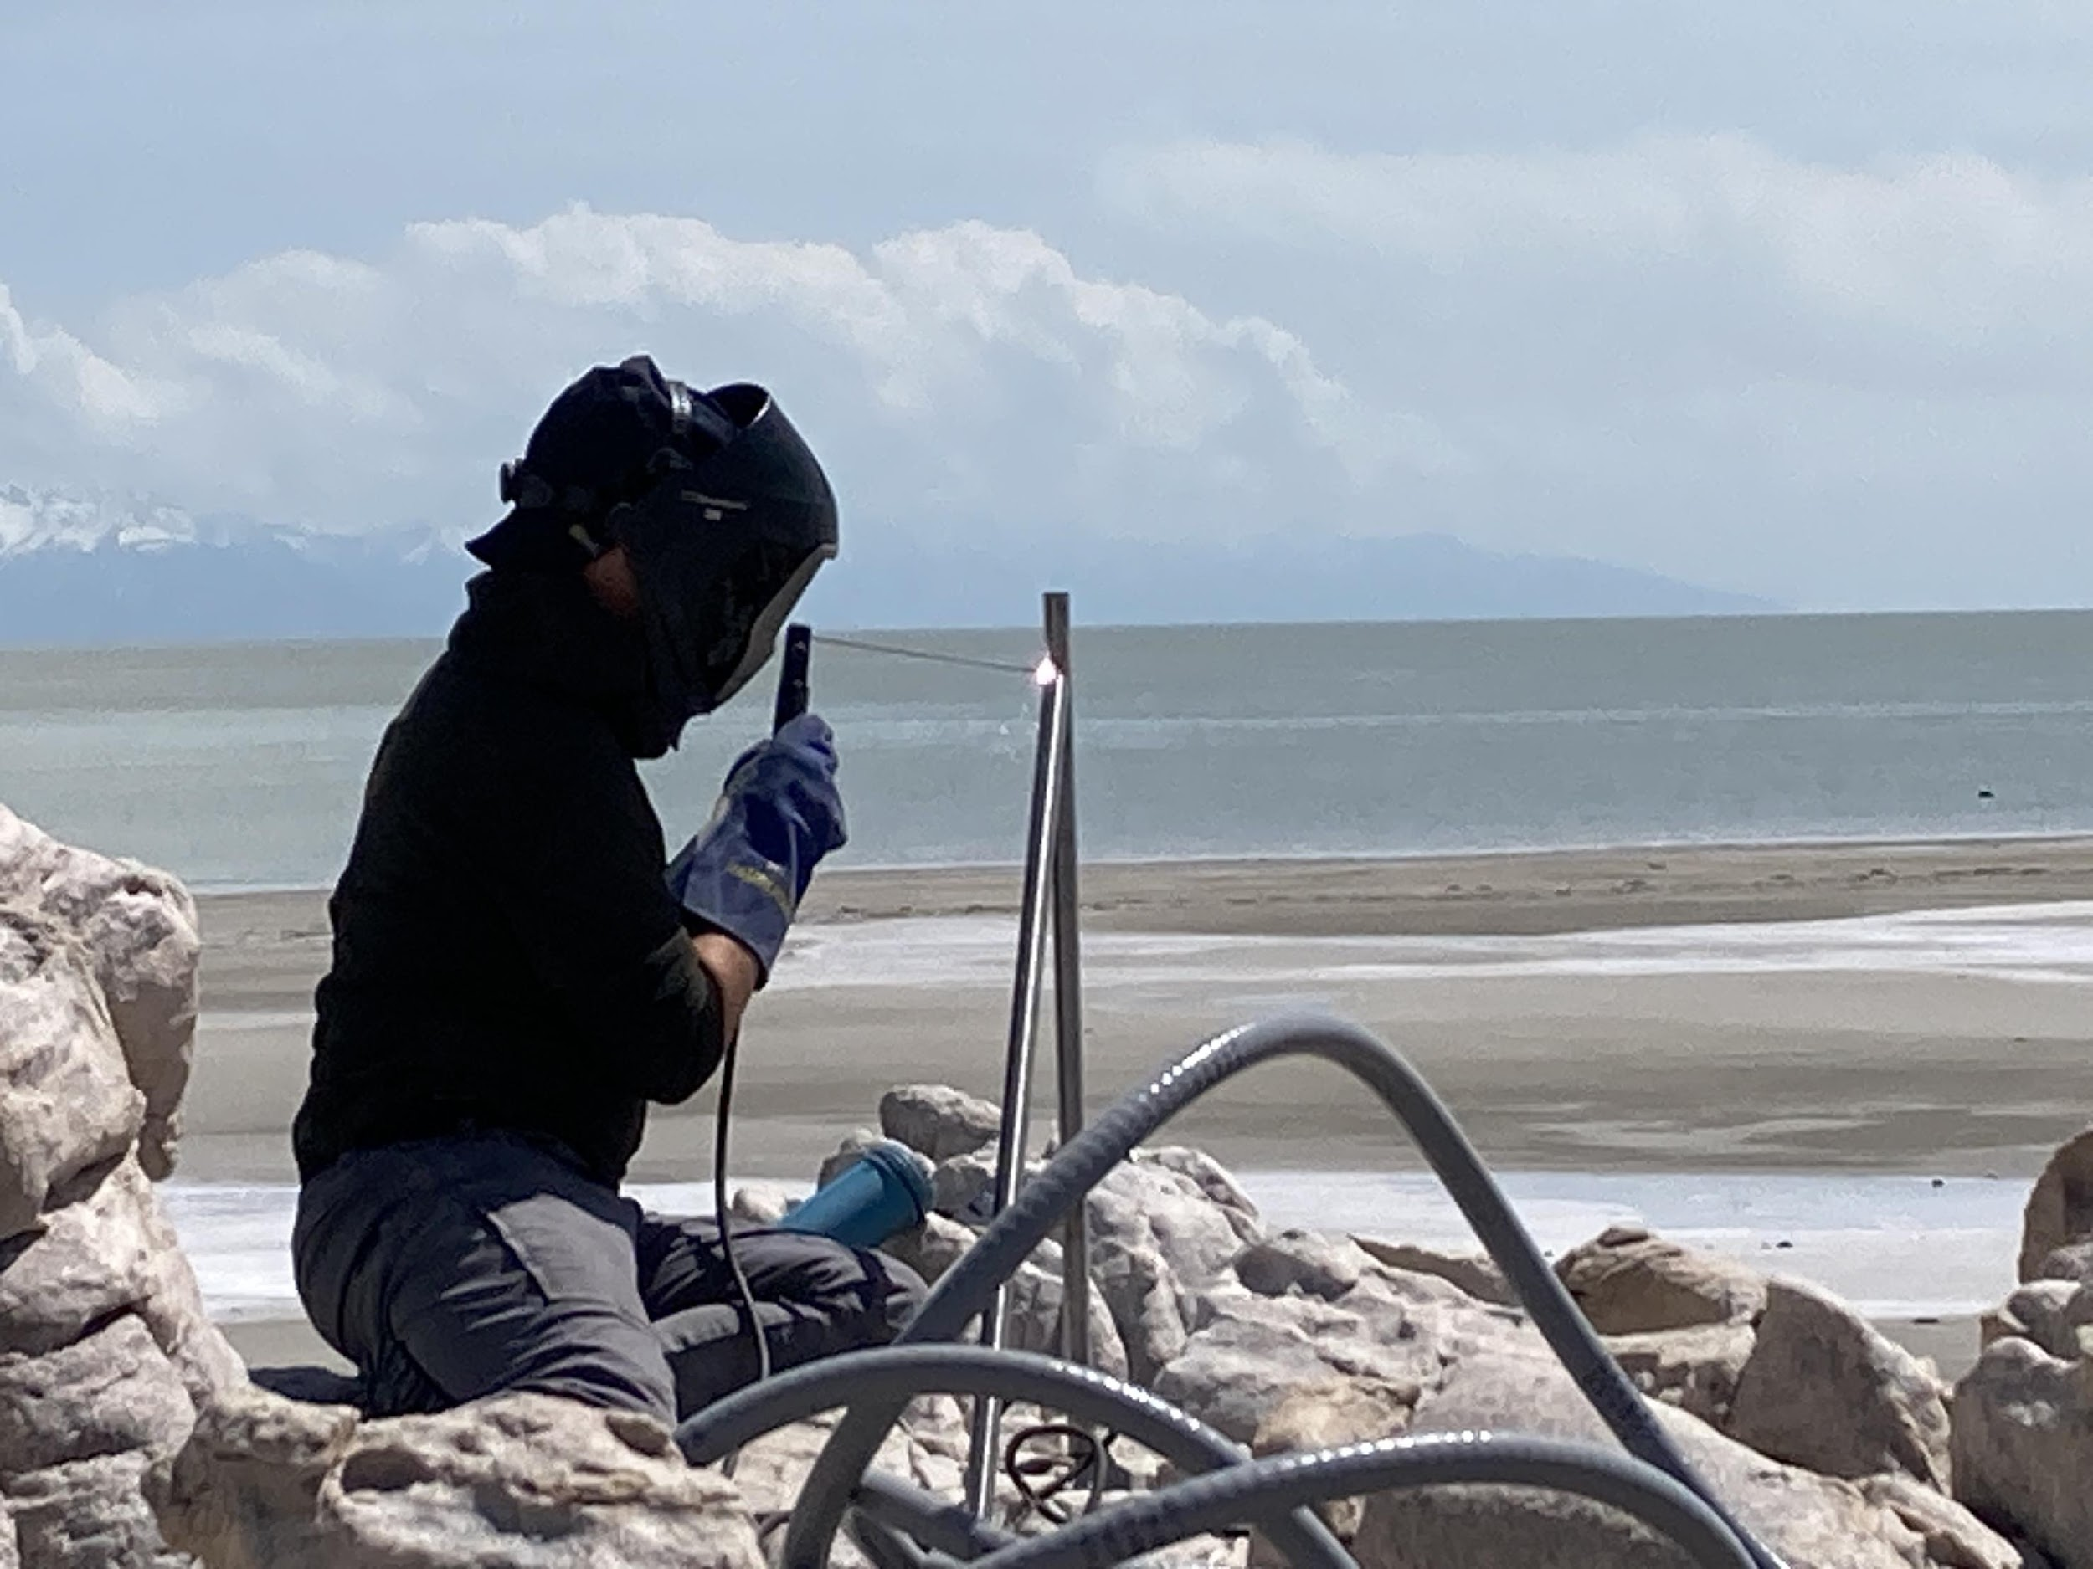
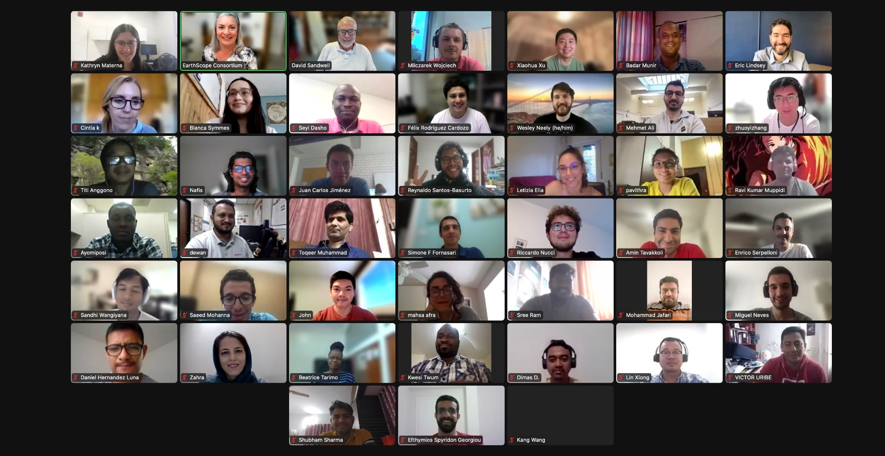
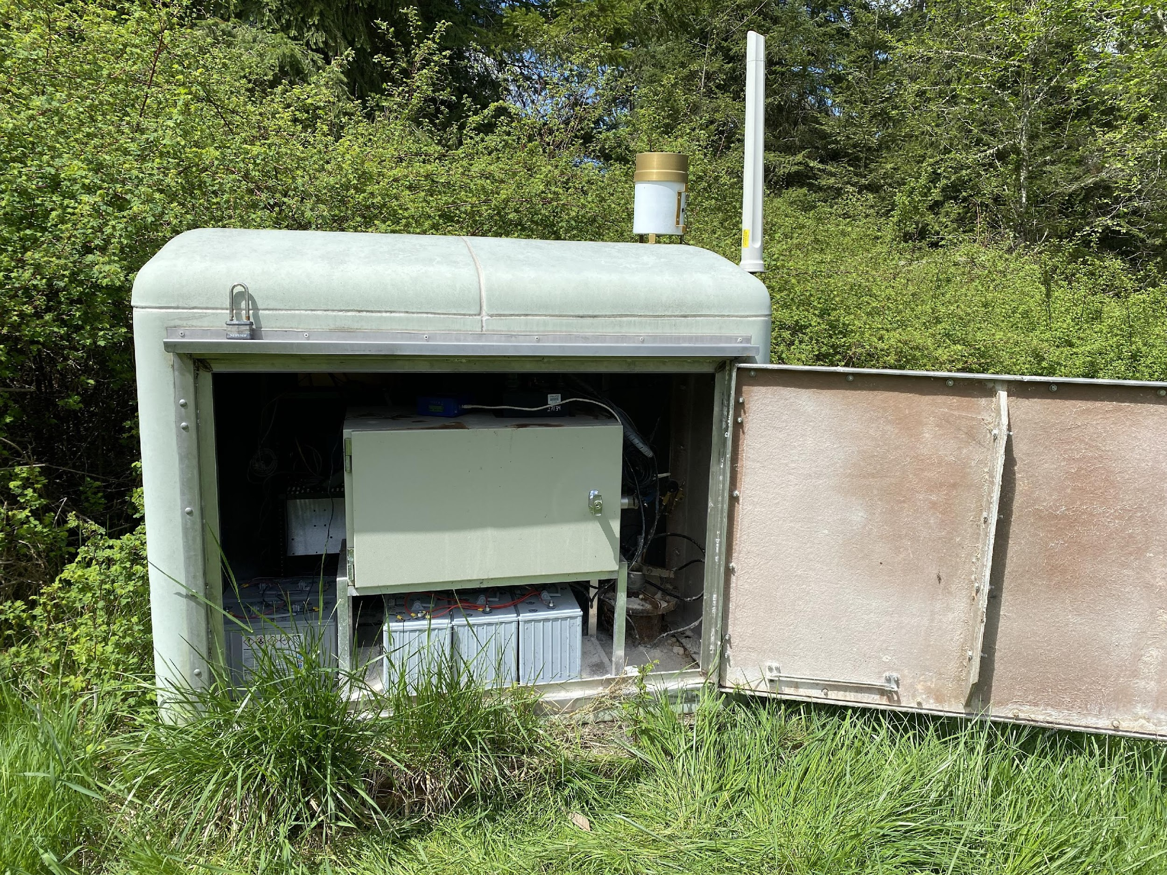
components of GAGE
GGN
data and products
PI support
NOTA
strain
training
PI support

Slide 5
Partnering with EPOS

Slide 6
Cyberarchitecture

Slide 7
Data federation

Slide 8
Community of practice

