Slide 1
Establishment of an EPOS TCS Kauzar Saleh Contell, EPOS ERIC Capacity Building Officer Andrey Babeyko, Coordinator of TCS Tsunami

Slide 2
1. What are the Thematic Core Services
Thematic Core Services (TCS) are transnational governance frameworks enabling community-specific integration and coordination across different domains in solid Earth science.
TCS are designed to:
operate under a common governance structure, at the TCS level and within EPOS,
provide and operate the community-specific data /products / services,
foster discussion and development of best practices for data harmonization and interoperability,
ensure joint strategies to tackle scientific, technica; financial, legal and ethical issues.

Slide 3
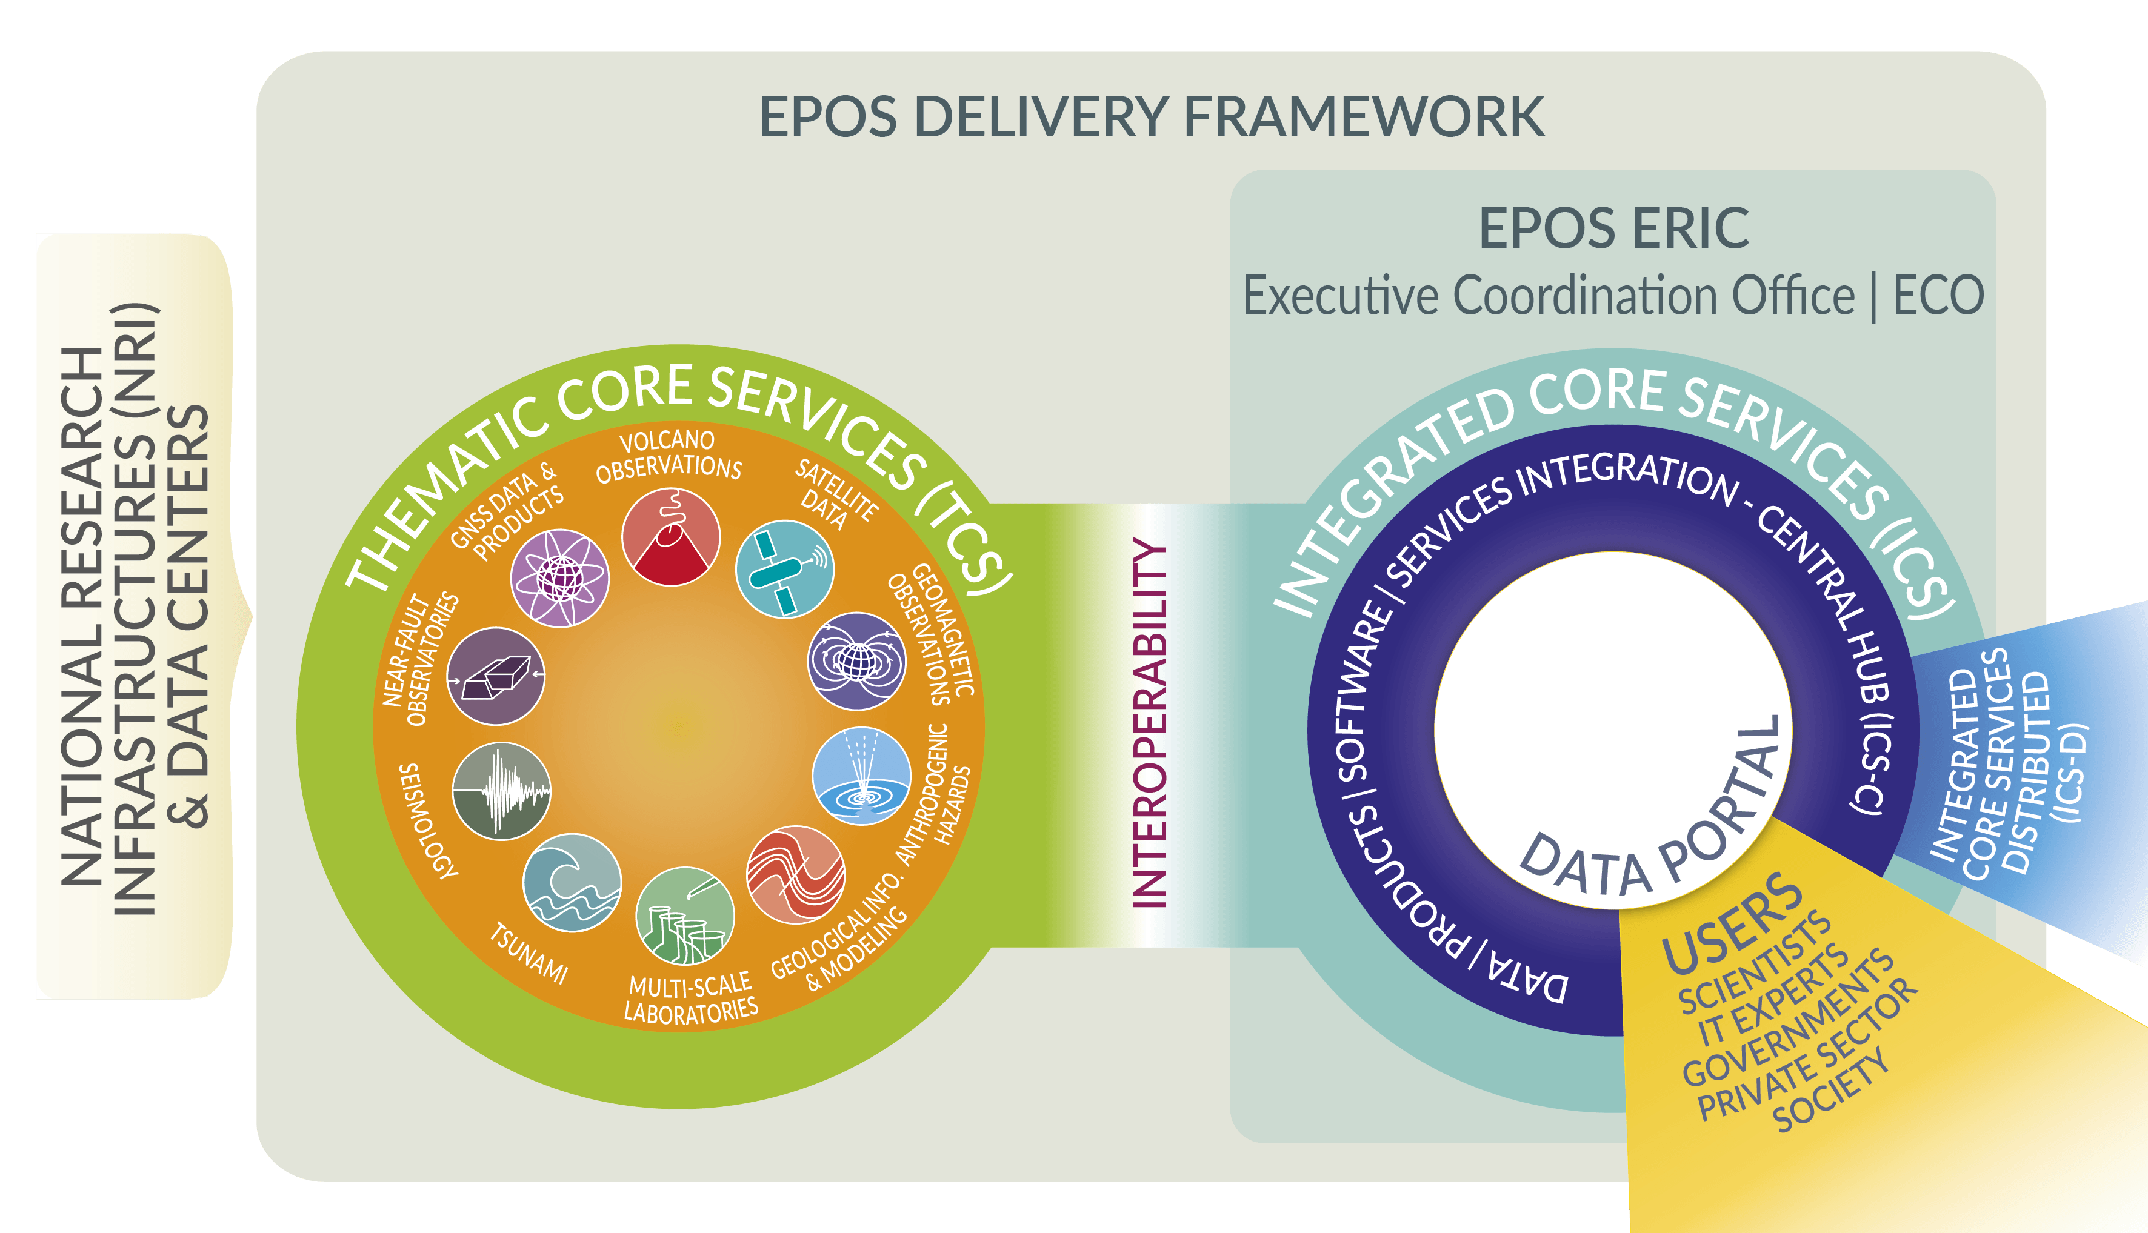
2. Thematic Core Services in the EPOS Architecture

Slide 4
3. Thematic Core Services in the EPOS Governance
The Service Coordination Committee (SCC):
shall be composed of one representative from each EPOS Core Services, namely TCS and ICS,
shall assist the Executive Director in any task they consider relevant for the EPOS Delivery Framework,
can take initiatives aimed at harmonizing activities across EPOS Core Services.

Slide 5
4. Requirements to become a Thematic Core Service
Step 1: Community identification
EPOS philosophy is bottom-up, where EPOS provides a framework for integration that research communities can use to build and structure their own community.
EPOS has a dissemination strategy in place, to reach out to potential new communities, and to inform those already considering to become an EPOS TCS (e.g. EPOS Days, EGU booth and sessions, social media, training program, Summer schools starting in 2025 etc.).
An EPOS thematic community may arise from already existing structures/organisations by incorporating the EPOS framework to the existing structure; or be created as a new thematic community, taking full advantage of the tools put in place by the EPOS research infrastructure.
Community-building is funded by the specific research communities, including through EC calls where EPOS ERIC may also participate, as direct funding to the thematic community via EPOS ERIC is not available for this phase.

Slide 6
4. Requirements to become a Thematic Core Service
Step 2: Application to become a Candidate TCS (as in EPOS ERIC Implementing Rules)
The process begings with the request to EPOS ERIC Executive Director to become a Candidate TCS.
The application shall include (main points) at least 3 organisations from the thematic community, a description of data and services proposed for integration in EPOS, an initial structure for the community governance, and an preliminary indication of costs and funds, including in kind, for operating the services.
After evaluation of the proposal by the Executive Director, SCC, Executive Committee and Scientific Board, the General Assembly may grant the candidate TCS status for up to 3 years.
While being candidate, the thematic community has access to the EPOS research infrastructure, e.g. attendance to the SCC and technical meetings, intranet, workshops, financial support (if granted by the General Assembly).
The candidate TCS reports yearly on their activities and progress to integrate within EPOS.

Slide 7
4. Requirements to become a Thematic Core Service
Step 3: Establishment of the TCS (as in EPOS ERIC Implementing Rules)
By the end of the third year, the candidate TCS shall submit to the Executive Director the application to become a TCS, together with a draft of the TCS consortium agreement (CA), and a letter signed by each member of the intended consortium. About the CA:
The TCS Consortium Agreement is a document external to EPOS ERIC, outlining the mission of the TCS, and the organizational, managerial and financial rules to be followed by the TCS Consortium.
Signed by all consortium partners (once in force).
Template available via EPOS Executive Coordination Office.
After evaluation of the proposal by the Executive Director, SCC, Executive Committee, the EPOS ERIC General Assembly has the decision to grant the TCS status.
From then on, the TCS will have to perform in line with the role and responsibilities of TCS (EPOS ERIC Implementing Rules).

Slide 8
5. Purpose of this session
Learn about the status of thematic communities relevant in solid Earth sciences, but not integrated in EPOS yet.
Built Environment Data (Rui Pinho, Eucentre, Pavia)
Gravimetry (Lucia Seoane, Géosciences Environnement, Toulouse)
[Landslides (Jean-Philippe Malet, Université de Strasbourg) – absent]
Share with new communities the experience of TCS Tsunami, that joined EPOS in 2024.

Slide 9
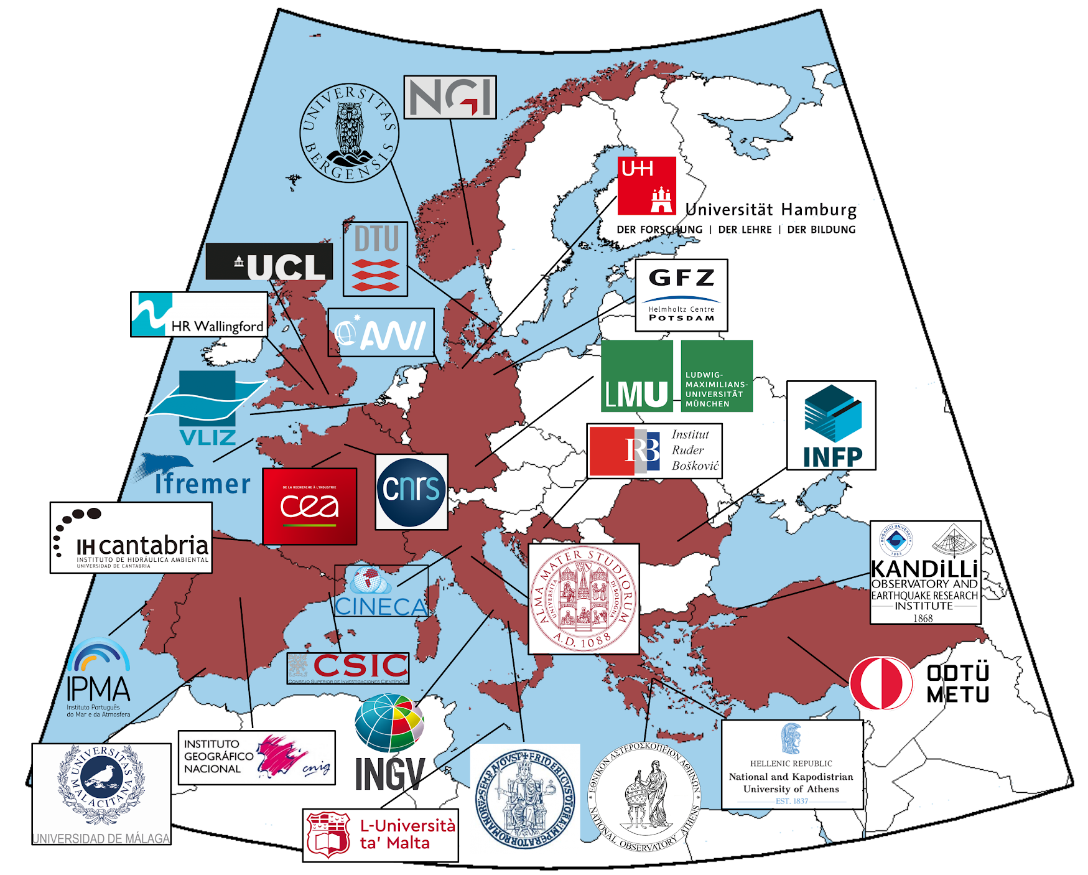
6. TCS Tsunami established in 2023
Tsunami Community interested in building EPOS TCS Tsunami
Geography
Initiative Core Group
(interim executive body)
A.Babeyko (GFZ) – interim coordinator | J.Lauterjung (GFZ) – CP finances
D.Cambaz (KOERI) – CP communications + TSP | S.Lorito (INGV) – coordination (proxy) + CP science
F.Carrilho (IPMA) – TSP representative | F.Lovholt (NGI) – CP science
M.Charalampakis (NOA) – TSP representative | F.Romano (INGV) – TSP representative
H.Hebert (CEA) – WG&CP governance + TSP | A.Rudloff (GFZ) – CP governance (proxy)
F.Hernandez (VLIZ) | M.Sorensen (UiB)
F.Jalayer (UCL) – CP ethics | M.Volpe, B.Brizuela (INGV) – WG services + CP technical
N.Kalligeris (NOA) – TSP representative | A.Yalciner (METU) – CP communications

Slide 10
6. TCS Tsunami established in 2023 Relevance of the Tsunami Community to EPOS ERIC
Strong inter-disciplinarity: natural interaction with other TCSs
Strong international (beyond Europe) network
Rich portfolio of stakeholders: research, private sector, civil protection, early warning, policy makers
State of the art numerical modeling and observing systems

Slide 11
6. TCS Tsunami established in 2023 Timeline (c)TCS Tsunami
Involvement into EPOS-ERIC daily activities: TCS-ICS pitches, communication & outreach, ‘foreign relations’, SRA, joint projects, …
9/2018
MUC Intl.
01/2021
7/2021
EPOS GA
12/2023
EPOS GA
02/2024
1st Cons. Board
11/2018
3/2021
12/2021
2022
10/2023
Meeting initiative group
Start dialog w/EPOS
TCS website and portal
Community
paper (Ann.Geophys)
TCS approved
TCS In force
Granted status of Candidate TCS
CA Draft
Start w/ 2 Pilot ICS-C services
ICG/NEAMTWS endorsed
2
20+
continuous service uptake to ICS-C

