Slide 1

EPOS Strategies for the European and international landscape
Moderator: Helen Glaves

Slide 2
EPOS Strategy in the European and international landscape
Primary goal of EPOS is to expand its scope and increase participation, which has led to:
    More countries having joined the EPOS ERIC
    New and emerging TCS becoming part of EPOS community
Ensure EPOS is fully embedded in the global landscape of solid RIs and similar related initiatives
EPOS continues to build partnerships with other RIs e.g AuScope in Australia and related initiatives
Notes:
An underlying tenant of the future success and sustainability of EPOS is the continued growth of the RI, which includes EPOS being fully embedded in the intermational l RI landscape.

Slide 3







International collaboration: MoU
Notes:
Collaboration agreements have already been signed with a number of organisations and initiatives. Several MoUs have been signed that provide the framework for collaboration between EPOS and selected partners.

Slide 4
EPOS Strategy in the European and international landscape
Primary goal of EPOS is to expand its scope and increase participation, which has led to:
    More countries having joined the EPOS ERIC
    New and emerging TCS becoming part of EPOS community
Ensure EPOS is fully embedded in the global landscape of solid RIs and similar related initiatives
EPOS continues to build partnerships with other RIs e.g AuScope in Australia
Participates in regional and global initiatives such as the Group on Earth Observations (GEO) and BEERi
Notes:
An underlying tenant of the future success and sustainability of EPOS is the continued growth of the RI, which includes EPOS being fully embedded in the intermational l RI landscape.

Slide 5

GEO (Group on Earth Observations)
global network connecting government institutions, academic and research institutions, data providers, businesses, engineers, and scientists
linking Earth observation systems and supports the development of new ones were there are gaps in the supply of environment-related information
GEO System of Systems (GEOSS) delivers EO data (satellite and ground-based observations) to support activities in defined societal benefit areas including disaster resilience, energy and mineral resources management, climate change
EPOS has been a Participating Organisation since 2011
Designated EPOS representative: Otto Lange
Notes:
EPOS one of 151 participating organisations

Slide 6
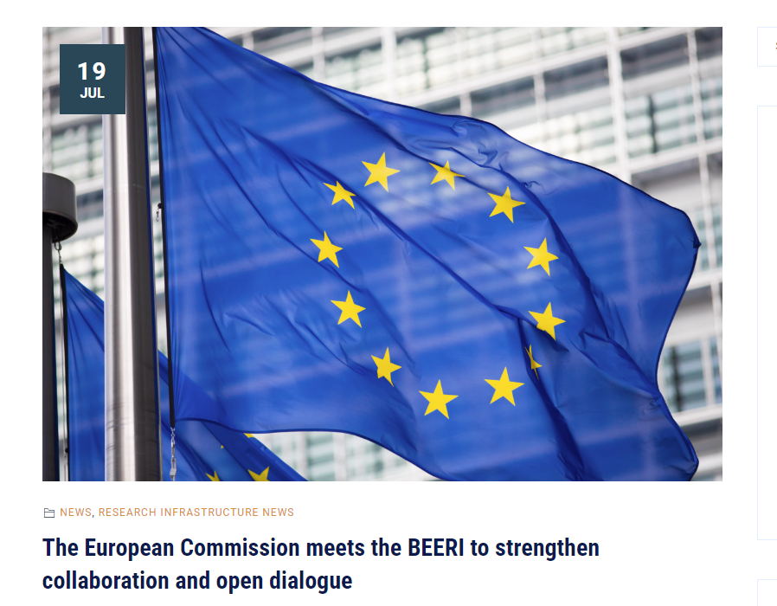
ENVRI cluster / Board of European Environmental Research Infrastructures (BEERi)
ENVRI cluster:
Community of 26 environmental RIs
Collaborative partnership across different domains aiming to provide open and FAIR data, tools and services for environmental research
Board of European Environmental Research Infrastructures (BEERi)
Coordinating body for European environmental RIs including ERICs and similar bodies
Composed of RI Directors
Notes:
As well as the formalised partnerships EPOS also collaborates with other relevant organisations and initiatives both through coordinating bodies such as BEERi and GEO as well as through being a partner in EU-funded projects.

Slide 7
EPOS Strategy in the European and international landscape
Primary goal of EPOS is to expand its scope and increase participation, which has led to:
    More countries having joined the EPOS ERIC
    New and emerging TCS becoming part of EPOS community
Ensure EPOS is fully embedded in the global landscape of solid RIs and similar related initiatives
EPOS continues to build partnerships with other RIs e.g AuScope in Australia
Participates in regional and global initiatives such as the Group on Earth Observations (GEO) and BEERi
Wider adoption of EPOS tools and services including through EU-funded projects such as GEO-Inquire, and DT-GEO
Notes:
An underlying tenant of the future success and sustainability of EPOS is the continued growth of the RI, which includes EPOS being fully embedded in the intermational l RI landscape.

Slide 8








International collaboration: project based collaboration
Notes:
As well as the formalised partnerships EPOS also collaborates with other relevant organisations and initiatives both through coordinating bodies such as BEERi and GEO as well as through being a partner in EU-funded projects.

Slide 9
EPOS Strategy in the European and international landscape
Primary goal of EPOS is to expand its scope and increase participation, which has led to:
    More countries having joined the EPOS ERIC
    New and emerging TCS becoming part of EPOS community
Ensure EPOS is fully embedded in the global landscape of solid RIs and similar related initiatives
EPOS continues to build partnerships with other RIs e.g AuScope in Australia
Participates in regional and global initiatives such as the Group on Earth Observations (GEO) and BEERi
Wider adoption of EPOS tools and services including through EU-funded projects such as GEO-Inquire, and DT-GEO
Active promotion of EPOS to support open research and raise awareness of the tools and services provided by the EPOS Delivery Framework to support new and innovative research
Notes:
Active participation and promotion of EPOS including through meetings, workshops and conferences. E.g. forthcoming EGU conference

Slide 10
Agenda
09:00 – 13:00 EPOS strategies in the European and International landscape (Helen Glaves)
09:00-09:30 Welcome and introduction of the session
09:10 – 10:45 European and international collaborations (Chairs: Otto Lange, Daniele Bailo)
  09:10 - 09:20 EarthScope Becks Bendick
  09:20 -09: 30 AuScope Tim Rawling
  09:30 - 09:45 EUREF Juliette Legrand
  09:45 -10:00 JERICO Miguel Charcos Llorens
  10:00-10:15 GEO-Inquire Angelo Strollo
  10:15-10:30 DT-GEO Daniele Bailo
  10:30-10:45 Krafla Magma Testbed Paolo Papale
10:45-11:15 coffee break
Notes:
Session will look at various aspects of the EPOS strategy for engagement at the regional and international level. The first part of the session will include contributions both from partner organisations where EPOS has an existing MoU, and EU-funded projects.

Slide 11
Agenda
11:15-12:20 Engagement of New Communities (Chairs: Kauzar Saleh, Jan Michalek)
11:15 - 11:30 Establishment of an EPOS TCS Kauzar Saleh and Andrey Babeyko
11:30 - 12:00 Built Environment Data Rui Pinho
12:00 - 12:15 Gravimetry Lucia Seoane
12:15 – 12:30 Landslides Jean-Philippe Malet
12:30 - 12:45 Open Discussion
12:45-14:15 lunch
Notes:
The second part of this session will focus on engaging with new communities that fosters a widening and diversification of the EPOS community to other disciplines .

