Slide 1
EPOS Sponsored Research Activities 2023/2024
Interactive VREs and ML applications for the EPOS portal
Alessandro Spinuso, Luca Trani - KNMI

Slide 2
EPOS Sponsored Research Activities
Purpose
Mechanism in the EPOS ERIC Strategic Plan for the financial support to research activities.
Aims to implement the EPOS Science Plan.
Add value, explore new opportunities, and engage new communities.
Process
Drafting of SRA call based on inputs from the Scientific Advisory Board.
Focus on selected topics from the EPOS strategy and community requirements.
Service Coordination Committee involved in prioritisation and evaluation.

Slide 3
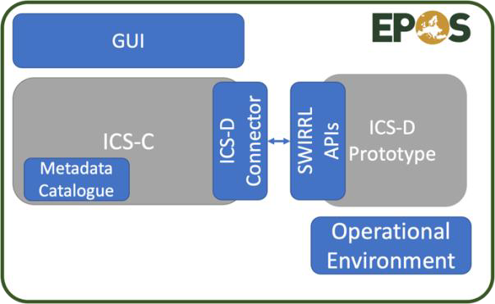
2023 - Integration of ICS-D prototypes into ICS-C
Vision: Transform EPOS into a Multi-Purpose Virtual Research Environment covering the Data Lifecycle from Data Production to Data Reuse and Analysis.
Partners: EPOS-ERIC, NORCE, AGH, NGI, ORB, KNMI
Tasks
Landscape analysis, features collection, validation
ICS-D Connector
Metadata
EPOS GUI
Operational Environment
Implementation of the SWIRRL ICS-D architecture
Preparation of fit-for purpose VRE (Jupyter, Enlighten)

Slide 4
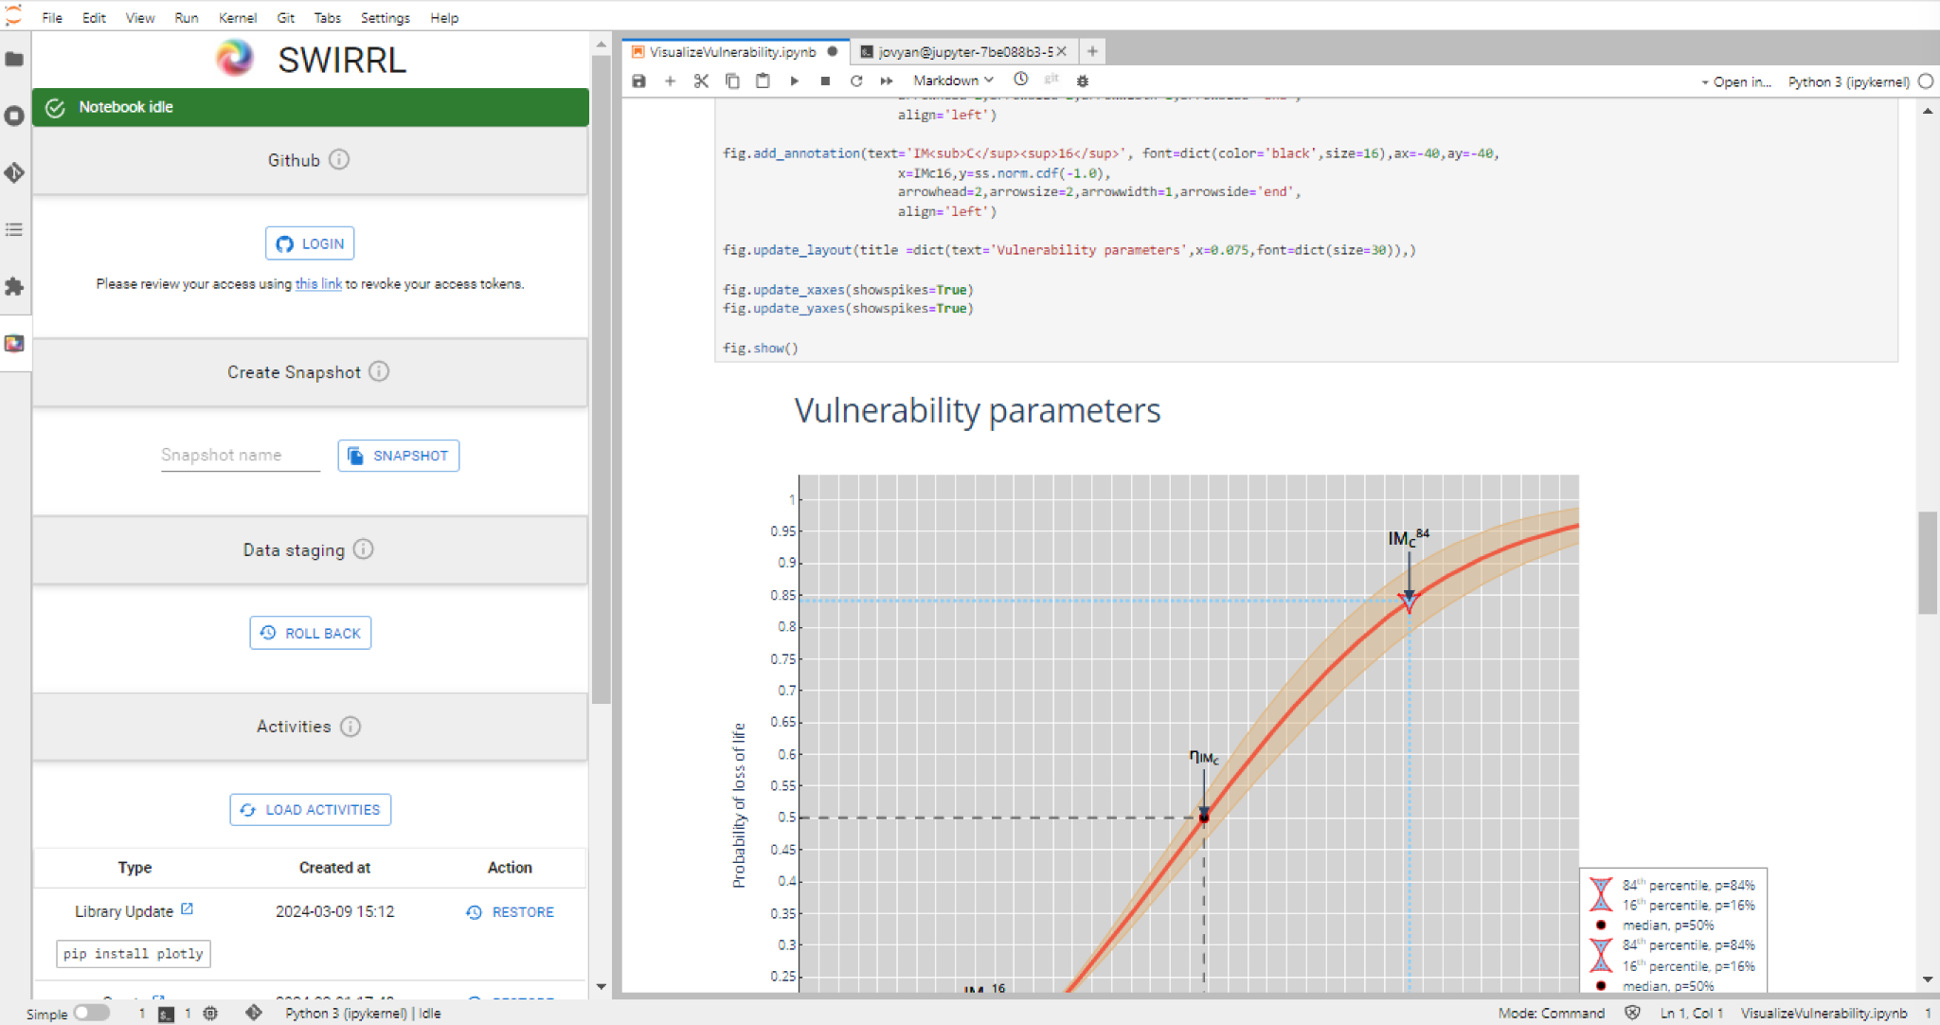
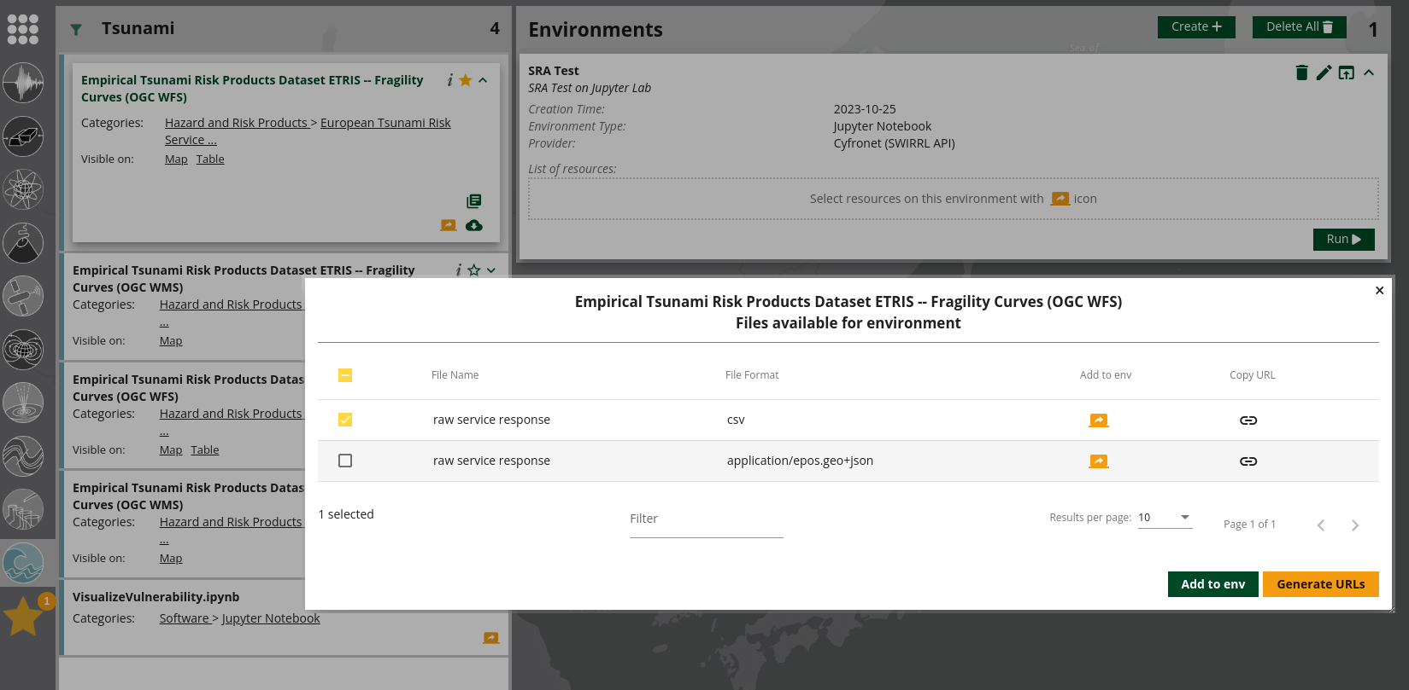
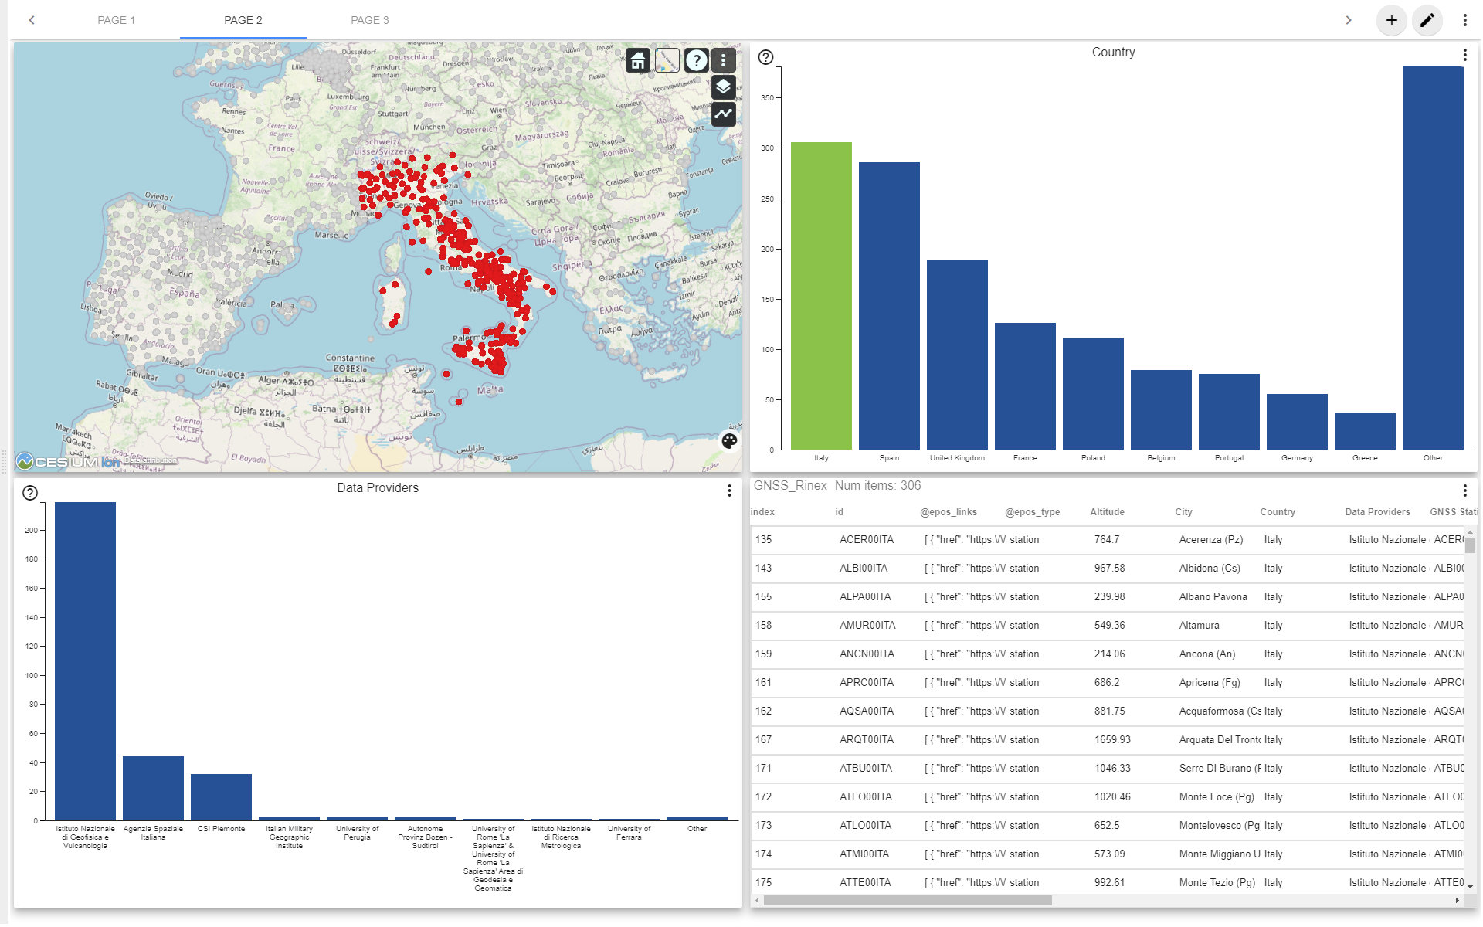
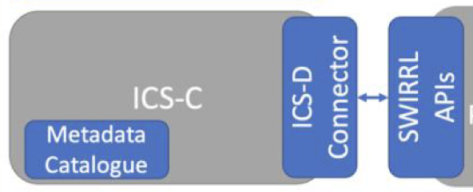
Highlights - Interactive Workspaces
https://epos-ci.brgm.fr/ics-tcs/jupyter-notebook-examples
Discover and Associate Data Resources with Analysis Tools
TSU
Use Case
Data Staging & Preprocessing (Enlighten)
Workflows
ICD-D Connector
Seamless control
of multiple
types of ICS-D
Services

Slide 5
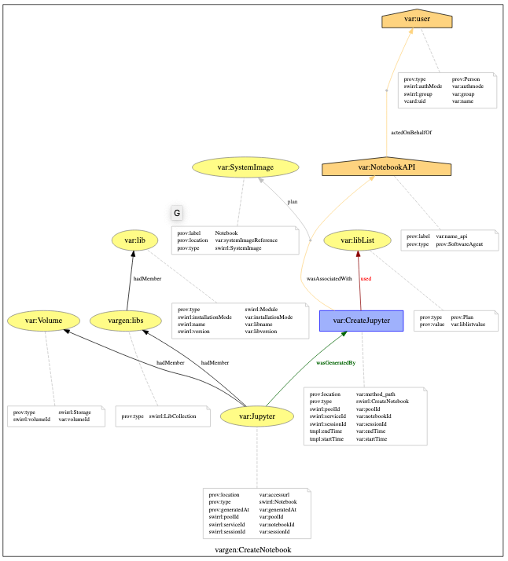
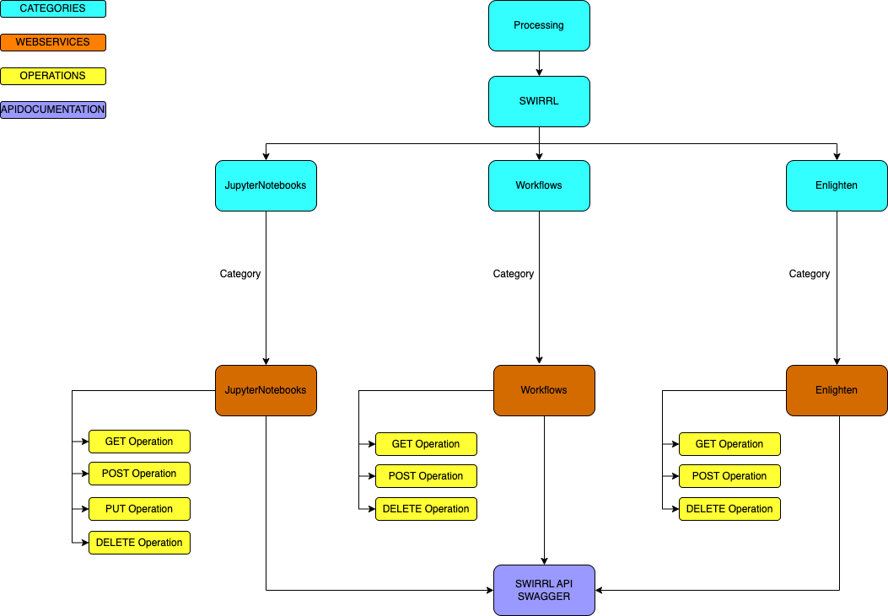
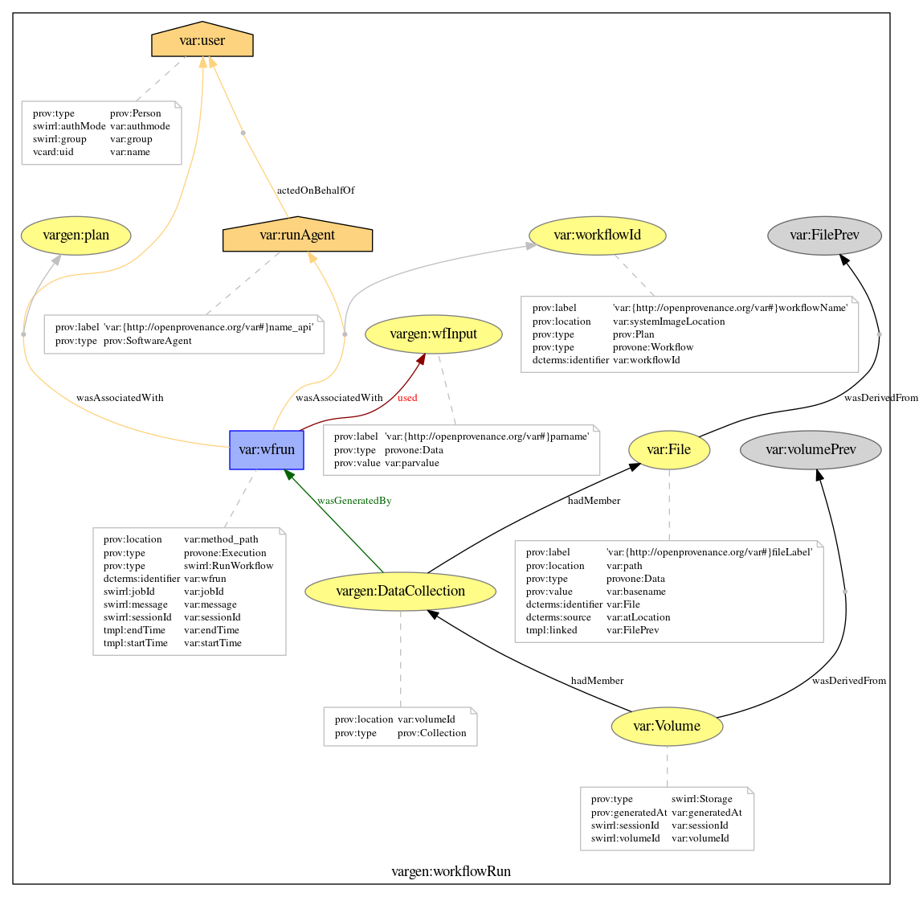
Highlights - Rich and Interoperable Metadata
(ICS-C) VREs Components are described in the EPOS DCAT-AP
(ICS-D) VREs keep track of operations in PROV
Create a Notebook
Run a workflow

Slide 6
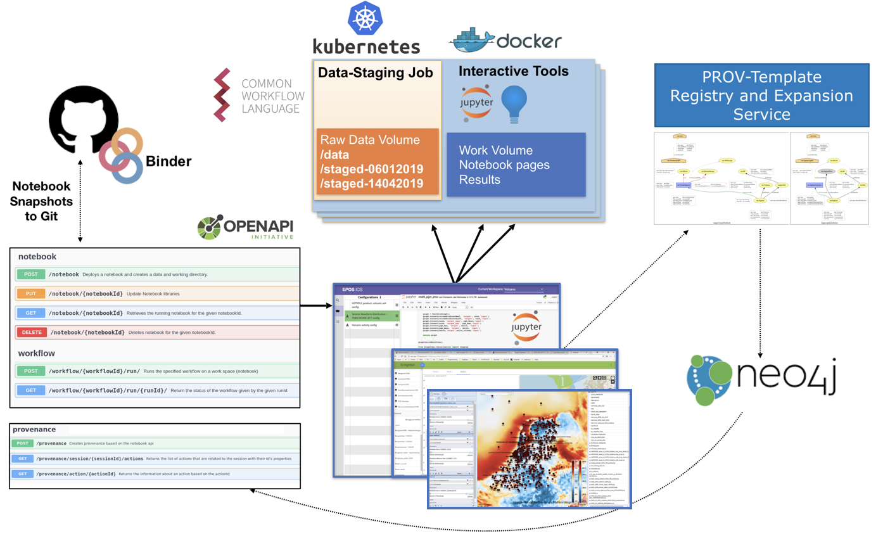
SWIRRL - Virtual Research Environment Technology
SWIRRL Manages data-driven VREs,
combining Workflows, Notebooks and
Visualisation tools on the Cloud
via Containers Orchestration
Enables Collaboration
via Reproducible and
Shareable analysis
data-spaces
VREs are controlled by
Community Portals via a
Web API
Embeds a provenance
management framework
and KB (Templating)
[1] Spinuso, A., Veldhuizen, M., Bailo, D., Vinciarelli, V., Langeland, T.,: SWIRRL: Managing provenance-aware and reproducible workspaces. Data Intelligence 4(2), (2022),
https://doi.org/10.1162/dint_a_00129 https://gitlab.com/KNMI-OSS/swirrl/swirrl-api

Slide 7
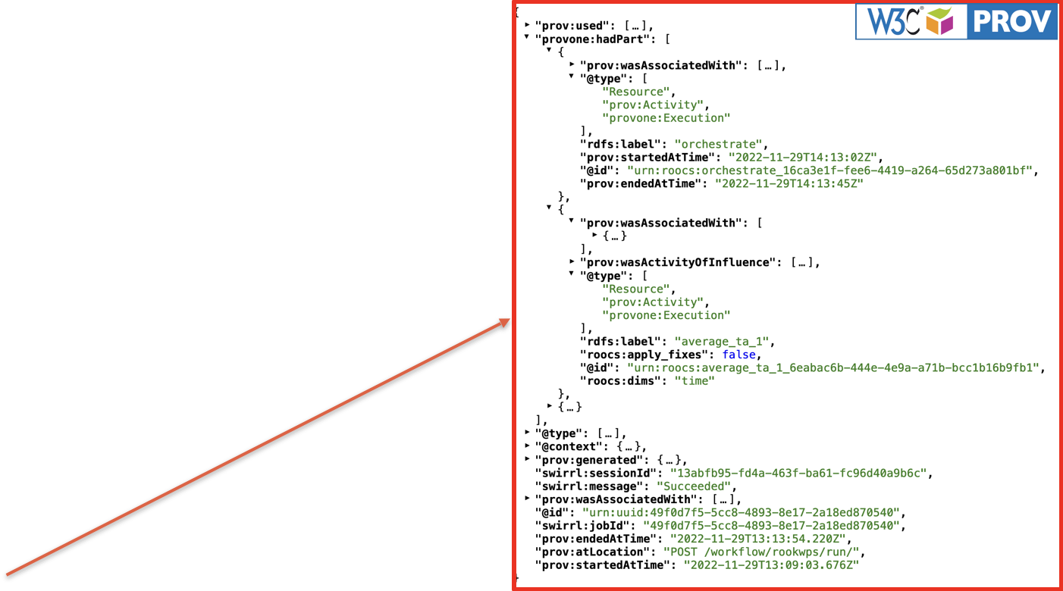
SWIRRL - Reproduce & Restore

Slide 8
SRA 2024
Machine Learning Applications for the EPOS Portal
Luca Trani

Slide 9
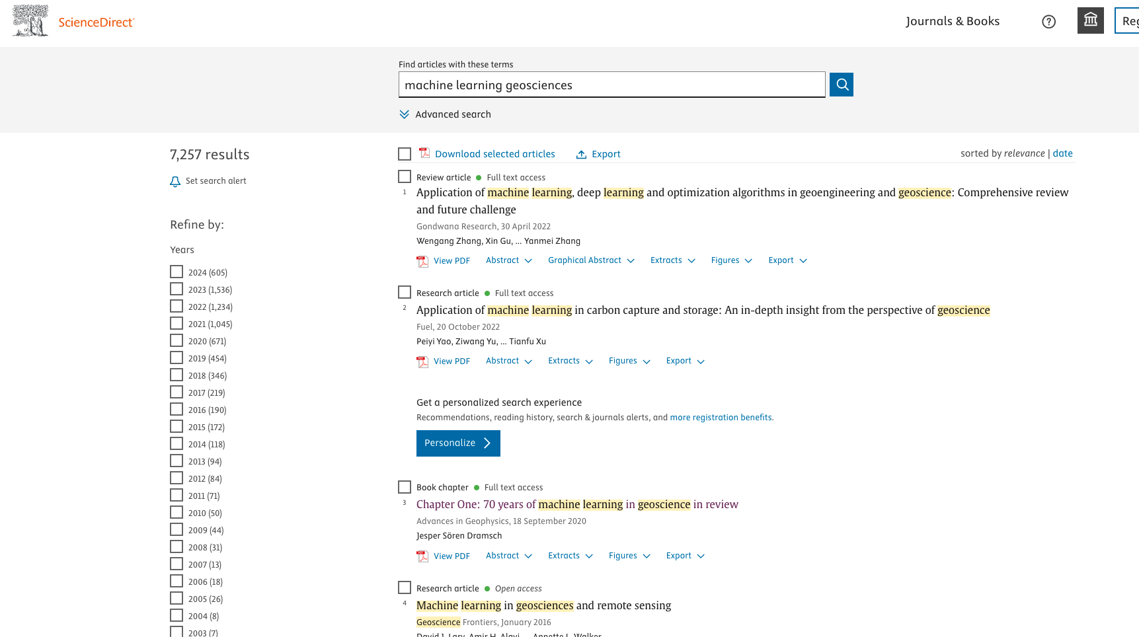
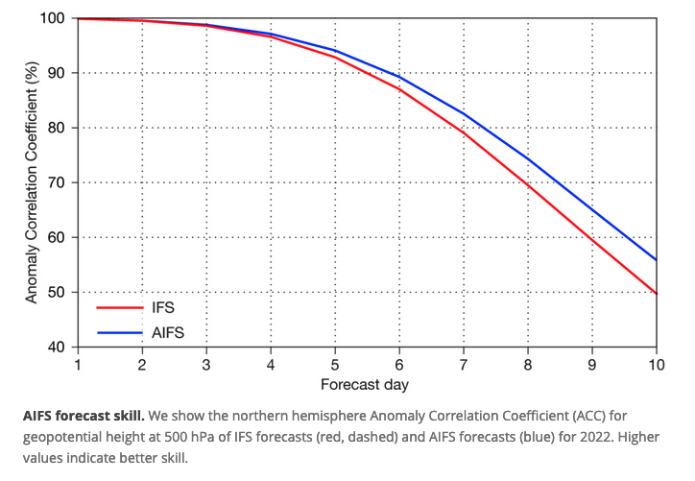
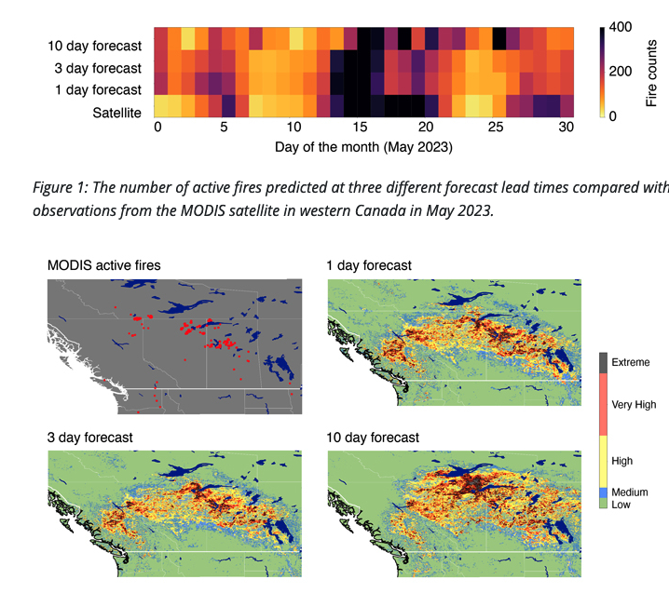
The rise of ML in geosciences
AIFS: a new ECMWF forecasting system
(source ECMWF)
Machine learning ignites wildfire forecasting
(source ECMWF)

Slide 10
The rise of ML in geosciences

Slide 11
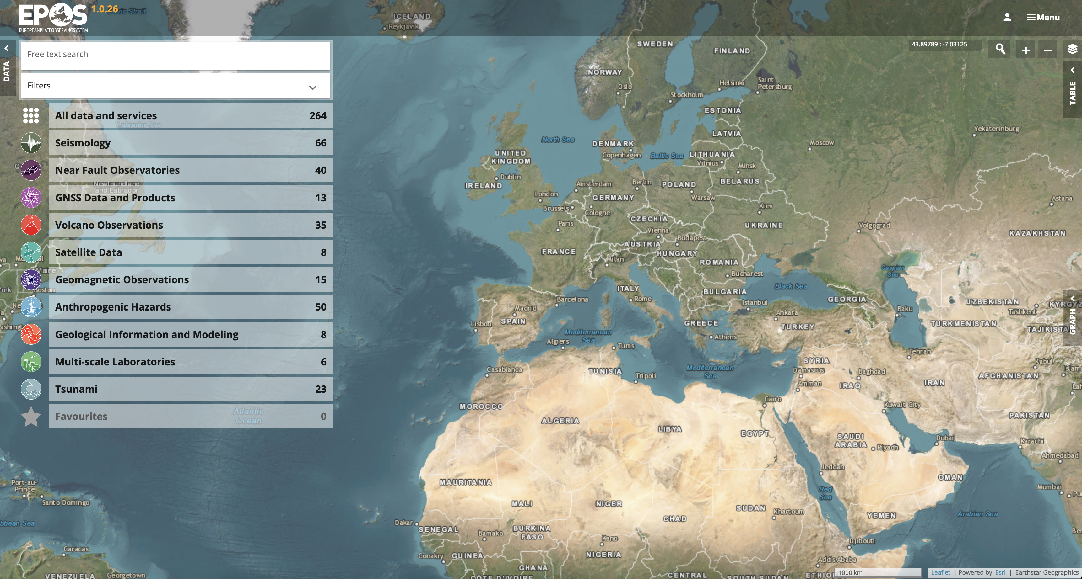
A wealth of data

Slide 12
From data to ML applications
Formulating the problem to solve
Building the training dataset
Developing the ML model
Training, testing and validating the model
Running predictions on pre-trained model
Measuring performance

Slide 13
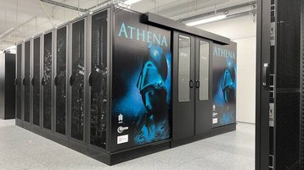
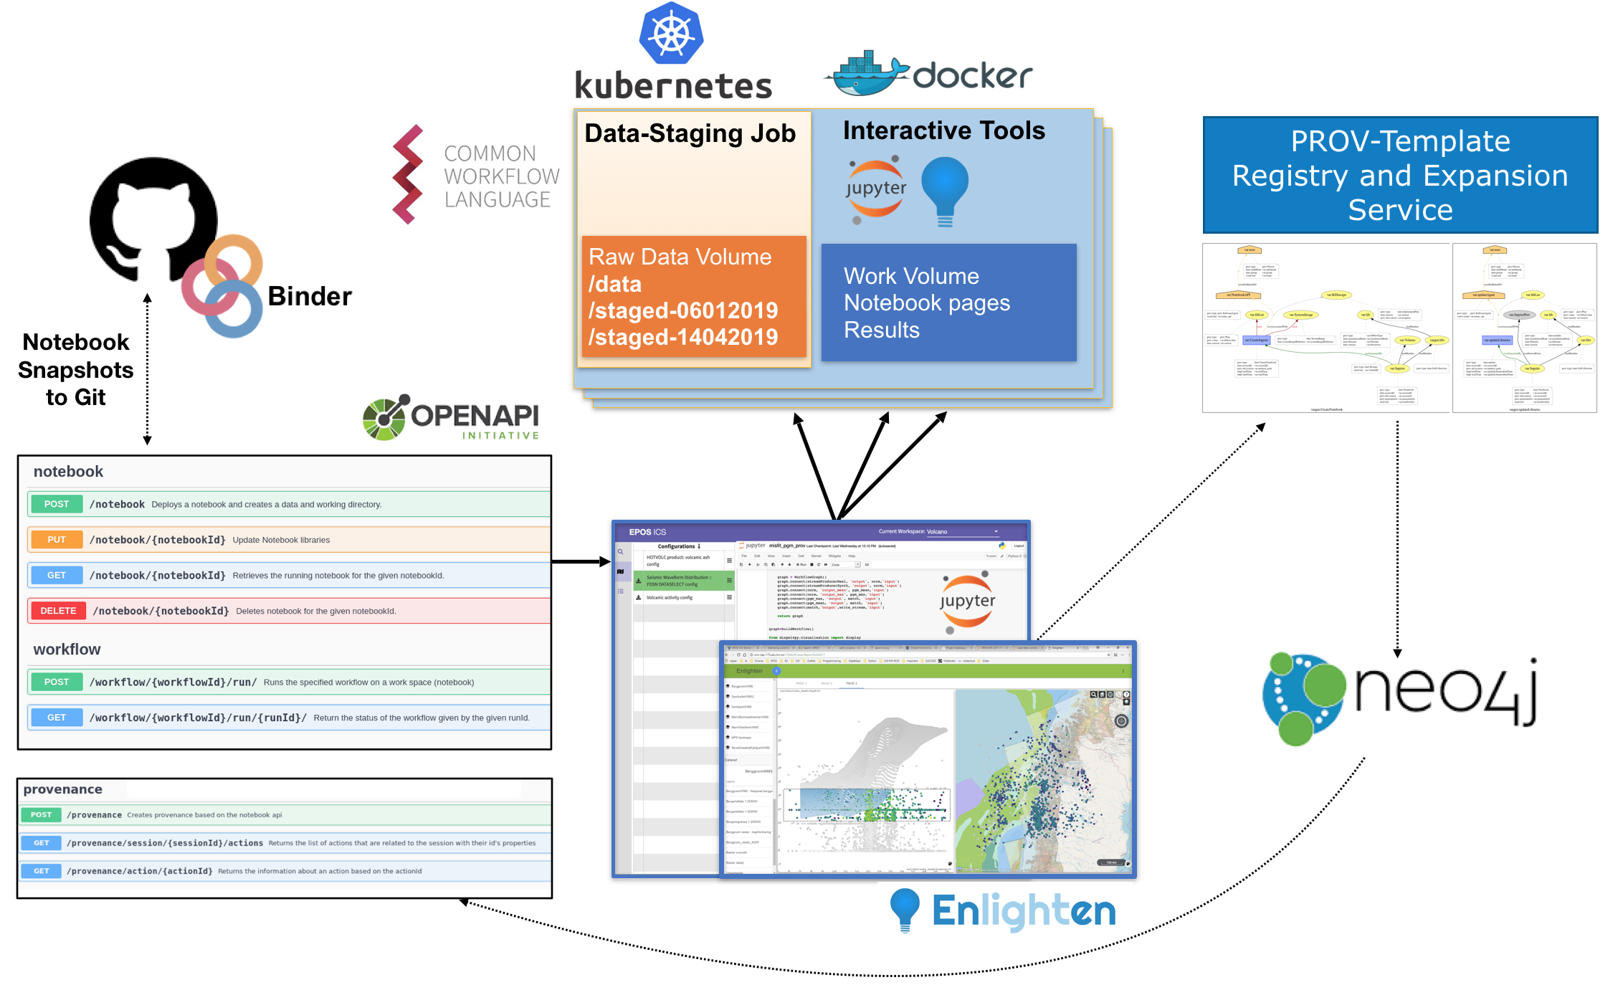
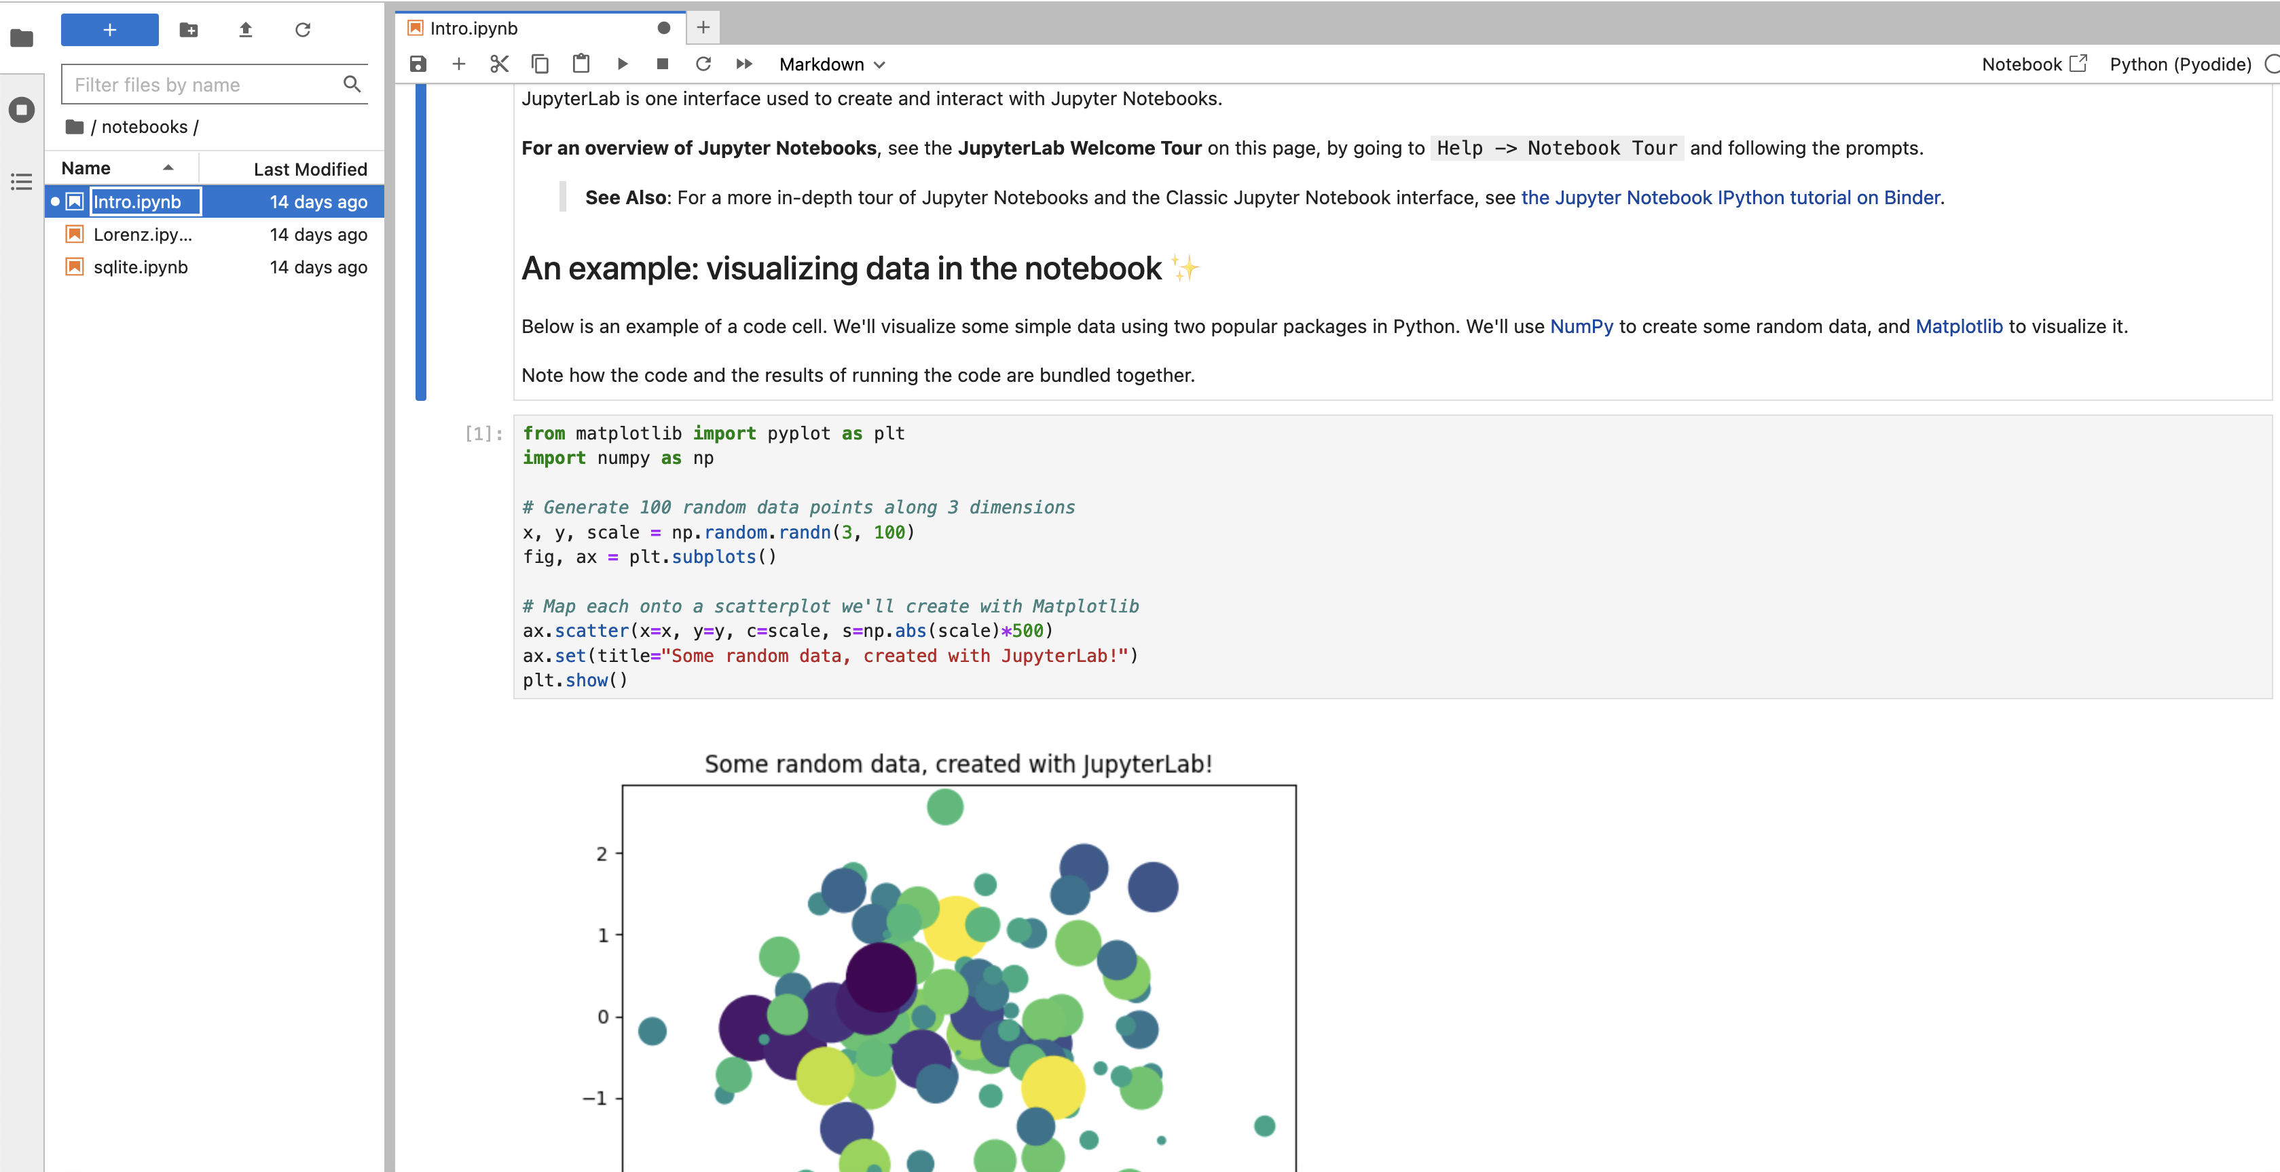
Import/create dataset
Import/create model
Launch model training
Monitor performance
Launch predictions

Slide 14
Use cases
UC1 Perform training on existing benchmark dataset
UC2 Evaluate performance of pre-trained models
UC3 Run predictions on live data retrieved via the EPOS portal
UC4 Creation of training datasets and publication in the EPOS portal
UC5 Perform model re-training and transfer learning
UC6 ML model tuning and development
UC7 Investigate support for Active Learning
Exploit experts’ annotations to refine and augument the training set
Schedule regular re-training

Slide 15
Project structure
SRA Coordination
Infrastructure definition and deployment
Implementation of scientific use cases
Data provisioning and EPOS Catalog support
Use case evaluation, infrastructure and user validation

Slide 16
Not starting from scratch…
Initial investigations focused on induced seismicity
Problem: Earthquake detection and phase picking
Knowledge and experience at KNMI and Cyfronet AGH
Training datasets available
Groningen region
Bodanka and Lumineos networks
Automated tools for building new datasets based on Seisbench
Well-known ML models: EqTransformer, PhaseNet, …

Slide 17
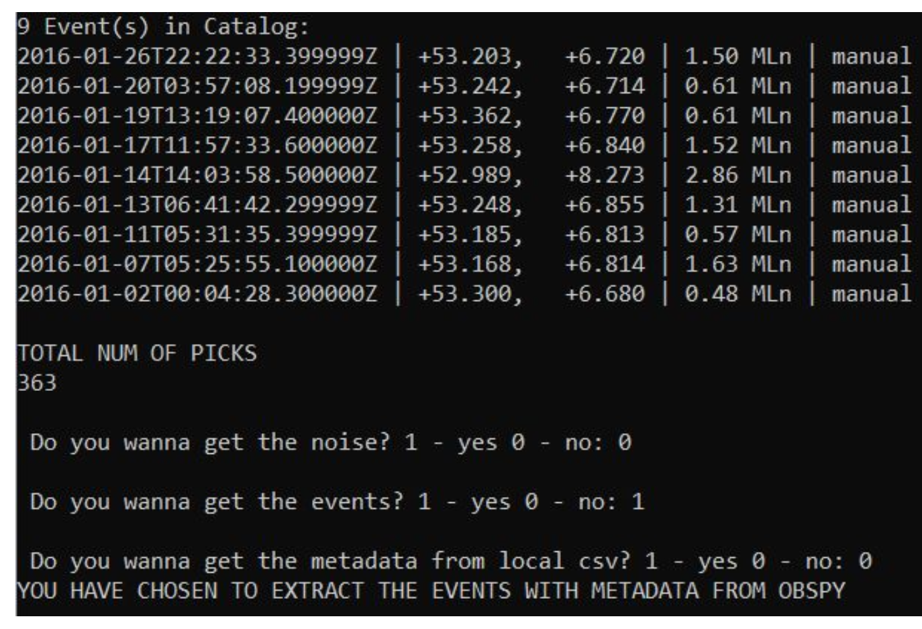
Data preparation
Tool to generate datasets compatible with
Use FDSN services and local catalogues
Including pre-processing steps e.g. rotation, detrending, filtering

Slide 18
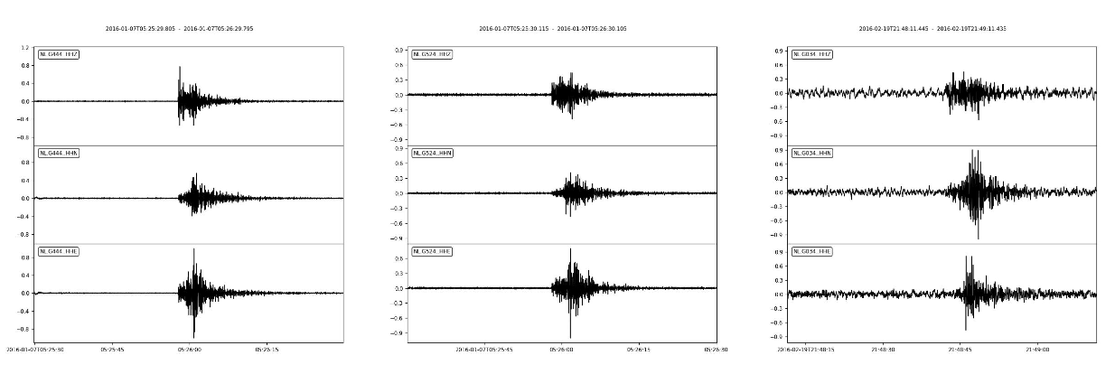
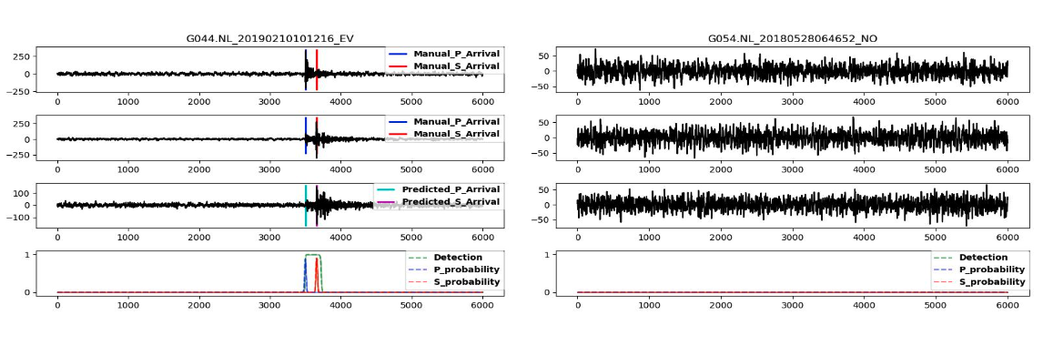
Example of training data and results
Events
Prediction results on testing dataset
Noise

Slide 19
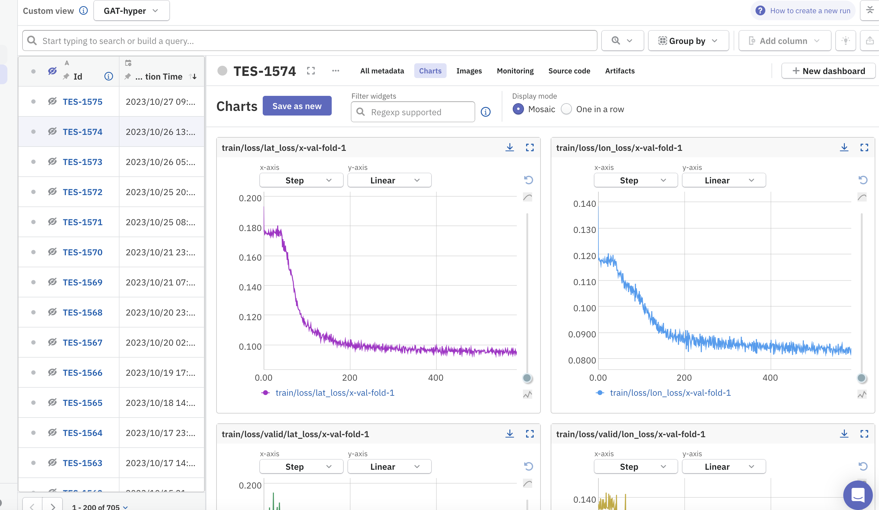
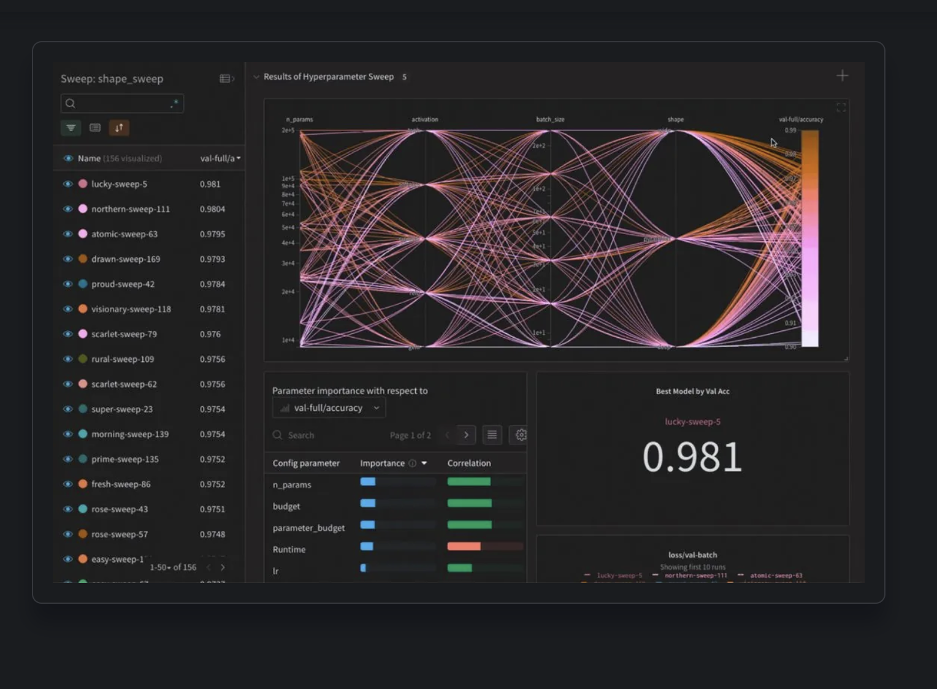
Experiment monitoring
Neptune AI
Weights & Biases
https://neptune.ai
https://wandb.ai

Slide 20
Thank you for your attention!
Questions?

Slide 21
References
Alessandro Spinuso, Mats Veldhuizen, Daniele Bailo, Valerio Vinciarelli, Tor Langeland; SWIRRL. Managing Provenance-aware and Reproducible Workspaces. Data Intelligence 2022; 4 (2): 243–258. doi: https://doi.org/10.1162/dint_a_00129
Jack Woollam, Jannes Münchmeyer, Frederik Tilmann, Andreas Rietbrock, Dietrich Lange, Thomas Bornstein, Tobias Diehl, Carlo Giunchi, Florian Haslinger, Dario Jozinović, Alberto Michelini, Joachim Saul, Hugo Soto; SeisBench—A Toolbox for Machine Learning in Seismology. Seismological Research Letters 2022;; 93 (3): 1695–1709. doi: https://doi.org/10.1785/0220210324
Mousavi, S.M., Ellsworth, W.L., Zhu, W. et al. Earthquake transformer—an attentive deep-learning model for simultaneous earthquake detection and phase picking. Nat Commun 11, 3952 (2020). https://doi.org/10.1038/s41467-020-17591-w
Weiqiang Zhu, Gregory C Beroza, PhaseNet: a deep-neural-network-based seismic arrival-time picking method, Geophysical Journal International, Volume 216, Issue 1, January 2019, Pages 261–273, https://doi.org/10.1093/gji/ggy423
https://www.ecmwf.int/en/newsletter/178/news/aifs-new-ecmwf-forecasting-system
https://www.ecmwf.int/en/about/media-centre/science-blog/2024/machine-learning-ignites-wildfire-forecasting

