Slide 1
EPOS Data Portal Open Source
Valerio Vinciarelli (EPOS ERIC)

Slide 2
Open Source Release
Data Portal developed in collaboration with scientists and IT experts
Adopting advanced software technologies for integrating data coming from heterogeneous sources.
The Data Portal is officially Open Source since December 2023
The release includes:
The source code of the entire microservice-based software
Technical documentation
Multi-platform application which allows users to easily install it locally or remotely
Released under the GPLv3 license.

Slide 3
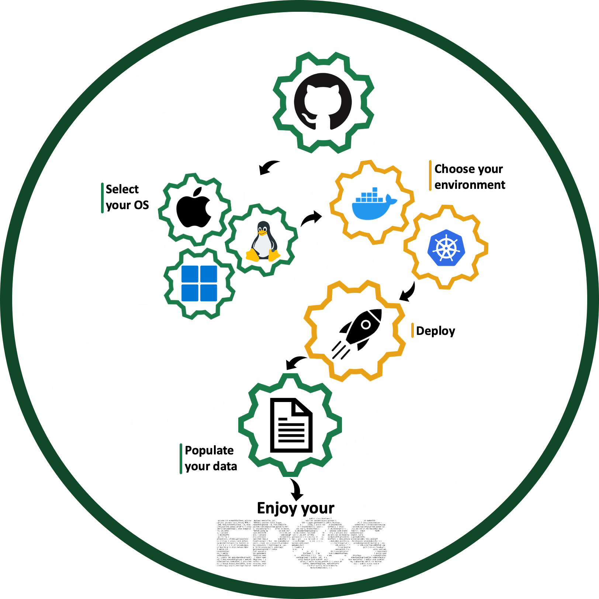
How to use
Download the application from GitHub
Let the application deploy your Data Portal
Populate your Data Portal with metadata
Access to your Data Portal

Slide 4
Stakeholders
The EPOS Data Portal Open Source software enables other communities, initiatives and research infrastructures to capitalize on the work done within EPOS.
Three target user groups:
Generic users (who want to use the software and install it on their own laptop)
Developers (who want to access and modify the code)
System administrators (who want to deploy it on a server to create an infrastructure)
This multi-faceted approach ensures that EPOS Open Source can be utilized by a wide range of users and can facilitate collaboration across different scientific disciplines.

Slide 5
Availability
The platform's source code and documentation are both available on GitHub
making it easy for developers to contribute to its development
potentially improving its overall quality and competitiveness
Application available on GitHub, for local machines and servers (Docker + Kubernetes)
Open Source Webpage: https://epos-eu.github.io/epos-open-source/

Slide 7
Showcasing Open Source Solution
Presented at EGU 2023
EPOS Open Source: A platform for integrating high-quality research products and services
Presented at AGU 2023
EPOS Data Portal Open Source: a FAIR Data Management Tool for Multi-disciplinary Data Integration in Solid Earth Sciences and beyond
Will be presented at EGU 2024
The EPOS open source platform for multidisciplinary data integration and data analysis in solid Earth science
Advancing Open Data Portals: Learnings from the EPOS Open-Source Solution

Slide 8
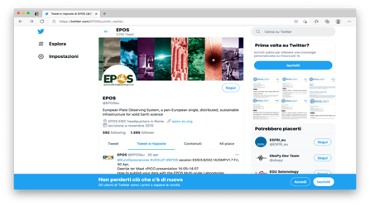
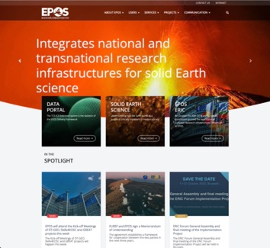
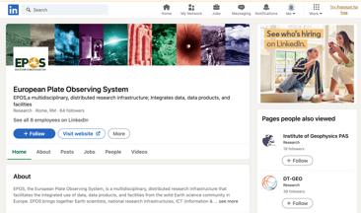
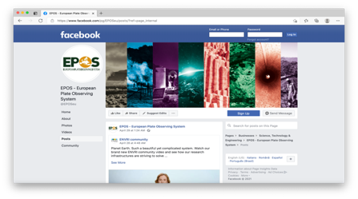
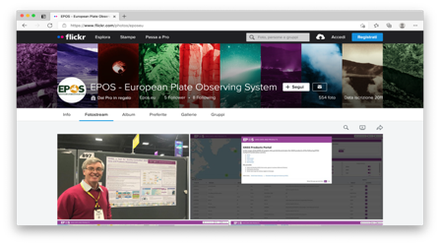
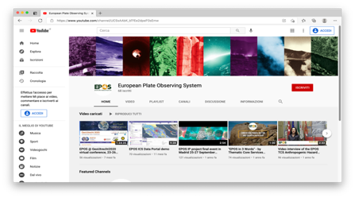
Web site
Social media
www.epos-eu.org
Thank You!

