Slide 1
ICS-C Hosting Organization
Jean Baptiste Roquencourt & Helen Glaves

Slide 2
Plan
Context
MYPA
Roles
DevOps culture
Hosting Organisations 2023

Slide 3
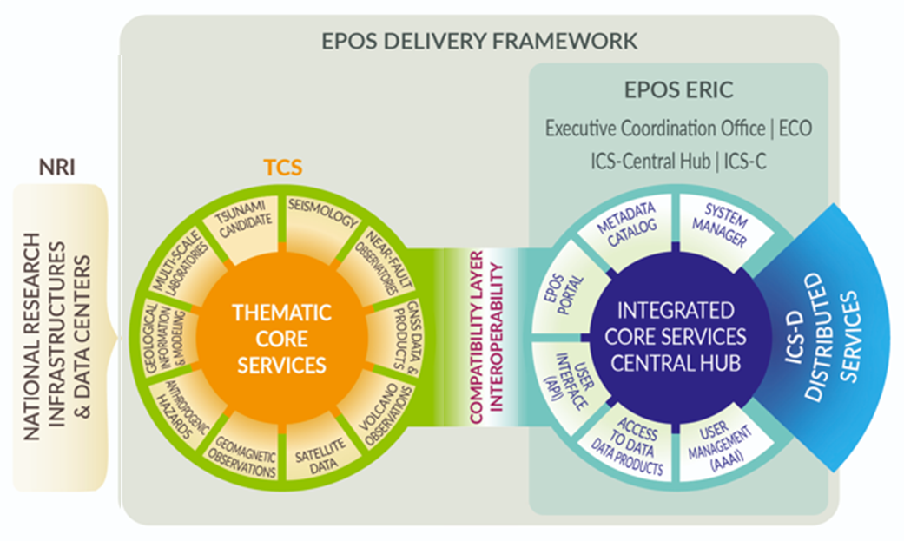
Hosting organizations
Integrated Core Services (ICS-C)
BRGM (France)
British Geological Survey (UK)
Monitoring

Slide 4
Roles and Responsibilities
ICS- C Strategic Director (BGS): Helen Glaves
overall responsibility for strategic management of the ICS-C
member of the ECO / EPOS Executive Committee and Service Coordination Committee
ICS Technical Director (BRGM): Jean-Baptiste Roquencourt
overall responsibility for the technical development and operation of the ICS-C
member of the IT Board
deputy: Patrick Bell (BGS)
ICS-C Monitoring Coordinator (GEUS): Jakob Molander
deputy: Viktor Rasmussen

Slide 5
Multi-Year Partnership Agreement (MYPA)
Hosting of the ICS-C:
signatories BRGM, UKRI (BGS) and EPOS ERIC
three-year agreement: 1 January 2023 – 31 December 2025
defines framework for hosting and operation of the Integrated Core Services - Centralised (ICS-C)
Technical Annex: documents IT framework for hosting ICS-C
annual work plan:
Monitoring
Signatories GEUS and EPOS ERIC
three-year agreement commencing 1 January 2023
Notes:
MYPA outlines the services and procedures that will be carried out in order to ensure the effective management and operation of the EPOS-ERIC ICS-C.
Annual work plan provides flexibility to accommodate any new and emerging requirements including any up dates to the ICS-C, and also allows for any agreed updates to the TA. Aligned with annual planning activities undertaken in the context of the IT Board

Slide 6
DevOps comitology
Objectives:
Smooth interaction between different skills and focus
Developers : functionality
Operators : reliability
2 sides of the same coin
RUN :​
Tasks :
operational and minor issues​
plan the releases of ICS-C​
Group : DevOps
Frequency : Meeting every Friday
Skills : Developers and Operators
BUILD
Tasks:
problem = long lasting issues
major functionality changes: ie Backoffice
Group: Architecture comitee​
Frequency : monthly
Skills: 1 Developer (EPOS ERIC), 1 software architect(BGS), technical architect (BGS, BRGM)

Slide 7
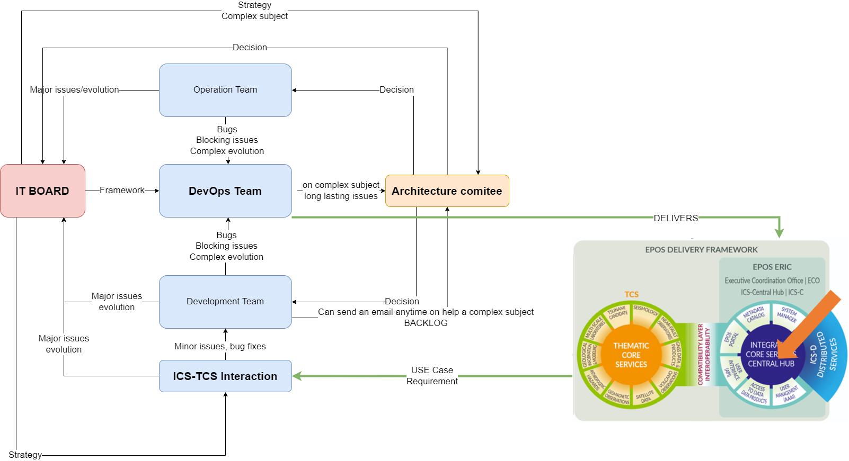
DevOps interactions

Slide 8
Hosting Organisations 2023
Key achievements:
EGU – required performance level achieved in preparation for the official launch of the porta
Quality assurance - Performance testing procedures now fully embedded in the periodic work
KPI - availability above 99,35% thanks to the ICS-C EGU release
Security : embedded Hosting Organisation security framework
Hardware and software : ie scan for vulnerability during the release process
Information System Security Policy
Recurring IT security assets audit
Infrastructure: underlying infrastructure fully managed by Hosting Organisation
Data privacy
Resilience
Datacenters: Networking, storage, Storage
Etc.
Human resources:
More than 10 IT different jobs
More than 20 IT people

Slide 9
THANKS

