Slide 1
IT Board Introduction
Daniele Bailo, EPOS ERIC IT Officer
Jan Michálek, ICS-TCS Interaction Coordinator

Slide 2
The EPOS approach for FAIR data provision:
a multidimensional perspective
Community Building
Technical
Legal and Governance
Financial
Bottom-up approach: to ensure scientific and technological strategies are fully shared by the Community
Community-driven effort: scientists, e-scientists, data practitioners, data managers and policy-makers participate in the co-design and co-development of the RI, including its Data Portal
Data and service providers are an essential part of the user community
Open Science and FAIR principles implementation agreed within the Community and put in practice since the design phase
Data Portal implemented by adopting a metadata and service-based approach that guarantees data remain where they are generated (National Research Infrastructures)
The source code of the Data Portal will be released under a Open Source GPL3 license
Integration of European Research Infrastructures under a common federated framework coordinated by the ERIC
Several Boards, beyond the GA, contribute to the Governance (Scientific, Ethical, Executive, Service Coordination, etc.)
Domain-specific research communities organized in Consortia for an an effective FAIR management of data and services ( adhering to EPOS Data Policy and Ethical Guidelines)
Financial model takes into account diverse financial sources (National, EU, ERIC) to support activities at RI level, such as:
service integration and operation of the Data Portal
governance of the thematic communities
integration of new communities
whereas
Data generation and management are fully supported at National level
The ERIC costs are a small fraction of the entire national investments for Data generation
IT BOARD

Slide 3
IT Board Mandate and Responsibilities
Mandate
Established by the EPOS Executive Director.
Manages/oversees EPOS IT strategies, and technical development relevant to the ICS and TCS systems; coordinates with service committees; considers IT implications of EPOS policies; ensures compliance and liaisons to EU standards and practices (e.g. FAIR)

Slide 4
IT Board Mandate and Responsibilities
Responsibilities
Plans and aligns ICS implementation with executive strategies.
Proposes IT strategies and development activities for the Annual Planning Report
Organizes ICS-TCS Interaction Workshops and ensures the execution of prioritized technical developments.
Regular strategic and technical meetings to discuss ICS operations and coordination with other initiatives, and other IT relevant topics
tracks international initiatives and developments that may be relevant to EPOS – some of which become funded projects

Slide 5
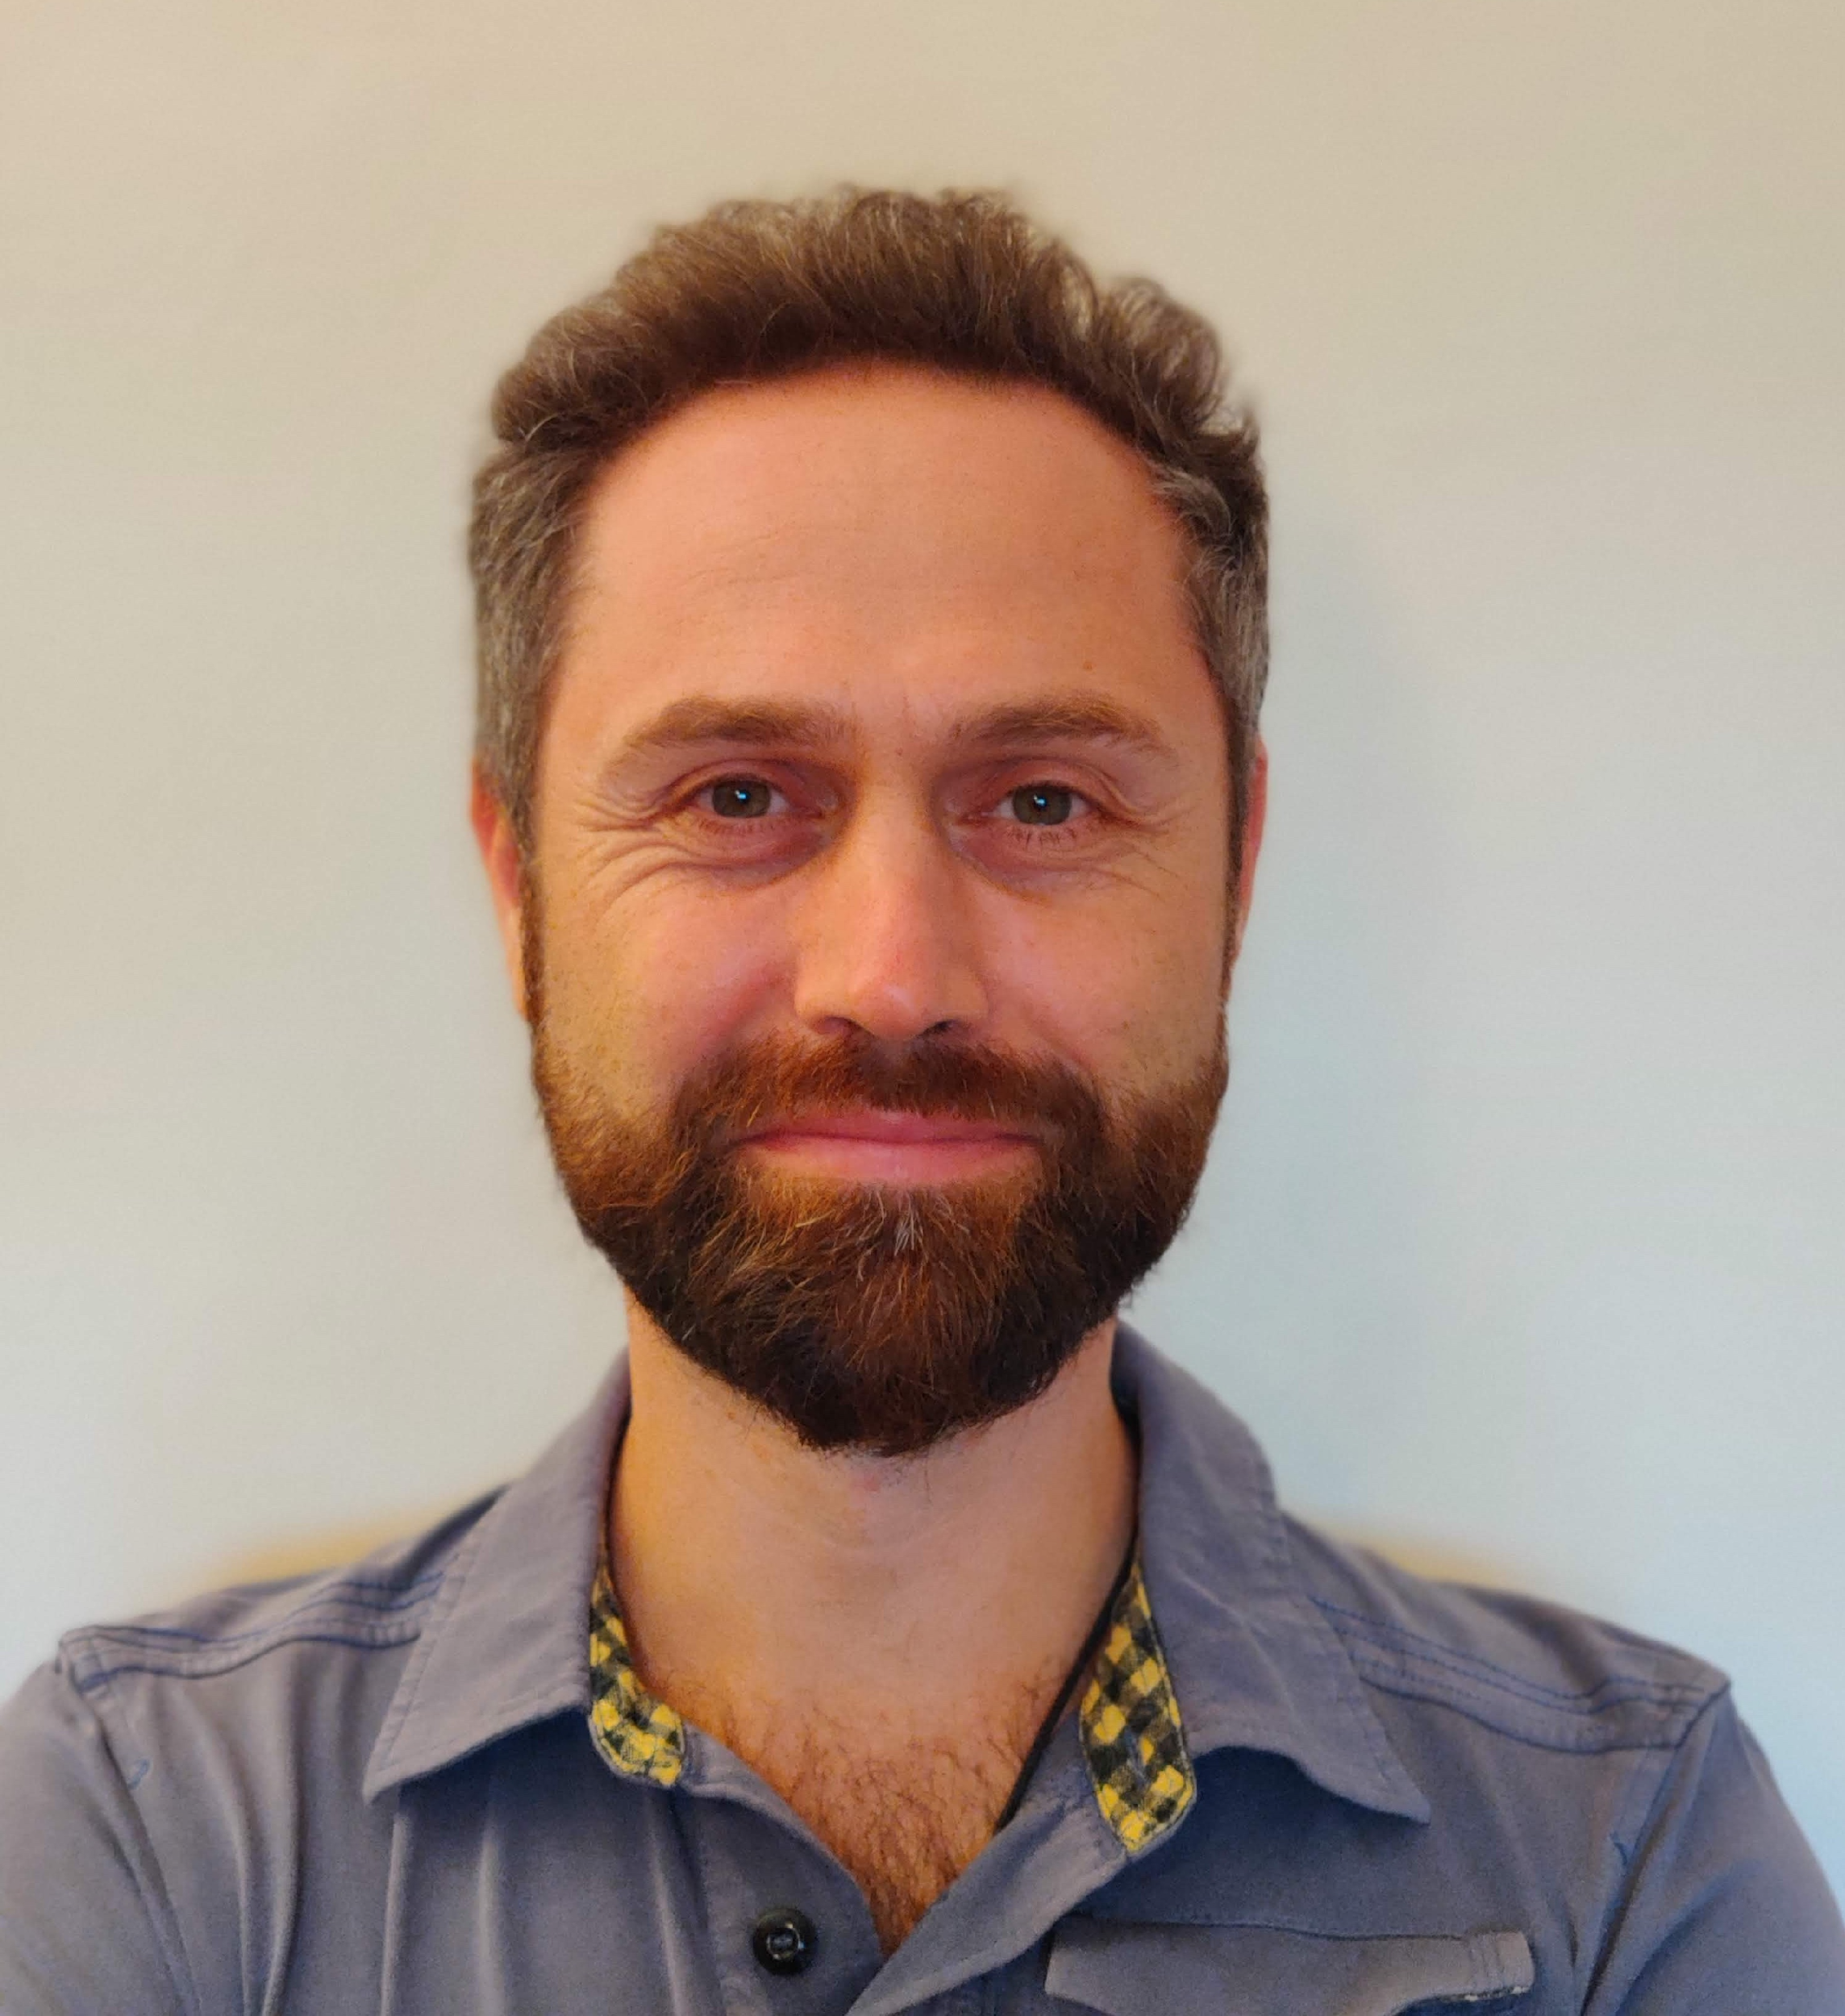
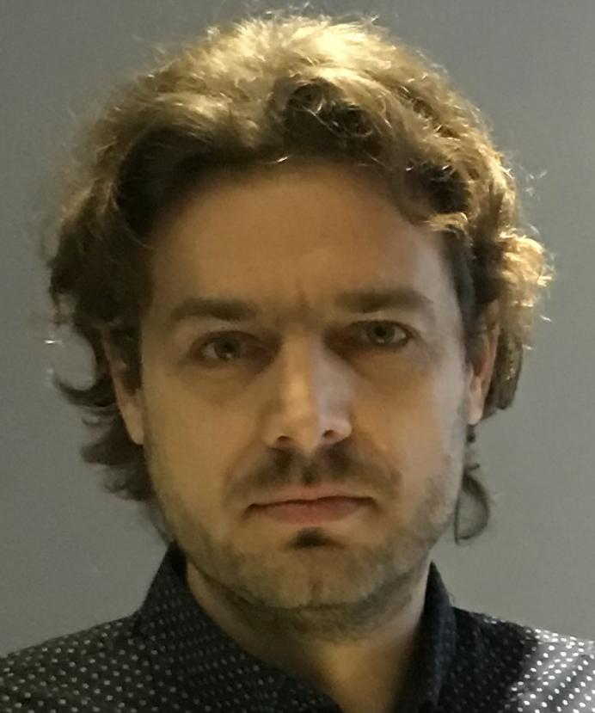
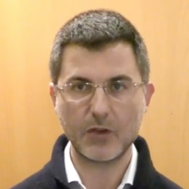
EPOS ERIC IT Board
IT BOARD
IT BOARD Chair:
Daniele Bailo - INGV
ICS-C Director: Helen Glaves – UKRI/BGS
ICS-C Tech. Coord: J.-B. Roquencourt -BRGM
Lead: Jan Michalek - UiB
ICS-C Hosting & Operation
TCS-ICS
TCS-ICS interaction
In charge of managing the interactions between ICS and TCS
In charge of hosting the Data Portal
Monitoring System - GEUS
SCC representatives:
Otto Lange - UU
Michele Manunta – CNR-IREA
ICS-C H&O
ICS-C Dev
Lead: Rossana Paciello - INGV
TCS Representatives
ICS-C Data Portal Development
Represents TCS and assets integrated into the Data Portal
TCS
In charge of developing the Data Portal software
Advise on Global initiatives
Keith G Jeffery

Slide 6
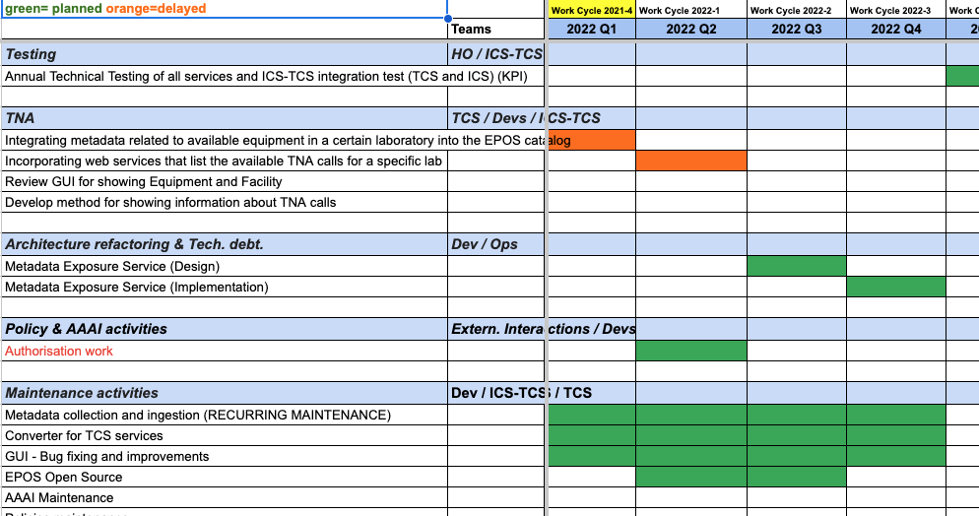
ANNUAL PLANNING
The strategic planning outlines the priorities, scheduled activities, and development cycles for the year, incorporating the key elements of the “EPOS ERIC Strategy for 2024-2028” document.

Slide 7
ANNUAL PLANNING: Activities
Annual Testing: evaluating ICS-TCS system functionalities to ensure the portal functions correctly and meet design specifications.
Facility Registry: catalogue showing available facilities and equipment provided by the TCS communities.
Portal Improvement: Enhancing the user interface and structural design of the web portal for better user experience and functionality.
Maintenance Activities: Routine technical tasks to keep the system operational, updated, and free of issues.
Backoffice platform: Administrative User interface to manage metadata and cost book.
VREs, AI and Computational Services: Development and provision of Virtual Research Environments, Artificial Intelligence tools, and computational resources to support scientific analysis.

Slide 8
ICS-TCS interactions
Jan Michálek

Slide 9
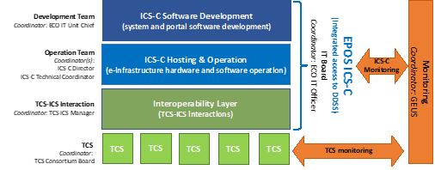
ICS-TCS Interactions
ICS-TCS Interaction Team
is acting as a mediator between ICS and individual TCS
provides guidance for new service integration
collects requirements from communities and users for the ICS improvements
evaluates testing results of services before implementation to ICS and reviews monitoring results
manages issues in issue tracker and oversees their progress
implements ICS-TCS Interaction Workshops (3-5 days; online or in-person)
provides training on EPOS Data Portal usage

Slide 10
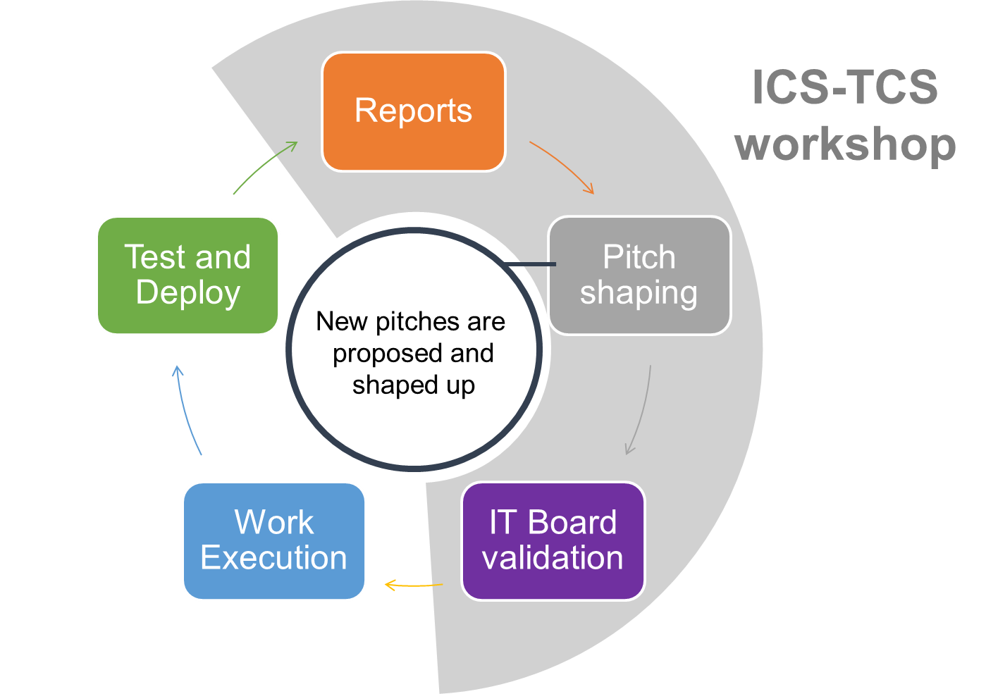
How Key Actors work together
EPOS developments are executed in quarterly development cycles.
One cycle consists of the following components.
One cycle takes 3 months

Slide 11
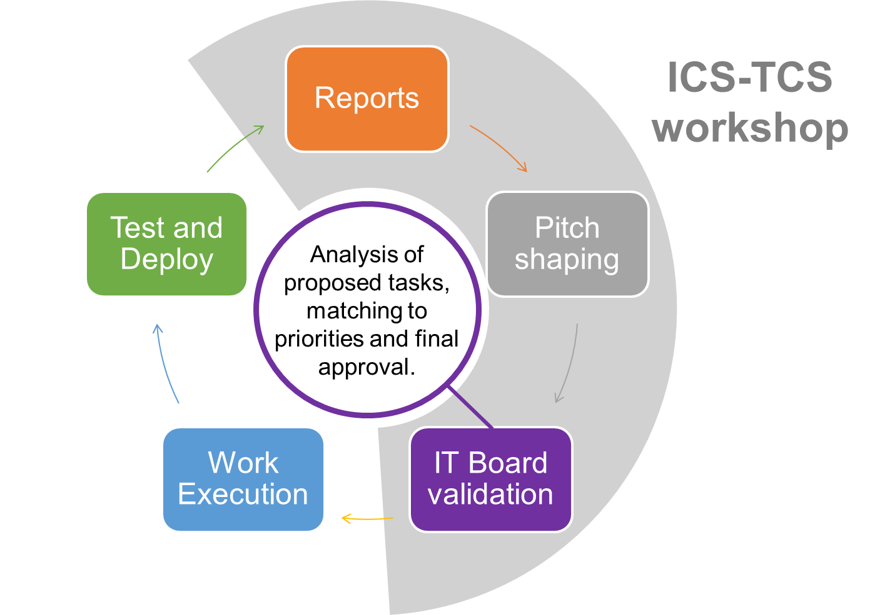
How Key Actors work together
One cycle takes 3 months

Slide 12
How Key Actors work together
One cycle takes 3 months

Slide 13
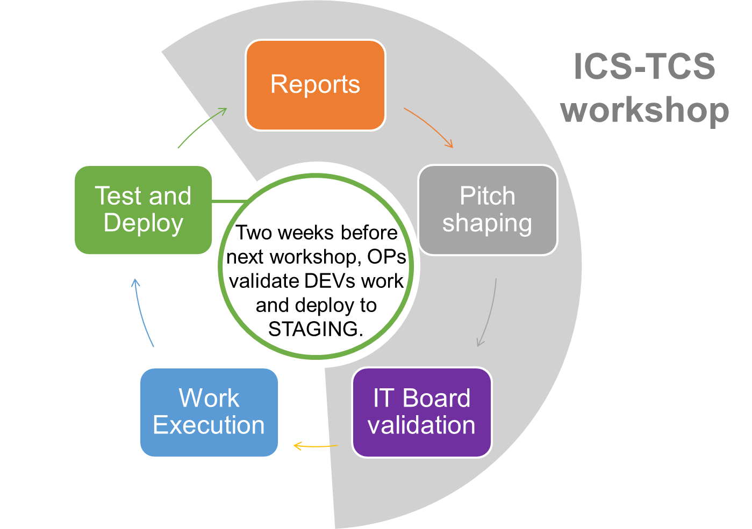
How Key Actors work together
One cycle takes 3 months

Slide 14
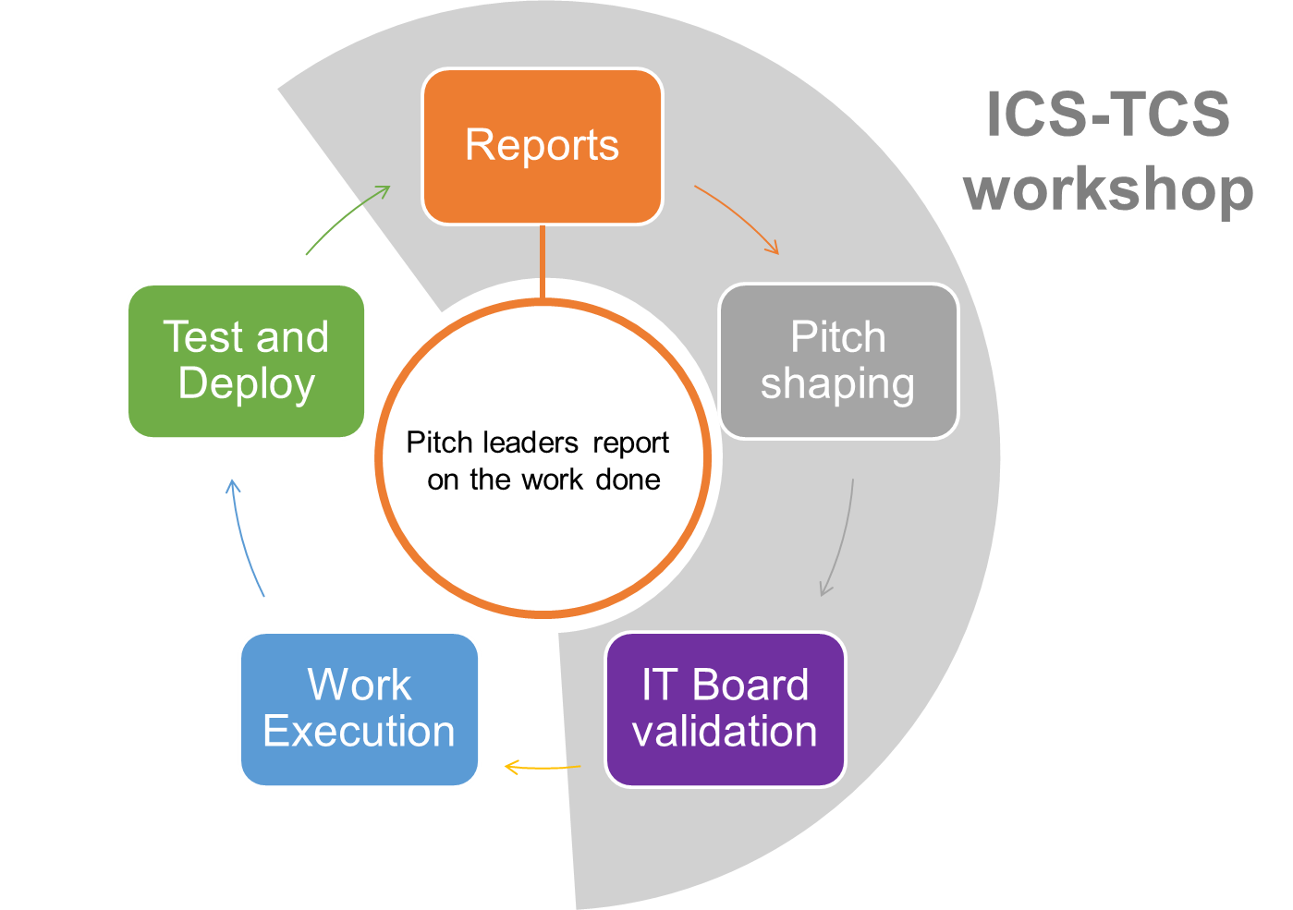
How Key Actors work together
One cycle takes 3 months

Slide 15
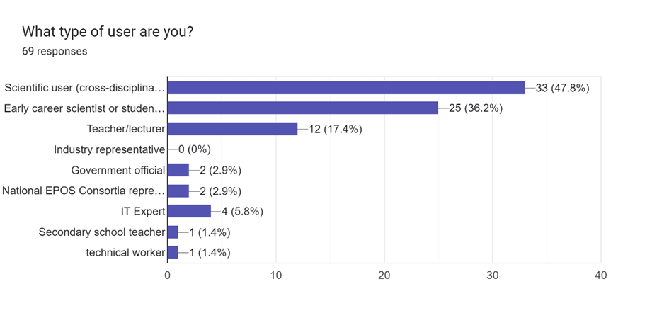
Training - EPOS Data Portal
Summary from training in January 2024
400 registered participants, 182 participated, 69 provided feedback

Slide 16
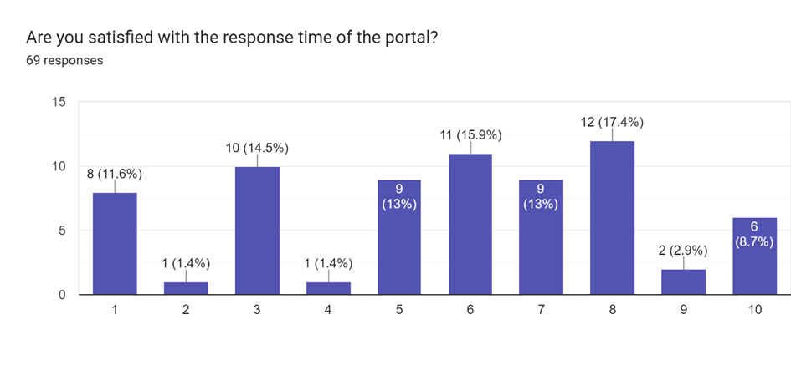
Training - EPOS Data Portal

Slide 17
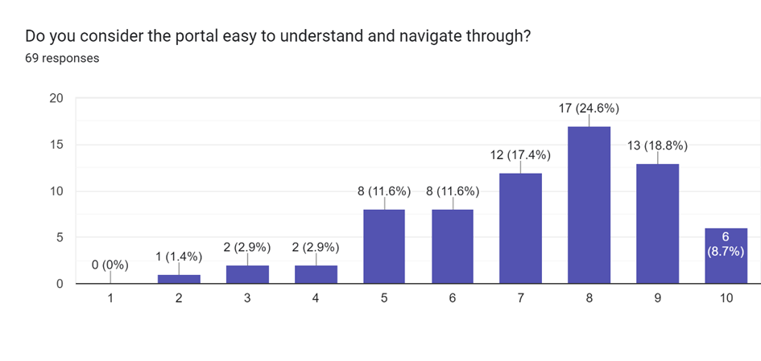
Training - EPOS Data Portal

Slide 18
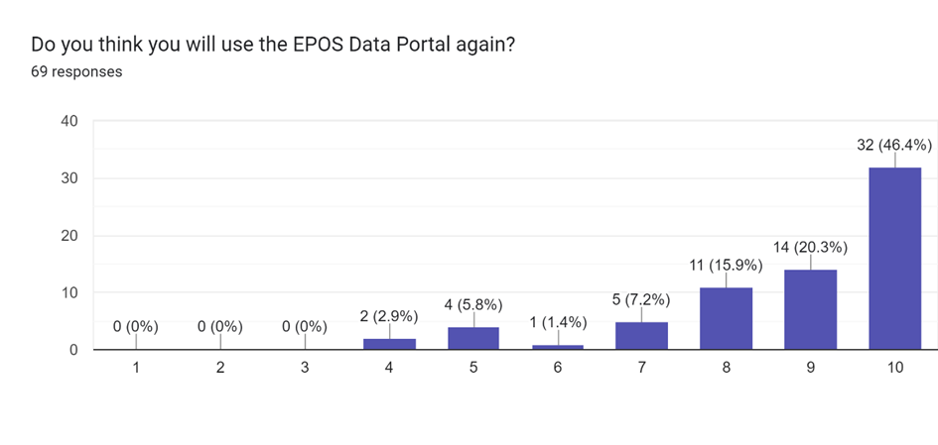
Training - EPOS Data Portal

Slide 19
FUTURE STEPS
Future activities for the ICS-C and ICS-D
Sponsored Research Activities
DT-GEO and GEOINQUIRE
Computational centers etc.

Slide 20
Thank you

