Slide 1
TCS TSUNAMI @ EPOS DAYS
Rome, 11-14 March, 2024

Slide 2
TCS Participants attending the EPOS Days
Name | Institution | Role in TCS
Andrey Babeyko | GFZ-Potsdam | TCS coordinator
Stefano Lorito | INGV | TCS representative in SCC
Alejandro González del Pino | Uni Malaga | Early Career Researcher
Beatriz Brizuela | INGV | TCS Contact person for Service Provision
Roberto Vallone | INGV | TCS Contact person for IT issues
Finn Lovholt | NGI | Contact person for ICS-D
Clea Denamiel | RBI | TCS Contact person for Ethics
Iñigo Aniel-Quiroga Zorrilla | IH Cantabria | Pillar 1 “Support to Tsunami Service Providers”, Contact person for Training
Antonio Scala | Uni Napoli | Service provider, Pillar 3 “Numerical models”
Manuela Volpe | INGV | Service provision Support
Fatemeh Jalayer | UCL | Pillar 4 “Hazard and risk products”

Slide 3
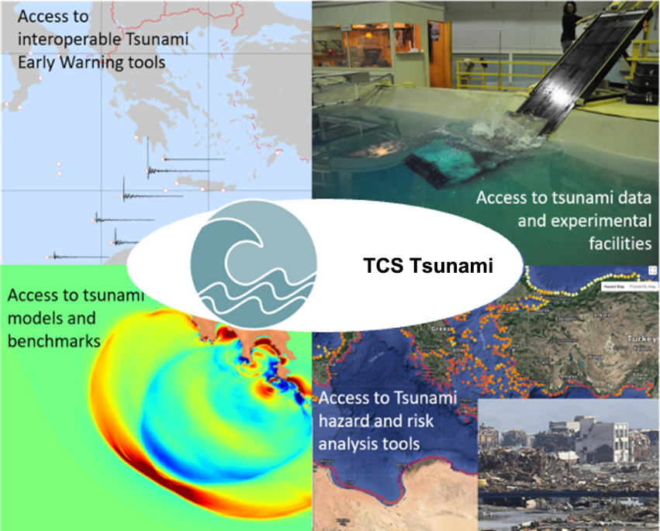
Pillar 1
Pillar 2
Pillar 3
Pillar 4
Presenting the scientific area of the TCS (1/2)

Slide 4
Relevance of the Tsunami Community to EPOS-ERIC
Presenting the scientific area of the TCS (2/2)
Strong inter-disciplinarity: natural interaction with other TCSs
Strong international (beyond Europe) network
Rich portfolio of stakeholders: research, private sector, civil protection, early warning, policy makers
State of the art numerical modeling and observing systems

Slide 5
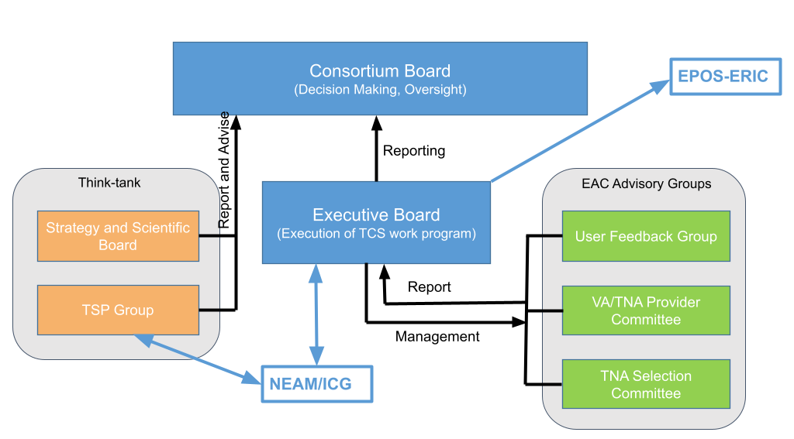
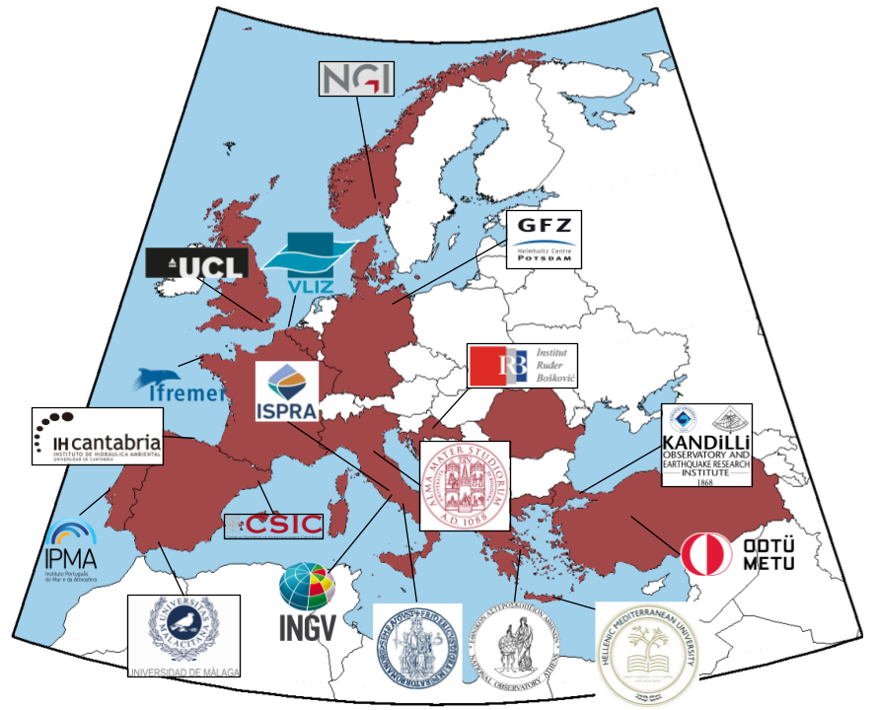
TCS governance structure
18 Partners
TCS Governance (1/3)
Executive Board includes:
Chairperson of the Consortium Board: M. Charalampakis, NOA
TCS representative in the EPOS SCC: S. Lorito, INGV
Signatory of MYCA (= TCS Coordinator): A. Babeyko, GFZ
One representative of each of the four Pillars: Íñigo Anel-Quiroga, IHC; Francisco Hernandez, VLIZ; Jorge Macías, UMA; Fatemeh Jalayer, UCL
One TSP-representative: Rachid Omira (IPMA)
TCS contact persons to EPOS ERIC for: service provision, IT issues, comm/outreach, ethics (B. Brizuela, INGV; R. Vallone, INGV; D. Cambaz, KOERI; C. Denamiel (RBI))

Slide 6
From an idea, to candidate, to full TCS: the Timeline
Involvement into EPOS-ERIC daily activities: TCS-ICS pitches, communication & outreach, ‘foreign relations’, SRA, joint projects, …
9/2018
MUC Intl.
01/2021
7/2021
EPOS GA
Dec 2023
EPOS GA
11/2018
3/2021
12/2021
2022
10/2023
02/2024
1st ConsBoard
Meeting initiative group
Start dialog w/EPOS
cTCS website and portal
Community
paper (Ann.Geophys)
Granted status of Candidate TCS
CA Draft
TCS approved
Start w/ 2 Pilot ICS-C services
TCS in force!
Endorsement by ICG/NEAMTWS
2
continuous service uptake to ICS-C
20+

Slide 7
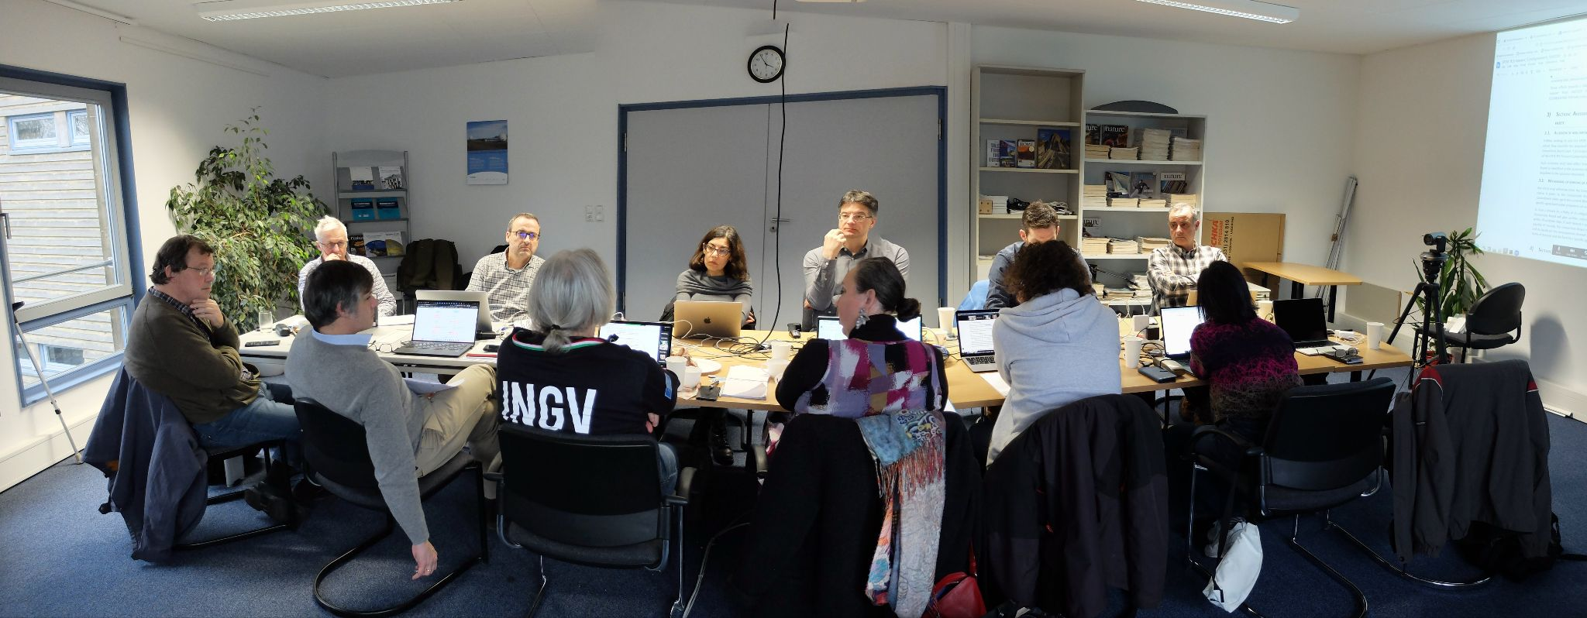
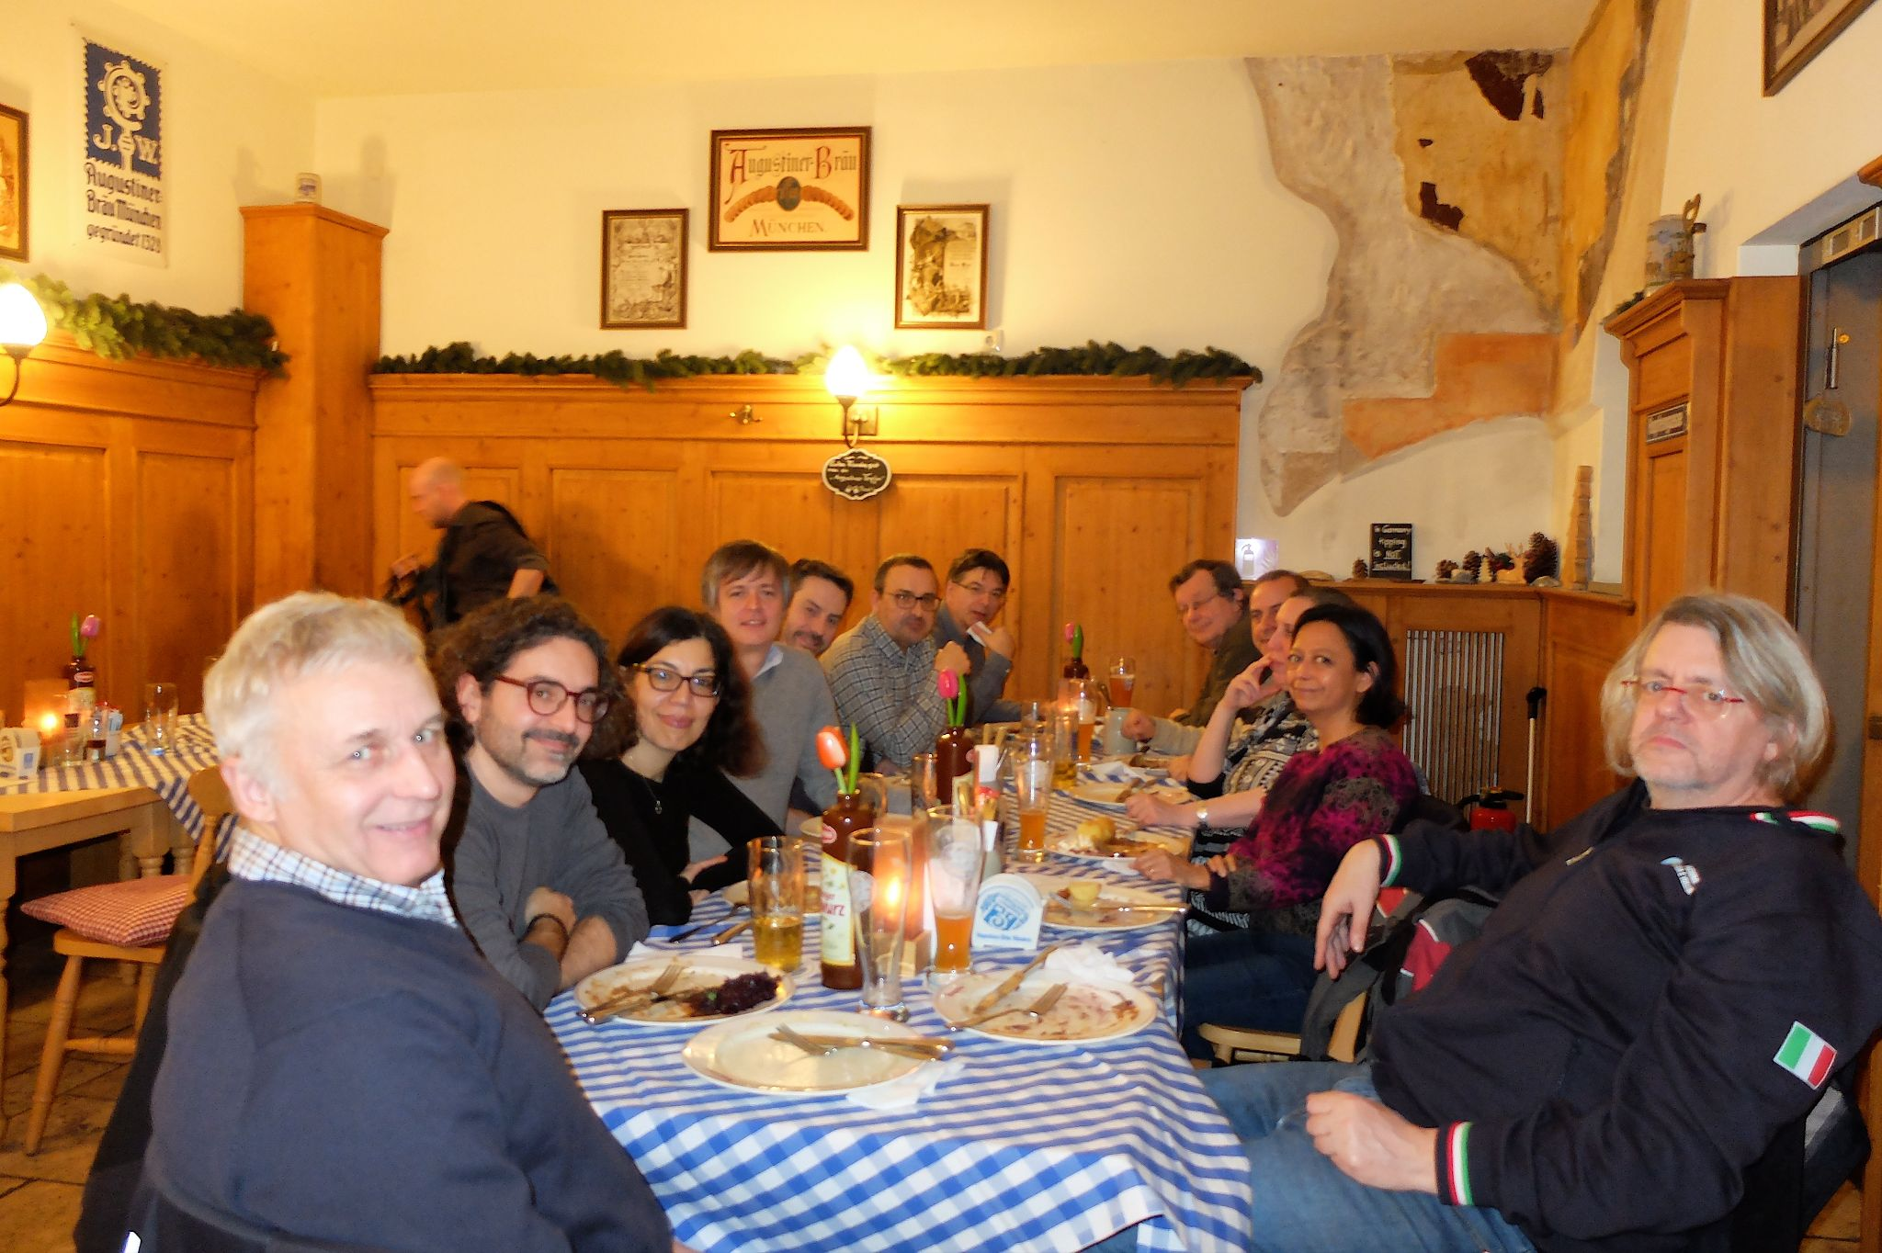
TCS Governance (2/3)
TCS TSUNAMI Consortium Agreement signed in February 2024!
1st constitutive Consortium Board Meeting took place in Potsdam on Feb 15-16
Elections
Setting priorities by TCS development
Modes of service provision (sustainability)
Drafting MYCA and Work Program for 2024

Slide 8
TCS Governance (3/3)
Ingredients of a sustainable service provision in TCS TSUNAMI (not a full list)
Community consensus on priorities in TCS development including principles of service provision
EPOS ERIC funding presumably for uptake of new services into the EPOS delivery framework
Optimizing resources for service provision by setting up a centralized “TCS-node” @INGV+CINECA
Participation to long-term initiatives: GTM (Global Tsunami Model)
Additional (but consistent) fundraising via active participation to 3rd party EU-projects related to EPOS:
DT-GEO
Geo-INQUIRE
EPOS-ON
And new 2024 proposals:
EOSCLIMA
GEMINI
EPOS-ON

Slide 9
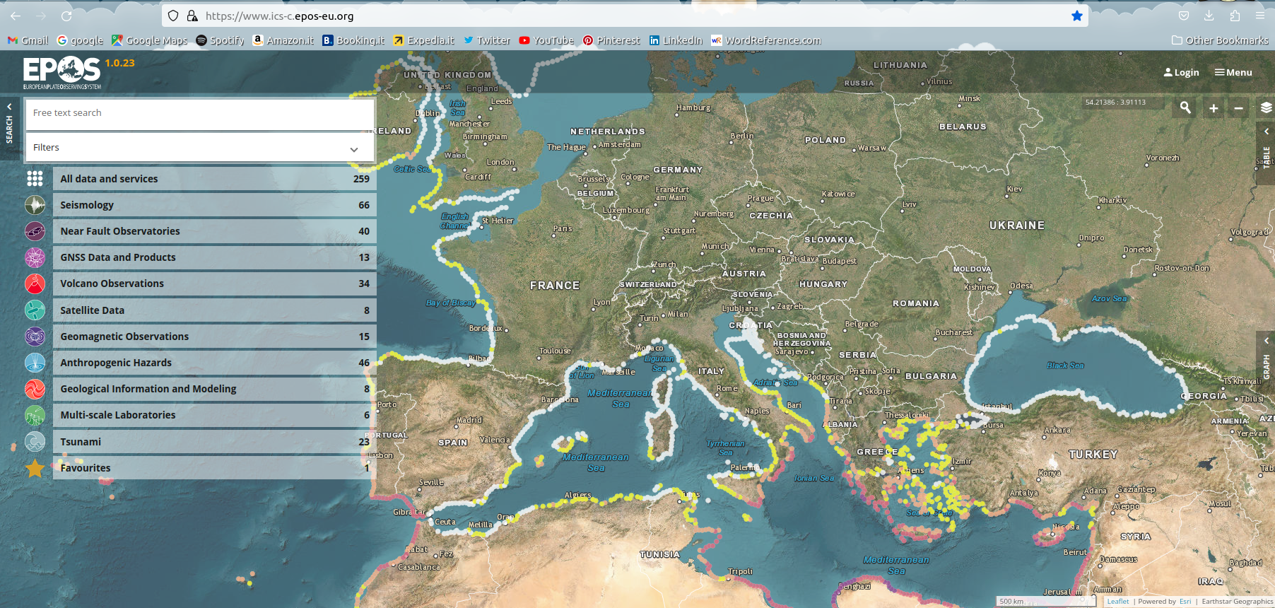
TCS Services (1/5)
INGV, VLIZ, UCL, CSIC

Slide 10
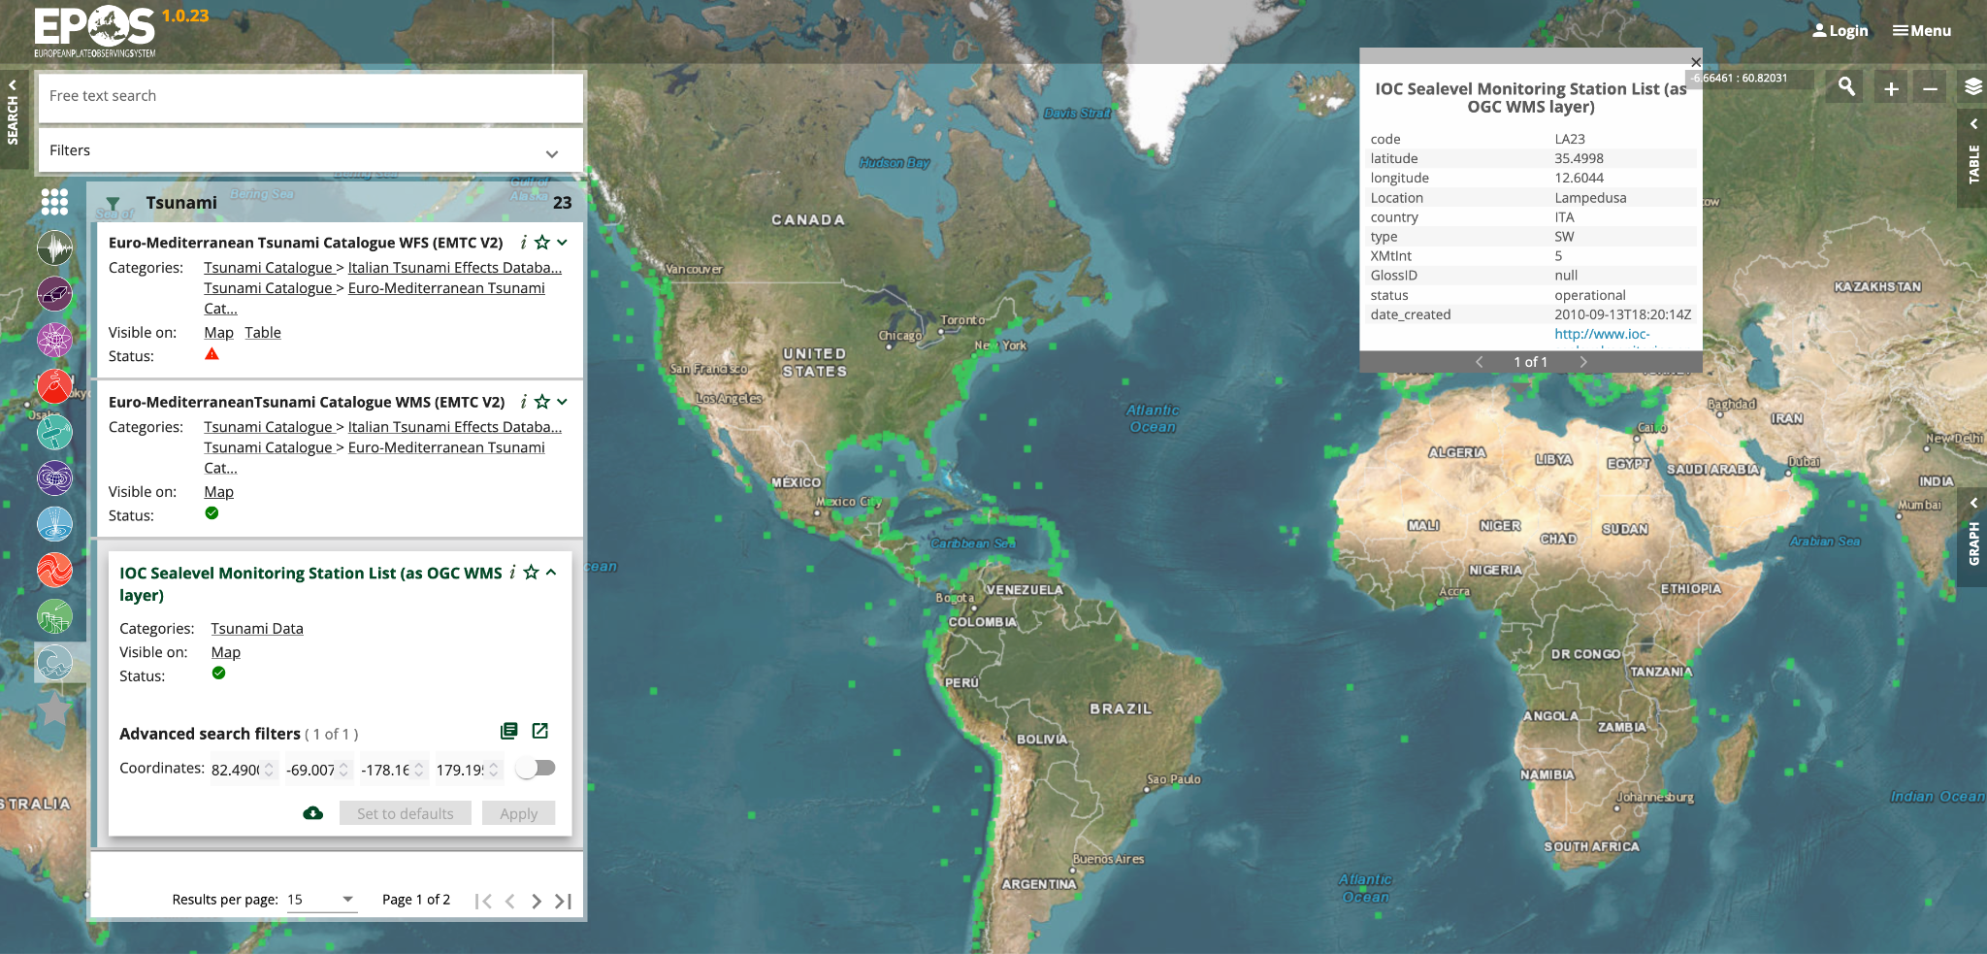
TCS Services (2/5)
Example services :: Pillar 2 “Tsunami data” :: Real-time sea level observations

Slide 11
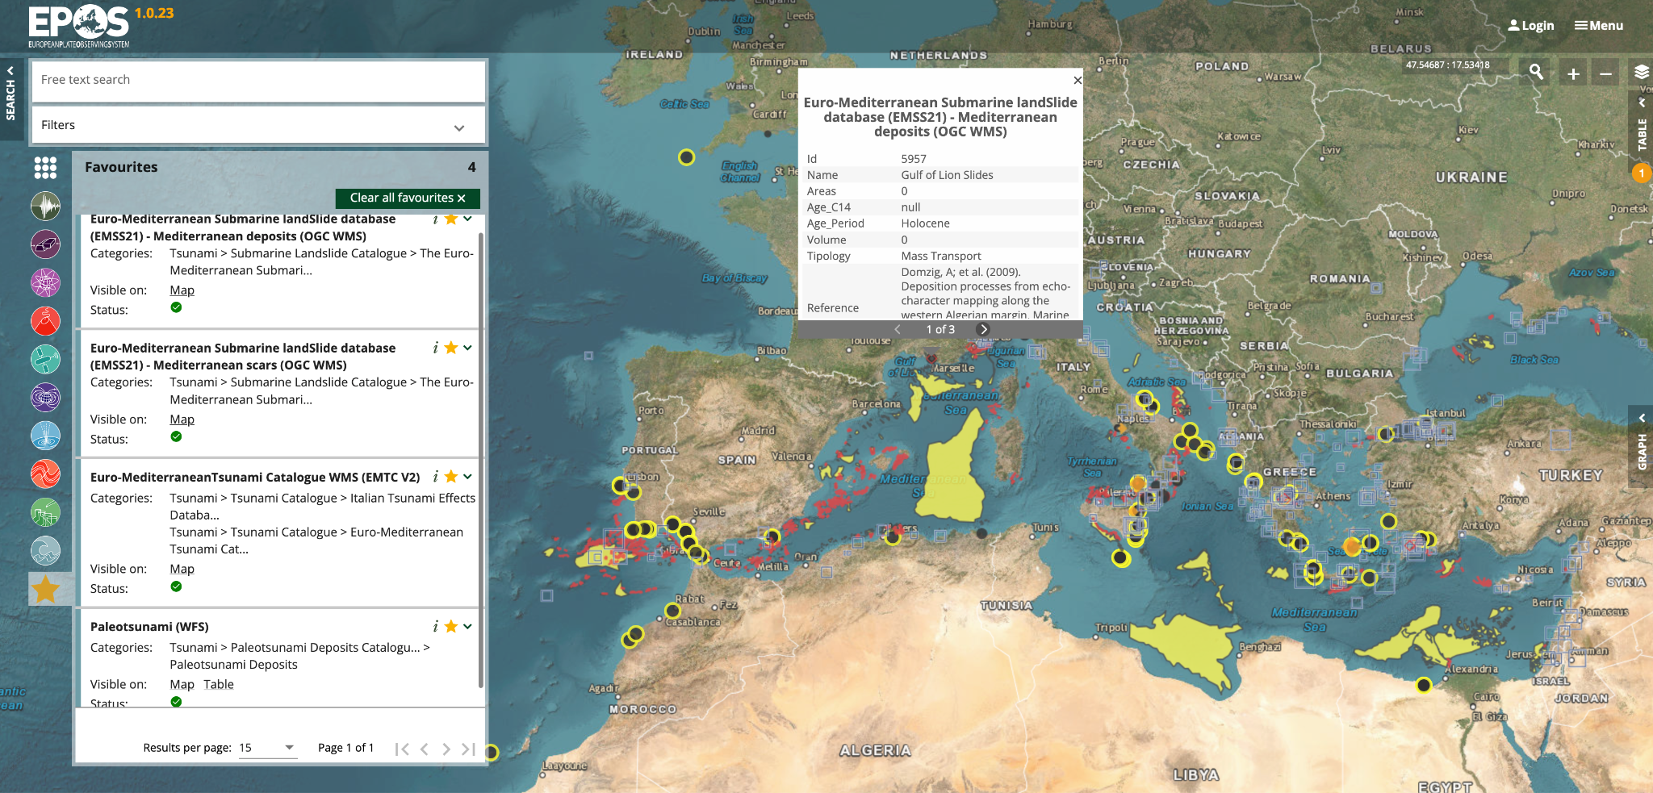
TCS Services (3/5)
Example services :: Pillar 2 “Tsunami data” :: Catalogs combined

Slide 12
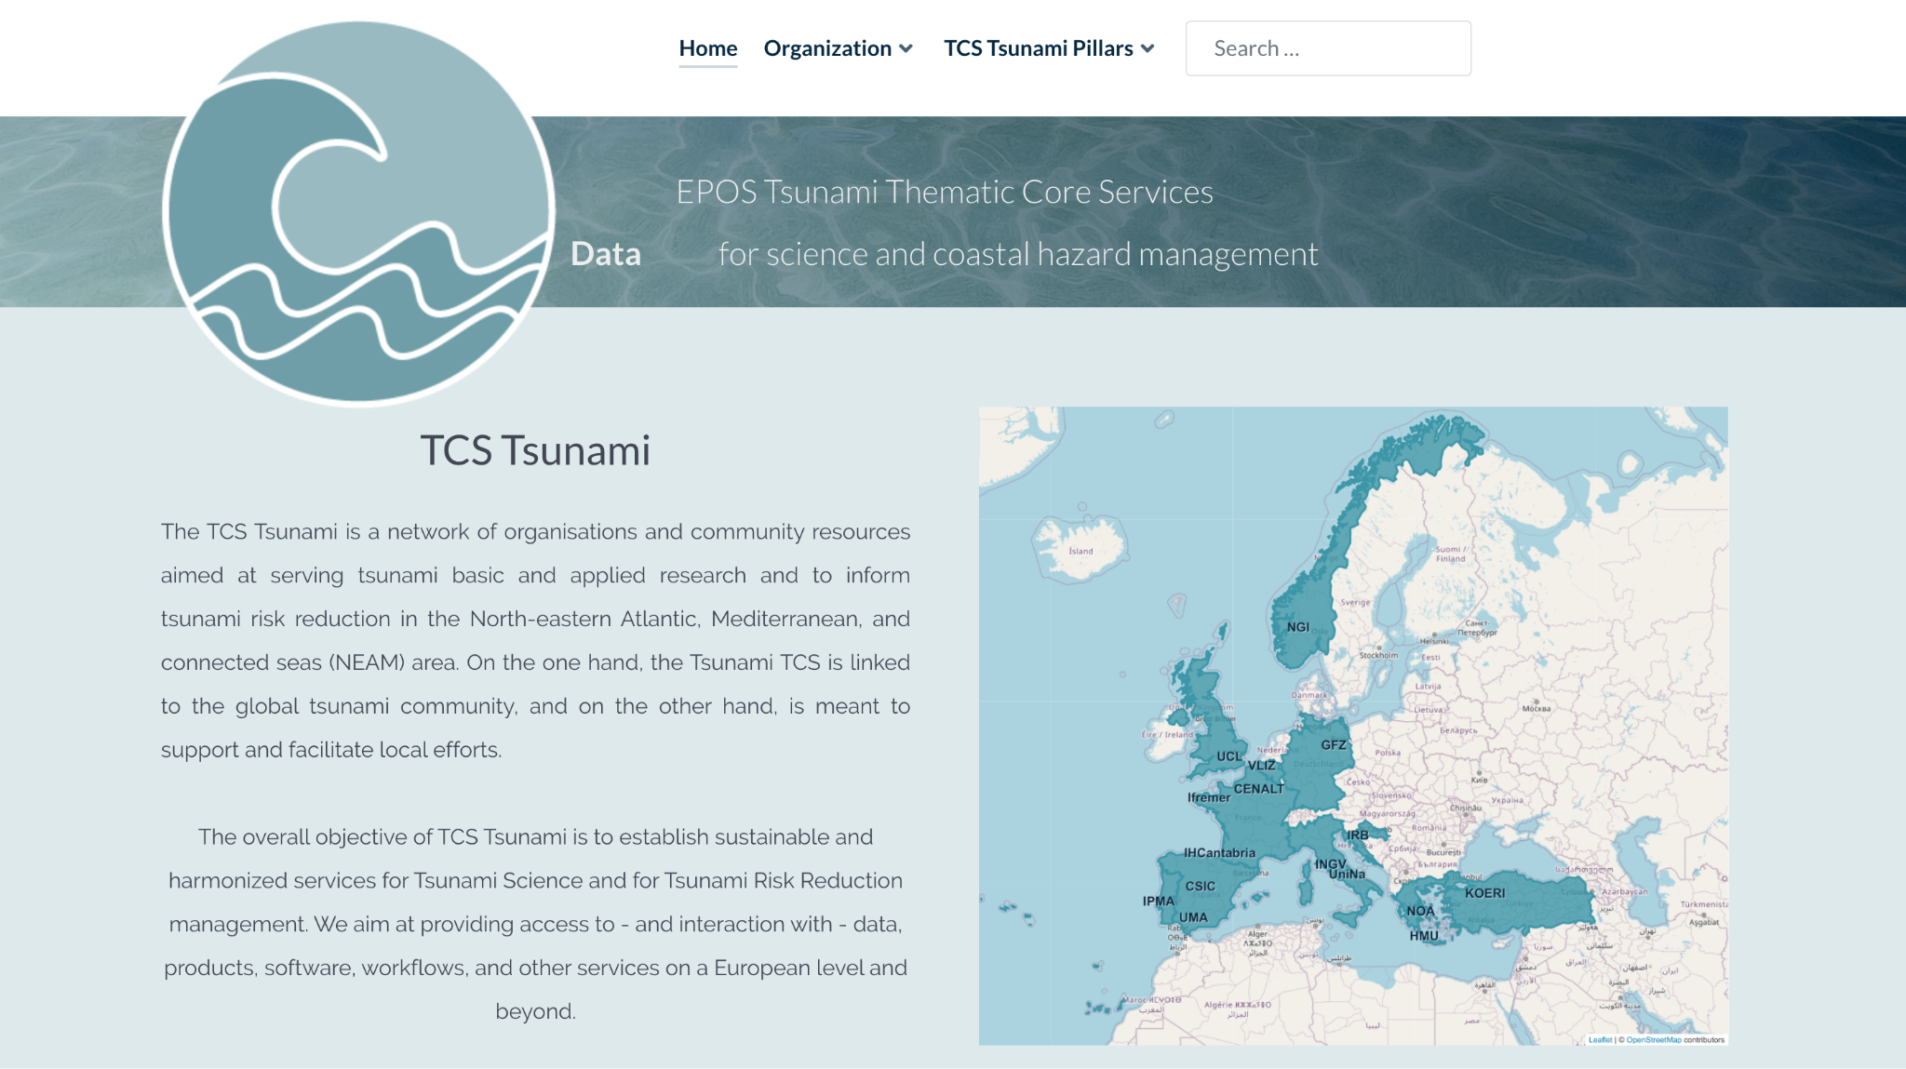
TCS Services (4/5)
More services available through the Community website https://tsunamidata.org
New website version in preparation

Slide 13
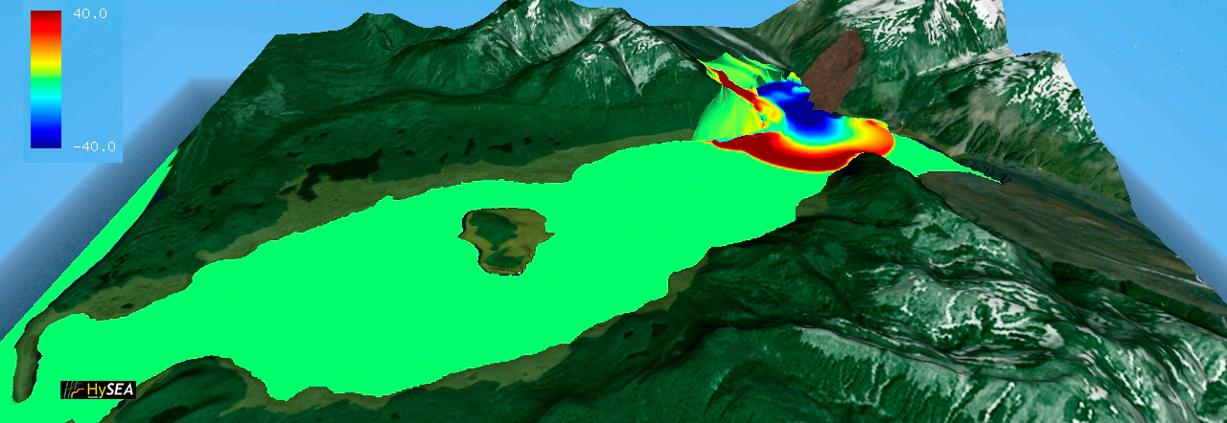
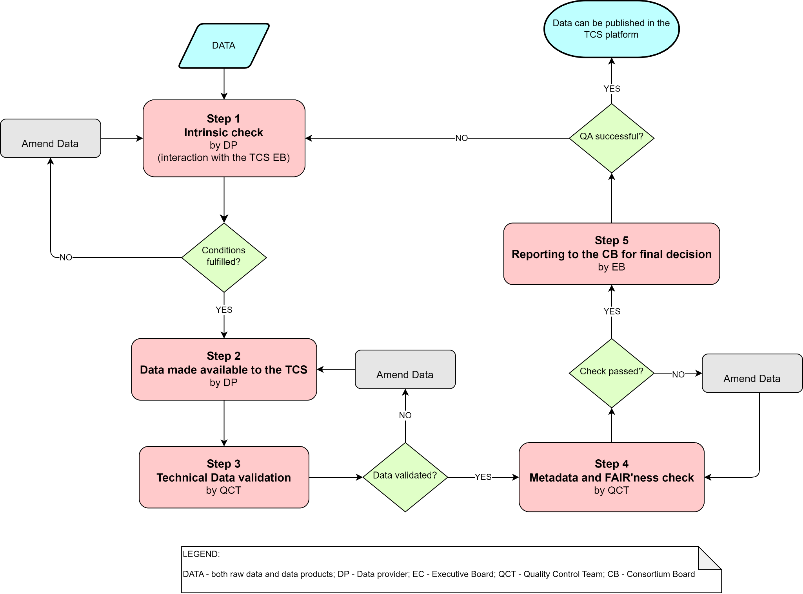
TCS Services (5/5)
Plans for near and not-so-near future (TCS Tsunami)
Strengthen services beyond ICS-C (Pillar 3, mainly)
Simulation Data Lake (SDL)
Software
Web services and apps
HPC based services (also as TNAs, already ongoing in Geo-INQUIRE)
Include Experimental Lab facilities as TNAs
SDL, software and workflow registry, their metadata schema already started in Geo-INQUIRE and DT-GEO. Q to EPOS-IT: if links to “external” DDSS elements could be made visible at EPOS ICS-C Portal?
Strengthen policy and practice regarding TCS User Feedback Groups. To monitor both technical and scientific quality of services.
Conduct a review (through user surveys) of all TCS Tsunami services distributed via ICS-C and via community web-portal, by full application of the QA cycle
Foster integration of Pillar 1 (“Support to Tsunami Service Providers”) through EPOS-ON
and Pillar 4 (“Hazard and Risk Products”) services (link with GTM)
More services (some already at staging) and more Partners in the Consortium

Slide 14
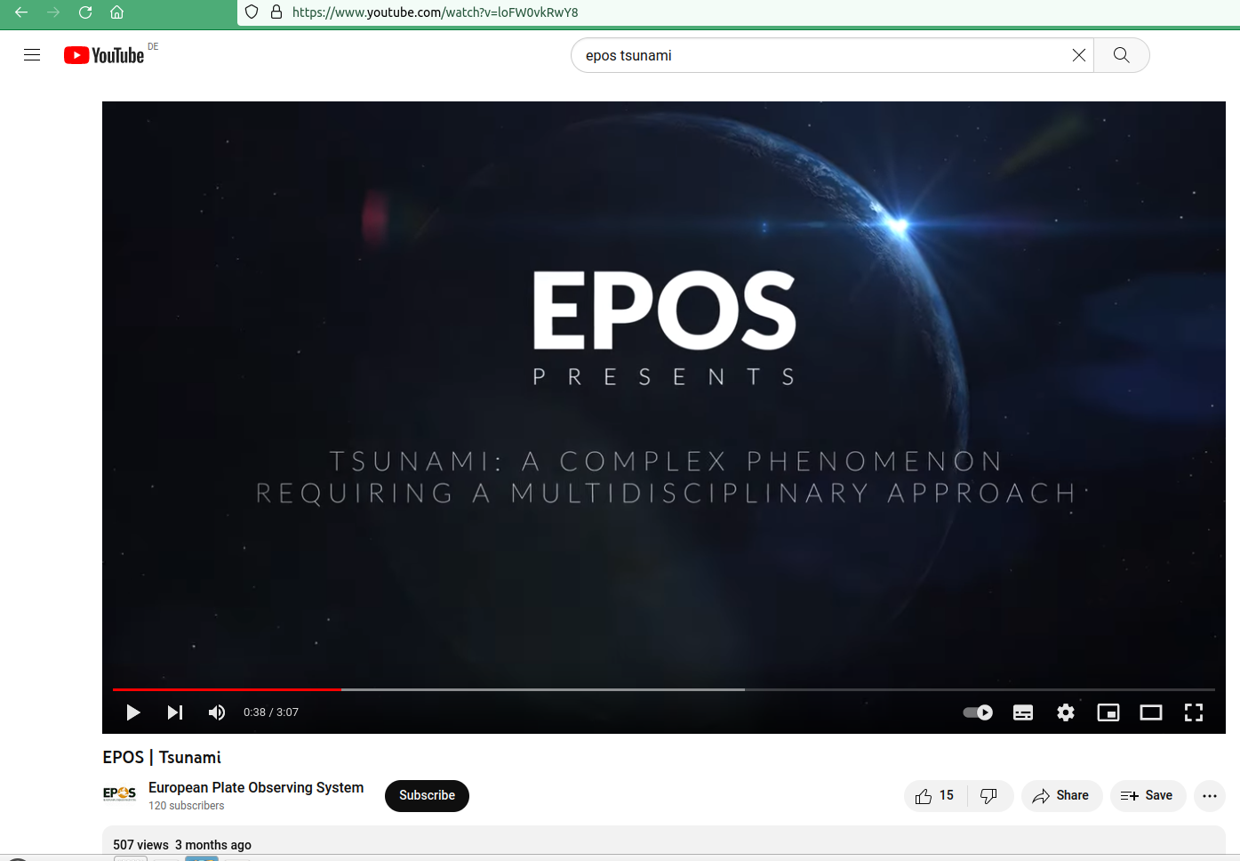
TCS Communication and Dissemination (1/1)
Official EPOS promo-video “Tsunami”
Plans for 2024
Upgrade community portal https://tsunamidata.org
Training events within Geo-INQUIRE

Slide 15
TCS findings and recommendations (1/1)
As a New Community
Our experience shows that EPOS is fully open and supportive to integrate new communities.
Communities will receive friendly support by integration of their assets into the ICS-C Data Portal and be involved into the daily EPOS life (WGs, project proposal, international activity, etc).
Communities should themselves be very active in TCS building – better start asap:
governance structure;
Consortium agreement;
principles and modes of service provision;
understand and think CostBook;
sustainability is a key issue.

