Slide 1
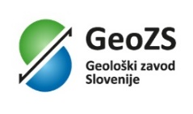
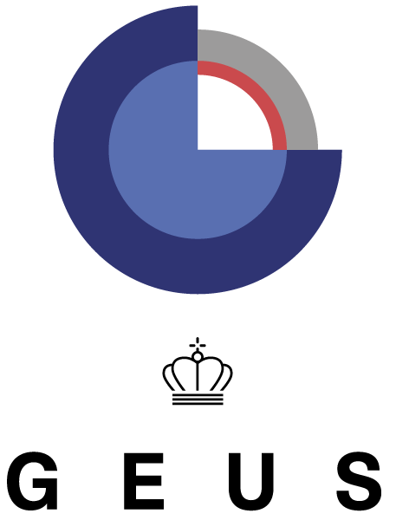
TCS Geological Information and Modelling TCS GIM
Marc URVOIS, BRGM – French Geological Survey
TCS GIM Coordinator

Slide 2
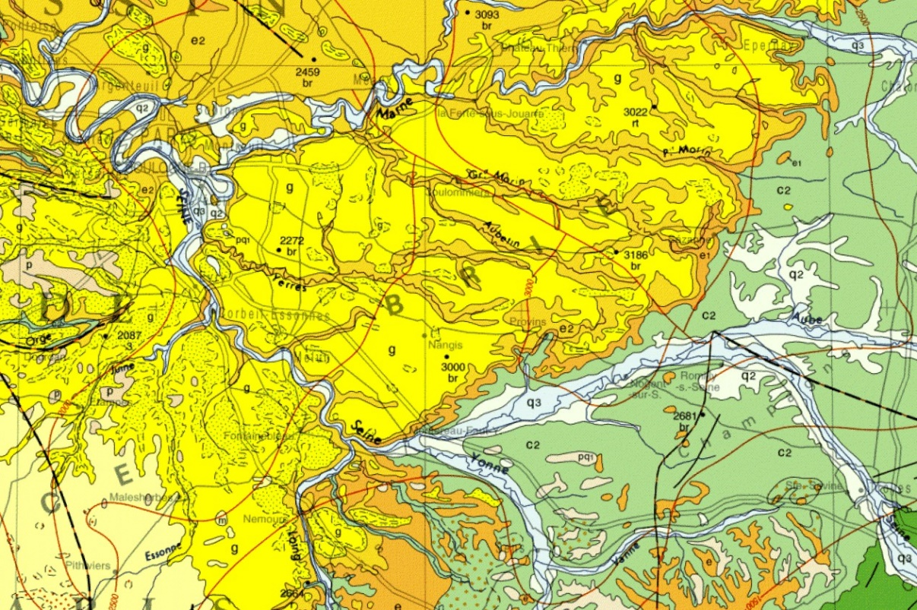
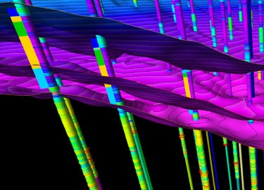
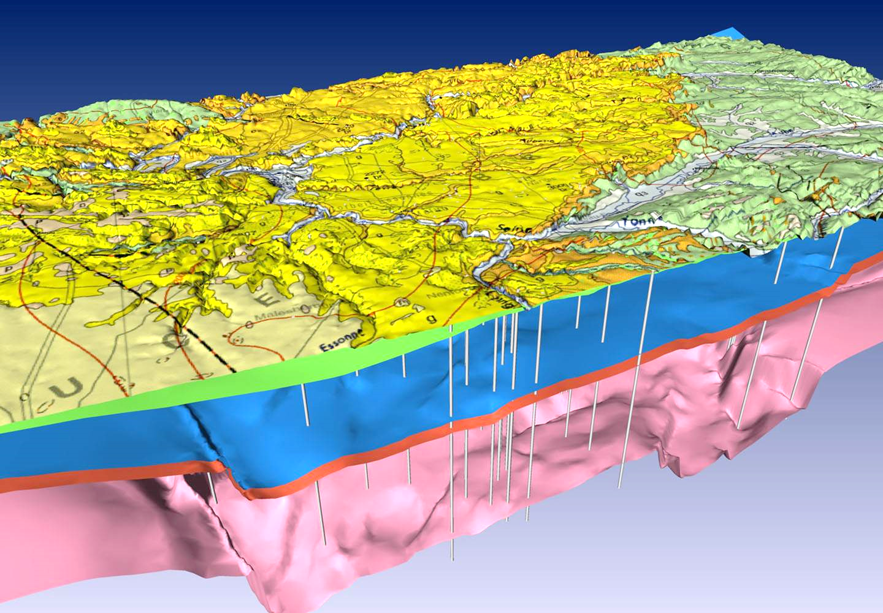
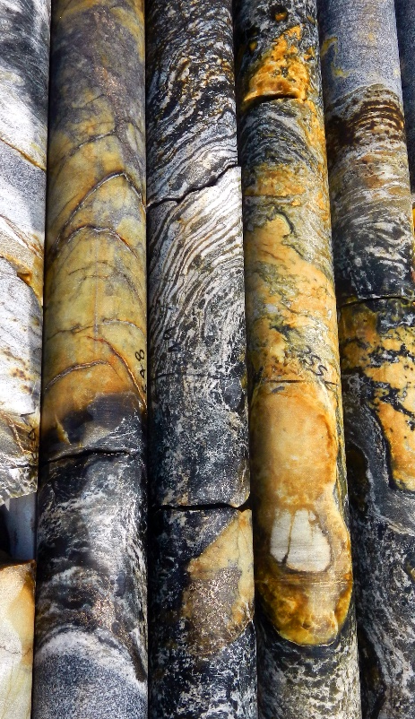
TCS Participants attending the EPOS Days and role in the TCS
TCS GIM delegation in Rome:
Marc URVOIS – BRGM, French Geological Survey – TCS Coordinator
Henning LORENZ – UU, Uppsala University – Data Provider and Communication representative
Franck CHAN THAW – BRGM, French Geological Survey – IT Contact Point & Service Provision Boreholes
Matija KRIVIĆ – GeoZS, Geological Survey of Slovenia – IT Contact Point & Service Provision Geological Map
Helen GLAVES – BGS, British Geological Survey – Data Provider
Luca GUERRIERI – ISPRA, Istituto Superiore per la Protezione e la Ricerca Ambientale – Data Provider
Paolo PRIMERANO – ISPRA, Istituto Superiore per la Protezione e la Ricerca Ambientale – Early Career Researcher

Slide 3
Presenting the scientific area of the TCS (1/2)
Overall objective: design and implement efficient and sustainable access to geological multi-scale data assets: observations, measurements, maps, models…
Applied geoscience examples: rock mechanical testing and modelling for subsurface construction / estimating the risk for seismic hazards to a settlement / modelling groundwater flow patterns / mine or water reservoir close to a fault zone / heat flow and geothermal potential
Describe and understand the geological characteristics of soil and subsoil
Identify the main active processes: implications for the society and development of mitigation plans
Essential base information in solid Earth sciences is geology or a property that depends on geology or an interpretation of such properties
Geological map: interpretation from field and remote sensing observations with the most recent knowledge. Revisable document with new observations and updated geological concepts
In addition to geological outcrops, boreholes are the only subsurface features observable in-situ: (1) sample material (drill cores) supplemented by a geological description, image documentation and geophysical downhole logs; (2) time series data from downhole sensors (e.g., seismometers, piezometers…)
Connections to other TCSs: Seismology, Near Fault Observatories, Anthropogenic Hazards [Geo-INQUIRE WP4]

Slide 4
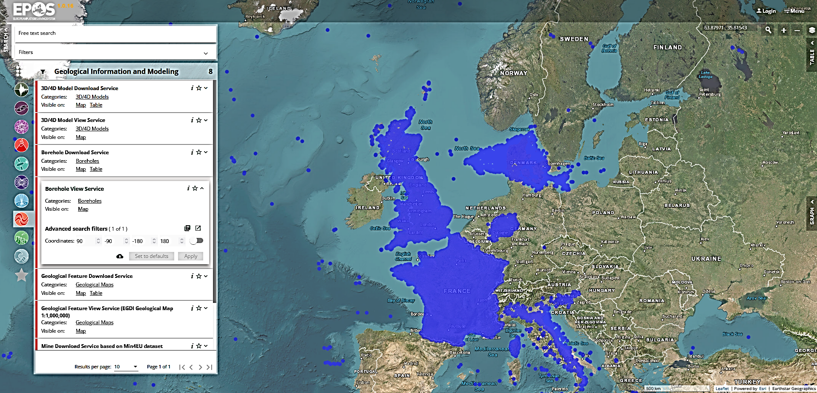
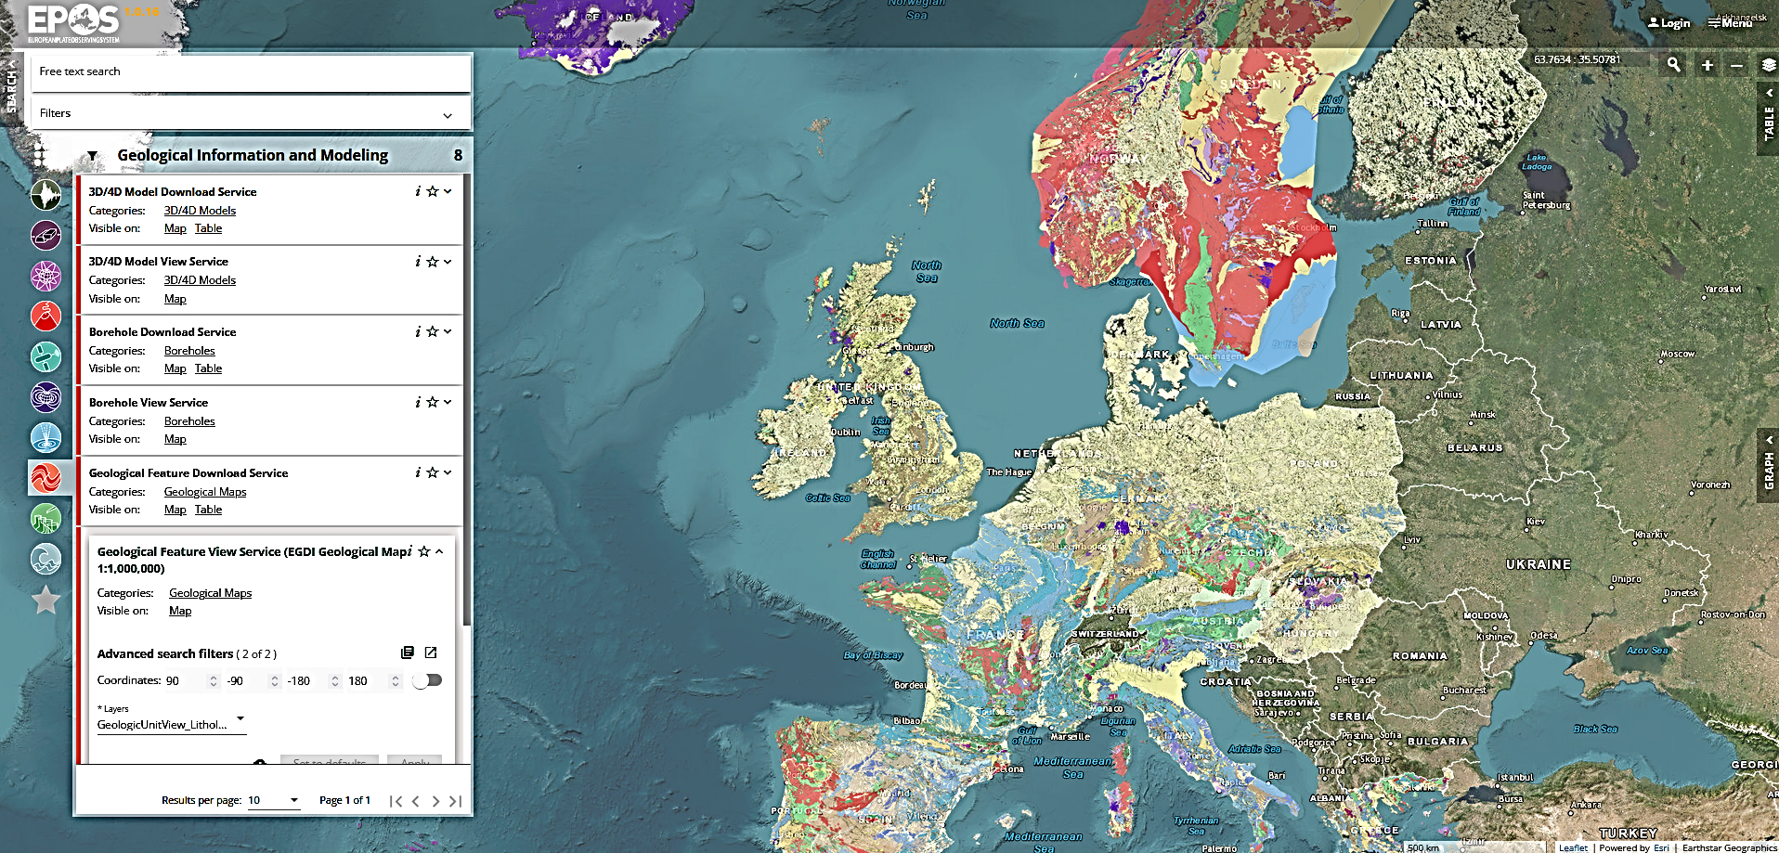
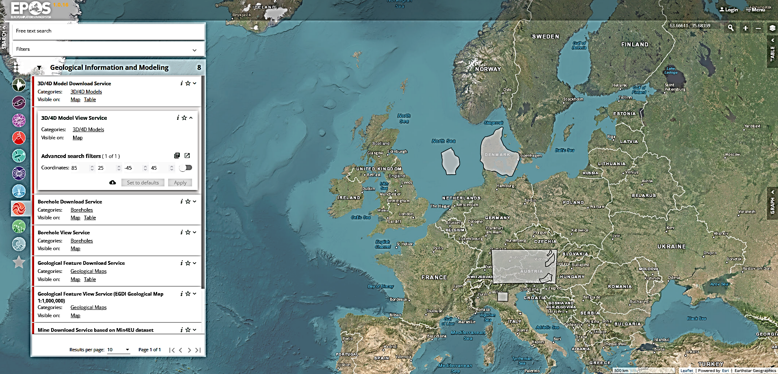
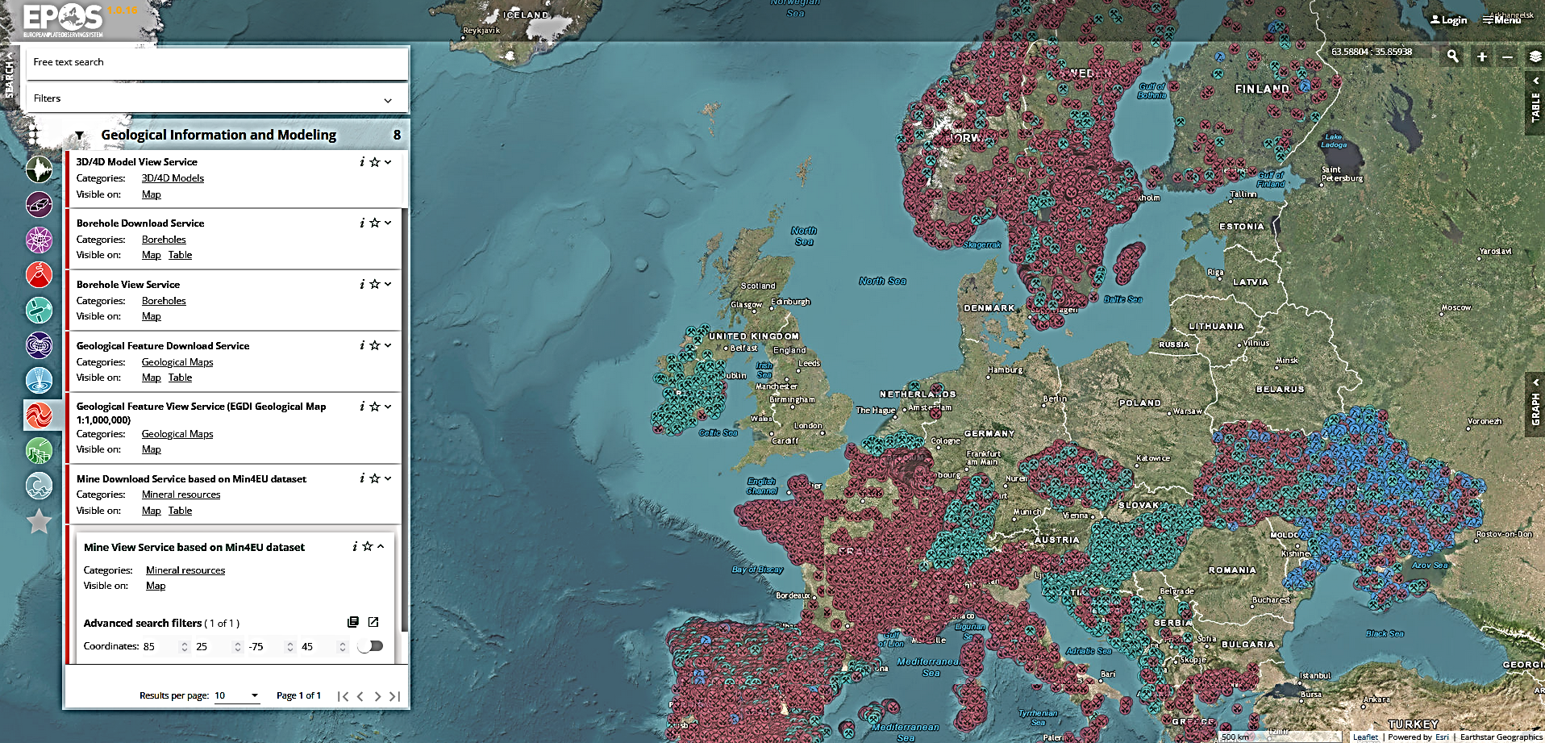
Presenting the scientific area of the TCS (2/2)
Services in operation on the EPOS Data Portal
A. 4 groups of services
Boreholes (BRGM)
Borehole View Service
Borehole Download Service
Geological Map (GeoZS)
Geological Map View Service (EGDI Map 1:1,000,000)
Geological Map Download Service
3D/4D Models (GEUS)
3D/4D Models View Service
3D/4D Models Download Service
Mineral Resources (GEUS)
Mine View Service based on Min4EU dataset
Mine Download Service based on Min4EU dataset
B. Populate and use domain controlled geoscience vacabularies through the European Geoscience Registry (INSPIRE Register Federation)

Slide 5
TCS Governance (1/3)
TCS GIM Consortium Agreement signed in 2019
10 members: BRGM (FR), BGS (UK), CGS (CZ), GEUS (DK), GSI (IE), GeoZS (SI), GFZ (DE), ISPRA (IT), Uppsala University (SE) and EuroGeoSurveys (EU)
Governance
Chair: EuroGeoSurveys + Co-Chair (renewal in progress)
Coordinator: BRGM
Stakeholder Panel: includes main representatives of the user community
Data Provider Committee: includes an EGS representative, an academic representative and representatives of entities providing data sets – Advise the Coordinator
Formal relations with EPOS ERIC: Multi-Year Collaboration Agreements (MYCA)
Memorandum of Understanding between EPOS ERIC and EuroGeoSurveys
Meetings
TCS GIM Consortium meetings (~quarterly and upon request)
TCS GIM Data and Service Technical meetings (bi-monthly)
Full member in ICS-TCS Interaction workshops (quarterly)
Full member in the Service Coordination Committee meetings (quarterly)

Slide 6
TCS Governance (2/3)
Summary of MYCA activities in 2023
Management of the Collaboration Agreements 2023 and preparation of 2024-2028
Chair the TCS Consortium and manage the Consortium Board meetings and activities
Contributions to the relationship between EPOS ERIC and EuroGeoSurveys in the framework of the MoU
Synergy between EPOS and EGS-EGDI European Geological Data Infrastructure
Building strategic partnerships and attracting new partners:
Icelandic Institute of Natural History: geological map
University of Iceland, Research Centre in Breiðdalsvík: selected boreholes
Utrecht University, Netherlands: borehole dataset in a gas field (in preparation)
Geological Survey of Spain: transfer of knowhow for a new borehole end point

Slide 7
TCS Governance (3/3)
Sustainability of the Thematic Core Service Geological Information and Modelling
TCS GIM data services are provided through EGDI-European Geological Data Infrastructure
5-year project GSEU-Geological Service for Europe aims to design and ultimately implement a permanent European geoscientific organisation
TCS GIM and EGS members explore options to ensure the long-term sustainability of EGDI as a data and services provider for EPOS in terms of funding, organisation and technical resources
The ambition is there and formalised with a program (2022-2027)
© BRGM, M. Urvois

Slide 8
TCS Services (1/2)
Summary of MYCA activities in 2023
January to April
Assessment of the quantity and quality of data services, and identification of ways to improve them
Last bug fixing to ensure the stability and reliability of the data services for the launch of EPOS Data Portal
May to December
Integration of new datasets => extension of the service contents and geographic coverage: Iceland and Czech Republic; mentoring: Spain and Netherlands
Restoration of borehole dataset accessibility (Ireland) after resolving a gateway issue and software upgrade
3D Model Index rebuilt at GEUS and synchronised with the EGDI 3D model database
Mineral resources: any evolution of the dataset in EGDI is reflected in EPOS
Restoration of online access to the data and service documentation
IT (system, applications) upgrade to prevent from intrusion attempts and comply with cyber security standards

Slide 9
TCS Services (2/2)
Main technical challenges - Plans for the near future (2024)
Improve the service provision after the Data Portal stress tests (Feb. 2024), e.g. manage the workload
Extend the geographical coverage with new data assets and upgrade current TCS services:
Boreholes from new providers (Czech, Spain, Netherlands)
New boreholes from current providers (Italy, shallow drillings)
New geological map at 1:1,000,000 (Romania; Switzerland expected)
3D models: increase the number of models proposed
Improve the borehole harvester (differential harvesting - impact at central service and data provider levels)
Increase the granularity of the data: implement the access to borehole detailed information (geological and geophysical log, water level…)
Facilitate the connection of borehole and geological map data from the Anthopogenic Hazards Episodes
Bug fixing and improvements: borehole rendering, clustering; geological map legend display

Slide 10
TCS Communication and Dissemination
Summary of MYCA activities in 2023 and plans for the near future
Presentation of TCS GIM work progress at the EGS-Spatial Information Expert Group semester meetings
Presentation of TCS GIM work progress at the Geoscience Information Consortium (GIC) annual conference
TCS GIM data services (geological map and boreholes) regularly visible in EPOS demos and training sessions
TCS GIM involved in Geo-INQUIRE communications mentioning virtual access to georesources data (EGU)
Presentation of EPOS at conferences and exhibitions that have a focus on geology and mineral resources
Abstract submitted at International Geological Congress, IGC37 (Aug. 2024)
© BRGM, B. Gourcerol

Slide 11
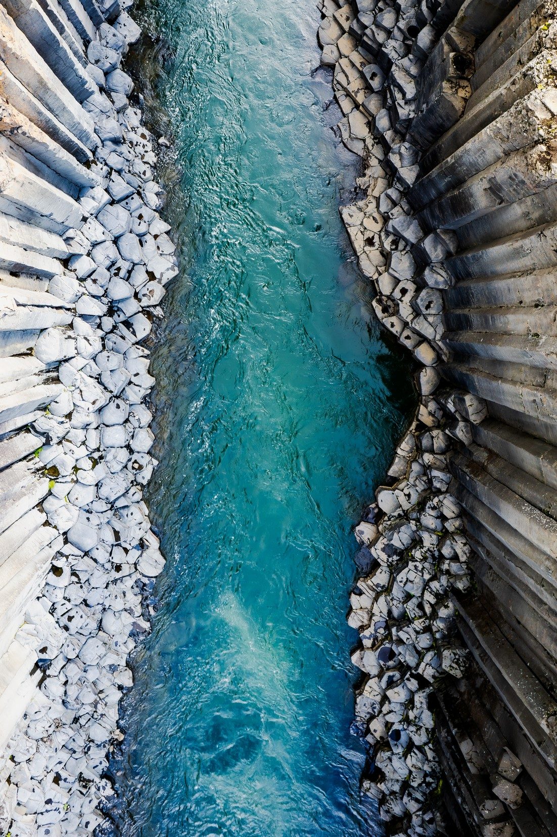
The EPOS operational phase: TCS findings
The portal launch was in important step as it provides us with the possibility to showcase EPOS data assets and start targeted outreach
Mutual visibility of EPOS and EGDI data platforms
Bridge complementary communities: geological surveys, academia, research and education
The number of services (260+) may be reduced by merging, in each TCS and when possible, all data of one kind in a single service
Simplify the data integration workflows to avoid non-expert users to integrate their data outside the portal
Identify and connect/integrate new data assets: keep up the effort to encourage to follow the EPOS bottom-up approach for developing new services to complement and improve EPOS (geothermal energy, geochemistry…)
Last training session showed a high level of interest: keep on organising such webinars, also with thematic focus
Capacity building may include topics for data providers on database sharing, interoperability compliance, dataset harvesting
© BRGM, M. Parizot

