Slide 1
TCS Anthropogenic Hazards
EPOS Days
Rome • 11.03.2024 - 14.03.2024

Slide 2
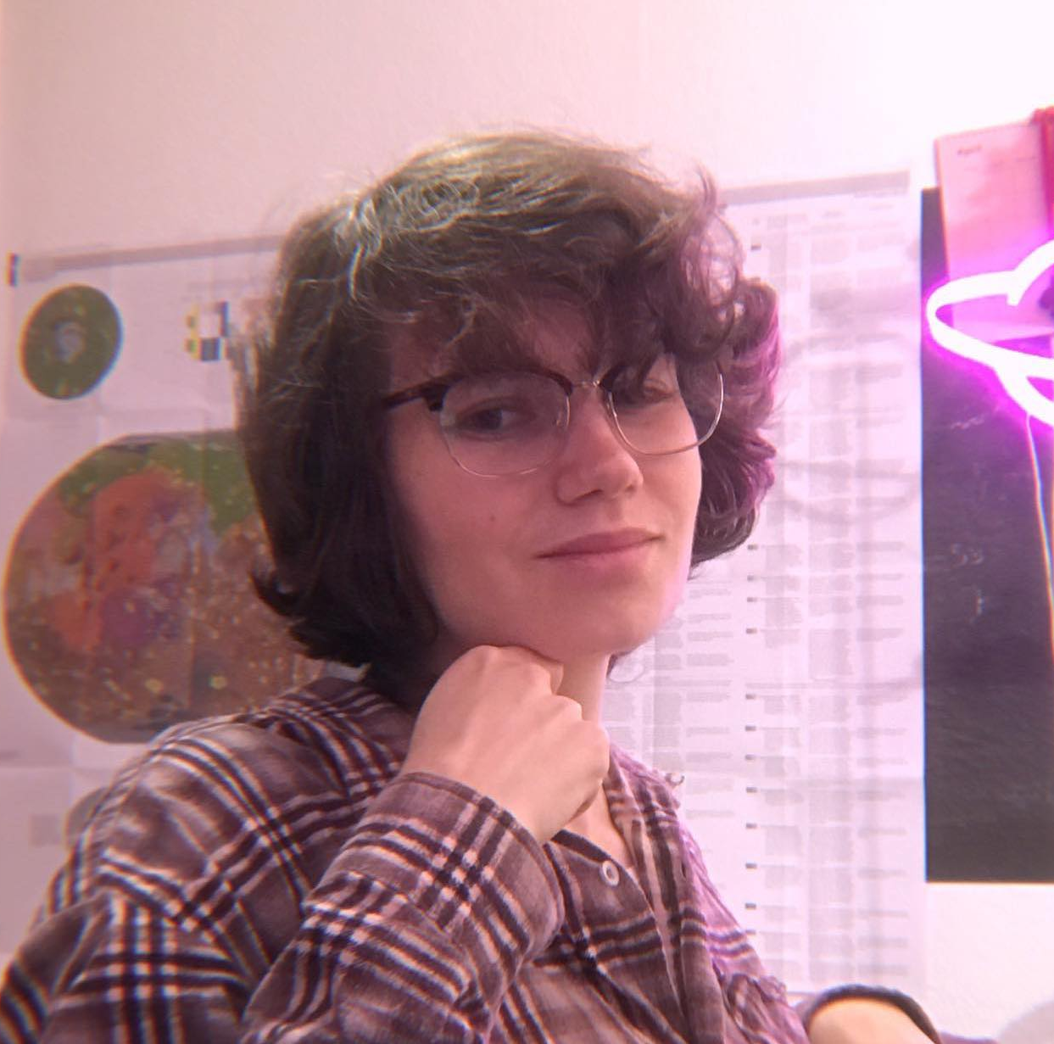
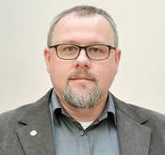
TCS Participants attending the EPOS Days and role in the TCS AH
Anna Leśnodorska
TCS AH Director
Joanna Kocot
TCS AH IT Coordinator
CYFRONET
Agnieszka Mtupa-Ndyaie
TCS AH IT Specialist
Helena Ciechowska
Early Career Researcher
PhD studies at IG PAS
Jan Kapłon
TCS AH Consortium Board Member
UPWr

Slide 3
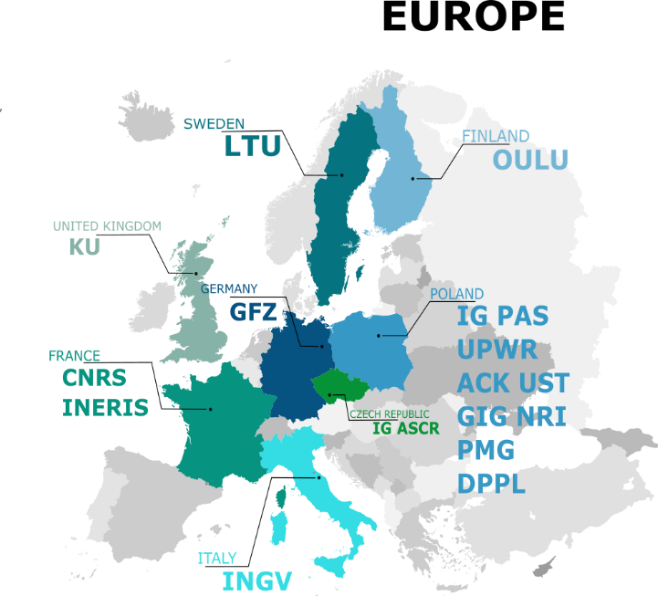
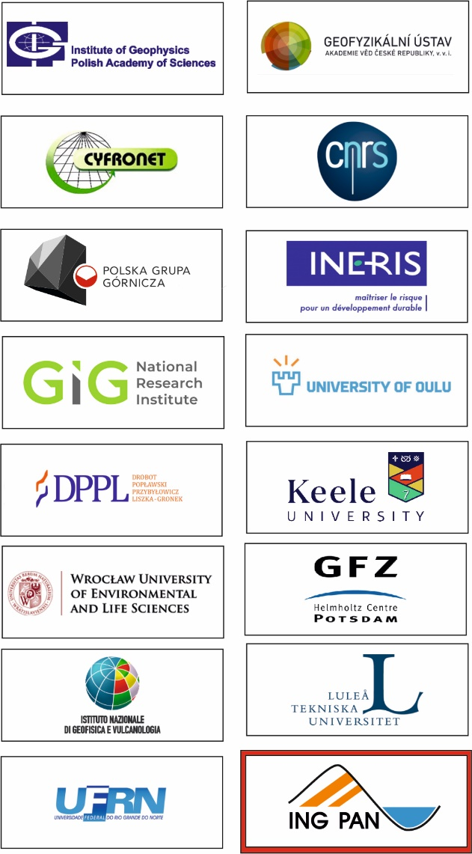
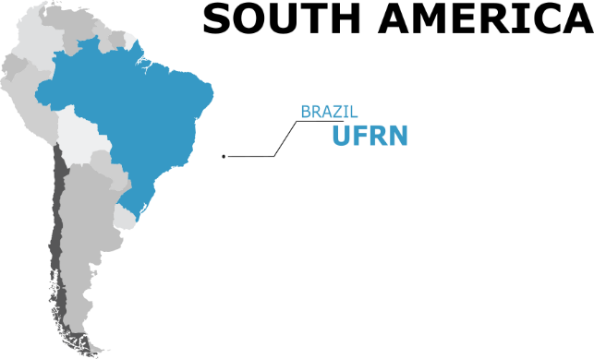
EPOS Thematic Core Service Anthropogenic Hazards (TCS AH) Consortium
16 Institutions from 8 European and 1 Non-European Country
TCS AH Consortium Board
TCS AH Director
TCS AH ECO
External Committees
Working Sections
INNOVATION ADVISORY COMMITTEE
LEADER: Christophe Maisons
USER COMMITTEE
LEADER: Ian Stimpson
DATA PROVIDER COMMITTEE
LEADER: Sławomir Olechowski

Slide 4
TCS AH Working Sections
FOR THE IMPLEMENTATION OF TCS AH SERVICES
LEADER: Joanna Kocot Cyfronet, Poland
Maintain technical resources and software components that are used for the delivery of services, including monitoring security and upgrading the systems to avoid vulnerabilities.
FOR EPISODE INTEGRATION AND APPLICATION IMPLEMENTATION
LEADER: Aglaja Blanke GFZ, Germany
Adds and manages new episodes and new applications provided by the EPISODES Platform related to anthropogenic hazards.
Provides maintenance to episodes and applications already integrated in the EPISODES Platform, including application, data and metadata updates
FOR PROMOTION AND DISSEMINATION
LEADER: Glenda Jones KU, United Kingdom
Maintains and develops existing social media channels compiles dissemination materials
and sets up a communication plan and strategy. Defines stakeholder categories and target stakeholder organizations
FOR PROJECTS & PARTNERSHIP
LEADER: Savka Dineva LTU, Sweden
Establishes multi-sector collaboration, strategic partnerships. Prepares technical requirements for new data and software
(in collaboration with the sections for Episodes Integration and Application Implementation and implementing TCS AH services)

Slide 5
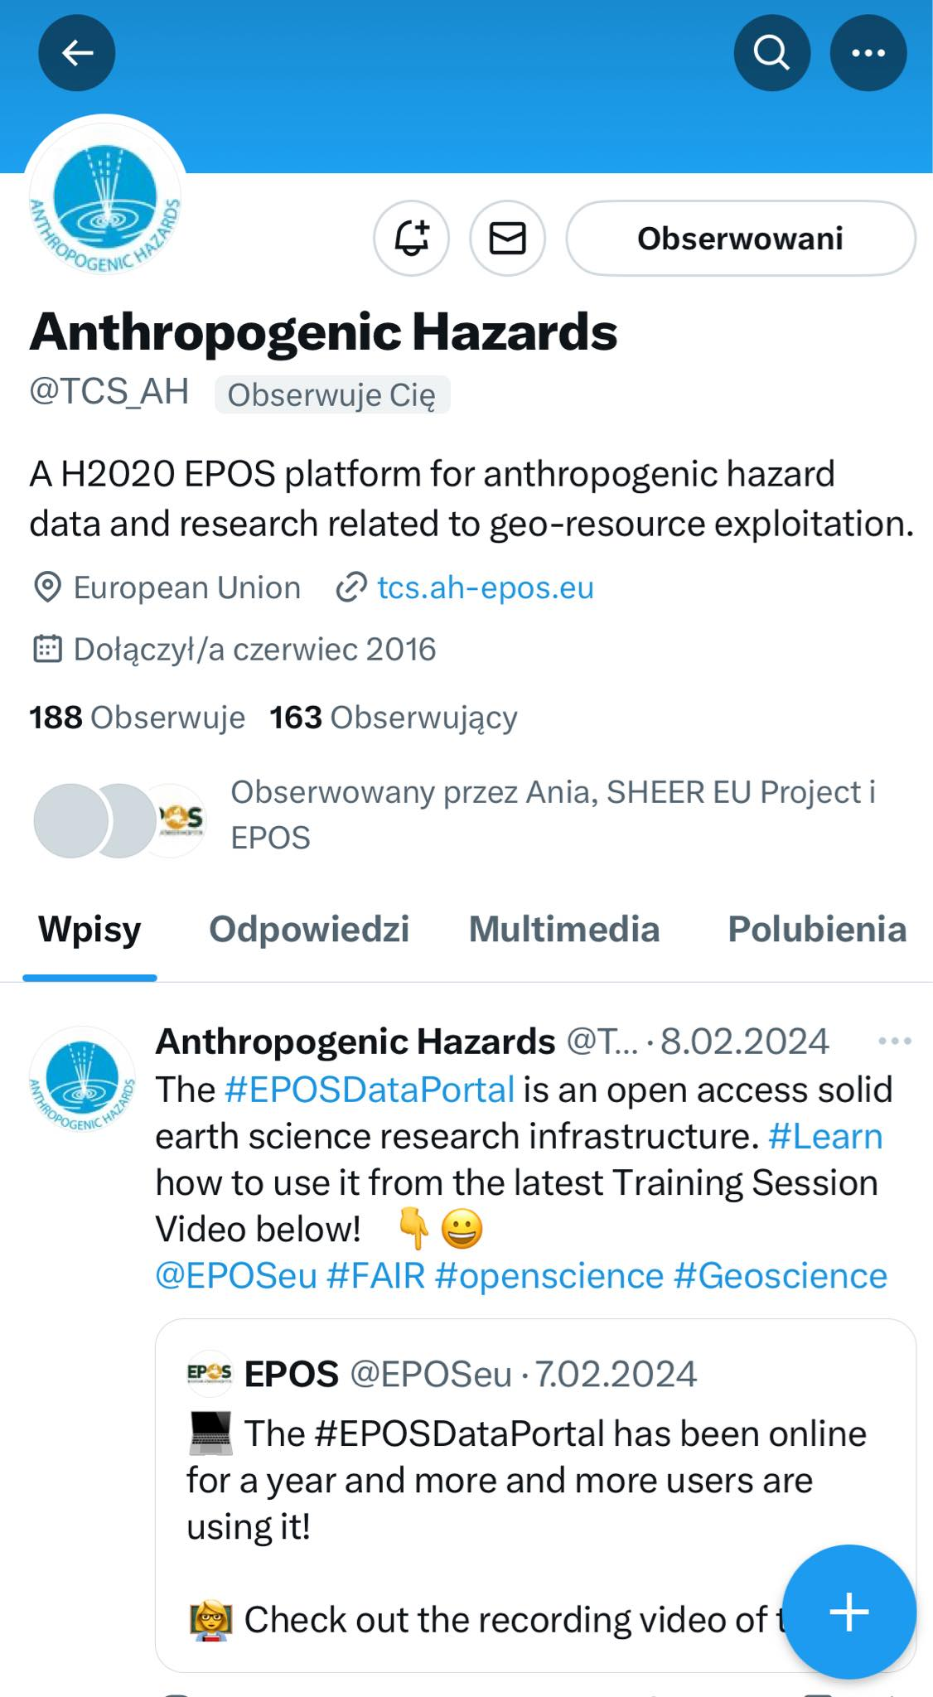
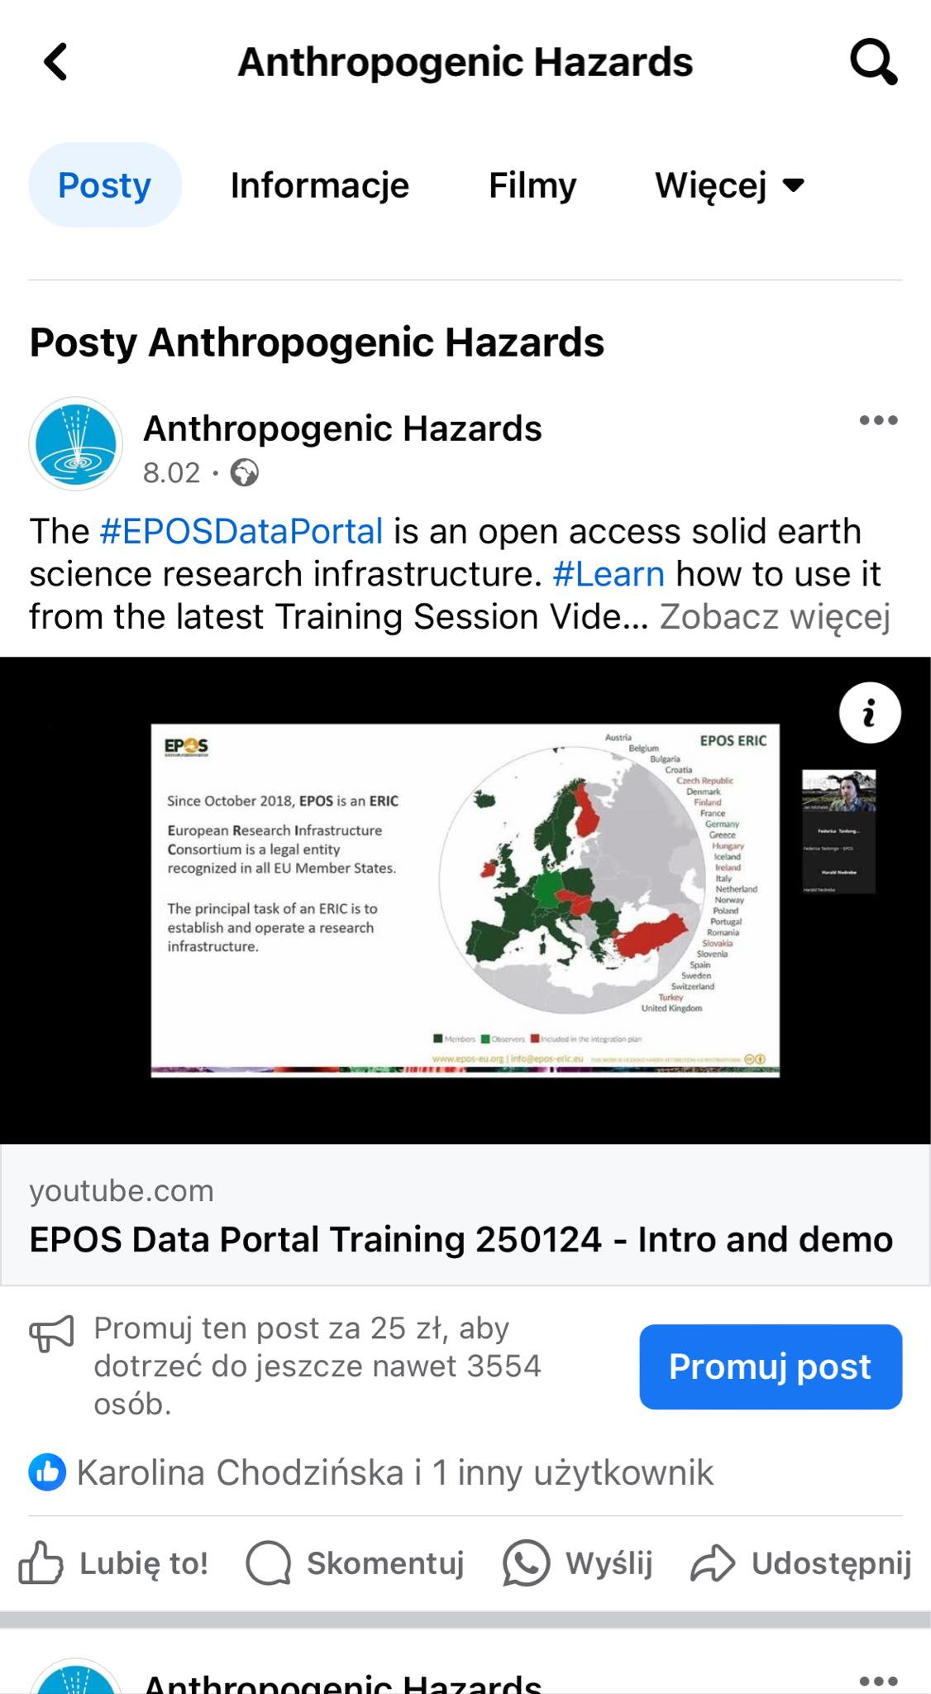
TCS Communication and Dissemination
Publications:
Beata Orlecka-Sikora, Łukasz Rudziński, Monika Staszek, Grzegorz Lizurek, Krzysztof Mizerski; Seismic swarms as intermittent quasi-static ruptures driven by pore pressure variations due to the water reservoir impoundment, Tectonophysics Volume 863, 20 September 2023, 230005 https://doi.org/10.1016/j.tecto.2023.230005
Estimation of location errors for local seismic network in an area with intense and weak seismicity; J.Kokowski, Ł.Rudziński; March 2023; Geophysical Journal International (2023) 0, 13-0; DOI: https://doi.org/10.1093/gji/ggad102

Slide 6
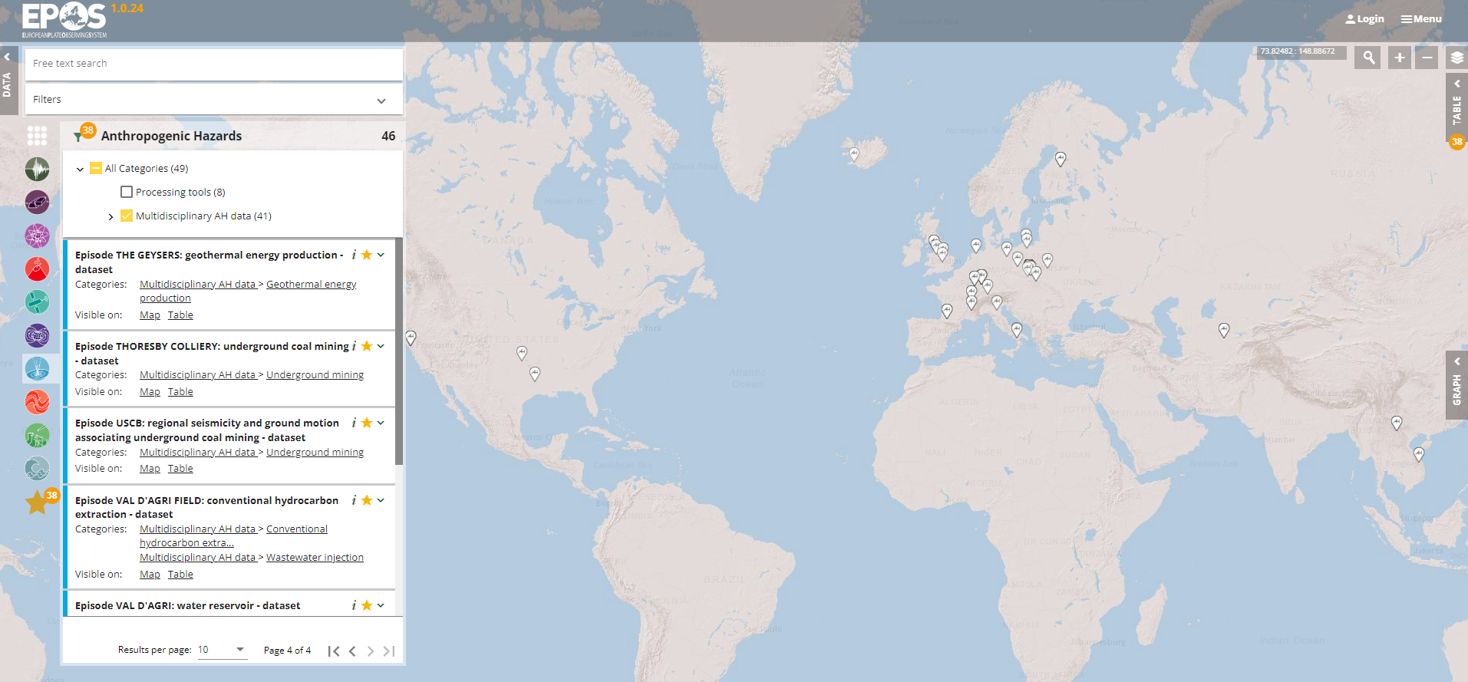
TCS AH asstets accesible from EPOS Data Portal
Processing tools (8)
Multidisciplinary AH data (42)

Slide 7
Projects, Agreements = sources of funding
2024-2028
MYCA For Governance and Services
2021 - 2023
2024 - 2028
TCS AH project; funded by Polish Ministry of Education and Science under the framework of the programme supporting Polish research institution, members of the international RI.
2022 - 2025
2022 - 2024
2022 - 2026
National Funding Programmes supporting EPOS:
ITALY
SWEDEN
FINLAND
POLAND
2024-2027
EPOS ON (EPOS Optimization and evolutioN)

Slide 8
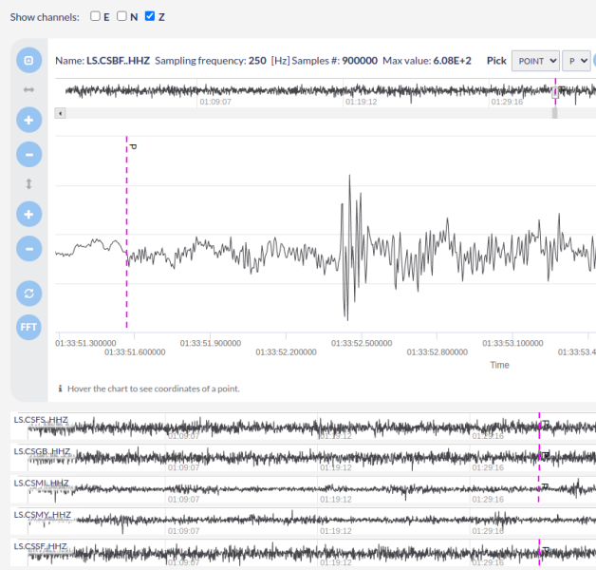
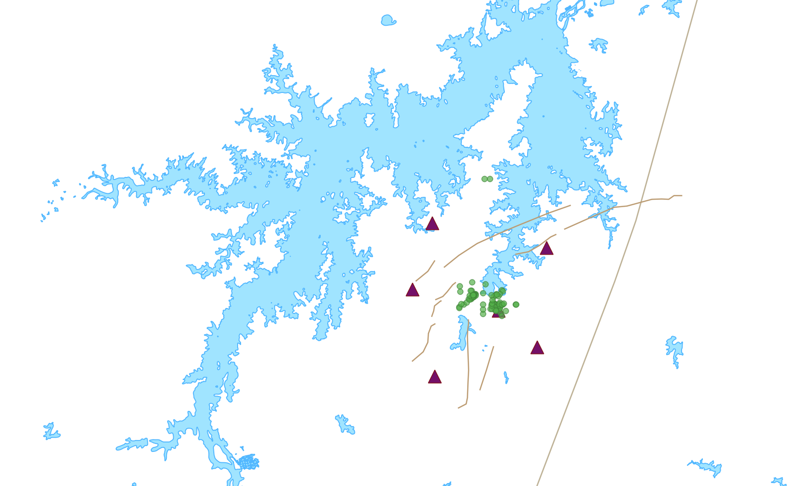
Scientific activities in TCS consortium
The case of RIS in Castanhão Region – Brazil – Global Dimension
The relations between the seismicity and reservoir impoundment
The need of tools for data processing,
Development of the EPISODES Platform,
Reaching towards Intercontinental partners,
Building new episodes requiring interdisciplinary approach (seismological, geological, hydrological, geotechnical data)
Castanhão Reservoir Induced Seismicity
Earthquake picking at EPISODES Platform

Slide 9
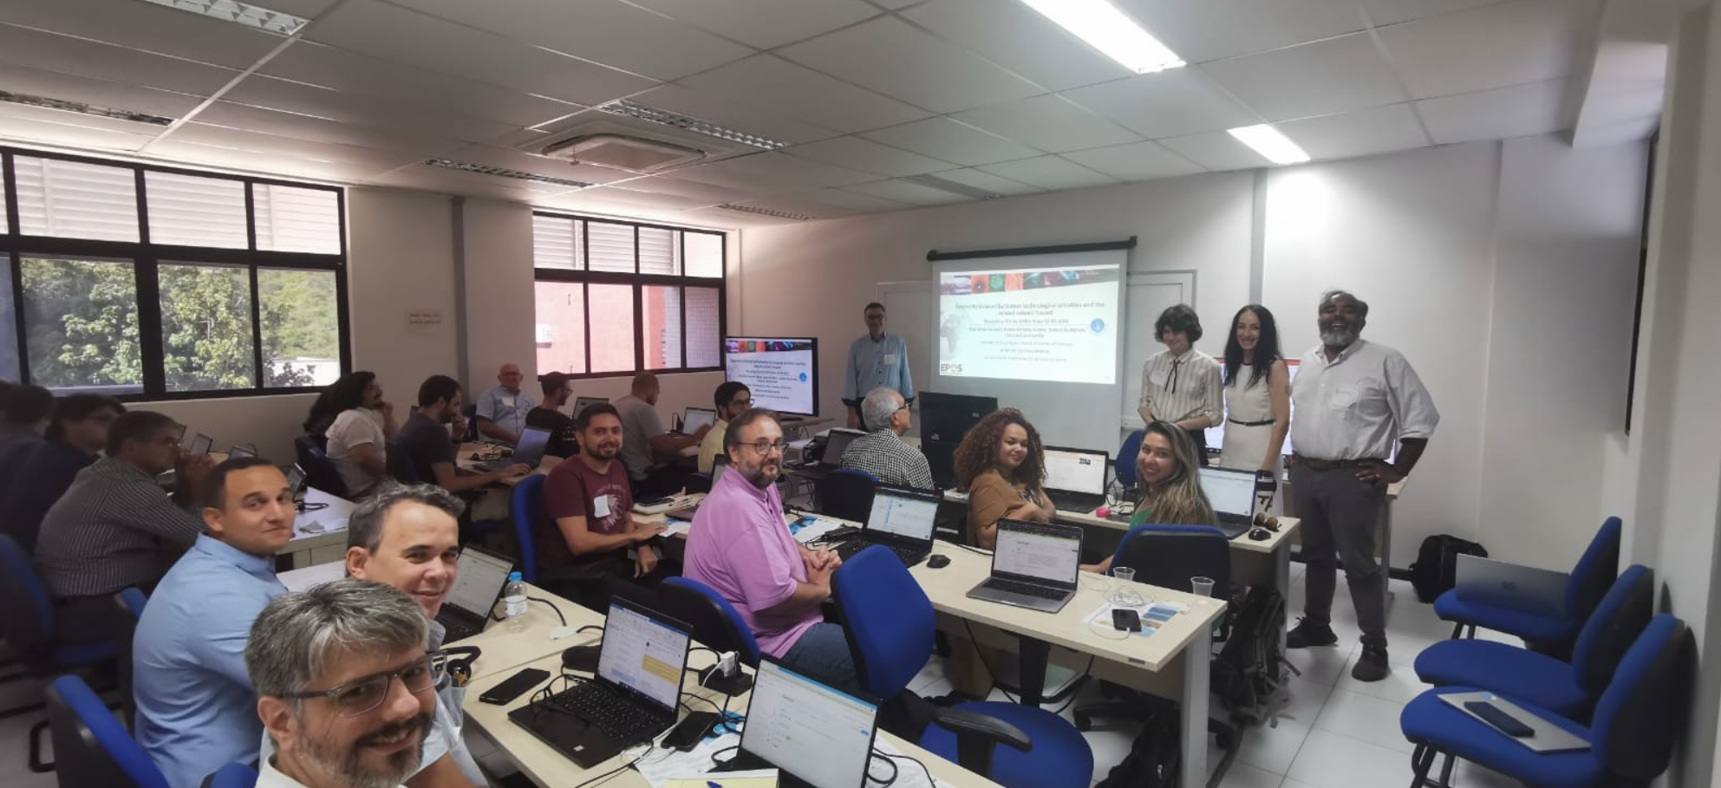
Early Career Researchers role in TCS AH
The work generates the feedback of how to improve the infrastructure and make it more attractive
Popularization of EPOS infrastructure:
Workshops (National and International range – Natal, Brazil)
Outreach towards students organizations such as {iaps} NC Poland.
New perspectives:
Testing the applications, providing feedback, and own inputs,
Finding new solutions,
Interdisciplinary approach and good connection between ERCs studing in various disciplines
EPOS EPISODE Platform workshop in Natal, Brazil (2023)

Slide 10
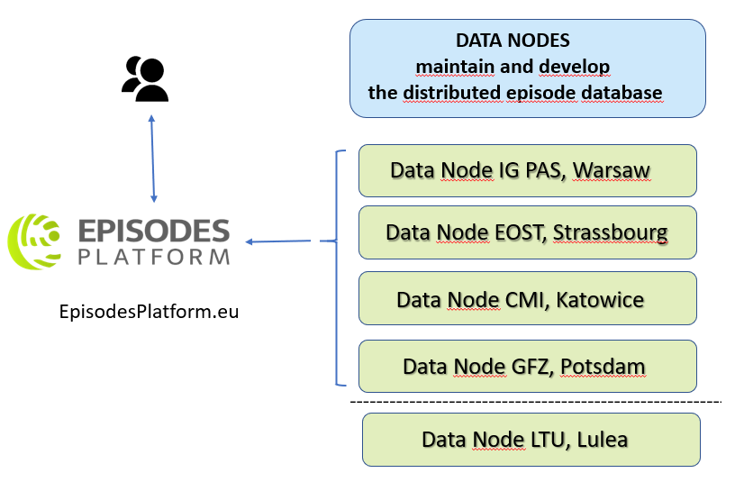
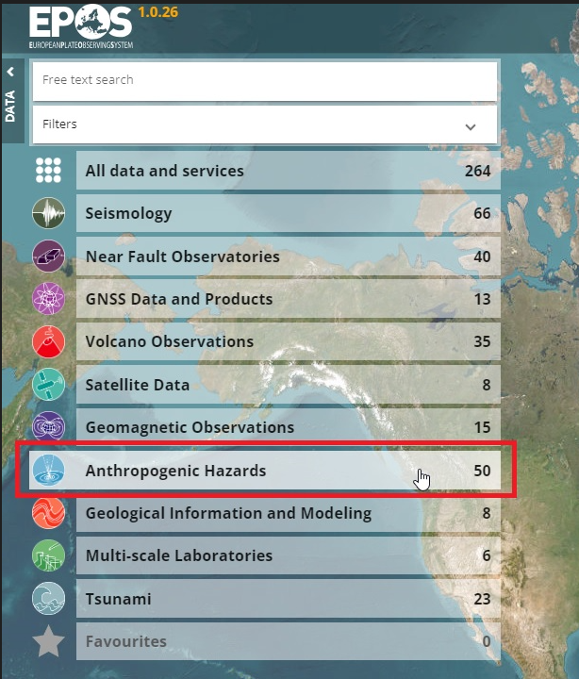
TCS AH INTEGRATED INFRASTRUCTURE – DATA NODES
https://episodesplatform.eu/

Slide 11
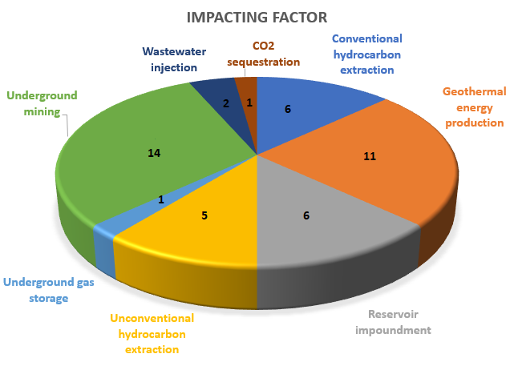
TCS AH INTEGRATED INFRASTRUCTURE – EPISODES PLATFORM
Episodes - Sets of time-correlated seismic, technological,
and other relevant geo-data that relate comprehensively
anthropogenic seismic processes to their industrial causes
Open access to data and applications
42 worldwide, multidisciplinary datasets - episodes,
72 dedicated services (8 categories of applications and software tools),
User’s workspace
Virtual laboratory for data computation,
HPC,
Collaboration functionalities,
Document repository
4 languages versions: English, French, Polish, Italian
Integration of new multi-scale episodes and
setting up of new Data Nodes in 2024
https://episodesplatform.eu/

Slide 12
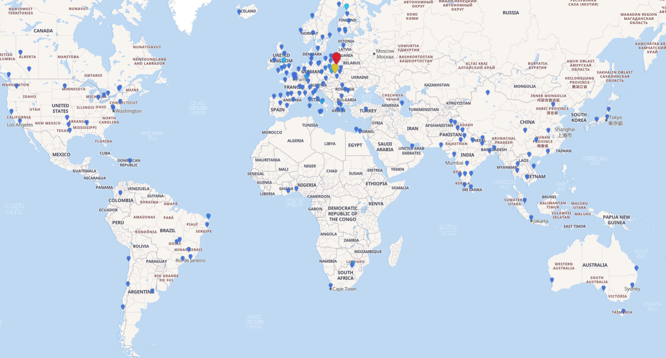
TCS AH INFRASTRUCTURE - EPISODES PLATFORM STATISTICS
over 1800 users from 66 countries,
1255 users with institutional affiliations from 442 institutions
https://episodesplatform.eu/

Slide 13
Please accept our kind invitation to visit:
EpisodesPlatform.eu
tcs.ah-epos.eu

