Slide 1
VOLC-TCS presentation at the EPOS Days
Giuseppe Puglisi (1) and
The Consortium Board: Domínguez Cerdeña Itahiza Francisco (2), Adelina Geyer (3), Jean-Christophe Komorowski (4), Rikey Juliusdottir (5), Philippe Labazuy, (6), Kristín Vogfjörd (5)
The Management Team: Enrico Indovina (1), Rosella Nave (1), Danilo Reitano (1), Letizia Spampinato (1),
(1) Istituto Nazionale di Geofisica e Vulcanologia, Italy
(2) Istituo Geografico National; Spain
(3) Geosciences Barcelona, CSIC, Lluis Solé Sabaris s/n, 08028 Barcelona, Spain
(4) Université Paris Cité, Institut the Physique du Globe, CNRS, F-75005 Paris, France
(5) Icelandic Meteorological Office, Iceland
(6) Université Clermont Auvergne, CNRS, OPGC, F-63000 Clermont-Ferrand, France,

Slide 2
VOLC-TCS Participants attending the EPOS Days and role in the TCS
Name | Institution | Role in VOLC-TCS
Giuseppe Puglisi | INGV | Consortium Board member and Executive Committee Chair
Kristin Vogfjord | IMO | Consortium Board Chair
Philippe Labazuy | CNRS-OPGC | Consortium Board member
Adelina Geyer Traver | CSIC | Consortium Board member
Itahiza Francisco Dominguez | IGN | Consortium Board member
Rikey Juliusdottir | IMO | Technical Committee member
Danilo Reitano | INGV | Technical Committee member and Management team member
Enrico Indovina | INGV | Management team member
Laura Privitera | Catania University | ECS
Valentin Freret-Lorgeril | CNRS-OPGC | ECS
Letizia Spampinato (remotely) | INGV | Management team member
Rosella Nave (remotely) | INGV | Management team member
Lucia Cacciola (remotely) | INGV (MEET Project) | past Management team member

Slide 3
Presenting the scientific area of the TCS (1/2)
VOLC-TCS Objectives
provides coordination between the European Volcano Observatories (VOs) and Volcano Research Institutions (VRIs) to implements interoperable volcanological services (VA and TNA)
provides long-term and sustainable access to Volcanological DDSSs related to volcanic areas monitored and/or studied by the European VOs and VRIs
promotes good practices through EPOS among the volcanological community
The intrinsic heterogeneity of the VOLC-TCS data required harmonization with
SEIS-TCS
NFO-TCS
GNSS-TCS
SAT-TCS
MSL-TCS
Seismic/Acceleration
Waveforms
Earthquake parameters
Services
Geochemistry
products
Services
GNSS Raw data Services
SAR products Services
TNA activities
Geochemistry products
Services
Notes:
Max.1 slide, minimum font 18
Introduction to the scientific area of the TCS and connection to other TCS (if any)

Slide 4
Presenting the scientific area of the TCS (2/2)
SERVICE NAME | CATEGORY | SERVICE PROVIDER
Seismic stations Guadeloupe Martinique Reunion | Seismological Data | IPGP
Seismic waveforms Guadeloupe Martinique Reunion | Seismological Data | IPGP
Mt.Etna Earthquake Parameters (2000-2019) | Seismological Data | INGV
Earthquake parameters from Guadeloupe, Martinique and La Reunion islands | Seismological Data | IPGP
GNSS raw data Iceland | Geodetic data | IMO
GNSS station list Iceland | Geodetic data | IMO
GNSS Site Logs in Iceland | Geodetic data | IMO
Tiltmeter waveforms Guadeloupe Martinique Reunion | Geodetic data | IPGP
Tiltmeters Guadeloupe Martiniqaddue Reunion station | Geodetic data | IPGP
Tide stations Guadeloupe | Geodetic data | IPGP
Tide waveforms Guadeloupe | Geodetic data | IPGP
GNSS geodetic stations from Guadeloupe, Martinique and La Réunion islands (IPGP) | Geodetic data | IPGP
GNSS geodetic Rinex from Guadeloupe, Martinique and La Réunion islands (IPGP) | Geodetic data | IPGP
Mt. Etna Bulk Rock Analysis | Geochemical data | INGV
Collection of Magmatic Rocks and Samples from Piton de la Fournaise volcano, on Réunion island | Geochemical data | OPGC
Wrapped Differential Interferograms | Satellite data | INGV
Ground based radar data Iceland | Ground based remote sensing data & products | IMO
Services in operation on the EPOS Data Portal
SERVICE NAME | CATEGORY | SERVICE PROVIDER
Ground based visible and thermal/IR camera Iceland | Ground based remote sensing data & products | IMO
Ground based UV spectra (DOAS) Iceland | Ground based remote sensing data & products | IMO
Weekly Volcanic Report Iceland | Volcanological/petrological | IMO
Volcano Observatory Notice for Aviation Iceland | Volcanological/petrological | IMO
Volcano Observatory Notice for Aviation Guadeloupe Martinique Reunion | Volcanological/petrological | IPGP
Aviation color codes for Icelandic volcanoes | Volcanological/petrological | IMO
Volcano Observatory Notice for Aviation Italy | Volcanological/petrological | INGV
Catalogue of Icelandic volcanic eruptions | Volcanological/petrological | IMO
Volcanic eruption images from Iceland | Volcanological/petrological | IMO
S02 probabilistic hazard maps Iceland | Geohazards | IMO
Tephra fallout hazard maps Iceland | Geohazards | IMO
Daily ash/gas forecasting Iceland | Geohazards | IMO
Susceptibility Maps Distribution | Geohazards | CSIC
Lava flow invasion hazard maps | Geohazards | CSIC
PDCs Hazard maps | Geohazards | CSIC
Probabilistic Hazard maps | Geohazards | CSIC
Software catalogue Italy | Data services | INGV
Multi-parametric Station information in Italy | Data services | INGV
Notes:
Max.1 slide, minimum font 18
Services in operation on the EPOS Data Portal

Slide 5
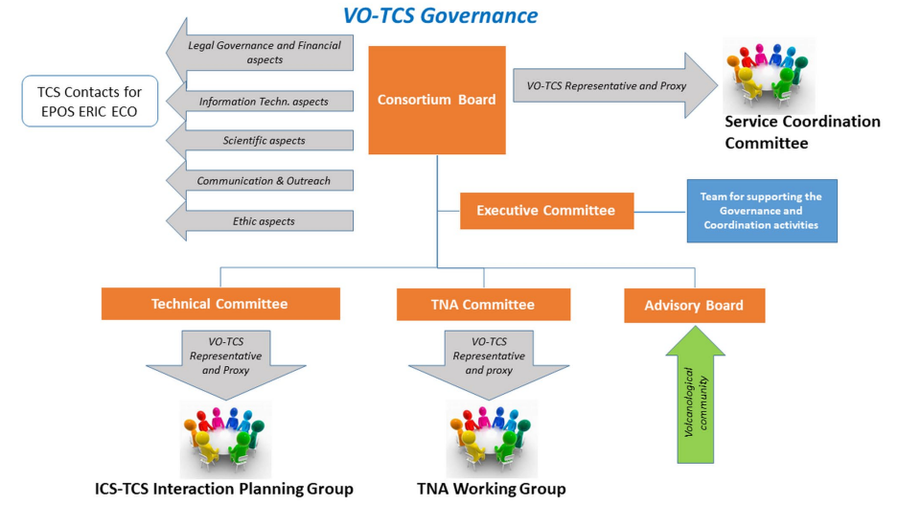
TCS Governance (1/3)
VOLC‑TCS Governance structure:
Consortium Board (CB): Decision-making body responsible for the overall performance of the VOLC‑TCS Consortium
Executive Committee (ExC): Supervisory body for the execution and implementation of the TCS activities and of the CB decisions
Technical Committee (TeC): Provides technical advice, introducing new technology and shares ideas on how the services can develop
Transnational access Committee (TC): Responsible for the financial and technical management of the transnational access (TNA) activities
Advisory Board (AB): Supports the community building, advises the CB on the development of the TCS work programme, provides users perspective on the services, and priorities to further extend the services.
VOLC-TCS Governance
Current VOLC-TCS Participants
Notes:
Max.1 slide, minimum font 18
Presentation of the TCS consortium (e.g. participants, governance structure, new members, activities of boards/committees)

Slide 6
TCS Governance (2/3)
Summary of MYCA activities in 2023
Activity 1 - Management of the Collaboration Agreement and preparation and collection of financial and activity reports.
Coordination for the implementation and update of the yearly work programme;
Daily exchange with the administrative offices of ECO and of the other partners involved in the MYCA-G&C (CNRS,IMO)
Preparation of the reporting documents relevant to the work programmes
Activity 2 - Governance & Coordination
Coordination of the Governance Bodies (Consortium Board, Executive Committee, Technical Committee): meetings’ organization; minutes and documentation
Activity 3 - Legacy of national / international projects / initiatives linked to EPOS in the VOLC-TCS.
The most relevant projects/initiatives in this framework was/are EUROVOLC; EPOS-ON; Geo-INQUIRE, DT-GEO…….,
The most relevant outcomes of the EUROVOLC project considered are the community portal (Gateway) and the European Catalogue of Volcanoes.
Activity 4 - Coordination of the VOLC-TCS contribution to ICS-TCS working group activity and monitoring of the services (POT).
The Technical Committee contributed to the ICS-TCS working group activity by implementing the services accordingly and by attending the meetings.
Activity 5 - Communication and Dissemination.
See slide 10.

Slide 7
TCS Governance (3/3)
VOLC-TCS Sustainability
Governance aspects
Financial aspects
Technical aspects
The governance structure and data policy is compliant with the EPOS ERIC.
The bodies are implemented to define and execute shared strategies.
INGV has been appointed as signatory entity for the 2024-28 period (selection process).
A proper management team to support the governance activities has been established.
The Service provision in supported by EPOS-ERIC & in-kind contributions:
EPOS ERIC supports the Governance and (partially) the services adaptation
in-kind contributions come from:
International projects in line with EPOS strategy (to update / implement new services; to contribute to the EPOS strategies, …)
National / institutional projects / initiatives (to maintain the services; supporting service implementation, …)
The Data and Service providers are institutions monitoring or studying the volcanoes by statue / mission. This guarantee the technical and scientific update / upgrade of the systems and the facilities involved in the DDSSs provision (both VA and TNA).
Stakeholder aspects
Scientific stakeholder are engaged through communication actions.
Private sector, or society stakeholders to be engage by proper actions.
Global aspects
Initiatives to cooperate with global infrastructures (e.g. WOVODat).
Initiatives to foster international cooperation (e.g. participation to projects with Africa)
Notes:
Max.1 slide, minimum font 18
TCS sustainability (challenges related to securing of human resources, funding to operate the services, capacity to develop new services, capacity to address emerging needs like machine actionability of services and data)

Slide 8
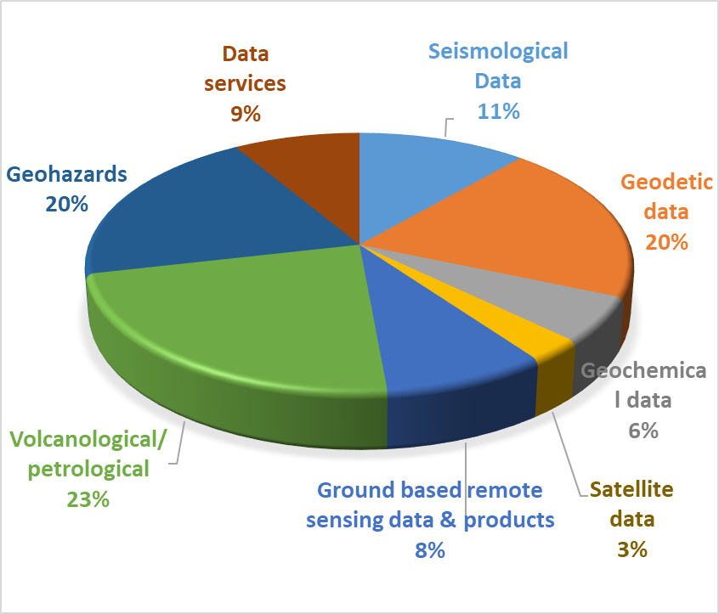
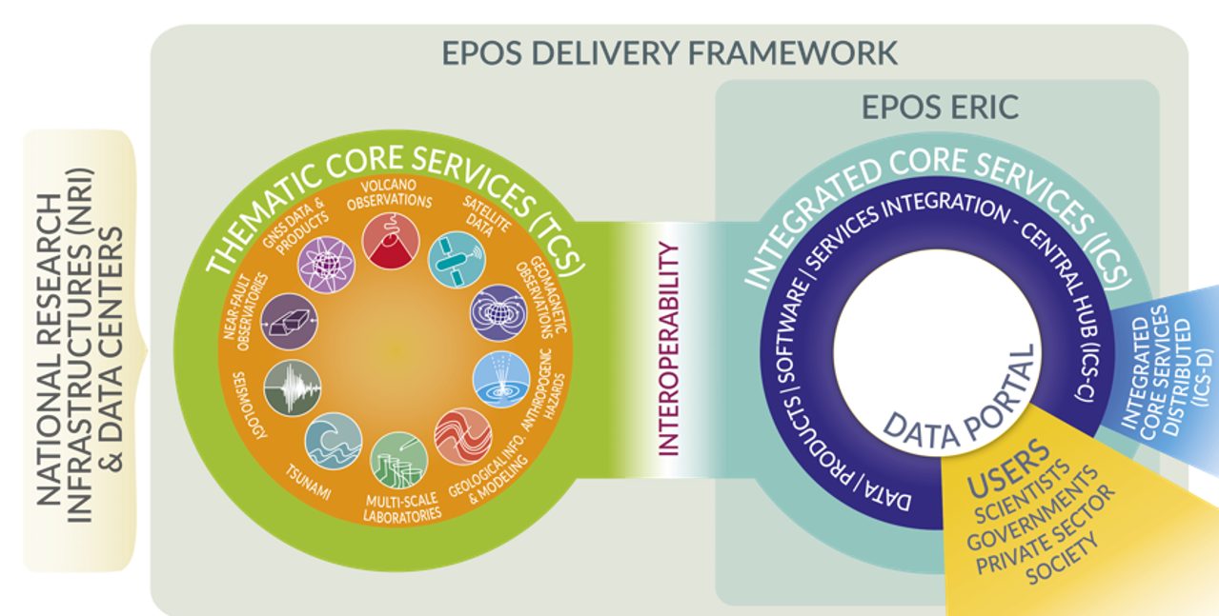
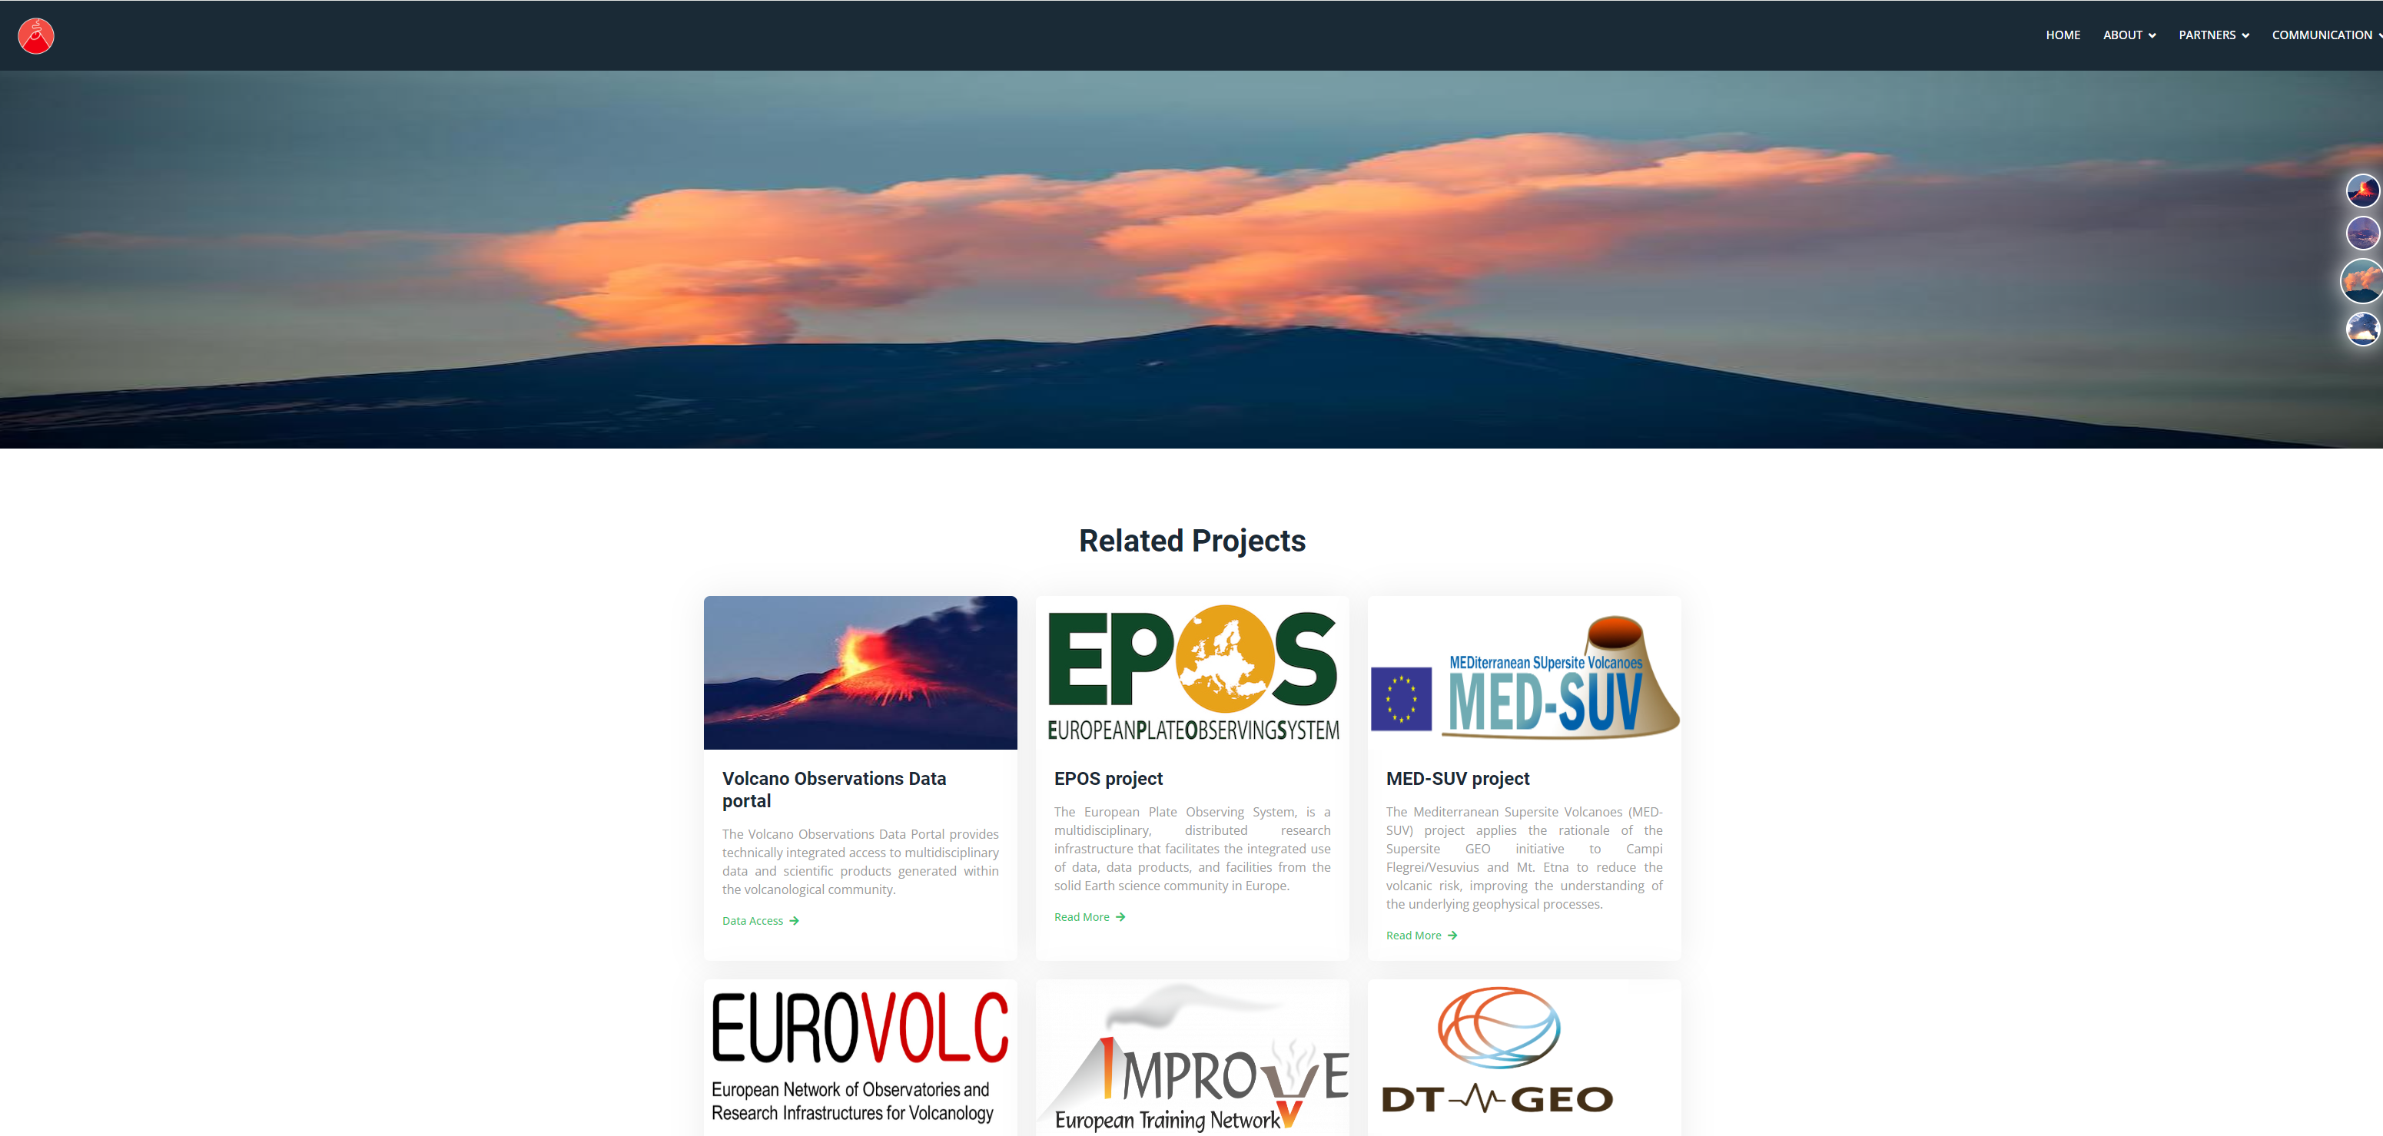
TCS Services (1/2)
The overall objective of the activity during 2023 was to implement and made operational the 35 VOLC-TCS services to the EPOS Data Portal. The actions were aimed at:
Providing and maintain the access to data through web-services
Enhancing the web-services robustness and availability to meet relevant performance specifications defined with ICS
Providing data, metadata and access services in compliance with the FAIR data principles
Providing and maintaining metadata of web-services in compliance with the EPOS metadata format
Providing documentation for web services
Participation of VOLC-TCS to the ICS-TCS, workshops
Defining an integration plans into ICS-C for the VOLC-TCS Gateway
EPOS non-compliant
EPOS compliant
Providers
TBD
Users
Gateway Prototype
Notes:
Max.1 slide, minimum font 18
Summary of MYCA activities in 2023

Slide 9
TCS Services (2/2)
Main technical challenges have consisted in:
Improve the harmonization within VOLC-TCS of data, products and services
Improve the harmonization across TCSs of data, products and services (e.g. exposure of the same service in different TCSs)
Interoperability of the no-EPOS compliant services exposed through the Gateway with the EPOS Data Portal
Technical bridge between the Gateway and WoVODat
Implement the documentation; documentation specific per each service / category is required
Definition of DOI/PIDs
ICS – VOLC-TCS activities and proposals consisted in:
Create specific converters and tools for VOLC-TCS services for metadata description
Inventory of the TNA facilities and equipment and contribution to the implementation of the brokering system
Plans for the near future:
Implementation of new services and upgrade of the payload (of the existing ones)
New use case definition
Engagement of new partners / countries (Greece and Nederland under way; Portugal, Bulgaria, Croatia, will come ...;
Finalization of the Gateway
Participation to the EC proposals (this will increase the services and improve the way to access)
Notes:
Max.1 slide, minimum font 18
Main technical challenges
ICS-TCS activities and proposals
Plans for the near future (new services (in particular from new EPOS ERIC countries Bulgaria, Croatia, Spain), new developments, …)

Slide 10
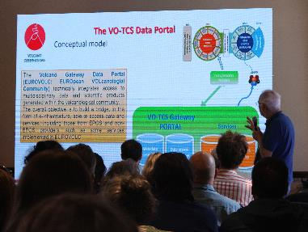
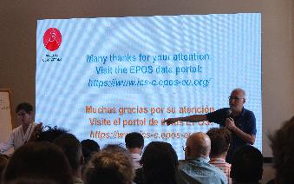
TCS Communication and Dissemination (1/1)
Main VOLC-TCS outreach and communication activities in 2023
Appointment of the reference contact person to the EPOS-ERIC Communication team (R. Nave)
Participation to the TCS Communication monthly meetings
Contribution to the EPOS VOLC-TCS web pages update
Implementation of the existing TCS-related communication materials (e.g., videos, articles, quotes, presentations, flyers..)
Collaboration to structure “EduBox” tool, an education/outreach/training resources database suitable for multi-query searches, in a peculiar custom sub-site in the Gateway
Active participation to training activities with the identification of trainer contacts within the VOLC-TCS group for training activities preparation
Pro-active participation in national and international events relevant to disseminate EPOS (e.g., EPOS EGU session, BeGEO conference, Summer Schools, CoV12 congress)
VOLC-TCS presentation at CoV12
Notes:
Max.1 slide, minimum font 18
Summary of MYCA activities in 2023 and plans for the near future.

Slide 11
The EPOS operational phase: TCS findings (1/1)
The first 35 services are operational and accessible through the EPOS ICS portal. This variety of services has implied the harmonization with other TCSs. This is a challenge and also an opportunity to enlarge the EPOS portfolio.
In parallel the VOLC-TCS is also implementing a Gateway (EUROVOLC) to allow services not fully compliant with EPOS to be accessible through EPOS eco-system. Strategic implementation plan with ICS is needed (good to see that in the new work plan).
The VOLC-TCS aims to cooperate with other international initiatives (e.g. WoVodat) to create a global infrastructure for providing data, products and services to the volcanological community; technically it is feasible through either the EPOS-ICS Portal or the Gateway (EUROVOLC). Strategic EPOS supported actions are required.
The last EC calls confirms the attractiveness of the VOLC-TCS (both services and science). Participation to: ENDEAVOR, EPOS-ON, EOSCLIMA, GEMINI, HEKATE, CHESS. This is good, but… the main issue is the limited human resource / sustainability!
Notes:
Max.1 slide, minimum font 18
TCS comments regarding e.g. impact of the EPOS Data Portal launch, met/unmet expectations, recommendations, …

Slide 12
Further information/remarks (1/1)
ENVRI and EUROVOLC (past) and Geo-INQUIRE projects confirmed the attractiveness of the physical / remote access to volcanological facilities. Thanks to this experience the VOLC-TCS contributed to the technical implementation of the TNA Registry and will contribute to the TNA Tasks. TNA are strategic for EPOS. A roadmap to define and strengthen the role of the physical / remote access in EPOS is necessary. Continuity in the action!
The VOLC-TCS DPs and SPs are largely involved in the monitoring/surveillance activity. This is a strength point (for the sustainability) but a week point (for the service harmonization; for the daily operational activity of EPOS). This issue should be addressed with a greater support to the VOLC-TCS activity at the National level.
Future perspective: improvement of the portfolio of the services; engagement of new VOLC-TCS participants and new stakeholders; cooperation with / participation in global initiatives
Notes:
Max.1 slide, minimum font 18
Free content (if desired)

