Slide 1
GNSS Data & Products
Thematic Core Service

Slide 2
TCS Participants attending the EPOS Days and role in the TCS
Rui Fernandes (UBI, Portugal), Chair of Governing Board, Products Portal
Carine Bruyninx (ROB, Belgium), Chair of Executive Board, Harmonization data providers
Luis Carvalho (UBI, Portugal), TCS-ICS Iterations, Software
Paul Crocker (UBI, Portugal), Software
Juliette Legrand (ROB, Belgium), Software, Data quality monitoring
Jean-Luc Menut (CNRS-OCA, France), Software, Nodes
Anne Socquet (CNRS-UGA, France), Products
Mathilde Vergnolle (CNRS-UGA, France), Data Portal
Andras Fabian (ROB, Belgium), Station and data providers metadata
Fikri Bamahry (ROB, Belgium), Early Career Researcher

Slide 3
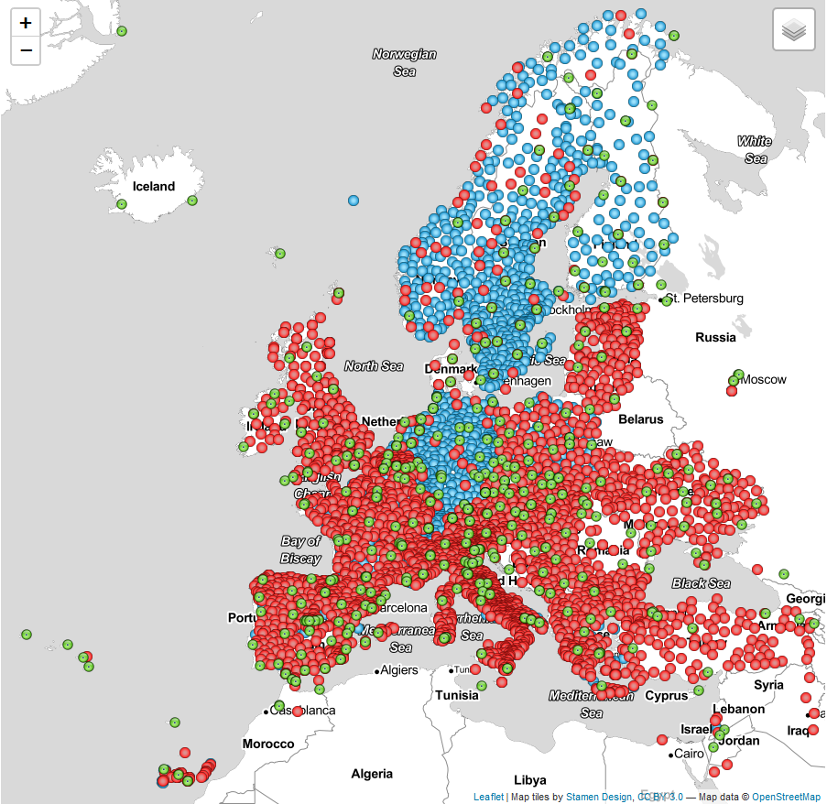
GNSS Data & Products – Scientific Area (1/2)
Implement the distributed dissemination of:
File-based GNSS observation data (currently for almost 2000 stations)
Correct Stations Metadata and Observations
Derived Products (currently for ~2700 stations):
Coordinate Time Series
Velocities
Strain Rates
Interact with the geodetic community in Europe, at national and Pan-European (EUREF) levels
Ensure interoperability between EPOS GNSS services and EPOS Integrated Core Service
Promote multidisciplinary interoperability with other disciplines within EPOS, particularly:
Near-Fault Observatories
Volcanoes

Slide 4
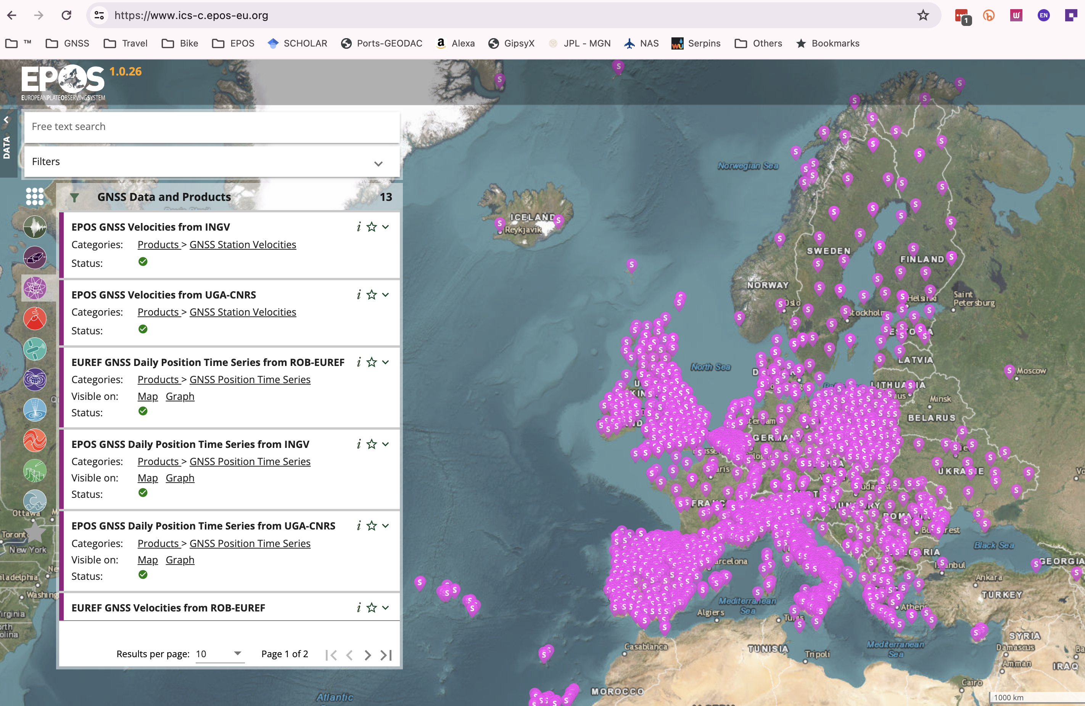
Presenting the scientific area of the TCS (2/2)
13 Services:
GNSS Stations with RINEX* Data
List RINEX Files search Parameters
Metadata and url of RINEX Files
GNSS Stations with Products
Positions Time-Series (4 providers)
Velocities Solutions (4 providers)
Strain Rates (1 Provider)
*Receiver-Independent Exchange Format

Slide 5
TCS Governance (1/3)
GNSS TCS (EPOS-ERIC) Partners
List of Pan-European Service Providers:
BKG Bundesamt für Kartographie und Geodäsie, DE
CNRS-OCA Observatoire Cote d’Azur, FR
CNRS-UGA Université Grenoble Alpes, FR
INGV Istituto Nazionale di Geofisica e Vulcanologia IT
LM Lantmäteriet, SE
LTK-SGO Space Geodetic Observatory, HU
ROB Royal Observatory of Belgium, BE
UBI/C4G U. Beira Interior/Colaboratory for Geosciences, PT
WUT Warsaw University of Technology, PL
TCS GNSS Data & Products Community
5 Product Centers
3 Portals (M3G, Data, Products)
11 Service Providers
+
Data Providers (National Research Infrastructures)
EUREF (Data, Data Products & Services)

Slide 6
TCS Governance (2/3)

Slide 7
TCS Governance (3/3)
GNSS TCS created a new infrastructure operating solely for EPOS.
All nodes and Data & Product Portals are solely operated for EPOS (big effort)
The long-term sustainability of many of the existing services is not guaranteed since most of the partners rely on soft money from projects (e.g., EPOS-SP, Geo-INQUIRE, EPOS-ON).
Money to be used for R&D, not for operating services
The implication is that is extremely difficult to hire Human Resources with long term contracts.
Several of the partners do not have the institutional responsibility at national level to provide similar services (e.g., management of observation files; estimation of products).
The implication is that most of the GNSS TCS services do not have secured long term funding.

Slide 8
TCS Services (1/2)
Governance (UBI, ROB, CNRS-OCA, CNRS-UGA)
Governance: Consortium Board (2x/year), Executive Board (each 6-8 weeks), User Feedback Group, Data Providers Committee
EPOS-GNSS coordinators in charge of day-to-day operation of the EPOS’ GNSS infrastructure/services and contributing agencies
Communication and outreach
Services (UBI, ROB, CNRS-OCA, CNRS-UGA, INGV, SGO)
Station network (Communication with existing and new Data Providers)
Data nodes (Ensure the link between Portals (including ICS) and existing and new Repositories)
Products (Generation of dedicated products)
Software (Maintenance and Development of GLASS)

Slide 9
TCS Services (2/2)
Main accomplishment:
GLASS - unique software installed in the data and product nodes to make GNSS data & products available in harmonized way
Monitoring tools
Weakest Point (apart from funding):
GLASS – because it is new and needs to be continuously improved
Data Management. Due to the Human Resources need to respond to the monitoring alerts
Plans for future:
Make available High-Rate data (1 sec)
Near real-time processing of the data
Real-time data (need more resources and more partners)

Slide 10
TCS Communication and Dissemination (1/1)
2023 Main Activities:
Coordinate TCS communication plans and dissemination with the Communication Unit of EPOS:
Feeding the news, events, and trainings section of the EPOS Website.
Updating the TCS mini-website.
Answering EPOS ERIC requests.
Organization of the annual TCS Workshop
Presenting TCS activities at major Conferences (EGU, AGU)
2024 Plans:
Continue the same activities of 2023
Corinth Summer School (in the frame of Geo-INQUIRE)
Training on different services provided by EPOS GNSS, notably access data and product portals.

Slide 11
The EPOS operational phase: TCS findings (1/1)
Major Advantage:
EPOS Data Portal is providing an additional point of entry to the GNSS data and products
Issues:
EPOS Data Portal is bringing additional stress with the constant need to adapt current and new services.
Necessary to ensure a good balance between the services provided by the TCS, particularly for the dissemination of data & products, and the EPOS Data Portal

Slide 12
Further information/remarks (1/1)
GNSS E-INFRASTRUCTURE FOR EPOS (current status)
13 services at EPOS data portal providing data and data products of thousands of GNSS stations
Coordinate community of 100+ agencies (many not scientific!)
Governance framework, 4 TCS GNSS community portals, 5 coordinators, GLASS software
GNSS E-INFRASTRUCTURE FOR EPOS (challenges)
Optimize the chain of operational services (not yet an established e-infrastructure)
Add new GNSS datasets, data nodes, data types
Improve GNSS node software, web services (i.e. FAIR data principles!)
Improve and extend GNSS products

