Slide 1
NFO-TCS - EPOS Days

Slide 2
TCS Participants attending the EPOS Days and role in the TCS
Lauro Chiaraluce – Chair Executive Committee (Italy)
Alexandru Marmureanu – Chair Service Committee (Romania)
Oliviu Jianu – IT group (Romania)
Luca Elia – IT group (Italy)
Ivano Matiddi – IT group (Italy)
Gaetano Festa – Chair NFO Board (Italy)
Antonio Scala – TNA proxy (Italy)
Mihaela Dragan – Dissemination office (Romania)
Arianna Cuius – Early career scientist (Italy)
Stanka Šebela - Member of NFO Observer (Slovenia)
Magdalena Aljančič - Member of NFO Observer (Slovenia)

Slide 3
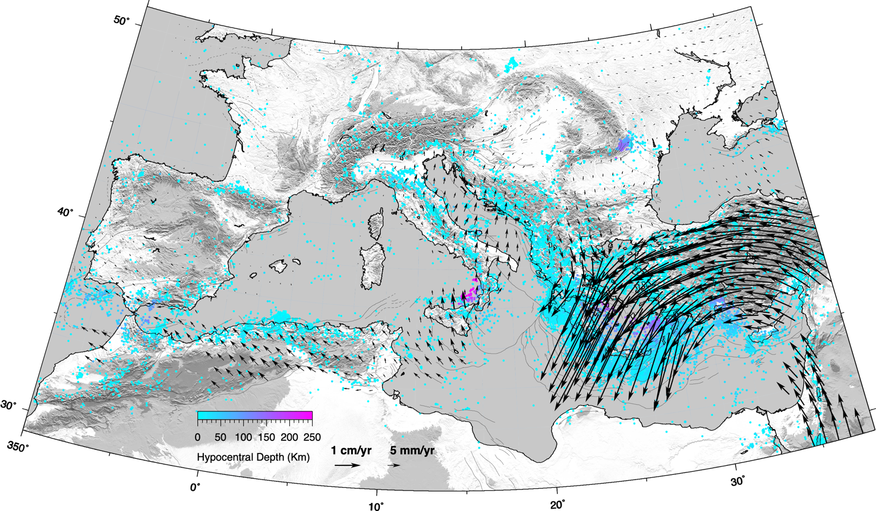
Scientific area
Toward a better understanding of the multi-scale, physical/chemical processes responsible for the earthquakes
When studying earthquakes we consider phenomena intersecting different research fields
To this end we settled modern and multidisciplinary infrastructures near active faults in different tectonic contexts
The collection of raw high-resolution data
at dense networks
allow the generation
of innovative scientific products
FRIDGE - Federated data gateway for sharing multidisciplinary data and scientific products
We develop tools for scientific analysis, target-oriented alert systems and decision modules for risk mitigation actions
CREW – testing centre for earthquake early warning systems comparison on benchmarked datasets
NITRO
VALAIS
KARST
VRANCEA
TABOO
MARMARA
IRPINIA
CORINTH
Connections: Seismology – Geodesy – Satellite - Anthropogenic Hazard - Volcanology

Slide 4
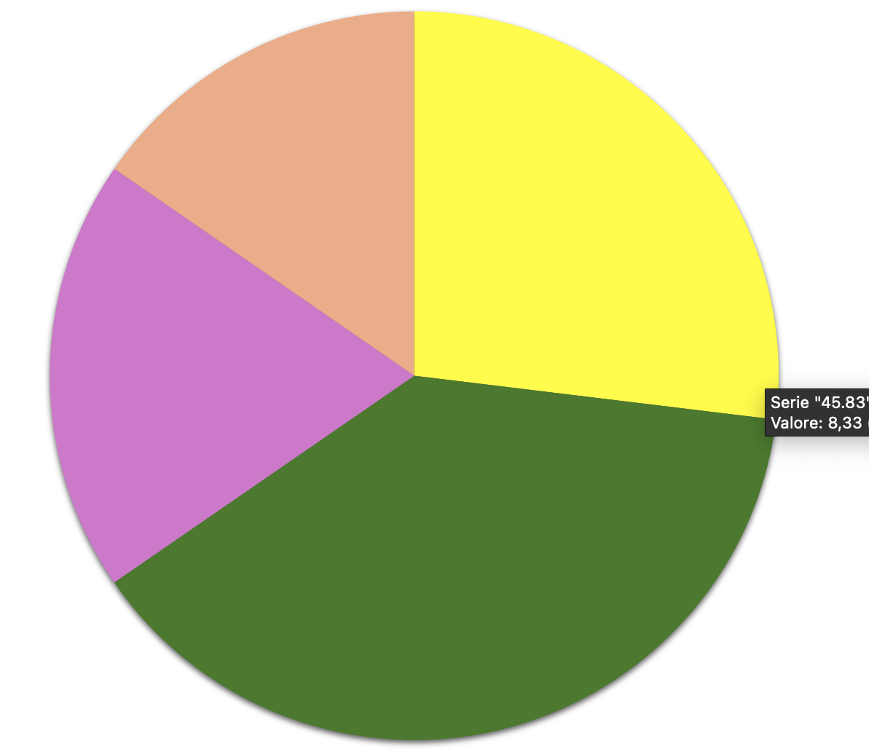
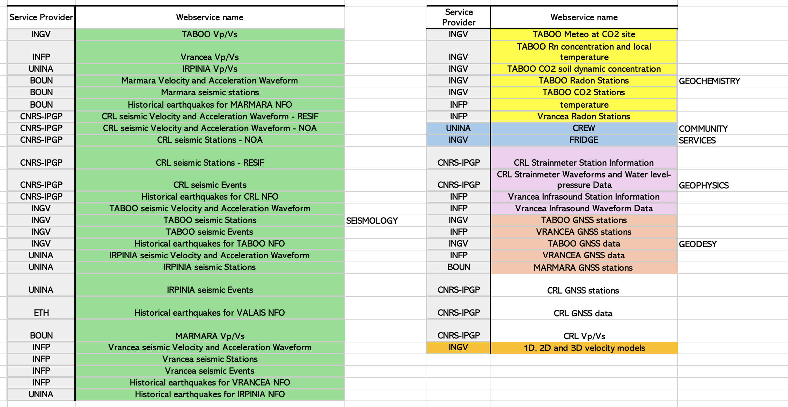
Services in operation on the EPOS Data Portal
GEODE
GEOKEM
GEOPHYS
SEISM
http://creativecommons.org/licenses/by/4.0/

Slide 5
Max.1 slide, minimum font 18
Presentation of the TCS consortium (e.g. participants, governance structure, new members, activities of boards/committees)
TCS Governance (1/3)
ExCom
Executive Committee
Supervision for implementation of the Work Programmes
L. Chiaraluce (Chair), E. Sokos, G. Festa
Service Committee
Provide a technical view on the services
SeC
A. Marmureanu (Chair)
1 IT Person per NFO; core group NIEP, INGV, UNINA
NFO Consortium
Consortium Board
UNINA (Chair, Info, IT)
INGV (Taboo, IT)
INFP (Vrancea, RO)
CNRS (CRL, GR)
NOA - NKUA - UPAT (CRL, GR)
KOERI (Marmara, TR)
ETHZ (Valais, CH)
Observers:
ZRC-SAZU (Slo-Karst, SLO)
OGS - UNITS (Nitro, IT)
Advisory Board:
Provide user perspective on the services
AdB
S. Ergintav (Chair)
External people changing
each year

Slide 6
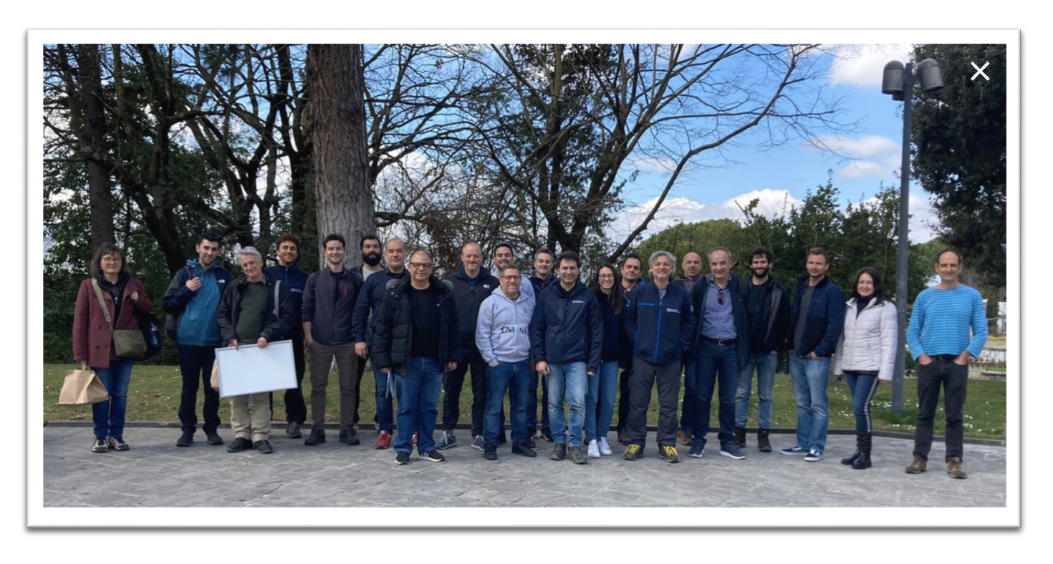
Max.1 slide, minimum font 18
Summary of MYCA activities in 2023
TCS Governance (2/3)
Activities performed in 2023 – MYCA Governance and Coordination
Management of the Collaboration Agreements (TCS vs ERIC, intra-TCS)
Consortium Board meetings (4 meetings, 2 in presence, Gubbio –IT; Bucharest – RO)
Revision of the Cost Book and financial issues
TCS – ICS interactions (7 meetings)
Service committee meetings
Quality control documentation and revision
Attracting new members (2 NFO Observers – KARST - NITRO)
Communication and Dissemination
Funded Institutions: INGV - NIEP - UNINA

Slide 7
TCS Governance (3/3)
NFO sustainability
Human resources /maintenance from in-kind contribution and soft money (Eu/national projects)
Developments from competitive projects and ERC
Human resources/ maintenance from in-kind contribution, national funding to EPOS and EPOS-ERIC
Developments from national/EU projects
Human resources/ maintenance from national funding to EPOS and EPOS-ERIC
Developments from national/EU projects
NFO DDSS distribution
NFO portals and facilities
EPOS – ICS
NFO Infrastructure
Different landscape for different countries about financial resources and organizations (national consortia)

Slide 8
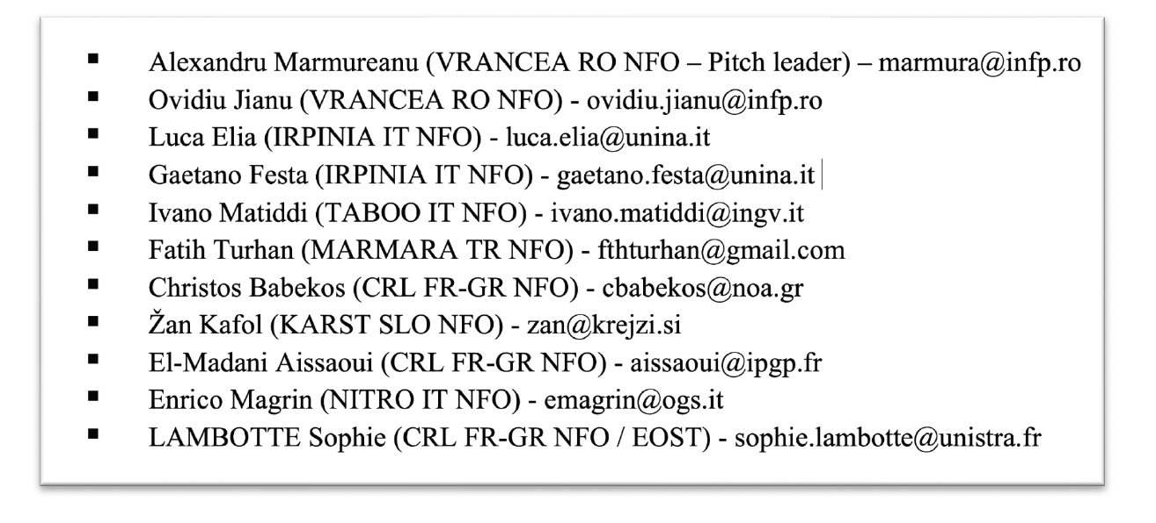
Max.1 slide, minimum font 18
Summary of MYCA activities in 2023
TCS Services (1/2)
Activities performed in 2023 – MYCA Service and Data provision
Provision, maintenance and enhancement of the access to data and products
via webservices in compliance with the FAIR data principles (via EPOS portal and FRIDGE)
Implementation Level Matrix, Stress test
Provision and maintenance of metadata in compliance with the EPOS metadata format
Provision of online documentation for web services
Active participation of the nominated TCS IT representatives to ICS-TCS activity and meetings
Integration plans into ICS-C for TCS services currently distributed through TCS portals only
Assessment by the TCS of the representativeness of the data provided through the EPOS Data Portal
Working on the continuous increase of data assortment to enlarge the DDSS portfolio guaranteeing standard formats, description and access through web-services based on community portals (CRL - MARMARA).
Funded Institutions: INGV - CNRS - KOERI

Slide 9
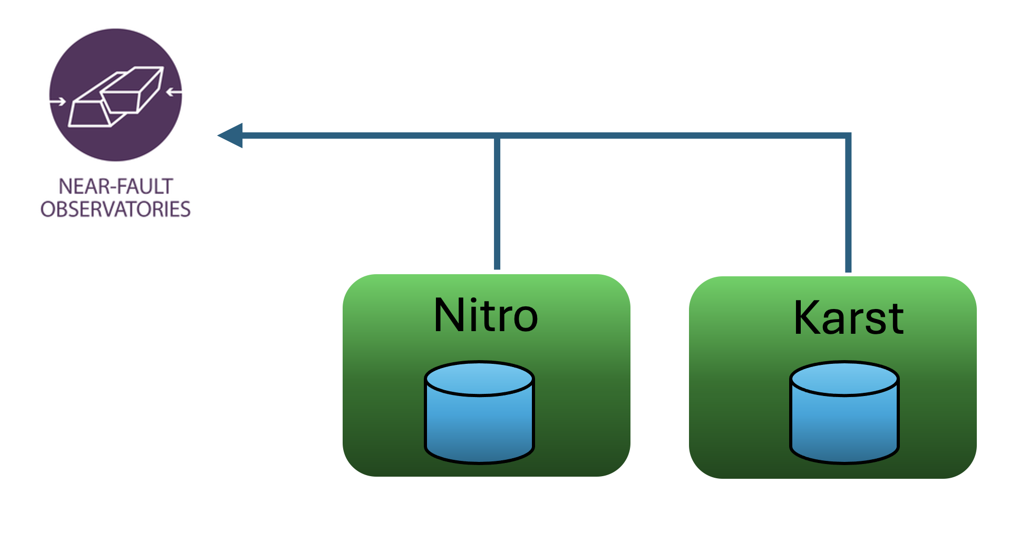
TCS Services (2/2)
Workplan 2024 - Services
Improvement existing services and interoperability - harmonization of DDSS across the TCSs and ICS, plus increase service robustness through improved interoperability layer (FRIDGE)
Enlarging the DDSS portfolio through new services - services development for new products like Velocity and attenuation models (1D-2D-3D); Enhanced earthquakes catalogues.
Integration of DDSS from Observer NFOs (NITRO and KARST).
New tools - Visualization of multidisciplinary time series for comparison and analysis,
software for specific data/products quality assurance.
Plans for the future
Integrate the TNA experience from external projects (e.g., GeoInquire) into
the Access offer of the NFOs and participate to TNA calls
New service for EPOS grounded on innovative geochemical technology and
data (isotopes of gases: EPOS-ON)
Extend the TCS participation to new NFOs across Europe (contacts from Spain, Israel)
Interaction with international initiatives worldwide (United States Rupture and Fault Zone Observatory (RuFZO) – EPOS - ON)
Connecting EEW facility CREW with data provision from different NFOs (EPOS- ON)
DOI for Virtual Networks?

Slide 10
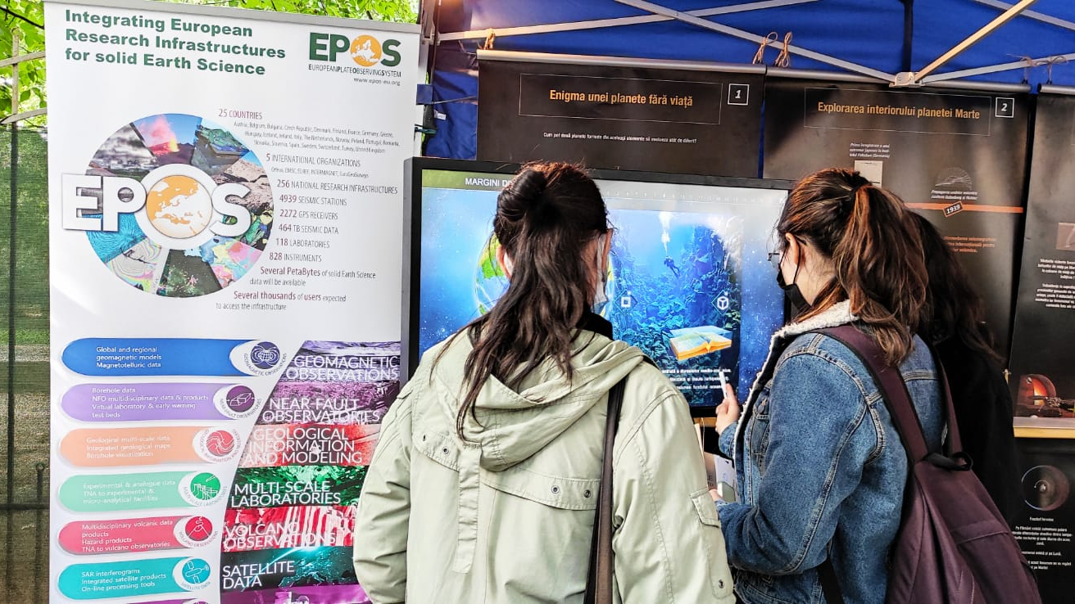
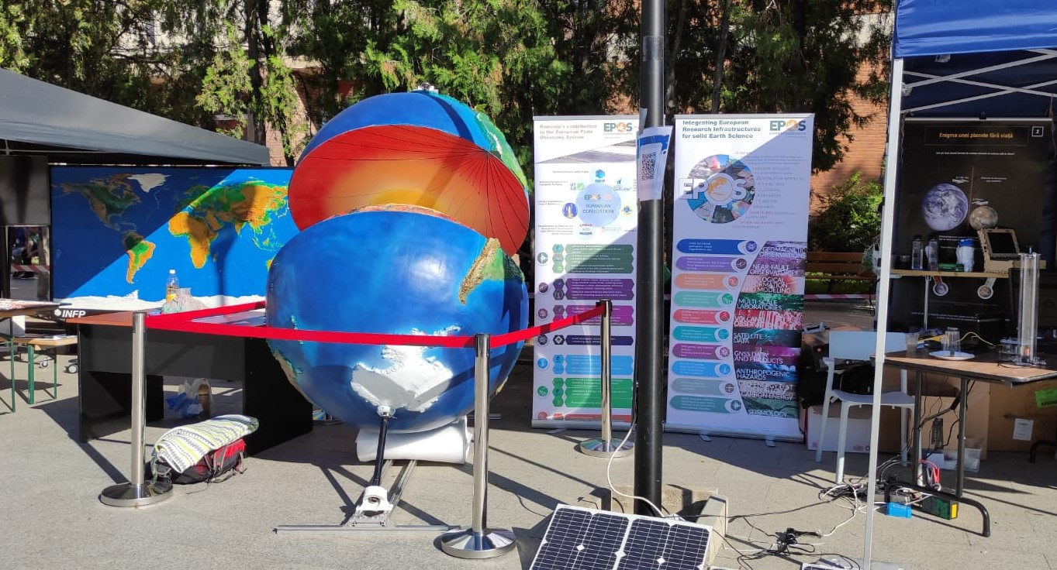
Max.1 slide, minimum font 18
Summary of MYCA activities in 2023 and plans for the near future.
TCS Communication and Dissemination (1/1)
Dissemination and communication activities
Communication TCS activities within the EPOS community
Increasing EPOS visibility within diverse communities via institutional social media
Participation EPOS Communication TCS meetings
Interaction with EPOS communication team about EPOS website
Updating the TCS-specific minisite and NFO TCS leaflet
Workshops organization (Italy, Romania)
Dissemination of EPOS infrastructure
REactive project launch conference, March 2023 (www.reactive.infp.ro, universities and private companies)
8th edition of the Geoscience International Symposium, Bucharest, November 2023, (scientists, university representatives, private companies, https://geosymposium.org/)
EPOS Data Portal Webinar through institutional media channels [more than 180 participants (50%) were from Romania]
Future acts
Expand outreach within universities via training sessions dedicated to EPOS presentation
Disseminate NFO knowledge through educational materials
Training programs for researchers and various stakeholders to familiarize them with EPOS tools

Slide 11
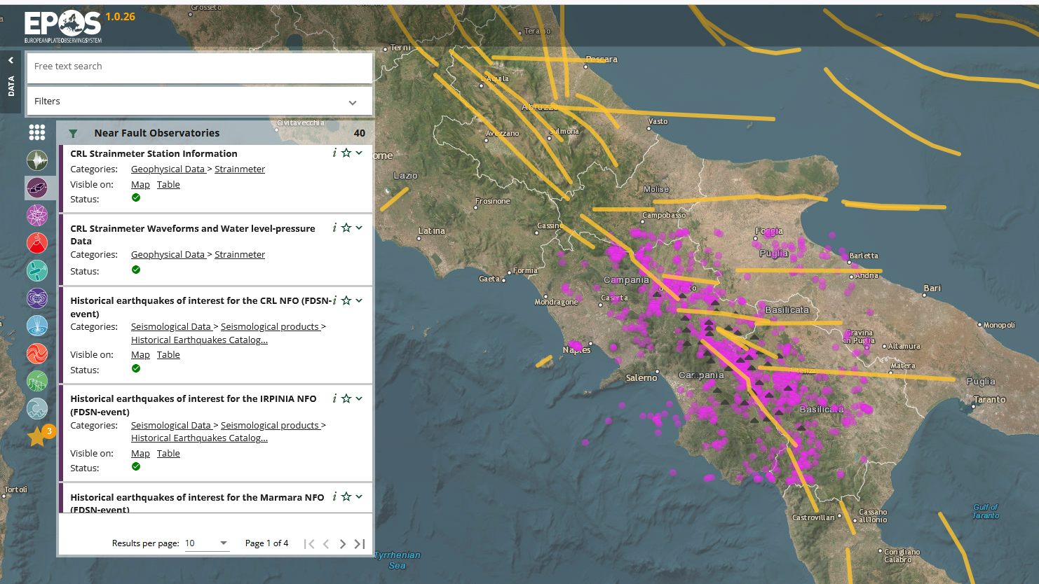
Max.1 slide, minimum font 18
TCS comments regarding e.g. impact of the EPOS Data Portal launch, met/unmet expectations, recommendations, …
The EPOS operational phase: TCS findings (1/1)
Strength points
EPOS Data Portal provides an additional entry point for NFO data and products
Discovery of NFO data and products portfolio
Data download
Time series visualization
Opportunities
Connecting data to CREW for EEW performance evaluation
Use of AI for seismic catalog enhancement (ICS-D)
Multidisciplinary time series comparison
Enlarge DDSS portfolio

Slide 12
Remarks
One key goal in the near future is to grow the community by opening up as much as possible to new infrastructure on the European (and global) territory, writing projects together but also trying to align DDSS offerings as much as possible among all NFOs.
We believe that EPOS future lies in the availability of data and scientific products.

