Slide 1
TCS Seismology at EPOS Days
Margarita Segou
Senior Researcher, British Geological Survey, Chair, EPOS-Seismology &
the EPOS Seismology Consortium Assembly
Anastasia Kiratzi (EPOS Seismology Secretary)
ORFEUS: Carlo Cauzzi, Susana Custodio
EMSC: Rémy Bossu, Paivi Mantyniemi, Margarita Segou EFEHR: Fatemeh Jalayer, Laurentiu Danciu, Roberto Basili
Community representatives: Irene Molinari, Adrien Oth

Slide 2
TCS Participants in EPOS Days and their role
Anastasia Kiratzi (EPOS Seismology Secretary)
ORFEUS: Carlo Cauzzi, Susana Custodio
EMSC: Rémy Bossu, Paivi Mantyniemi, Margarita Segou (EPOS Seismology Chair) EFEHR: Fatemeh Jalayer, Laurentiu Danciu, Roberto Basili
Community representatives: Irene Molinari, Adrien Oth
Early-career researcher: Miguel Neves

Slide 3
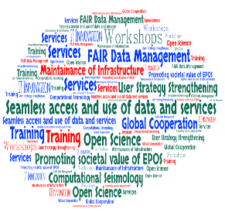
Scientific area & mission of the TCS Seismology
a pivotal component of the foundation of EPOS
Enhance seismological research through the development and maintenance of infrastructure, data services, data products, and collaborative initiatives
Global cooperation
Open Science, FAIR data management
User Strategy
Societal value of EPOS

Slide 4
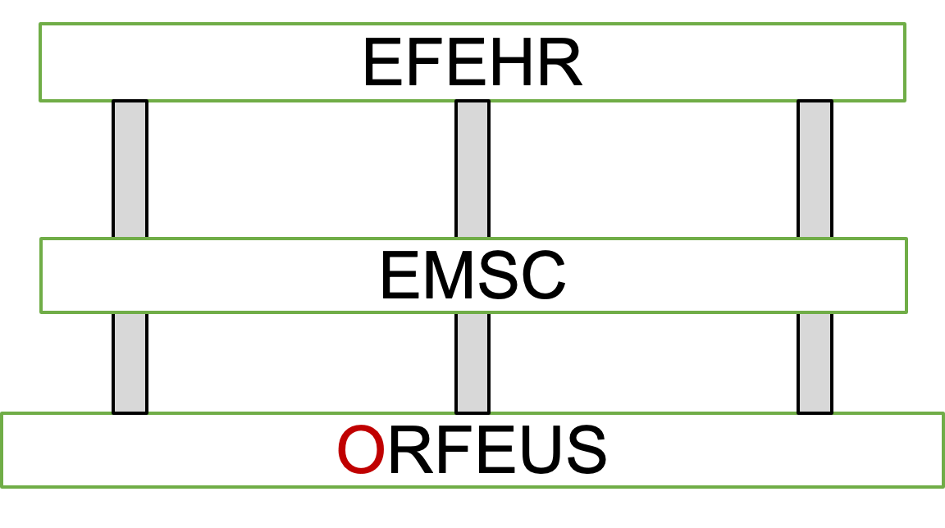
Scientific area & mission of the TCS Seismology
a pivotal component of the foundation of EPOS
Enhance seismological research through the development and maintenance of infrastructure, data services, data products, and collaborative initiatives
The EPOS-Seismology pillars
European Facilities for Earthquake Hazard and Risk
European-Mediterranean Seismological Centre
Observatories & Research Facilities for European Seismology

Slide 5
ORFEUS: Current and future service domains
All existing data services are integrated in the EPOS data portal, and more will be, as they become available.
European Integrated
waveform Data Archive
(EIDA)
Strong-motion databases
(RRSM=Rapid-Raw Strong-Motion Database
ESM= Engineering Strong-Motion Database)
Mobile Pools
(onshore & offshore)
New SMC!
Emerging focus groups:
ML, Big Data, CompSeis
New data types & disciplines
Real-time waveform seismology
Community experiments
TRAINING

Slide 6
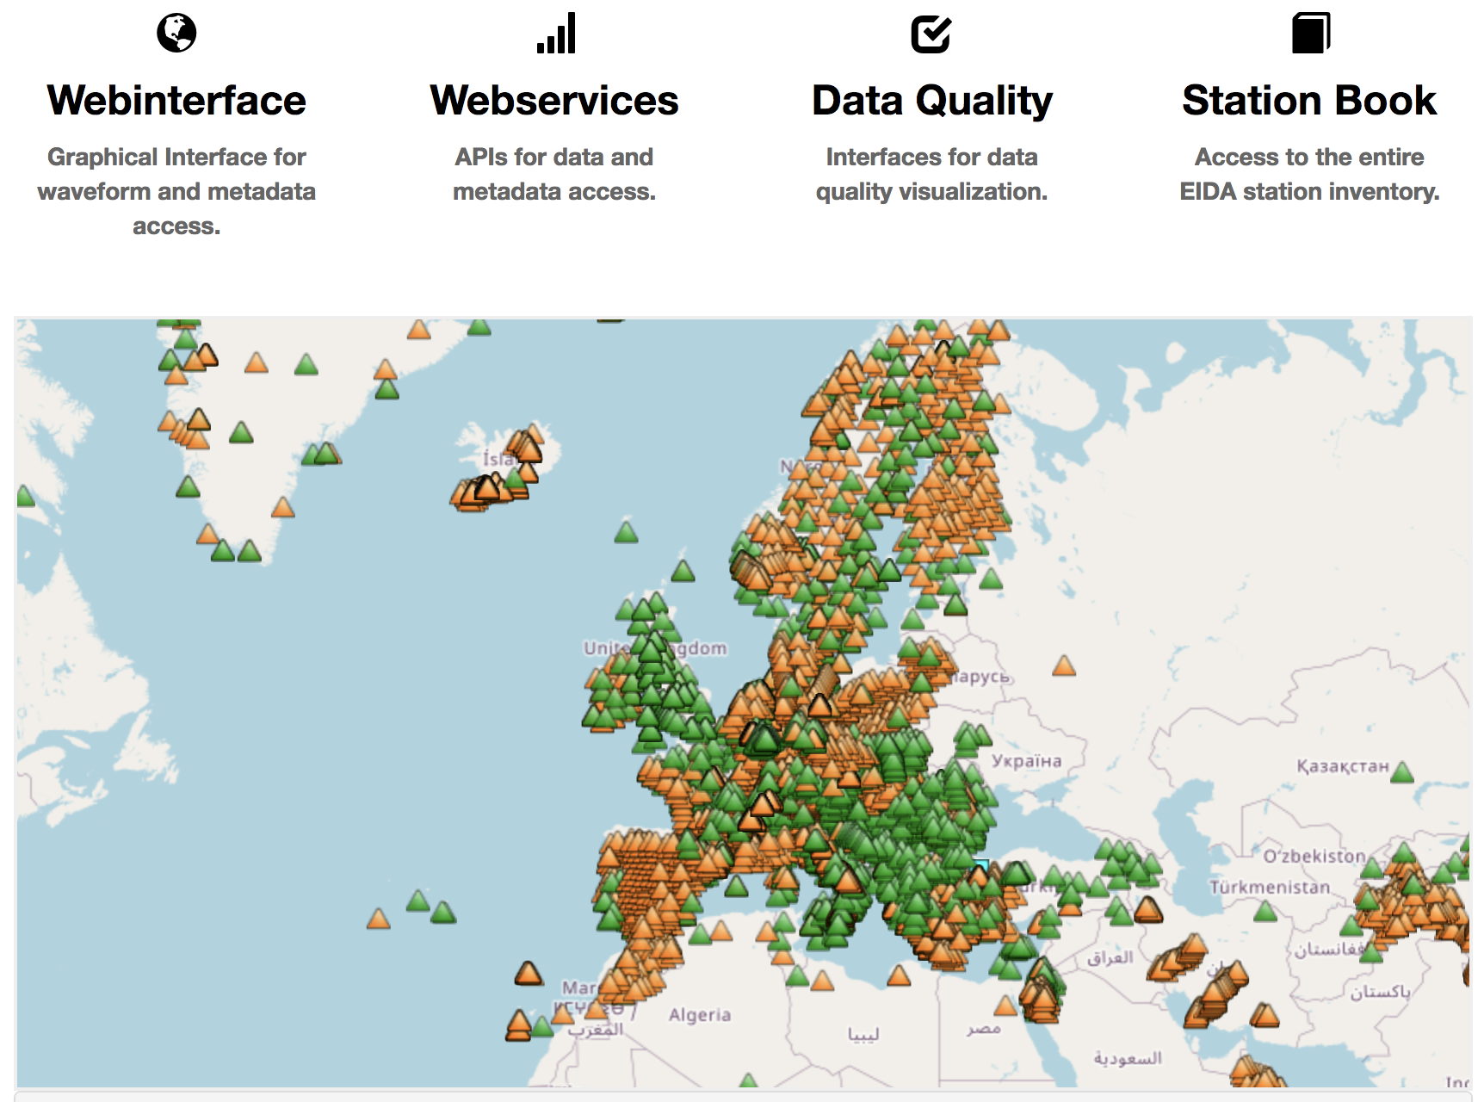
The European Integrated Waveform Data Archive
http://www.orfeus-eu.org/
data/eida/
New EIDA node in the UK in 2024.
AFAD being integrated.
New nodes expected in Portugal, Spain, Iceland.
Federation: 650+ TB distributed across 10+2 nodes; ~ 22,050 stations; ~450 networks
Standardised services for data discovery, access & download
Acknowledgement of data providers
(MoUs, ToRs, DOIs)
http://www.orfeus-eu.org/data/
eida/networks/
Notes:
Make a point on missing data
New web services coming (process to integrate in ICS?)

Slide 7
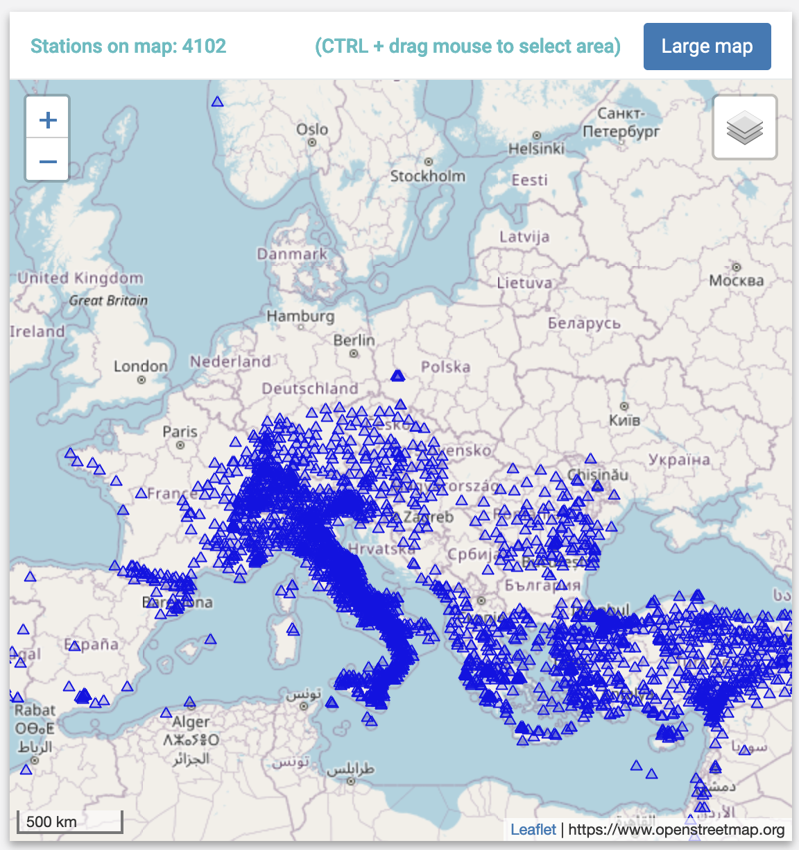
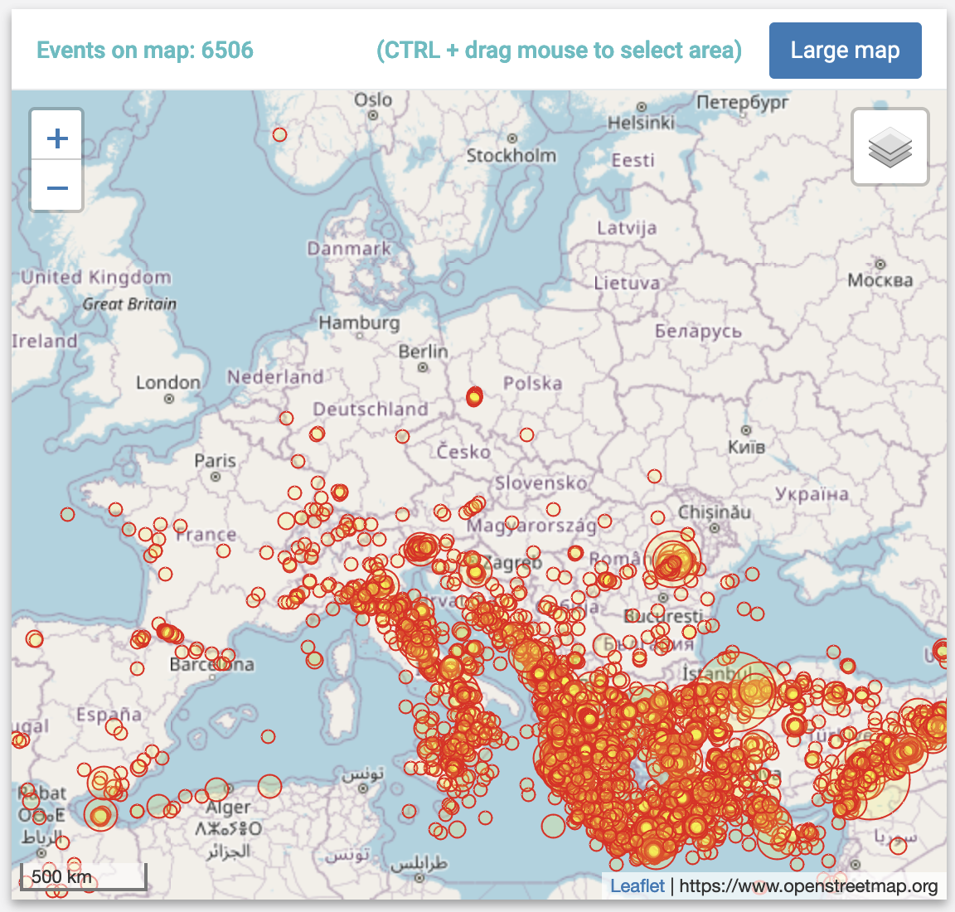
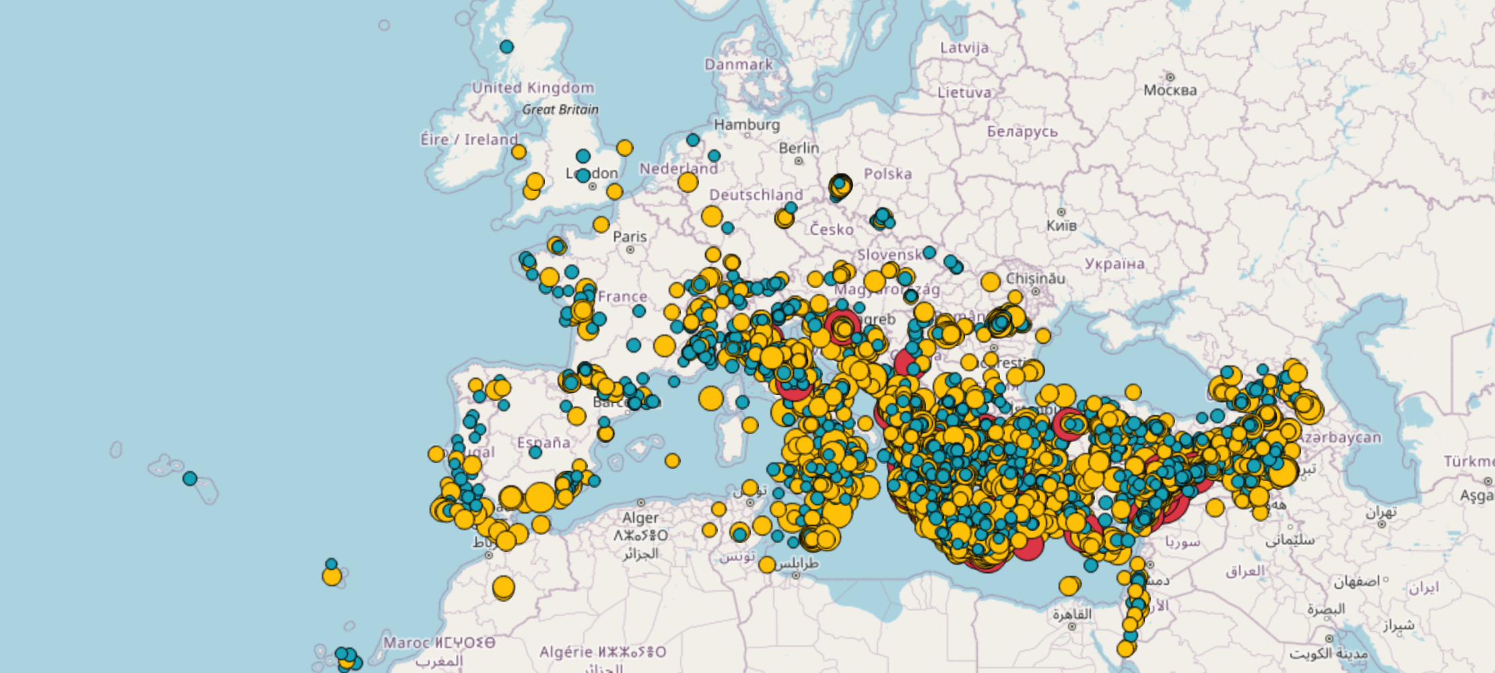
Strong-motion (= event-based) databases and services
Rapid-Raw Strong-Motion Database
and Associated Services
Engineering Strong-Motion Database and Associated Services
http://www.orfeus-eu.org/rrms
http://www.orfeus-eu.org/esm
~ 11650 events
~ (4700) /22000 stations
~ 4100 sta.
~ 6600 events
European ShakeMap System, integrating new countries/institutions within the
GeoInquire project
https://shakemapeu.ingv.it/

Slide 8
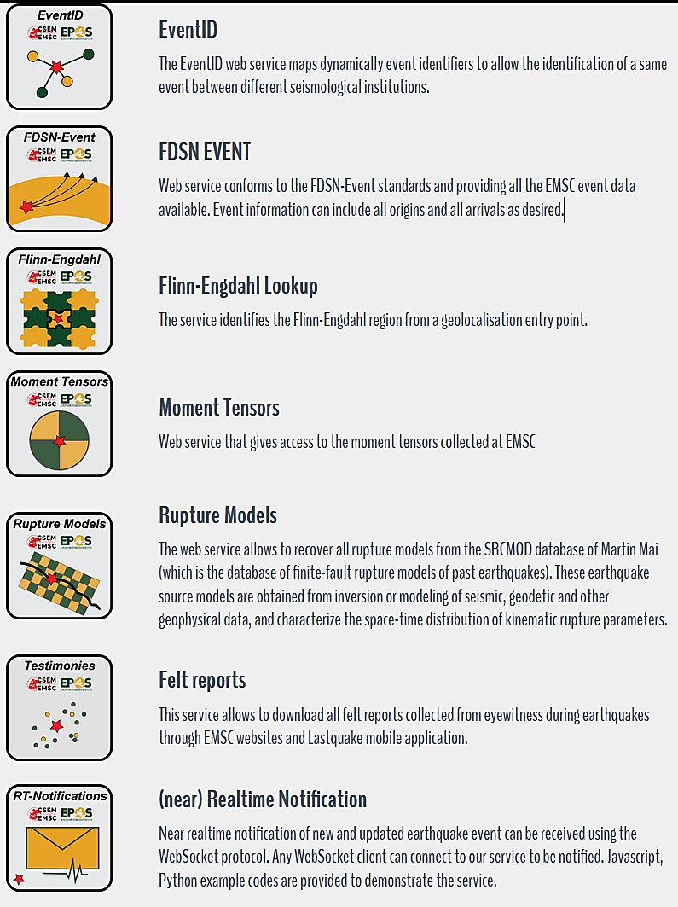
Services in operation of the EPOS Data Portal (EMSC)
Provide rapid information on global earthquakes and their effects to the scientific community, the public and emergency responders
A non-profit NGO:
Long established: 1975, 50th anniversary during the ESC 2024
International (75 Institutes from 56 countries as members and 113 data contributors)
Operational (24/7)
Highly visible (10M visits/month on LastQuake system)
2 main webservices (2023 kpi):
FDSN event (108.5k eq; 9 300 stations; 431k daily requests)
Felt reports (450k collected; 10 min median collecting time, 4.3k daily requests)

Slide 9
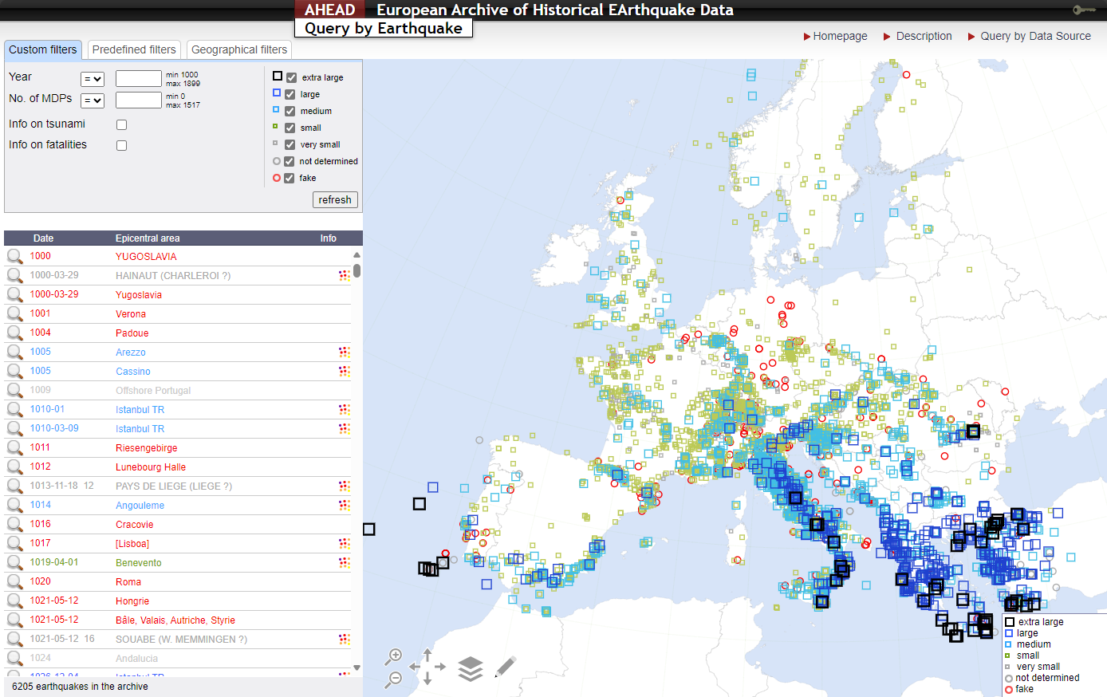
AHEAD, the European Archive of Historical Earthquakes Data
AHEAD is a pan-European, common, and open platform to support the research on historical earthquake data and the compilation of earthquake catalogues. It gathers and distributes the most updated data on European pre-instrumental seismicity (1000-1899), including parametric earthquake catalogues, macroseismic intensity data and historical macroseismic studies.
AHEAD provides the EPOS Data Portal with:
Parameters of historical earthquakes
Macroseismic intensity data for historical earthquakes
Bibliography for historical earthquakes
AHEAD was established in the framework of the EC FP6 NERIES (2006-2010), and since then the infrastructure is run by INGV and maintained by participating in various projects.
The structure, aims, functions, and roles are defined in a MoU, periodically renewed.
The MoU update of March 2024 includes 16 organisations from 12 EU countries.

Slide 10
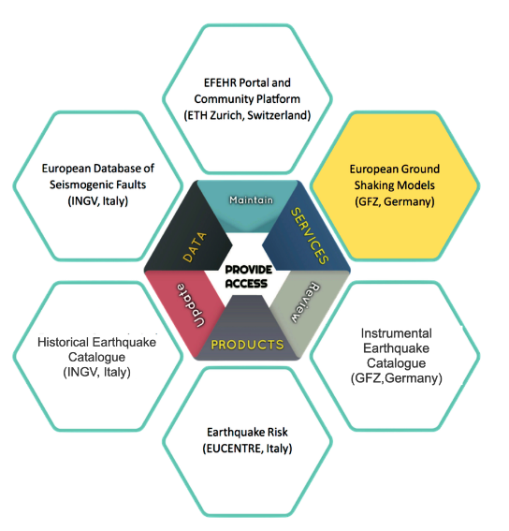
Services in operation on the EPOS Data Portal (EFEHR)
EFEHR Coordinates Six Federated Installations for Seismic Hazard and Risk Models:
Seismic Hazard Portal and Data Access (ETH Zurich, CH)*
European Seismic Risk Services (EUCENTRE Pavia, IT)
Historical Earthquake Catalogue (INGV Milano, IT)
Instrumental Earthquake Catalogue (GFZ Potsdam, DE)
European Databases of Seismogenic Faults (INGV Rome, IT)
Ground Motion Shaking Models(GFZ Potsdam, DE)
Main activities in 2023:
Implement the corporate design for all EFEHR services
Harmonize the look and feel of the web-page services
Promote the proper use/citation of these services
Coordinate with WP3 in GeoINQUIRE to harmonize KPIs,
Community standards and interoperability with research infrastructures
Participate in the EPOS-ICS technical harmonisation and implementation of geo-hazard output definition and display

Slide 11
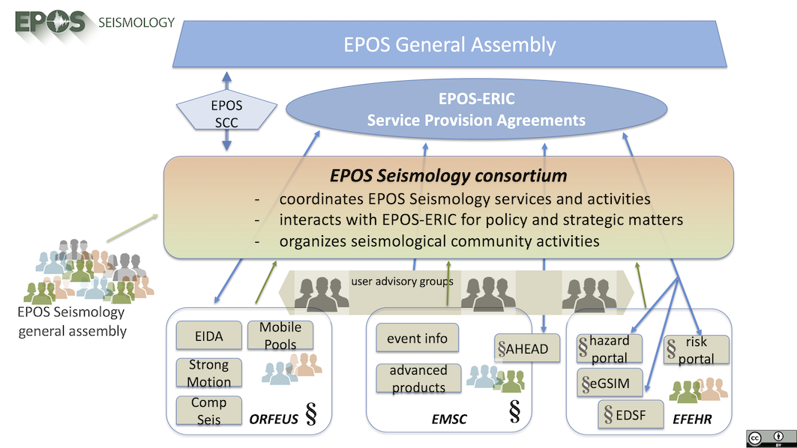
TCS Seismology Governance
Anastasia Kiratzi
(EPOS Seismology Secretary)
ORFEUS: Carlo Cauzzi, Susana Custodio
EMSC: Rémy Bossu, Margarita Segou, (EPOS Seismology Chair), Paivi Mantyniemi
EFEHR: Laurentiu Danciu, Jalayer Fatemeh,
Roberto Basili
Community representatives: Irene Molinari & Adrien Oth (ESC)

Slide 12
Governance in 2023
Governance and Services are distributed across different Institutions as required
by the multi-domain nature of the TCS.
Activity and/or contribution¹ | host institution²
EPOS Seismology Governance and Coordination
EPOS Seismology Secretary | AUTH, Aristotle University of Thessaloniki
ORFEUS Secretary General | ETH Zürich, Swiss Seismological Service SED
EMSC Secretary General | EMSC
EFEHR Consortium Secretary | ETH Zürich, Swiss Seismological Service SED
EFEHR governance and coordination support (Chair of EFEHR Consortium) | UCL, Institute for Risk and Disaster Reduction, UK
EFEHR governance and coordination support (EFEHR EDSF Service) | INGV, Rome, Italy
EPOS Communication and Dissemination
EPOS Seismology overall coordination | AUTH, Aristotle University of Thessaloniki
ORFEUS contribution | ETH Zürich, Swiss Seismological Service SED
EMSC contribution | EMSC
EFEHR contribution | ETH Zürich, Swiss Seismological Service SED
 | UCL, Institute for Risk and Disaster Reduction, UK

Slide 13
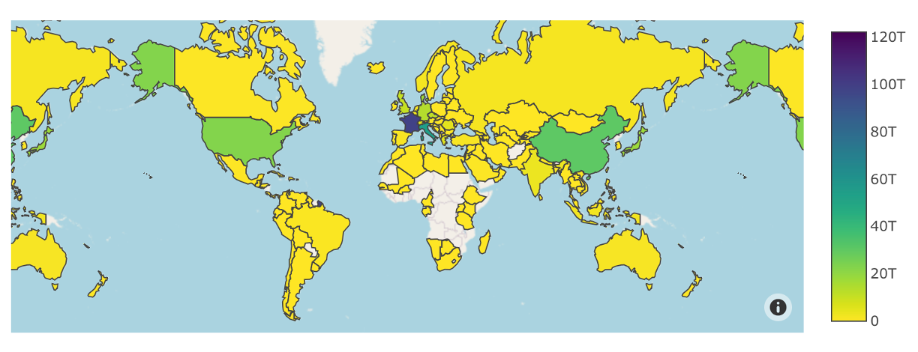
TCS Services (1/2)
Activity and/or contribution¹ | host institution²
Waveform services
EIDA data and metadata access – IT Hub & Admin | GFZ, CNRS-RESIF, NOA, KNMI as Participants of ORFEUS
EIDA data and metadata access - node operation & service maintenance | ORFEUS/KNMI, GFZ, INGV, CNRS-RESIF, ETHZ, NOA, BOUN, BGR, INFP, UIB-NORSAR, LMU, ICGC
EIDA data and metadata federated access - service maintenance | ETH Zürich / SED
ODC products and services | ORFEUS/KNMI
European Strong Motion Data & Products | ORFEUS/KNMI
 | INGV Milano
Example of waveform data delivered by “dataselect” segregated by month and country.

Slide 14
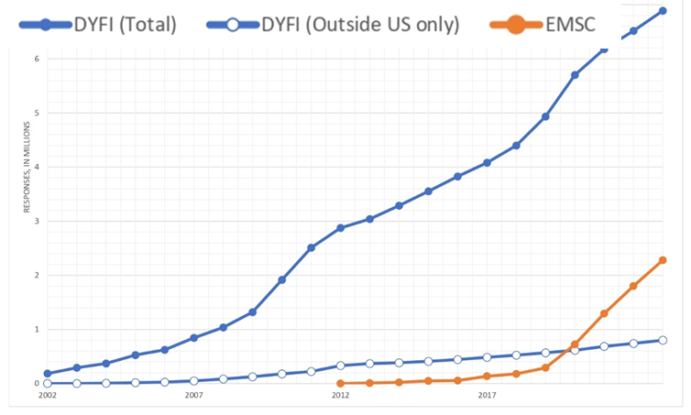
TCS Services (2/2)
Activity and/or contribution¹ | host institution²
Seismological products services
EMSC earthquake parameter information | EMSC
EMSC seismological products platform | EMSC
AHEAD historical earthquake data | INGV Milano
Seismic hazard and risk services
EFEHR EDSF service | INGV Rome
EFEHR ground motion service | GFZ Potsdam
EFEHR hazard platform | ETH Zürich / SED
EFEHR risk platform | EUCENTRE
EMSC Felt Reports: A truly global service

Slide 15
TCS Communication and Dissemination
Core activities in 2023 by all “Pillars”:
Contributions and organisations of technical and scientific sessions at major international and national conferences in Europe and beyond, including: EGU 2023, IUGG 2023, SSA 2023, 2CroCEE
EFHR EGU 2023, IUGG 2023, Berlin: Analysis and discussions on the European Seismic Hazard and Risk Models post the Türkiye earthquakes.
EPOS Seismology Workshop, Podgorica. ORFEUS Forum and ReadTheDocs framework
EFHR Harmonize the look and feel of the web-page services
Other Workshops and training events:
EFEHR/GEM training on vulnerability modelling ~100 participants
ORFEUS community workshops and webinar
Plans for 2024 (evolving):
AdriaArray workshop during EPOS Days
Presence @EGU, SSA, WCEE, ESC in 2024
2024 EFEHR Scientific Session
ORFEUS Annual Workshop + Geo-INQUIRE Large-N workshop (4-8.11, Helsinki, Finland)
ESC 2024 will hold the
EMSC Anniversary session !!!!!!!
EPOS-Seis Community event with being considered broad topic on the Future of Seismological RIs, Invited Earthscope, CEO, Becks Bendick, Engage Early-Careers (e.g. live polling for arising matters, streaming), offer Scientific motivation of the discussion with leading ML and cloud experts (programme and practical details TBD within the CA)

Slide 16
The EPOS operational phase: selected challenges, thoughts, recommendations,
and a bit of vision (1/2)
Personnel and service costs are rising with TCS Seis and its Pillars; long-term sustainability of data and services remains the key goal and effort.
Administrative work is rising (etc staff hires, document review, meetings), and remaining agile and updated requires optimization and effort
A framework is required for requesting EPOS support for community activities (e.g. workshops): via EPOS ERIC or via TCS funds?
How EPOS & EPOS-Seismology will be best placed (role, scheme selection) in competitive funding schemes and how the EPOS-ERIC could support proposed implementation actions,
How will the EC funds will be allocated to the TCSs and ICS activities?
Interface and communication with EPOS governing bodies (ECO, SCC, ICS, TCS) should be improved with the ICS-TCS interactions being more strategic in nature
All TCSs should remain the key interface to data and services integration in EPOS

Slide 17
The EPOS operational phase: selected challenges, thoughts, recommendations,
and a bit of vision (1/2)
Improve current and design new services within 2024-2028 targeting data access and management (inc. cloud services) to support AI/ML applications, enhance users’ experience (benefits: decrease download times, avoid replication of services) to increase our visibility for data provision and sponsorship. Those are global challenges for RIs. Communication of those improvements to the community is critical.
Build on global collaborations capitalizing also on EPOS efforts and support our growth beyond current activities and aforementioned plans. In EPOS Days, we welcome the participation in the International session @Wed_AM of Earthscope, Auscope and colleagues from GNS New Zealand.
Ask, How EPOS scientific strategy could stand poised to address hot topics while focused on financial consolidation and growth, underpinned by the community especially in cross-disciplinary initiatives?
Honored to be part of, and keen to support EPOS. TCS Seismology holds a unique founding role in EPOS and our continuing evolution reflects the success of the microcosmos of data and services we see possible. We make a great TCS to model the EPOS vision.

